Slide 1
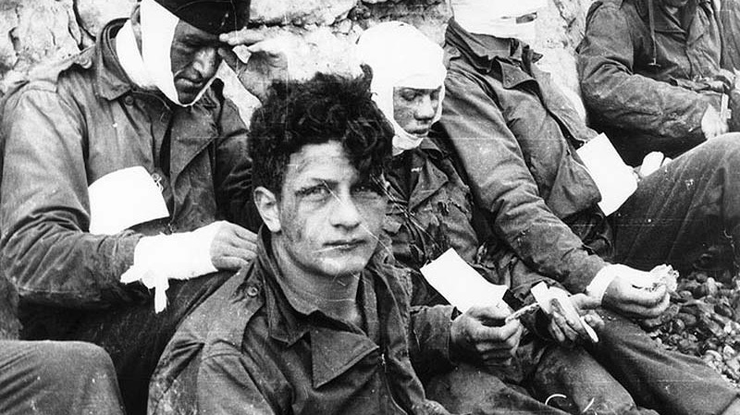
The remasculinization of wounded veterans after WWII
HI2C9 Term 1, week 9

Slide 2
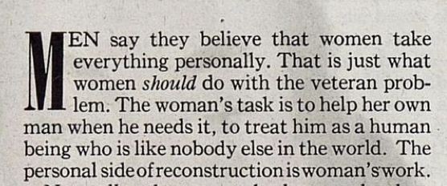
Willard Waller, 'What You Can Do to Help the Returning Veteran,' Ladies' Home Journal, Feb. 1945

Slide 3
Let There Be Light (dir. John Huston, 1946) Questions to consider as you watch:
Which specific audiences do you think this documentary was produced for?
How does the film explain the origins of men’s neuro-psychiatric disturbances?
(Combat exposure vs early childhood experience)
Where do women figure here–primarily agents of harm and/or tender carers? (Pay attention to how women, particularly mothers and intimate partners, are discussed by the psychiatrists and men in treatment, as well as women directly captured on film.)
How do you read the film’s politics of race? Is this a liberal portrayal of Black Americans?
What does the film suggest about the prospects of recovery for ‘NP cases’?
Why do you imagine the War Department, having commissioned the film, then suppressed it until 1980?
TASK: Pick out the scene you found most revealing. Come to class prepared to discuss it.

Slide 4
Let There Be Light
National Film Preservation Foundation print:
https://www.filmpreservation.org/preserved-films/screening-room/let-there-be-light-1946
YouTube version:
https://www.youtube.com/watch?v=uiD6bnqpJDE
Shades of Gray (1948)
https://www.youtube.com/watch?v=HKK5f4E7AFg
26 mins in—childhood safety—to 30 mins
45 mins—second group therapy—return to family/employers
52—final group—importance of love

Slide 5
Gendered prescriptions
Lt. Comdr. Leslie B. Hohman, 'Combat Fatigue', Ladies' Home Journal, Feb. 1945, pp.146-47
Franklin M. Reck, 'Will He Be Changed?', Better Homes and Gardens, Dec. 1944
Willard Waller, 'What You Can Do to Help the Returning Veteran,' Ladies' Home Journal, Feb. 1945
What do the magazine advice features tell us about:
How ‘invisible injuries’ were understood by contemporary US ‘experts’
The different roles assigned to men and women– more specifically to wives and mothers– in male veterans’ recuperative process?

Slide 6
Franklin M. Reck (November 29, 1896 – October 15, 1965) was an American writer best known for his books for boys. He also wrote books and magazine articles about American transportation.
Leslie Benjamin Hohman (1891-1972) was a professor of psychiatry at the Duke University School of Medicine from 1946 until 1960, later serving as professor emeritus. He also held the position of director of the Child Guidance Clinic in Durham, North Carolina from 1946 to 1953; maintained time in private practice in psychiatry; and acted as consultant to the Department of Psychiatry, Veterans Administration, United States Army, and United States Navy.
Willard Walter Waller (July 30, 1899 – July 27, 1945) was an American sociologist. Much of his research concerned the sociology of the family, sociology of education and the sociology of the military. His The Sociology of Teaching (1932) was described as an "early classic" in the field of the sociology of education. Before his sudden death, he was recognized as one of the most prominent scholars in the field of sociology.

