Slide 1
War, sex and gender in the US:
From the Civil War to WWII
Professor Susan carruthers
s.carruthers@warwick.ac.uk
https://warwick.ac.uk/fac/arts/history/students/modules/hi2c9/

Slide 2
Terms of engagement
A (very) brief overview of US war-making
Defining the module’s key terms
Explaining the module’s syllabus
Some tips for seminar preparation

Slide 3

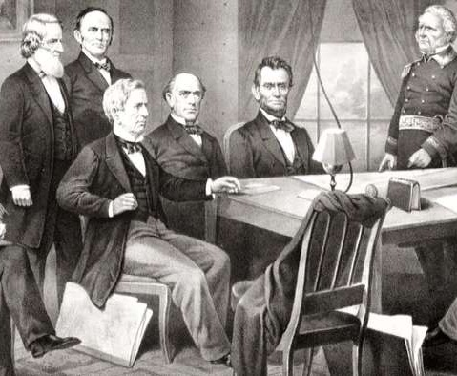
Changing approaches to the study of war
Until the 1980s, these suppositions broadly prevailed within and beyond the academy:
War was/is a preeminently masculine field of endeavour and inquiry
Men make war, and war makes men
Women’s roles in wartime were/ are largely supportive and subordinate
Military history was almost exclusively the history of men in uniform and (above all) men in combat
President Lincoln and his cabinet, with Lieutenant General Scott, at the start of the Civil War

Slide 4
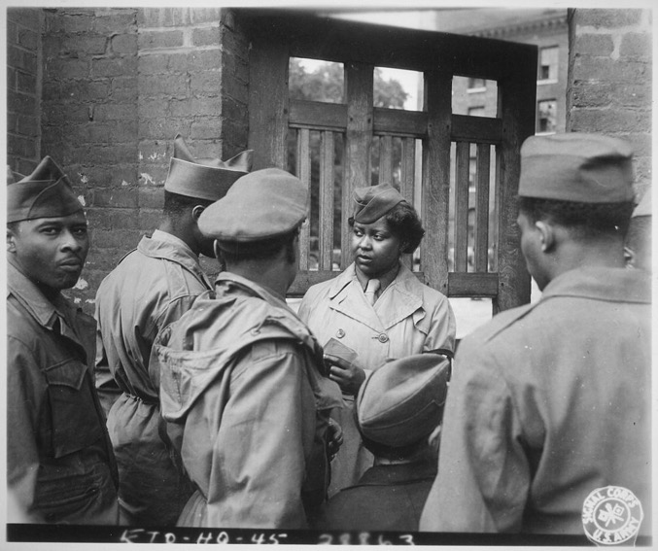
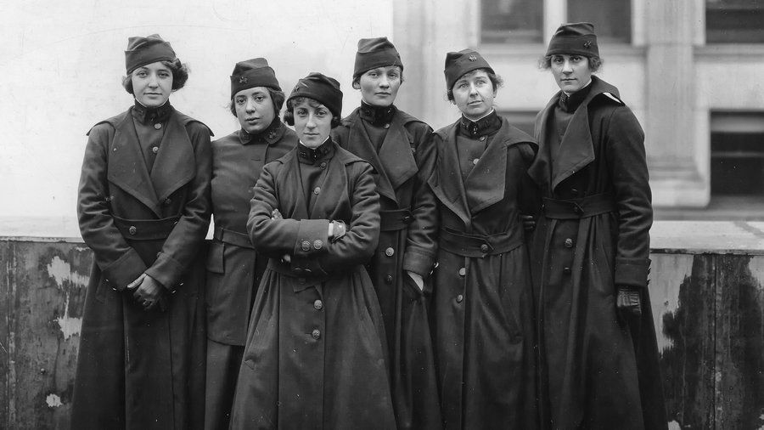
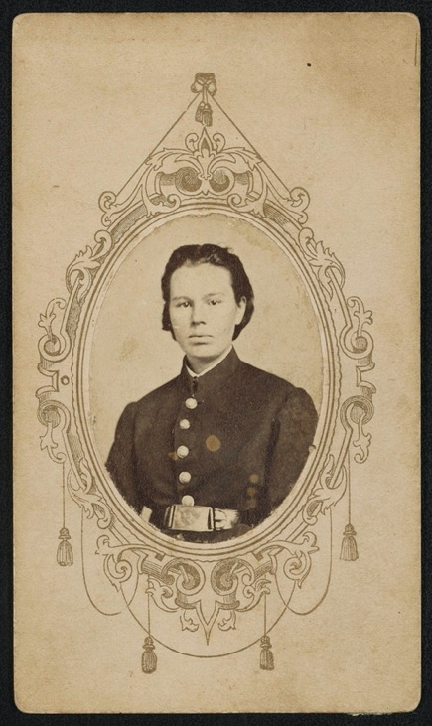
‘Hidden her-stories’
The “Hello Girls”– aka the Signal Corps Female
Telephone Operators Unit-- served with the AEF in
France during World War I
Frances Hook, aka Private Frank Miller, Frank Henderson, and Frank Fuller, was discovered to be a woman when s/he was wounded at the Battle of Fredericktown, Missouri in the Civil War.
Library of Congress: http://lccn.loc.gov/2016649648
African American WACs belonging to the 6888th Central Postal Directory Battalion, stationed in Birmingham, England.
US National Archives (May 26,1945)

Slide 5
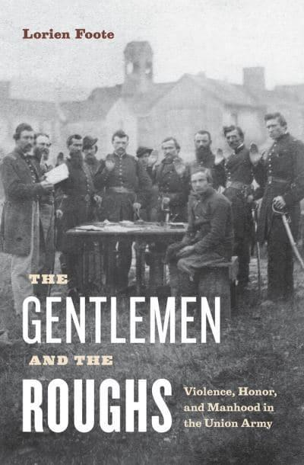
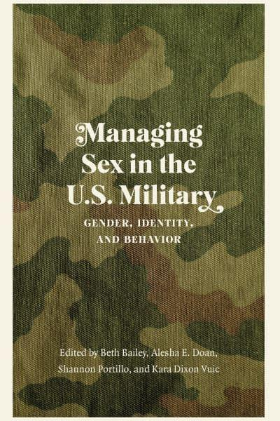
From ‘women’s history’ to gender & sexuality studies
(2010)
(2022)

Slide 6
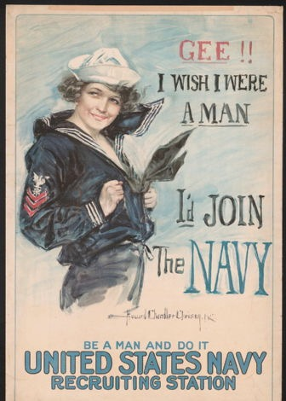
Some foundational propositions
That war– and militarism more broadly– has been a dominant force in US history
That war has had multiple and diverse consequences– emancipatory, oppressive, injurious and/or lethal– for American citizens and those aspiring to be recognized as citizens
That war (and its aftermath) relies on gendered appeals, norms and ideologies that make themselves felt in especially intense ways
Howard Chandler Christy
1917, Library of Congress
https://www.loc.gov/pictures/item/2002712088/

Slide 7
The United States at war
A brief overview
1861-1945

Slide 8
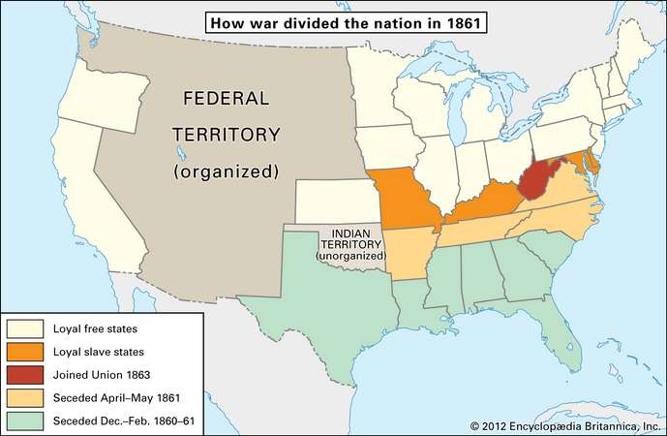
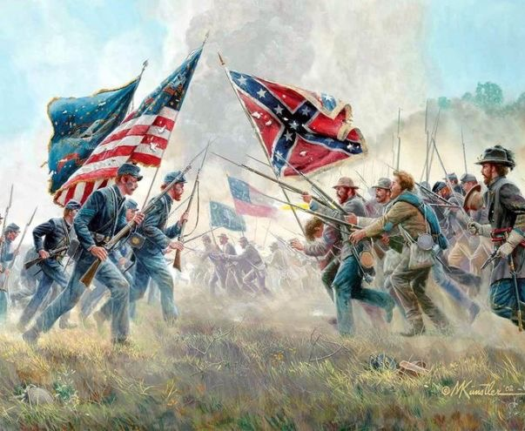
The Civil War
(1861-65)
To brush up on your Civil War history, read the article:
https://www.britannica.com/event/American-Civil-War/The-military-background-of-the-war

Slide 9
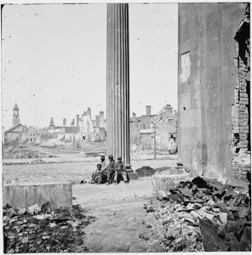
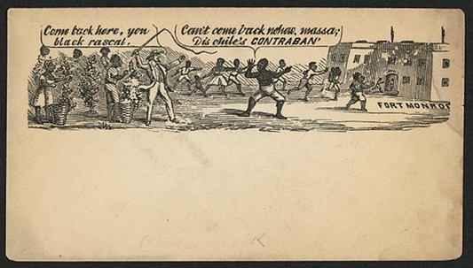
The first ‘total war’?
Epic losses
A world upended
No ‘home front’
Est. 620,000 military fatalities—
Approximately equal to the total US fatalities in the Revolutionary War, the War of 1812, the Mexican War, the Spanish-American War, WWI, WWII, and the Korean War combined.
Eliminating about 2% of the entire population, a war of comparable destructiveness today would result in 6 million deaths.
To learn more about urban destruction in the Civil War, including the provenance of the images above, read this:
https://oxfordre.com/americanhistory/view/10.1093/acrefore/9780199329175.001.0001/acrefore-9780199329175-e-313?result=1&rskey=vkiW5v

Slide 10
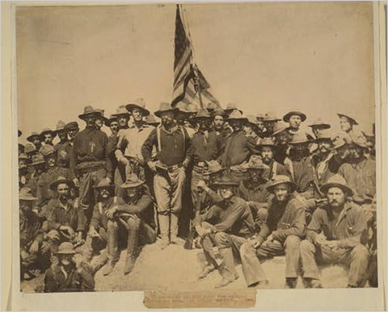
Spanish-American-Cuban War (1898 + )
A ‘splendid little war’ (TR) fought between the US & Spain over the fate of Cuba & the Philippines
Lasted 3 months, 3 weeks; few US military casualties
Est. 385 battle deaths; 2061 other fatalities;
1662 wounded
War in the Philippines lasts several years longer– a counterinsurgency campaign against Filipino nationalists
Source: Library of Congress. Theodore Roosevelt and his Rough Riders at the top of the hill they captured in the Battle of San Juan.
https://learning.blogs.nytimes.com/2011/07/01/july-1-1898-the-battle-of-san-juan-hill/

Slide 11
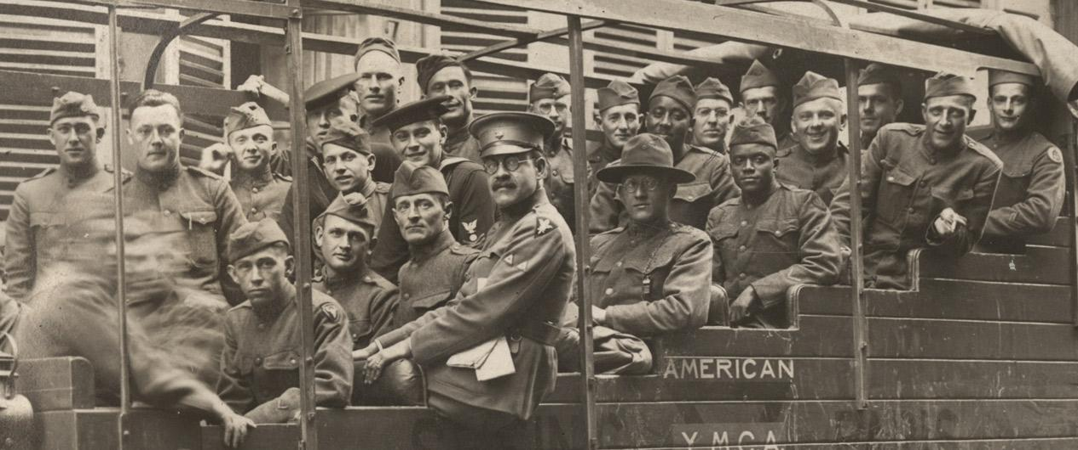
World War I (April 1917 – Nov. 1918)
https://www.theworldwar.org/doughboys
4,734,991 Americans served; 53,402 US battle deaths

Slide 12
World War II (Dec. 1941 – September 1945 +)
Profile of US Servicemen (1941-1945)
38.8% (6,332,000) of U.S. servicemen and all servicewomen were volunteers
61.2% (11,535,000) were draftees
Average duration of service: 33 months
Overseas service: 73% served overseas, with an average of 16 months abroad
Combat survivability (out of 1,000): 8.6 were killed in action, 3 died from other causes, and 17.7 received non-fatal combat wounds
Non-combat jobs: 38.8% of enlisted personnel had rear echelon assignments—administrative, support, or manual labor.
Average base pay: enlisted—$71.33 per month; officer—$203.50 per month
Year | Army | Navy | Marines | Coast Guard | Total
1939 | 189,839 | 125,202 | 19,432 |  | 334,473
1940 | 269,023 | 160,997 | 28,345 |  | 458,365
1941 | 1,462,315 | 284,427 | 54,359 |  | 1,801,101
1942 | 3,075,608 | 640,570 | 142,613 | 56,716* | 3,915,507
1943 | 6,994,472 | 1,741,750 | 308,523 | 151,167 | 9,195,912
1944 | 7,994,750 | 2,981,365 | 475,604 | 171,749 | 11,623,468
1945 | 8,267,958 | 3,380,817 | 474,680 | 85,783 | 12,209,238
Some statistics about the 16 million Americans who served in WWII

Slide 13
‘Minority’ participation in the US Military in WWII
Women's Army Corps (WAC) | 150,000
Navy’s Women Accepted for Voluntary Emergency Service (WAVES) | 100,000
Coast Guard Women’s Reserves (SPARS) | 10,000
Marine Corps Women’s Reserve | 23,000
Army Nurse Corps | 60,000
Navy Nurse Corps | 14,000
Women’s Airforce Service Pilots (WASP) | 1,074
African American | 901,896
Puerto Rican | 51,438
Japanese American | 33,000
American Indian | 20,000
Chinese American | 13,311
Filipino American | 11,506
Hawaiian | 1,320
.
https://www.nationalww2museum.org/students-teachers/student-resources/research-starters/research-starters-us-military-numbers

Slide 14
What do we mean by ‘sex’?
And ‘gender’?

Slide 15
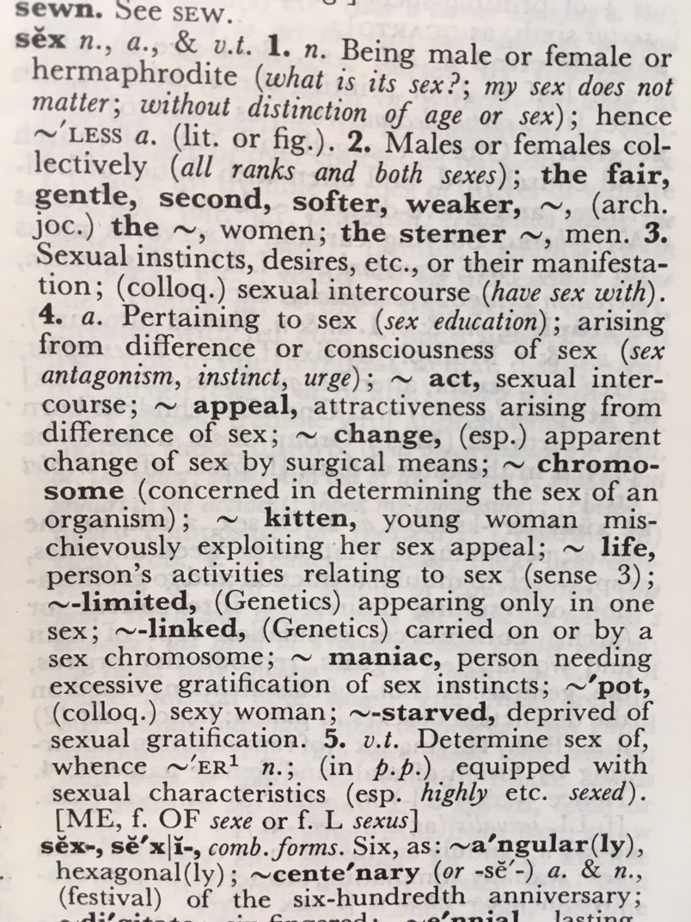
How would you amend this 1978
definition for the contemporary era?

Slide 16
Gender: a social construction
socially assigned characteristics that differentiate ‘maleness’ from ‘femaleness’ (typically construing men and women in oppositional/antithetical terms)
gender norms change over time: i.e. today’s ideas about what it means to be male, female or non-binary aren’t the same as those prevalent 20, 50 or 100 years ago.
normative gender identities and roles are also subject to contestation at any particular point in time.
studying gender is thus not reducible to the study of women-in-history, but rather how ideas about gender, and especially (in this era) how binary constructs of masculinity and femininity have taken shape

Slide 17
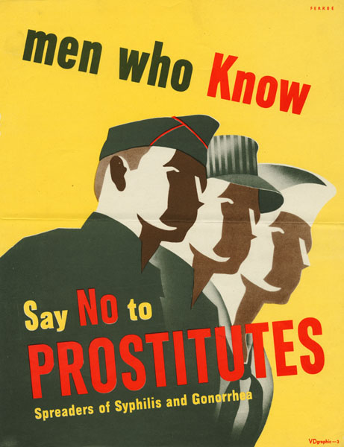
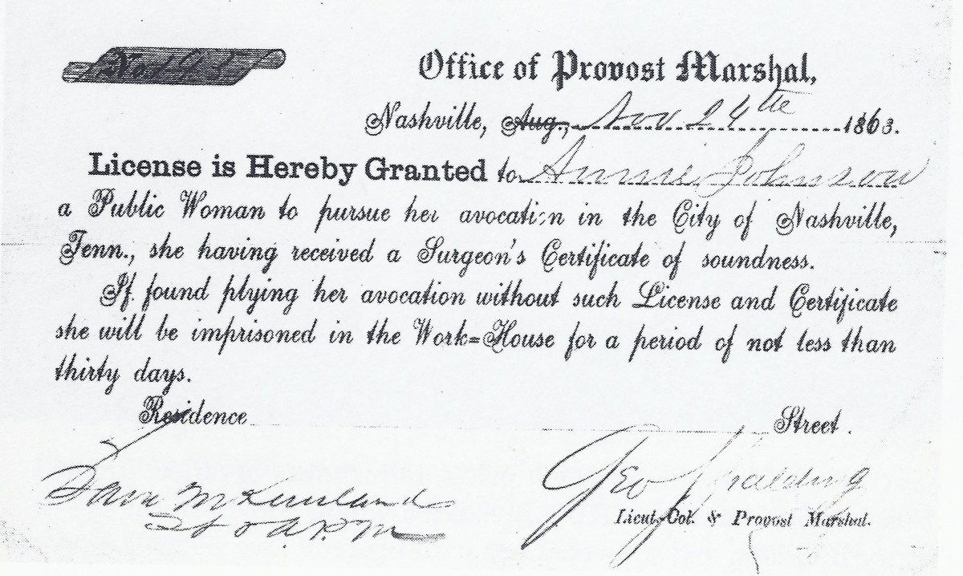
Sex: hazard or reward?
A license to protect sex workers, signed by George Spalding circa 1863.
The National Archives
https://www.history.com/news/civil-war-prostitution-nashville
https://www.motherjones.com/media/2010/05/us-military-std-posters/

Slide 18
Part I: Mobilisation
LECTURES
1) Terms of engagement: war/sex/gender
2) Forging martial masculinity
3) Pacifism, feminism and anti-war resistance
SEMINARS
1) Gender as construct and 'cause'?: the Spanish-American War (1898-99)
2) Conscripting masculinity
3) Maternalism and women's resistance to World War I

Slide 19
Part II: At War
Gendered war work
Seminar topics
4) Nursing and the evolution of gender norms
5) The Women's Army Corps and the politics of sexuality in World War II
6) Reading Week [no seminar]
7) 'Good' and 'bad girls' in the 'Good War'
LECTURES
4) What do soldiers do?
5) Women in uniform
6) Reading Week [no lecture]
7) Morale, morality and sexuality in the 'Good War’

Slide 20

Part III: After War
Seminars
8) Gendered grief and 'Gold Star Mothers'
9) The 'remasculinization' of wounded veterans after World War II
10) War as an agent of progressive social change?
LECTURES
8) Mourning and memorialization
9) Wounded bodies, disordered minds, and the gendered work of veterans' rehabilitation
10) Demobilisation: restoring the gendered status quo ante?

Slide 21
Seminar preparation for week 1:
All the information you need is on the module website
https://warwick.ac.uk/fac/arts/history/students/modules/hi2c9/syllabus/week1
Required viewing/reading:
Note: all assigned book chapters and journal articles are electronically accessible from the library.
Primary sources: Library of Congress, Spanish-American War in Motion Pictures collection
Explore a selection of contemporary newsreels of the Spanish-American-Cuban war, watching them in particular with a view to how/where gender constructs appear. Make sure to watch the three I've selected here as well as a few others that catch your eye to get a feel for the flavour of the time and of this brand new cinematic medium:
https://www.loc.gov/collections/spanish-american-war-in-motion-pictures/about-this-collection/
'Roosevelt's Rough Riders': https://www.loc.gov/item/98500909/
'Love and war': https://www.loc.gov/item/98501279/
'Blanket-tossing a new recruit': https://www.loc.gov/item/98501030/
Robert Dean, 'Gender as a Cause of War' in Kara Vuic (ed), The Routledge History of Gender, War and the U.S. Military (2017), pp.167-84, e-book
Kristin L Hoganson, Fighting for American Manhood: How Gender Politics Provoked the Spanish-American and Philippine American Wars (1998); extract from the book, included in Dennis Merrill & Thomas G Paterson (eds), Major Problems in American Foreign Relations, Vol. 1 (7th ed, 2010), Hoganson

Slide 22
Suggestions for seminar preparation
before you start reading/viewing, look at the seminar questions
keep them in mind as you read, thinking about how you’d answer them in class
take notes sparingly-- think primarily about concepts and arguments
stay alert to things that seem curious, surprising, or counter-intuitive to you. Jot them down!
Think not just about the questions I’ve set, but what YOU want to ask about these sources
If you’re puzzled about anything– either conceptual or empirical– let me know and I’ll try to clarify

Slide 23
Assessments
Find full details of the assessments on the module website:
https://warwick.ac.uk/fac/arts/history/students/modules/hi2c9/assessment/
Seminar participation
1 x 1500 word assignment (due week 5)
1 x 3000 word essay
(due week 10)

