Slide 1
Pacifism, feminism and anti-war resistance
Or, the military’s problem with mothers
Hi2c9 week 3

Slide 2
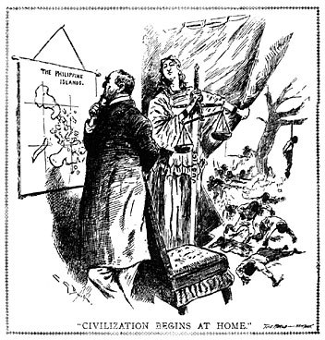
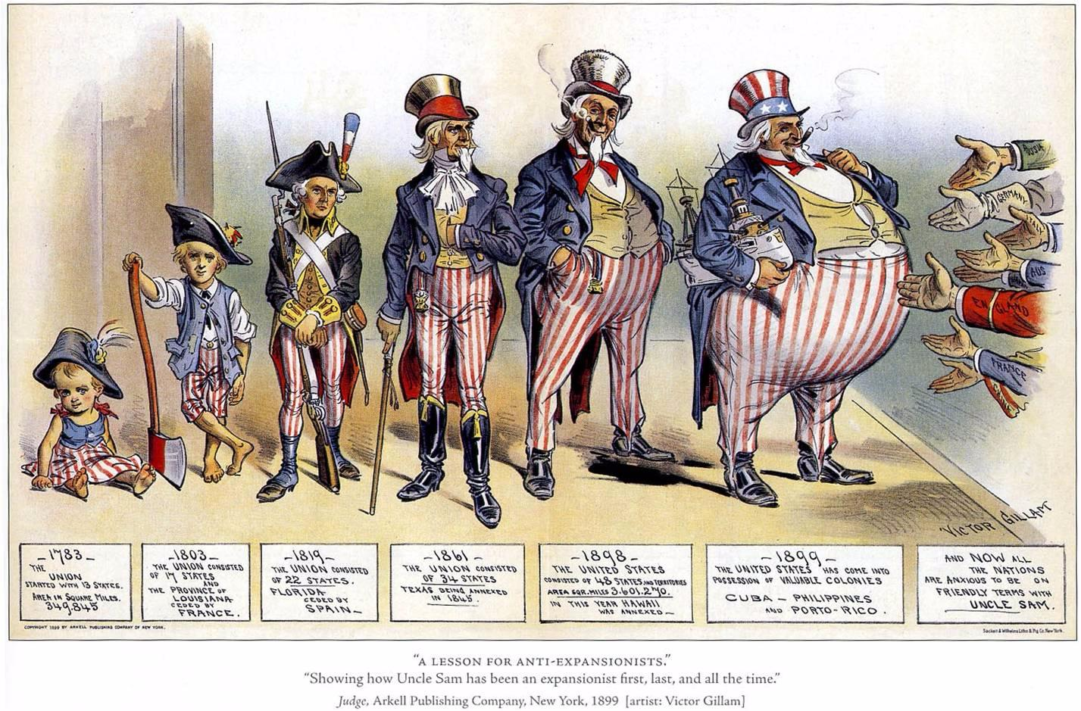
America’s anti-war and anti-imperialist traditions
The Anti-Imperialist League, founded 1898

Slide 3
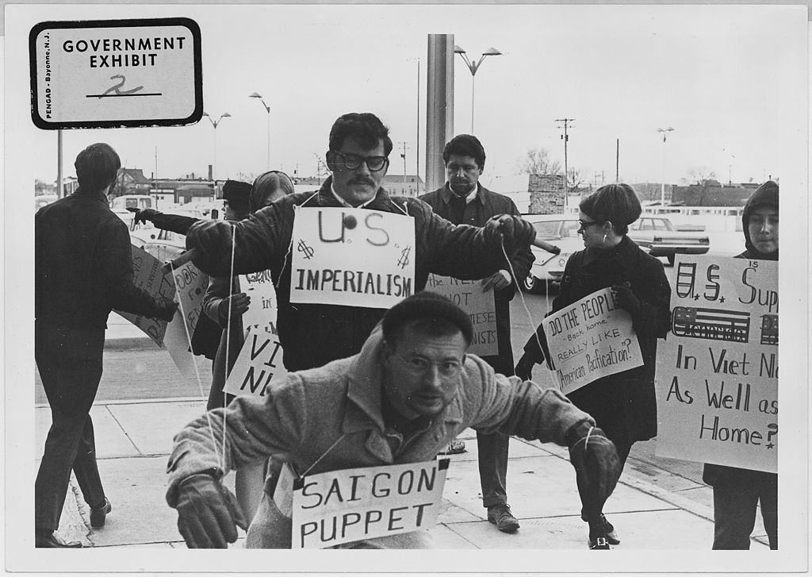
Protesters carry signs and act out "Saigon Puppet" demonstration in front of Wichita City Building,
Kansas.
1967
Photo credit:
US National
Archives and
Records
Administration

Slide 4
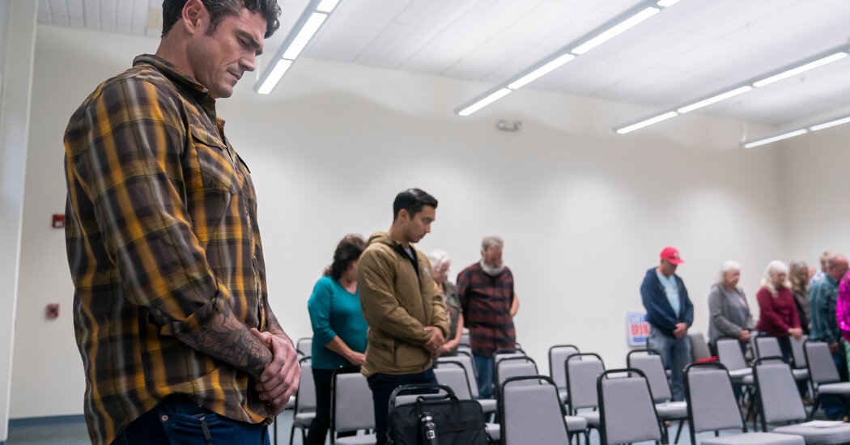
“New Generation of Combat Vets, Eyeing House, Strike From the Right”
New York Times, Oct. 15, 2022
https://www.nytimes.com/2022/10/15/us/politics/new-generation-of-combat-vets-eyeing-house-strike-from-the-right.html

Slide 5
Women fight for peace
Men make war

Slide 6
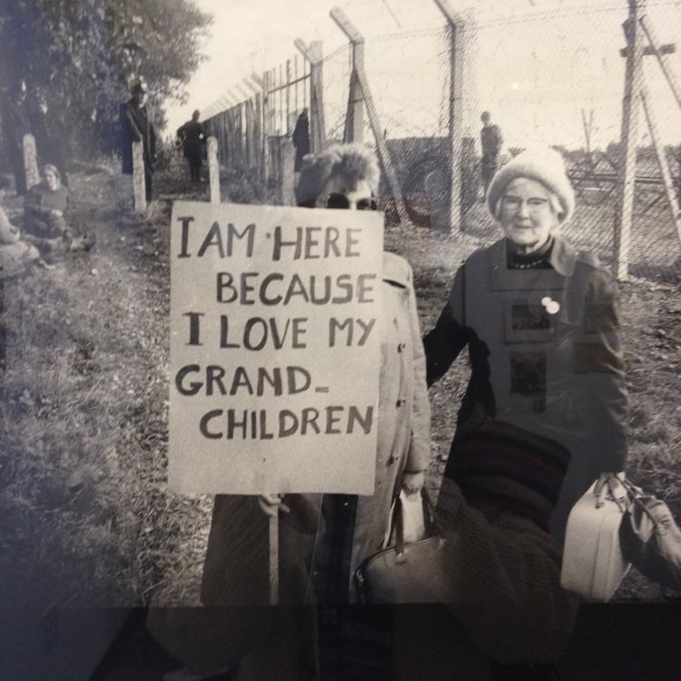
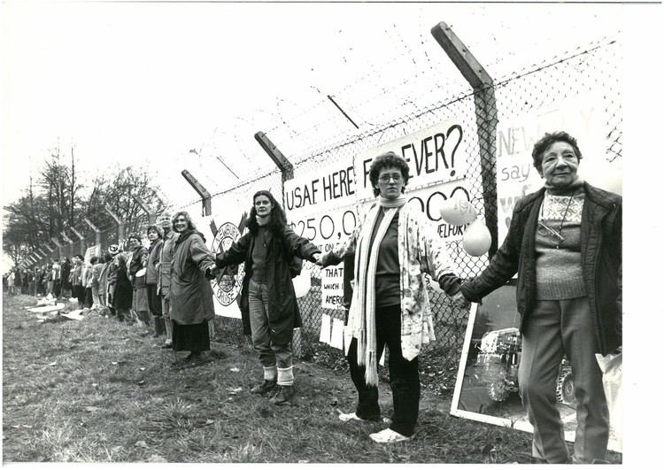
Greenham Common women’s peace camp
The
first
protest
1981
Women
only
camp
1982-
2000
Missiles
removed
1991
https://alchetron.com/Greenham-Common-Women%27s-Peace-Camp

Slide 7
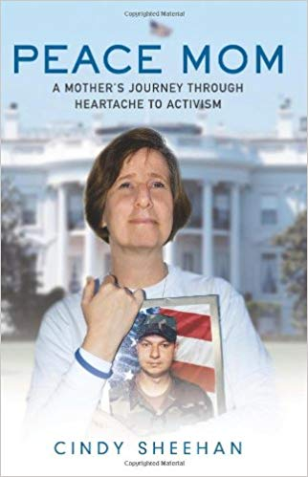
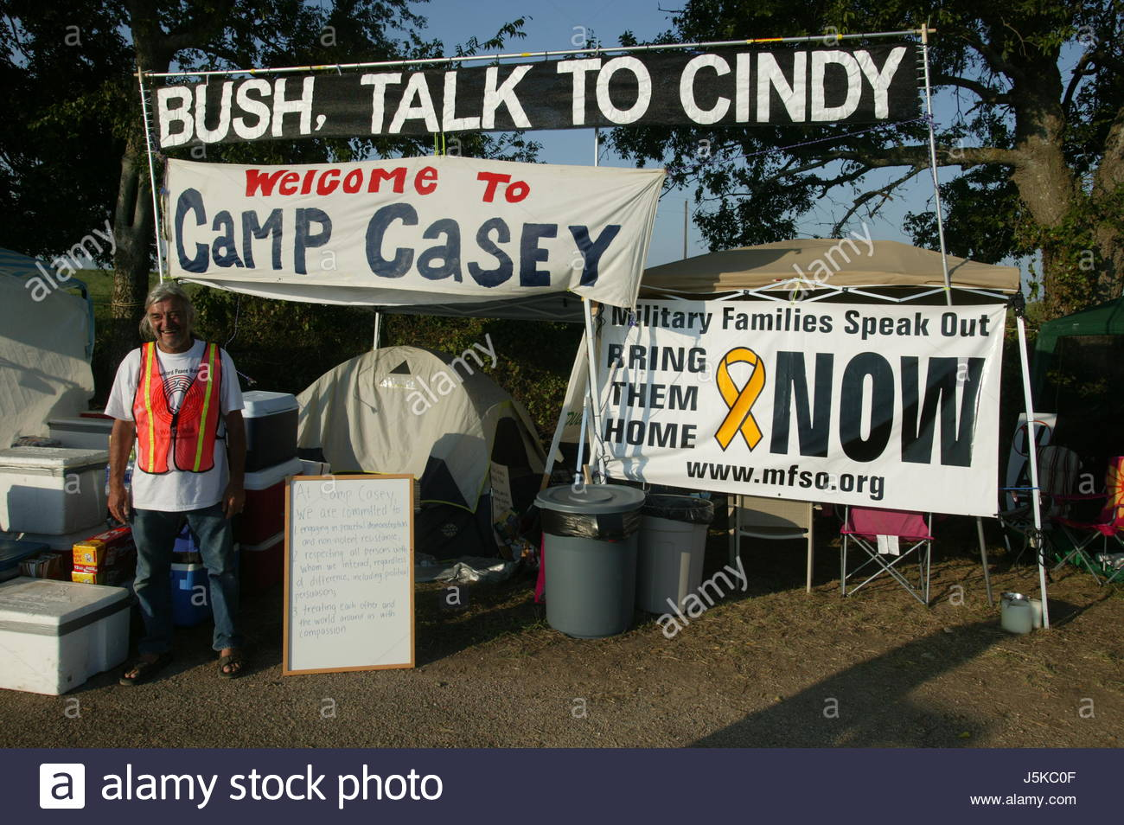
Cindy Sheehan and opposition to “OIF”
Sheehan
set up camp
near
George W Bush’s
ranch in
Crawford, TX,
protesting the
war in Iraq
which had claimed
the life of her
son, Casey, in 2004.
Aged 24.

Slide 8
American women’s opposition to
World War I
Some context

Slide 9
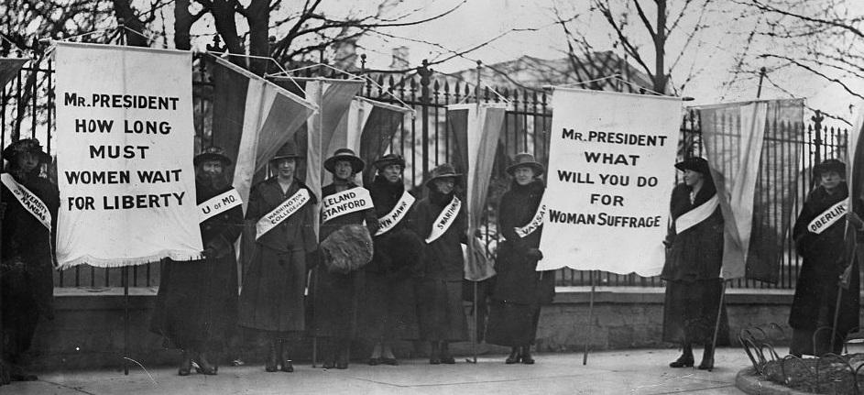
Women’s suffrage
1848: Women’s rights convention,
Seneca Falls, NY
Early 1900s: leadership of the suffrage movement passed to two organizations. The National American Woman Suffrage Association (NAWSA), led by Carrie Chapman Catt, was a moderate organization. The NAWSA undertook campaigns to enfranchise women in individual states, while lobbying Wilson and Congress to pass a woman suffrage Constitutional Amendment. In the 1910s, NAWSA’s membership numbered in the millions.
The National Woman’s Party (NWP), led by Alice Paul, was more militant. The NWP took radical actions, including picketing the White House to convince Wilson and Congress to pass a woman suffrage amendment. https://www.womenshistory.org/resources/general/woman-suffrage-movement
1920: 19th Amendment, enfranchising
women, ratified

Slide 10
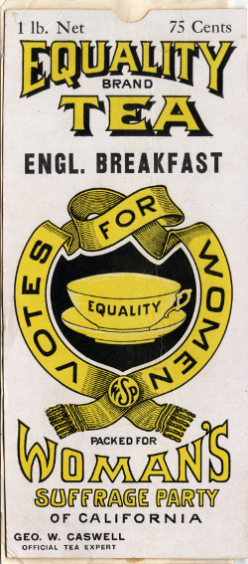
In California, women gained the right to vote in
state elections, and to hold office in 1911.
This resulted from women’s suffrage activists
narrowly winning a 1911 ballot, which asked voters
Whether women should have the right to vote.
California was the 6th state to enfranchise women.
https://www.sos.ca.gov/archives/women-get-right-vote/

Slide 11
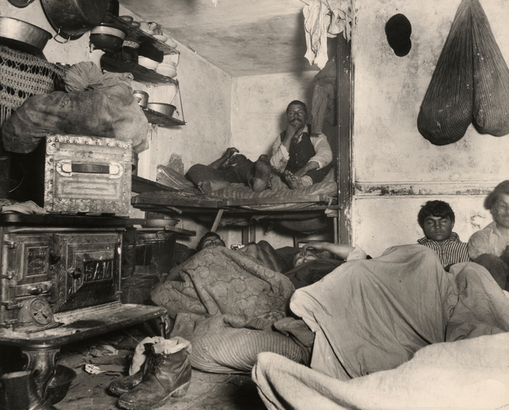
The Progressive Era and women’s activism
Progressive Era (1890s – 1920s)
Reform movements dedicated primarily to mitigating the “evils” associated with rapid industrialization, urbanization and immigration, and taming the retrogressive tendencies of corporate monopolies
Women as prominent figures in Progressive social welfare reform-- ”Maternalism”
The “Club Movement”
Particularly involved in causes relating to women, children and the family
“Demoralizing” conditions in overcrowded city slums
Child labour
Temperance
Birth control (eugenics)
Jane Addams and the “settlement house” movement
Jacob Riis, How the Other Half Lives (1900)

Slide 12
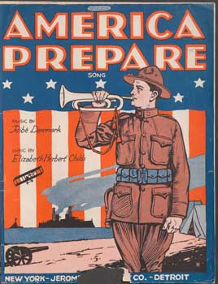
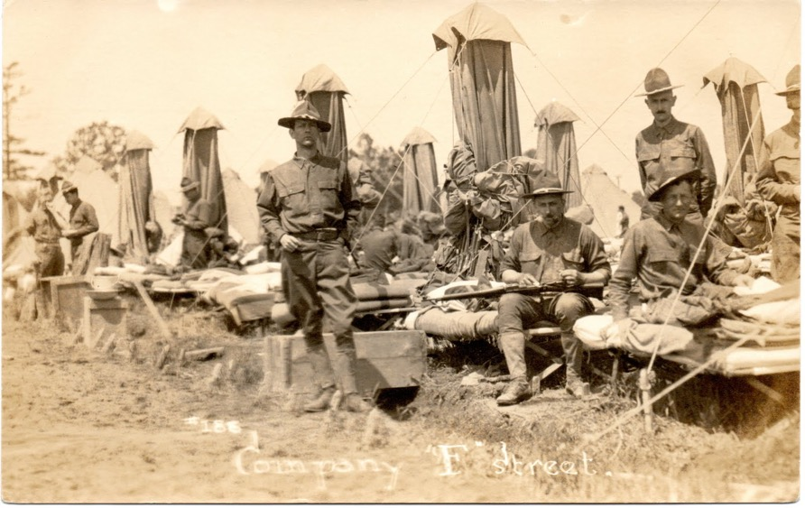
The “preparedness movement”
1915:
Preparedness
Movement founded
TR; Gen. Leonard Wood;
Elihu Root; Henry Stimson
Universal Military
Training a key goal
The “Plattsburg
Movement”:
All 18 y/o old men
should spend 6
months in compulsory
military training
1916: Presidential election campaign pits Hughes, a
pro-Preparedness Republican vs. Democrat Wilson,
campaigning to “keep America out” of the war
https://www.worldwar1centennial.org/index.php/illinois-in-wwi/934-illinois-in-wwi-article-2.html

Slide 13
Women’s pacifist internationalism
Many leading women’s suffrage campaigners and progressive reformers were also pacifists, ardently opposed to US entry into WWI
”Maternalism” was a pronounced component of anti-war sentiment for many liberal women activists
1915: Henry Ford chartered an ocean liner, inviting anti-war activists to sail to Europe, where he hoped to convene a peace conference which would forge a settlement between the belligerents
Illness, infighting and public ridicule beset this endeavour
Four days after arriving in Norway, Ford abandoned the mission and returned home
’I saw a little fordship
Go chugging out to sea,
And for a flag It bore a tag
Marked 70 h.p.
And all the folk aboardship
Cried “Hail to Hennery!”’
John O’Keefe,
“The Flivvership”

Slide 14
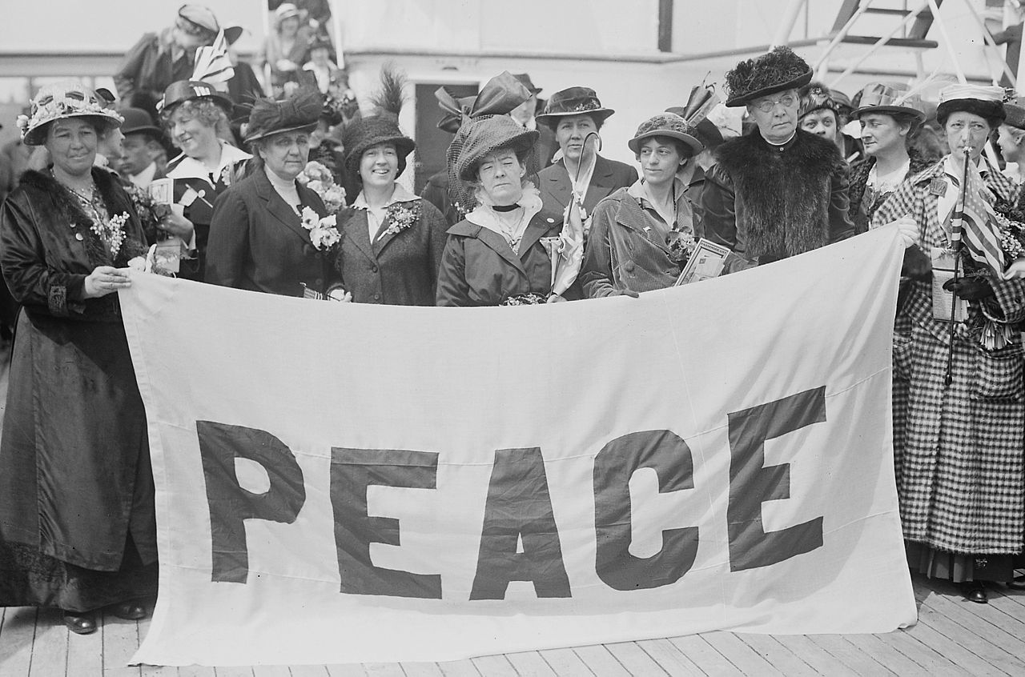
Female delegates to the 1915 Women's Peace Conference in The Hague, aboard the MS Noordam. April 1915. 1,300 delegates from 12 countries participated. Photograph shows the American delegates to the International Congress of Women held at the Hague, the Netherlands in 1915. The delegates include: feminist and peace activist Emmeline Pethick-Lawrence (1867-1954), social activist and writer Jane Addams (1860-1935), and Annie E. Malloy, president of the Boston Telephone Operators Union. (Photo credit: Library of Congress)

Slide 15
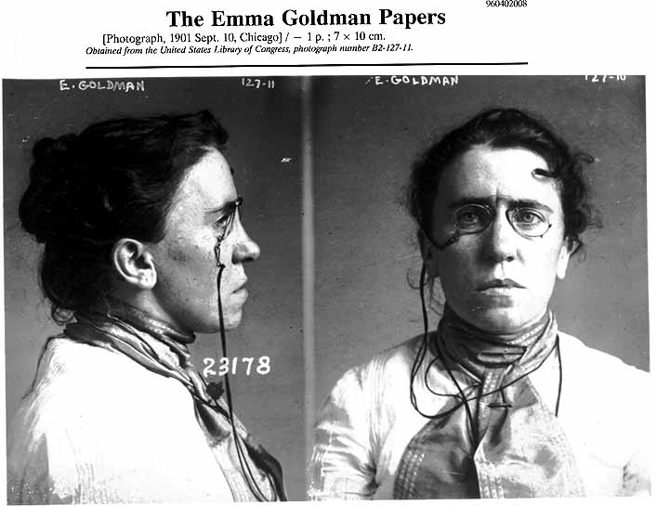
Radical resistance
The notorious Emma Goldman, feared and revered, who dedicated her life to the cause of freedom.
(b. 1869, Kovno, Lithuania)
(Mug shot taken in 1901 when Goldman was implicated in the assassination of President McKinley. Library of Congress)
Read more about Goldman’s life
and politics:
http://www.lib.berkeley.edu/goldman/MeetEmmaGoldman/index.html

Slide 16
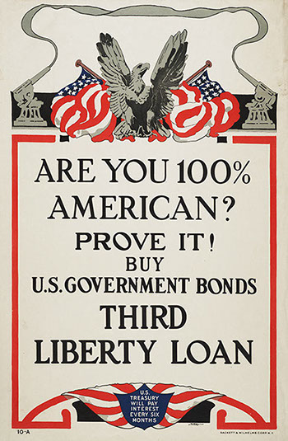
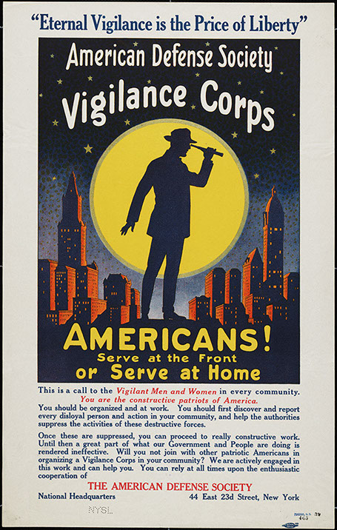
Wartime co-optation and coercion
Espionage Act (1917) intended to prohibit interference with military operations or recruitment, to prevent insubordination in the military, and to prevent the support of US enemies during wartime
Goldman was charged under this Act. More recently so, too, were Chelsea Manning, Julian Assange, and Edward Snowden
Sedition Act (1918) made it a crime to "willfully utter, print, write, or publish any disloyal, profane, scurrilous, or abusive language about the form of the Government of the United States" or to "willfully urge, incite, or advocate any curtailment of the production" of the things "necessary or essential to the prosecution of the war."
“report every disloyal person
and action in your community”
http://exhibitions.nysm.nysed.gov/WWI/phone/war-at-home.html

Slide 17
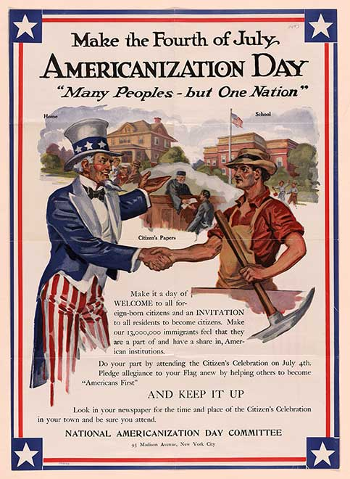
‘By 1910, nearly a third of the United States’ 92 million residents were either born abroad or the progeny of parents who immigrated to America. The idea of “hyphenated Americans”—citizens who identified as Polish-American or Italian-American, for example—discomforted many native-born citizens. Former President Teddy Roosevelt insisted all citizens, no matter their birthright or ethnic heritage, embrace “the simple and loyal motto, America for Americans.” Future president Woodrow Wilson, too, expressed doubts about foreign-born citizens, worrying they might harbor “alien sympathies.”’
https://blogs.loc.gov/loc/2017/09/world-war-i-immigrants-make-a-difference-on-the-front-lines-and-at-home/
July 1918

Slide 18
The US military
And “mom”

Slide 19
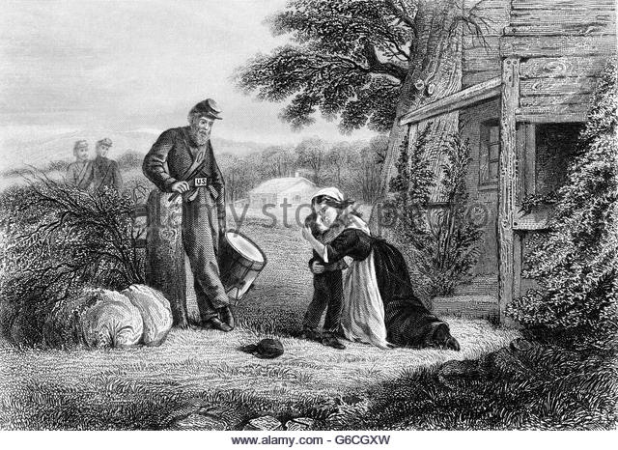
Soldiers and sentimentality: the Civil War
While mothers have worried about war,
sometimes hesitating to deliver their sons
into the arms of the military, the latter has
also persistently worried about mothers:
Can maternal love be instrumentalized?
What if soldiers yearn for home too much?
Do American “moms” raise sons that are
suitable stuff for martial recruitment, or
do intrusive, suffocating mothers raise
“namby-pamby,” “sissified” sons liable
to crack under pressure?
Jan. 1862: THE MOTHERS SACRIFICE KISSING HER YOUNG SON ABOUT TO BECOME A DRUMMER BOY FOR UNION TROOPS IN AMERICAN CIVIL WAR,
Charles Phelps Cushing

Slide 20
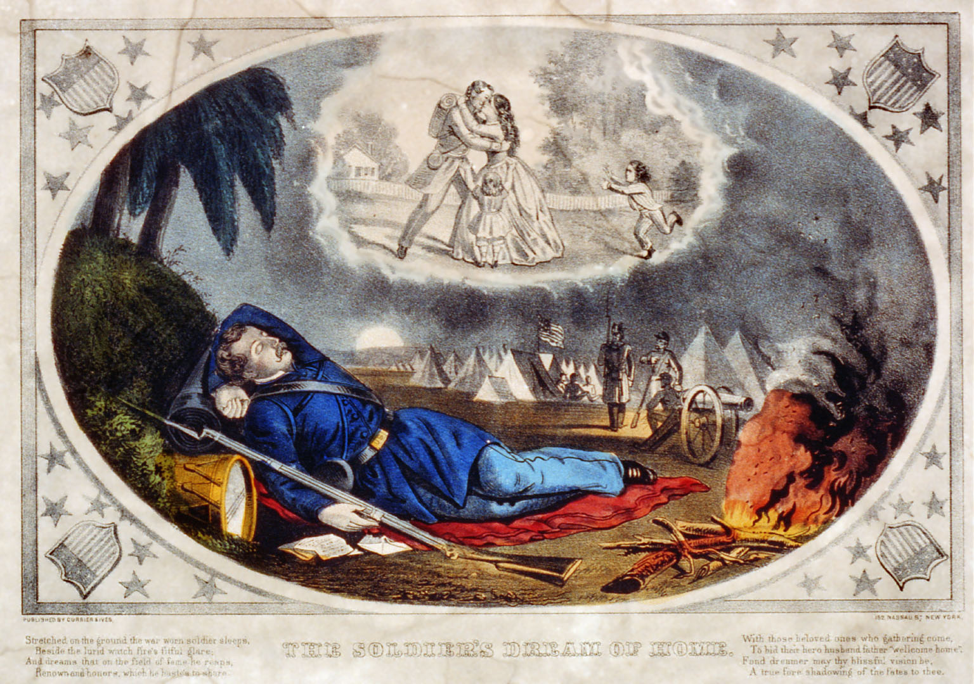
“Nostalgia” was
understood as a
clinical condition—
one that might
prove fatal
“The Soldier’s
Dream of Home”
Currier & Ives
Library of Congress

Slide 21
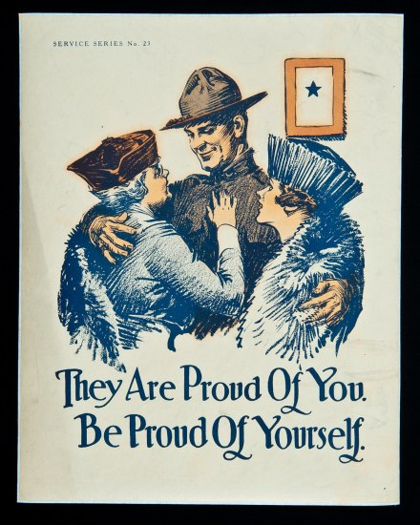
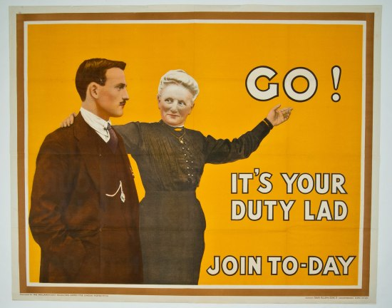
“Mother love” in WWI
British World War I recruitment poster (near R). Published by the Parliamentary Recruiting Committee, London, 1915.
Far right, US
WWI poster.
https://americanhistory.si.edu/blog/mothers-world-war-i

Slide 22
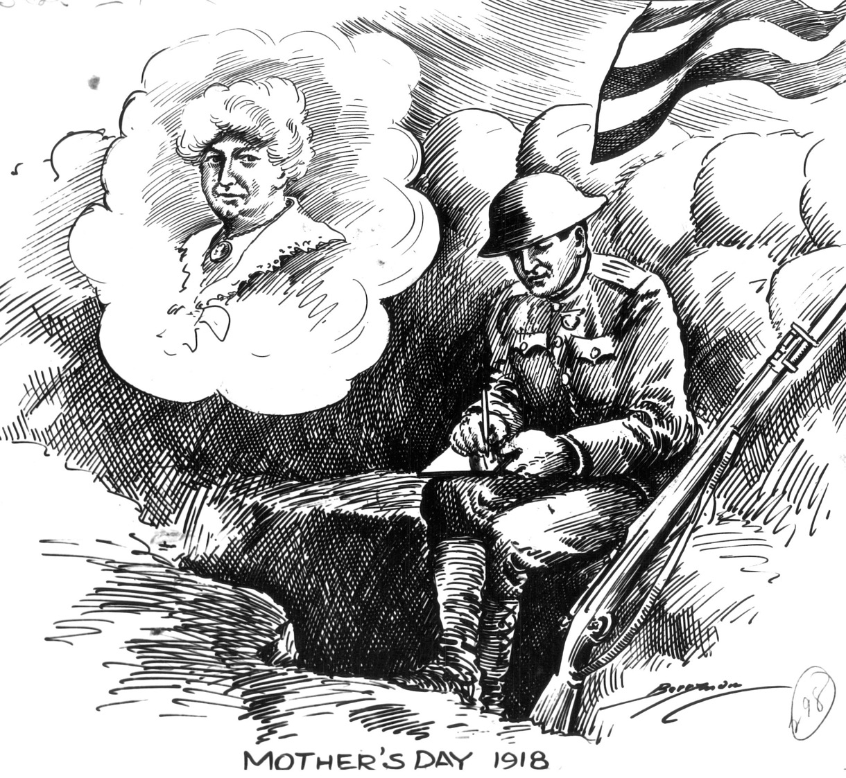
Mother’s Day, May 12, 1918
Cartoonist Clifford Berryman captures the spirit of Mother's Day. Here, amidst the chaos of battle, a soldier writes a letter to his mother, her image clearly in his mind.
National Archives, Records of the U.S. Senate
https://museum.archives.gov/featured-document-display-write-mom-thats-order

Slide 23
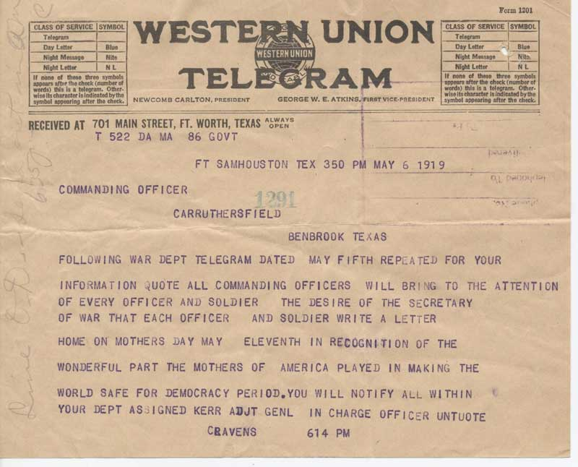
“By the date of this communication, May 6, 1919, those moms had been waiting almost six months for their children to come home. Although the Armistice was announced in November 1918, it took over a year to transport the millions of American troops stationed overseas back to the United States.”
Mother's Day Telegram, May 6, 1919
National Archives, Records of the Army Air Forces

Slide 24
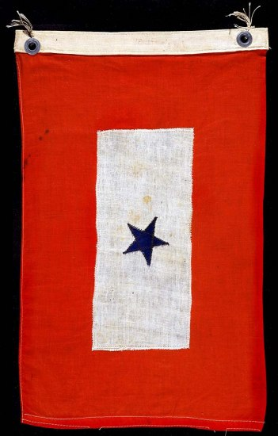
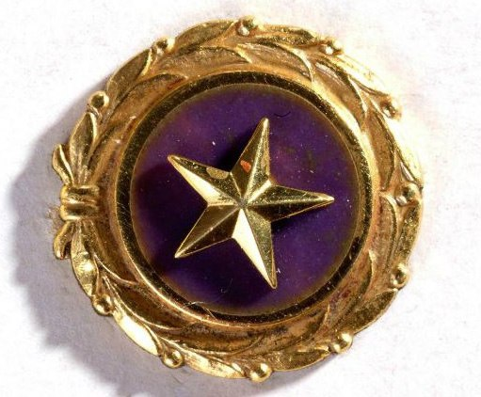
Gold Star pin from the era of World War II. Gold star surrounded by gold laurel wreaths. This pin is worn by mothers who have lost a child in military service.
Man-in-Service Flag. Cotton bunting, blue star in the center of a white field with a red border. This flag was hung in the window of a home to signify that they had a family member in service. The blue star was covered with yellow fabric if the soldier died in action.

Slide 25
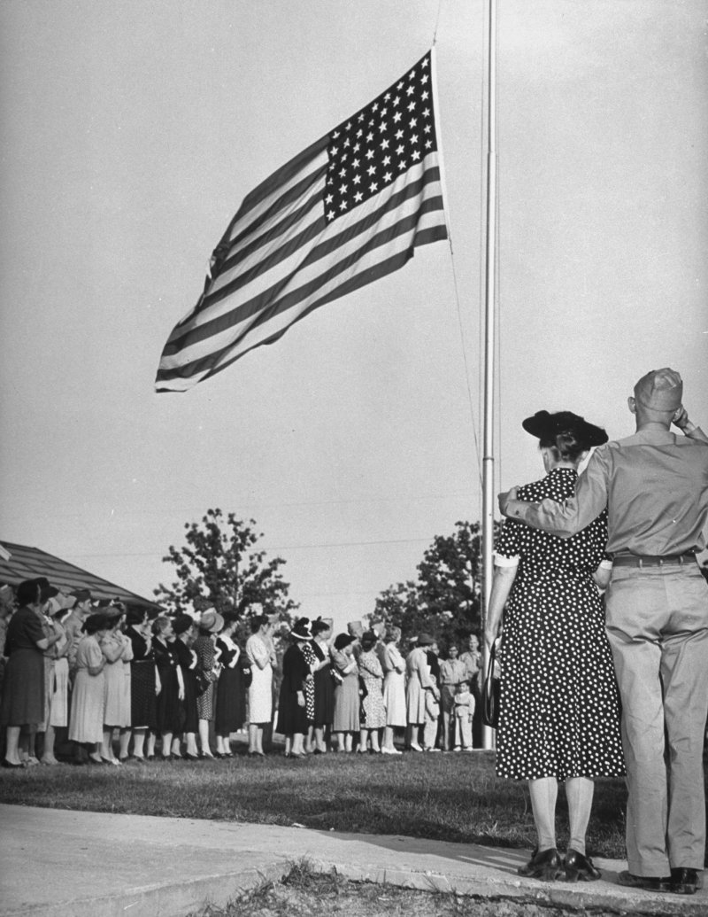
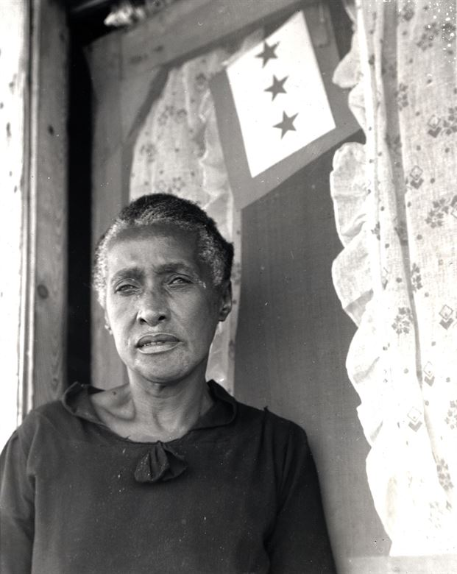
A mother of three children in military service, Placquemines Parish, La., June 1943. Service flags for individual families can have up to five stars each. (U.S. Air Force photo)
https://www.nationalmuseum.af.mil/Visit/Museum-Exhibits/Fact-Sheets/Display/Article/196842/service-flags-and-pins/
Mothers standing in line near the American flag during the crowing ceremonies of Mother's Day on a U.S. Army base. 1942.
William C. Shrout—The LIFE Picture Collection/Getty Images
https://time.com/5585264/mothers-day-origins-military/

Slide 26

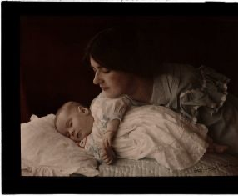
Shifting interwar views on mothers
A turn-of-the-century mother watches over her sleeping baby.
(Image: © Henry Essenhigh Corke (1883-1919); Autochrome. Collection of National Media Museum)

Slide 27
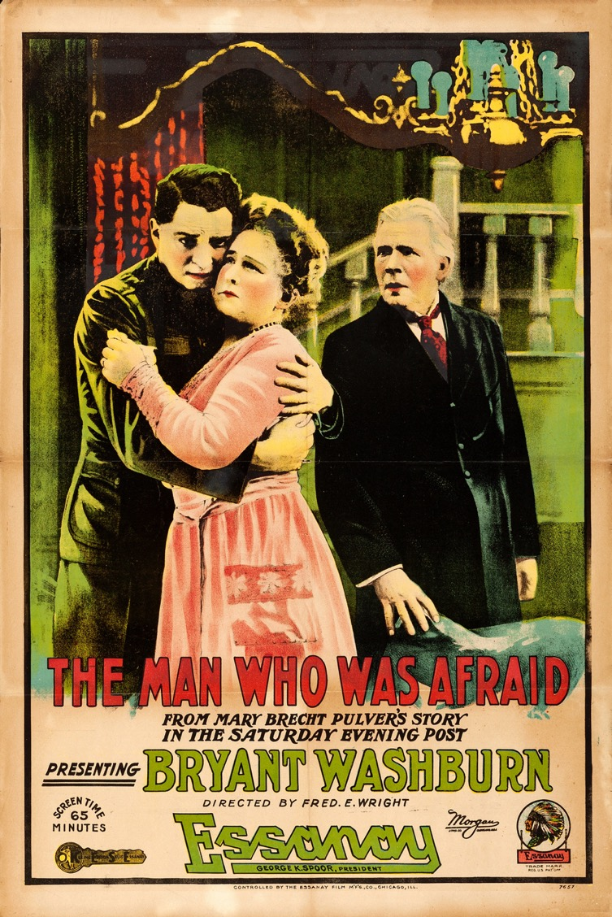
Movie poster, 1917
See discussion in Zeiger’s essay

Slide 28
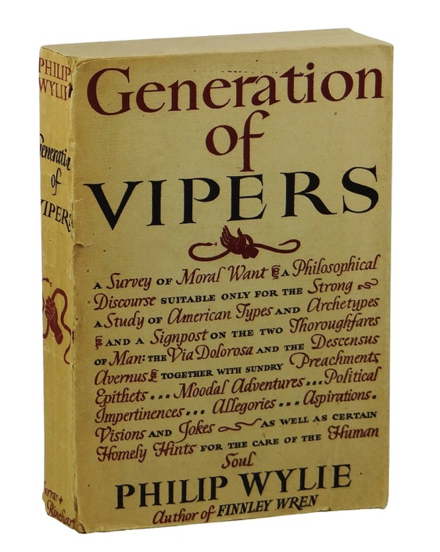
“Mom”: an all-American monster
"[L]et us look at mom. She is a middle-aged puffin with an eye like a hawk that has just seen a rabbit twitch far below. She is about twenty-five pounds overweight, with no sprint, but sharp heels and a hard backhand which she does not regard as a foul but a womanly defense. In a thousand of her there is not sex appeal enough to budge a hermit ten paces off a rock ledge. She none the less spends several hundred dollars a year on permanents and transformations, pomades, cleansers, rouges, lipsticks, and the like — and fools nobody except herself.”
1942

Slide 29
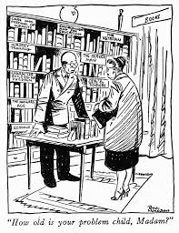
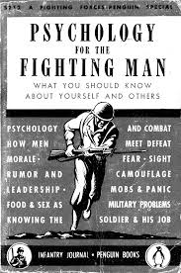
Neuro-psychiatric (NP) cases in WWII
“He [the new recruit] probably wouldn’t
admit it, but worst of all for him is the
fact that there are no women in the
Army. He misses his girl friend, his wife,
or his mother. And he secretly longs
for someone in skirts to bake him a cake,
mend his socks, put away his belongings,
or comfort him when he is tired and
aching from the hard work of training.”
From ch. XV, “The Soldier’s Personal
Adjustment”
(July 1943)

