Slide 1
What do soldiers do?
How the military works, And who works at what
Hi2C9 Week 4

Slide 2

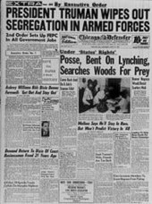
Segregation and hierarchy
Class: most career army officers were middle class/wealthier
No fraternization between officers and enlisted men [EM]
Race: The US military was racially segregated until 1948
Most units of Black soldiers were officered by white men
Gender: Service women debarred from combat until 2013
women’s auxiliary services in WWI & II (more next week)
US Army Nurse Corps (est. 1901); all female until 1955
Sexuality: The military actively attempted to exclude LGB Americans from the armed forces throughout the c20th, up to 1994, when “Don’t Ask Don’t Tell” (DADT) was adopted.
LGB personnel permitted to serve openly in the US armed forces only since 2011
Chicago Defender, July 31, 1948

Slide 3
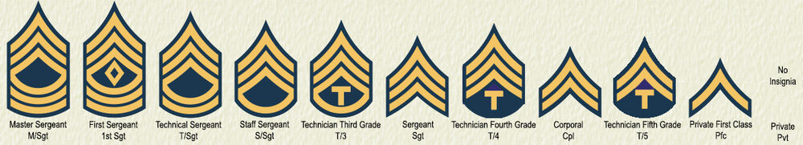
Military rank
US Army insignia (enlisted Ranks)
World War II

Slide 4
Enlisted Ranks Before July 1, 1942 |  |  |  | Enlisted Ranks After July 1, 1942
Rank | Abbrev. | Pay Grade | Monthly Pay | Rank | Abbrev. | Pay Grade | Monthly Pay
Private | Pvt. | G-7 | $21 | Private | Pvt. | G-7 | $50
Private First Class | Pfc. | G-6 | $30 | Private First Class | Pfc. | G-6 | $54
Specialist | Spl. | G-7 or G-6 | Var. | Technician Fifth Grade | T/5 | G-5 | $66
Corporal | Cpl. | G-5 | $42 | Corporal | Cpl. | G-5 | $66
 |  |  |  | Technician Fourth Grade | T/4 | G-4 | $78
Sergeant | Sgt. | G-4 | $54 | Sergeant | Sgt. | G-4 | $78
 |  |  |  | Technician Third Grade | T/3 | G-3 | $96
Staff Sergeant | SSgt. | G-3 | $72 | Staff Sergeant | S/Sgt. | G-3 | $96
Technical Sergeant | TSgt. | G-2 | $84 | Technical Sergeant | T/Sgt. | G-2 | $114
First Sergeant | 1st Sgt. | G-2 | $84 | First Sergeant | 1st Sgt. | G-1 | $138
Master Sergeant | MSgt. | G-1 | $126 | Master Sergeant | M/Sgt. | G-1 | $138
US Army
enlisted
ranks
(1920-48)
Adjusted for
inflation, $50.00
in 1942 is equal
to $810.43 in
2019.
A private’s
annual salary
was approx.
$9,725
https://ww2-facts.fandom.com/wiki/United_States_Army_Ranks

Slide 5
Rank | Abbreviation | Pay Period | Monthly Pay | Yearly Pay
Second Lieutenant | 2nd Lt. | 1st | $150 | $1800
First Lieutenant | 1st Lt. | 2nd | $166 | $2000
Captain | Cpt. | 3rd | $200 | $2400
Major | Maj. | 4th | $250 | $3000
Lieutenant Colonel | Lt. Col. | 5th | $291 | $3500
Colonel | Col. | 6th | $333 | $4000
Brigadier General | Brig. Gen. | 7th | $500 | $6000
Major General | Maj. Gen. | 8th | $666 | $8000
Lieutenant General | Lt. Gen. | 8th | $666 | $8000
General | Gen. | 8th | $666 | $8000
General of the Army | GA | 8th | $666 | $8000
US Army
Officer ranks
(1942-46)

Slide 6
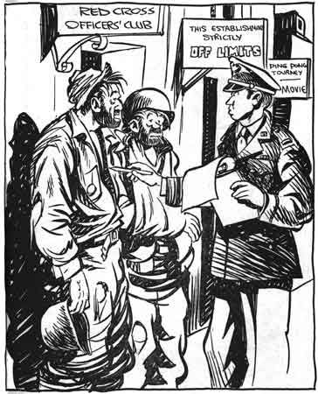
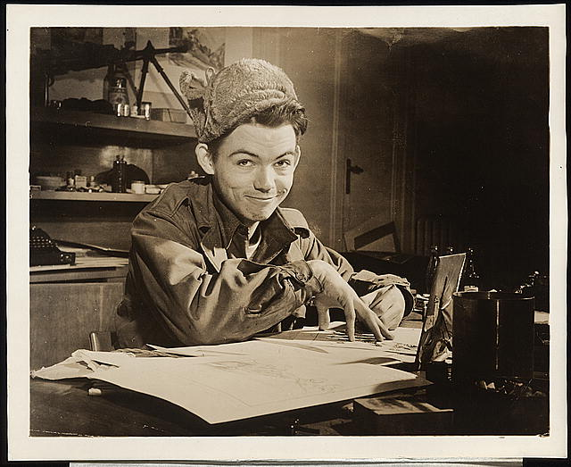
“R.H.I.P. “Rank Has Its Privileges”
Bill Mauldin
https://www.loc.gov/rr/print/swann/mauldin/mauldin-atwar.html
Bill Mauldin (b.1921) satirized class– or “caste”-- hierarchy in the army with his “Willie and Joe” comic strip
in the US army newspaper, Stars and Stripes, edited, written and drawn by enlisted men.

Slide 7
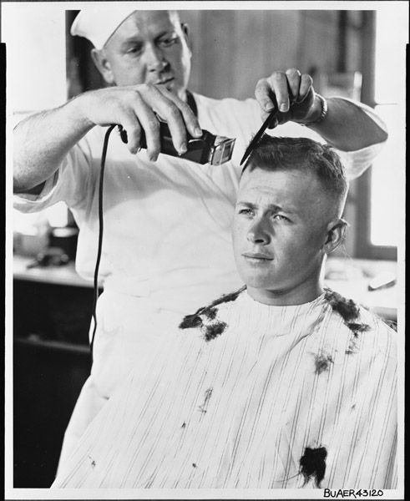
Induction and basic training
“Shipshape and Squared Away Recruit Fred Roberts from
Greenville, Tennessee, receives his first “G.I.” haircut.
September 28, 1943

Slide 8
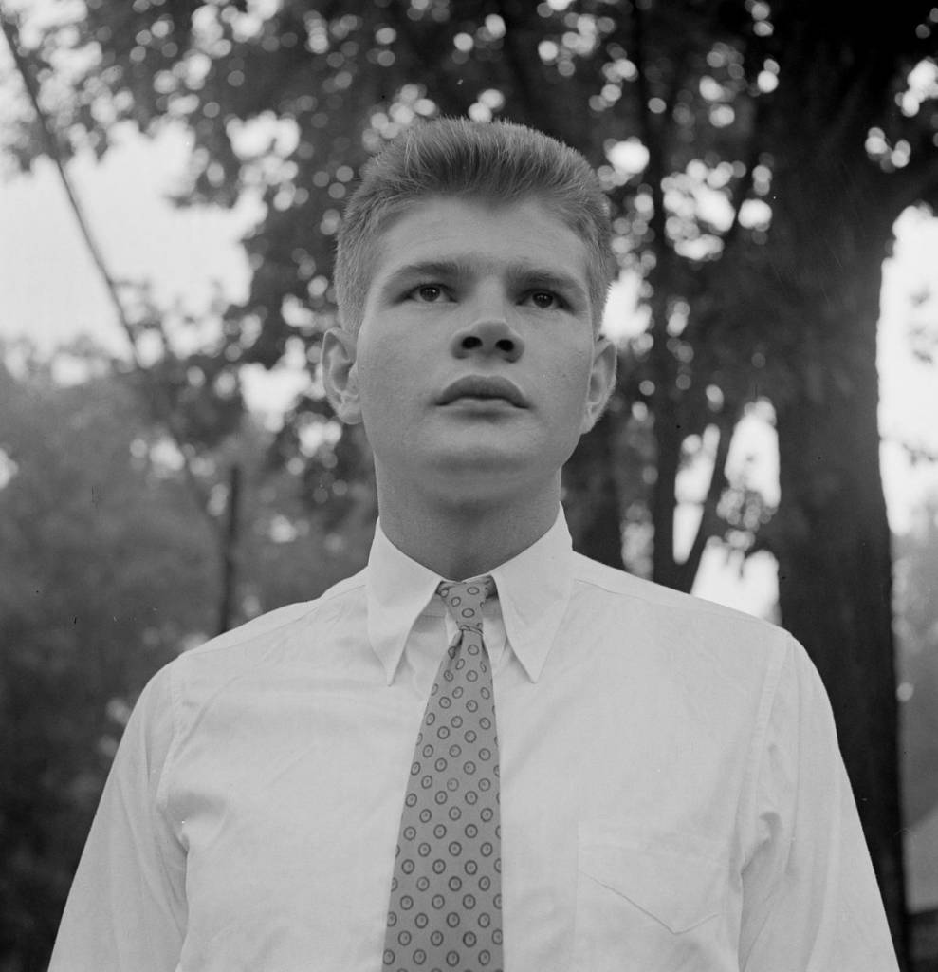
An idealized vision of army induction WWII
George Camblair’s transformation
from civilian to soldier/boy to man
Fort Belvoir, Virginia, 1942
Pictured by the Office of War Information
https://flashbak.com/the-making-of-a-gi-one-mans-journey-from-working-stiff-to-man-of-war-1942-380735/

Slide 10
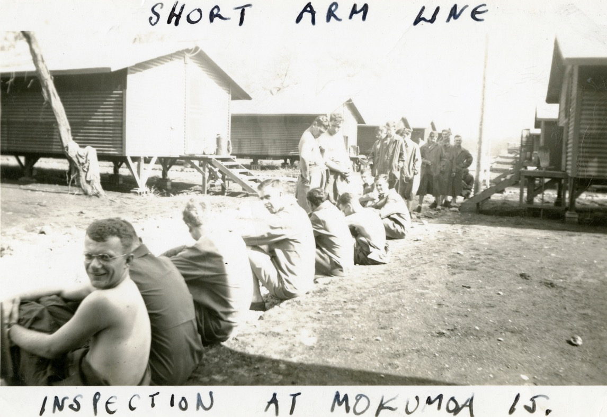
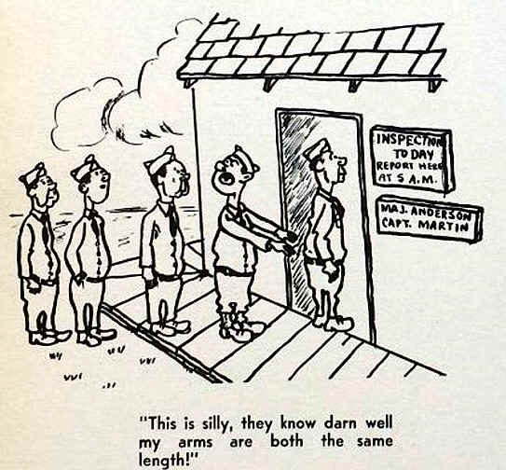
The indignities of army life: “short arm” inspection
https://www.ww2online.org/image/us-soldiers-line-sexually-transmitted-disease-inspection-mokumoa-island-hawaii-c1945
http://www.psywarrior.com/PSYOPVD.html

Slide 11
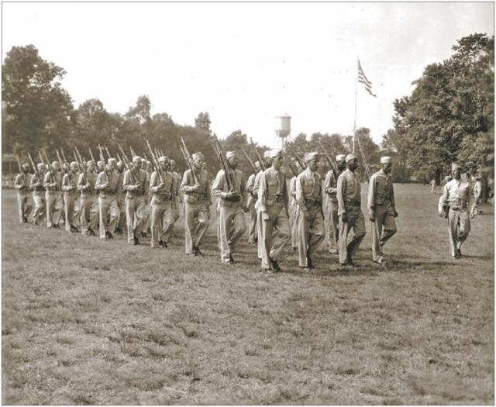
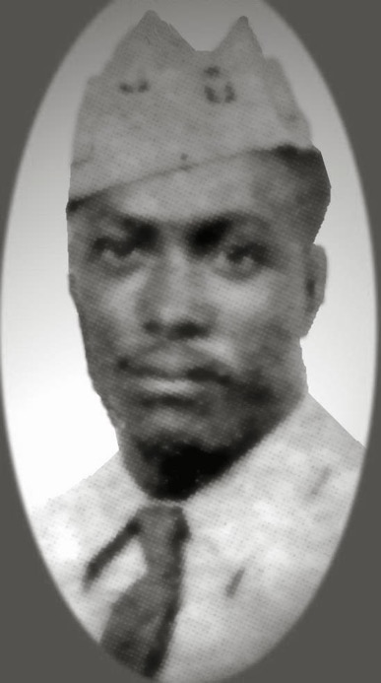
Female infidelity and male bonding
“Ain’t no use in going home
Jody’s got your girl and gone
[...] Gonna get a three-day pass
Just to kick old Jody’s ass.”
— U.S. Army marching cadence
Pvt. Willie Lee Duckworth is
credited with having introduced
the “Sound Off” cadence into
the US army during WWII
https://www.army.mil/article/51827/
us_army_jody_call_has_black_roots

Slide 12
Military occupations
Front line troops vs
The “Chairborne”

Slide 13
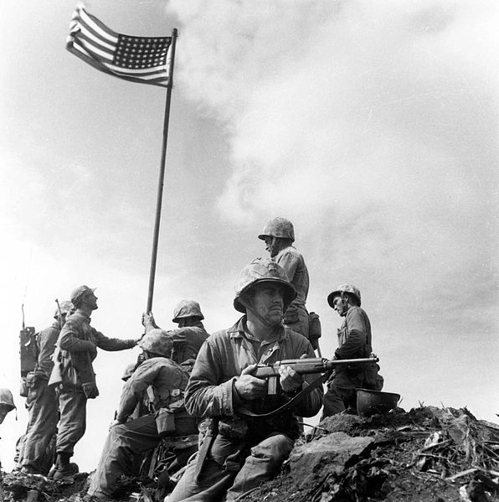
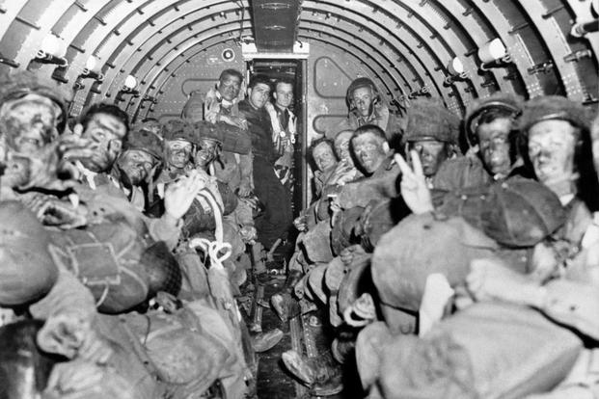
Combat forces: “guts and glory”?
American paratroopers give the 'V' for victory sign inside their C-47 bound for Normandy on June 5, 1944.
US National Archives
A small flag carried by the 2nd Battalion, 28th Marines is planted atop Mount Suribachi at 10:20 a.m. February 23, 1945. Official NAVY Photo. This is the first flag raising on the top of Mt. Suribachi. The famous flag-raising photo was taken when the second flag was put up later that day. This photo was taken by Leatherneck's Lou Lowery.
https://commons.wikimedia.org/wiki/File:Iwojimaflag.jpg

Slide 14
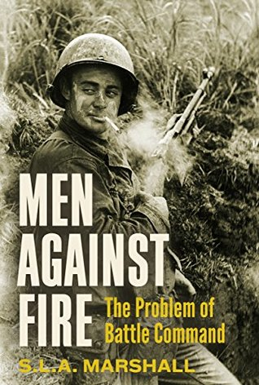
The problem of killing in warfare
“In a squad of 10 men, on average fewer than three ever fired their weapons in combat”
Brigadier General Samuel Lyman Atwood Marshall (S.L.A. Marshall, or ‘Slam’) concluded in a series of military journal articles and in his book, Men Against Fire, about America’s World War II soldiers.
Marshall had been assigned as a military analyst for the U.S. Army in both the Pacific and Europe. The American, he concluded, comes ‘from a civilization in which aggression, connected with the taking of life, is prohibited and unacceptable….The fear of aggression has been expressed to him so strongly and absorbed by him so deeply and pervadingly — practically with his mother’s milk — that it is part of the normal man’s emotional make-up. This is his great handicap when he enters combat. It stays his trigger finger even though he is hardly conscious that it is a restraint upon him.’”
https://www.historynet.com/men-against-fire-how-many-soldiers-actually-fired-their-weapons-at-the-enemy-during-the-vietnam-war.htm

Slide 15
The “tooth-to-tail” [T3R] ratio
“During World War I… the United States initially fielded about twice as many combat troops as support troops, for a 2-to-1 tooth-to-tail ratio. By 1945, as World War II wound down, that had changed; only about 40 percent of troops in the European theater were combat troops, while the rest were headquarters, administrative, logistics, and support troops of varying kinds (giving a T3R of roughly 2-to-3). By 1953 — in Korea — the tooth-to-tail ration was 1-to-3. By the 1991 Gulf War, it was even lower: McGrath estimates it as 1-to-3.3. During the Iraq War [2003], the ratio of combat to non-combat troops deployed ticked up slightly, but primarily as a function of the increased use of civilian contractors.”
Rosa Brooks, “Fog of War: How Can We Talk About the Military if We Can’t Define What It Is?” Foreign Policy, Aug. 8, 2008, https://foreignpolicy.com/2012/08/08/fog-of-war/
Reference: John J. McGrath, “The Other End of the Spear: The Tooth-to-Tail Ratio in Modern Military Operations” (Army Combat Studies Institute, 2007)

Slide 16
Military occupational specialties [MOS]
“To effect proper classification on all jobs performed by Enlisted Men, Military Occupational Specialties (MOS) were given Specification Serial Numbers (SSN) on a scale from 001 > 999.
Numbers below 500, designated military jobs having corresponding occupations in civilian life – such as, Automobile Mechanic (014), Cable Splicer (039), Cook (060), Pharmacist (149), Photographer (152), Tailor (234), Light truck Driver (345), and Clerk-Typist (405), etc.
Numbers above 500, designated jobs having no parallel in civilian life, such as Ammo Bearer (504), Light Machine Gunner (604), Antitank Gunner (610), Military Policeman (677), Rifleman (745), Bugler (803), Medical Supply Technician (825), or Mine Detector Operator (968).
Officers, either directing or supervising operations, also received an occupational classification, while their specific MOS numbers were represented by groups of 4 numerals, such as Postal Officer (0030), Signal Officer (0210), Radio Officer (0500), Glider Pilot (1026), Dental Officer (3170), Ammunition Supply Officer (4514), Public Relations Officer (5401), Legal Assistance Officer (8120), Provost Marshal (9100), Camouflage Officer (9511) to name but a few.” https://www.med-dept.com/articles/ww2-medical-mos-definitions/

Slide 17
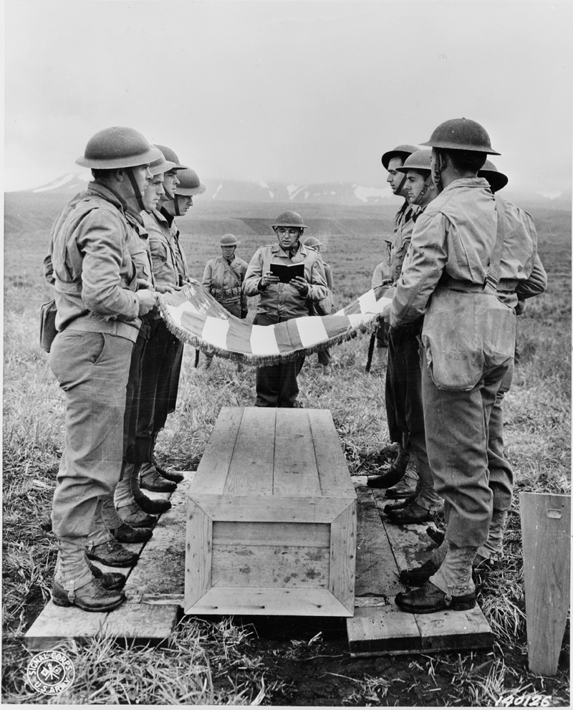

“Nurture the living.
Care for the wounded.
Honor the dead.”
https://www.loc.gov/wiseguide/mar11/mission.html

Slide 18
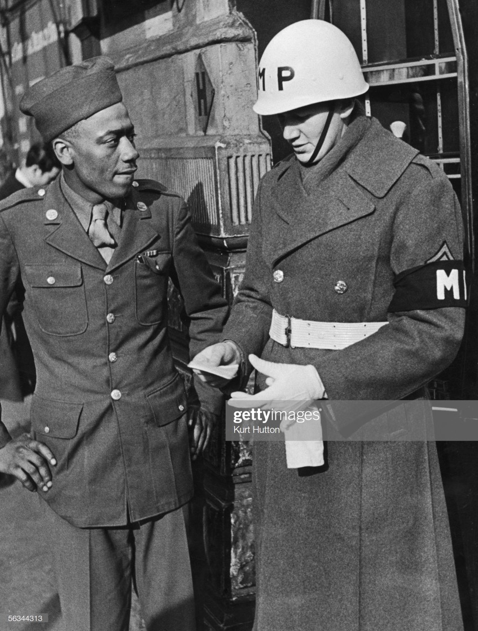
“A US military police officer inspecting documents during World War II, 1944.”
Original Publication: Picture Post
US Military Police - unpub.
Photo by Kurt Hutton/Picture Post/Hulton Archive/Getty Images

Slide 19
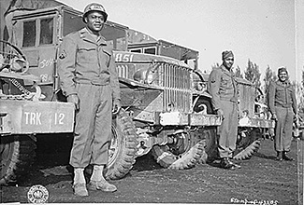
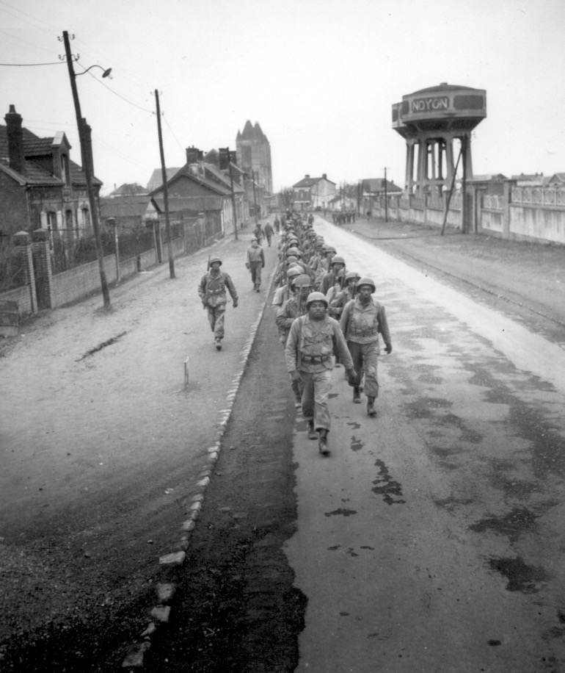
“These drivers of the 666th Quartermaster Truck Company, 82nd Airborne Division, who chalked up 20,000 miles each without an accident, since arriving in the European Theater of Operations…” [original caption]
National Archives Identifier: 535533
"Volunteer combat soldiers prepare for a day's training in preparation for shipment to veteran units at front lines in Germany." February 28, 1945. Edgren. 111-SC-337901.
https://www.archives.gov/research/african-americans/ww2-pictures

Slide 20
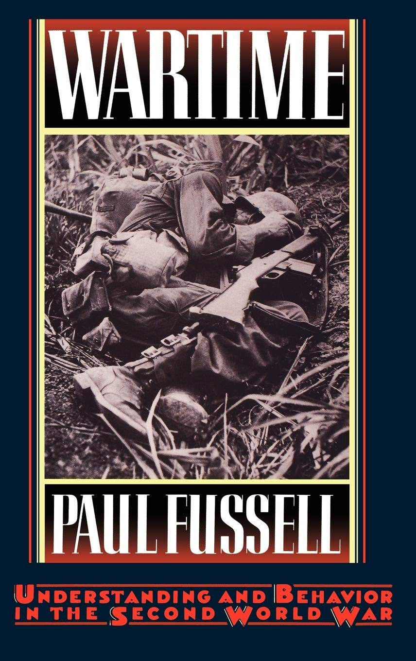
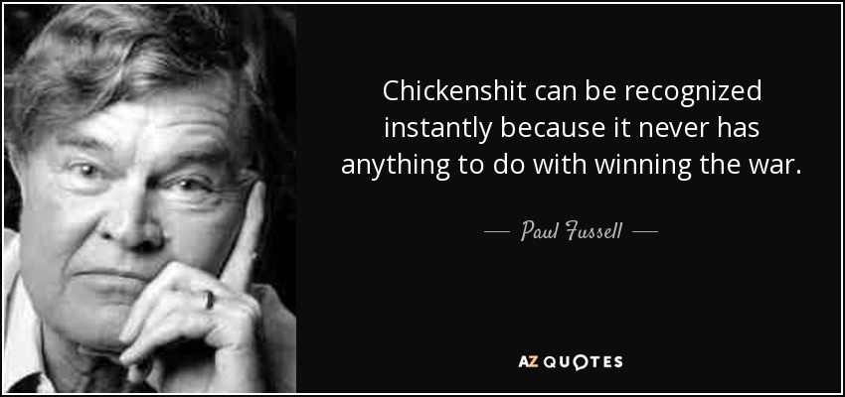
“Chickenshit”
https://www.artofmanliness.com/articles/wwii-slang/

Slide 21
KP
Sailors assigned to Kitchen Patrol sitting in circle with baskets of potatoes pealing them with paring knives during World War II.

Slide 22
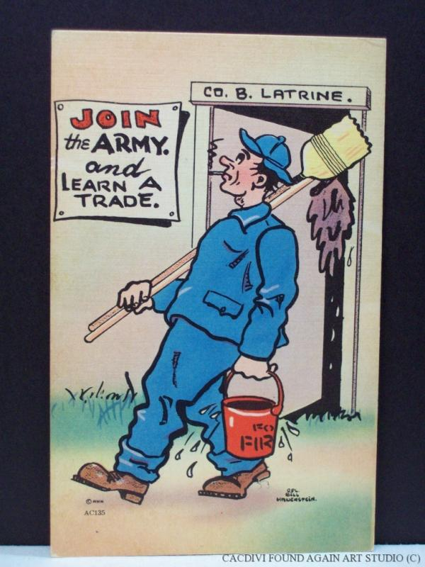
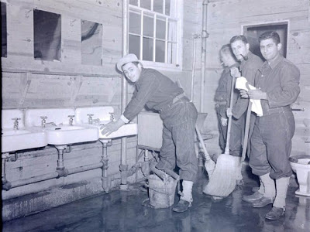
Latrine duty
Humorous
postcard,
World War II
Latrine duty at Camp Croft, near
Spartanbury, South Carolina, WWII

Slide 23
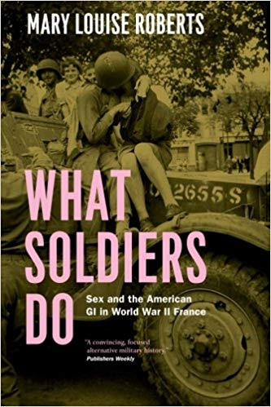
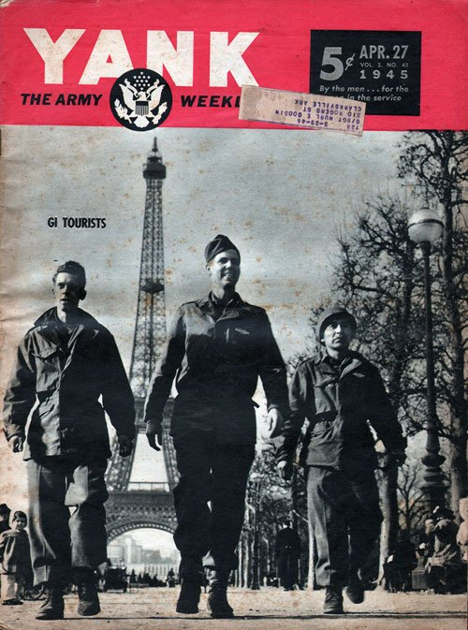
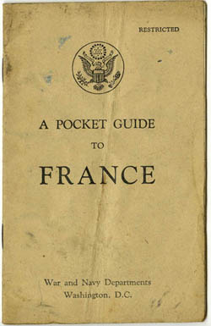
Further reading:
Andrew Buchanan,
‘“I Felt Like a Tourist
Instead of a Soldier”:
The Occupying Gaze-
War and Tourism in
Italy, 1943-45,’
American Quarterly
68, 3 (Sept. 2016): 593-
615

Slide 24
Nursing
Who Cares?

Slide 25
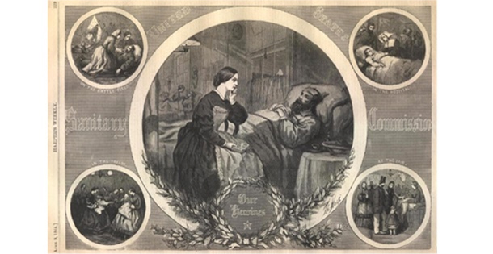
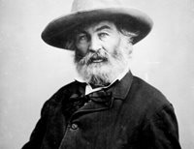
The Civil War and shifting gender norms
“I onward go, I stop,
With hinged knees and steady hand to dress wounds,
I am firm with each, the pangs are sharp yet unavoidable,
One turns to me his appealing eyes—poor boy! I never knew you,
Yet I think I could not refuse this moment to die for you, if that would save you”
Walt Whitman, “The Wound Dresser”
Abolitionist and novelist Louisa May Alcott, best known as author
of Little Women, wrote about her experiences as a Sanitary Commission nurse in a series of letters for the abolitionist Boston Commonwealth.
The letters, published as Hospital Sketches in 1863, earned Alcott her first public attention as a writer and wit.
https://www.nursingcenter.com/ncblog/may-2014/nurses-who-led-the-way-walt-whitman

Slide 26
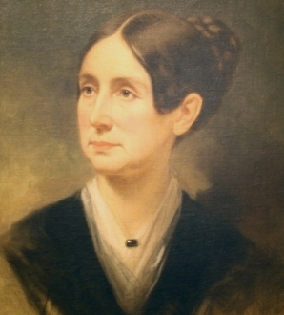
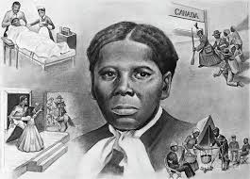
Towards a feminized– and white– profession
“The exact number of female Civil War nurses is hard to establish. Though many historical accounts estimate 2,000 on each side, Union hospital documents show at least 21,000 women on the payroll during the war… Some women volunteered with aid organizations or religious groups. Others followed their husbands or brothers to the battlefields. Some, including Harriet Tubman, were freed and escaped slaves, though they were rarely called nurses, even when they cared for patients… Black women were more often called laundresses or cooks than anything else…”
https://www.nurse.com/blog/2011/04/29/the-civil-war-and-nursing/
For more background on Civil War nurses and the origins of the nursing profession: https://www.historynet.com/civil-war-nurses
Dorothea Dix (1802-87)
Superintendent of Army Nurses
Harriet Tubman [left corner] is shown as a nurse tending to a sick person.
https://harriettubmam.weebly.com/union-nurse--aide.html

Slide 27
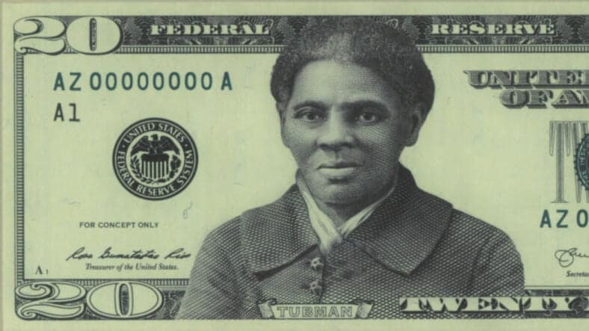
The Harriet Tubman $20 bill is on track to debut to the public in 2030.
Treasury Secretary Janet Yellen to the entire department, Yellen reaffirmed the department’s commitment to ensuring that US currency is more inclusive in representation.
https://thegrio.com/2022/02/13/us-treasury-harriet-tubman-20-bill/

Slide 28
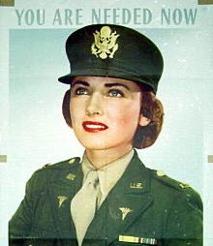
The US Army Nurse Corps
The US Army Nurse Corps (ANC) established by Congress in 1901. The Navy Nurse Corps in 1908.
WWI: the military recruited 20,000 registered nurses (all women) for military and navy duty in 58 military hospitals; they helped staff 47 ambulance companies that operated on the Western Front. More than 10,000 served overseas, while 5,400 nurses enrolled in the Army's new School of Nursing.
WWII: By 1945, the Army and Army Air Forces (AAF) had 54,000 nurses and the Navy 11,000—all women. 217 African American nurses served in all-Black Army medical units.
On 26 February 1944 Congress passed a bill that granted Army and Navy Nurses military rank, approved for the duration of the war plus 6 months.
On Aug. 9, 1955, Congress passed a law authorizing commissions for male nurses in the U.S. Army Reserve for assignment to the Army Nurse Corps.
NB: Men had provided nursing services hitherto as “corpsmen” and ”orderlies” in different medical branches of the military– but not termed “nurses.”
WWII recruitment poster for the Army Nurse Corps

Slide 29
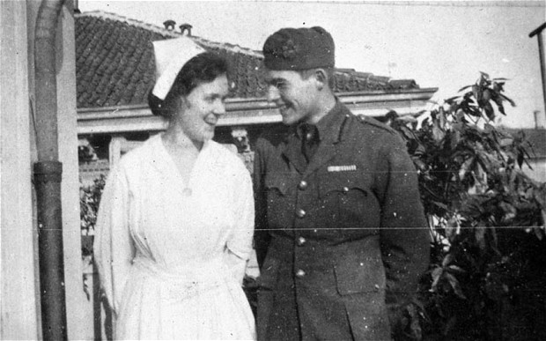
What do nurses do?
Tend to wounded, sick and/or dying soldiers,
providing medical/biological care
Take emotional care of patients, providing
reassurance, solace, and compassion
Provide substitute mother/sister figures–
or romantic love objects
Serve as spiritual counsellors
Act as amanuenses (i.e. scribes)
Ernest Hemingway (18) with Agnes von Kurowsky (26), the nurse who became the inspiration for the heroine of A Farewell to Arms
Photo: JOHN F KENNEDY PRESIDENTIAL LIBRARY AND MUSEUM, BOSTON

