Slide 1
Morale, morality and sexuality
Emotional work In the “Good War”
HI2C9 week 7

Slide 2
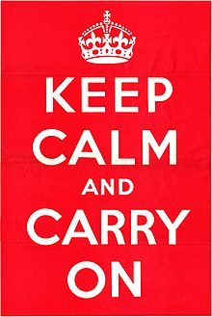
Morale
A ubiquitous war-word
But what was constitutive of “morale”?
British
Ministry of
Information
poster
(June/July
1939)

Slide 3
The determinants of morale
The ‘Primary Group’
Edward Shils & Morris Janowitz (1948)
Team spirit (esprit)
Good leadership
Camaraderie within the unit
Men fight with/for other men
Ideological motivation (“belief in the democratic cause”)
An animating vision of “home” as a place worth defending (“motherhood and apple pie”)
The ideology of non-ideological Americans

Slide 4
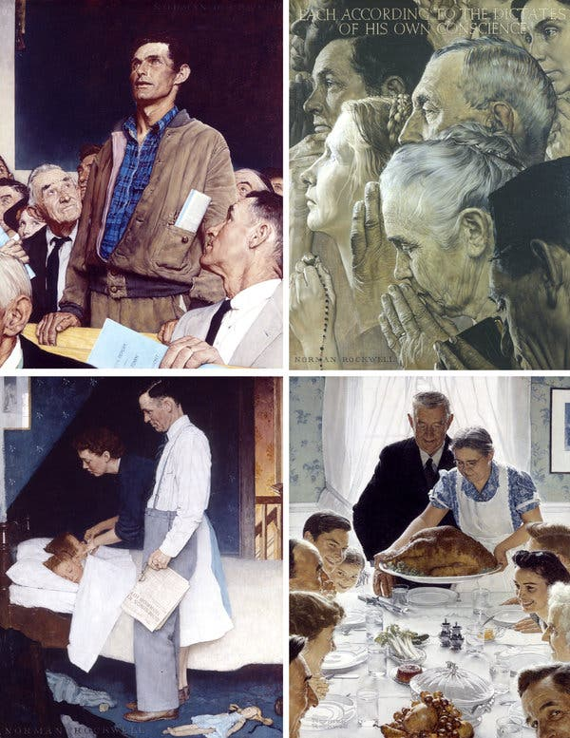
“The American Way of Life”
In the early 1940s, famed painter Norman Rockwell began working on a set of oil paintings interpreting the “four freedoms” that FDR outlined in his 1941 State of the Union address.
The images were reproduced in the Saturday Evening Post and were, the New Yorker wrote in 1945, “received by the public with more enthusiasm, perhaps, than any other paintings in the history of American art.”
https://gwtoday.gwu.edu/norman-rockwell%E2%80%99s-%E2%80%98four-freedoms%E2%80%99-will-come-gw-part-international-tour

Slide 5
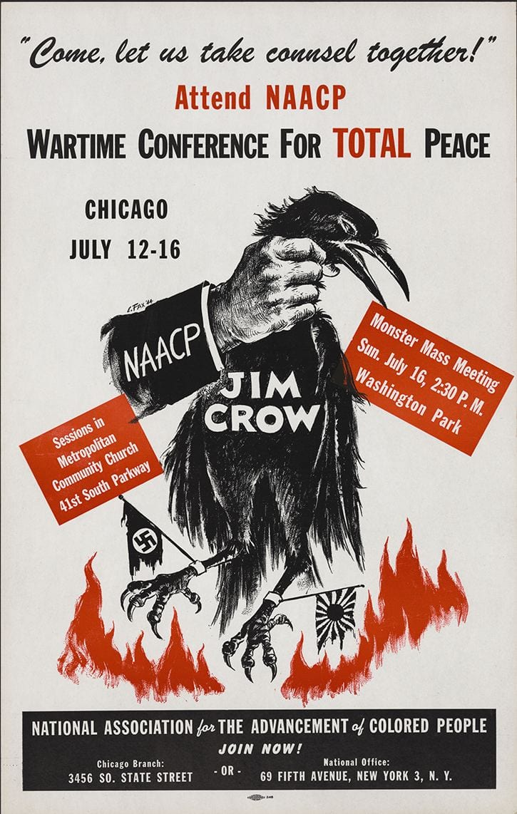
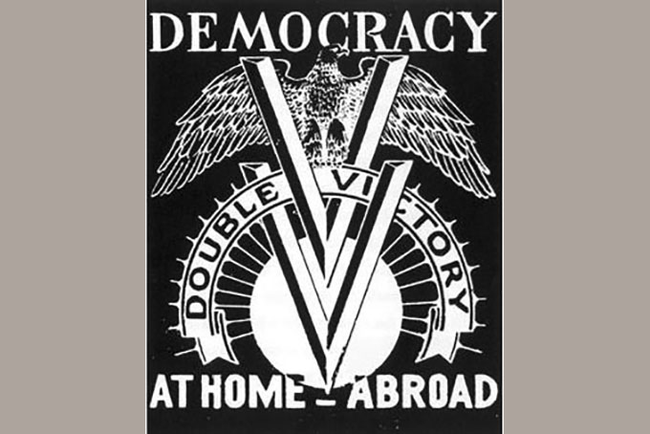
The non-ideological GI?
Double V Campaign logo used on the front page of the Pittsburgh Courier and other Black newspapers during World War II. https://newpittsburghcourier.com/2018/05/30/memorial-day-historic-double-v-campaign-still-raging/
https://sites.psu.edu/erys/2018/08/29/civic-artifact-double-v-campaign-poster/

Slide 6
The American Soldier surveys
EXPLORE THE THOUGHTS, OPINIONS, AND EXPERIENCES OF AMERICANS WHO SERVED
During World War II, the US Army administered more than 200 surveys to over half a million American troops to discover what they thought and how they felt about the conflict and their military service. The surviving collection of studies is now accessible to the public for the first time at The American Soldier in World War II. Browse and search over 65,000 pages of uncensored, open-ended responses handwritten by servicemembers, view and download survey data and original analyses, read topical essays by leading historians, and access additional learning resources.
https://americansoldierww2.org

Slide 7
Gendered emotional labour
Care
concern
Support
Love
Sex?

Slide 8
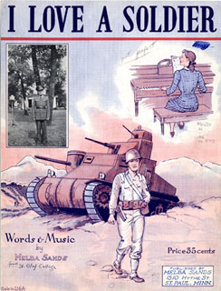
Morale
an attribute of male soldiers for which women were ‘responsibilized’
Creator: Melba Sands
Publisher: St. Paul, MN: Melba Sands
Date: 1943

Slide 9

Wives
Fiancees
Girlfriends
Mothers
A new hierarchy of significant Female others?

Slide 10
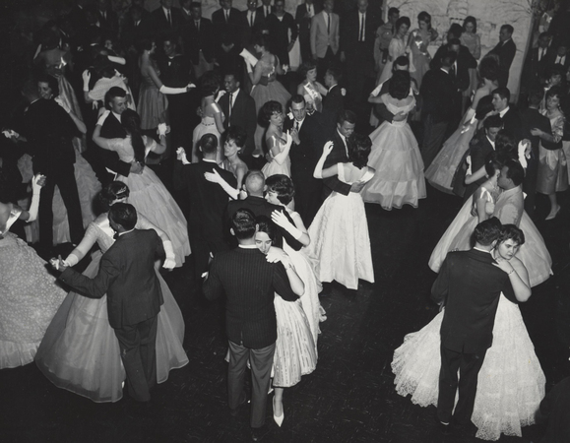
Modeling respectable femininity-
USO hostesses
United Services Organization (Feb.1941)
The Salvation Army, Jewish Welfare Board (JWB), National Catholic Community Service (NCCS), Young Men's Christian Association (YMCA), Young Women's Christian Association (YWCA), and National Traveler’s Aid Association
Caption from the USO website:
“USO hostesses were not allowed to wear slacks—they weren’t popular at the time anyway—and they were asked to wear brightly colored skirts and dresses to special events.”
Photo credit USO photos
https://www.uso.org/stories/149-in-the-uso-s-early-years-hostesses-provided-a-wholesome-morale-boost

Slide 11
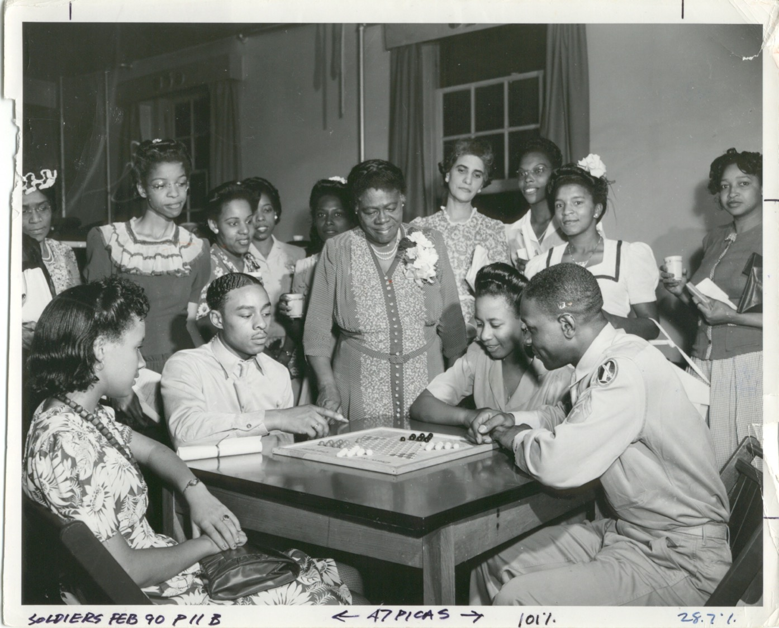
By 1943, “more than 180 of 1,326 USO operations were designated for African Americans.”
https://theuso.wordpress.com/2010/02/18/black-history-month-2/

Slide 12
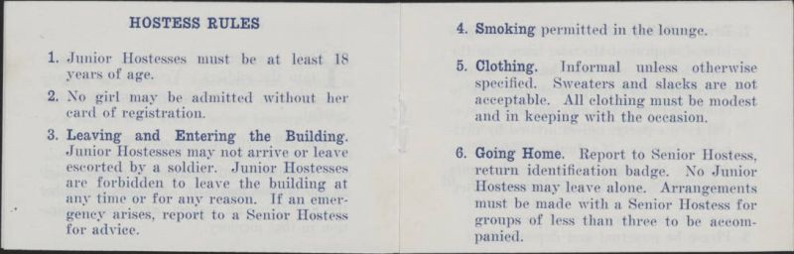
Terms of engagement
Two pages from the pocket USO Club Junior Hostess Rulebook, used at the South Bloodworth Street (Raleigh, N.C.) USO Club during WWII [from Box 1, Folder 30, North Carolina USO Clubs Records, WWII 6, WWII Papers, Military Collection, State Archives of North Carolina, Raleigh, N.C.].
https://medium.com/nc-stories-of-service/north-carolina-wwii-uso-clubs-records-online-ebe06d524de4

Slide 13
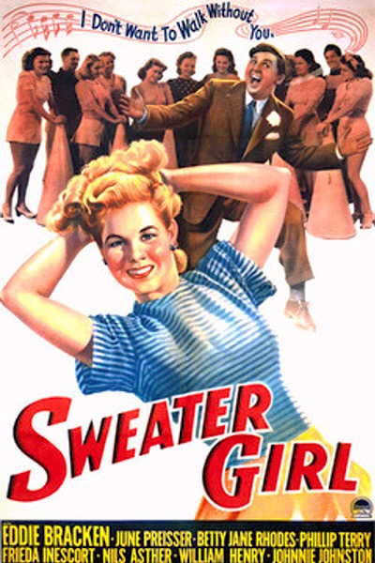
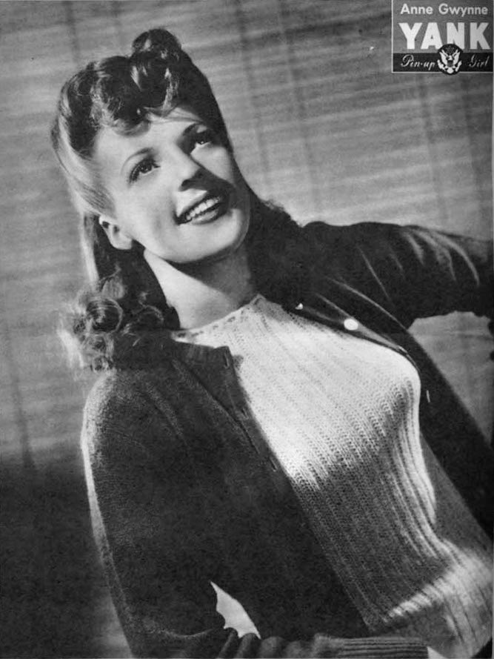
And what’s wrong with sweaters, exactly?
1942
USA/B&W-77m.
Dir: William Clemens
Pin-up photo of Anne Gwynne for the Dec. 3, 1943 issue of
Yank, the Army Weekly, a U.S. Army magazine produced by
enlisted men.
https://en.wikipedia.org/wiki/Sweater_girl#/media/File:Anne_Gwynne.jpg

Slide 14
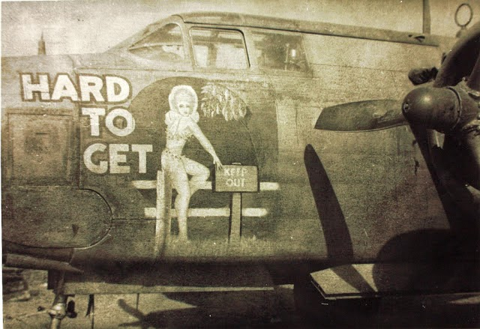
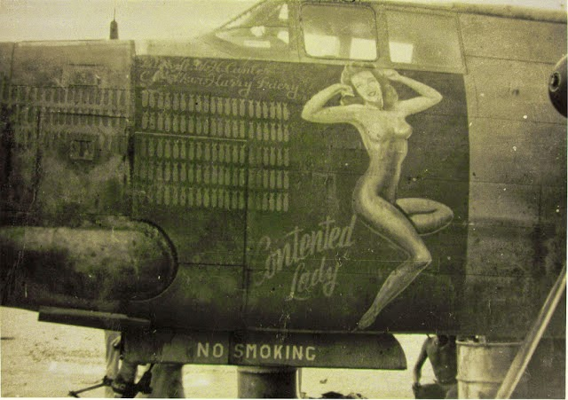
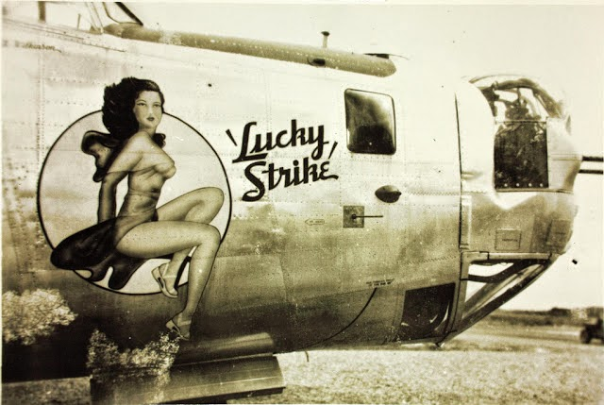
The sexualization of
morale
“Nose-art” on WWII bombers
Photos: The San Diego Air and Space Museum
https://aviationhumor.net/airplane-art-during-world-war-two/

Slide 15
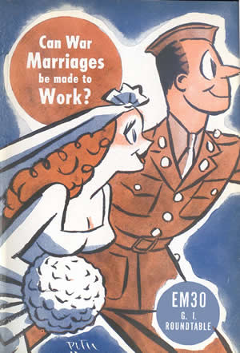
“War Marriage”
https://www.historians.org/about-aha-and-membership/aha-history-and-archives/gi-roundtable-series/pamphlets/em-30-can-war-marriages-be-made-to-work-(1944)

Slide 16
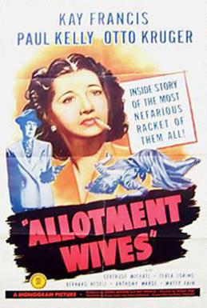
Marriage for the “wrong reasons”
Wives as “flight risks”
(1945)

Slide 17
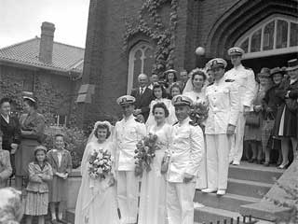
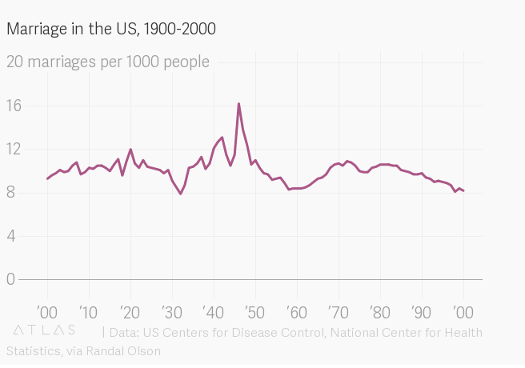
And yet…
Four bridal couples, military wedding, 1943
Minnesota Historical Society
https://www.mnhs.org/mgg/war/weddings/learn-more
1942: the ”peak year” for American marriages to date

Slide 18
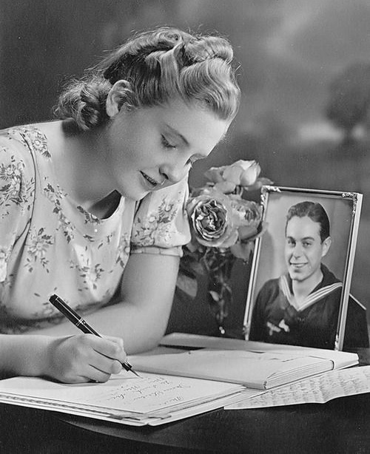
Letter writing as women’s war work

Slide 19
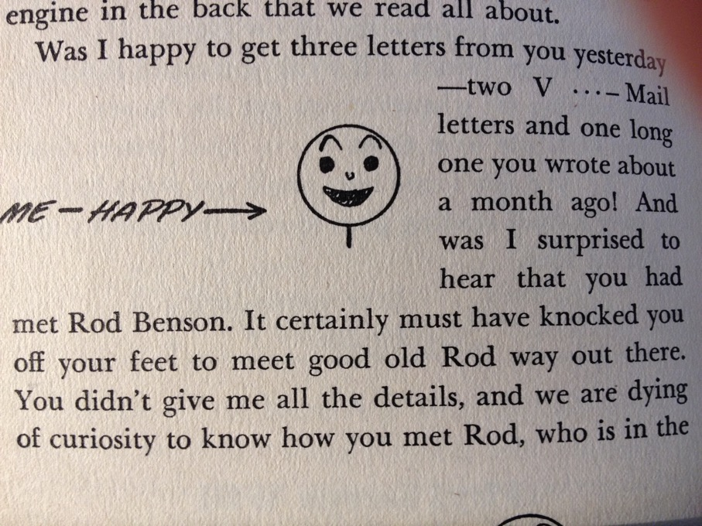
“Write right!”
“Don’t fail to mention a man, however, once in a while; otherwise he will know something is wrong. But let it be some friend of the family, or some 50-year-old uncle, or some other man he knows is perfectly harmless.”
G.A. Reeder, Letter Writing in Wartime:
How and What to Write About (Books, Inc., 1943)

Slide 20
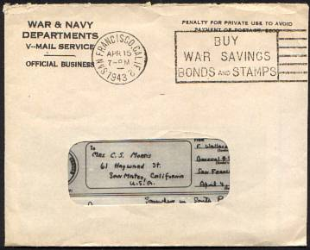
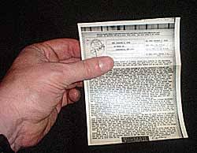
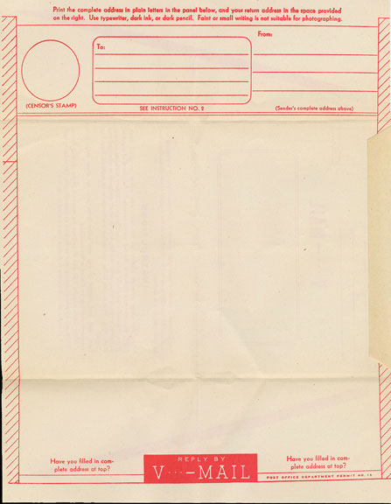
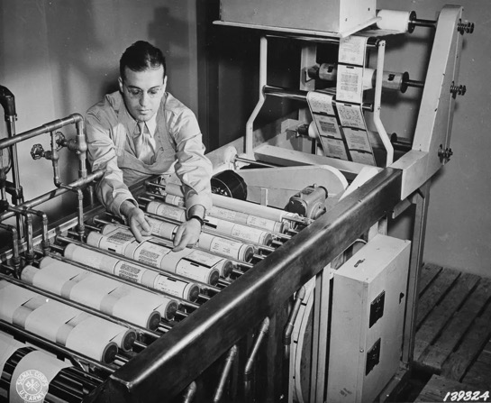
V-mail
https://www.youtube.com/watch?v=WR8cBKhgELc
Read more on V-mail and morale from the Smithsonian National Postal Museum:
https://postalmuseum.si.edu/collections/object-spotlight/v-mail-advertisements.html

Slide 21
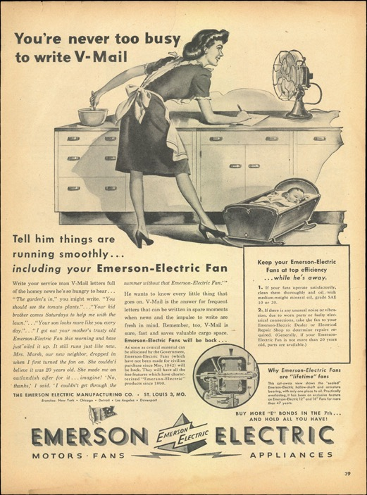

Slide 22
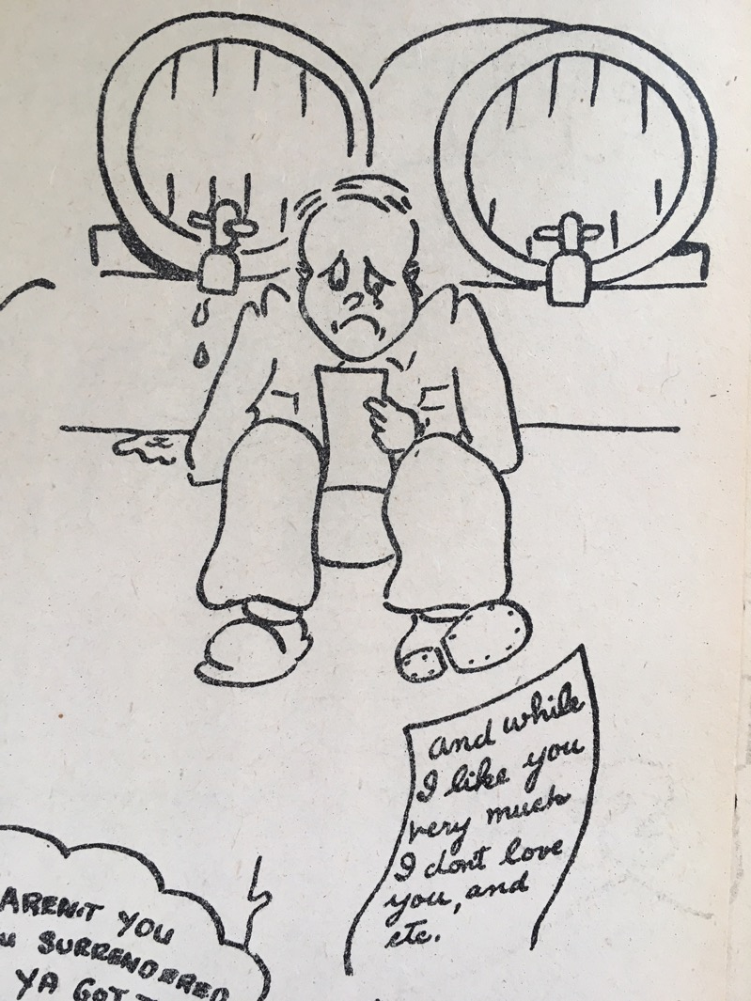
The “Dear John” letter
From the US army pamphlet,
Nervous in the Service
US National Archives II, College Park, MD

Slide 23
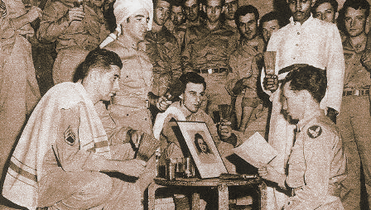
“Brush-off Clubs”
“AT A U.S. BOMBER BASE, INDIA – For the first time in military history, the mournful hearts have organized. The Brush-Off Club is the result, in this land of sahibs and saris; as usual, it is strictly G/I.
Composed of the guys whose gals back home have decided “a few years is too long to wait,” the club has only one purpose – to band together for mutual sympathy. They meet weekly to exchange condolences and cry in their beer while telling each other the mournful story of how “she wouldn’t wait.”
The club has a “chief crier,” a “chief sweater” and a “chief consoler.” Initiation fee is one broken heart or a reasonable facsimile thereof.”
Yank, The Army Weekly – China-Burma-India Edition
(January, 1943)

Slide 24
Sex, soldiers and double standards
Morale vs. morality

Slide 25
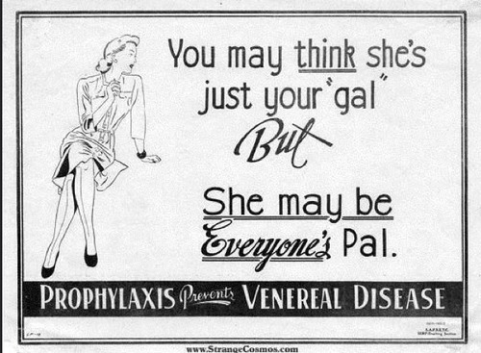
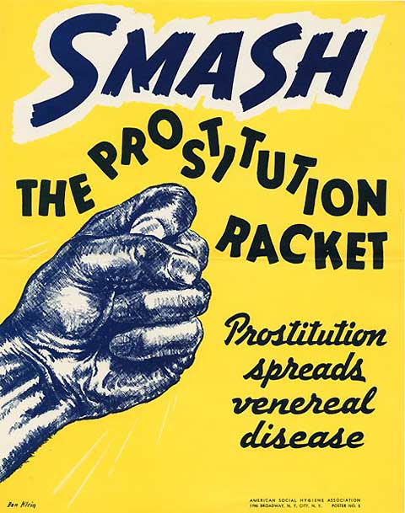
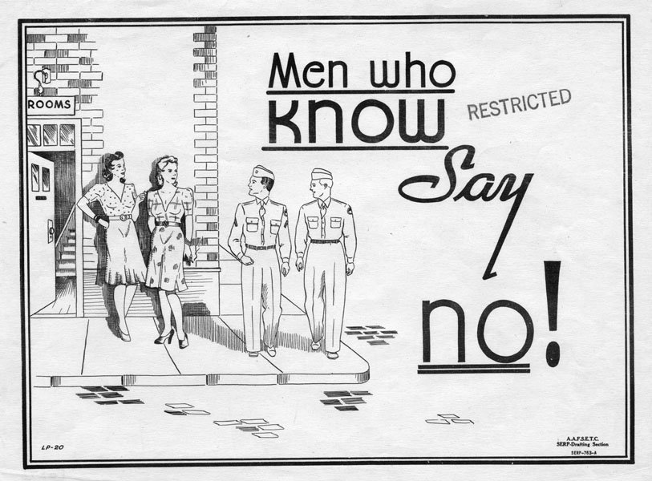
The May Act, which became law in June 1941, intended to prevent prostitution on restricted zones around military bases.
It was invoked chiefly during wartime and only in selected areas, primarily the Carolinas and Tennessee.

Slide 26
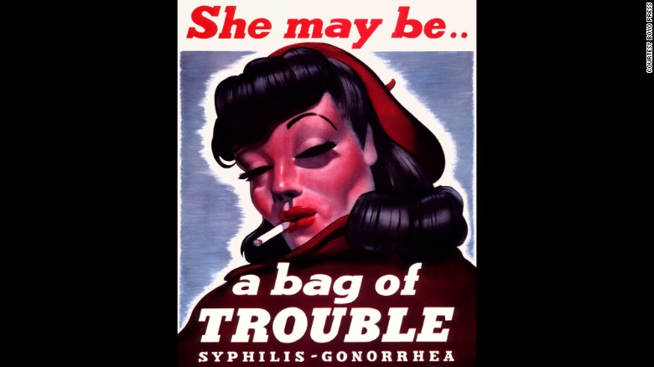
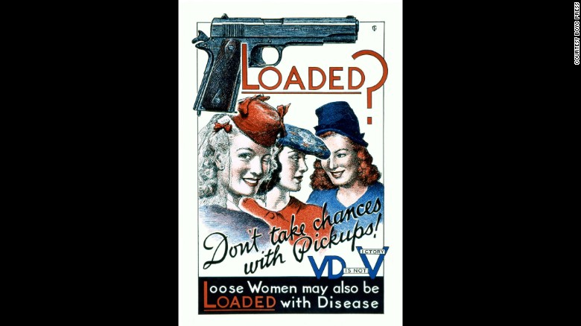
“Sex hygiene” campaigns: safe sex or no sex?
To review a fuller gallery of posters:
https://edition.cnn.com/2015/08/25/health/wwii-vd-posters-penis-propaganda/index.html
See also: https://www.theatlantic.com/health/archive/2015/10/during-world-war-ii-sexually-active-women-were-a-national-security-threat/409555/

Slide 27
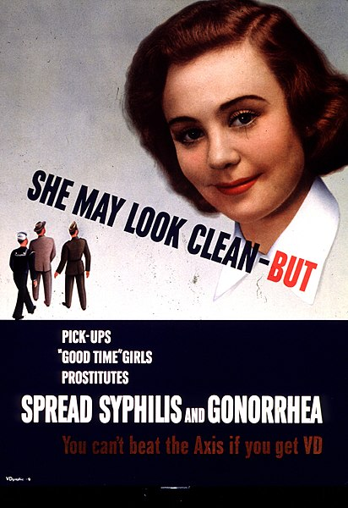
The “girl next door”
as “Victory Girl”?

Slide 28
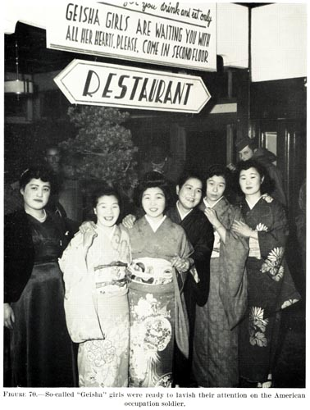
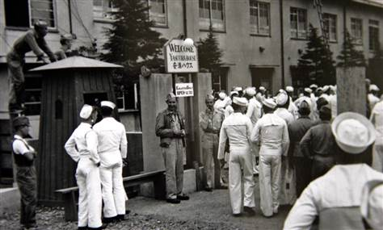
“Over there:” soldiers’ sexual entitlement
In this undated image released by the Yokosuka City Council in Japan, U.S. sailors gather in front of a Yasu-ura House "comfort station" in Yokosuka, south of Tokyo.
http://www.nbcnews.com/id/18355292/ns/world_news-asia_pacific/t/us-troops-used-japanese-brothels-after-wwii/#.XchB9r9b9E4

Slide 29
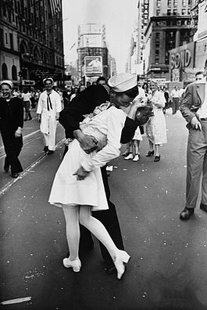
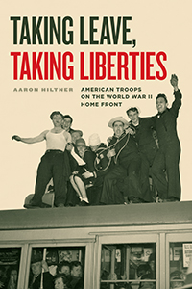
What’s in a kiss?
V-J Day in Times Square, a photograph by Alfred Eisenstaedt, was published in Life in 1945 with the caption:
"In New York's Times Square a white-clad girl clutches her purse and skirt as an uninhibited sailor plants his lips squarely on hers."
Brooke L. Blower, 'V-J Day, 1945, Times Square,' in Brooke L. Blower and Mark Philip Bradley (eds), The Familiar Made Strange: American Icons and Artifacts after the Transnational Turn (2015), e-book

