Slide 1

Change or Continuity?
Some concluding thoughts

Slide 2
Lecture outline
What had changed and what had been left unreformed?
Look at each of our themes:
Religious corruption
Judicial corruption
Social corruption
Imperial corruption
Fiscal-military state
Office-holding
Accountability
Individuals or systems?

Slide 3
Start with a reminder that not everything had been reformed by the 1850s
Chartism 1838-58
votes for all men;
equal electoral districts;
Abolition of property qualifications for members of parliament
payment for M.P.s;
annual general elections; and
the secret ballot
Crimean war 1853-6
1854 Northcote-Trevelyan report: competitive exams for civil service (influence of Indian reforms); recruited to the civil service as a whole not particular departments; hierarchy of grades; promotion on merit. But great resistance to its implementation – for at least another 15 years, when recruitment was placed under control of Treasury, but still no single practice across government

Slide 4
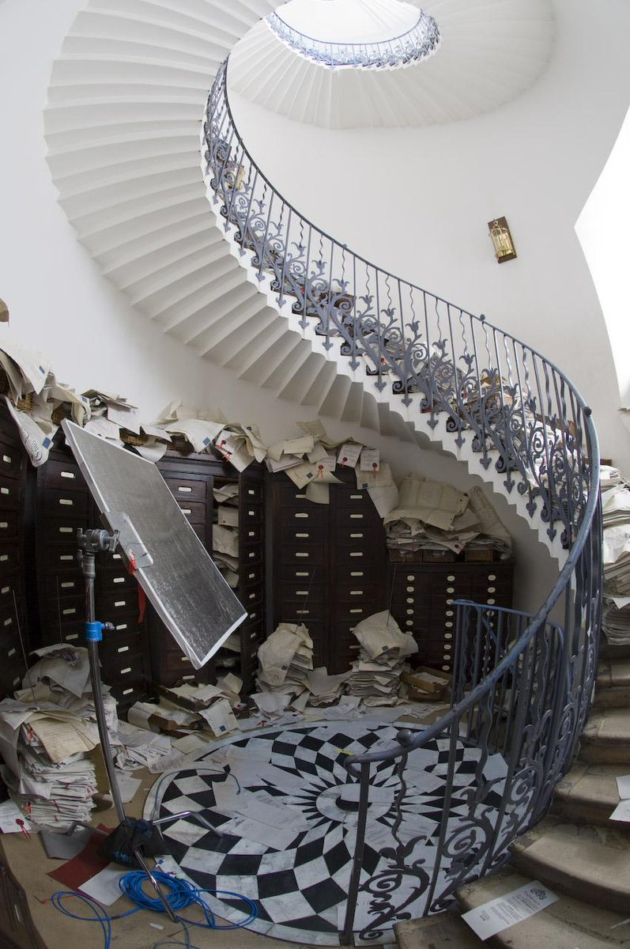
Administrative reform – too little or too much?
Administrative Reform Association – attack by ‘men of business’ on persistence of patronage in Parliament, government and the armed forces – incompetent nobility were in charge because of corruption – had replaced crown influence.
Dickens, speech 1855 to it – founding member; satire of the Circumlocution Office, in his novel Little Dorrit (1855-7), in which the public accounts were turned into incomprehensible bundles
Growing anxiety about bureaucratisation. ‘red tape’ (1736) – used to tie up official documents (introduced in 1650s); ‘red-tapeism’ (1834)
‘Anti-corruption’ introduced in derogatory sense: first used in Britain in 1831, in a pejorative way to describe the ostentatious zeal of those seeking parliamentary reform, and more widely in 1836 when The Times attacked the ‘Anti-Corruption reformers’ and ‘anti-Corruption Pharisees’ among the Whigs, who ‘thrived on pretence of putting down Tory corruption’, using the issue as ‘the white linen that covers their [own] rottenness’

Slide 5
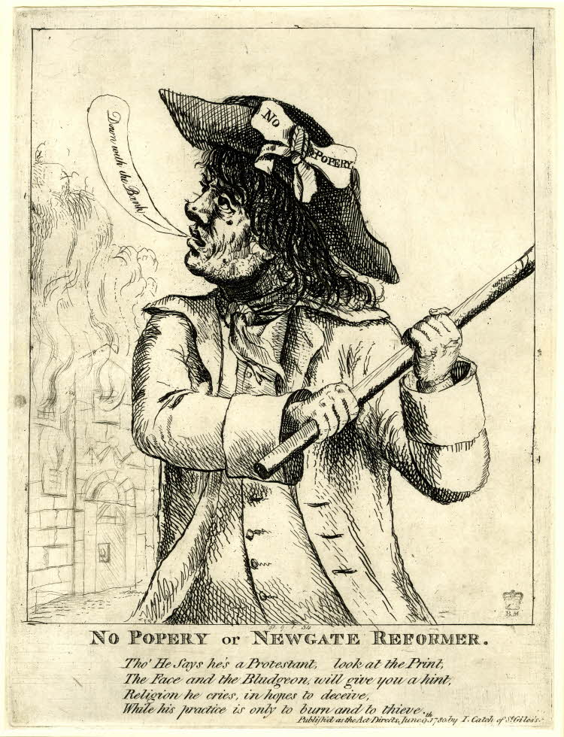
Religious corruption
Move away from religious notions of corruption and of popery as the key danger
Though anti-popery still had the capacity to cause unrest eg Gordon Riots of 1780;
1829 Emancipation controversy - permitted members of the Catholic Church to sit in the parliament at Westminster, though it raised the voting qualification
Ultra Tories dismayed and concluded Parliament was a corrupt institution to have passed the bill
But vestiges of the religious mentality persisted …

Slide 6
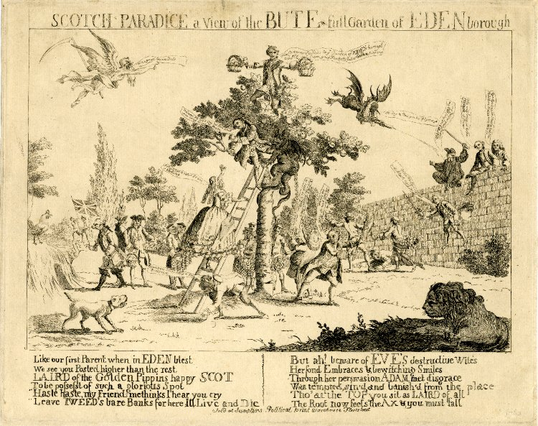
A satire of 1763 showing Eden’s tree as the emblem of Bute’s corruption. The verse ends: ‘The root now feels the Ax & you must fall’
Mathew 7. 17-18: ‘Do men gather Grapes of thornes, or Figs of Thistles. Even so every good Tree bringeth forth good Fruit, and a corrupt Tree brings forth evil fruit’.

Slide 7
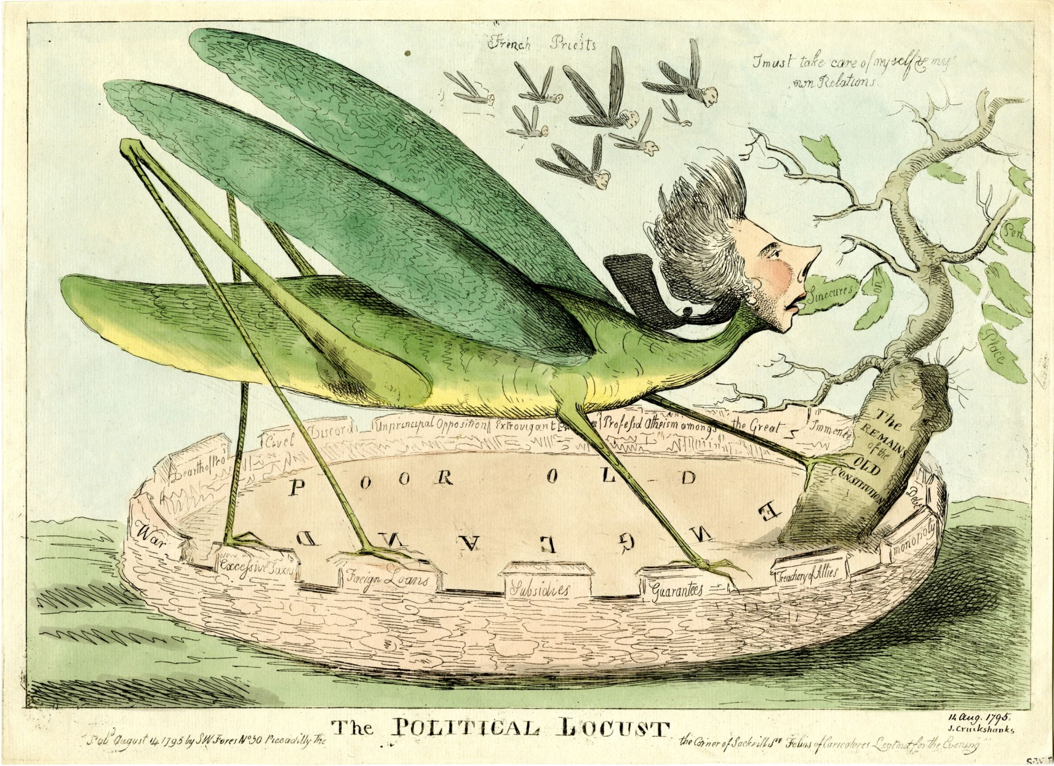
Pitt as a political locust in 1795.
He bites a leaf inscribed 'Sinecures'; other leaves are 'Pen[sion]', 'Place', '[Pensi]on'. He says: "I must take care of my self & my own Relations". Above his head a swarm of locusts with human heads flies; they are 'French Priests'.

Slide 8
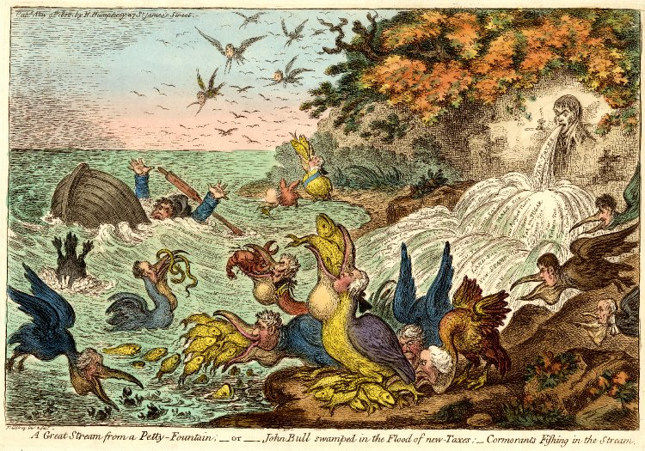
A Giant Stream from a Petty Fountain – or – John Bull swamped in the Flood of Taxes – Cormorants Fishing in the Stream (1806)
Cormorants were also ‘unclean’ in the King James Bible – they were nesting in the earlier tree of corruption and the metaphor was used in anti-tithe literature
Proverbs 25:26: A righteous man falling down before the wicked
is as a troubled fountain, and a corrupt spring.

Slide 9
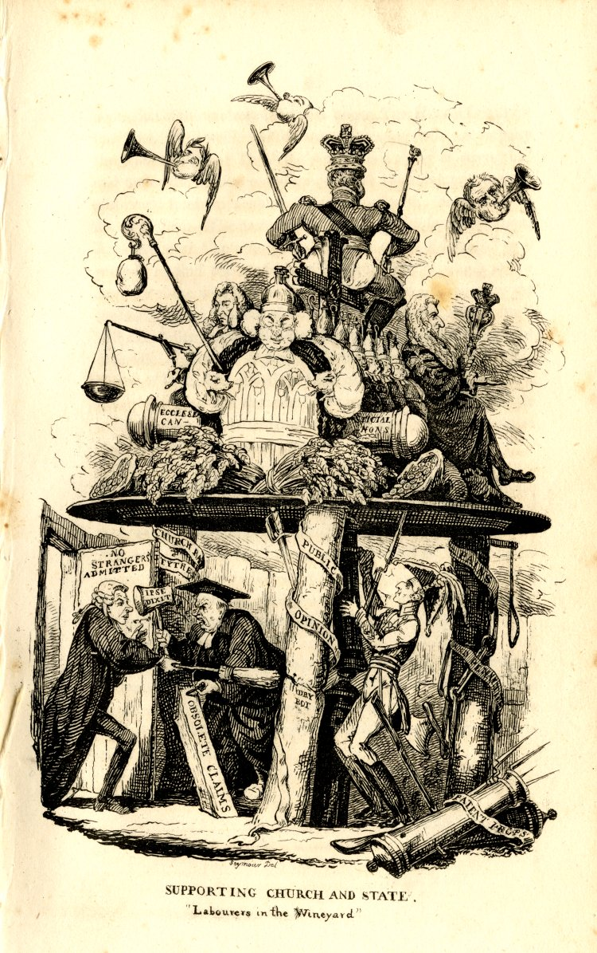
Tithes
again fused the economic and religious and the political
C17th precedents
Issue for late C18th dissent
1820s’-30s Eric Evans: rising anti-clericalism (tithes; enclosures; clerical magistrates)

Slide 10
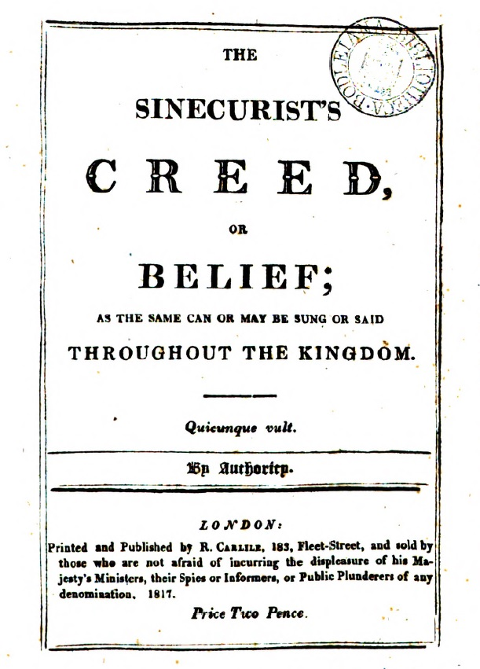
William Hone
Republished a collection of Murray’s sermons in 1817
Looks backs further to John Lilburne
published three parodies very early 1817, linking corruption and reform, through parody
Three trials 1817 for libel
Prosecution claimed Scripture should be ‘never used for secular purposes’: blasphemous ridicule of scripture

Slide 11
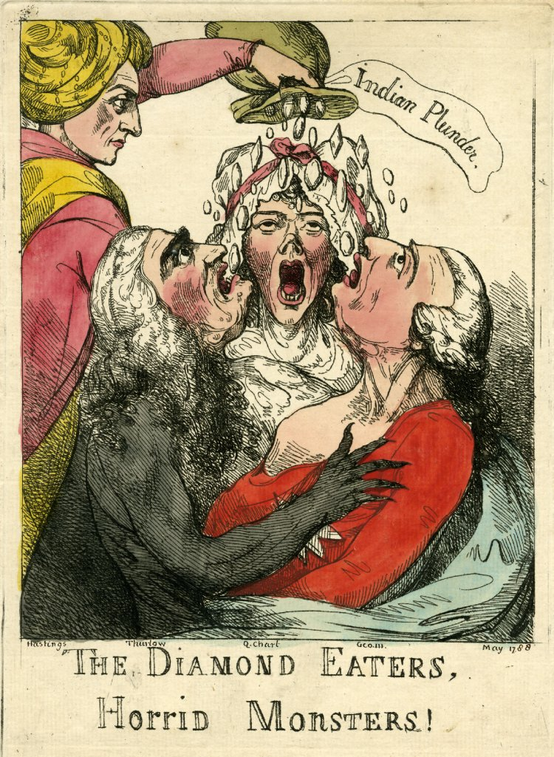
Judicial Corruption
1701 judges appointed for life ‘during good behaviour’ rather than ‘at the pleasure’ of the crown
Ideal of separation of powers
Pay rises: 1645 from under £200 to £1000 , 1759, 1779, 1799 and 1809
judges’ salaries were more than doubled in 1825 (from £2400 to £5500) to compensate them for the removal of their income from litigants’ fees and other perquisites
But
1830 Irish Judge Sir Jonah Barrington removed for peculation of court funds
magistrates…
A satire of the King, the Queen and Lord Chancellor Thurlow for being bribed by Hastings, 1788

Slide 12
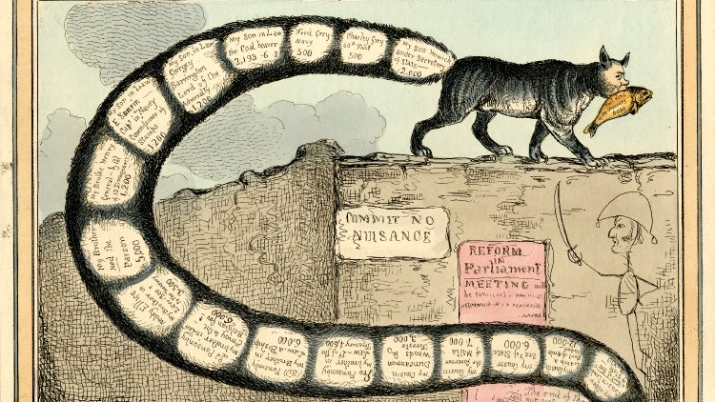
Social Corruption
Greater distinction between acceptable and unacceptable gifts
But patronage and nepotism remained strong
Trevelyan: reform necessary because patronage undermined good government; yet he saw the shift as upholding the influence of the social elite who could send their sons to be educated

Slide 13
Political Corruption and the Corruption of Politics
The influence of the crown had been largely constrained [Archibald Foord, ‘The Waning of “the influence of the Crown”’, The English Historical Review (1947)]
But other dangers of constitutional corruption: parties and the electoral system
Especially in local government
James Moore and John Smith (eds), Corruption in Urban Politics and Society 1780-1950 (2007); Moore, ‘Corruption and the Ethical Standards of British Public Life: National Debates and Local Administration, 1880–1914’ in Ronald Kroeze, André Vitória, and Guy Geltner (eds.) Anti-corruption in History: From Antiquity to the Modern Era (2017)

Slide 14
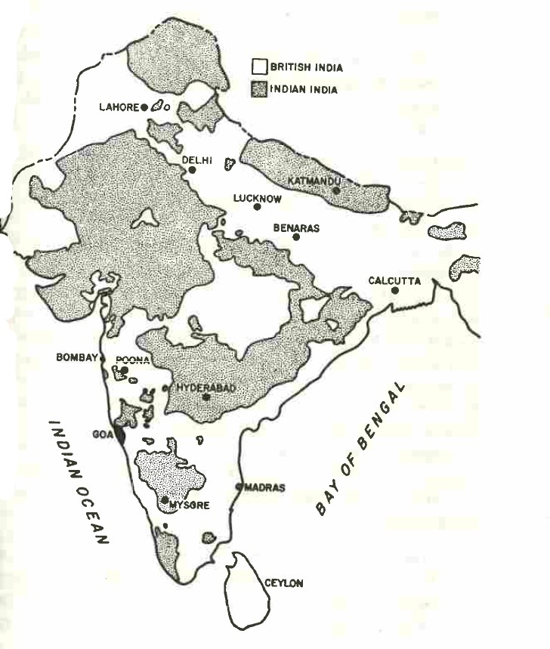
Imperial Corruption
British America had been lost – in part because of sense of corruption of the motherland
Slavery had been abolished – but left a long-term legacy
Despite – or because of? – imperial scandals British control in India had expanded
New etiquette of official behaviour had been introduced – but at expense of good relations with Indian culture?
1857 uprising led to final displacement of the EIC by the Crown
Corruption in the expanding empire (C19th grab for Africa) still remained rife
British India in 1857

Slide 15
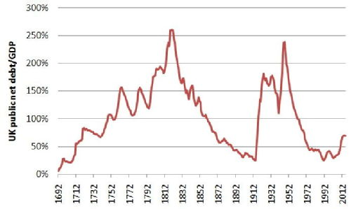
The Fiscal-Military State
Certain types of corruption had been closely associated with the rise of the fiscal-military state
Conflicts of interest between contractors and the state had been tackled to some extent in 1782
Free market economics gained traction and led to shift towards a laissez faire state [Philip Harling and Peter Mandler, ‘From "Fiscal-Military" State to Laissez-faire State, 1760-1850’, Journal of British Studies (1993)]
War forced transformation
Military spending and debt service never accounted for less than 85 percent of net public expenditure in any wartime period between 1700 and 1815. Small % spent on civil government.
But people no longer prepared after 1792-1815 wars to pay so much
The new professionalism was a reaction vs govt growth not a consequence of it ie desire to usher in small, laissez-faire government

Slide 16
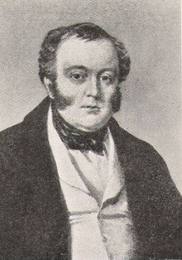
Office-holding
Peter Jupp argued for a modernisation process 1780-1830 in which a new professional class, able rather than landed, rose to cope with increased state demands [Jupp, "The Landed Elite and Political Authority in Britain, ca. 1760- 1850," Journal of British Studies 29 (1990)]
Harling and Mandler argue landed elite were still in control but had adapted to a new type of state
Shift from personal-particularistic to impersonal-universalistic, more transparent decision-making and legal framework
Trust had become prevalent notion
Slow evolution of a civil service but still had a long way to go
NB corporations. Expansion of the railways was another occasion for corruption eg George Hudson, the ‘Railway King’

Slide 17
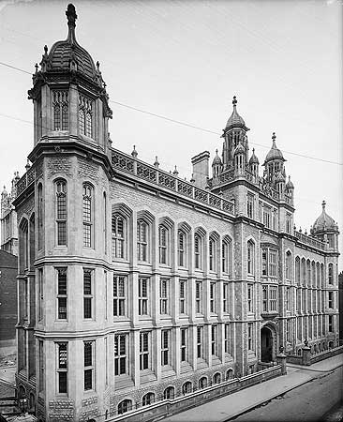
Accountability
Hudson is a good example of how much still had to be achieved in terms of accounting practices
but
Increasing notion of public money as distinct from private money
Public accounts committees
Double-entry book-keeping was more prevalent
Economic literacy and the amount of data were both growing
1857 establishment of Select Committee for Public Accounts (formalised 1861) – which is still in existence
1866 Audit Act required all departments, for the first time, to produce annual accounts; and created Comptroller and Auditor General (C&AG) and an Exchequer and Audit Department (E&AD)
Development of a Public Record Office (1852 requirement to preserve papers; building 1851-6)
Press as instrument of accountability

Slide 18
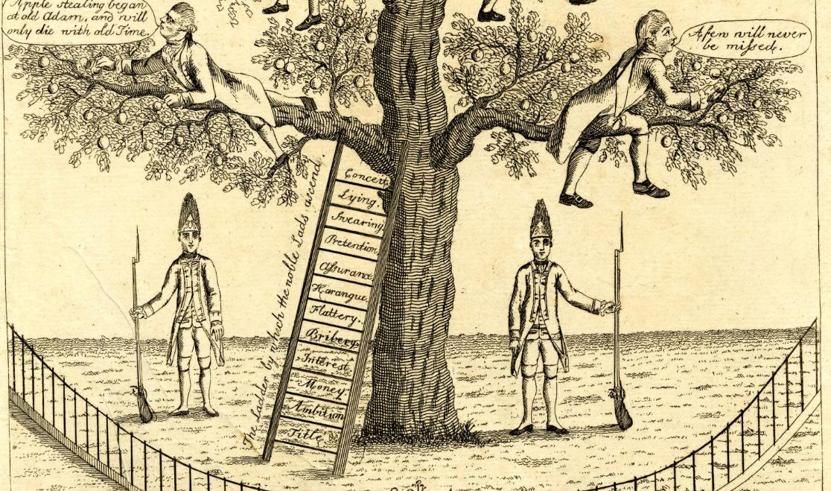
Corruption as individual moral failure: Politicians climb the tree, reaping the fruit, having used a ladder of vices
1784
Notes:
Nb corrupt tree

Slide 19
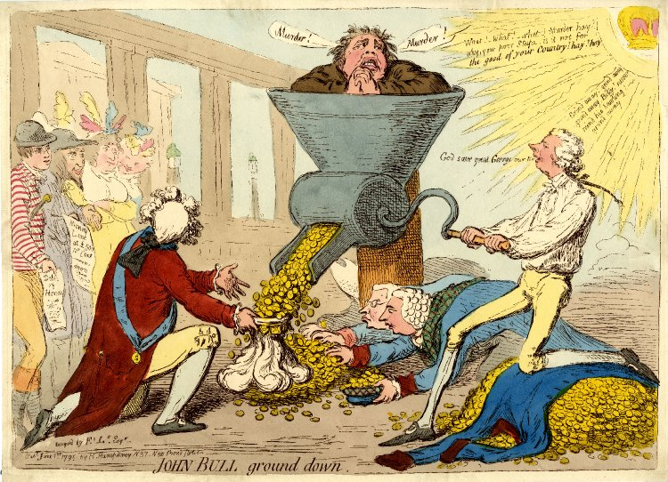
or corruption as the result of a system
William Cobbett: an interconnected ‘system of public corruption’ that operated like an ‘immense machine’ to oppress the people

Slide 20
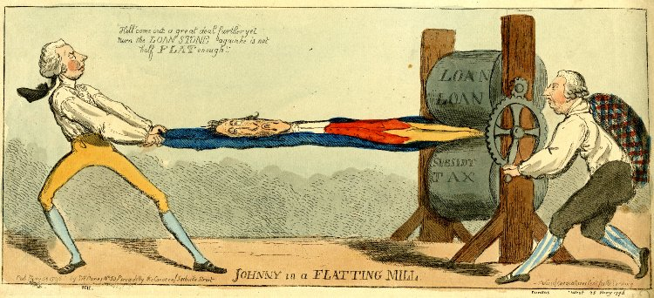
John Bull flattened by a ‘tax machine’

Slide 21
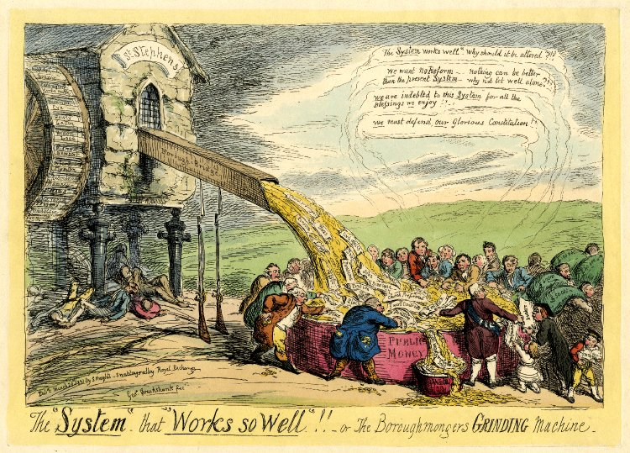

Slide 22
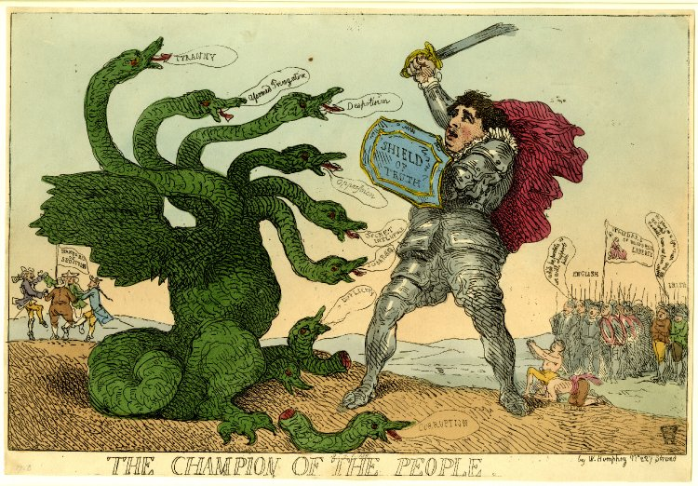
Conclusion
So is corruption a ‘thing’ in its own right that we can study in isolation or is it a systemic issue that requires us to examine society in the round?
Had administrative corruption been tackled but not social, economic, political corruption?
The hydra’s heads are corruption, duplicity (both decapitated) and 'Tyranny'; 'Assumed Prerogative', 'Despotism'; 'Oppression'; 'Secret Influence'; 'Scotch Politik'

