Slide 1
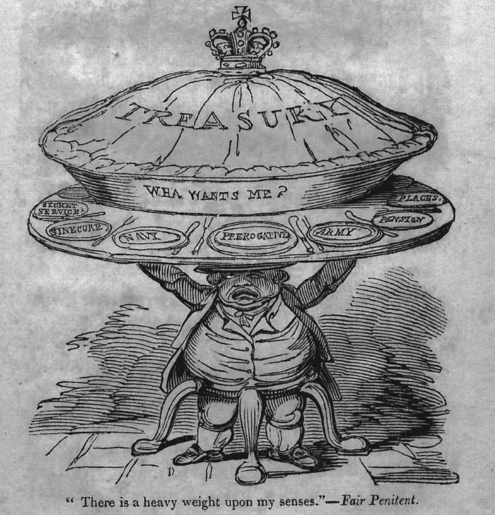
The Press and Corruption

Slide 2
Outline
The Print Revolution – types of print and output used in anti-corruption
The Public Sphere
The Press and Corruption
  Exposure: print became an essential way in which corruption was revealed and pursued, ridiculed and satirised
  Censorship: there was an important relationship between the exposure of official corruption and claims for freedom of the press – the two went hand in hand, though the story was a protracted one of conflict between government and the press

Slide 3
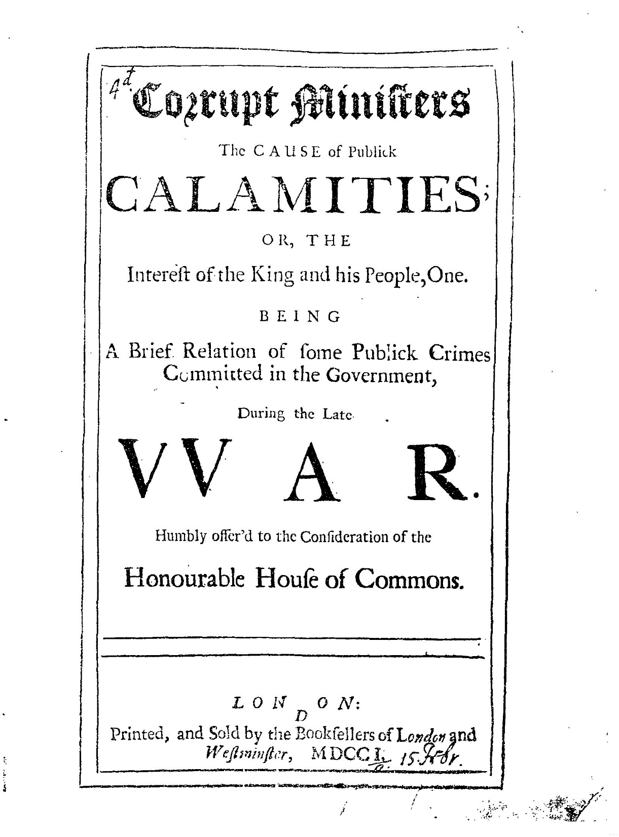
Pamphlets
Short books
Achieved popularity in late Elizabethan period
Myles Davies, Critical History of Pamphlets (1716) thought the word meant a thing beloved by all ‘adapted for every one’s understanding, for every one’s reading, for every one’s buying’.
Some longer ones are more like books

Slide 4
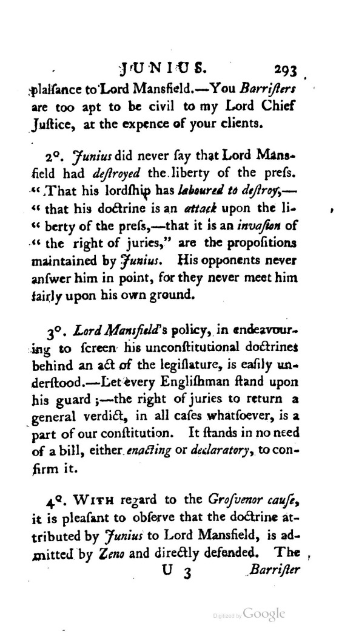
Periodicals and newspapers
Began in 1620s
Popularised in 1640s
Restrained after 1660
Expanded rapidly after 1695
Not just ‘news’
The Craftsman 1726-52 – set up to attack Walpolean corruption; Lord Bolingbroke
The ‘Junius Letters’ appearing in The Public Advertiser 1769-1772 – probably by Philip Francis who went on to become thorn in Warren Hastings’ side

Slide 5
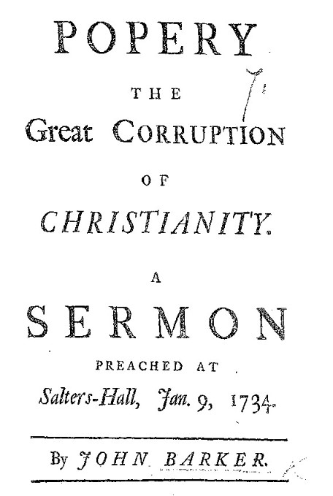
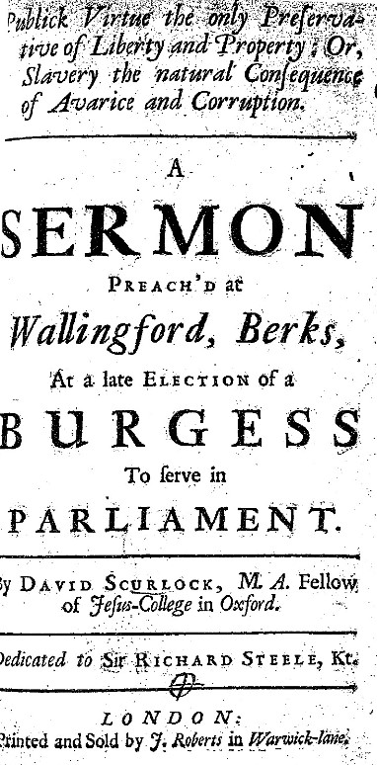
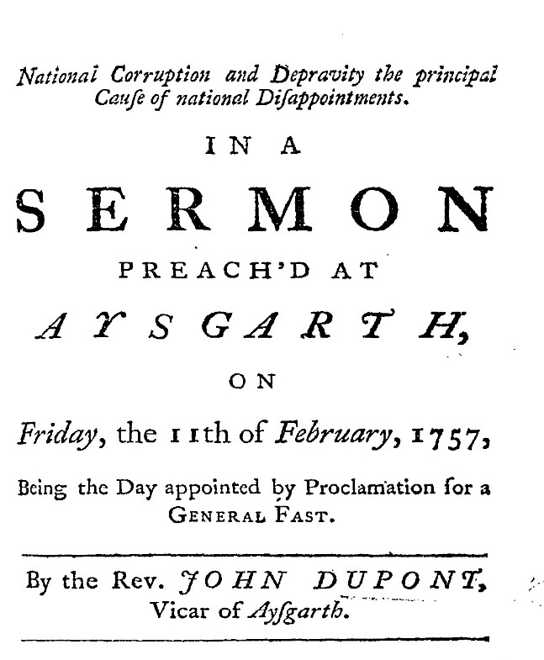
Sermons
National corruption and depravity the principal cause of national disappointments. In a sermon preach'd at Aysgarth

Slide 6
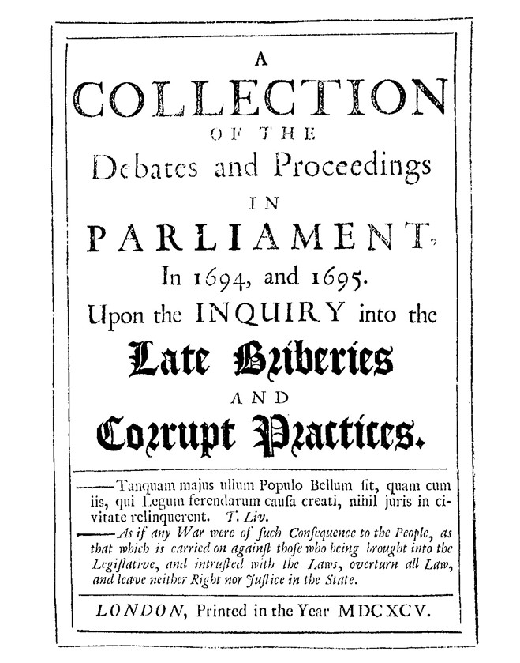
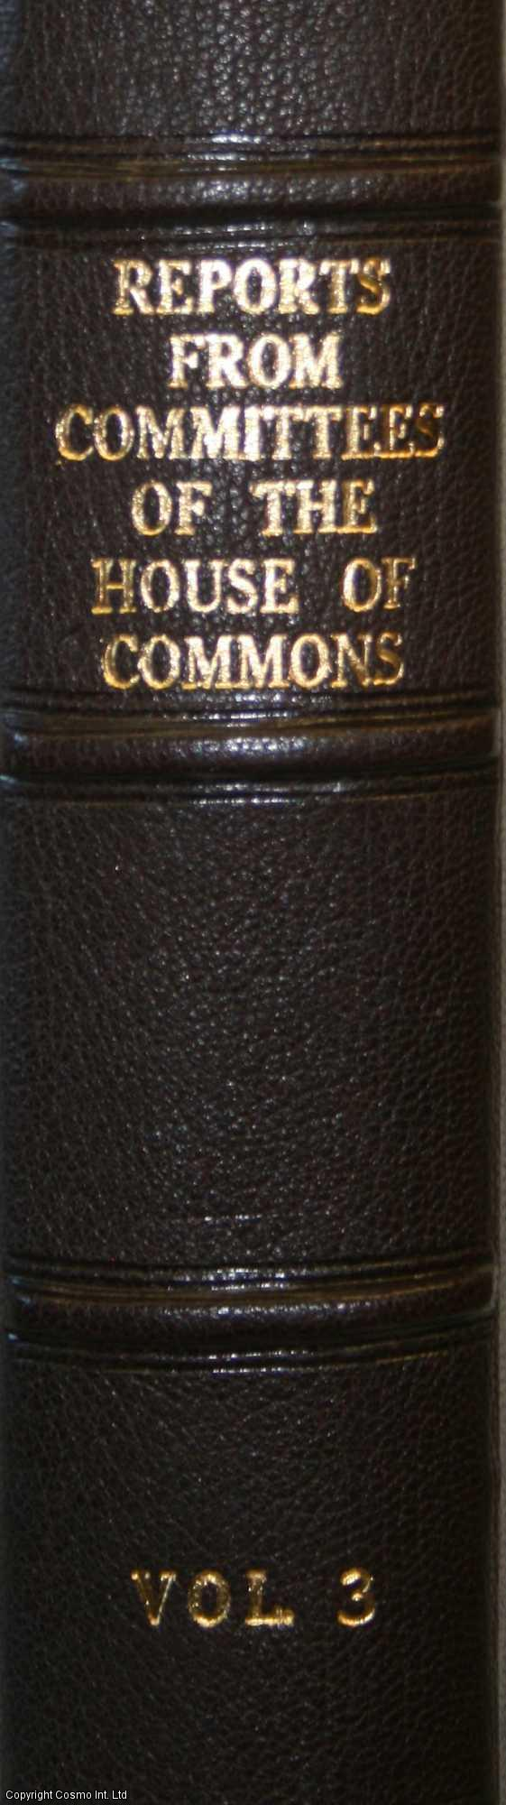
Official reports
Trials, prosecutions, impeachments
Parliamentary reports
From 1771 debates (and sometimes earlier)

Slide 7
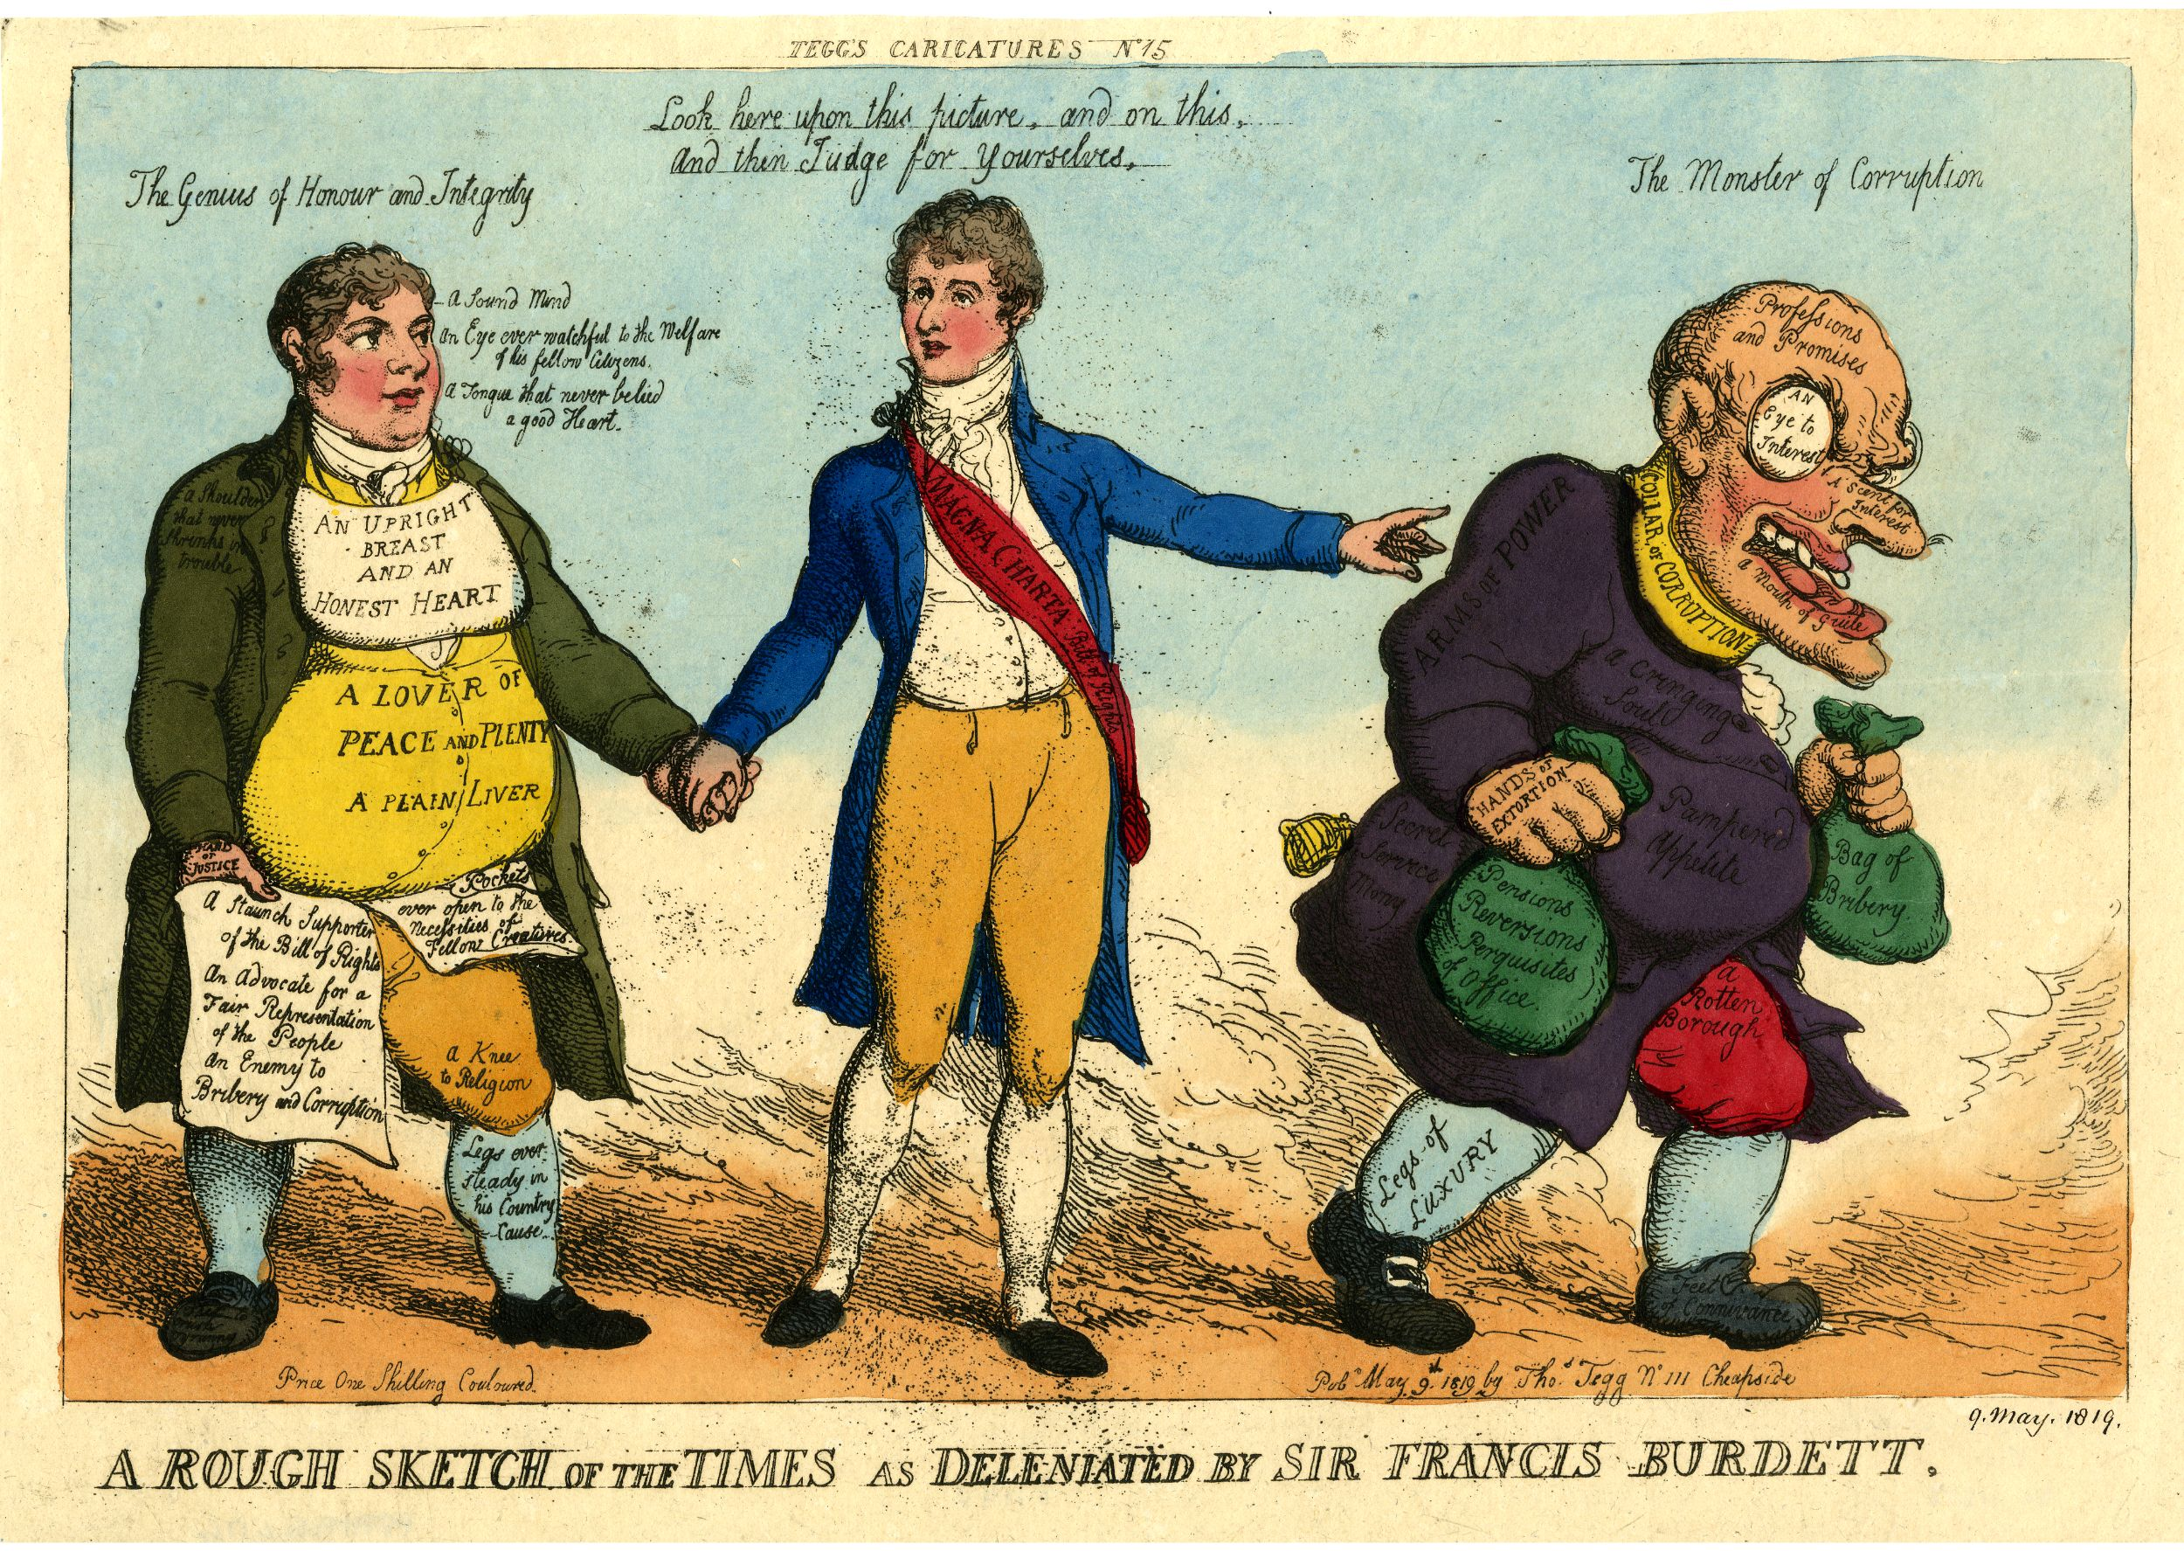
Graphic satire
NB functions of satire

Slide 8
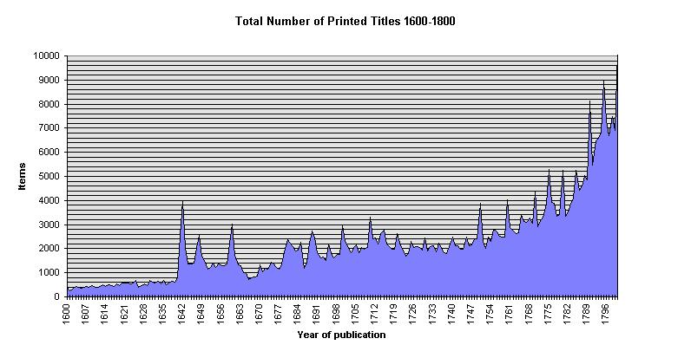
http://estc.ucr.edu/ESTCStatistics.html

Slide 9
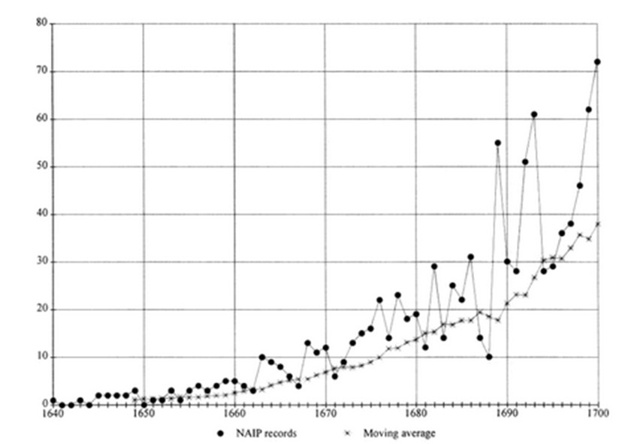
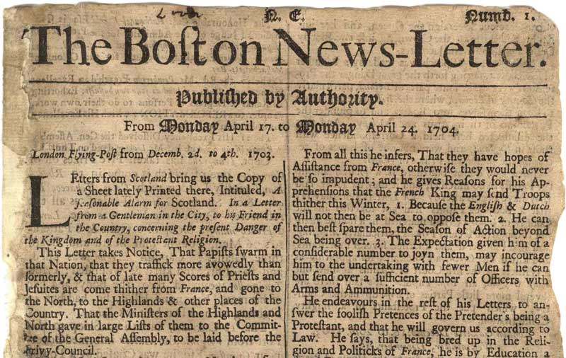
Print and America
Amory and Hall observe increase in American book production over C17th:
- 1640-1670 – maximum of 12 original titles published from American printing presses per year
- by 1700 – 72 original book titles published per year
- Boston’s first printing press comes in 1675; 1704 Boston’s first newspaper on a continuous basis

Slide 10
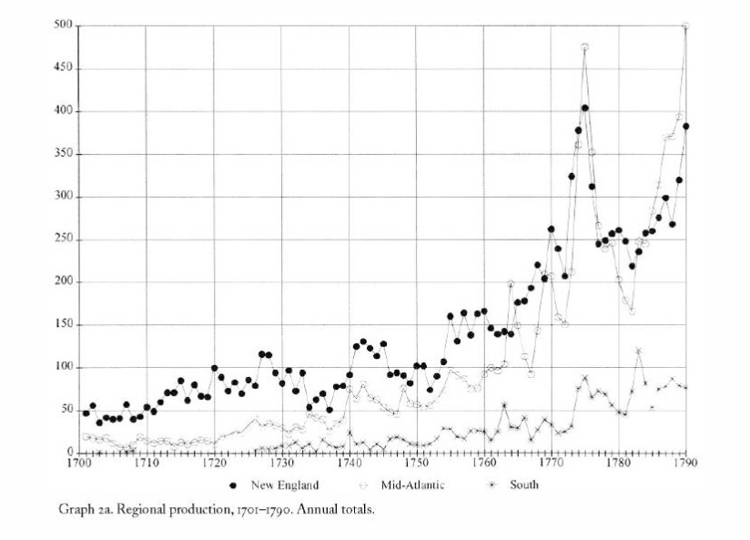

Slide 11
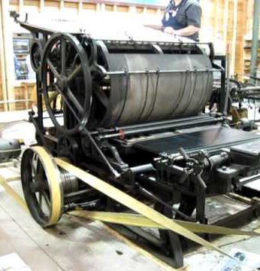
C19th development of mass circulation newspapers was the result of the steam-powered rotary press, adopted by the Times in 1814
The Times went from a circulation of 5,000 a day in 1815 to around 50,000 in the middle of the century.
Cheap print
Circulating libraries expanded
male literacy was 69.3 per cent in 1851; female literacy 54.8 per cent

Slide 12

The emergence of the ‘public sphere’
Jürgen Habermas, The Structural Transformation of the Public Sphere: An Inquiry into a Category of Bourgeois Society. Sociologist; written 1962; translated and published in English 1989
critical reason applied to matters of state
Post-1660 period as key, especially 1690s
Peter Lake and Steve Pincus, ‘Rethinking the Public Sphere in Early Modern England’ JBS (2006) suggest a longer trajectory
Others have criticized exclusion of religion from the model
But it may still have a core of utility

Slide 13
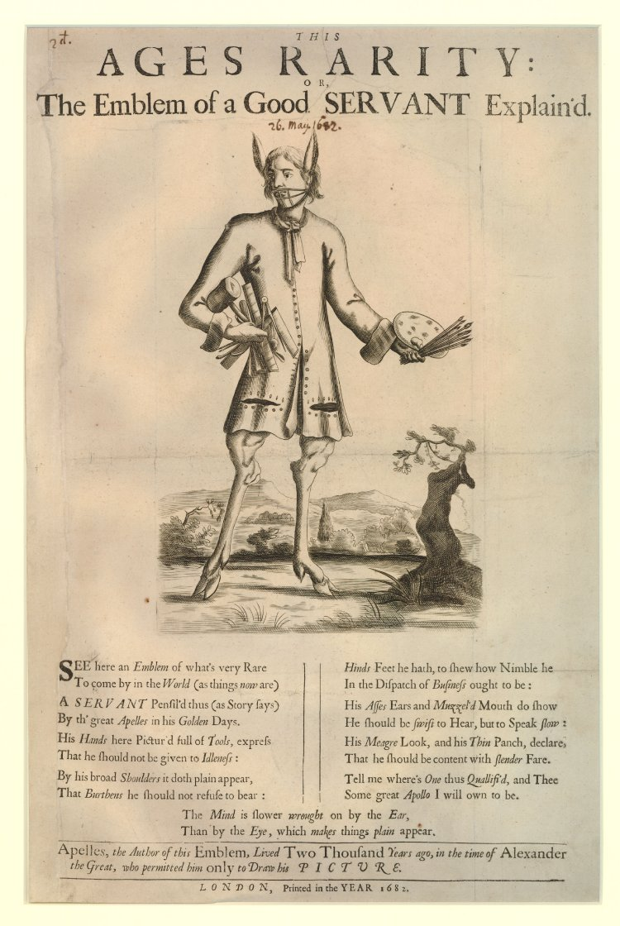
What is ‘censorship’?
Formal:
  Pre-publication licensing by the state and church
  Post-publication prosecution of seditious, treasonous or blasphemous material
Informal:
  Self-censorship
  Parameters of discourse (topic and style)
  Social expectations that some would be quiet

Slide 14
The changing state of censorship
Early C17th:
1) the state (pre-publication licensing; proclamations and treason statutes vs slander and treasonous books)
2) the church (1524 first licensing order initially placed it under the ecclesiastical supervision; 1611 Ecclesiastical Commission; 1613 extended this to all print ‘offensive to the state or set forth without sufficient and lawful authority’)
3) the Stationers’ Company (founded 1557)
This prevailed up to 1641 – though how effectively?
1641 Star Chamber and Court of High Commission were abolished. Printing was freed from royal control and placed under parliament’s.
1641-3 saw confusion. June 1643 sought to revive alliance of company and govt (now Parliament)

Slide 15
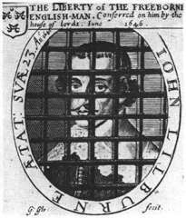
John Lilburne, the Levellers, Corruption and Freedom of the Press
Early writings were primarily religious for which he was punished with imprisonment
In 1645 published attack on Presbyterian Prynne; Prynne had Lilburne arrested; 3 months in prison. Led to England’s Birthright Justified, which attacked control of press.
1647-9 new restraints on press including pre-publication censorship
Levellers demanded freedom of press. 1649 petition argued that it was good for any government ‘to hear all voices and judgments which they can never do but by giving freedom to the press… and therefore, all things being duly weighed, to refer all book and pamphlets to the restraint upon the press seems altogether inconsistent with the good of the commonwealth’.

Slide 16
1647 new licensing act but unlicensed news books continued to appear.
1649 attempt to suppress unlicensed printing and new Treason act also imposed stringent controls on freedom of discussion.
Sept 1649 new printing act – most detailed list of regulations; all printers to pay bond of £300. All to be licensed and newsbooks suppressed; official news of Parliament was to be licensed.
Act of 1653 council of state had authority to regulate number of printing houses and 1649 act was revived.
Aug 1655 the council of state became chief regulatory body. Oliver Cromwell appointed 3 commissioners to regulate printing and they suppressed newsbooks.

Slide 17
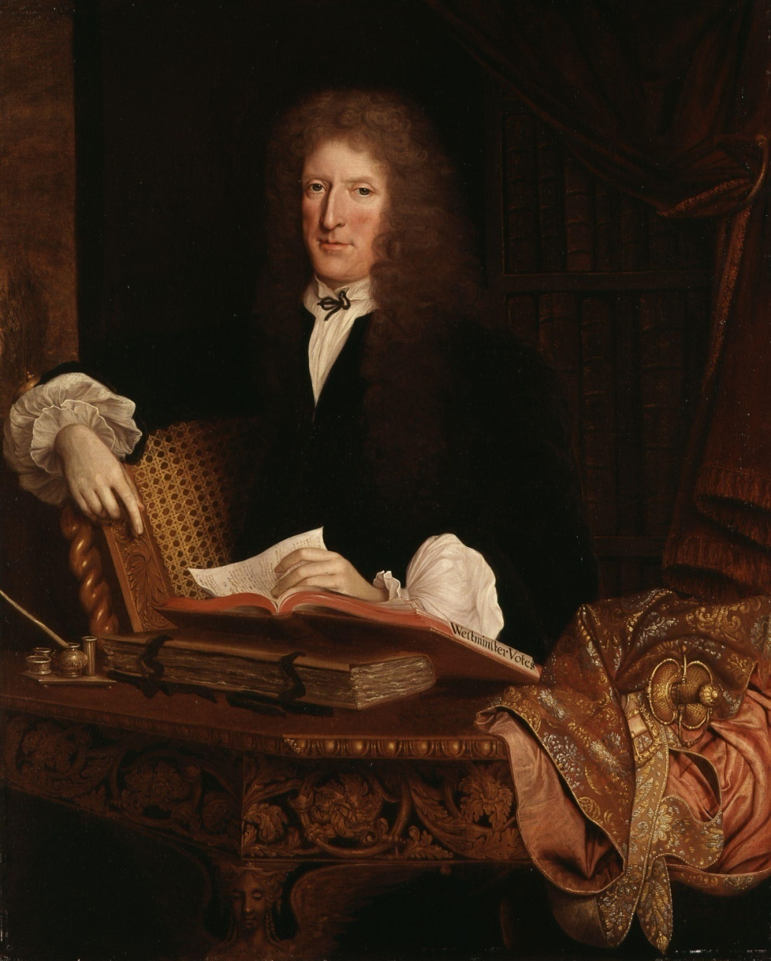
Act of 1653 council of state had authority to regulate number of printing houses and 1649 act was revived.
Aug 1655 the council of state became chief regulatory body. Oliver Cromwell appointed 3 commissioners to regulate printing and they suppressed newsbooks June 1662 Licensing Act
1663 Licenser – Roger L’Estrange.
1679 lapsed. 1682-5 government made use of other means
1685 Licensing act re-imposed
Renewed after the Revolution
Lapsed 1695 and not renewed
Often seen as a watershed

Slide 18
After 1695
With hindsight…
But there were still attempts to reintroduce licensing and regulation.
1710 trial of Henry Sacheverell – his supporters accused Whigs of trying to gag him
Jacobites. 1693 William Anderton executed (treason).
1712 stamp act – control through taxation
Reliance on laws of slander, seditious libel, treason and blasphemy

Slide 19
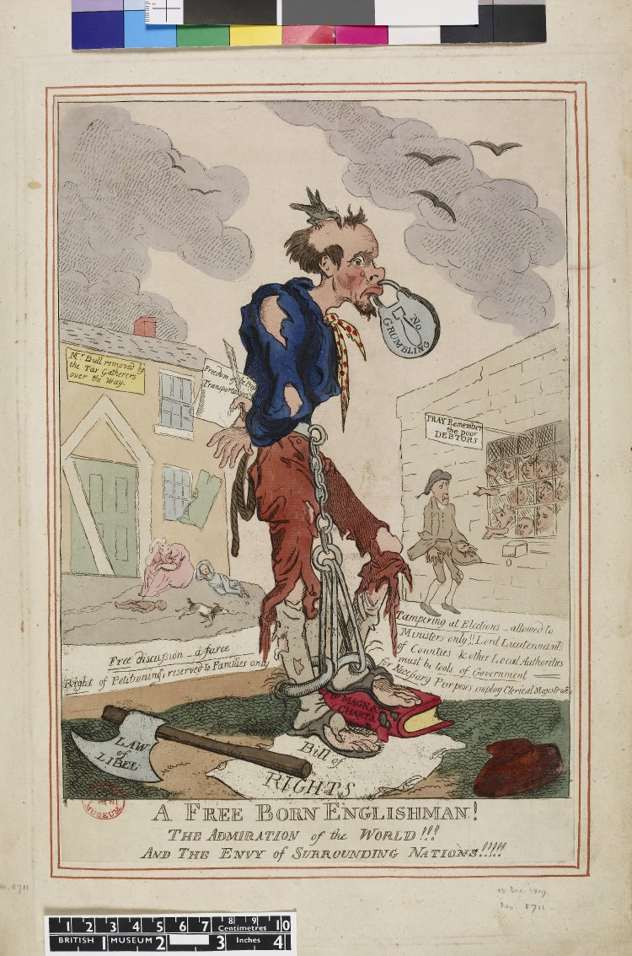
But repression was not over
In 1737, partly as a result of political attacks by Henry Fielding against Robert Walpole, Theatrical Licensing Act: "the Examiner of the Stage" was appointed to censor plays on the basis of both politics and morals
1764 Wilkes found guilty of seditious libel (the North Britain)
Royal Proclamation against Seditious Writings issued by George III in 1792
1792 trial of Thomas Paine; 1794 treason trials
1795 Two Acts vs Treason and Seditious Meetings
spike in the number of cases for seditious libel heard at the King’s Bench in 1808–1811
Prosecutions of authors and publishers continued into the early C19th eg William Hone (who looked back to Lilburne) and T J Wooler in 1817
1817 two further ‘gagging acts’
1819 Six Acts led to another wave of prosecutions – 50 indictments 1819-20

Slide 20
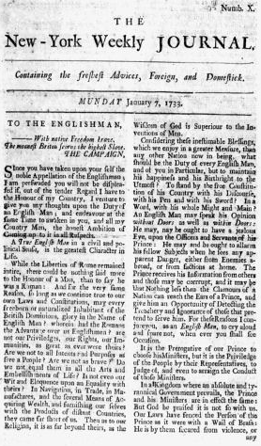
Imperial story
first successful newspaper in America, the Boston News-Letter, appeared in 1704; NY first newspaper 1725
Zenger case in America: John Peter Zenger printed The New York Weekly Journal.
He was accused of libel in 1734 by William Cosby, the royal governor of New York, who was in dispute with the colony of New York over his salary – the paper alleged Cosby had stolen tax money – political divisions
‘The Prince receives his information from others and those may be corrupt and it may be that nothing less than the Clamours of a Nation can reach the ears of a Prince’ [NY Weekly Journal, 7 Jan 1733]
The press was ‘a curb, a bridle, a terror, a shame, and restraint to evil ministers’

Slide 21
‘The dread of infamy hath certainly been of great use to the cause of virtue, and is a stronger curb upon the passions and appetites of some men than any other consideration moral or religious. Whenever, therefore, the talent of satire is made use of to restrain men by the fear of’ shame from immoral actions, which either do or do not fall under the cognizance of the law, it is properly, and justly, and commendably applied
1736 trial. Chief justice DeLancey: ‘To say that corrupt officers are appointed to administer affairs is certainly a reflection on the government. If people should not be called to account for possessing the people with an ill opinion of the government, no government can subsist’
Jury acquitted Zenger on grounds that truth could not be a libel.
37 newspapers by outbreak of 1776 war of independence

Slide 22
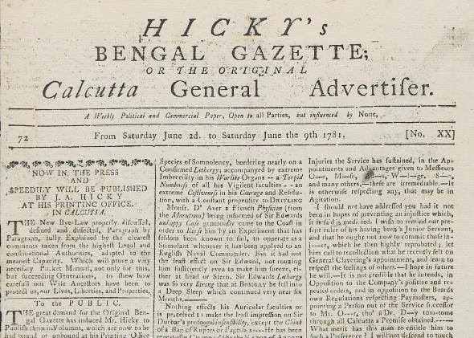
India
James Augustus Hicky began to publish a weekly by name The Bengal Gazette in 1780: hostile to the government. Closed in March 1782. Died in penury in 1802
Between 1780 and 1800, 24 weekly or monthly magazines came into existence. Madras Courier started publication in 1785; Bombay Herald in 1789.
1799 Wellesley introduced regulations for the press, which stipulated that no newspaper be published until the proofs of the whole paper, including advertisements, were submitted to the colonial government and approved; violation invited deportation to England its publisher was sent back to England
William Duane, editor of Bengal Journal, removed as editor and almost deported in 1791, and finally deported as editor of Indian World in 1794; Charles Maclean, editor of Bengal Hurkaru, deported in 1798;
In 1818, John Silk Buckingham started the Calcutta Journal and also attacked the policies of the British officials. He conceived his duty to be “to admonish Governors of their duties, to warn them furiously of their faults, and to tell disagreeable truths”. He too was deported (with assistant, Sandford Arnot and C. J. Fair, editor of Bombay Gazette) to England in 1823
India’s first newspaper. Hicky considered ‘the Liberty of the Press to be essential to the very existence of an Englishman and a free G[oveernmen]t. The subject should have full liberty to declare his principles, and opinions, and every act which tends to coerce that liberty is tyrannical and injurious to the COMMUNITY”

Slide 23
Press Ordinance on 14 March 1823 made it mandatory for editors and publishers to secure licences for their journals.
Acting Gov-Gen John Adam: “My objection is to the claim of that class of persons to exercise in this country, the privileges they are allowed to assume at home, of sitting in judgement on the acts of Government, and bringing public measures and the conduct of public men, as well as the concerns of private individuals, before the bar of what they miscall public opinion”.
But legal challenge by Indian publishers:
‘Every good Ruler, who is convinced of the imperfection of human nature, and reverences the Eternal Governor of the world, must be conscious of the great liability to error in managing the affairs of a vast empire; and therefore he will be anxious to afford every individual the readiest means of bringing to his notice whatever may require his interference. To secure this important aspect, the unrestrained Liberty of publication, is the only effectual means that can be employed. And should it ever be abused, the established Law of the Land is very properly armed with efficient powers to punish those who may be found guilty.’
1835 the Adam Press Ordinance was repealed

Slide 24
Conclusion
Those seeking to expose or attack corruption often had a very difficult time because they were censored or accused of sedition
But they often used the press to do so, after other means had failed
And hence freedom of the press became an essential part of the story of anti-corruption and vice versa

