Slide 1
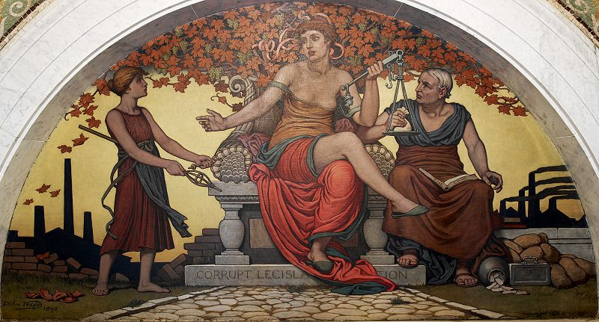
Sex, Morality and Corruption

Slide 2
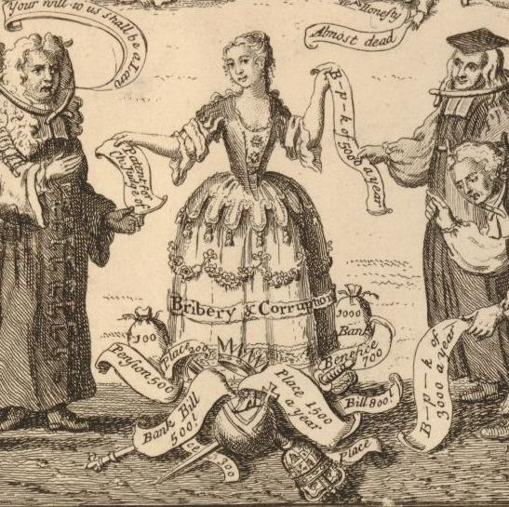
Lecture outline
We have already come across some of this theme before eg Pepys, Parke, Lady Colebrooke
Why sex and corruption were linked
Why women and corruption were linked
Luxury and its effeminising effect
The national morals
Campaigns for the reformation of manners
Women’s role in corruption
Sexual scandal as a tool in anti-corruption
Immorality and social critiques
Corruption as a woman

Slide 3
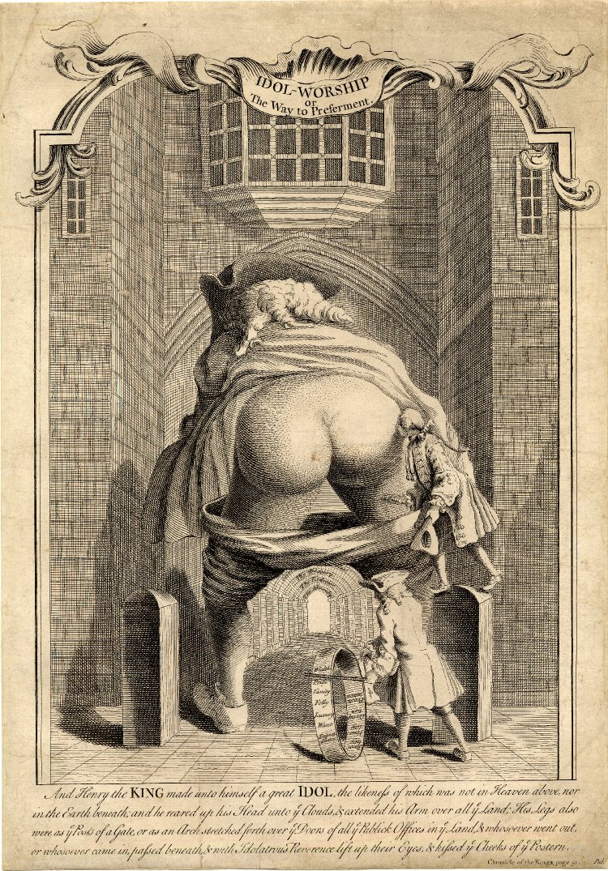
Idol Worship (1740)
"Wealth", "Pride", "Vanity", "Folly", "Luxury", "Want", "Dependence", "Servility", "Venality", "Corruption" and "Prostitution"
The language describing political and religious error was often sexualised: men were ‘seduced’ or ‘debauched’ from their principles, or ‘lusted’ after power. Metaphors breached boundaries.

Slide 4
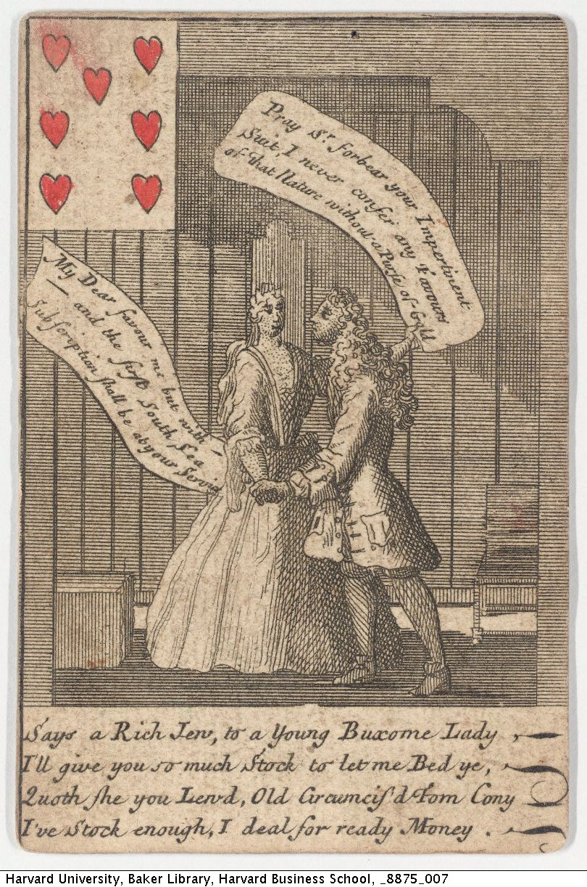
So, linking sexual scandal and political and economic corruption was commonplace across the early modern period
Sexual scandal drew public into politics and collapsed the boundary between public and private
  letter to Public Advertiser 13 June 1765 ‘I have ever been of opinion that a fair moral character was necessary toward forming a good minister of state, as it is highly improbable that those who are vicious in their private lives, should be virtuous in their public. And that there is no doubt that the people have as just a right and as much reason to enquire into and be informed of the private virtues and vices of those who are entrusted with the care of their liberties and properties, as any gentleman hath, to require a character of a steward who is to manage his estates; that we know by history and we feel by daily experience, how much private passions influence public actions’.

Slide 5
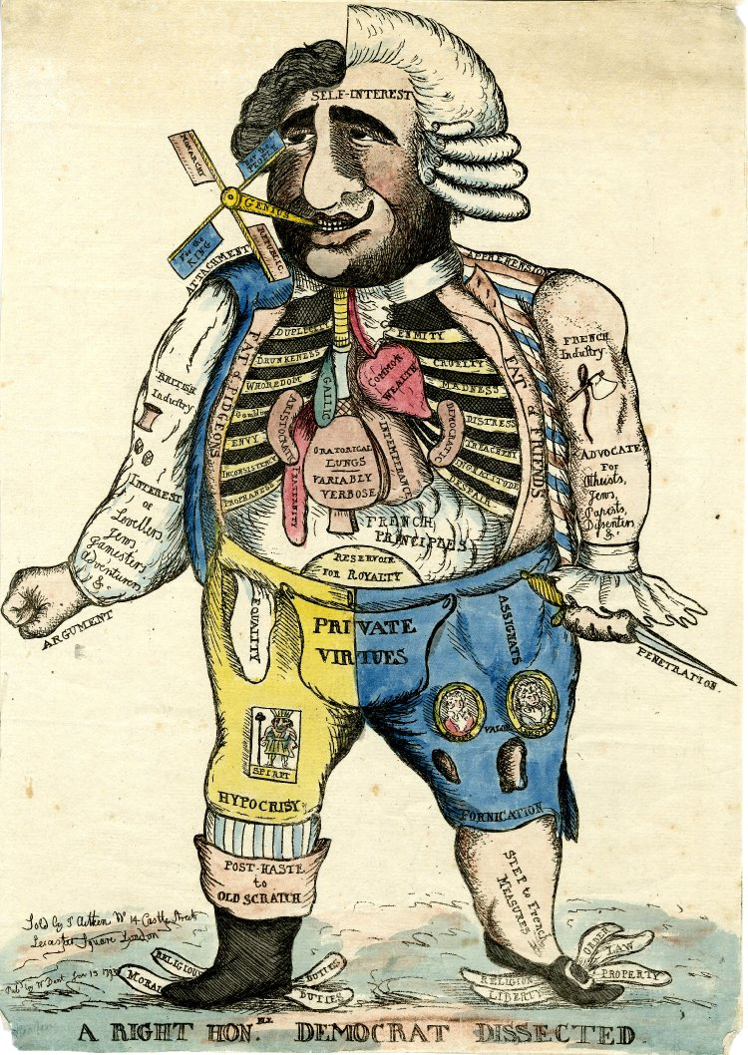
The body politic – His right ribs are 'Duplicity', 'Drunkenness', 'Whoredom', 'Gambling', 'Envy', 'Inconsistency', 'Prophaness';
His left ribs: 'Enmity', 'Cruelty', 'Madness', 'Distress', 'Treachery', 'Ingratitude', 'Despair'.
Corruption was the result of personal vices as much as a system
Charles James Fox
1793

Slide 6
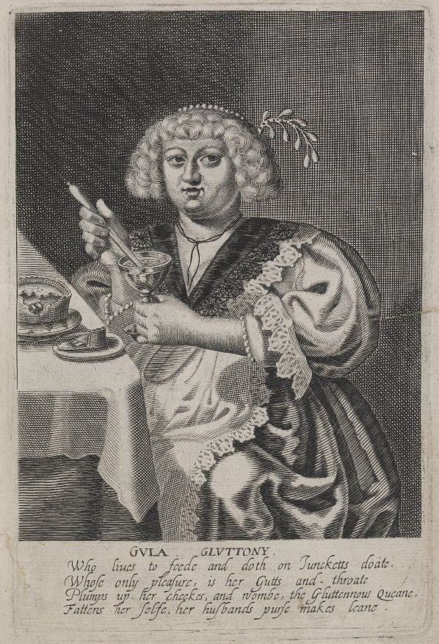
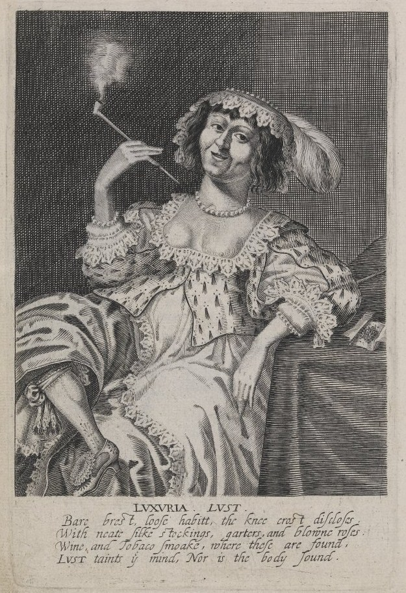
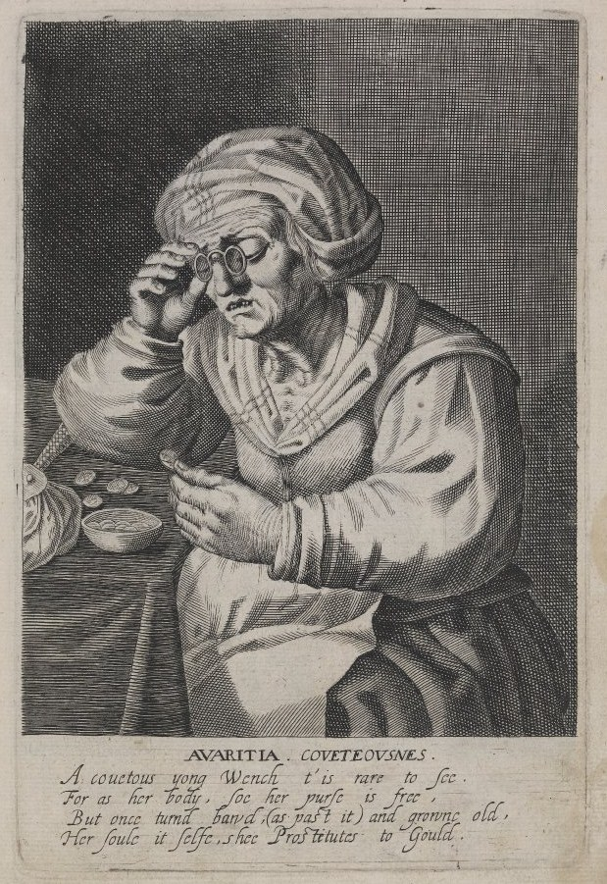
Networks of intertwined sins/vices – often depicted as female
Avaritia/covetousness
Gluttony
Envy and pride
1625-1635
Luxuria/Lust

Slide 7
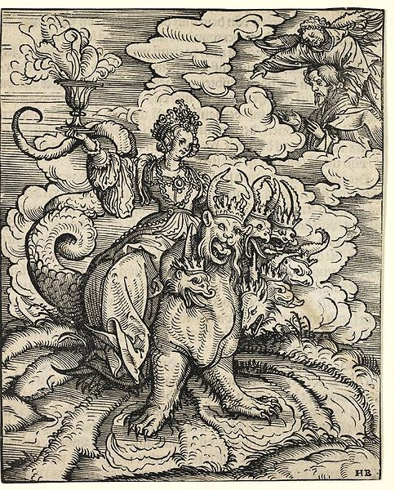
Anti-popery
Revelation 17-18:
I saw a woman sit upon a scarlet coloured beast, full of names of blasphemy, having seven heads and ten horns.
And the woman was arrayed in purple and scarlet colour, and decked with gold and precious stones and pearls, having a golden cup in her hand full of abominations and filthiness of her fornication
Anxieties about popery expressed in terms of the Whore of Babylon who links popery, monstrosity, lust and opulence.
But also that anti-popery’s stress on the whore shaped the construction of female identity (Frances Dolan)

Slide 8
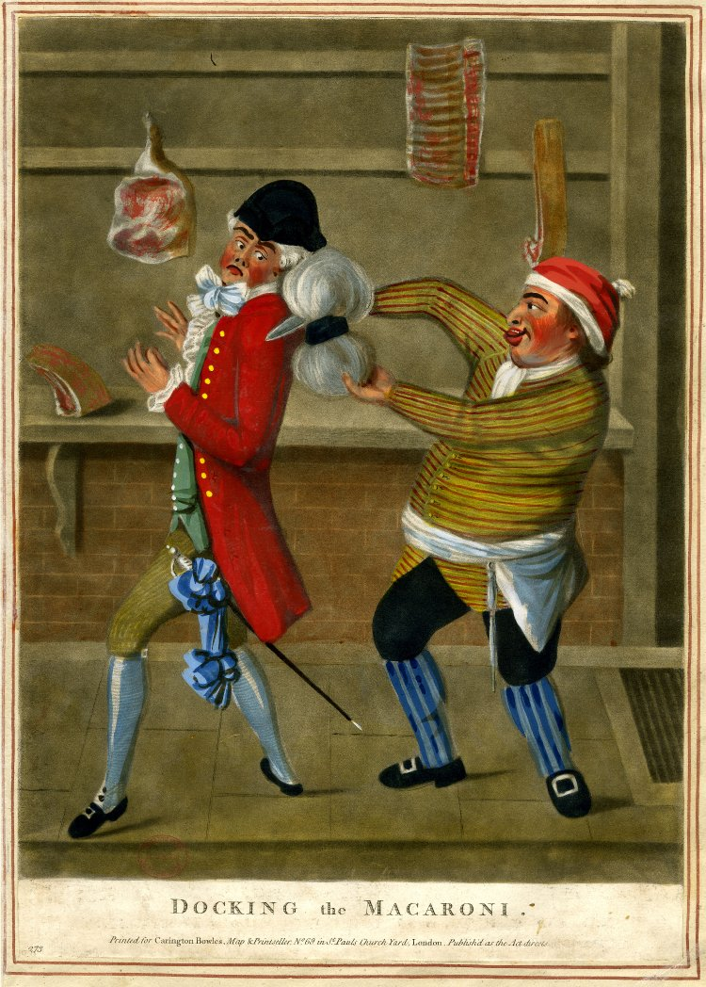
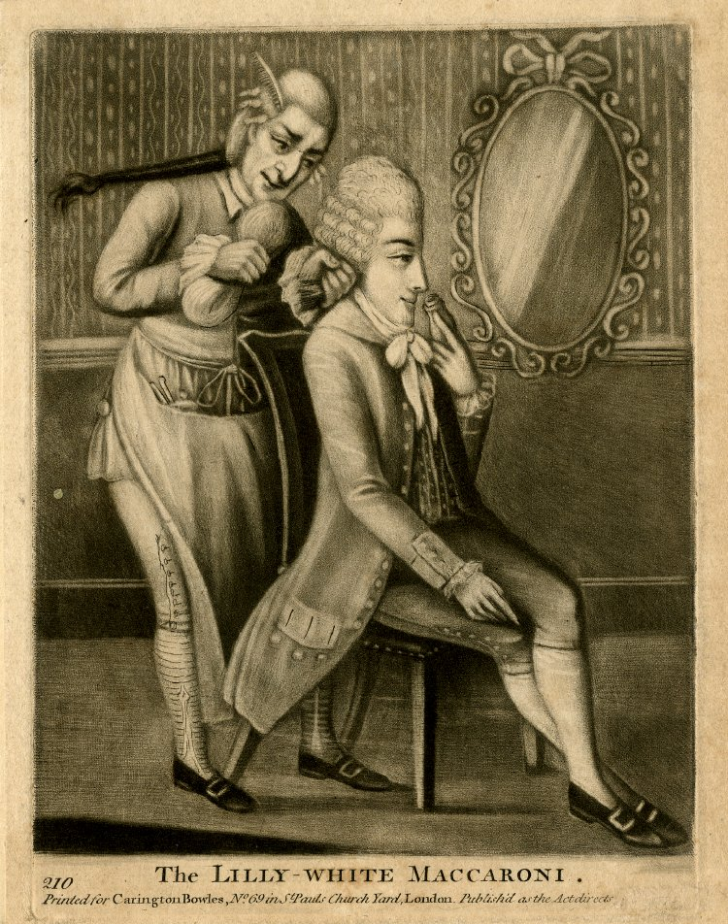
Luxury as effeminacy
Classical republicanism – need for reliance on militia and martial virtue
Fop, dandy and macaroni - effeminate

Slide 9
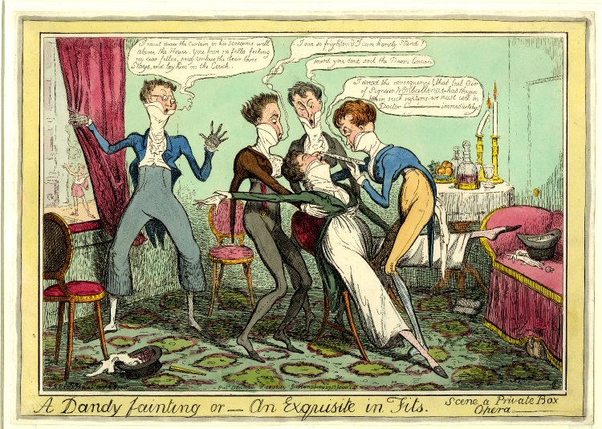

Slide 10
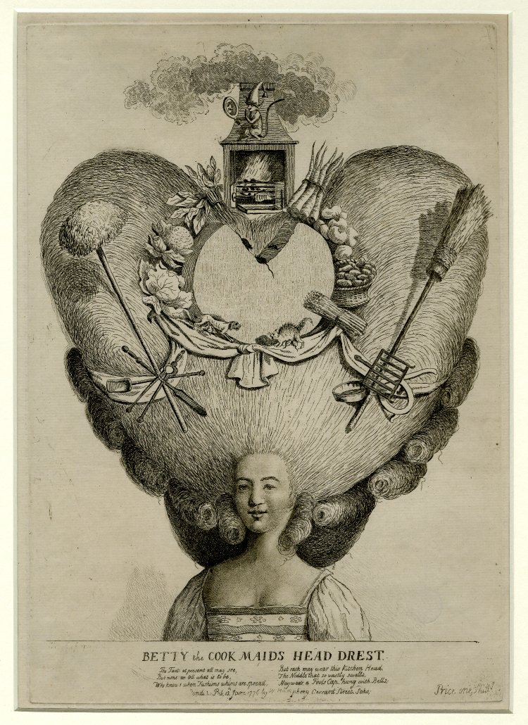
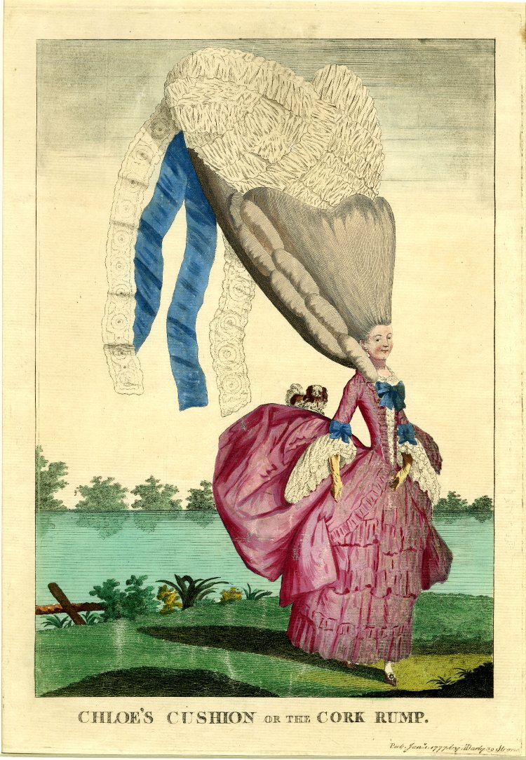
The danger of female fashion
Fear of parvenues and social climbers, upstarts

Slide 11
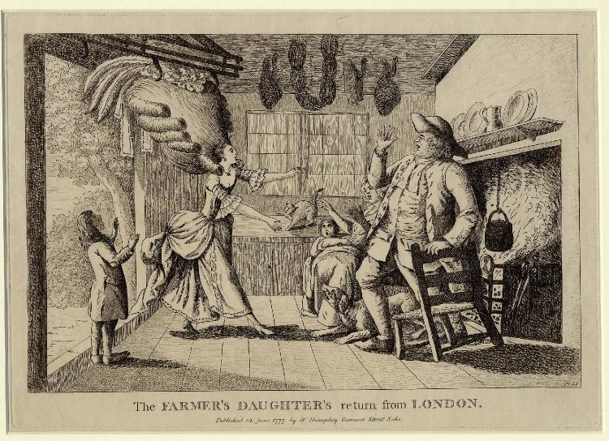

Slide 12
Moral reform
Waves of campaigns to reform morality – often coinciding with anti-corruption campaigns
Reformation of ‘manners’ in C16th (Martin Ingram) eg Philip Stubbes, The second part of the anatomie of abuses containing the display of corruptions, with a perfect description of such imperfections, blemishes, and abuses, as now reigning in euerie degree, require reformation for feare of Gods vengeance to be powred vpon the people and countrie, without speedie repentance and conuersion vnto God (1583)
The puritan revolution
After the 1688 revolution: royal edicts vs profanity and vice in 1689, 1691 and 1697. Reformation societies (Faramerz Dabhoiwala)
1780s produced new sense of moral crisis. Wyvill’s Association movement aimed to preserve constitution and restore national morals
reformation societies of 1795-1815
by early 1830s we can talk of ‘an identifiably continuous moral reform tradition’ [M J D Roberts, Making English Morals. Voluntary Association and Moral reform in England 1787-1886 (2004)]
Victorian morality became a criteria for office

Slide 13
Moral reformers vulnerable to criticism
Dislike of ‘informers’
John Bowles, assiduous leading light of Society for the Suppression of Vice and author of at least thirty-three pamphlets between 1791 and 1817, was publicly disgraced by Hen Thornton’s House of Commons finance committee in 1809 (re Commissioners had been appointed in 1795, to manage, sell, and dispose of the cargoes of Dutch ships; the commrs had paid themselves 5% = £80,000)
House of Commons debate 1 May 1809: Mr Ord attacked ‘John Bowles, a member of the society for the suppression of vice, or rather, as appeared by the Report, for pilfering the public .. It shewed the nature of the cry of Anti-Jacobinism, which had been set up with so much vigour to defeat the most beneficial political objects—it exposed the principle upon which the loudest of these Anti-Jacobin declaimers acted, which was solely a view to their own private emolument. This John Bowles afforded an admirable specimen of an Anti-Jacobin—the eulogist of existing powers—the defender of present establishments—the denouncer of all, who might condemn abuses, or call for reform, as vile Jacobins. These tricks would no longer impose upon the public—the mystery was discovered—Mr. John Bowles himself had let out the secret, and the reign of imposture and delusion was at an end’
Samuel Whitbread: ‘When a man sets himself up a self-elected censor of the manners of the age: an universal condemner of all whom he chuses to submit to his lash: when he affects the title, by distinction, of Christian, he ought to be most peculiarly upon his guard, as to the rectitude of his own conduct’

Slide 14
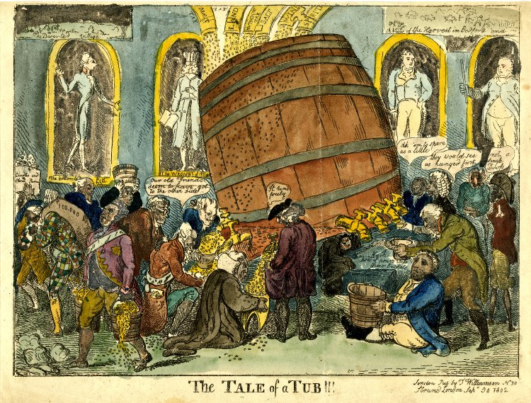
The Politics of Sexualised Corruption: Anti-court
King as father/husband – power was gendered so the abuse or perversion of power was also sexual
Illegitimate political influence often seen in sexual terms
Money/tax necessary to support excessive luxury and sensuality
Court as source of corrupting morals – flattery, hypocrisy, ambition, self-seeking
1802: taxes feed the barrel from which courtiers and placemen tap money

Slide 15
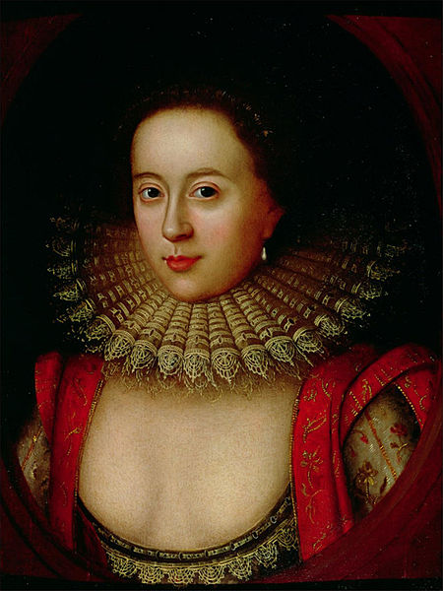
Women’s role in corruption
Frances Howard (1590-1632). Married the impotent 3rd earl of Essex and fell in love with Robert Carr, 1st earl of Somerset, James I’s favourite
David Lindley, The Trials of Frances Howard (1993): she was typecast and punished as epitome of female transgression 1615/16 after being accused of poisoning Sir Thomas Overbury who had opposed her marriage to Somerset. She was found guilty of murder; her husband was accused of paying bribes to cover up her involvement.
Alistair Bellany, The Politics of Court Scandal in Early Modern England: News Culture and the Overbury Affair, 1603-1660 (2002): different transgressions were seen as interconnected –corrupt courtiers and luxury were linked together
Frances sued her husband, the third earl of Essex, for annulment because he had failed to consummate the marriage

Slide 16
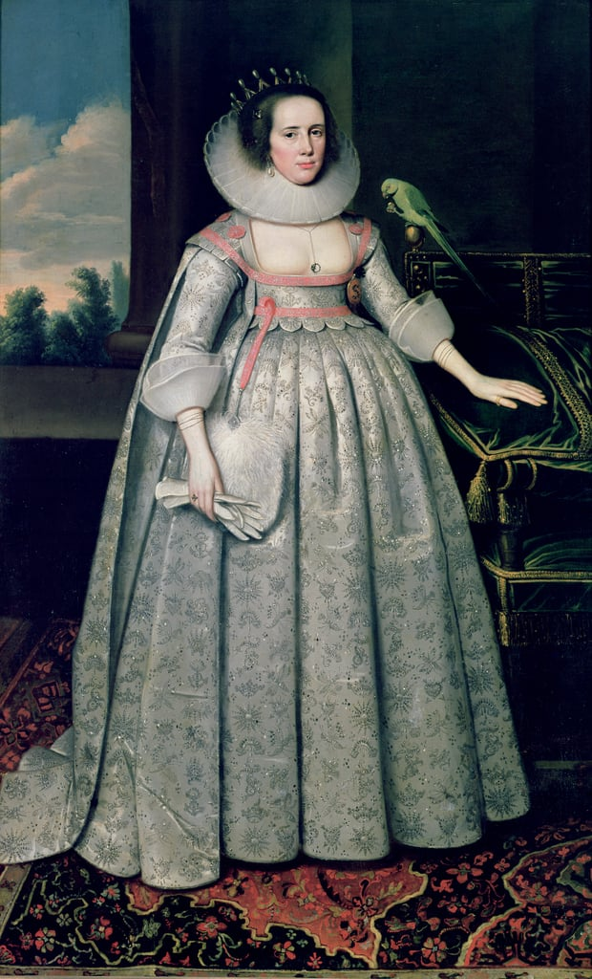
1618 the countess of Suffolk was accused of pushing her husband, the earl of Suffolk (lord Treasurer) into corrupt dealings (embezzlement and fraud as well as bribes to secure treasury payments). It was said ‘she made a shew to esteem no friend but money’. Sir Ed Coke called her ‘my Lady Treasurer though my Lord might seem to be her clerk’.

Slide 17
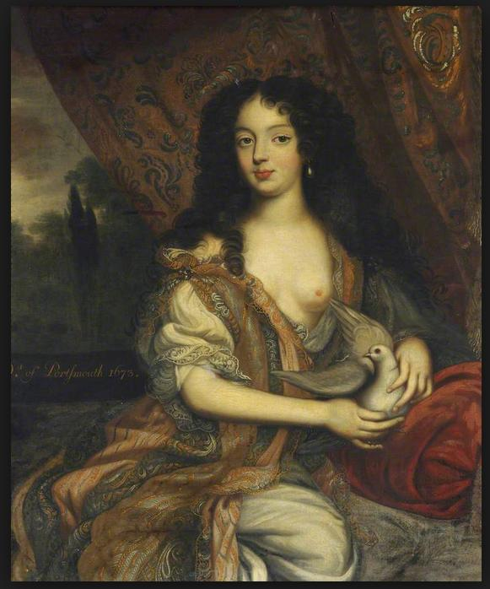
Royal mistresses were particularly problematic
Rachel Weil on political pornography – the lust of Charles II paralleling and describing the abuse of power
The indictment of the Duchess of Portsmouth in 1679 for prostitution but also for political and religious influence and her acceptance of bribes

Slide 18
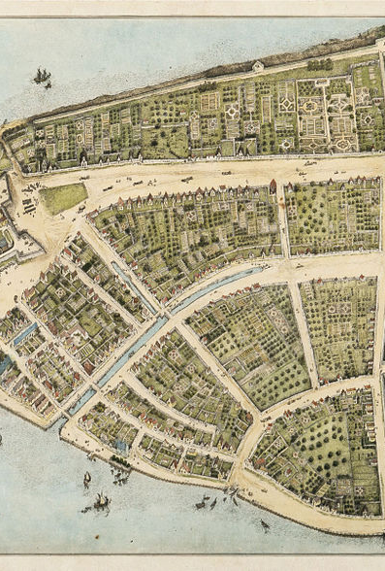
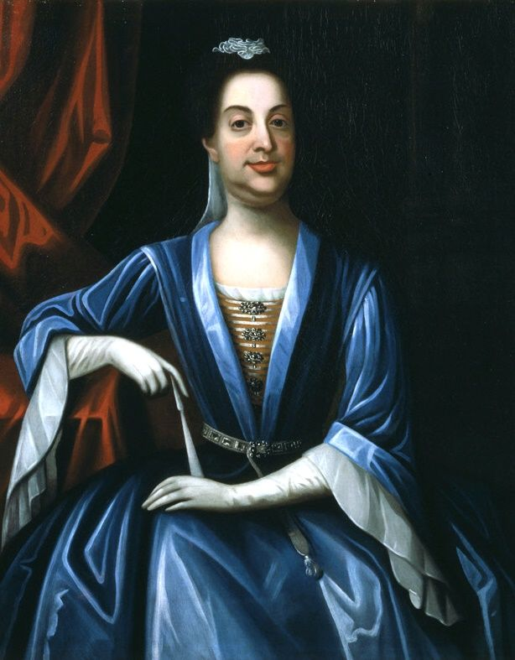
Tensions in New York and Lord Cornbury
Remuneration of governors was ill-defined
22 legal depositions gathered by Assembly accused Cornbury of corruption
Political opponents (eg Speaker Sam Jennings and land-owner Lewis Morris) headed/made use of this
Political influences of Whig and Tory from Britain
Tensions over scrutiny of revenues
Tavern gossip and focus on private lives
Sexuality became part of wider tensions [cf. murder of Parke]

Slide 19
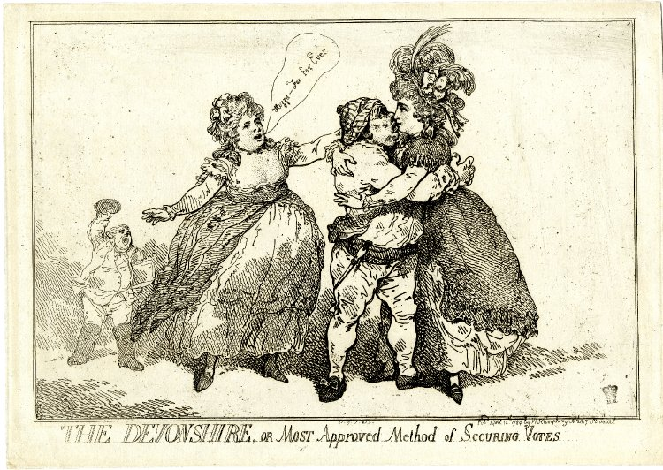
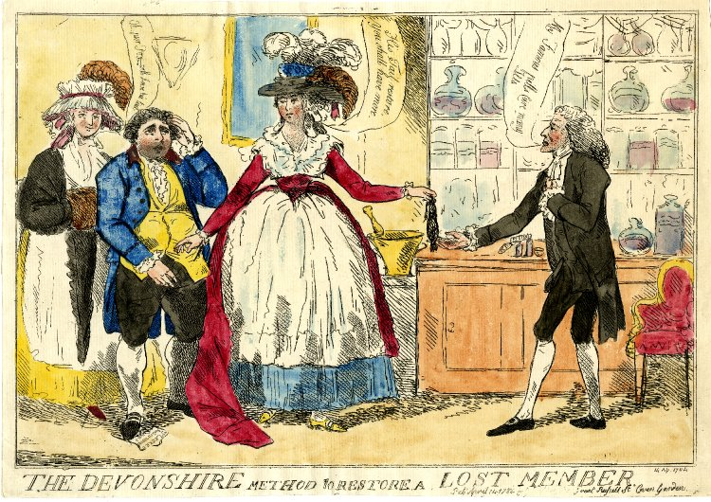
Female influence and corrupt electioneering
"Huzza - Fox for Ever“
The Duchess of Devonshire canvassing for Charles James Fox 1784
Male candidates ‘kissing the guinea’

Slide 20
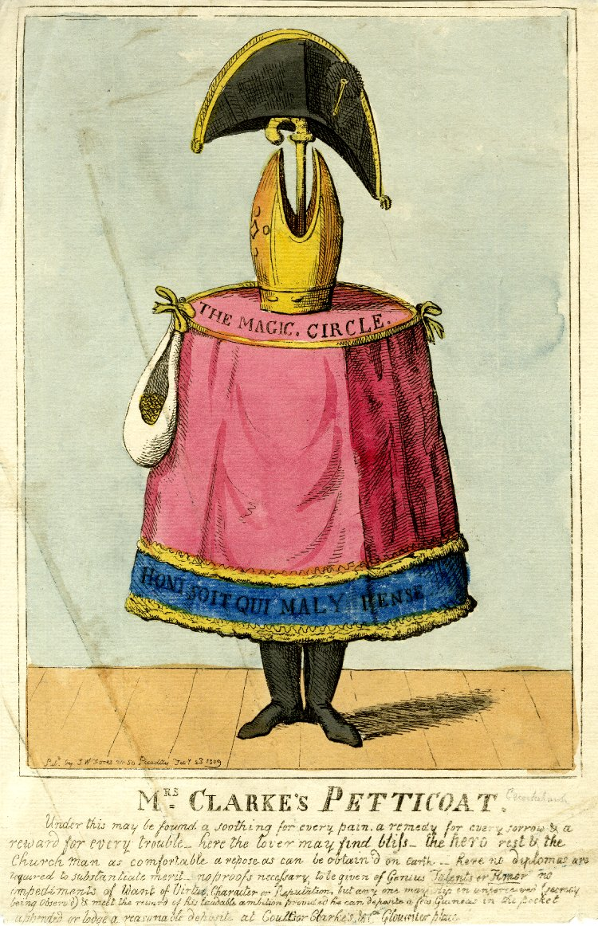
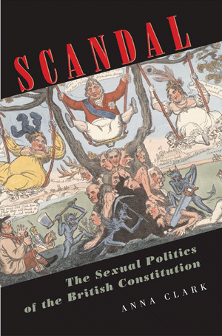
From 1760s onwards sexual scandals involving political figures and bribery were used to demand changes in the constitution and political order e.g. Mary Clarke and Critiquing the monarchy

Slide 21
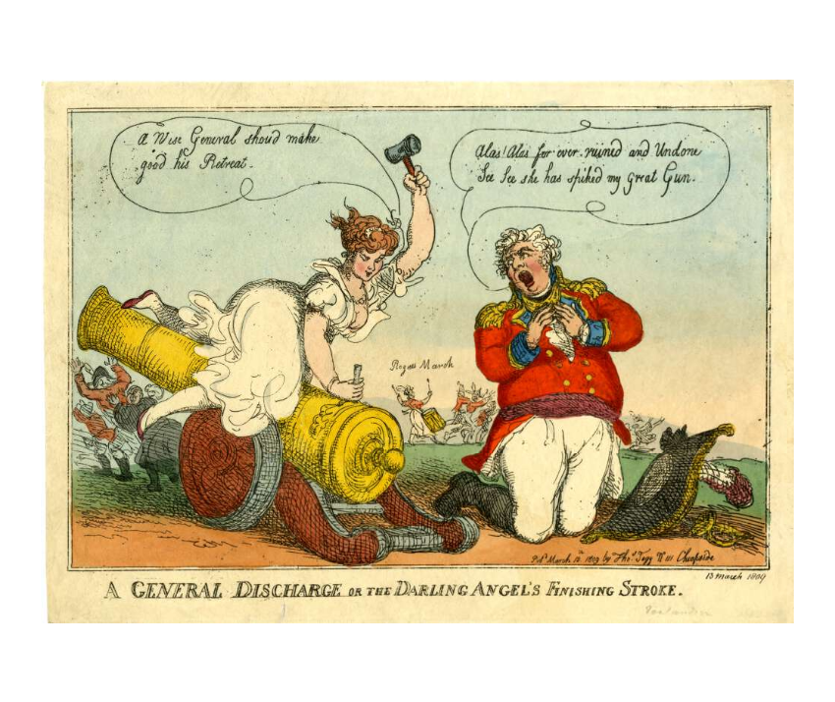

Slide 22
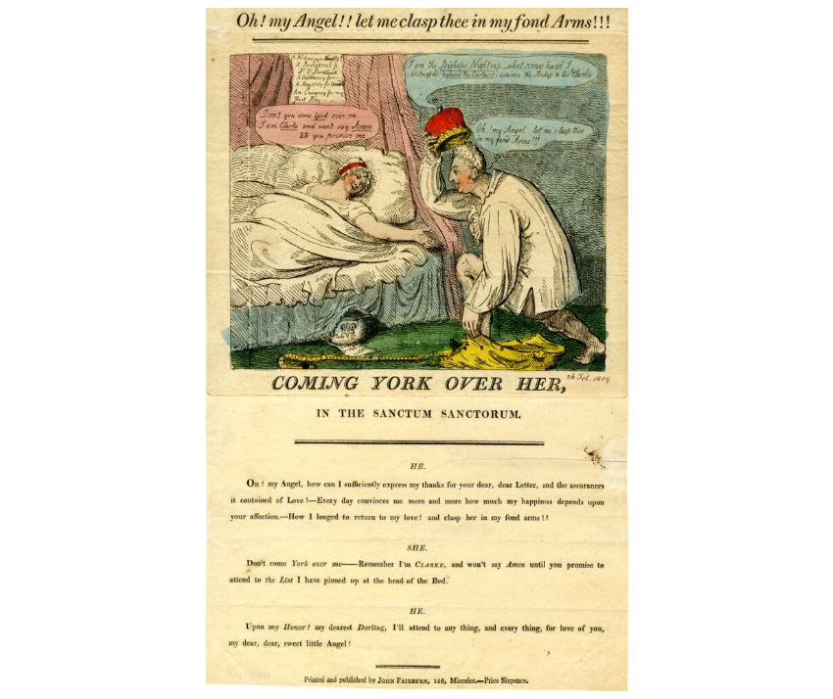
At the head of the bed is pinned up a list: A Colonelcy for Noodle, A Bishoprick for Dr O'Dundhead… Mrs. Clarke says: ‘Dont you come York over me I am Clarke and won't say Amen till you promise me …to attend to the List I have pinned up at the head of the Bed'

Slide 23
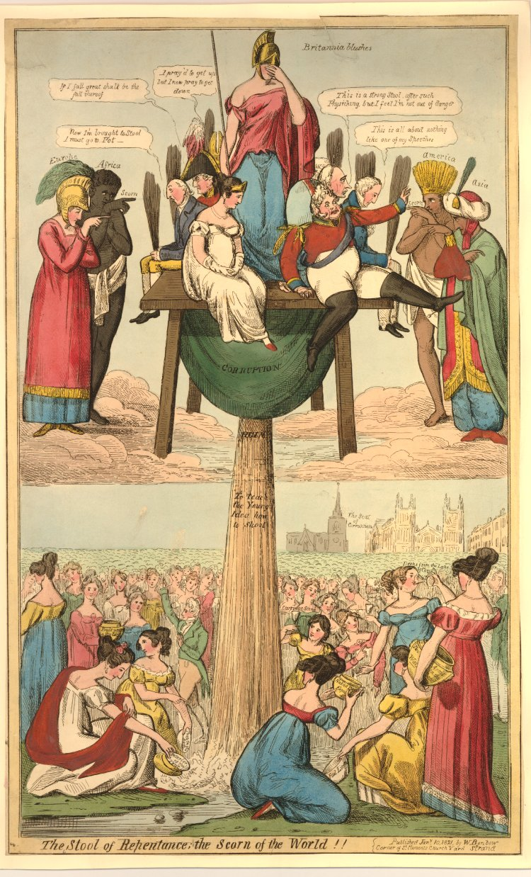
dsf
The Queen Caroline Affair 1819-21

Slide 24
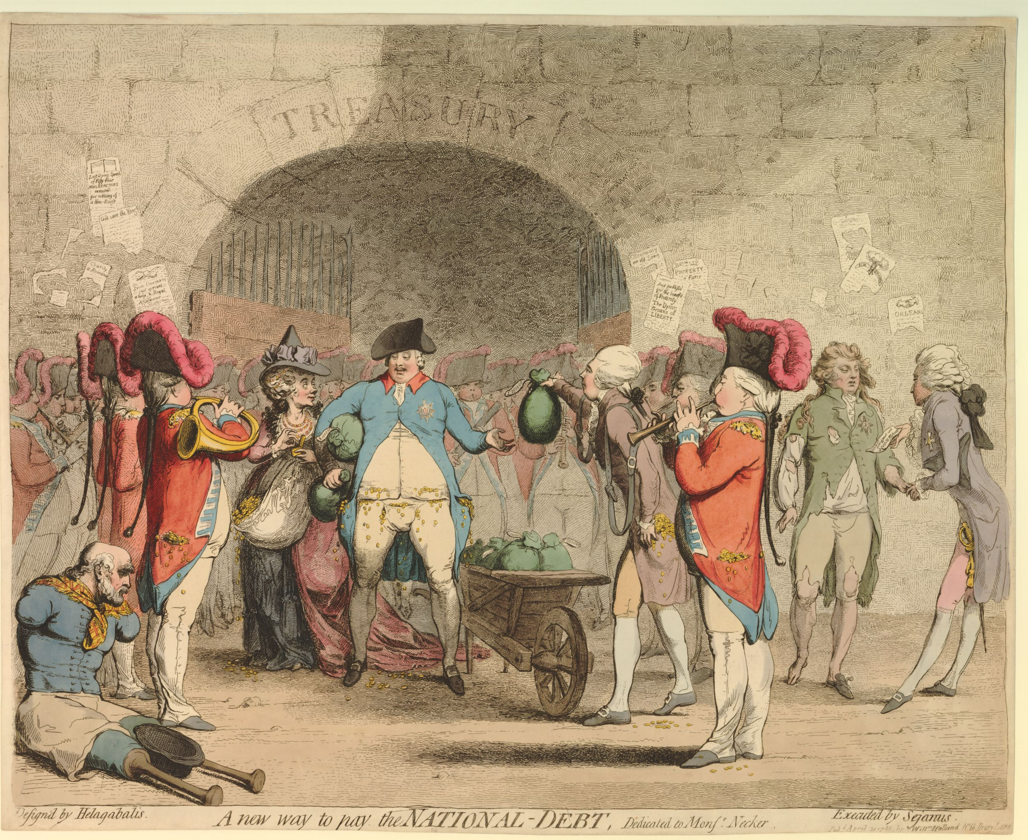
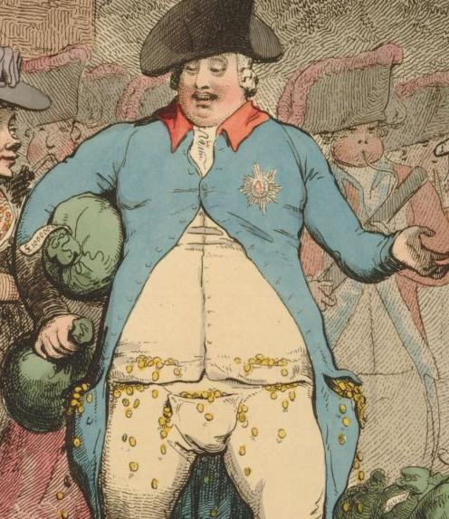

Slide 25
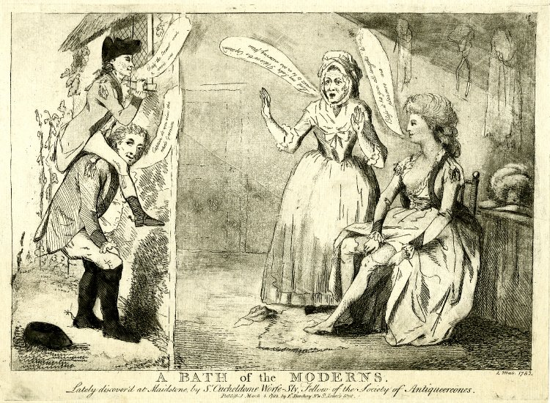
Elite immorality
Sir Richard Worsley. Army officer and MP; High Sheriff of Hants; comptroller of the king's household (1779–82),
in 1782 Worsley brought a criminal conversation case for £20,000 against one of them, George M Bissett, a Hampshire militia officer who lived near to them. However, the jury decided that Worsley had connived in the adultery and awarded him only one shilling in damages

Slide 26
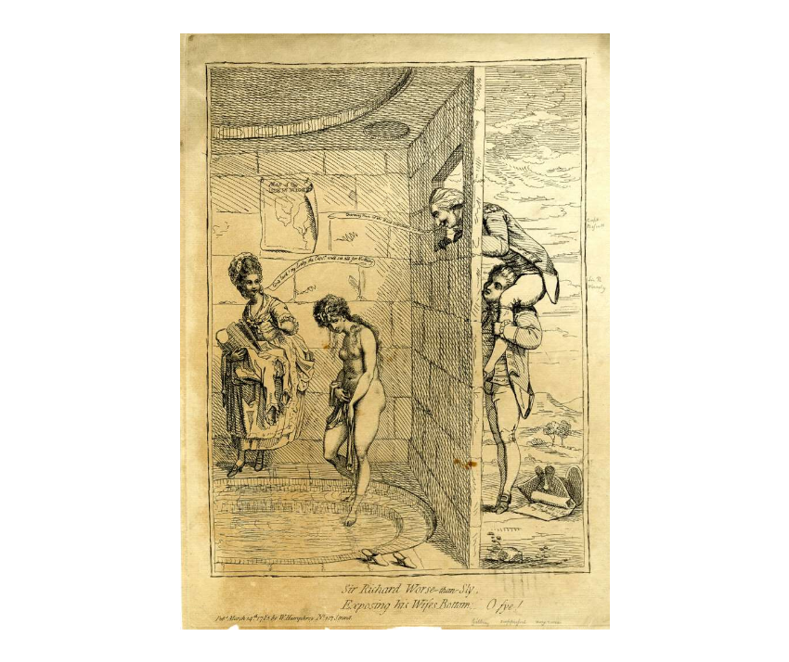

Slide 27
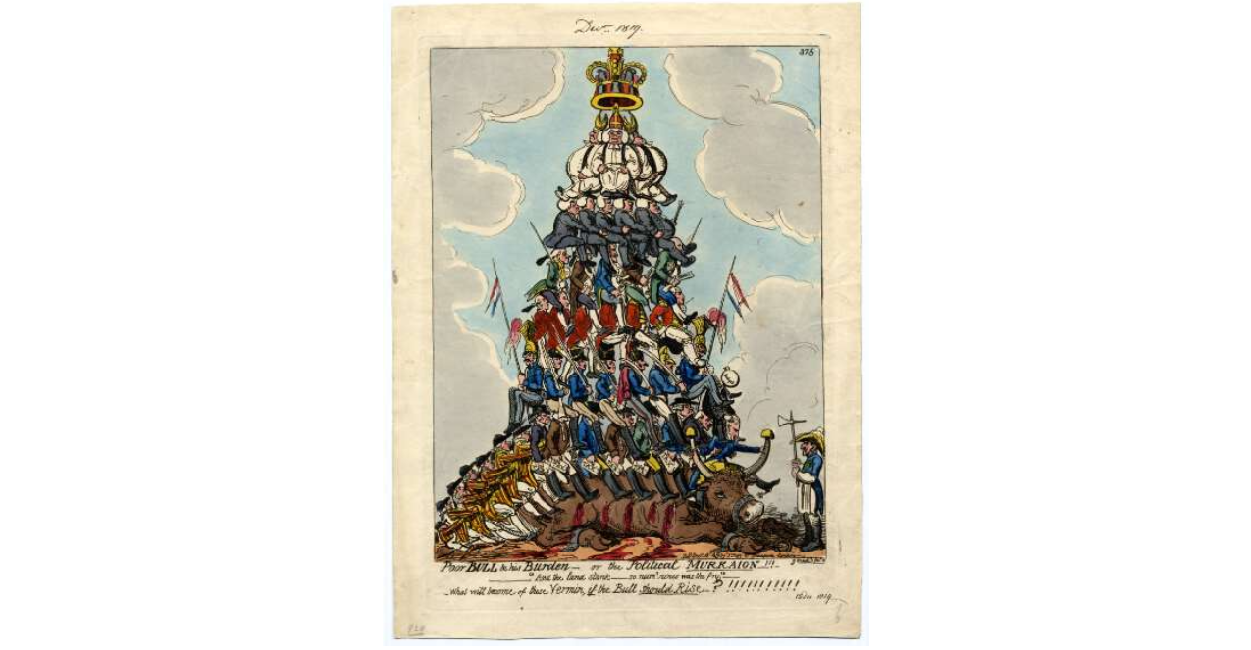
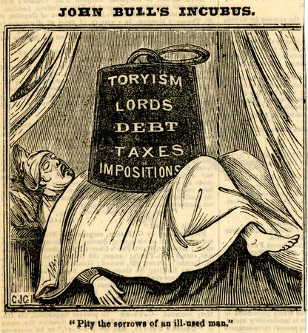
Elite immorality and social critique
Oxford Magazine: ‘Do we not see noblemen squandering away large estates, and then patching up their broken fortunes by fatal marriages and venal places at court?’ [1770 p139]
Early C19th radical critique of elite as immorally living off the backs of the poor
1835
1819

Slide 28
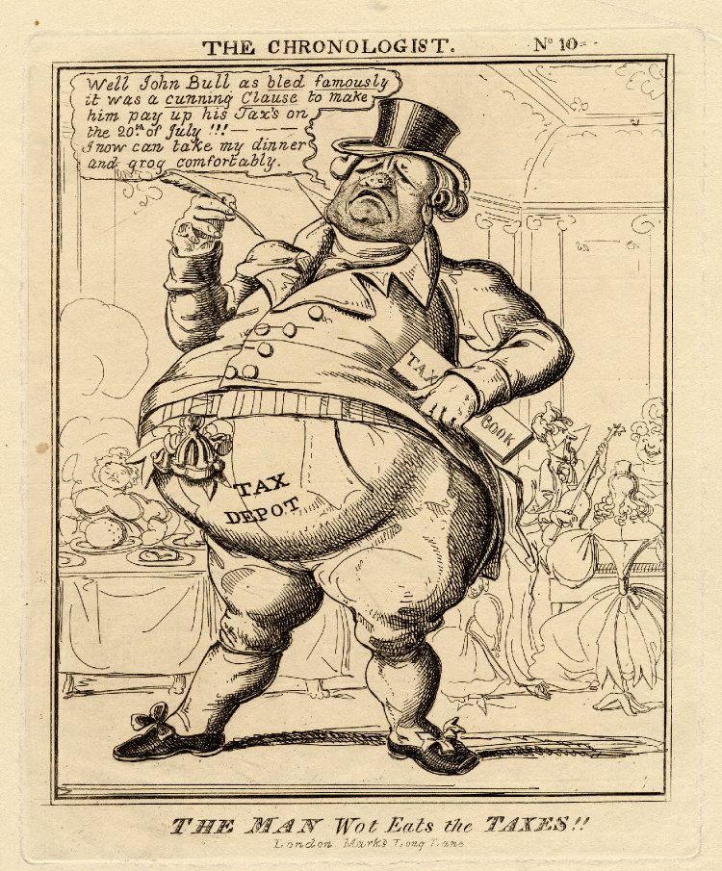
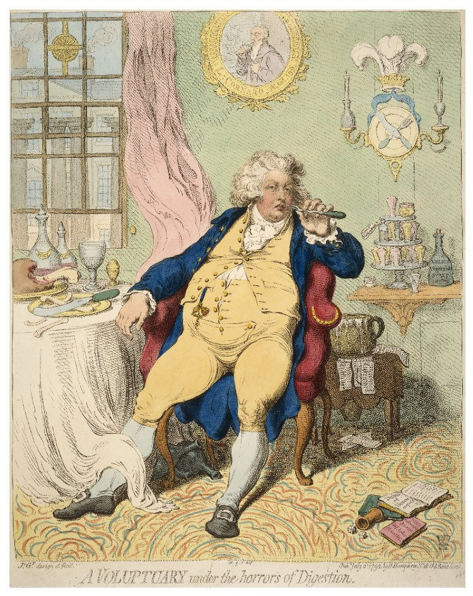
Greed – bodily and fiscal; critiquing the monarchy

Slide 29
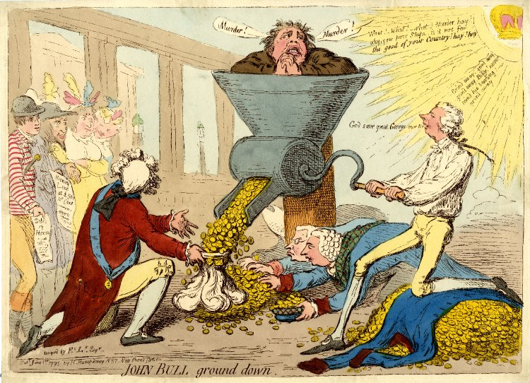
Conclusion
The study of political and economic corruption is also the study of vices associated with inner moral corruption and bodily appetites
This blurring of private and public was sustained throughout the period up to C19th reform
But a more ‘systematic’ view of corruption (which placed less stress on immorality) also gained sway

