Slide 1
Medieval division of sciences (scientia)
Scientia
Episteme
Philosophy
(= love of wisdom)
Speculative (or theoretical)
what to believe
Metaphysics (or theology)
non-sensible world
Mathematics
number abstracted from sensible world
Practical
how to act
Individual (ethics)
Natural philosophy
sensible world
State (politics)
Family (‘home economics’)
Sources:
Plato, Republic
Aristotle, Metaphysics, Nicomachean Ethics…
Boethius, De Trinitate, 6th century
Aquinas, Summa Theologiae, 13th century

Slide 2
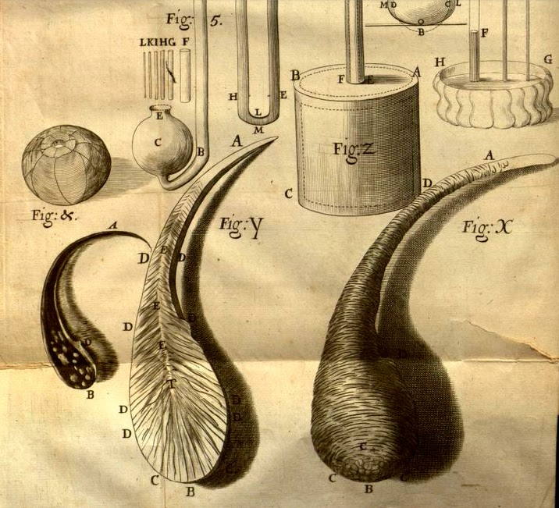
Glass drops, as shown in Robert Hooke, Micrographia: or Some Physiological Descriptions of Minute Bodies Made by Magnifying Glasses (London, 1665)

Slide 3
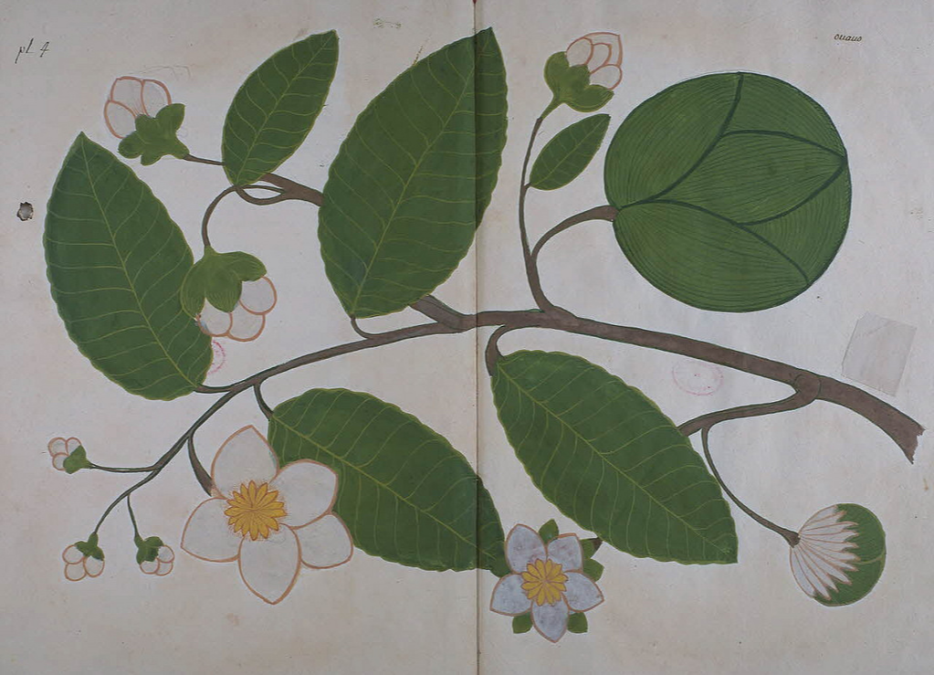
Illustration from Flora of Orixa, by local textile painters in Orissa

Slide 4
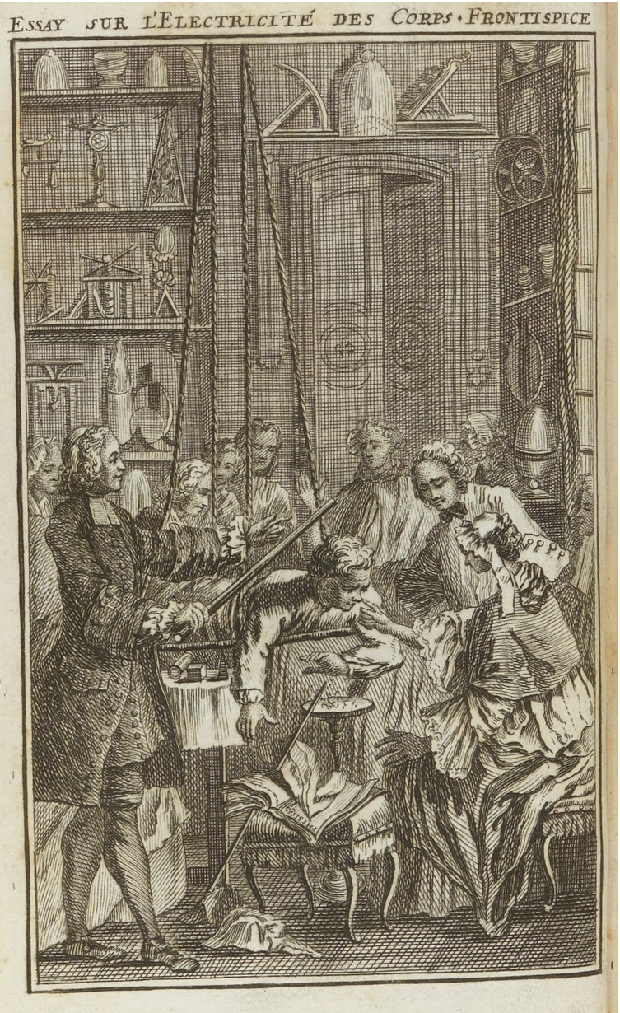
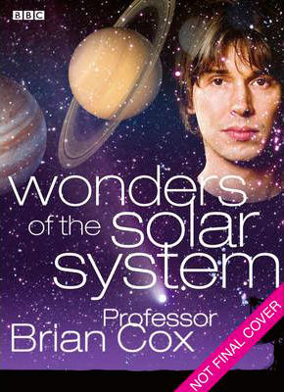
Jean-Antoine Nollet, Essay on the Electricity of Bodies (1746)
Brian Cox, Wonders of the Solar System DVD (2010)

Slide 5
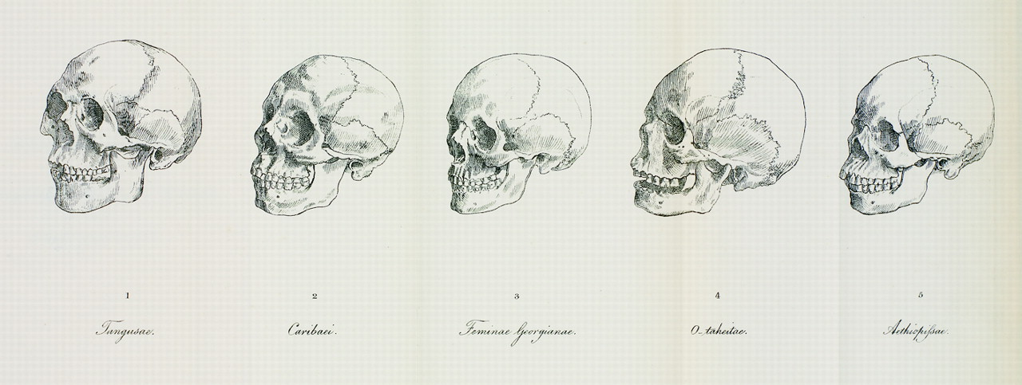
Johann Friedrich Blumenbach, De generis humani varietate nativa (On the Natural Variety of Mankind) (1775)

Slide 6
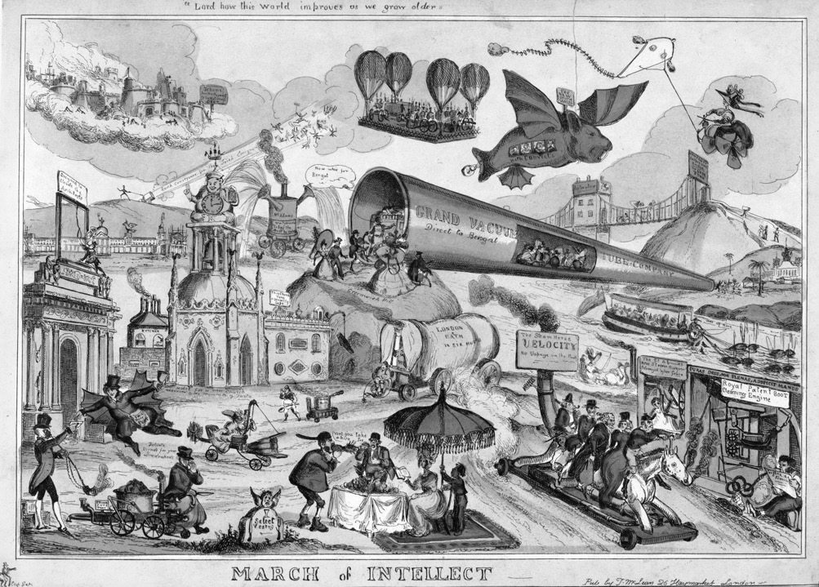
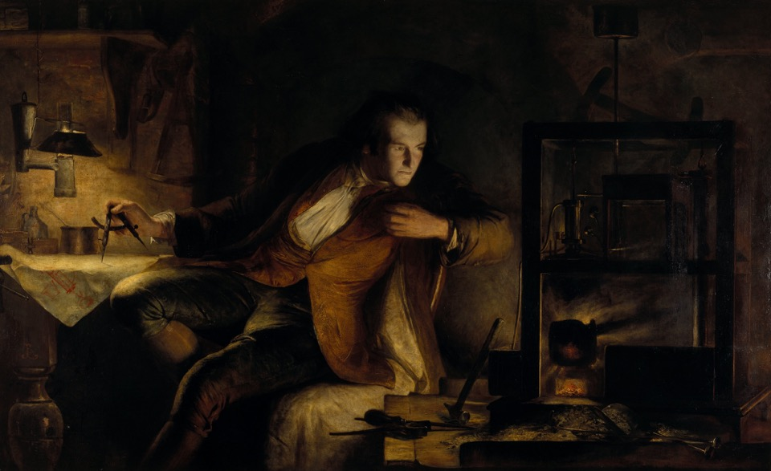
James Eckford Lauder, ‘James Watt and the Steam Engine: the Dawn of the Nineteenth Century’ (1855)

Slide 7
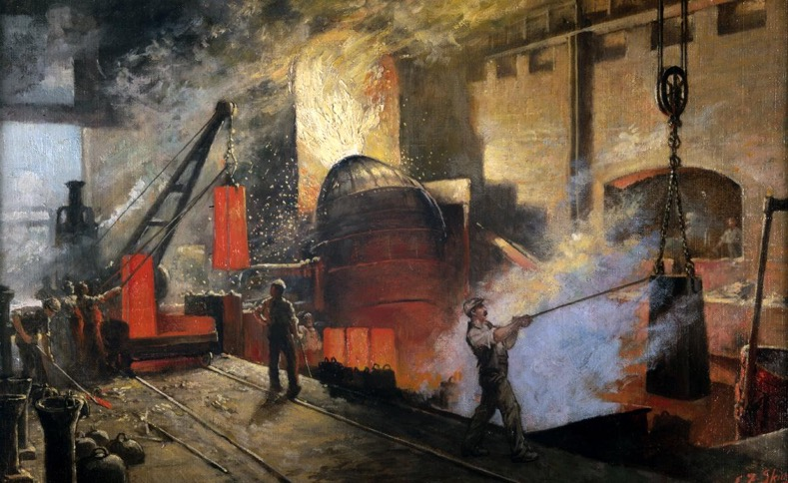
Edward Skinner, ‘Making Bessemer Steel, Sheffield’, 1917

Slide 8
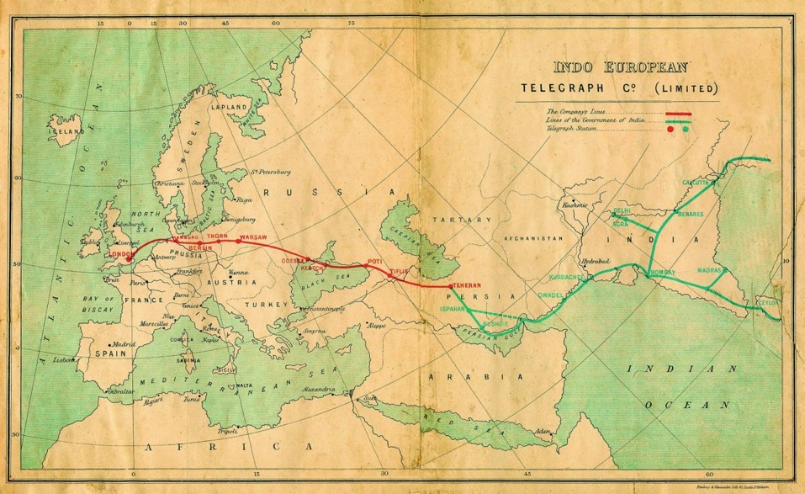
Map of telegraph from Britain to India built 1868-70.

Slide 9
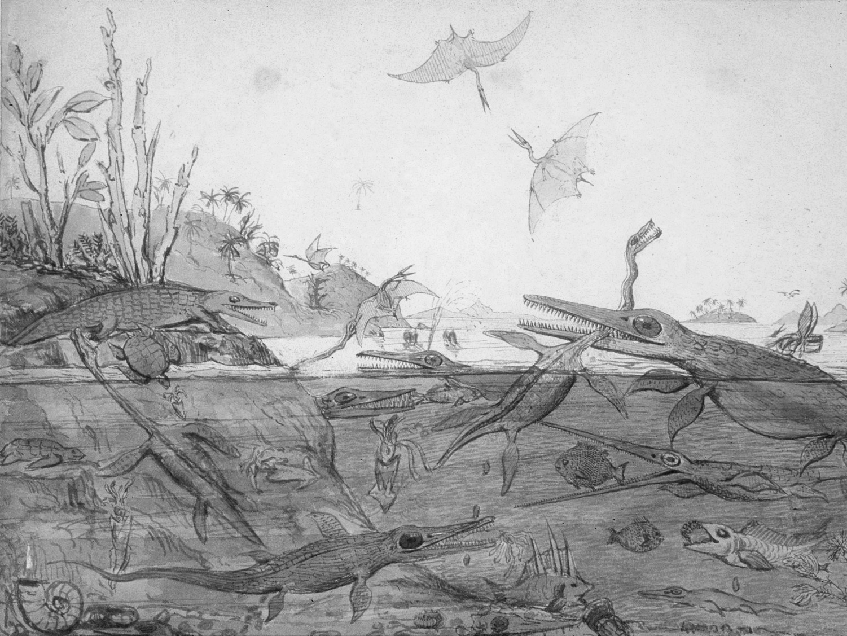
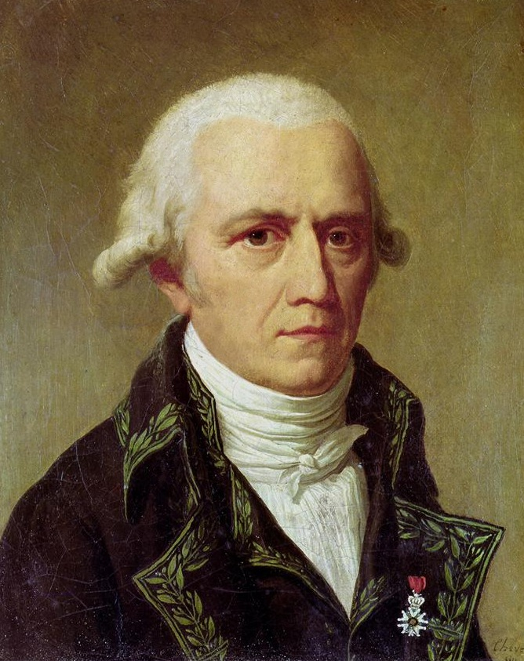
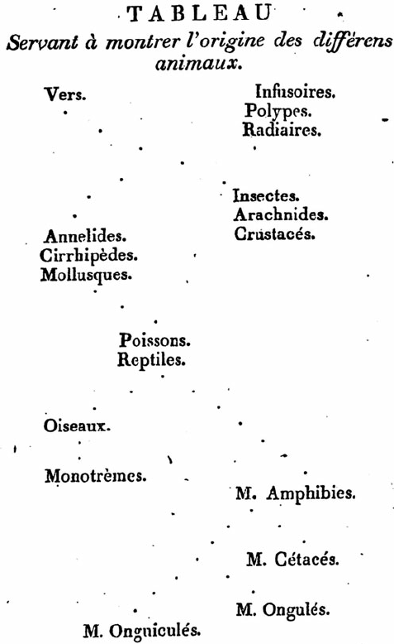
Jean-Baptiste Lamarck (1744-1829)
Lamarck, Philosophie zoologique (1809)

Slide 10
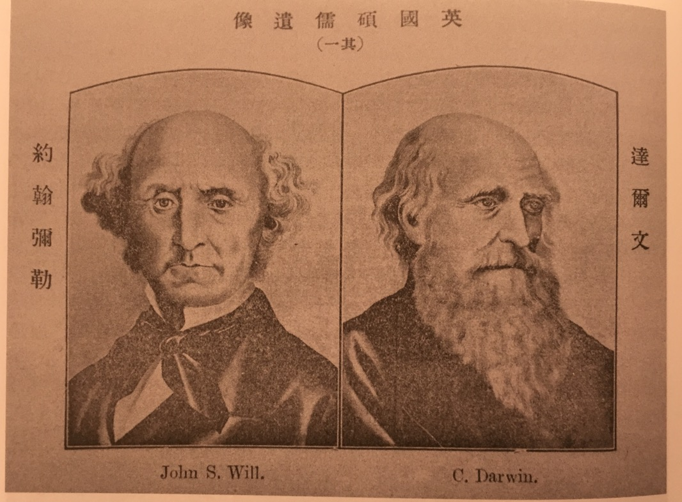
J.S. Mill (left) and C. Darwin (right) in Xinmin congbao (Journal of the New People), No. 6 (1902)

Slide 11
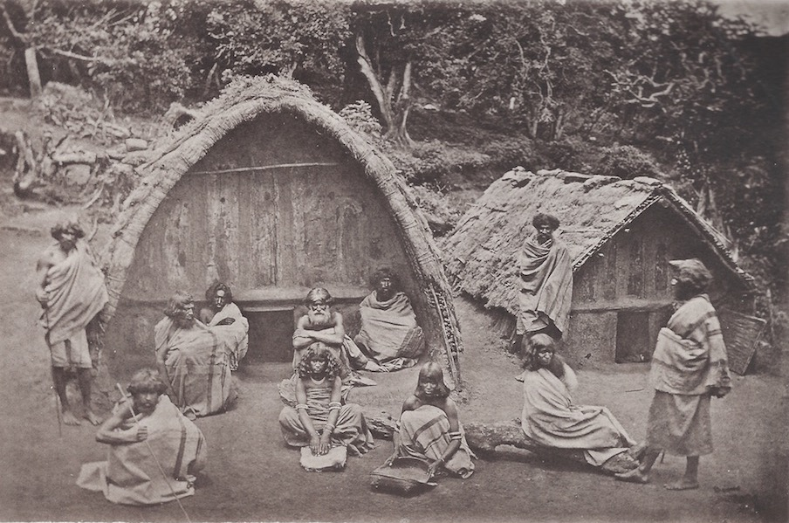
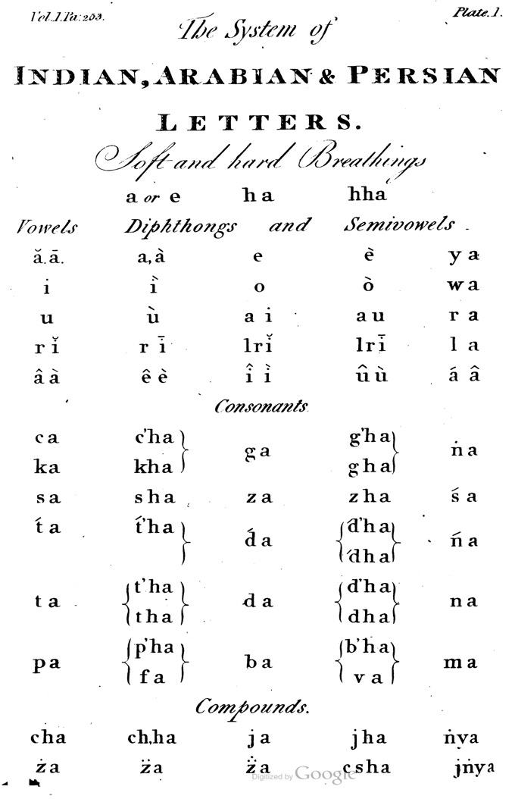
Jones, The Works of Sir William Jones (1807)

Slide 12
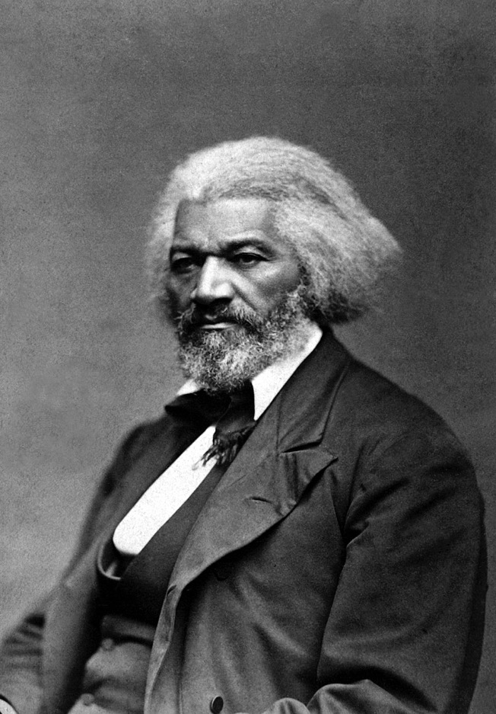
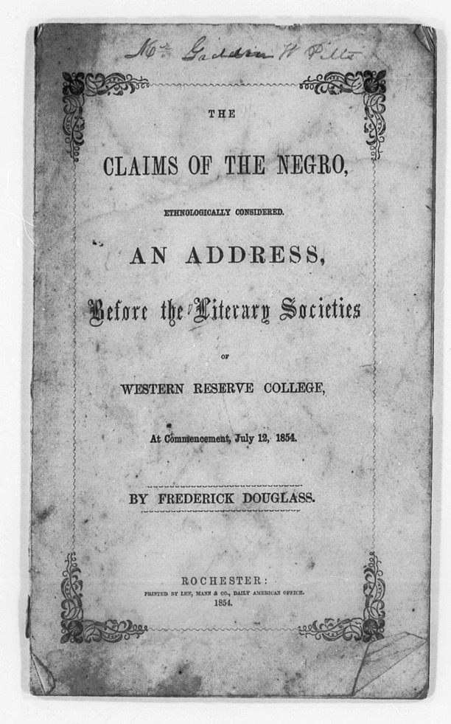
Douglass, The Claims of the Negro Ethnologically Considered (1854)

Slide 13
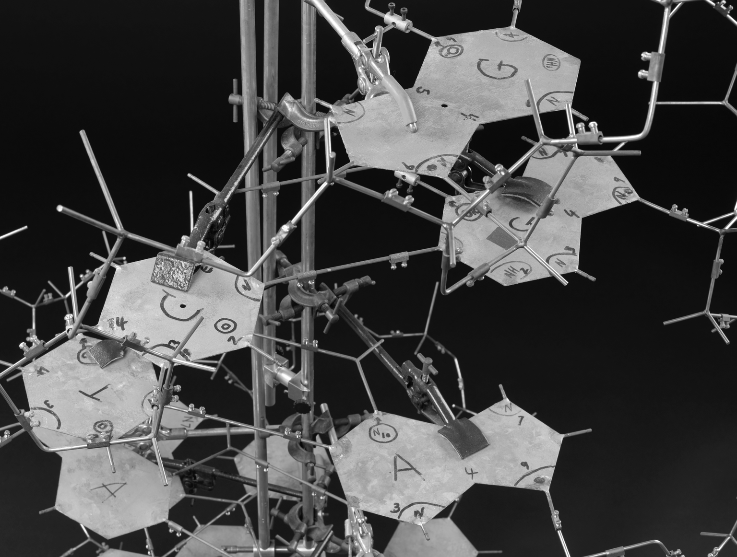
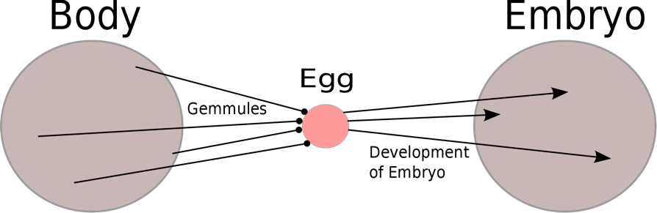
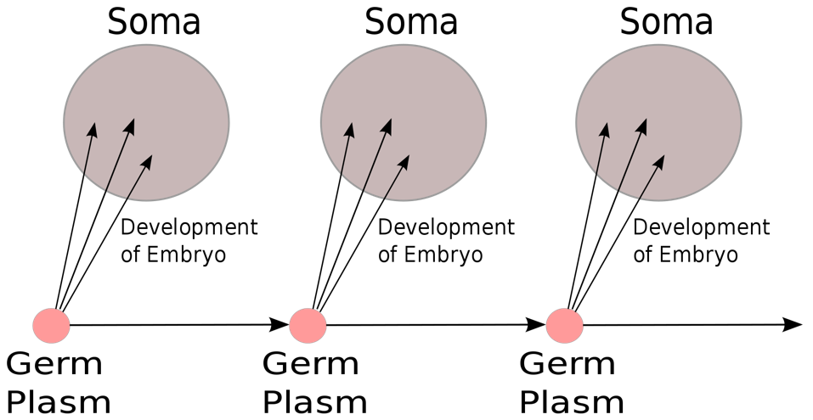
}
Charles Darwin’s theory of pangenesis (Lamarckian)
August Weissman’s theory of the germ line (Mendelian)
}

Slide 14
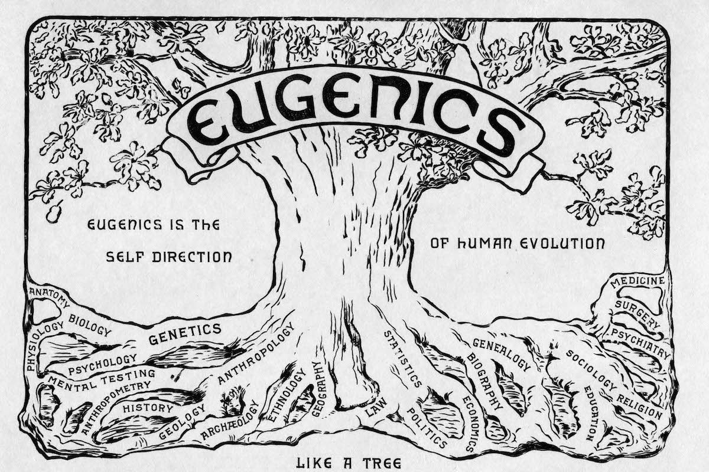

Slide 15
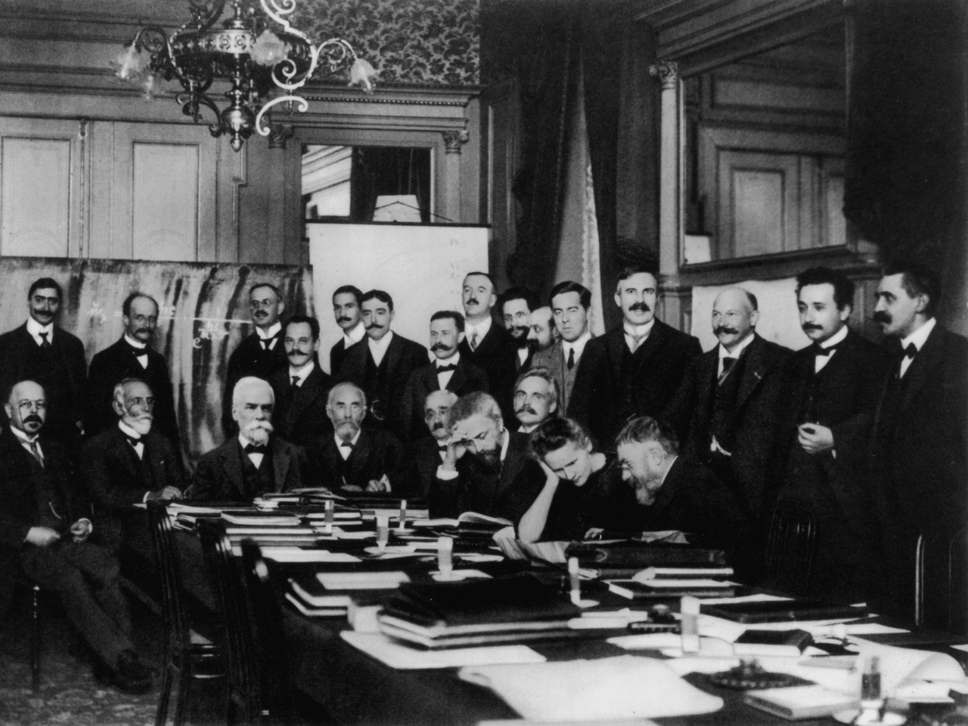
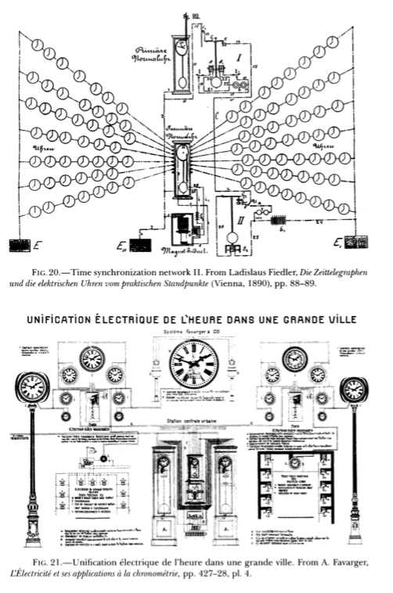
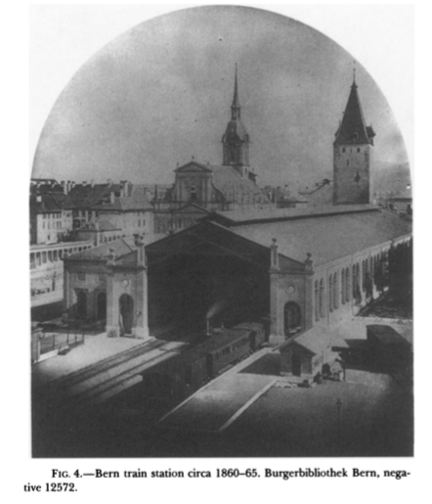
Industrial context
Electrical synchronisation of clocks
Bern train station

Slide 16
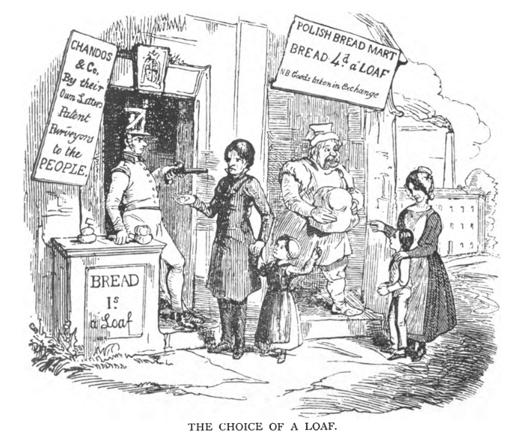
Satirical cartoon from Anti Corn Law Circular, Dec 10, 1839

Slide 17
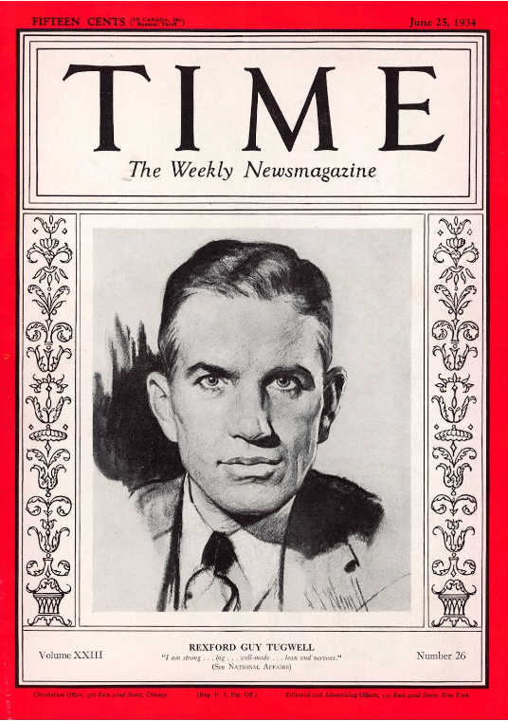
The jig is up. The cat is out of the bag. There is no invisible hand. There never was.
-- Tugwell in a 1934 speech

