Slide 1
Theories of Everything, 1400-1600
HI2D5 week 2
7 October 2019
Dr. Michael Bycroft

Slide 2
Earthquakes

Slide 3


Slide 4
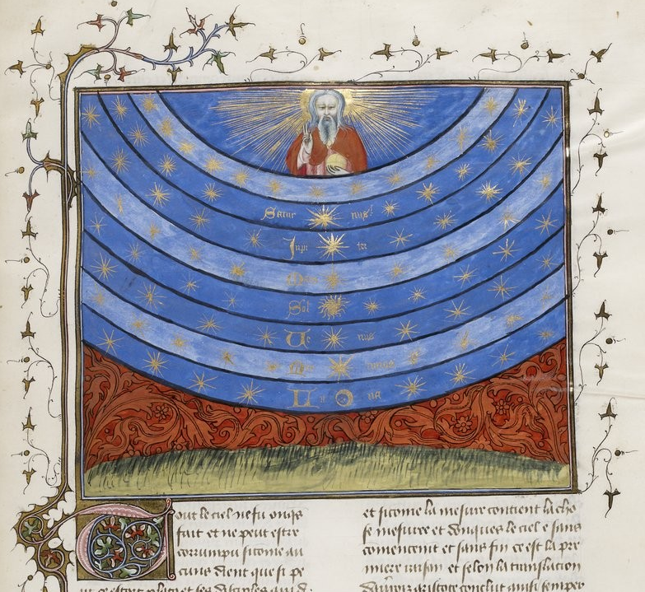
The Medieval cosmos, from French manuscript c. 1400-1420, containing works by Nicholas Oresme

Slide 5
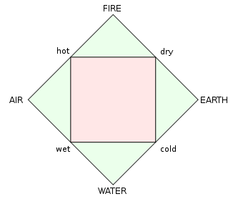

Slide 6
Medieval division of sciences (scientia)
Scientia
Episteme
Philosophy
(= love of wisdom)
Speculative (or theoretical)
what to believe
Metaphysics (or theology)
non-sensible world
Mathematics
number abstracted from sensible world
Practical
how to act
Individual (ethics)
Natural philosophy
sensible world
State (politics)
Family (‘home economics’)
Sources:
Plato, Republic
Aristotle, Metaphysics, Nicomachean Ethics…
Boethius, De Trinitate, 6th century
Aquinas, Summa Theologiae, 13th century

Slide 7
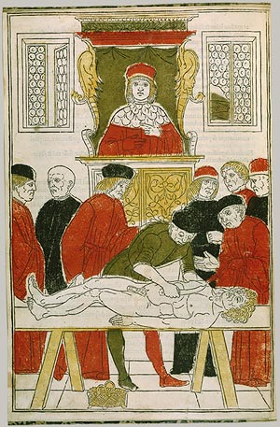
Medieval anatomical demonstration, from Johannes de Ketham, Fasciculo di Medicina (1493)
Notes:
I ended the last lecture by showing you an illustration that shows a typical anatomical demonstration as carried out in European universities from the 14th to the 16th centuries.
I pointed out the clear division of labour between the man who uses his mind – the professor – and the man who uses his hands – the surgeon or the cutter.
This division was very general in Medieval life. Not just anatomy and physiology. We can see this by recalling (lecture 2) how Medieval scholars divided up the map of knowledge.

Slide 8
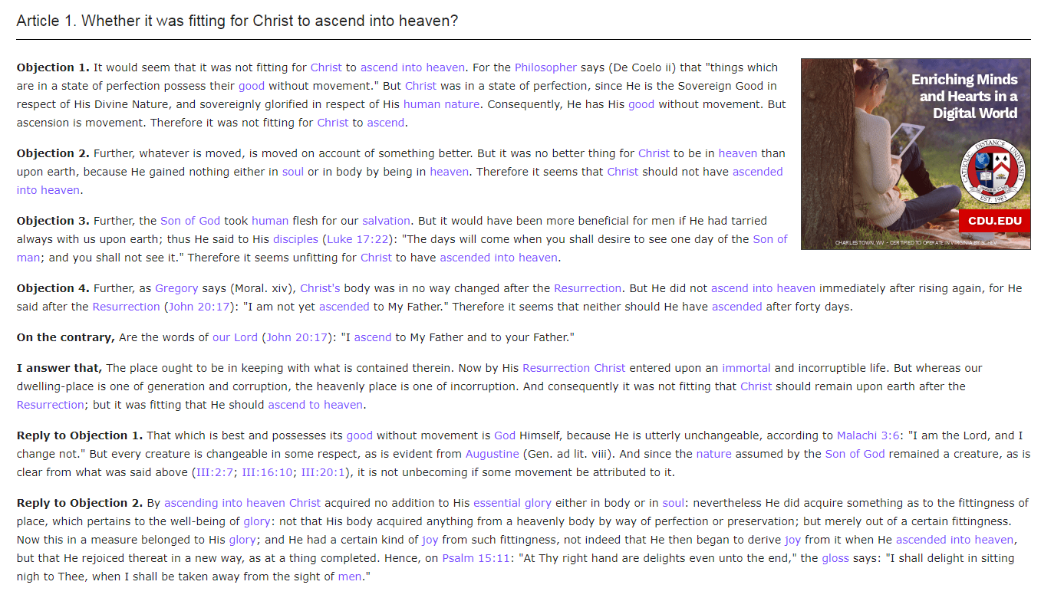
From Question 57 (on the ascension of Christ)
in Thomas Aquinas, Summa Theologiae (written 13th century)

Slide 9
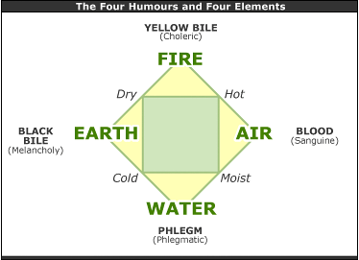

Slide 10
From Question 57 (on the ascension of Christ)
in Thomas Aquinas, Summa Theologiae (written 13th century)

Slide 11
The Medieval cosmos, from French manuscript c. 1400-1420, containing works by Nicholas Oresme

Slide 12
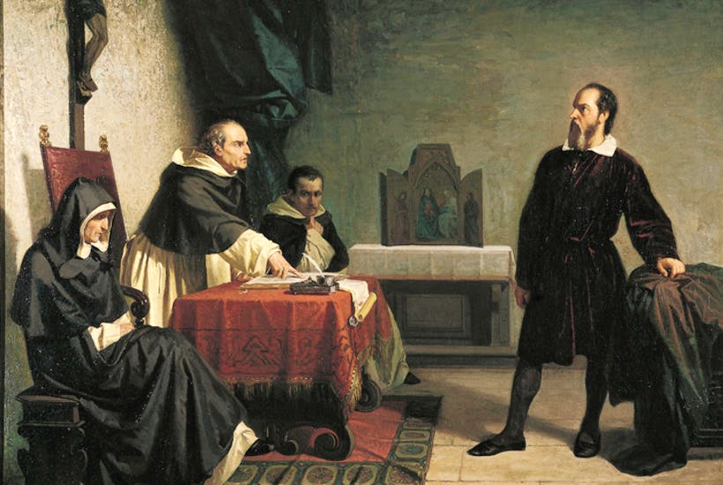
Galileo before the Inquisition in Rome, by Cristiano Banti (19th century)

Slide 13
The proposition that the Sun is the center of the world and does not move from its place is absurd and false philosophically and formally heretical, because it is expressly contrary to Holy Scripture.
-- text of the Papal Condemnation of Galileo, 1633

Slide 14
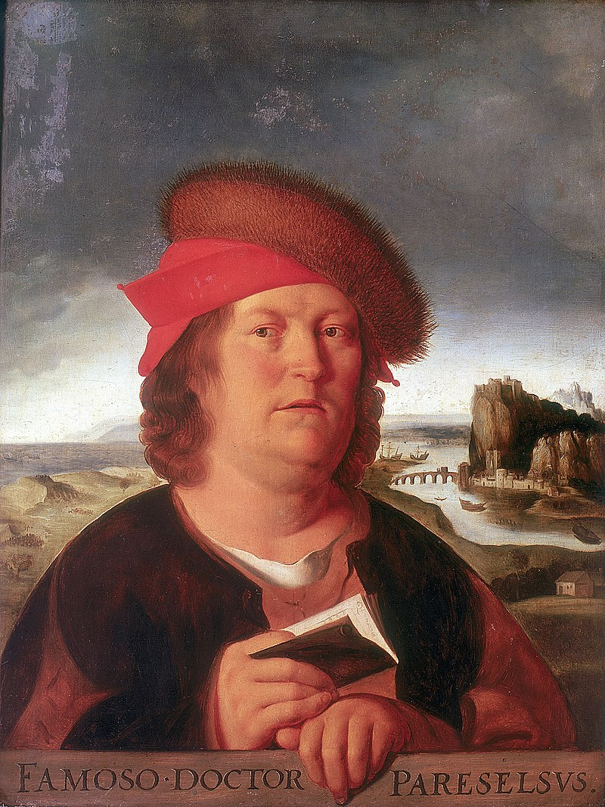
Paracelsus, painted from life by Quentin Matsys

Slide 15
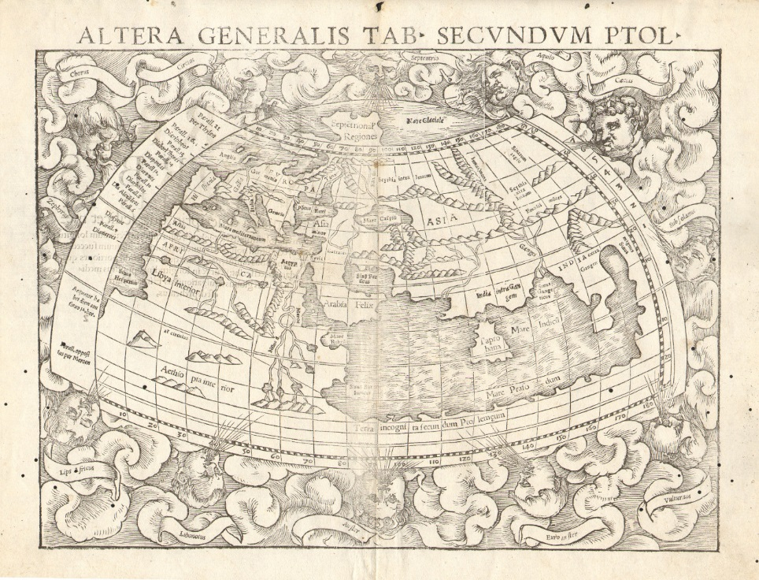
‘Map of the World as Described by Ptolemy’, from Sebastien Munster’s edition of Ptolemy, Geographica 1540

Slide 16
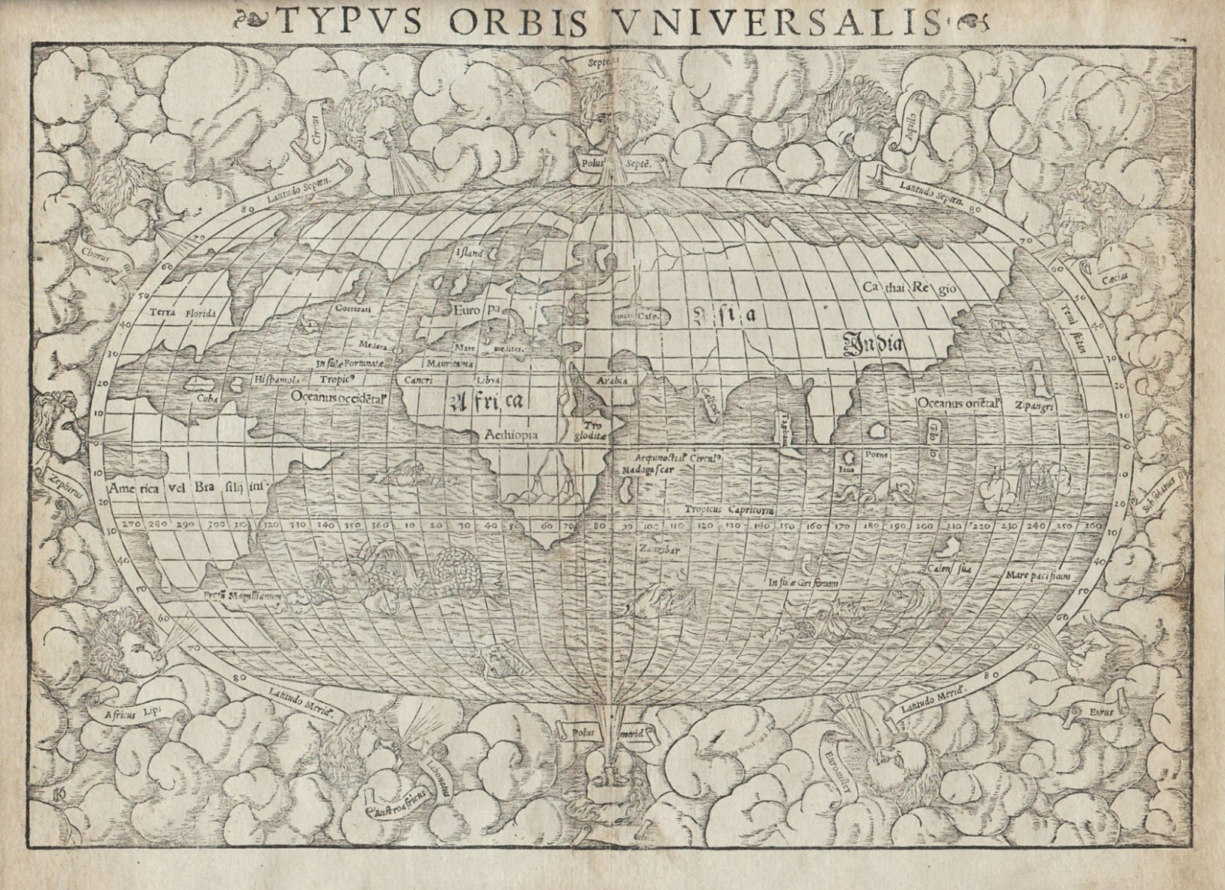
‘Map of the Whole World’, from Sebastien Munster’s edition of Ptolemy, Geographica 1540

Slide 17
early modern science differed fundamentally from current science
but not necessarily less ‘scientific’
in flux even before 1600
experiment, mathematics, networks

