Slide 1
Scholars and artisans, 1500-1700
HI2D5 week 3
14 October 2019
Dr. Michael Bycroft

Slide 2
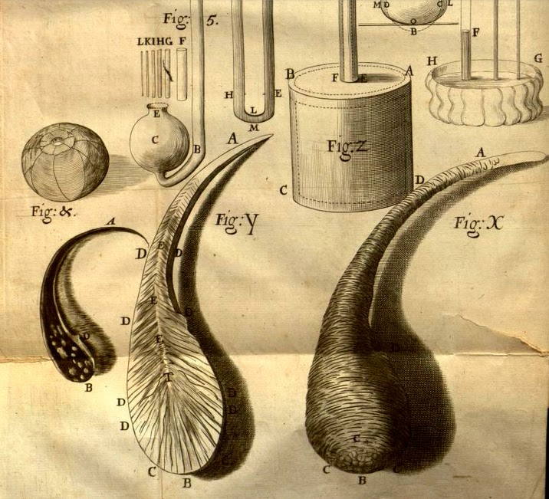
Glass drops, as shown in Robert Hooke, Micrographia: or Some Physiological Descriptions of Minute Bodies Made by Magnifying Glasses (London, 1665)

Slide 3
Modern science was invented between 1572, when Tycho Brahe saw a nova, or a new star, and 1704, when Newton published his Optics
-- David Wootton, The Invention of Science, 2015

Slide 4
Nicolas Copernicus, On the Revolutions of the Heavenly Spheres (1543)
Andreas Vesalius, On the Fabric of the Human Body (1543)
William Gilbert, On the Magnet (1600)
William Harvey, On the Motion of the Heart and Blood (1628)
Galileo Galilei, Dialogue on the Two Chief World Systems (1632)
Robert Boyle, On the Spring of the Air (1660)
Isaac Newton, Mathematical Principles of Natural Philosophy (1687)
Isaac Newton, Optics (London, 1704)

Slide 5
[in the 17c] change is brought about, not by new observations or additional evidence in the first instance, but by transpositions that were taking place in the minds of the scientists themselves
— Herbert Butterfield, The Origins of Modern Science, 1300-1800 (1949).

Slide 6
The scientific revolution needs not so much to be rewritten as written off
– Nick Jardine, 1991
We do not want to discuss here the last twenty years or so of attempts to put Humpty Dumpty together again. Our argument here is that such attempts are doomed to failure…
– Cunningham and Williams, 1993
There was no such thing as the scientific revolution, and this is a book about it
– Shapin, 1996

Slide 7
..we can now see it as the greatest event in human history since the Neolithic Revolution [12-7,000 years ago!]
– David Wootton, 2015
the advent of modern science [was] a decisive event in world history, really the most outstanding among prime motors of our modern world
– Floris Cohen, 2015

Slide 8
This is the Age wherein Philosophy comes in with a Spring-tide; and the Peripateticks may as well hope to stop the Current of the Tide, or to fetter the Ocean, as hinder the overflowing of free Philosophy: Me-thinks, I see how all the old Rubbish must be thrown away, and the rotten Buildings overthrown, and carried away by so powerful an Inundation.
Henry Power, Experimental Philosophy (London, 1664)

Slide 9
These are the days that must lay a new Foundation of a more magnificent Philosophy, never to be overthrown: that will Empirically and Sensibly canvass the Phaenomena of Nature, deducing the Causes of things from such Originals in Nature, as we observe are producible by Art
-- Henry Power, Experimental Philosophy (London, 1664)

Slide 10
‘There is nothing in the mind that is not first in the senses’
‘credence must be given to observation rather than to theory, and to theory only insofar as it agrees with what is observed’
Top: medieval scholastic maxim
Bottom: quote from Aristotle, Generation of Animals, 4th century BC

Slide 11
These are the days that must lay a new Foundation of a more magnificent Philosophy, never to be overthrown: that will Empirically and Sensibly canvass the Phaenomena of Nature, deducing the Causes of things from such Originals in Nature, as we observe are producible by Art
-- Henry Power, Experimental Philosophy (London, 1664)

Slide 12
Medieval division of arts (artes)
Arts
Liberal
Mathematical
Mechanical
Textiles, arms, commerce, agriculture, hunting, theatre, architecture, sports, navigation, divination, alchemy…
Verbal

Slide 13
1. History of the Heavenly Bodies; or Astronomical History
2. History of the Configuration of the Heaven
9. History of the Blue Expanse, of Twilight, of Mock-Suns, Mock-Moons, Haloes, various colors of the Sun
29. History of Gems; as the Diamond, the Ruby, etc.
35. Chemical History of Vegetables.
46. History of Excrements; Spittle, Urine, Sweats, Stools, Hair of the Head, Hairs of the Body, Whitlows, Nails, and the like.
90. Miscellaneous History concerning the care of the body — as of Barbers, Perfumers, etc.
95. History of manufactures of Feathers.
98. History of Leather-making, Tanning, and the arts thereto belonging.
From ‘Catalogue of Particular Natural Histories by Titles,’ in Francis Bacon, Preparative Toward Natural and Experimental History (1620)

Slide 14
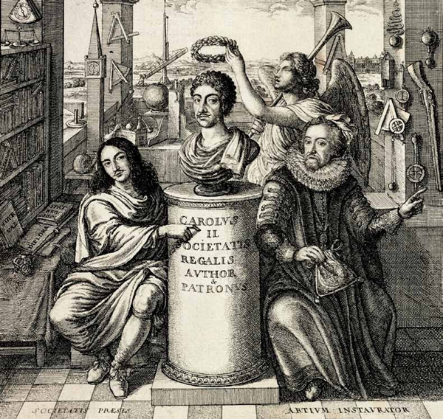
Frontispiece, from Thomas Sprat, History of the Royal Society of London for the Improvement of Natural Knowledge [est. 1662] (1671)

Slide 15
‘The social rise of the experimental method from the class of manual labourers to the ranks of university scholars in the early seventeenth century was a decisive event in the history of science’
‘England, the country of iron mines and advancing navigation, produced the first learned book on experimental physics’
-- Zilsel, Edgar. “The Origins of William Gilbert’s Scientific Method.” Journal of the History of Ideas 2, no. 1 (1941): 1–32

Slide 16
Benvenuto Cellini on goldsmithery and sculpture (Italy, 1568)
Konrad Keyser on instruments of warfare (Germany, 1405)
Roberto Valturio on military machines (Italy, 1472)
Albrecht Durer on descriptive geometry and fortifications (Germany, 1525 and 1527)
Nicola Tartaglia on ballistics ie. trajectories of cannons (Italy, 1537)
Georg Agricola on mining and metallurgy (Germany, 1546 and 1556)
Vannoccio Biringuccio on metals and metallurgy (Italy, 1570)
Simon Stevin on machines, eg windmills and drainage systems (Low Countries, 1586)
Pedro Nunes on navigation (Portugal, 1530s and 1540s)
Robert Norman on navigating with a magnet (England, 1581)
Thomas Harriot on navigation (England, 1594)

Slide 17
Benvenuto Cellini on goldsmithery and sculpture (Italy, 1568)
Konrad Keyser on instruments of warfare (Germany, 1405)
Roberto Valturio on military machines (Italy, 1472)
Albrecht Durer on descriptive geometry and fortifications (Germany, 1525 and 1527)
Nicola Tartaglia on ballistics ie. trajectories of cannons (Italy, 1537)
Georg Agricola on mining and metallurgy (Germany, 1546 and 1556)
Vannoccio Biringuccio on metals and metallurgy (Italy, 1570)
Simon Stevin on machines, eg windmills and drainage systems
Pedro Nunes on navigation (Portugal, 1530s and 1540s)
Robert Norman on navigating with a magnet (England, 1581)
Thomas Harriot on navigation (England, 1594)

Slide 18
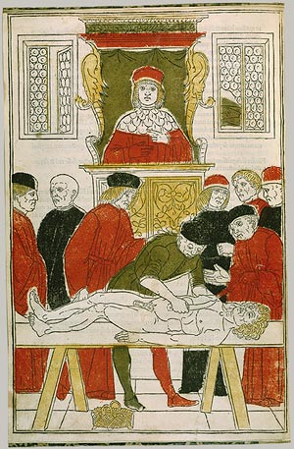
The [professor] is perched on a high pulpit like a crow and with an air of great disdain, he repeats to the point of monotony accounts concerning facts that he has not observed…Thus the students are confusedly taught less than what a butcher, from his meat-block, could teach the doctor
-- Andreas Vesalius, preface to On the Fabric of the Human Body (1543)

Slide 19
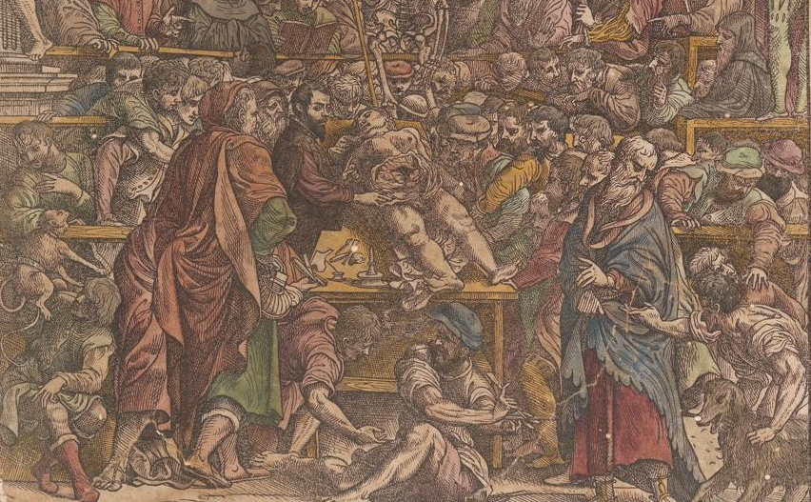
Title-page of Vesalius, On the Fabric of the Human Body (1543)

Slide 20
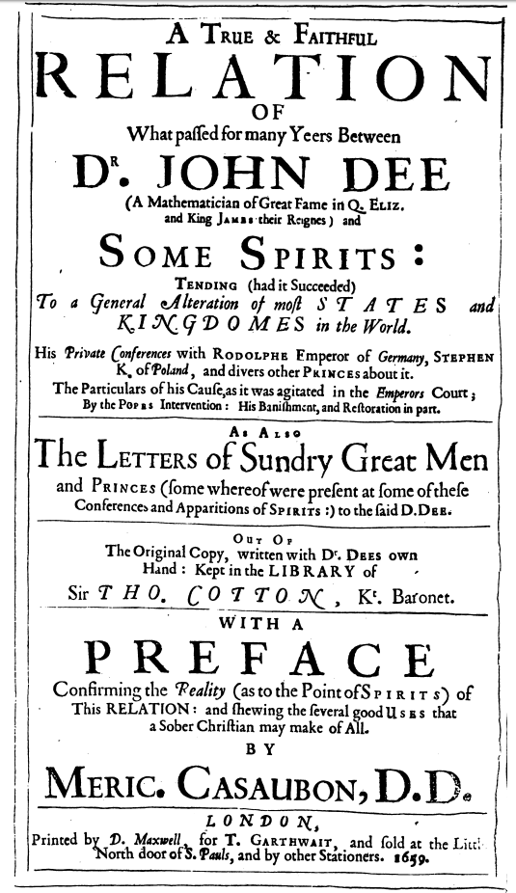
John Dee (1527-1609), with preface by Meric Casauban

Slide 21
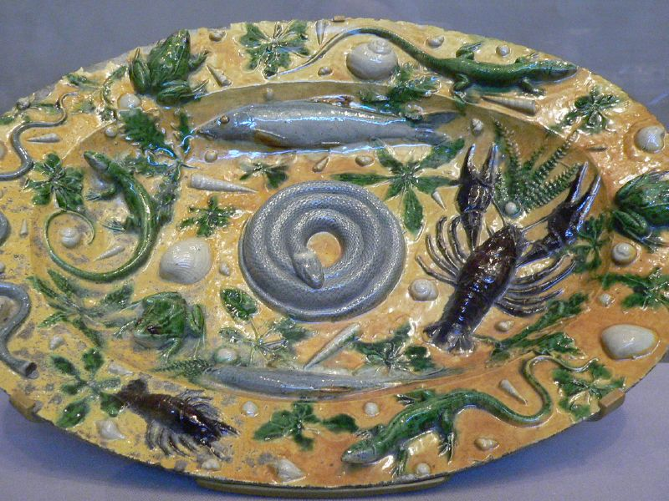
Rustic earthenware featuring life casts of marine creatures, c.1550
Bernard Palissy (1510-1590), ‘the king’s inventor of rustic figurines’ from 1562

Slide 22
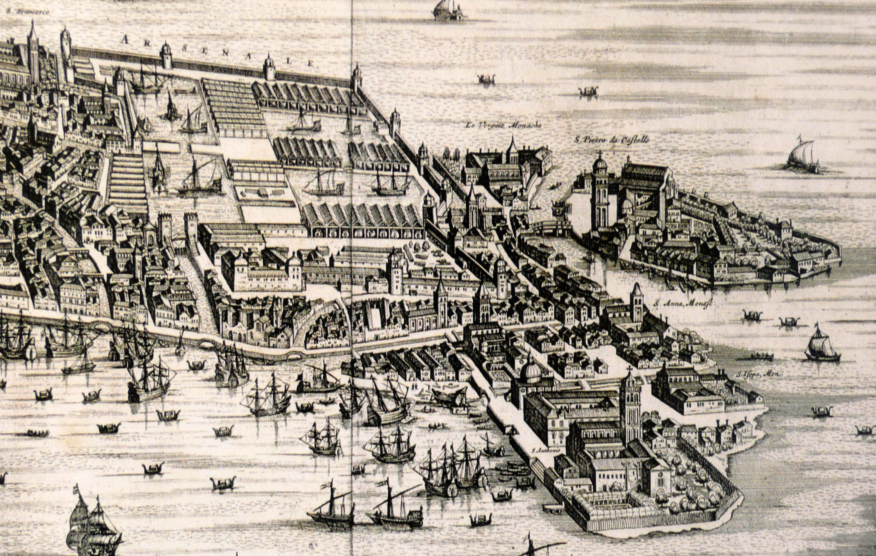
Venetian arsenal, c. 1724

Slide 23
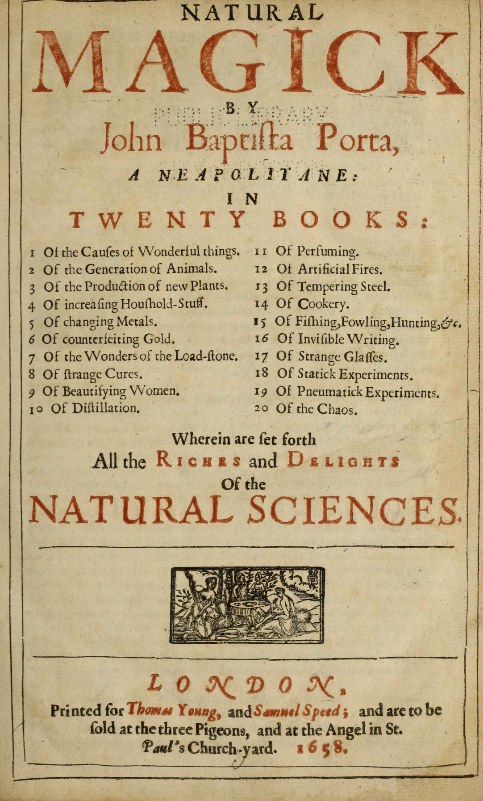
First published 1589
English translation 1658

Slide 24
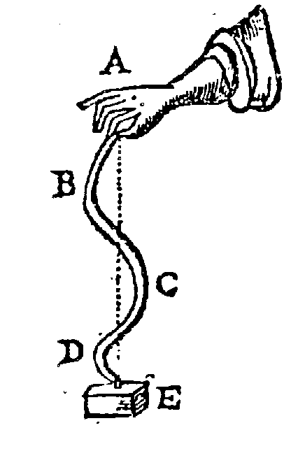
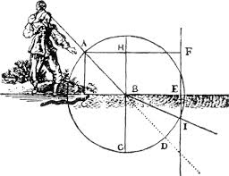
Walking stick and tennis racquet from René Descartes, The World (1664) and Dioptrics (1637)

Slide 25
From Robert Boyle, Experiments and Considerations Touching Colours (1664)

Slide 26
Journal of the History of Ideas, 1992

Slide 27
Hippocrates
Galen
Aristotle
Title-page of Vesalius, On the Fabric of the Human Body (1543)

Slide 28
And no doubt, if the Worship of false Gods had not blinded the Heathen, their moral Philosophy would have gone farther than to the four Cardinal Virtues; and instead of teaching the Transmigration of Souls [ie. reincarnation], and to worship the Sun and Moon, and dead Heroes, they would have taught us to worship our true Author and Benefactor, as their Ancestors did under the Government of Noah and his Sons before they corrupted themselves
-- last sentence in Newton’s Opticks, 1704

Slide 30
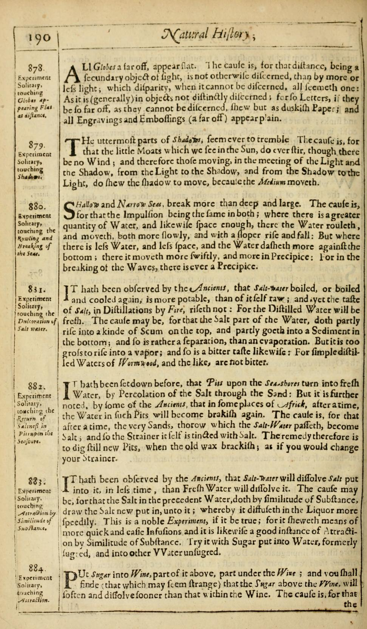
From Francis Bacon, Sylva Sylvarum: Or, a Natural History, in Ten Centuries (first published 1627)
Cf. Bacon, New Organon (1620)

Slide 31
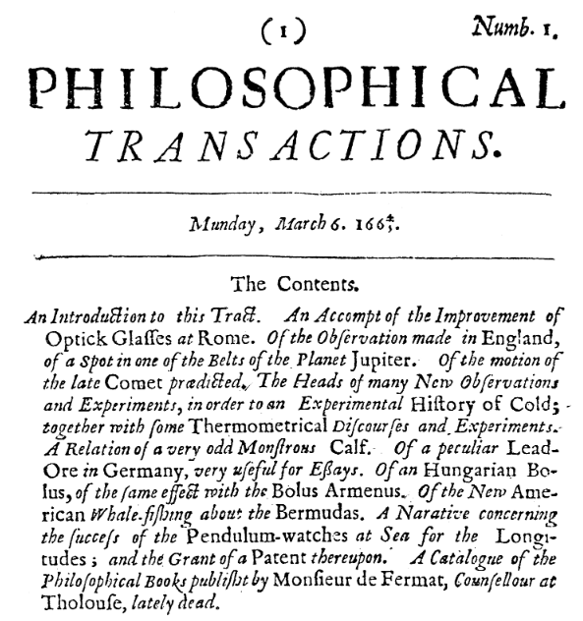
Volume 1, number 1 of the Philosophical Transactions of the Royal Society of London, 1664

Slide 32
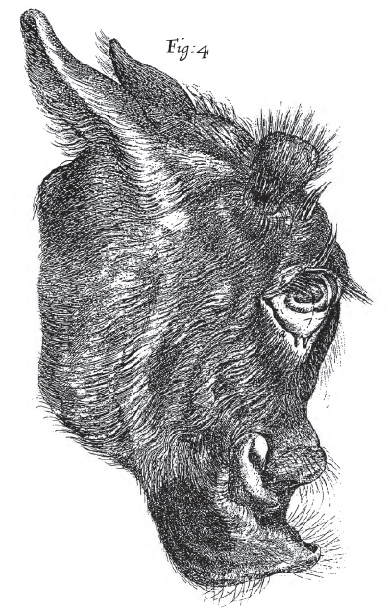
From Robert Boyle, “Observables Upon a Monstrous Head”, Phil. Trans (1665)

Slide 33
…a compilation, or particular natural history, must be made of all monsters and prodigious births of nature; of every thing, in short, which is new, rare, and unusual in nature.
-- Francis Bacon, New Organon (1620)

Slide 34
Walking stick and tennis racquet from René Descartes, The World (1664) and Dioptrics (1637)

Slide 35
From Robert Boyle, Experiments and Considerations Touching Colours (1664)

Slide 36
Although I am not able to give a solid judgment of the Art of Micrography…yet of this I am confident, that this same Art, with all its Instruments, is not able to discover the interior natural motions of any part or creature of Nature;
nay, the question is, whether it can represent yet the exterior shapes and motions so exactly, as naturally they are; for Art doth more easily alter then inform:
As for example; Art makes Cylinders, Concave and Convex-glasses, and the like, which represent the figure of an object in no part exactly and truly, but very deformed and misshaped
-- Margaret Cavendish, Duchess of Newcastle, Observations Upon Experimental Philosophy (1666)

Slide 37
…there was a party arising in the Society [the RSL], that were for rejecting all kinds of useful knowledge except ranking and filing of shells, insects, fishes, birds, etc., under their several species and classes; and this they termed Natural History, and Investigating Nature
-- William Molyneux, Fellow of the RSL (writing in 1686)

