Slide 1
Human nature and the Enlightenment
HI2D5 week 8
18/11/2019
Dr. Michael Bycroft

Slide 2
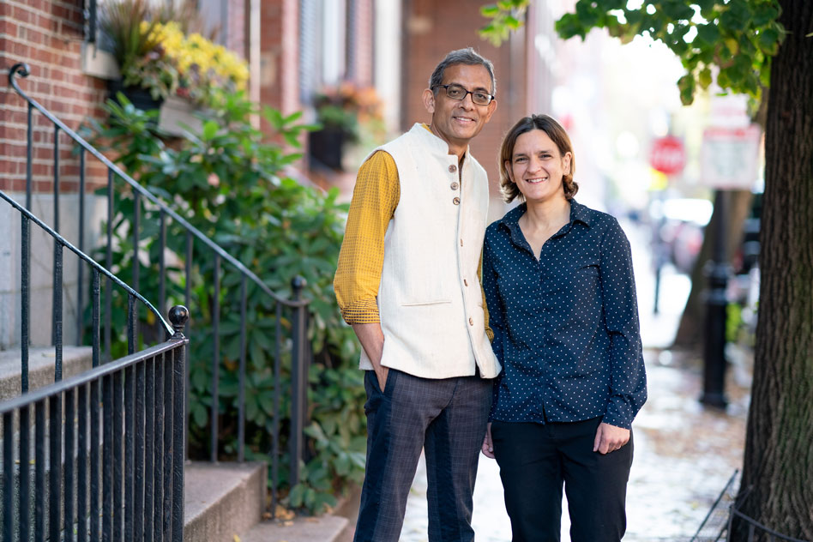
Esther Duflo and Abhijit Banerjee, MIT economists, co-winners of the Nobel Prize in economics 2019 "for their experimental approach to alleviating global poverty."

Slide 3
1. The science of human nature
2. Assumptions about human nature
3. Race science in the 18th century
4. Race science today

Slide 4
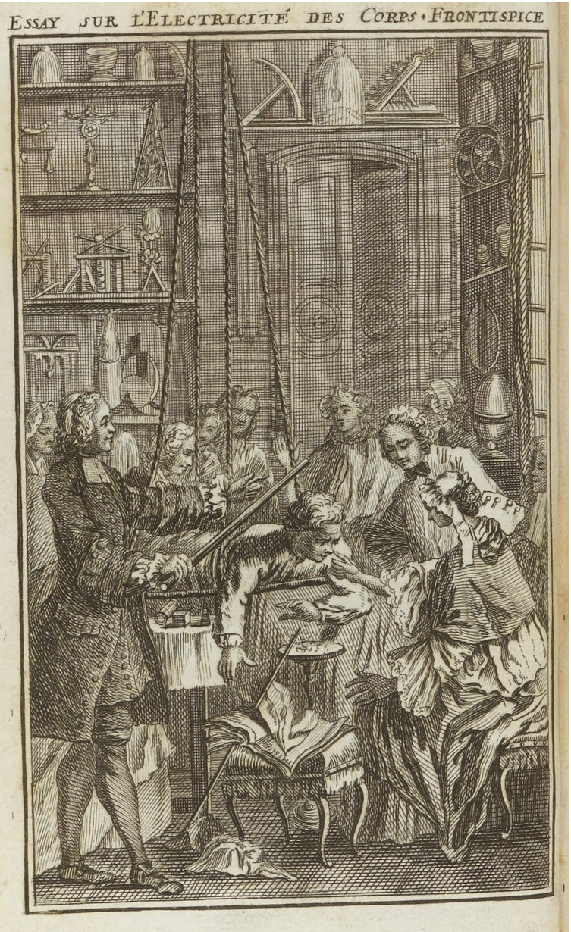
Jean-Antoine Nollet, Essay on the electricity of bodies (1746)

Slide 5
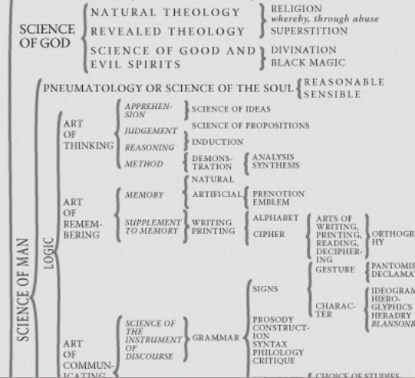
Extract from Denis Diderot and Jean Le Rond d’Alembert, Encyclopédie, 1749
Notes:
Traditionally study of mind or soul seen as part of theology, science of God. Soul was incorporeal, considered alongside other incorporeal substances like God and angels.
Began to change in 18C. Part of science of man, or even science of nature.

Slide 6
And as the science of man is the only solid foundation for the other sciences, so the only solid foundation we can give to this science itself [ie. ‘the science of human nature’] must be laid on experience and observation.
It is no astonishing reflection to consider, that the application of experimental philosophy to moral subjects should come after that to natural at the distance of above a whole century.
David Hume, A Treatise of Human Nature, 1739-40

Slide 7
Hans Sloane, A Voyage to Jamaica (London, 1707-1725)
Bernard de Mandeville, The Fable of The Bees (London, 1714)
Montesquieu, Persian Letters (Bordeaux, 1721)
Carl Linnaeus, System of Nature [botanical book] (Uppsala, 1735)
David Hume, Treatise of Human Nature (Edinburgh, 1739-40)
Jean-Jacques Rousseau, Social Contract and Emile (Geneva, 1762)
Catharine Macauley, The History of England (London, 1763-1783)
Adam Ferguson, A History of Civil Society (Edinburgh, 1767)
Adam Smith, Wealth of Nations (Glasgow, 1776)
Adam Smith, Theory of Moral Sentiments (Glasgow, 1759)
Mary Wollstonecraft, A Vindication of the Rights of Men (London, 1790)

Slide 8
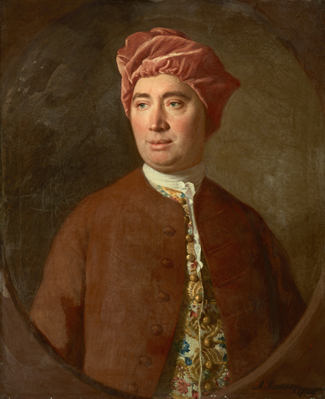
‘Mankind are so much the same, in all times and places, that history informs us of nothing new or strange in this particular. Its chief use is only to discover the constant and universal
principles of human nature, by showing men in all varieties of circumstances and situations and furnishing us with materials from which we may form our observations and become acquainted with the regular spring of human action and behaviour…’
David Hume, Enquiry Concerning Human Understanding
David Hume

Slide 9
1. Hunting – no property, no wealth to accumulate, stage of savagery
2. Pastoral – less mobile but still nomadic, wealth can be accumulated
3. Agriculture -- even less mobile, farmer live on land in own houses, more wealth and greater inequality
4. Commerce – property ownership, laws governing property, complex societies

Slide 10
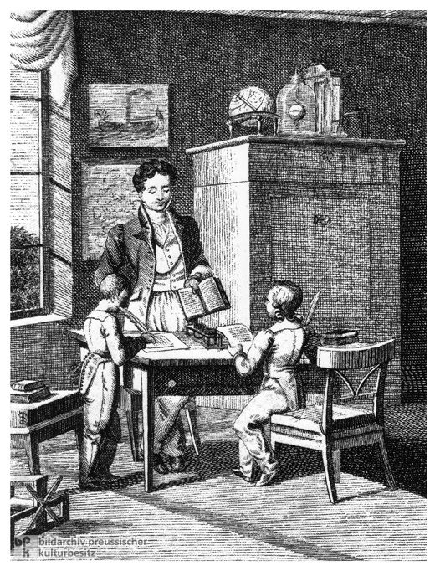
18th-century image showing two children and an instructor

Slide 11

It is not from the benevolence of the butcher, the brewer, or the baker, that we expect our dinner, but from their regard to their own interest.
Adam Smith, Wealth of Nations

Slide 12
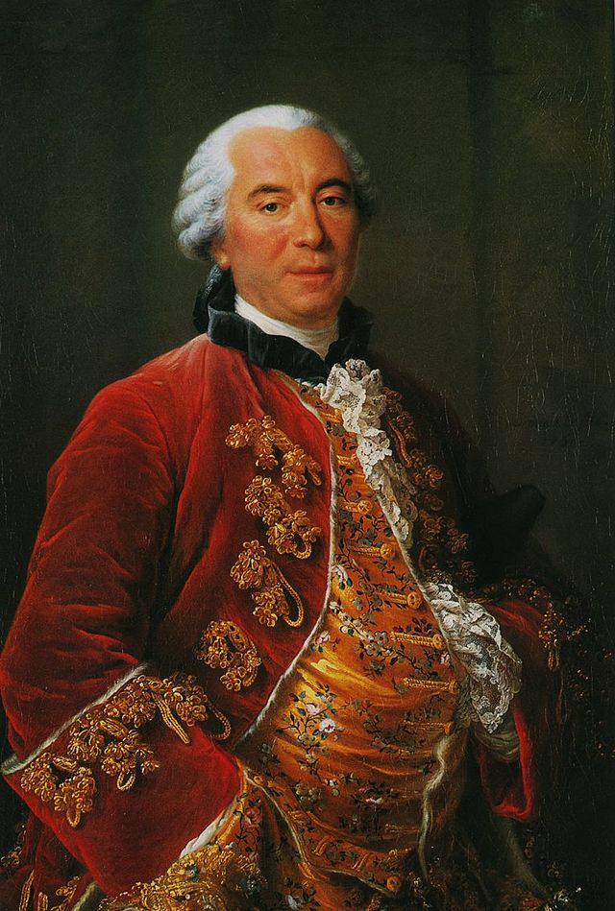
Georges-Louis Leclerc, Comte de Buffon Histoire naturelle, générale et particulière (1749–1788)

Slide 13
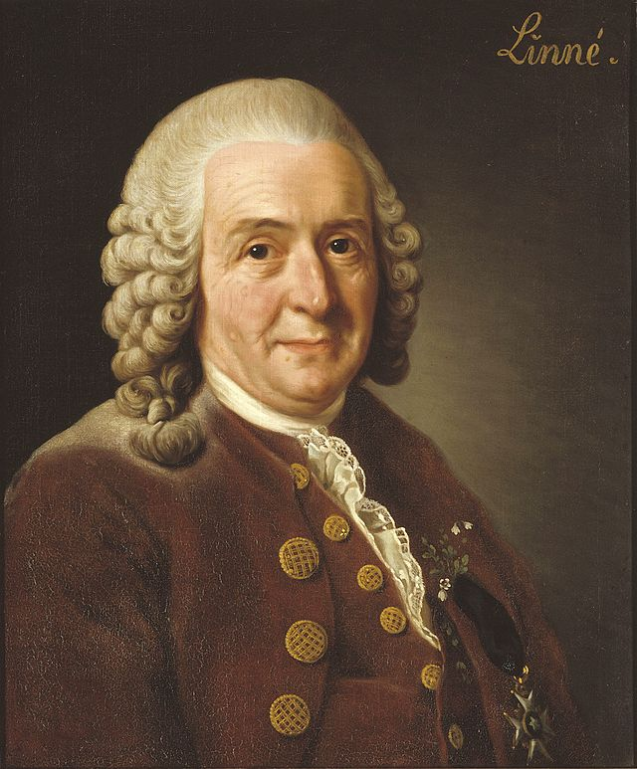
Carl Linnaeus
Systema Naturae (1735)

Slide 14
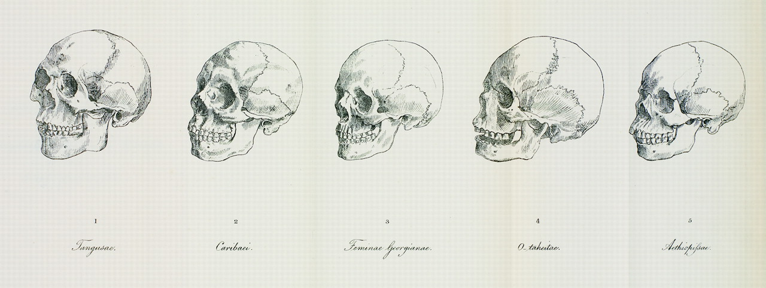
Johann Friedrich Blumenbach, De generis humani varietate nativa (On the Natural Variety of Mankind) (1775)

Slide 15
the Caucasian or white race
the Mongolian or yellow race, including all East Asians and some Central Asians
the Malayan or brown race, including Southeast Asian and Pacific Islanders
the Ethiopian or black race, including sub-Saharan Africans
the American or red race, including American Indians

Slide 16
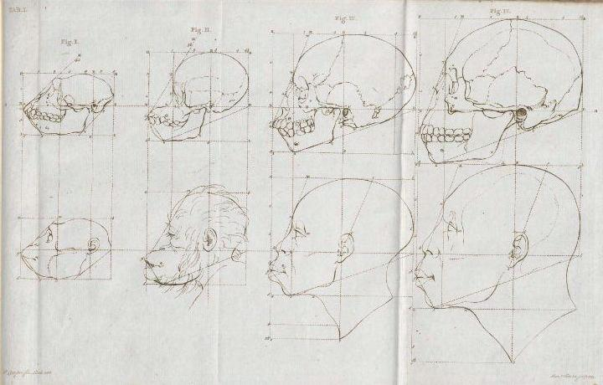
Petrus Camper, Report of the content of two lectures [delivered to the Amsterdam Drawing Academy by the Professor of Anatomy Petrus Camper], delivered 1770, published 1791

Slide 17
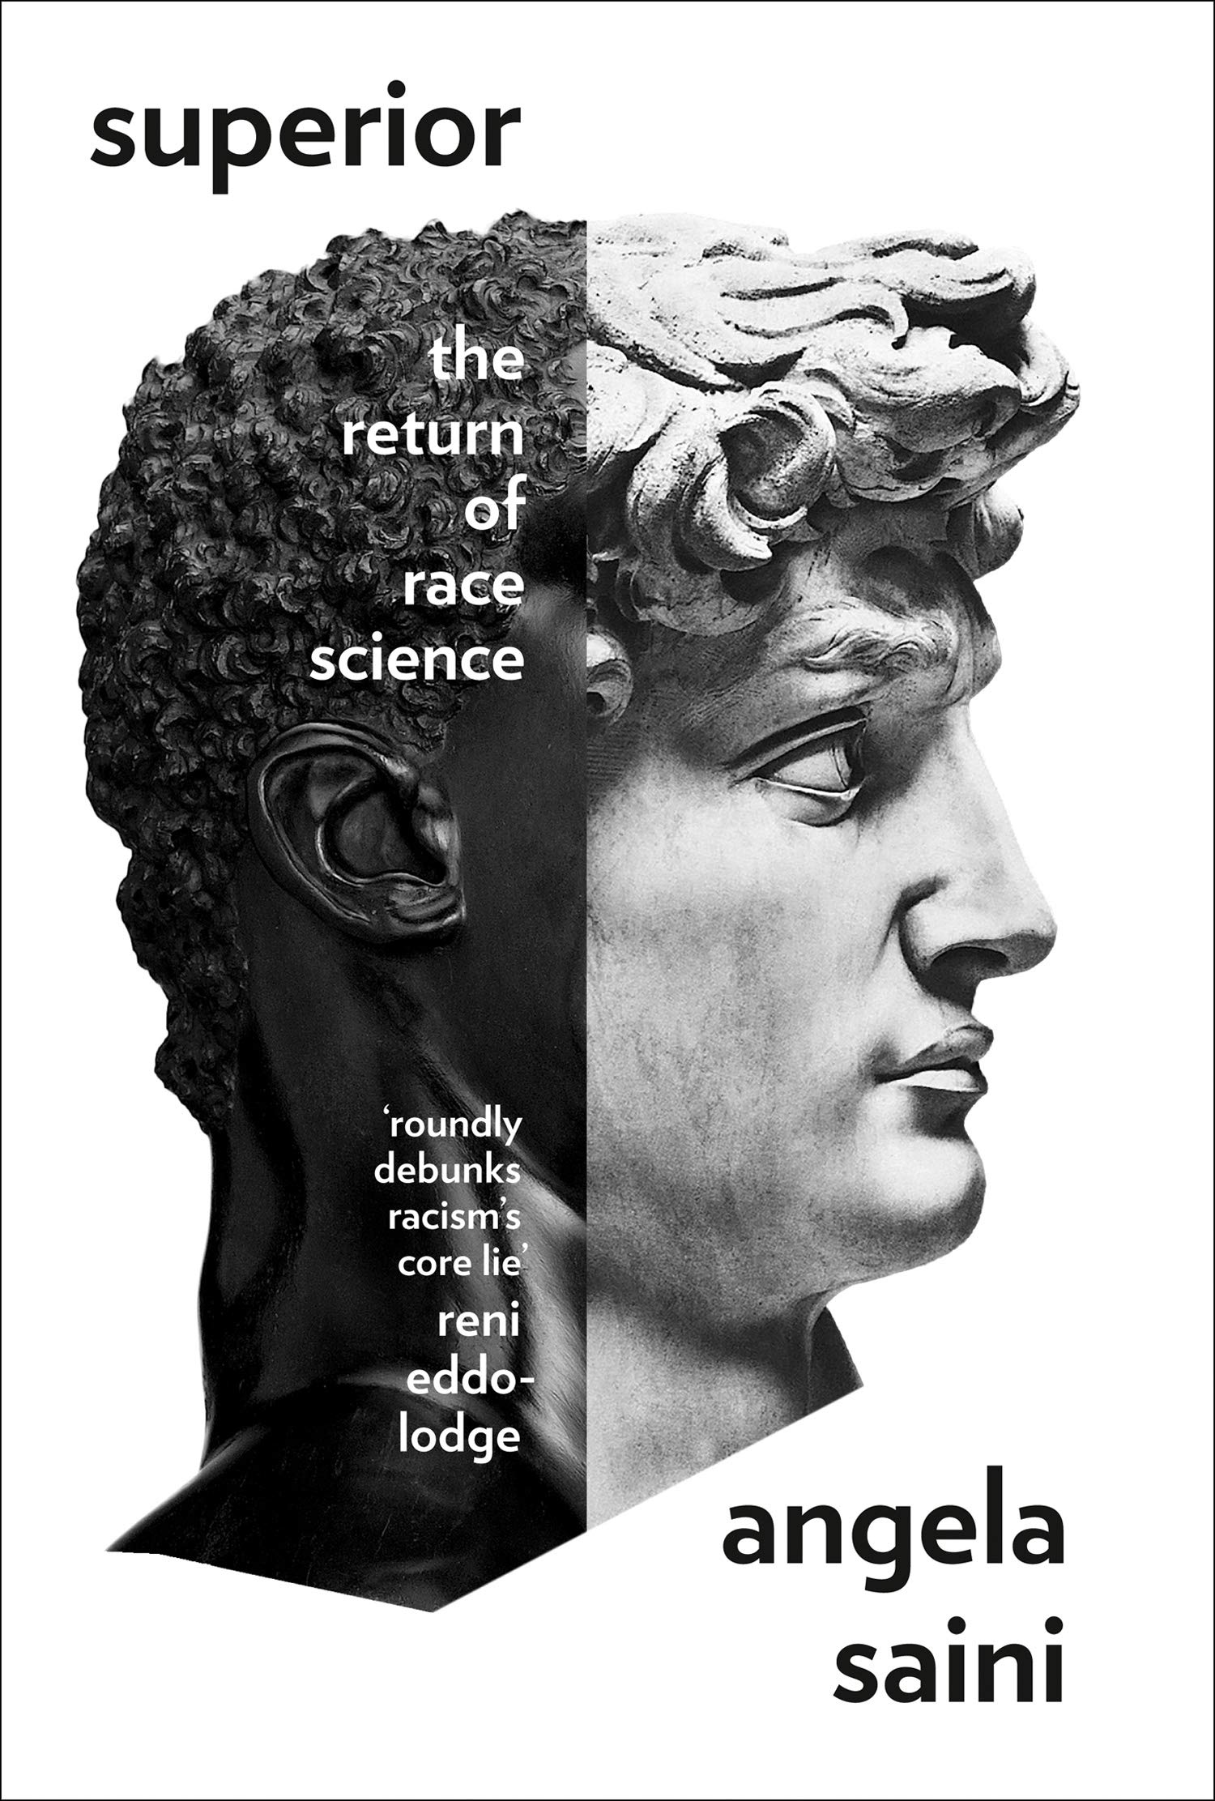
2014

Slide 18
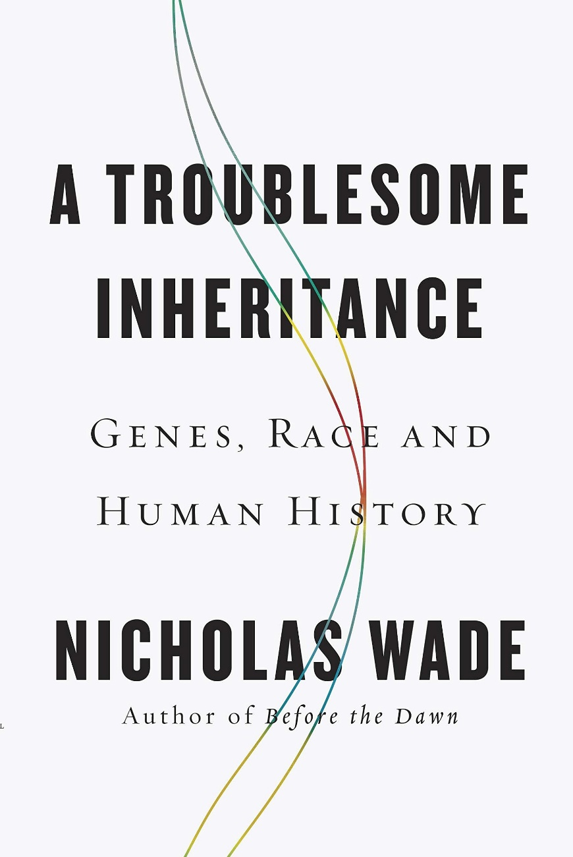
2014

Slide 19
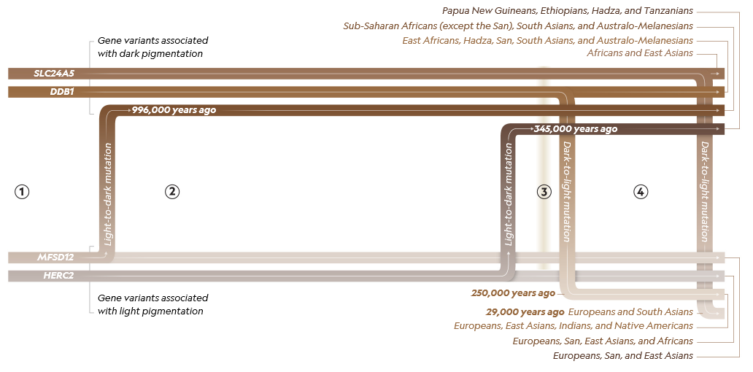
“Ancient Flows of Dark and Light,” in article entitled “There’s No Scientific Basis for Race—It's a Made-Up Label”, in National Geographic, April 2018

Slide 20
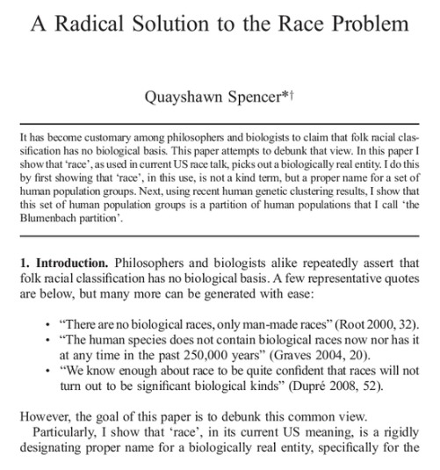
Philosophy of Science, vol. 81, no. 5, 2014

