Slide 1
Letters
The words that bound together the nineteenth-century world

Slide 2
Nineteenth-century transformations
Rising literacy, postal reforms, and technological changes

Slide 3
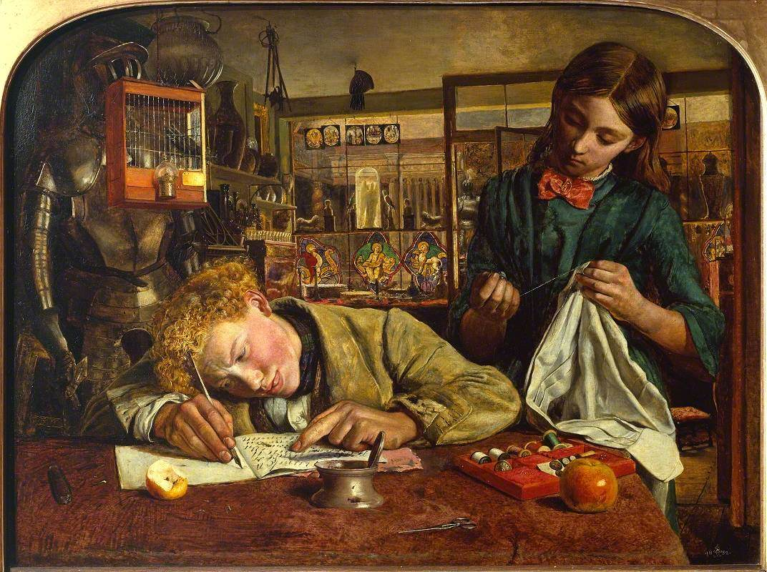
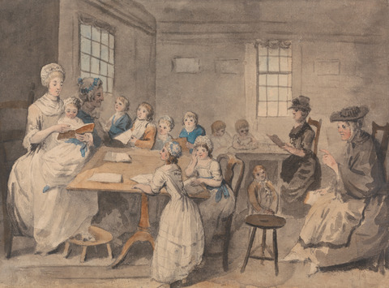
Changing literacy rates
Variety of educational provision in the nineteenth century – charity schools, parish schools, Sunday schools, private schools, dame schools, and academies. Most are privately funded or supported by the Church of England.
Informal traditions of schooling within the home or local community.
Basic literacy difficult to assess – traditionally defined by ability to sign the marriage register.
At the beginning of the nineteenth century, 50% of women are literate while 60-65% of men have basic literacy. After the 1840s, rates of basic literacy rise until universal literacy is achieved by the end of the century.
Top right - Martineau, Robert Braithwaite. Kit’s writing lesson. Oil on canvas, 1852. Tate, London.
Bottom right - Martin, Elias. Reading lesson at a dame school. Graphite, pen and ink, and watercolor. Yale Center for British Art.

Slide 4
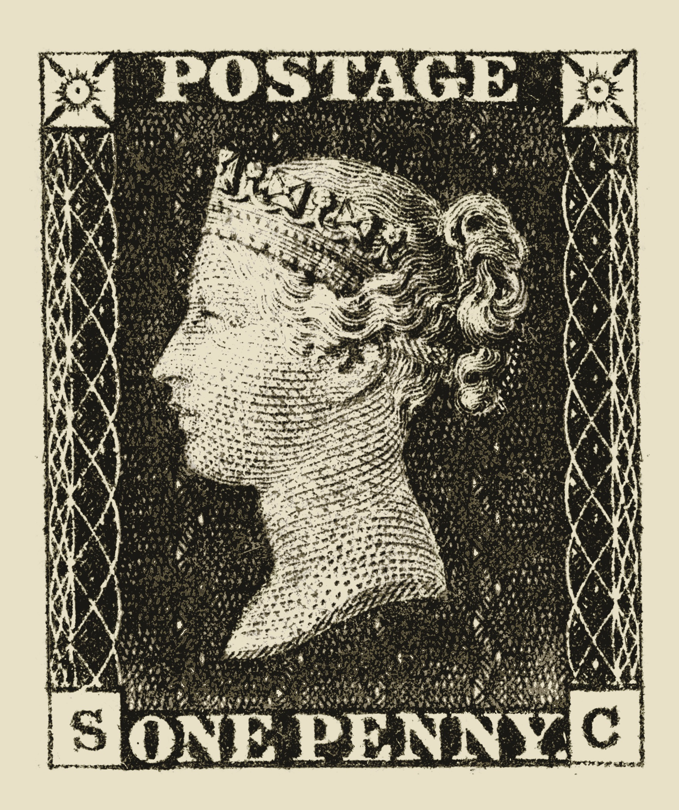
Postal reforms
1835-1839 - Rowland Hill (1795-1879) campaigns to reform postal service
Old postal service: transmitted by mail coaches or messengers on horseback; person who receives the letter has to pay for it; cost depends on number of sheets and distance letter had travelled
New postal service: universal postal rate of one penny per half ounce; payment marked by first adhesive postage stamp, the penny black
1898 Imperial Penny Post
1905 penny post reaches Australia and New Zealand

Slide 5
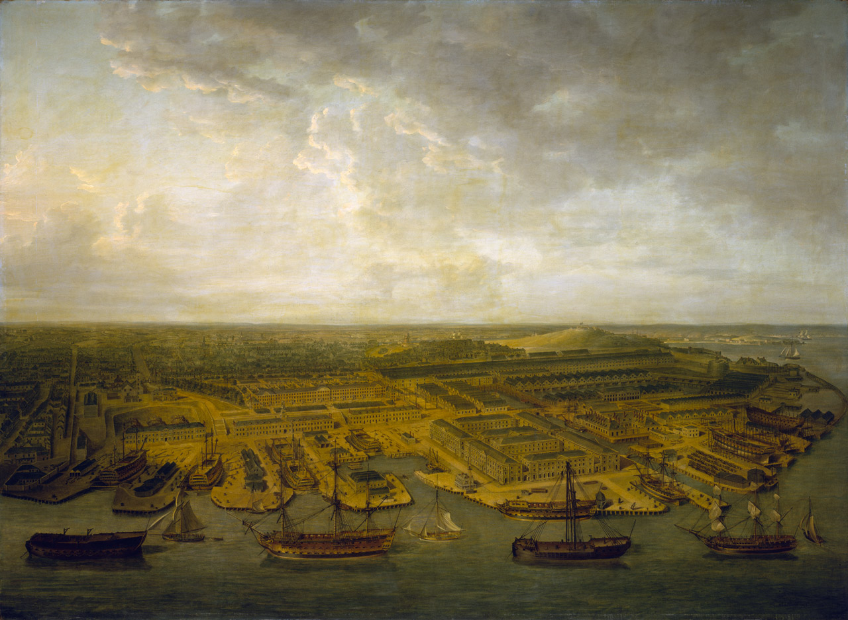
Packet ships
Packet boats in operation as early as the seventeenth century
Packet stations: Dover; Harwich; Great Yarmouth; Falmouth; Plymouth; Milford; Haven; and Holyhead.
Pocock, Nicholas. Plymouth dockyard. Oil painting, 1798. National Maritime Museum, Greenwich, London.

Slide 6
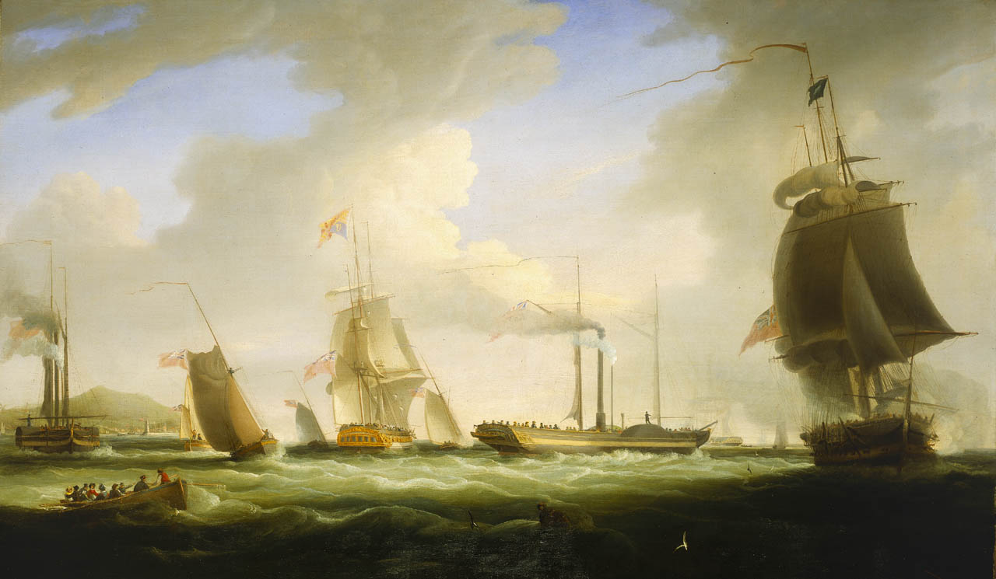
Huggins, William John. George IV on board the ‘Lightning’, the first Post Office Steam Packet to Dublin, 12 August 1821. Oil on canvas. National Maritime Museum, London.

Slide 7
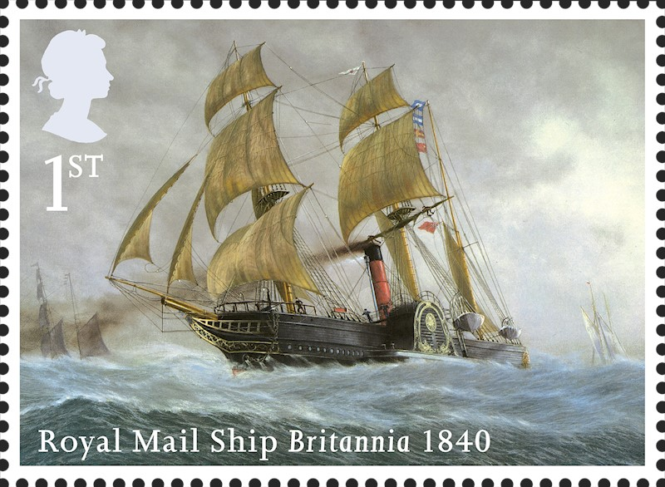
Royal Mail ships
First introduced in 1840, with the first contract for carrying mail awarded in 1850.
Early contracts to the City of Dublin Steam Packet Company (connecting Ireland and Wales) and the Cunard/White Star Line Group.

Slide 8
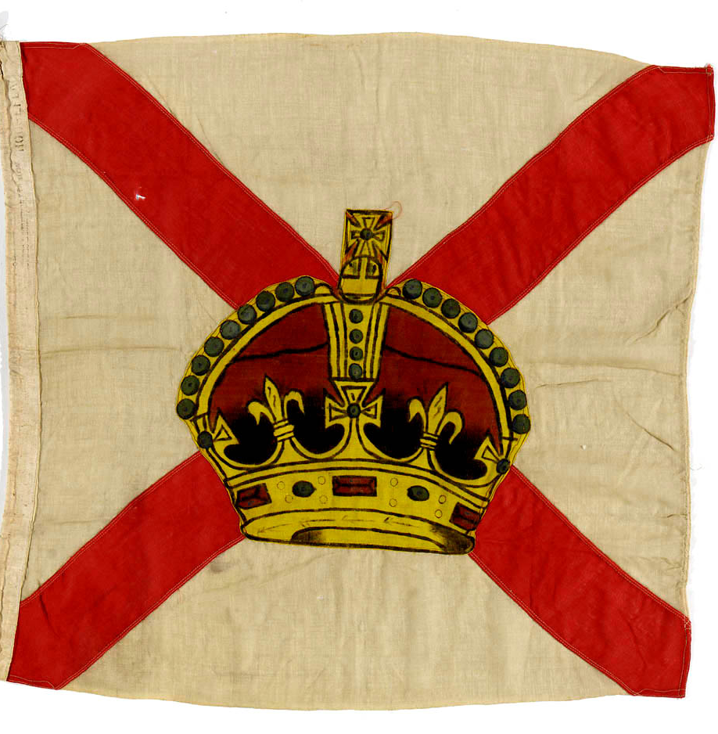
Royal Mail Steam Packet Company
James McQueen, A General Plan for a Mail Communication by Steam between Great Britain and the Eastern and Western Parts of the World (1837)
RMSPC was granted a royal charter in 1839 to carry mail to the West Indies and Central America
House flag of the Royal Mail Steam Packet Company, National Maritime Museum, London.

Slide 9
The nature and function of letters
How have historians thought about letters and letter-writing?

Slide 10
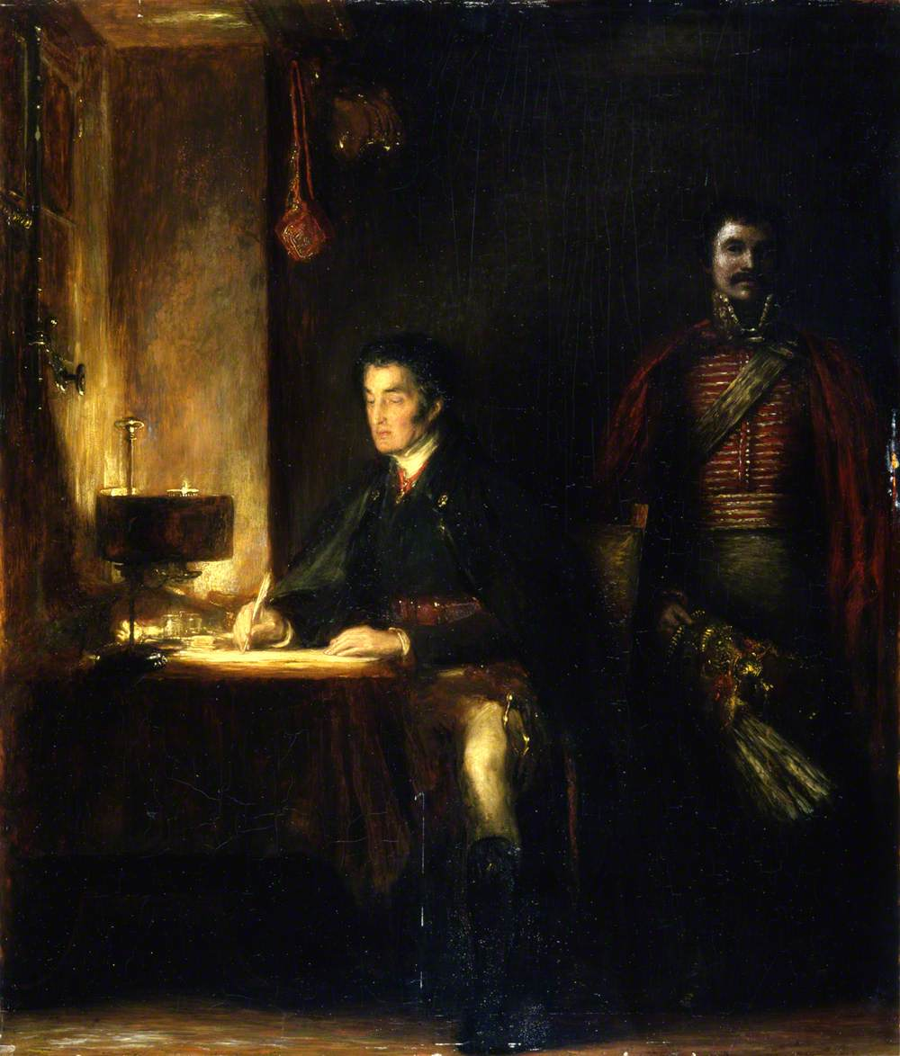
Varieties of letter
Official letter – written in formal language; neatly transcribed on clean paper (often copied out by scribes or secretaries); matter of public record
  Epistolary ceremonial: terms of address, salutations, modes of signing off, page layout, size and quality of paper, all signify status relationships between correspondents
Demi-official letter – writing in informal tones on matters of public import (additional, interpretative layers of opinion)
Familiar letter – personal; written in informal language; might be written messily on scraps of paper, penned by author themselves
Wilkie, David. The Duke of Wellington writing dispatches. 1836. Aberdeen Art Gallery & Museums.

Slide 11
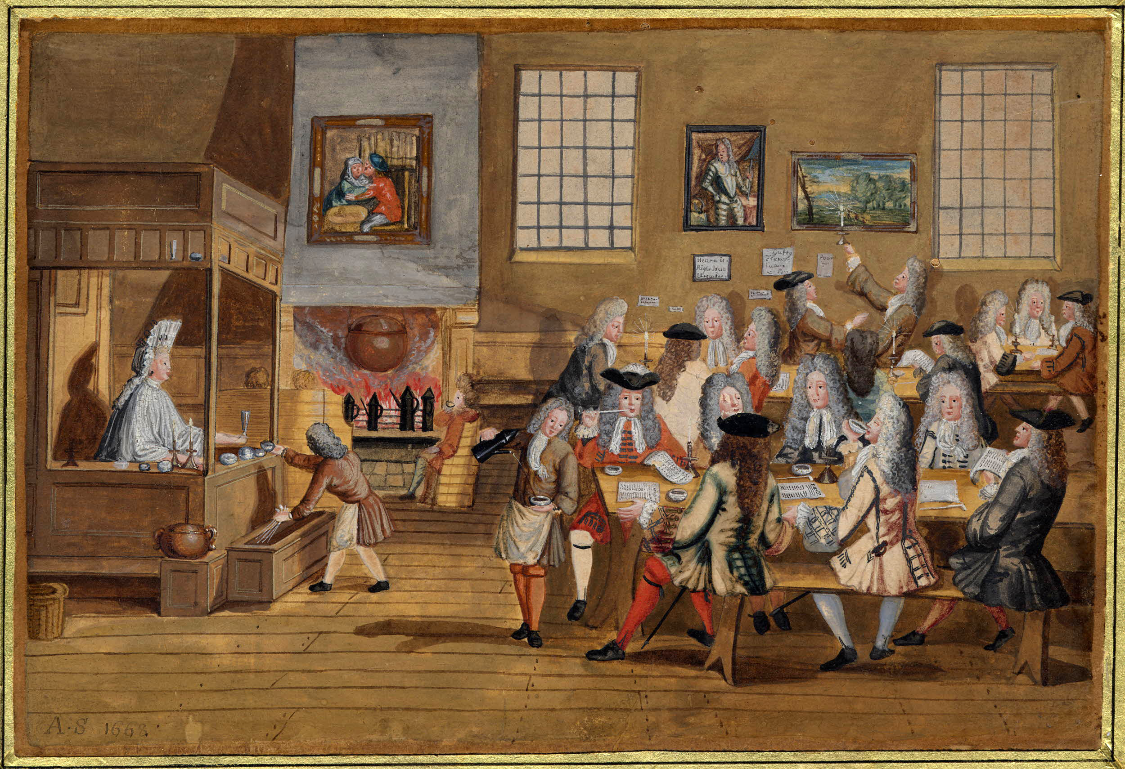
Habermas and the public sphere
Jürgen Habermas (German philosopher and sociologist) and his The Structural Transformation of the Public Sphere (published in German in 1962).
Public sphere – domain of social life where private individuals come together and freely express opinions on matters of general interest. The public sphere provides a counterpoint to the state.
Habermas locates the rise of the public sphere in the eighteenth century, and associates it with spaces like salons and coffee houses.
Unknown artist. Interior of a London coffee-house. 1690-1800. British Museum, London.

Slide 12
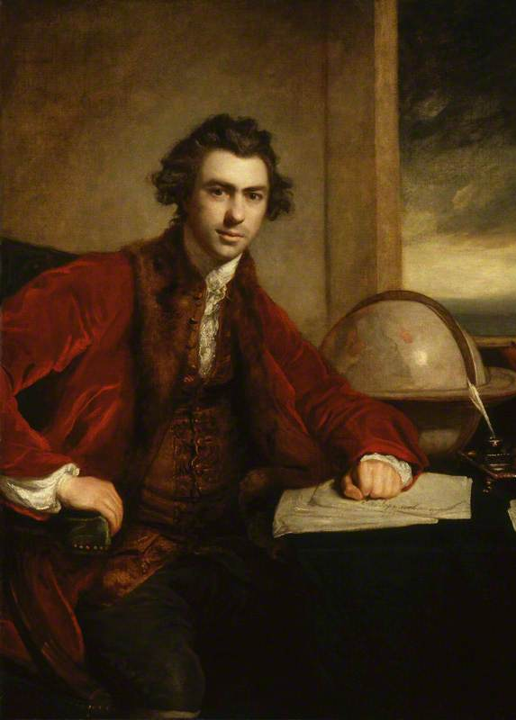
The republic of letters
The sharing, circulation, and publication of letters allowed private persons to enter into the public sphere
Through letters, scientists and intellectuals exchanged information and developed ideas in collaboration
Example of Joseph Banks, President of the Royal Society from 1778-1820 and director of the Royal Botanic Gardens, Key, who exchanged letters with a global network of correspondents on subjects relating to science, manufacture, politics, and trade. The surviving Banks correspondence consists of over 20,000 letters (of which 6,000 are written by him).
Reynolds, Joshua. Sir Joseph Banks. Oil on canvas, 1771-73. National Portrait Gallery, London.

Slide 13
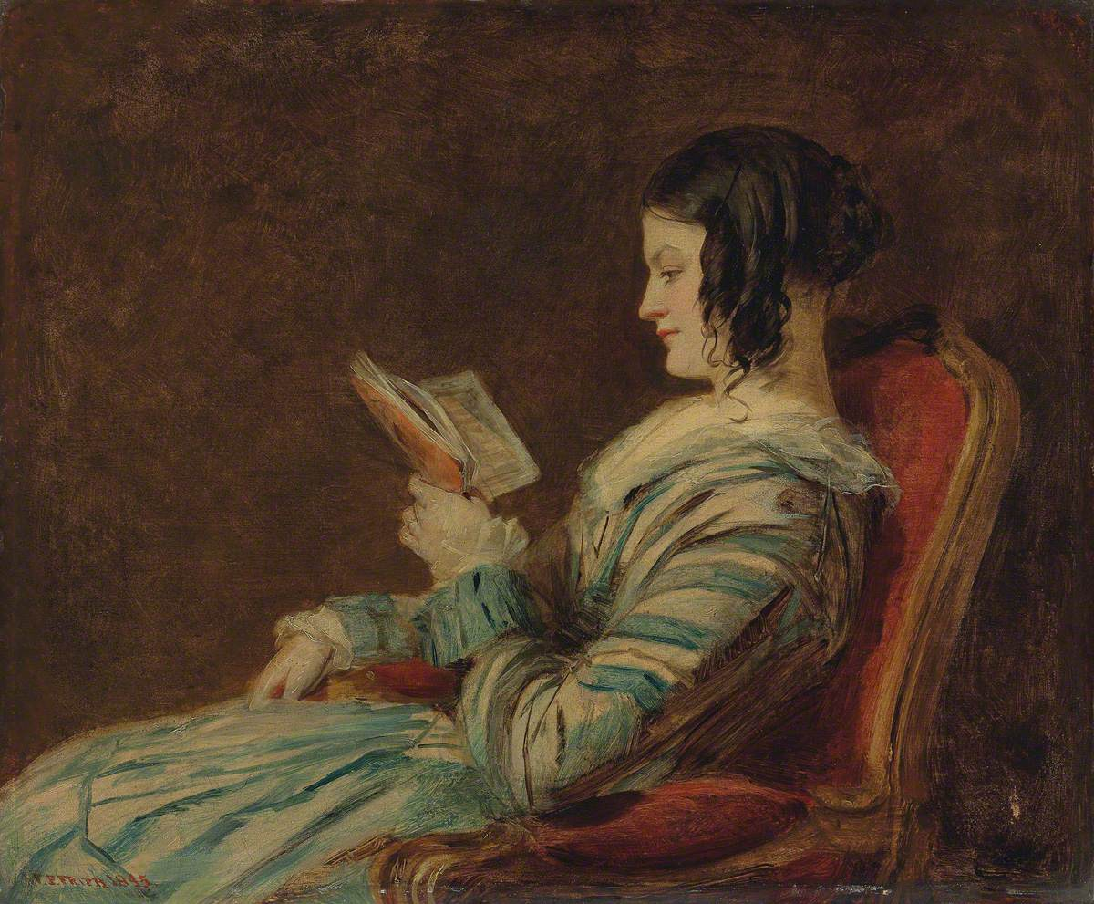
The history of private life
Habermas’ idea of public sphere predicated on idea of the self as a private person, achieved through private practices that developed interiority
Roger Chartier, Phillipe Ariès and the emergence of the private realm through the rise of the state; increased literacy; and new forms of religion
Letter as ‘ego document’
Frith, William Powell. Isabelle Frith, reading. Oil on panel, 1845. Mercer Art Gallery, Harrogate.

Slide 14
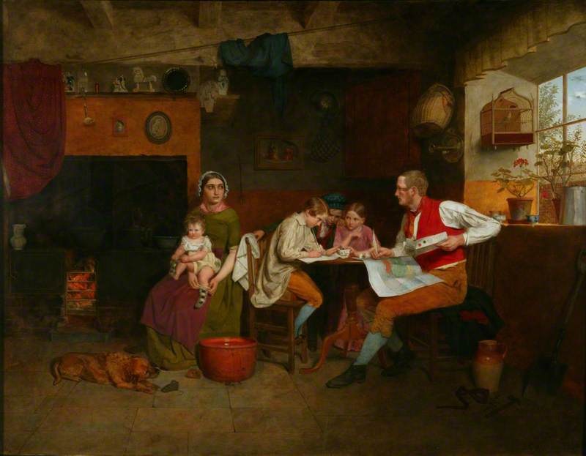
How private is the private letter?
Often written in company
Read aloud
Circulated among friends
Letter as a performance
  Theory of performativity as elucidated by Erving Goffman and Judith Butler
Collinson, James. Answering the emigrant’s letter. Oil on panel, 1850. Manchester Art Gallery.

Slide 15
Letter-writing outside Europe

Slide 16
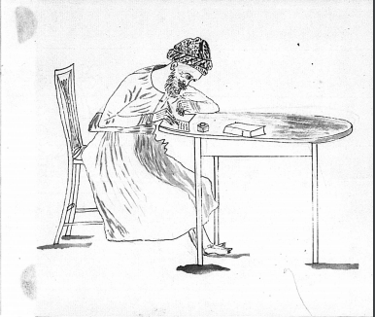
Letter-writing in India and the Persian-speaking world
Persianate insha tradition of belles lettres – rhymed prose, verse, figurative language, rhetorical embellishment
Dak – courier system relying on professional runners (harkaras) overseen by postmasters
1837 postal act – East India Company’s suppression of indigenous and unofficial mail services
Indian Postal Act of 1854 – ended practice of levying post according to distance, introduced postage stamps and an India-wide penny post.
Indian Postal Act of 1898 – granted postmasters greater powers to investigate suspicious correspondence
Sketch of a munshi by Jasper Nicholls, Oriental and India Office Collections, British Library, London.

Slide 17
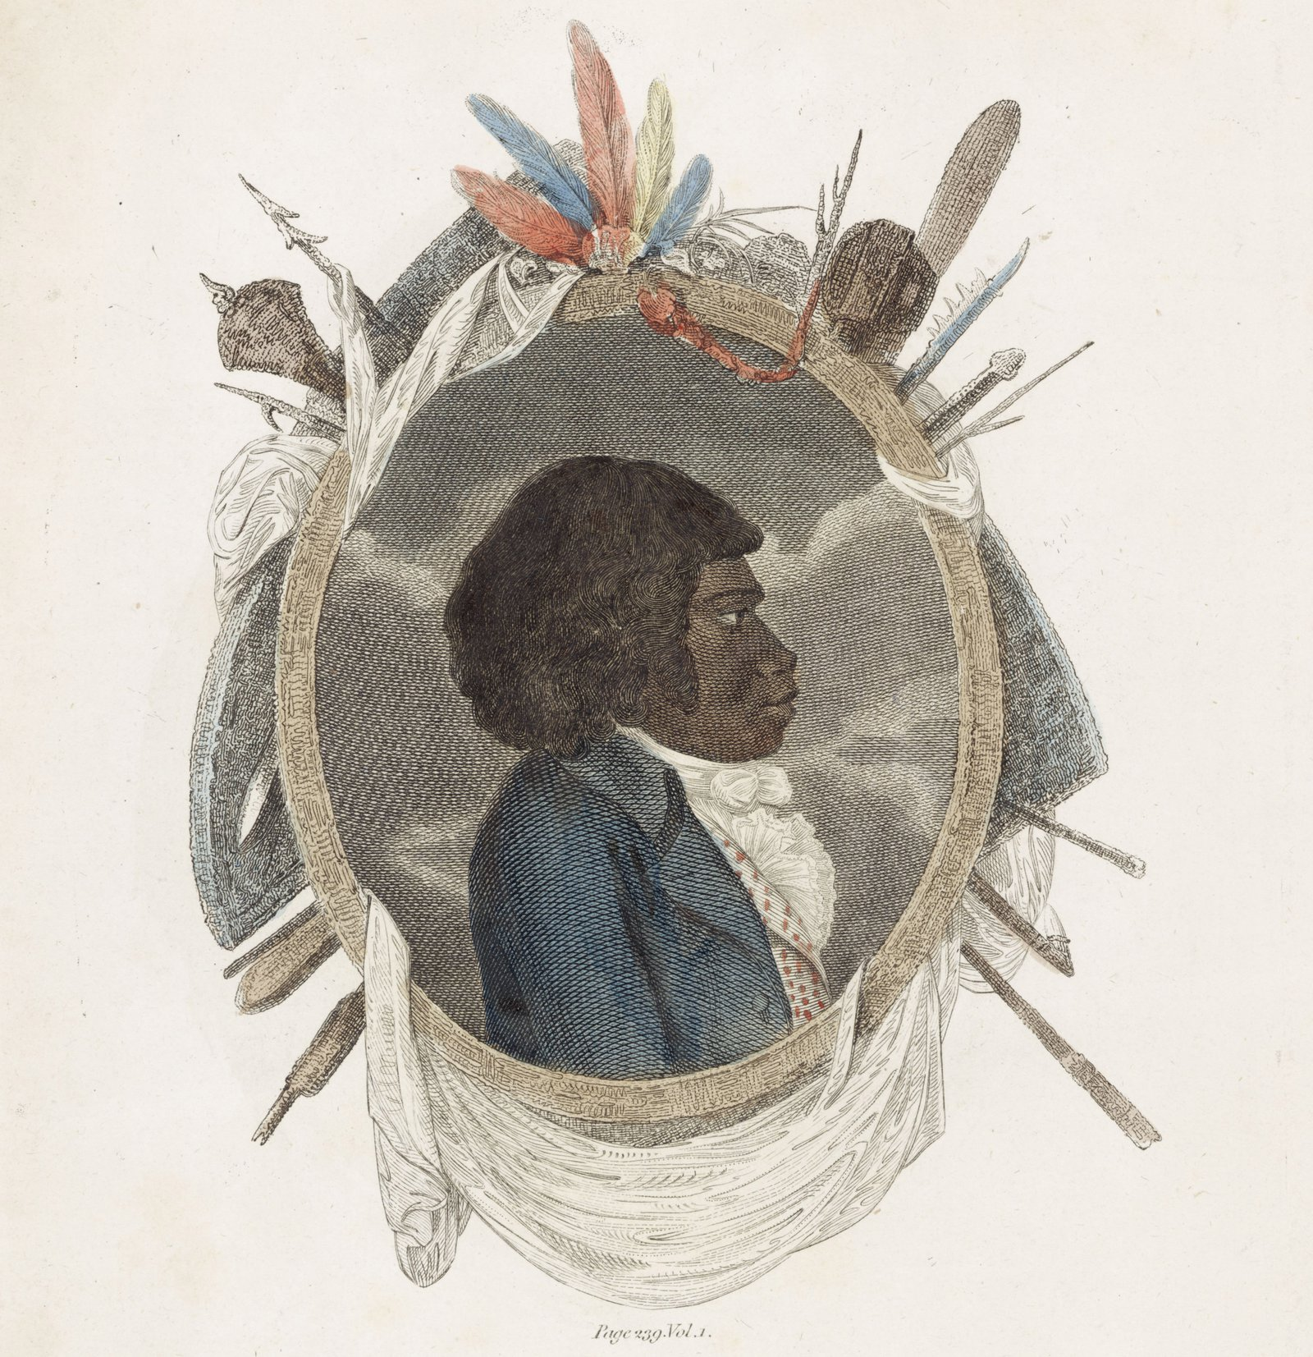
Nonliterate societies
Although reading and writing might be foreign to these communities, they quickly appropriate letter-writing as a political tool.
‘Tin trunk literacy’ or ‘vernacular literacy’ – ability to bend practices of reading and writing to one’s needs, without perhaps being fully literate.
Cooke, George Alexander. Portrait of Bennelong. 1798. National Library of Australia.

