Slide 1
Connections, Communications, and Technological Change across the British Empire
Dr Callie Wilkinson

Slide 2
Seminar Programme
Technologies
Media
Wind and Sail
Steamships
Railways
Telegraph
Letters
Newspapers
Photographs

Slide 3
Assessment
10% class participation
40% group project
50% final essay (3000 words)

Slide 4
A Whirlwind Tour of the British Empire, 1780-1914

Slide 5
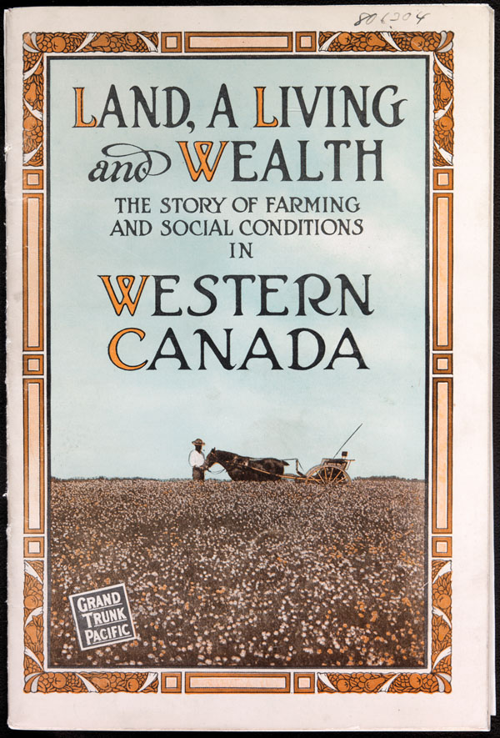
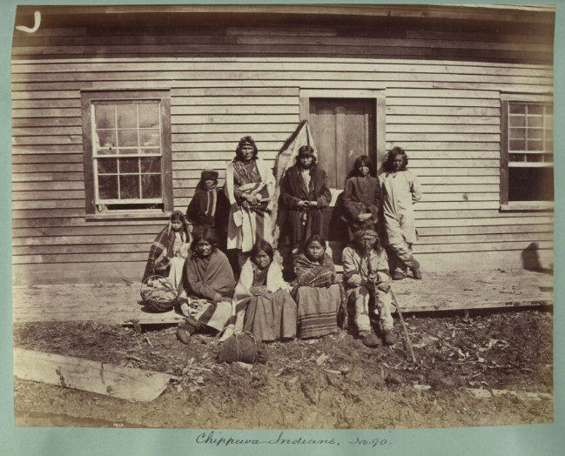
Settler Colonies
Bound pamphlet. Winnipeg: General Passenger Dept., Grand Trunk Pacific Railway, 1913. Canadian National Railways.
Chippewa Indians, Canadian-US border, 1876. National Archives UK Collections.

Slide 6
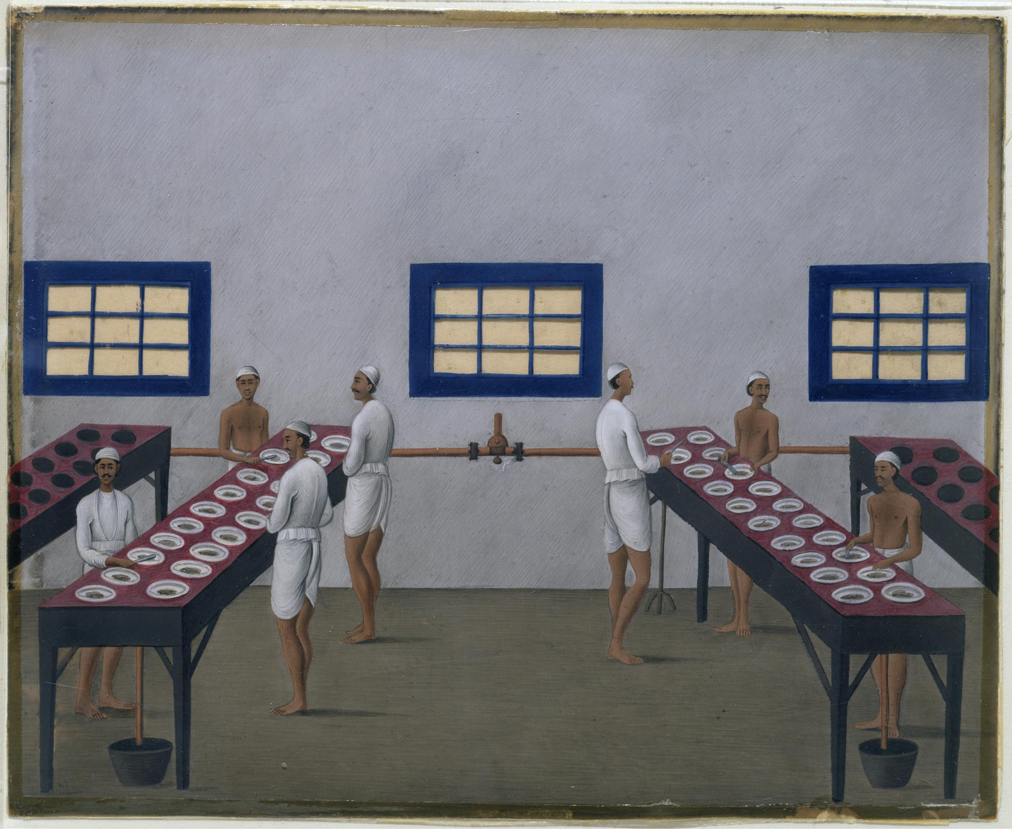
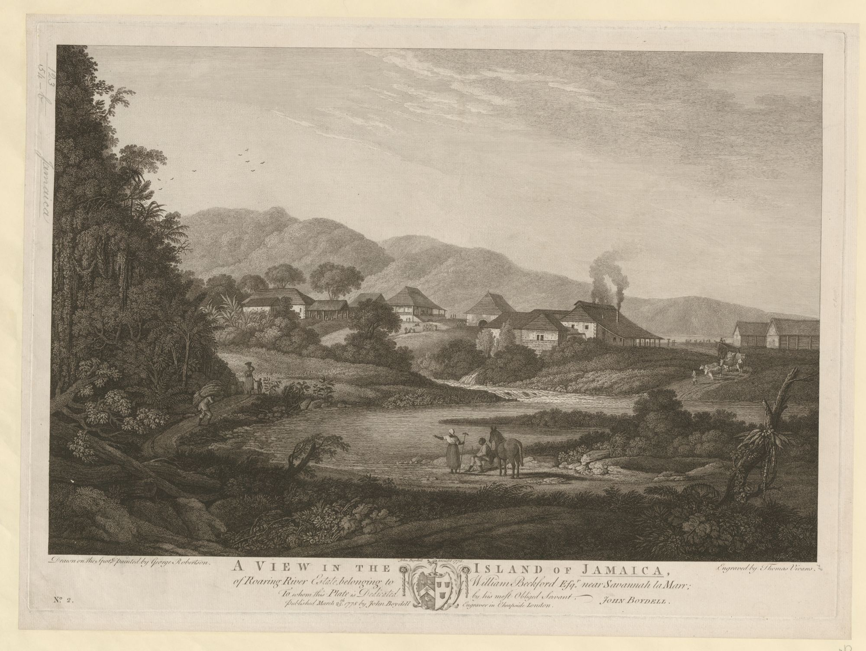
Colonies of Exploitation
Shiva Daya Lal. Opium processing at Gulzarbagh, Patna, in Bihar. ca. 1857. Gouache on mica. Victoria & Albert Museum Collections.
Robertson, George. A View in the Island of Jamaica, of Roaring River Estate, Belonging to William Beckford Esq. near Savannah la Marr. 1778. Engraving. British Library, London.

Slide 7
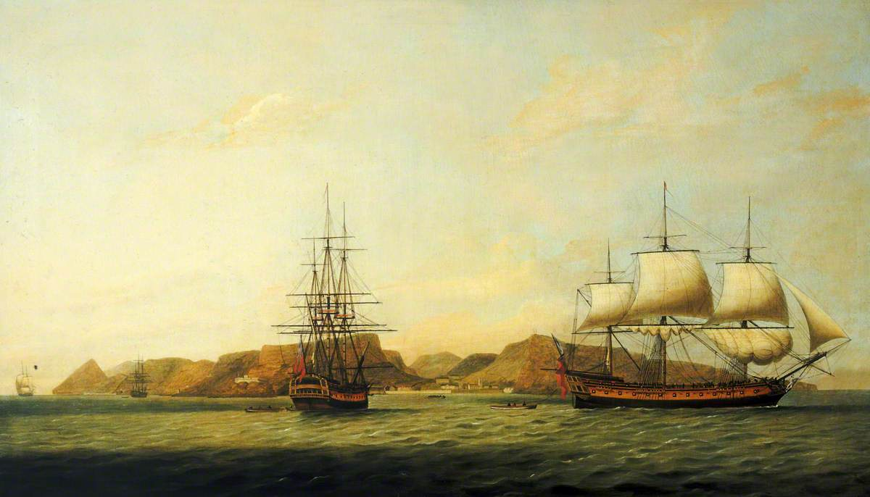
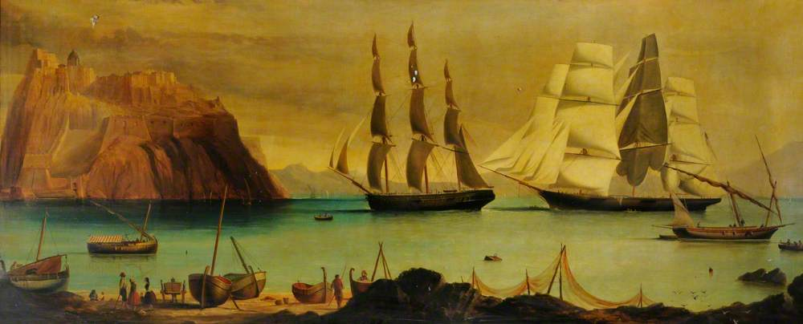
Imperial Outposts
Unknown artist. Ships off Gibraltar, 1800. Hull Maritime Museum.
Thomas Luny. The East Indiaman ‘Northumberland’ off Saint Helena. National Maritime Museum, Greenwich, London.

Slide 8
Networks and Counter Networks

Slide 9

Actor-Network Theory
Key figures: Michel Callon, Bruno Latour, and John Law.
Emphasis on relationships and interactions between human and non-human actors.
Bruno Latour at his home in Paris. Christopher Anderson/Magnum, for the New York Times.

Slide 10
Imperial Networks – Key Concepts
Contingent
Multiple
Assemblages
Lumpy
Processual
Space
Mobility
Materiality

