Slide 1
Photography
A window onto history?

Slide 2
Technological developments

Slide 3
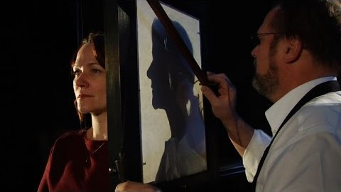
https://youtu.be/me5ke7agyOw

Slide 4
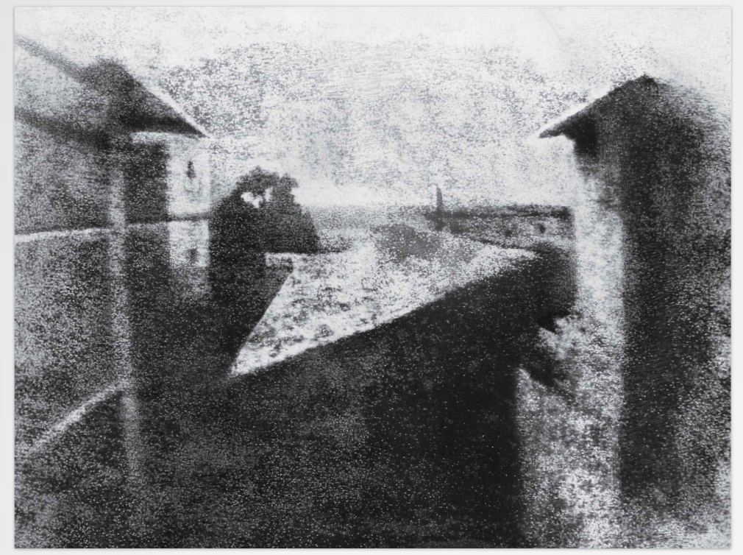
Heliography
Niépce, Joseph Nicéphore. View from the Window at Le Gras. 1826. TIME Magazine.

Slide 5
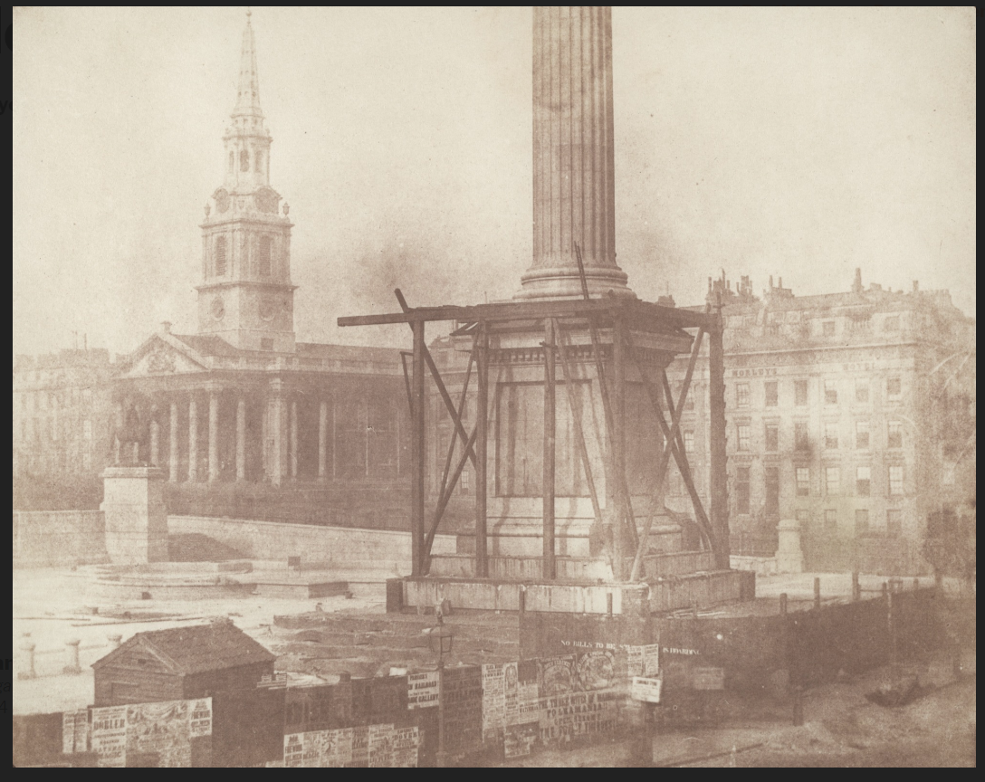
Calotype
Talbot, William Henry Fox. Trafalgar Square, London, during the Erection of the Nelson Column, c. 1844. MoMA.

Slide 6
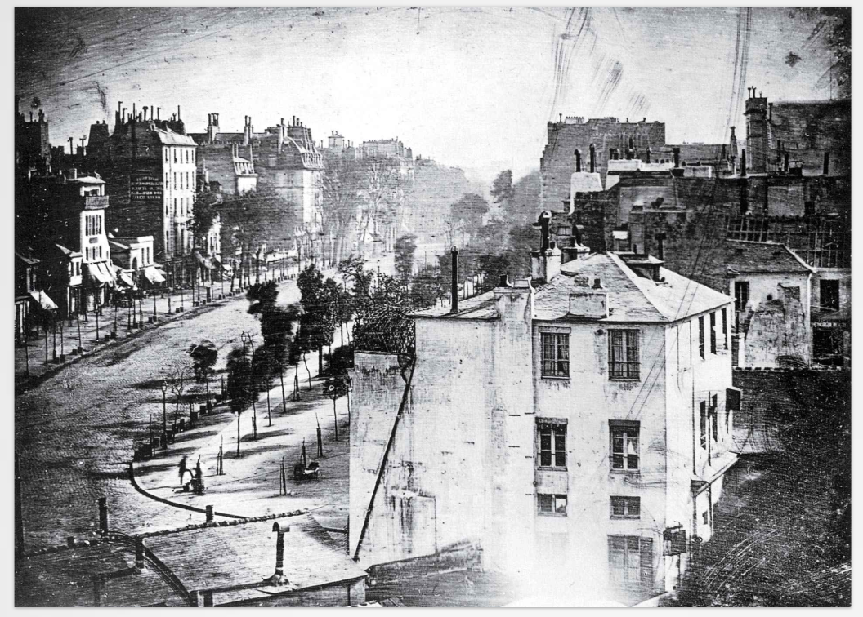
Daguerreotype
Daguerre, Louis. Boulevard du Temple. 1839. TIME Magazine.

Slide 7
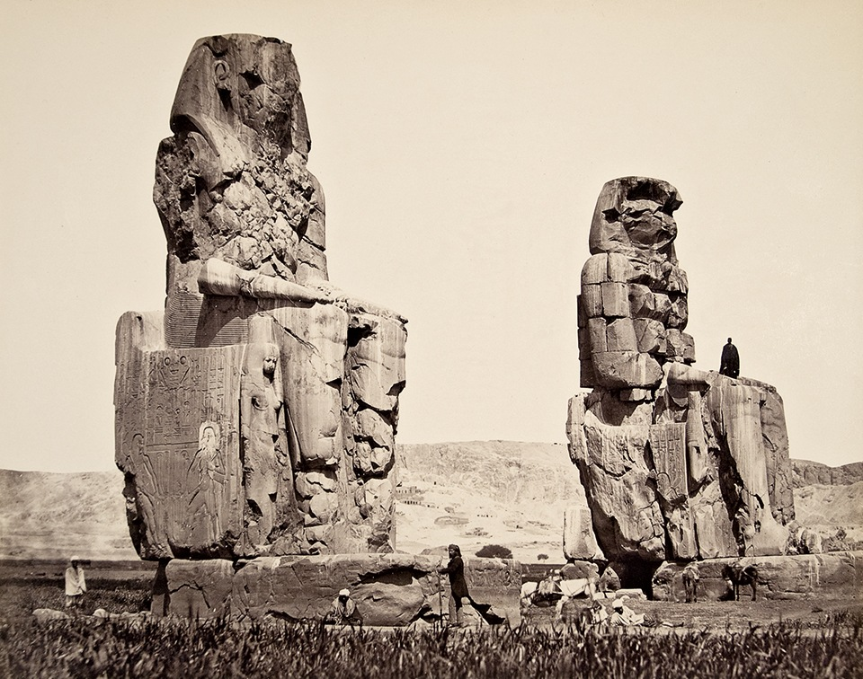
Wet collodion process, printed on albumen paper
Frith, Francis. The Statues on the Plain Thebes, 1857. Albumen print. Tate, London.

Slide 8
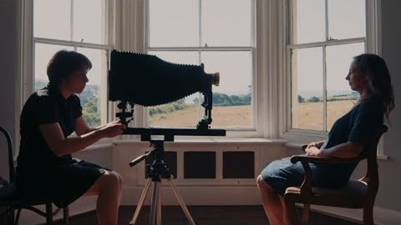
https://youtu.be/pNyQ0nfMsxo

Slide 9
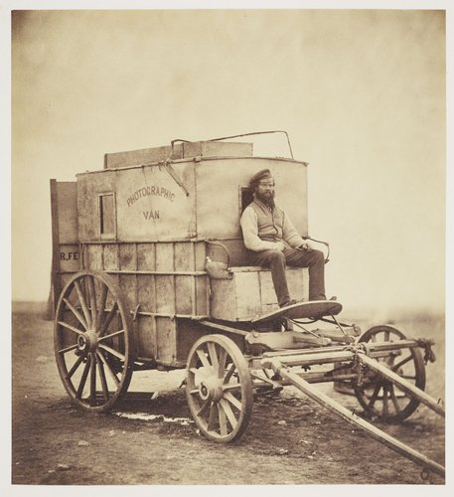
Fenton, Roger. Photographic Van. 1855. Albumen print. Royal Collection Trust.

Slide 10
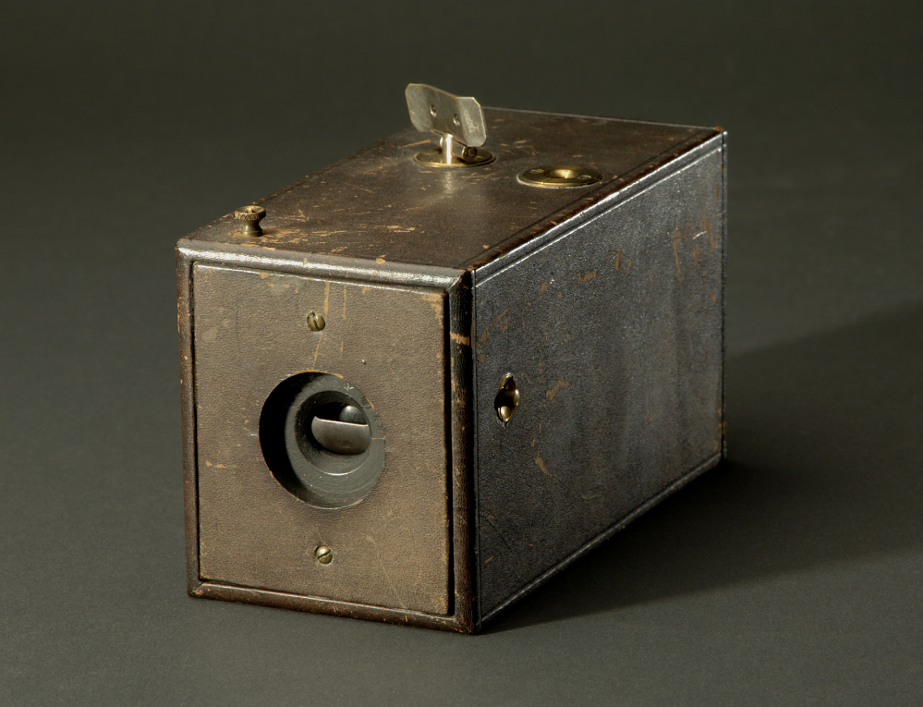
Original Kodak camera, 1888. Eastman Dry Plate and Film Company. 95 mm x 83 mm x 165 mm. National Museum of American History.

Slide 11
History of Photography
Daguerrotype (1839) – uses a silver plate to produce more detailed images; popular until the 1850s.
Calotype (1840) – salt prints on paper; used a negative permitting multiple positive prints to be made from the negative and development of the latent image.
Wet collodion process (1851) – high resolution of detail. Combined with albumen printing paper, permits more detail and contrast than older salted papers. The albumen print would be the most common type of print for the next 40 years.
Gelatin dry plate (1871) – allows plates to be prepared in advance and developed long after exposure, eliminating the need for a portable darkroom. Increased speed made a tripod unnecessary.
Kodak camera (1888) – simple handheld camera accelerating the growth of amateur photography. Reliant on rolls of film, process originated by George Eastman in 1885.

Slide 12
Genres of photography

Slide 13
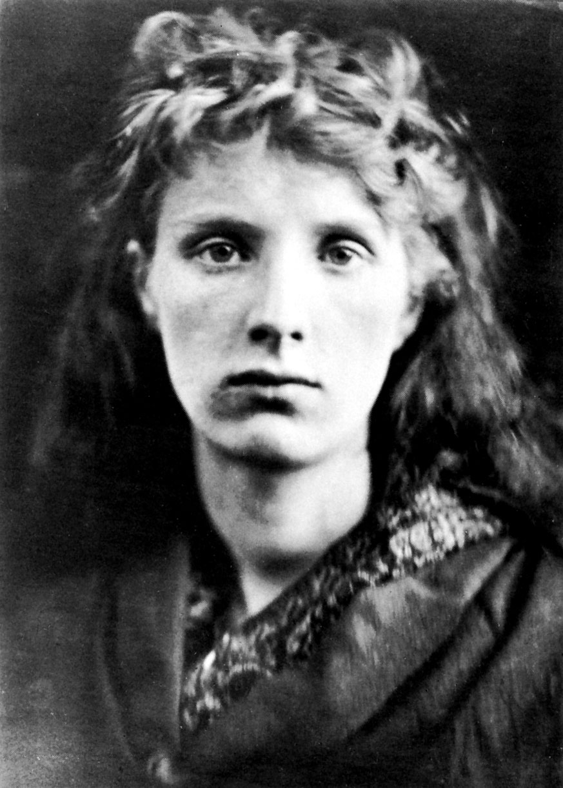
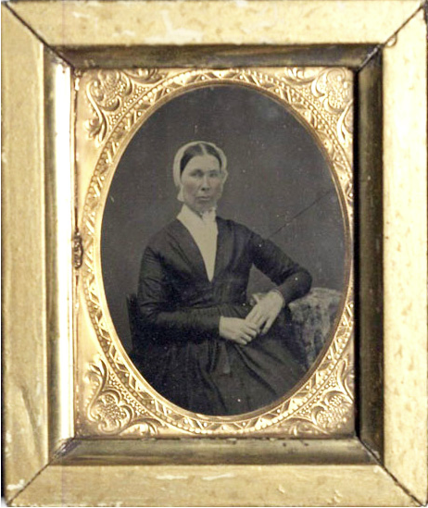
Ambrotype with broken plate. Nineteenth-Century Photograph Collection, CSUN Oviatt Library.
Portraiture
Cameron, Julia Margaret. The Mountain Nymph, Sweet Liberty. 1867. George Eastman House Collection, Rochester, New York.

Slide 14
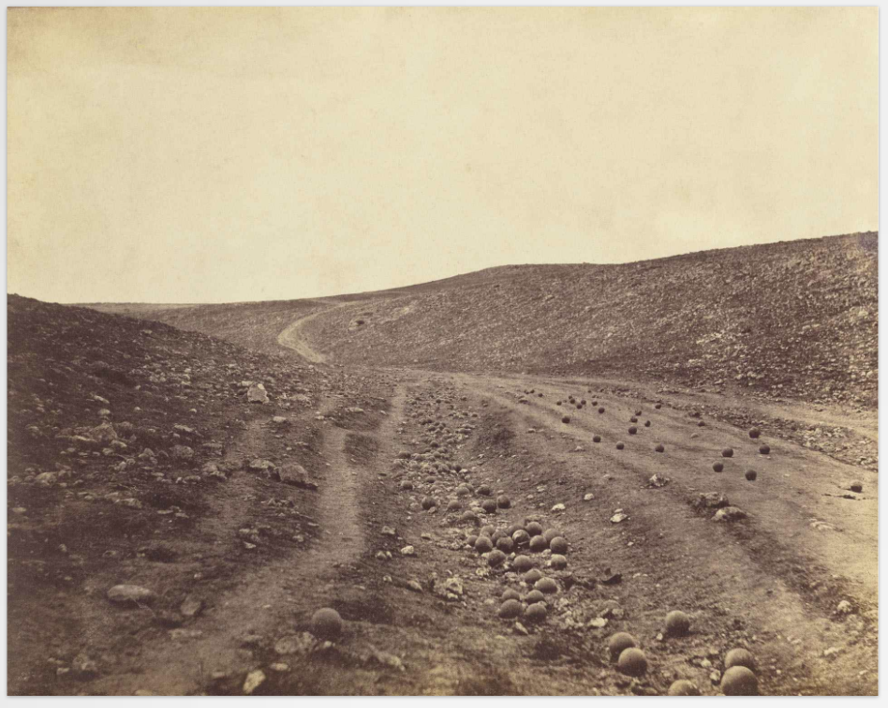
Photojournalism and combat photography
Fenton, Roger. The Valley of the Shadow of Death. 1855. TIME Magazine.

Slide 15
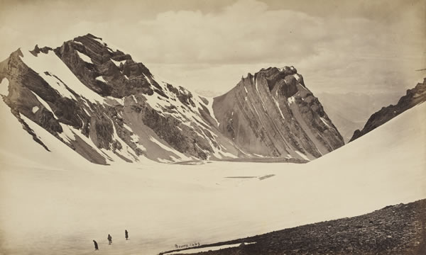
Travel photography
Bourne, Samuel. View from the top of the Manirung Pass, 18,600 feet, 1866. Albumen print. British Library, London.

Slide 16
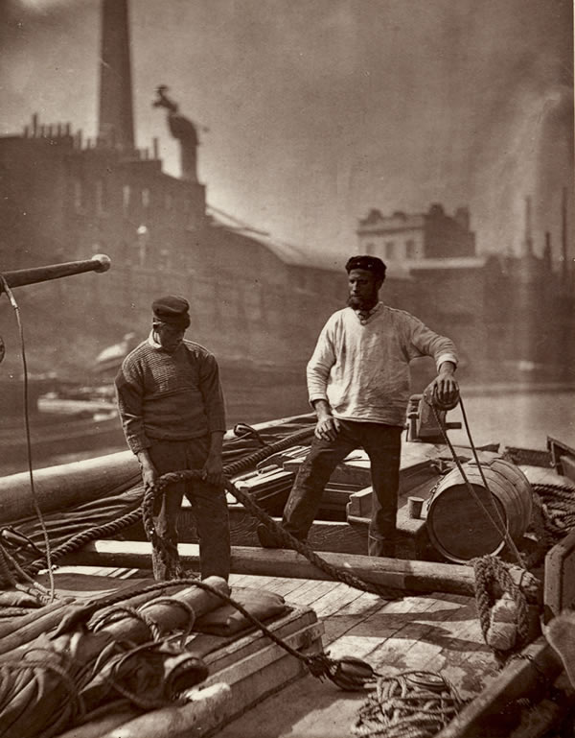
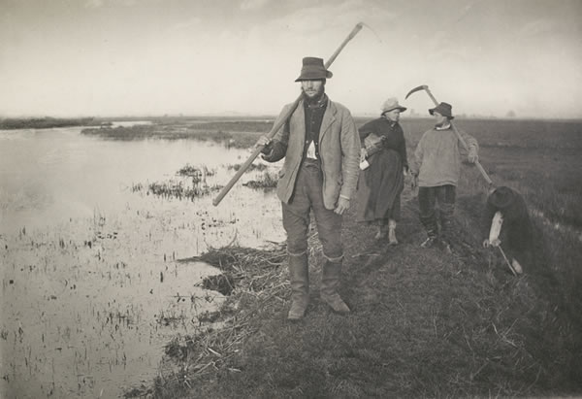
Thomson, John. Workers on the Silent Highway, 1876-77. From John Thomson, Street Incidents (London, 1881).
Social documentation
Emerson, Peter Henry. ‘Coming home from the marshes, 1886’. From Peter Henry Emerson, Life and Landscape on the Norfolk Broads (London, 1886).

Slide 17
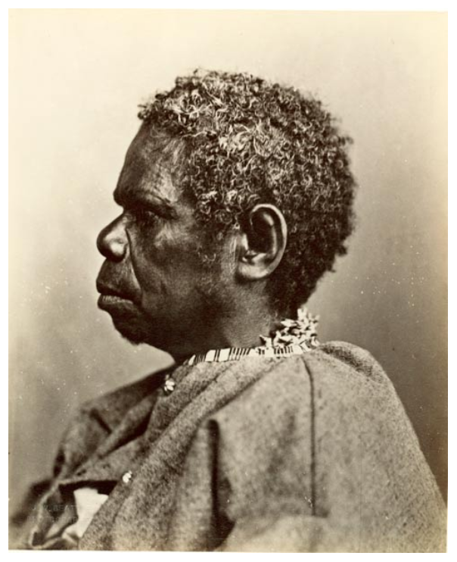
Anthropology and anthropometry
Woolley, Charles Alfred. Truganini. 1866. Pitt Rivers Museum, University of Oxford.

Slide 18
Photograph consumption

Slide 19
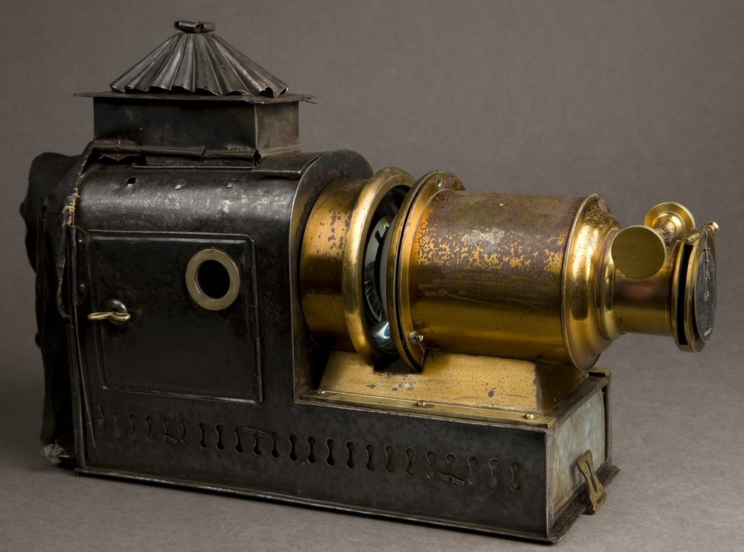
Lantern slide projector. 1879-1926. State Library of South Australia Digital Collections.

Slide 20
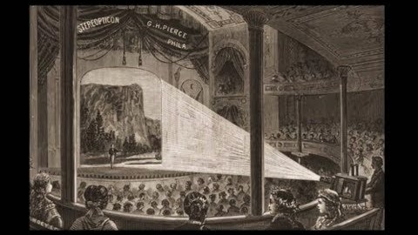
https://youtu.be/J1fUSqH5op8

Slide 21
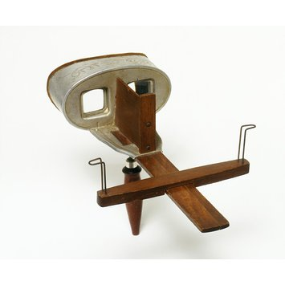
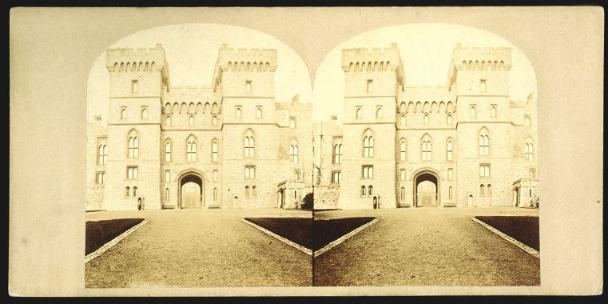
The Queen’s entrance to Windsor Castle, albumen print mounted on glass, stereograph, 1860-70, Victoria & Albert Museum.
Stereoscope, 1901. Victoria & Albert Museums.

Slide 22
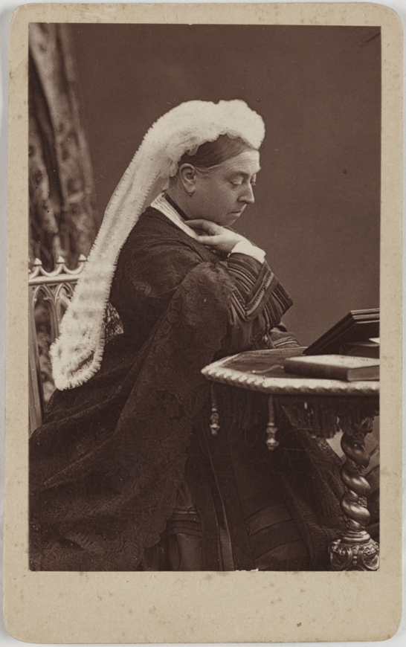
Carte-de-visite of Queen Victoria, c. 1887. Science Museum Group Collection.

Slide 23
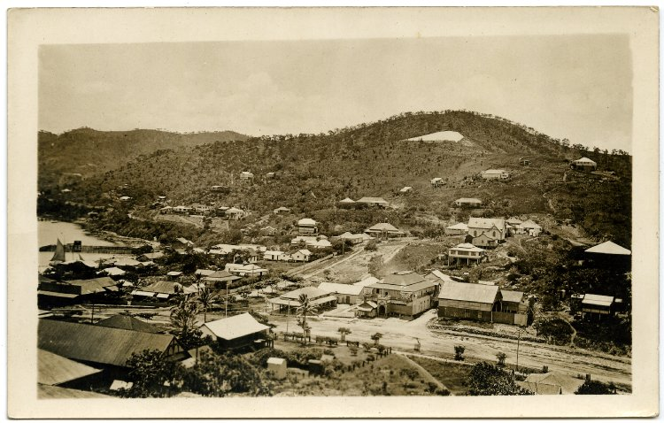
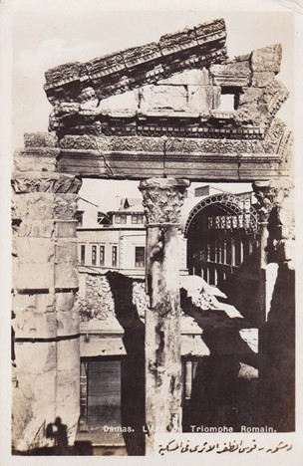
Port Moresby, Papa New Guinea. Printed paper postcard. British Museum Collections.
Roman triumphal gate, Damascus, Syria. British Museum Collections.

Slide 24
Photographs as sources

Slide 25
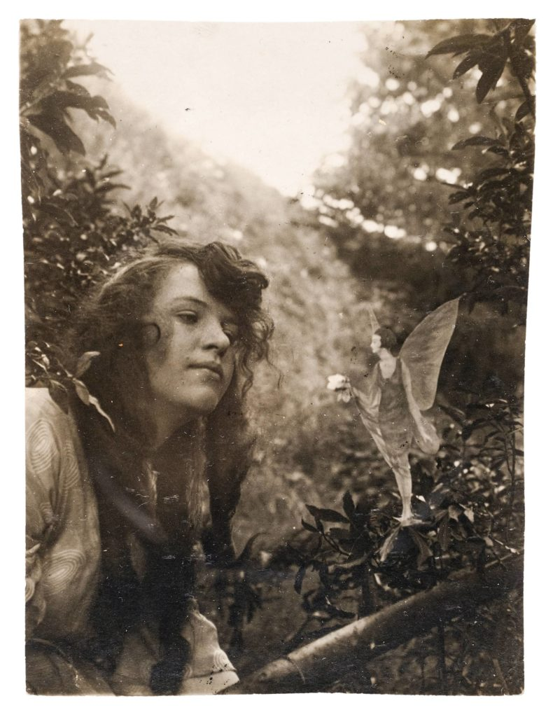
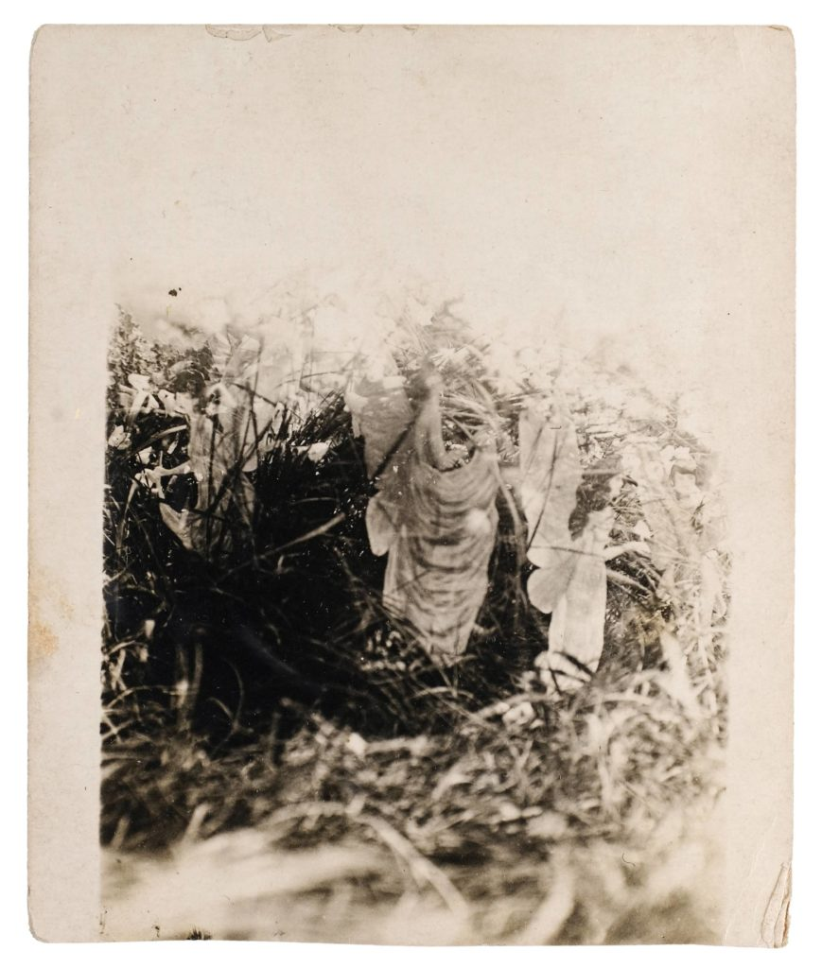

Slide 26
The social life of a photograph
Production
Circulation
Reception

