Slide 1
Railways
querying technological nationalism

Slide 2
Early railways in Britain

Slide 3
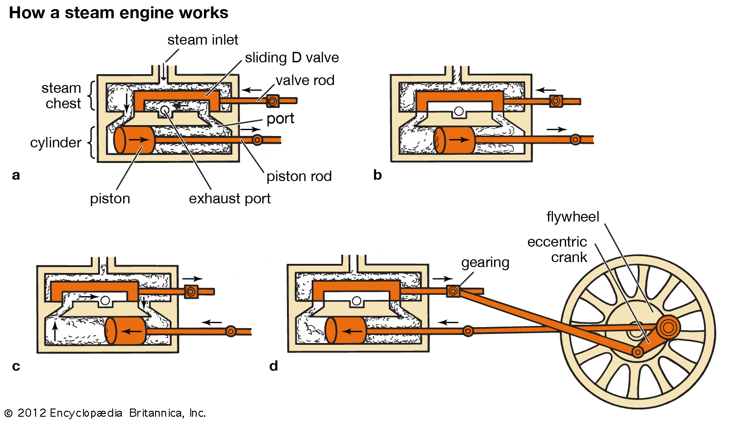

Slide 4
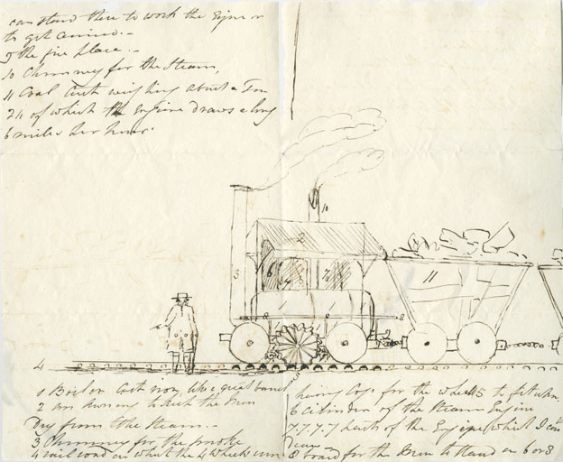
Dalrymple, Leighton. Middleton Railway colliery locomotive ‘Salamanca’. Sketch. 1812. National Railway Museum.

Slide 5
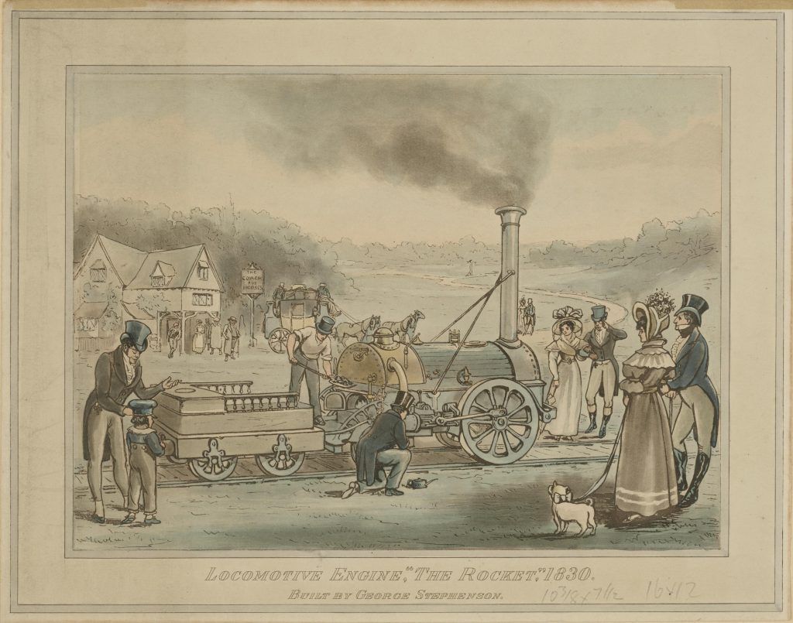
Illustration of the Rocket, designed by George and Robert Stephenson. 1894. Science Museum.

Slide 6
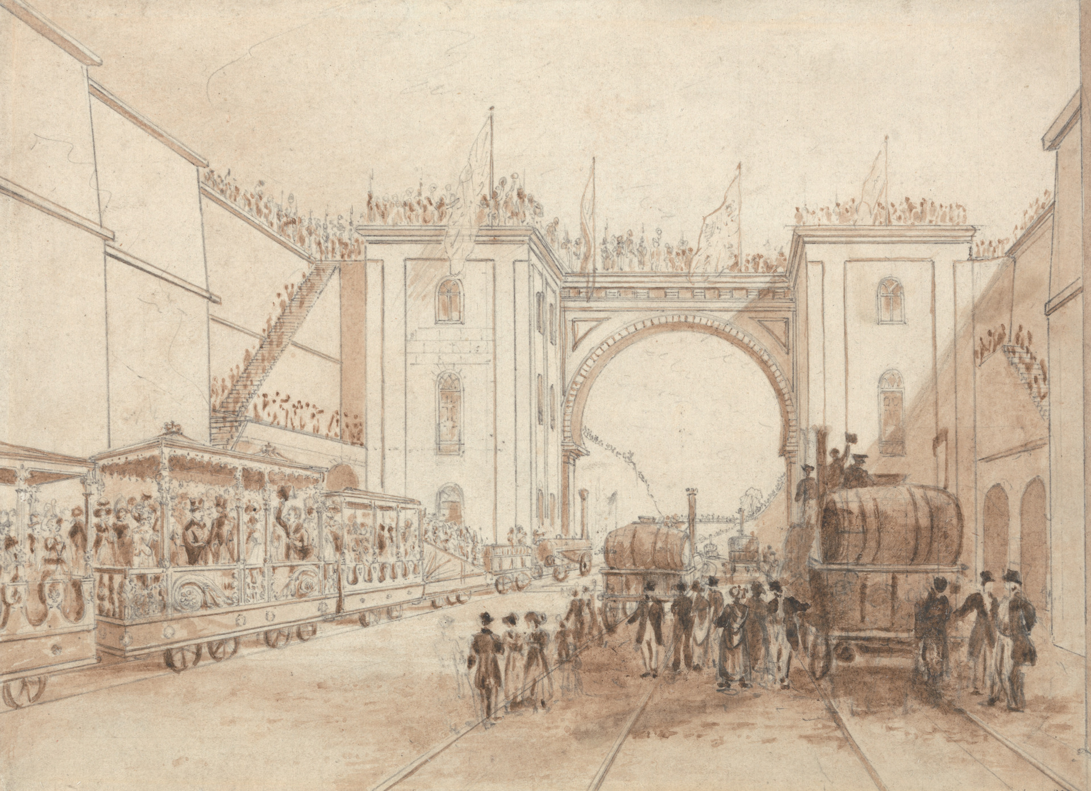
Shaw, Isaac. Opening of the Liverpool and Manchester Railway. 1830. Yale Center for British Art, Paul Mellon Collection.

Slide 7
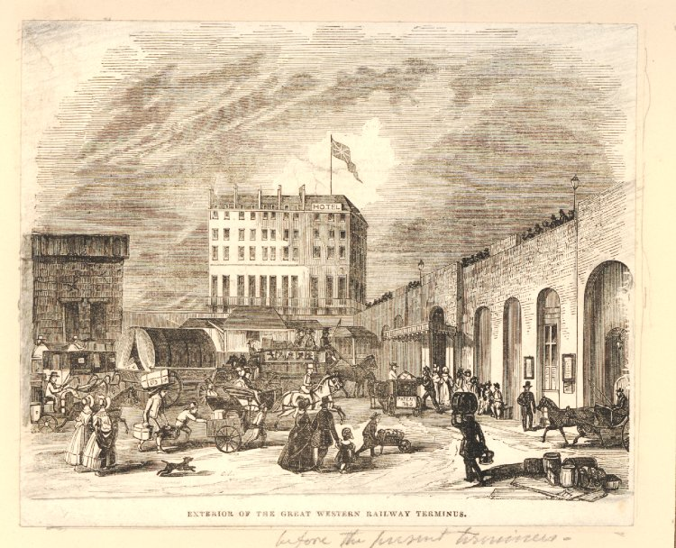
Exterior of the Great Western Railway terminus. 1854. Print. British Museum Collections.

Slide 8
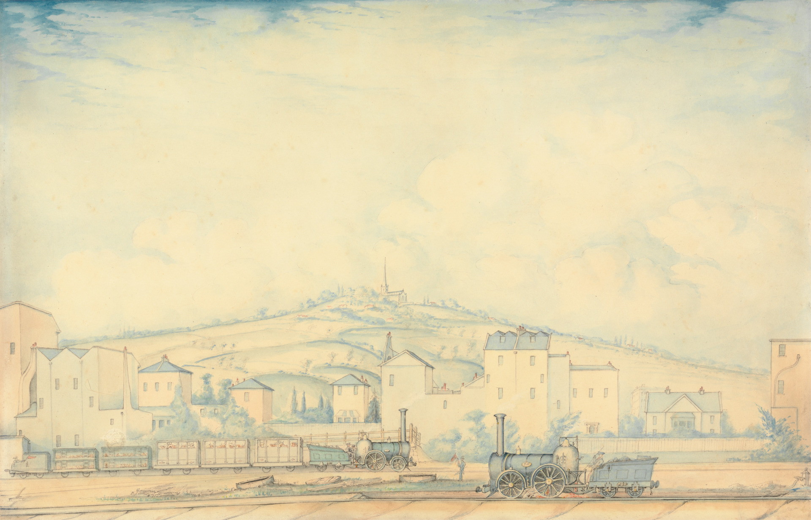
Penson, W. S. View on the London and Birmingham Railway at Chalk Farm. Watercolour. Yale Center for British Art.

Slide 9
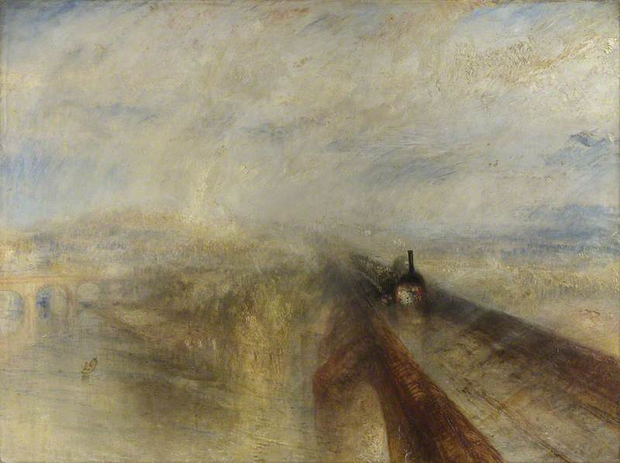
J. M. W. Turner, Rain, Steam and Speed – The Great Western Railway. 1844. National Gallery, London.

Slide 10
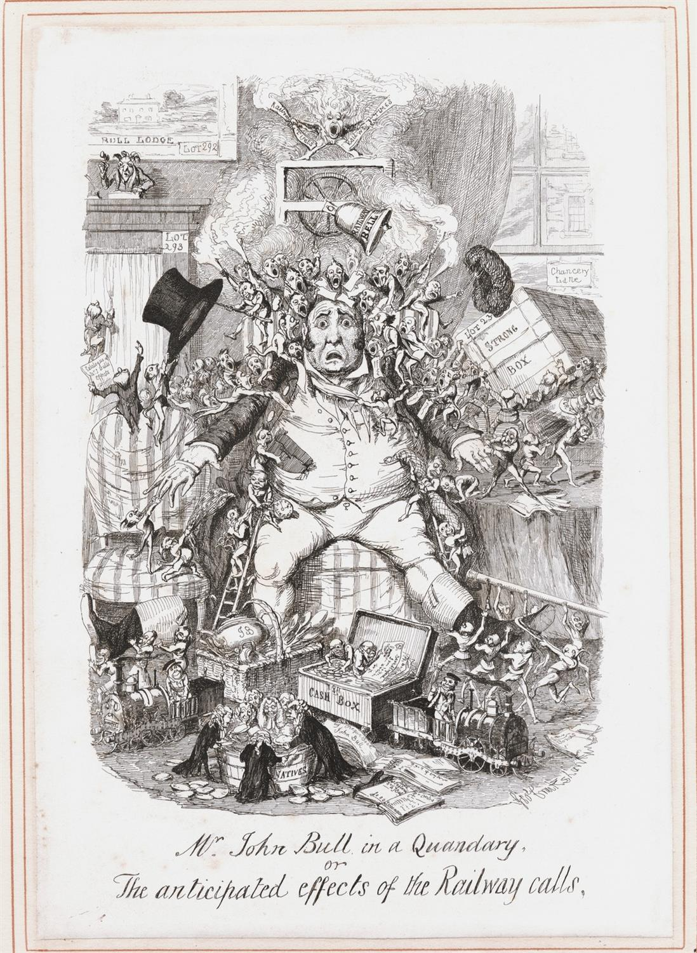
‘Railway calls’, in George Cruikshank’s Table-Book (London, 1845), p. 237.
Every man in the present day is a holder of shares in a Railway, that is to say, has got some pieces of paper, called scrip, entitling him to a proportionate part of a blue, red, or yellow line drawn across a map, and designated a Railway. […]
We hear a great deal of the inexhaustible resources of John Bull, but there are a few impossibilities that even he cannot accomplish. For instance, if he could even make a silk purse out of a sow’s ear, the purse would be of no use to him in paying his calls, if it happened to be an empty one. What his condition will be in a few months, may be seen in the accompanying etching. Calls will literally tear him to pieces, and there will not be an article he possesses that the great interests of locomotion will not carry away from him. A Grand Trunk will run away with his strong-box; a Junction of some kind or other will tear his coat in two; some stupendous cutting will cut away with his cash-box; a tremendous tunnel will run through all he has; and excavations on an extensive scale will empty all his pockets; his establishment will dwindle by degrees, as he continues making efforts to pay up his calls […]

Slide 11
Railways in India

Slide 12
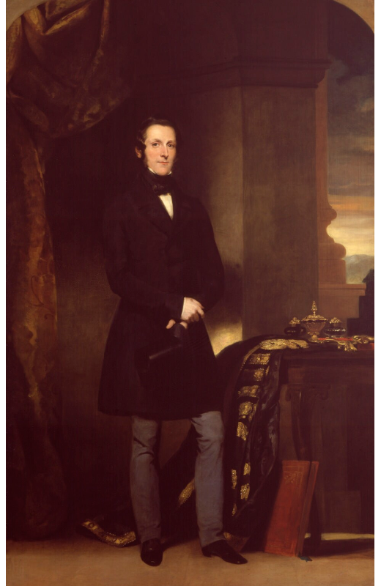
Watson-Gordon, John. James Andrew Broun Ramsay, 1st Marquess of Dalhousie. 1847. Oil on canvas. National Portrait Gallery, London.
As Governor-General of the East India Company, wrote his famous Minute on the Railways, 20 April 1853.

Slide 13
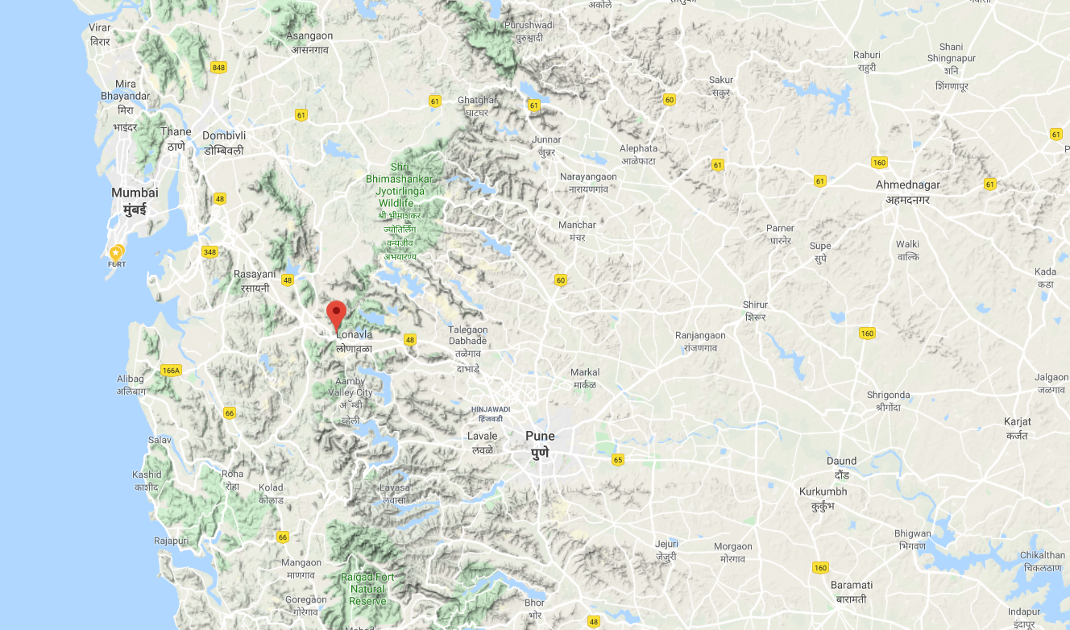

Slide 14
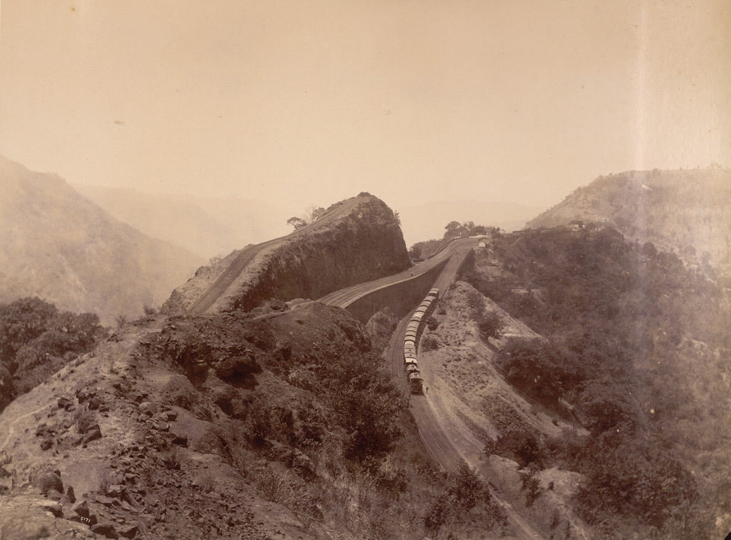
Dayal, Deen. Photograph of reversing station at Bhor Ghat, 1881. Macnabb Collection, British Library, London.
The Bhor Ghat pass was opened in 1861 as the main route over the Western Ghats linking the sea coast with the Deccan.

Slide 15
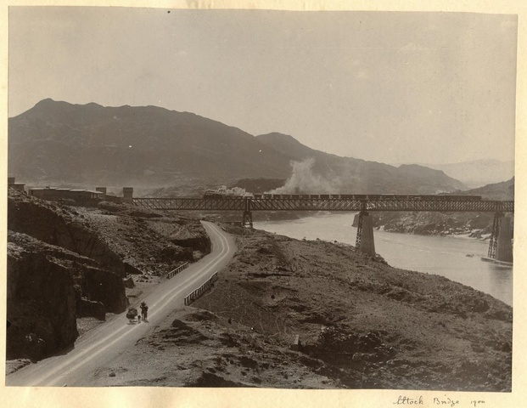
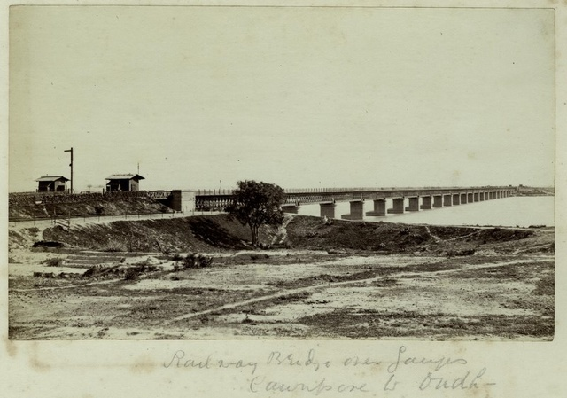
Railway bridge over the Ganges at Kanpur, 1880s. IRFCA.
Mixed train crossing the Attock River. 1900. IRFCA.

Slide 16
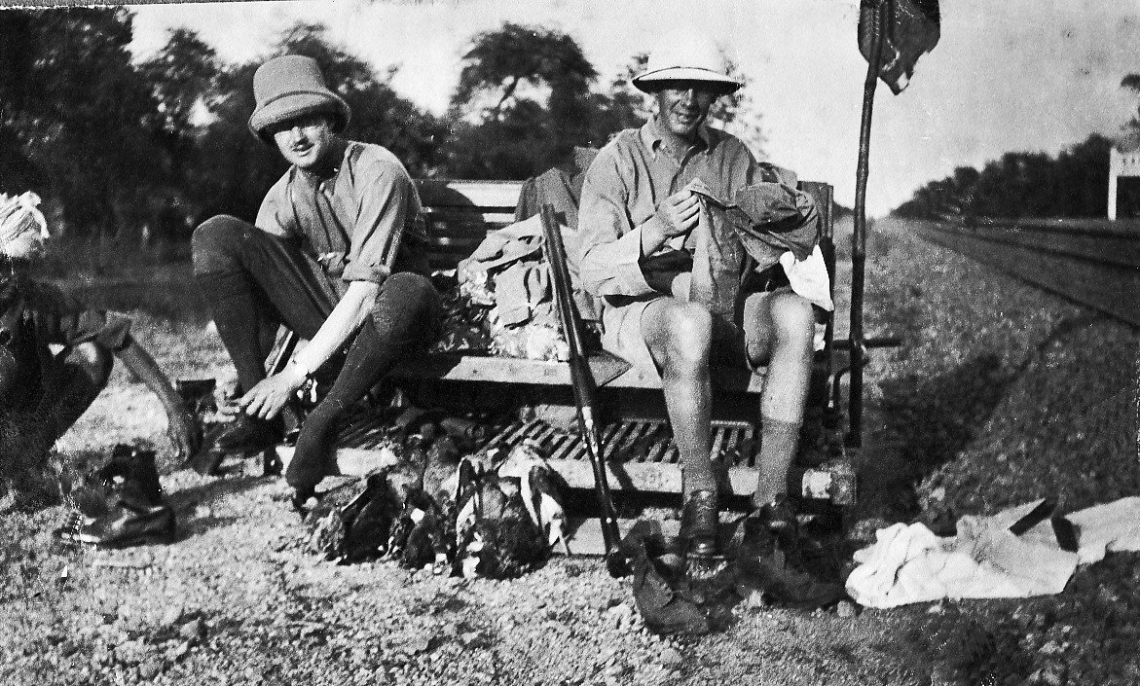
Railway engineers at Betul, 1920s. Image courtesy of Nigel Purdey, IRFCA.

Slide 17
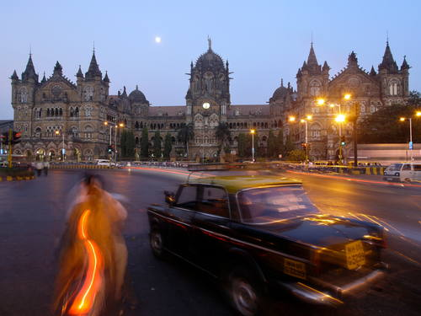
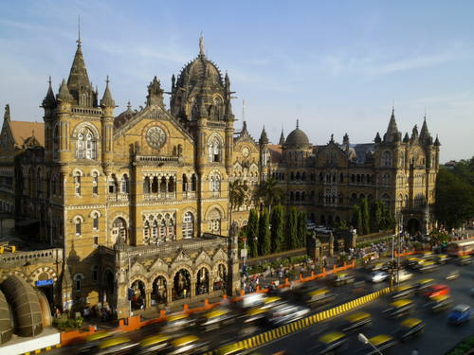
Chapple, Amos. Chhatrapati Shivaji Terminus (formerly Victoria Terminus). The World Heritage Collection, UNESCO.

Slide 18
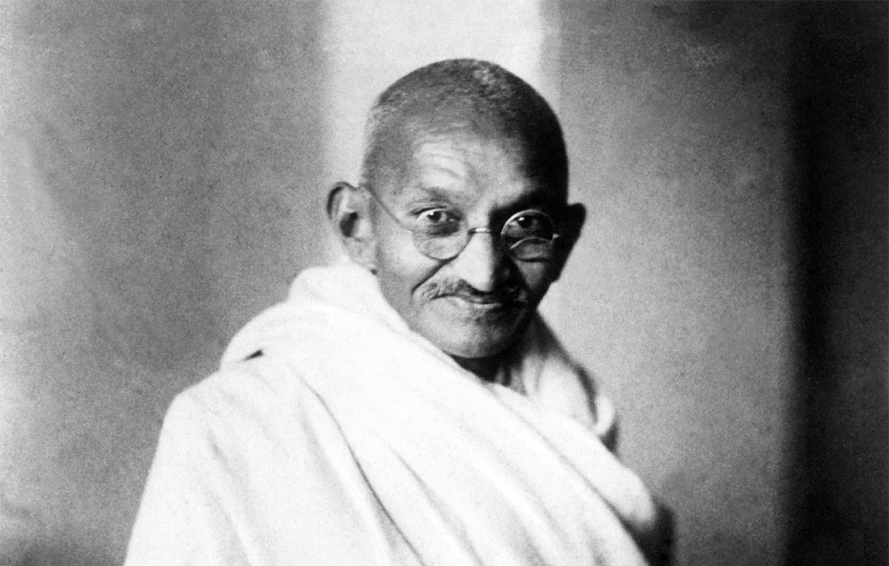
Mohandas Karamchand Gandhi or Mahatma Gandhi (1869-1948), lawyer, politician, social activist, and writer, a leader of Indian nationalist movement known for doctrine of nonviolent protest.
Hind Swaraj (“Indian Home Rule”), 1909.

Slide 19
Canadian Pacific Railway

Slide 20
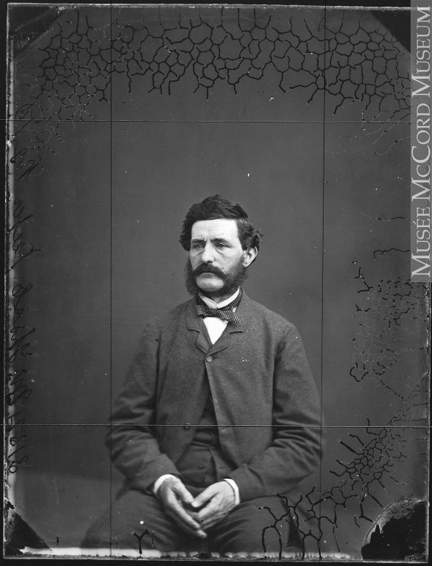
Notman, William. Thomas C. Keefer, civil engineer, Montreal, QC, 1861. Silver salts on glass. McCord Museum.
Philosophy of Railroads (1850), written at the behest of the Montreal and Lachine Rail-road, arguing for the importance of a strategic railway line linking Montreal and Toronto which he suggested would allow it to compete with Americans for control of interior trade. The pamphlet was reprinted four times, translated into French, and employed in promotion of several Maritime and New England projects.

Slide 21
Excerpt 1 from Philosophy of the Railroads
Old winter is once more upon us, and our inland seas are “dreary and inhospitable wastes” to the merchant and to the traveller; - our rivers are sealed fountains, - and an embargo which no human power can remove is laid upon all our ports. Around our deserted wharves and warehouses are huddled the naked spars, - the blasted forest of trade, - from which the sails have fallen like the leaves of the autumn. […] The animation of business is suspended, the life blood of commerce is curdled and stagnant in the St Lawrence – the great aorta of the North. On land, the heavy stage labours through mingled frost and mud in the West, - or struggles through drifted snow, and slides with uncertain track over the icy hills of Eastern Canada.

Slide 22
Excerpt 2 from Philosophy of the Railroads
Steam has exerted an influence over matter which can only be compared to that which the discovery of Printing has exercised upon the mind. These two great discoveries – pillars of cloud and fire which have brought us out of the mental wilderness of dark and middle ages,- have combined to supply the mind with daily food and illustrate the value of time. Men have now virtually attained antediluvian longevity; ideas are exchanged by lightning- readers and their books travel together but little behind their thoughts – while actors, materials, scenes and scenery are shifted with the rapidity and variety of the kaleidoscope.

Slide 23
Excerpt 3 from Philosophy of the Railroads
[…]we are placed beside a restless, early-rising, “go-a-head” people, - a people who are following the sun Westward, as if to obtain a greater portion of daylight: - we cannot hold back – we must tighten our own traces or be overrun – we must use what we have or lose what we already possess – capital, commerce, friends and children will abandon us for better furnished lands unless we at once arouse from our lethargy; we can no longer afford to loiter away our winter months, or slumber through the morning hours. Every year of delay but increases our inequality, and will prolong the time and aggravate the labor of what, through our inertness, has already become a sufficiently arduous rivalry; but when once the barriers of indifference, prejudice and ignorance are broken down, - no physical or financial obstacle can withstand the determined perseverance of intelligent, self-controlled industry.

Slide 24
Railways in Canada
1849 Guarantee Act
1867 Confederation
1871, British Columbia agrees to join Canada on condition that a transcontinental railway is constructed which would link it with the rest of the country.
1872 Pacific Scandal
1878 National Policy
1881 formation of Canadian Pacific Railway company
1885 Northwest Rebellion
Last spike driven in November 1885

Slide 25
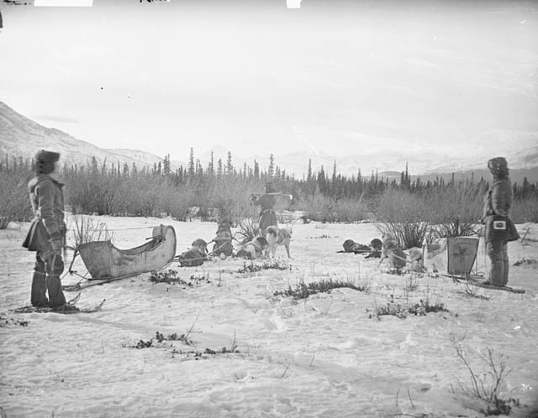
Horetzky, Charles. Athabasca survey party near Jasper House, Alberta. 1871.
Photograph taken by member of Sandford Fleming’s survey party to western Canada, searching for possible route through Canadian Rockies.

Slide 26
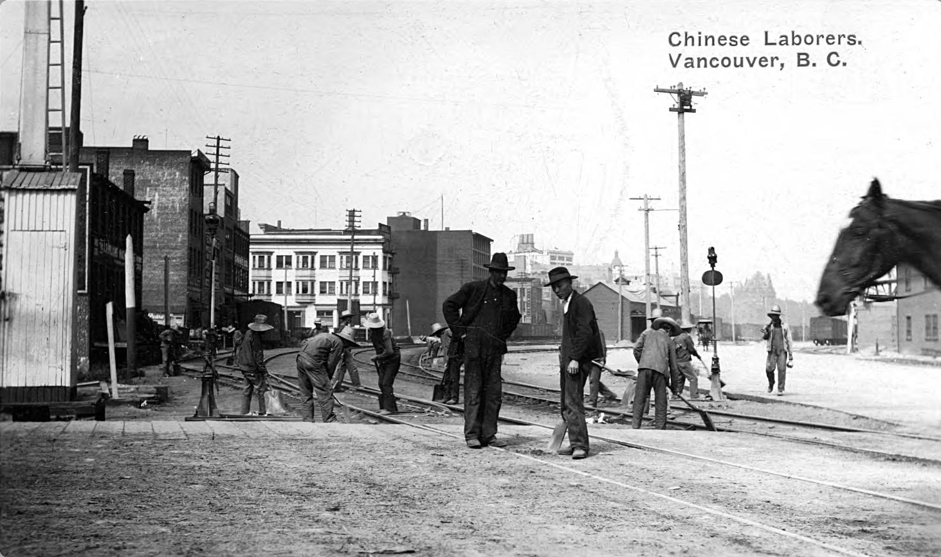
c.1908-09. Wallace B Chung and Madeline H. Chung Collection. University of British Columbia.

Slide 27
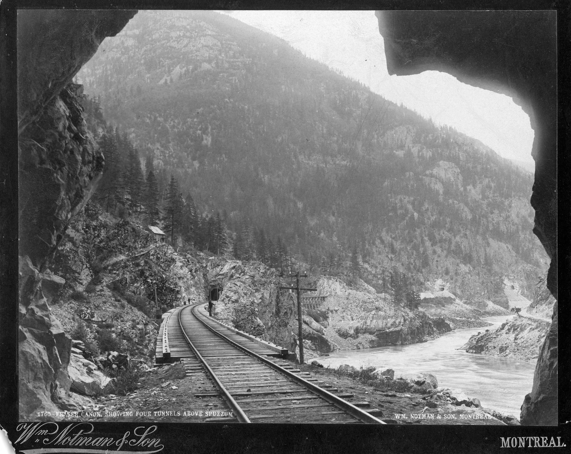
Fraser Canyon, c.1890s. Wallace B. Chung and Madeline H. Chung Collection, University of British Columbia.

Slide 28
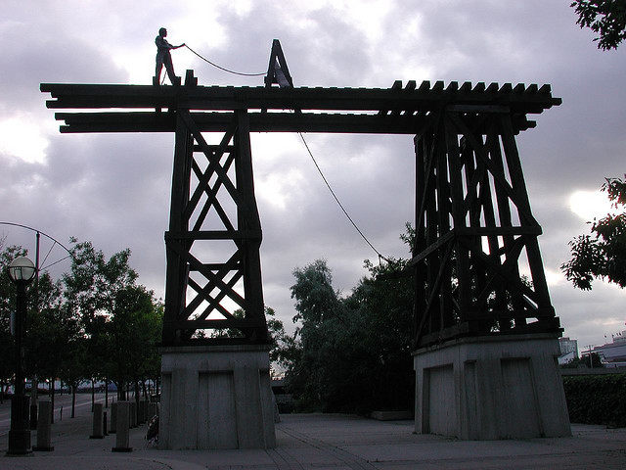
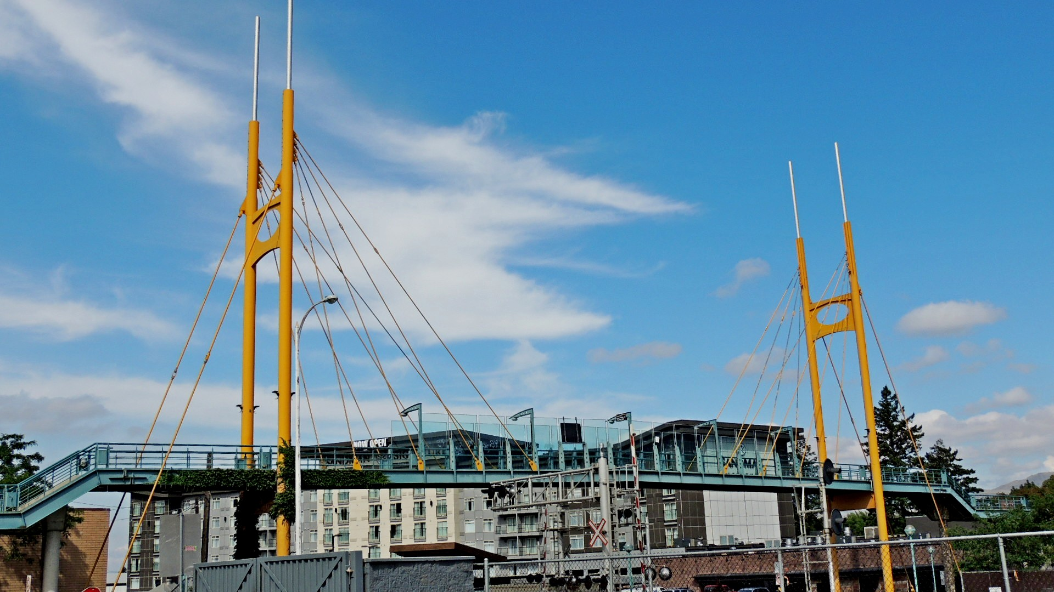
On 27 May, 2005, CPR named the railway interchange in Kamloops, BC, after Chinese labourer Cheng Ging Butt.
Monument to Chinese labourers, Toronto.

Slide 29
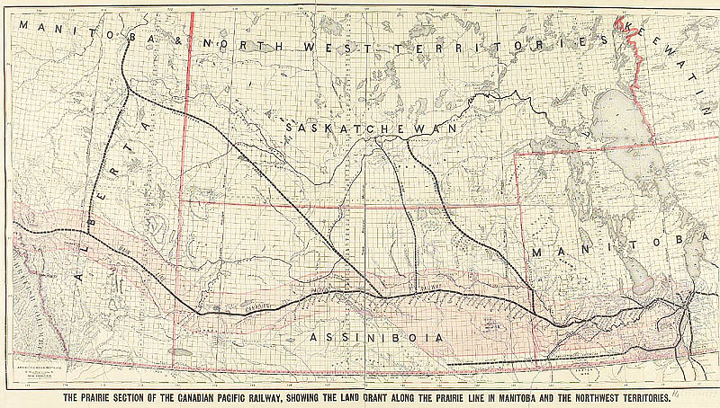

Slide 30
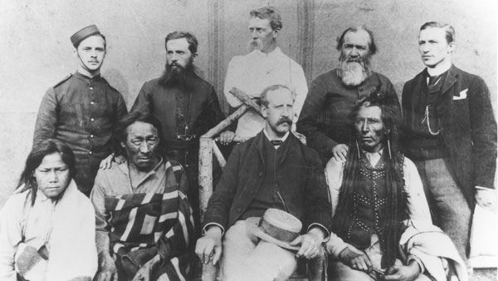
Group photographed during the trial after Northwest Rebellion, 1885

Slide 31
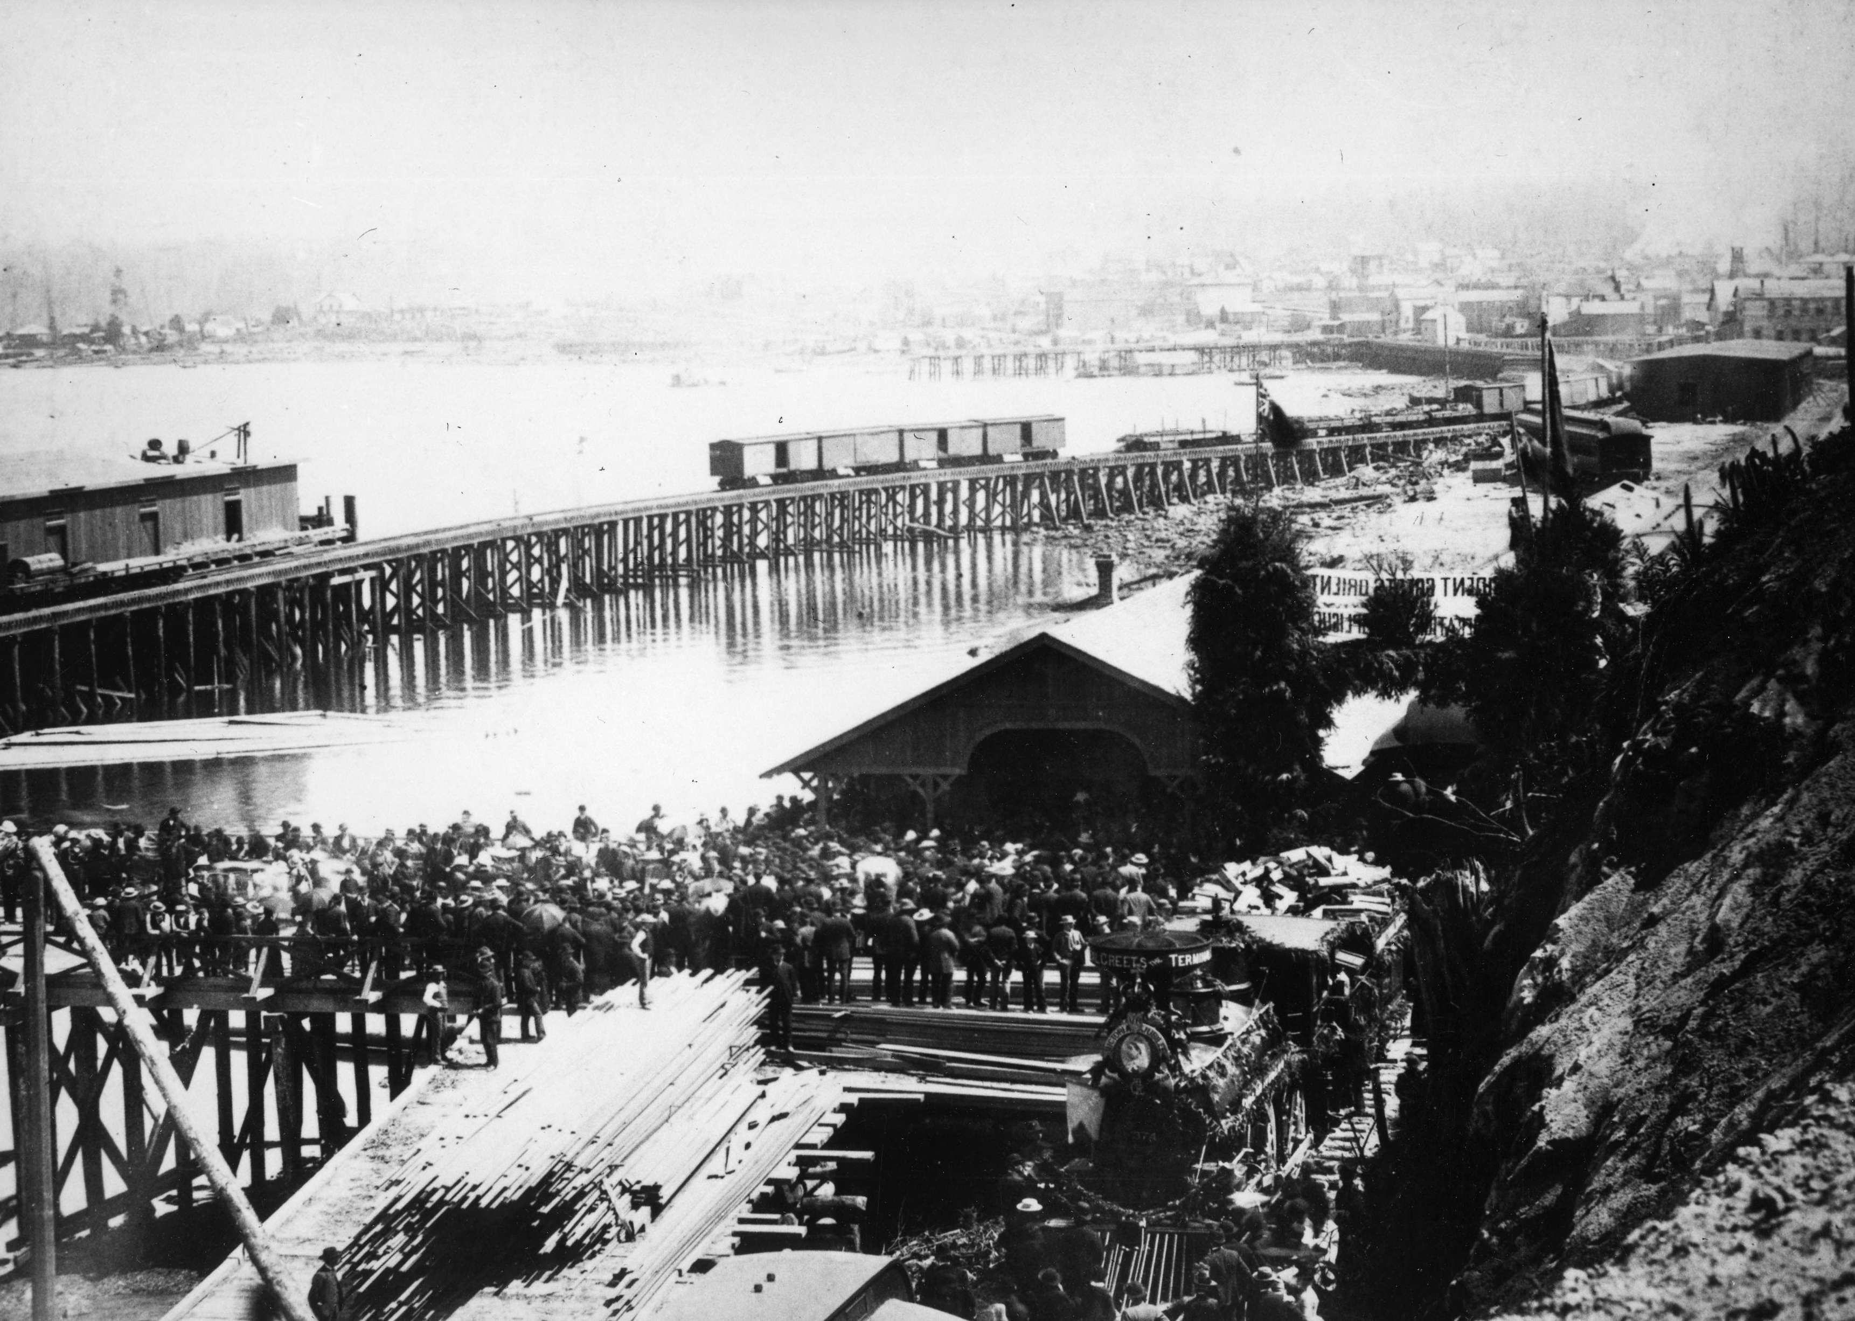
Construction of first railroad track by Vancouver’s wharf, c. 1880. Wallace B. Chung and Madeline H. Chung Collection, University of British Columbia.

Slide 32
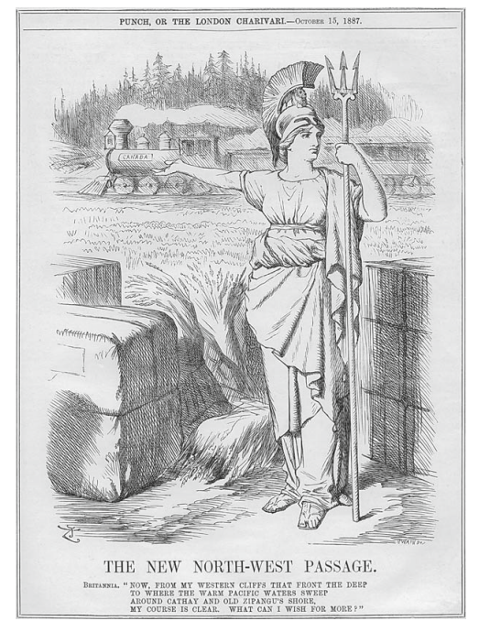
Punch 93 (October 1887), p. 175.

Slide 33
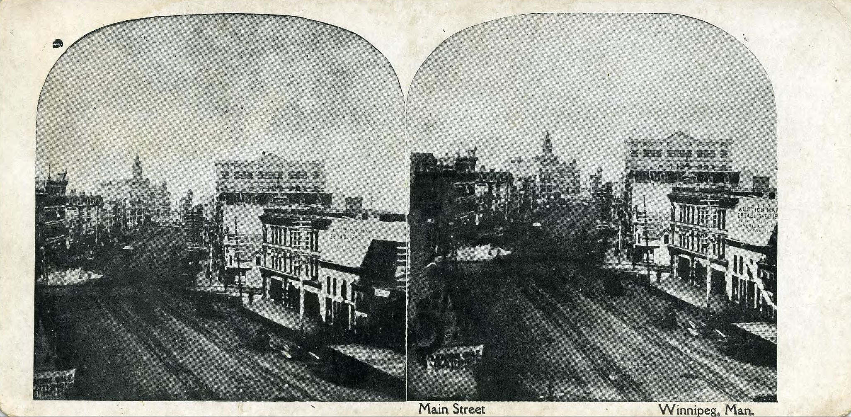
Main street, Winnipeg, Manitoba. 1904. Wallace B Chung and Madeline H Chung Collection, University of British Columbia.

Slide 34
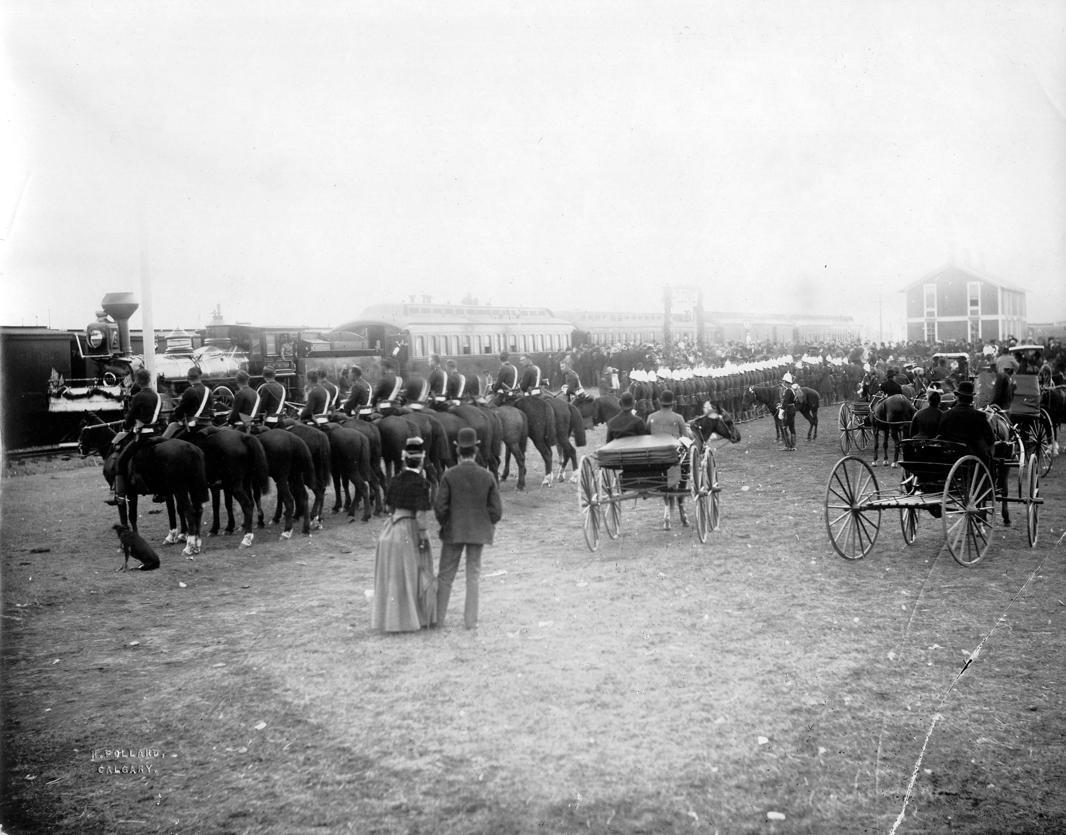
First CPR transcontinental passenger train arriving in Calgary. 1883. Wallace B. Chung and Madeline H. Chung Collection, University of British Columbia Library.

Slide 35
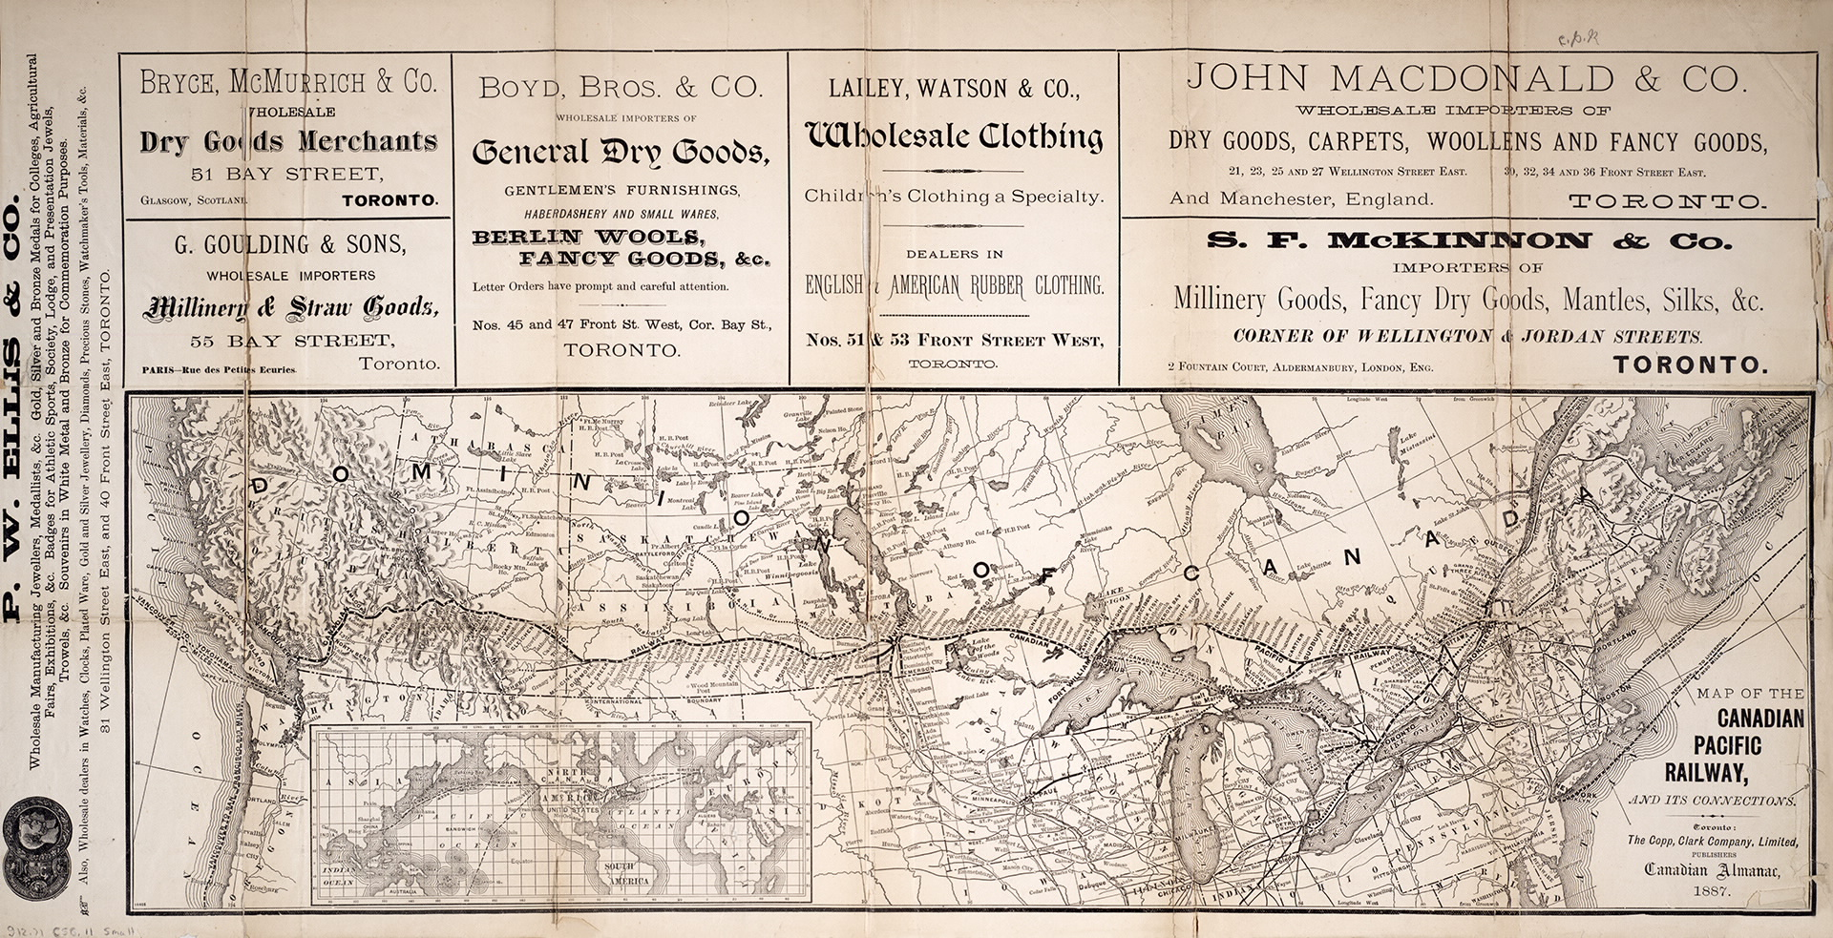
Map of the Canadian Pacific Railway and its Connections, 1887. Toronto Public Library.

Slide 36
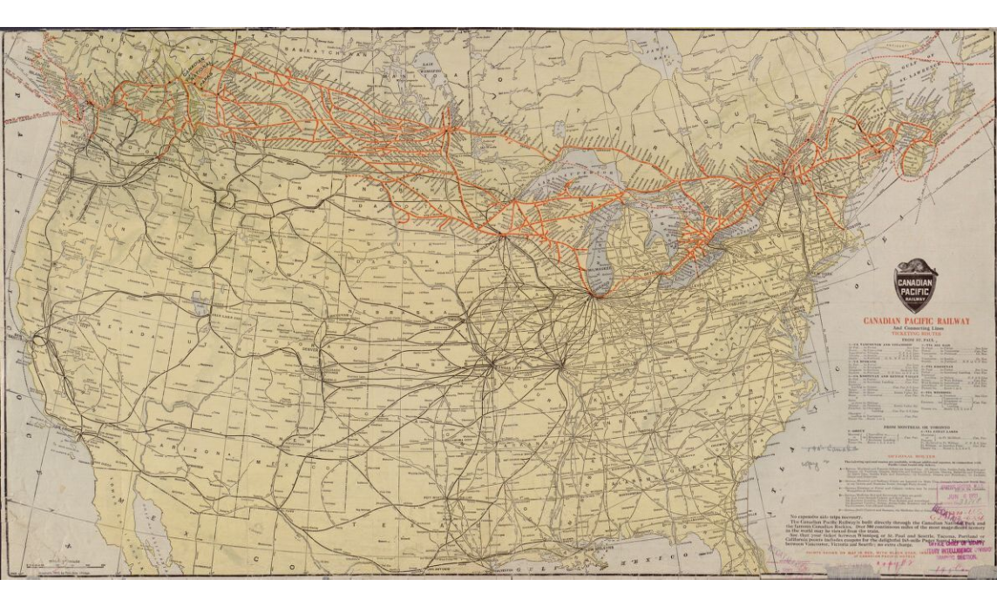
Canadian Pacific Railway and connecting lines. 1912. Library of Congress Geography and Map Division, Washington.

