Slide 1
Steamships
Disaster to decadence

Slide 2
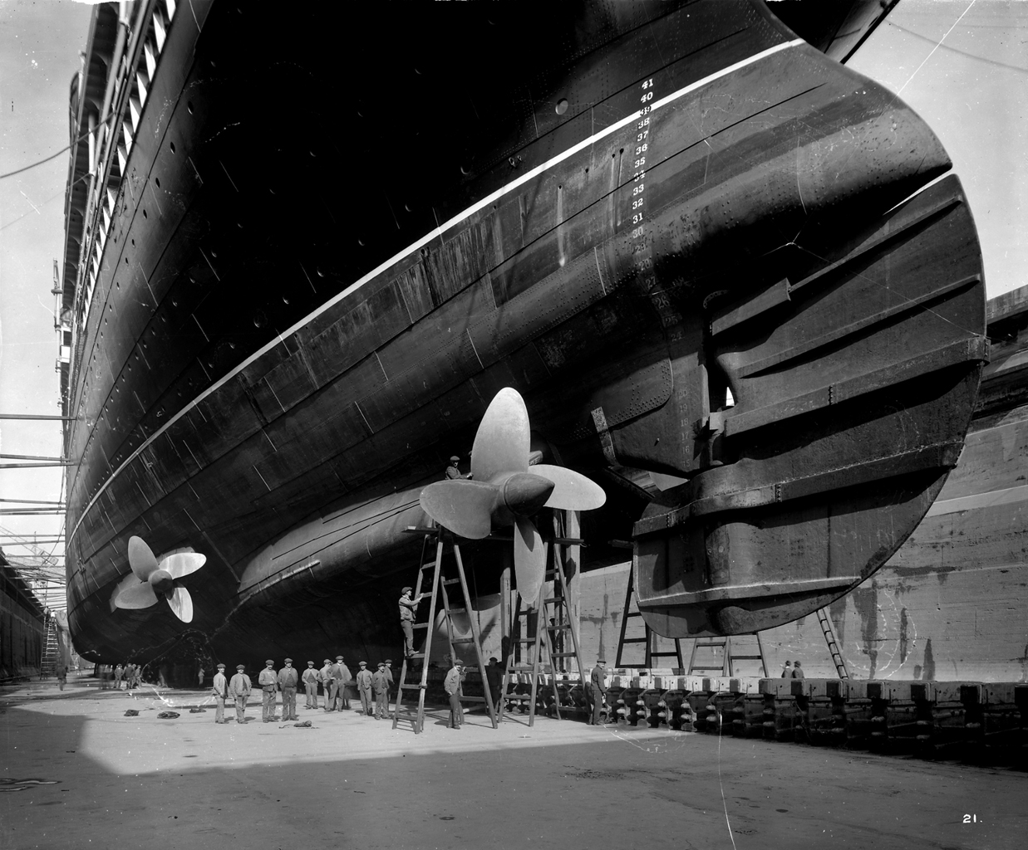
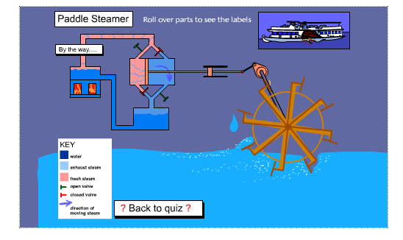
Boilers heat the water
Boiling water generates steam
Steam is piped to the ship’s cylinder (or cylinders)
Movement of the steam entering and exiting the cylinder exerts pressure on the pistons, creating motion
Movement of the pistons is translated into rotary motion by the crank shaft
The crank shaft turns the paddle shaft (rod), which turns the paddle wheels.
Stern view of the ‘Aquitania’ in drydock. Royal Museums Greenwich, London.

Slide 3
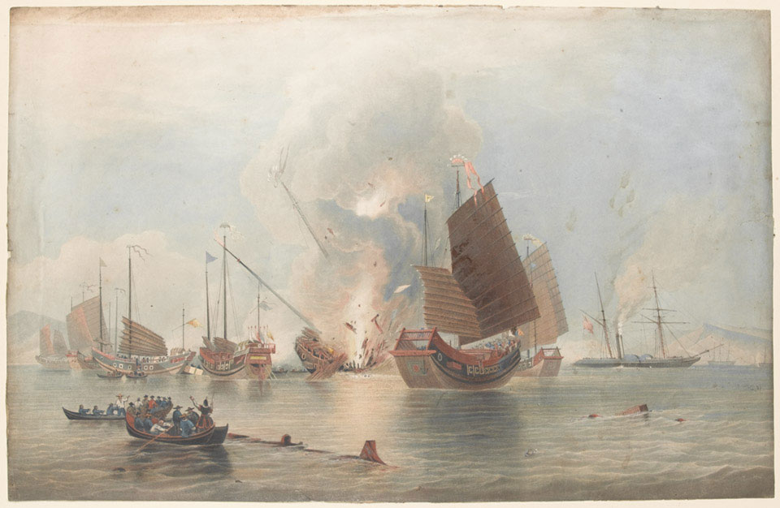
Duncan, E. The East India Company’s iron steamship Nemesis, Lieutenant W H Hall RN, Commander, with boats of Sulphur, Calliope, Larne and Starling destroying Chinese war junks in Anson’s Bay, January 7th 1841. National Army Museum, London.

Slide 4
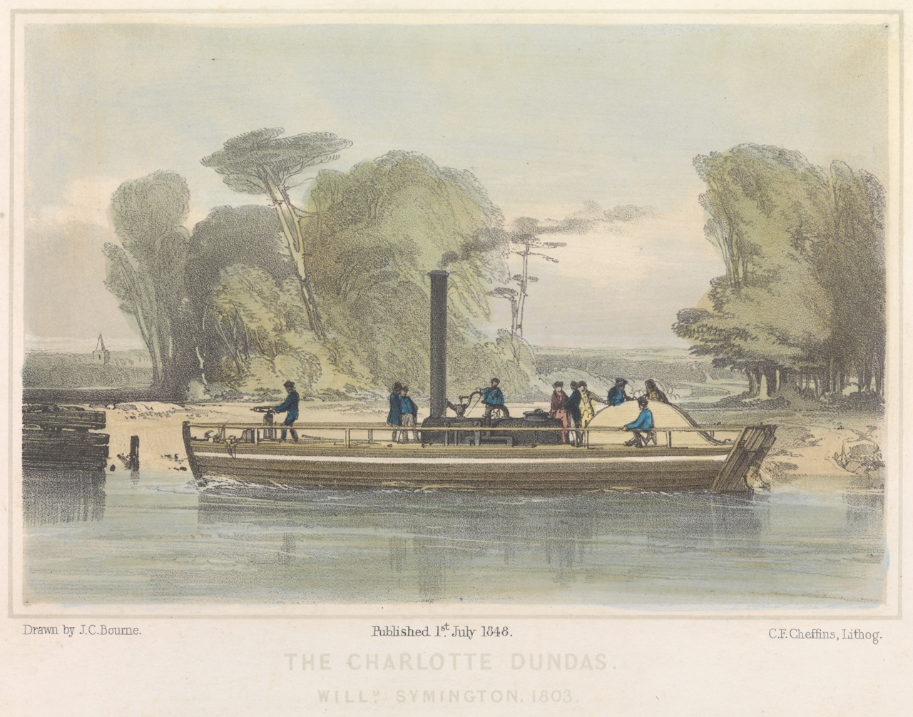
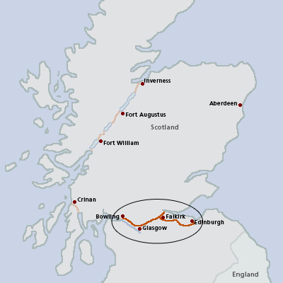
Bourne, JC and CF Cheffins. The Charlotte Dundas, Willm Symington, 1803. Coloured lithograph. 1848. National Maritime Museum, London.

Slide 5
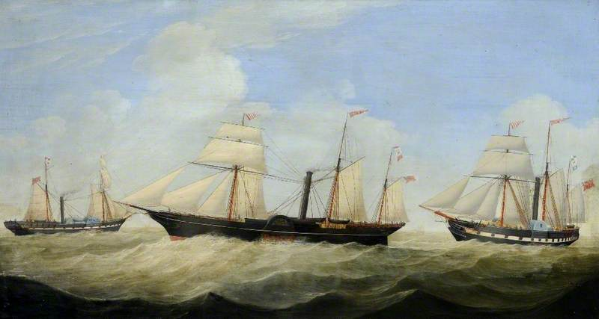
Griffin, William. Paddle steamers ‘Rob Roy’, ‘Emperor’, and ‘Queen of Scotland’. Oil on canvas. 1848. Hull Maritime Museum.

Slide 6
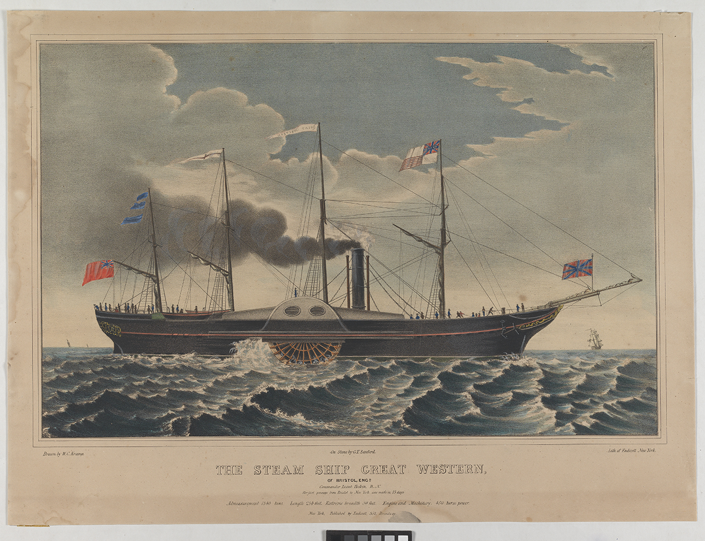
Kramp, WC, George T. Sanford and G&W Endicott. The steam ship Great Western. Coloured lithograph.

Slide 7
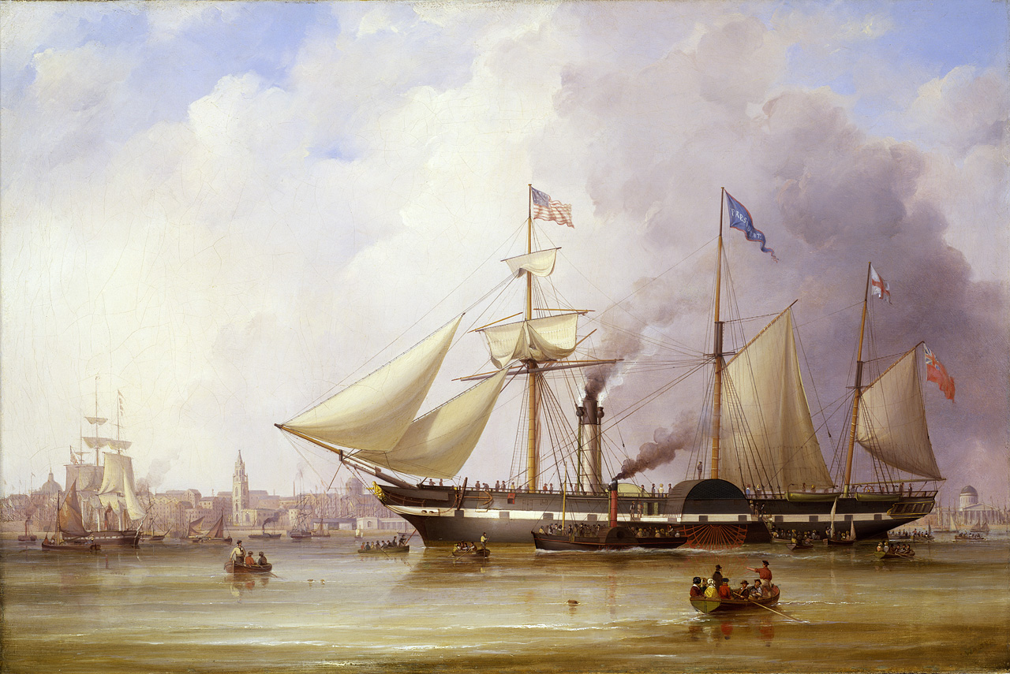
Walters, Samuel. Paddle steamer ‘President’ in the Mersey off Liverpool. Oil on canvas. 1841. National Maritime Museum, Greenwich, London.

Slide 8
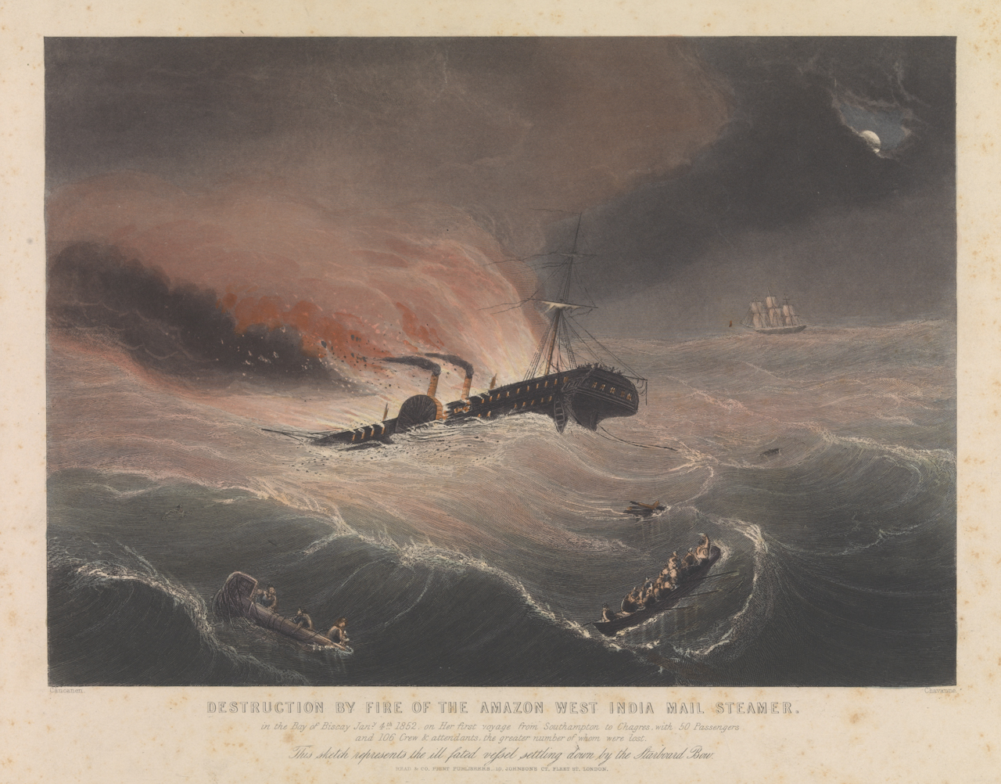
Caucanen, Chavanne, and Read & Co. Destruction by fire of the Amazon West India Mail Steamer in the Bay of Biscay Jany 4th 1852. Engraving & etching, coloured. National Maritime Museum, Greenwich.

Slide 9
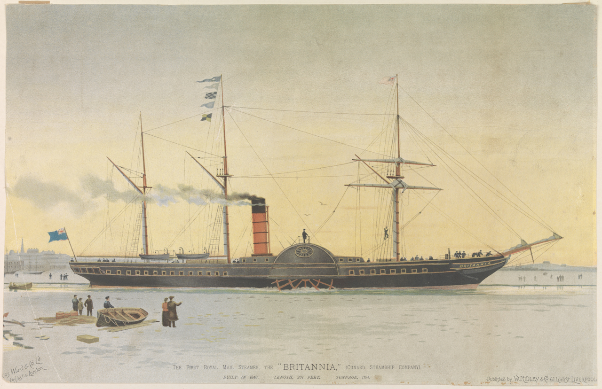
The First Royal Mail Steamer, the Britannia (Cunard Steamship Company). National Maritime Museum, Greenwich.

Slide 10
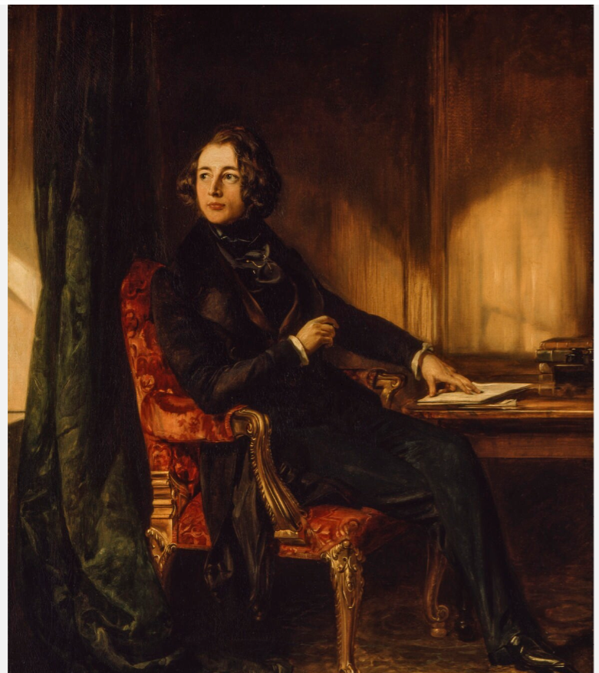
American Notes for General Circulation, Charles Dickens (1850)
Charles Dickens, novelist (1812-1870)
Early successes include Pickwick Papers (1836-7), Oliver Twist (1837), Nicholas Nickleby (1838-9), and The Old Curiosity Shop (1840-41).
Voyage to America in 1842 aboard the paddle steamship Britannia, a Cunard vessel renowned for their comfort and safety
Travelled from Liverpool to Boston via Halifax, Canada.
Maclise, Daniel. Charles Dickens. Oil on canvas. 1839. Tate, London

Slide 11
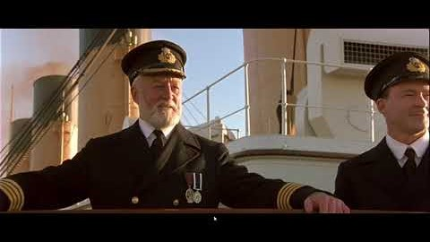

Slide 12
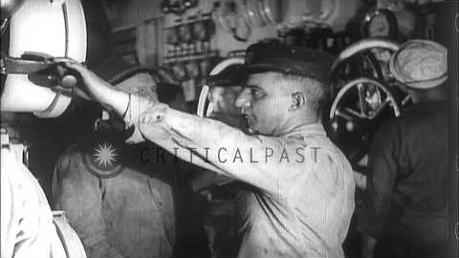
Views of engine controls and boilers of the SS Leviathan troop transport ship during World War I, Atlantic, 1918.

Slide 13
Shipboard labour
Stewards
Deckhands
Fireroom

Slide 14
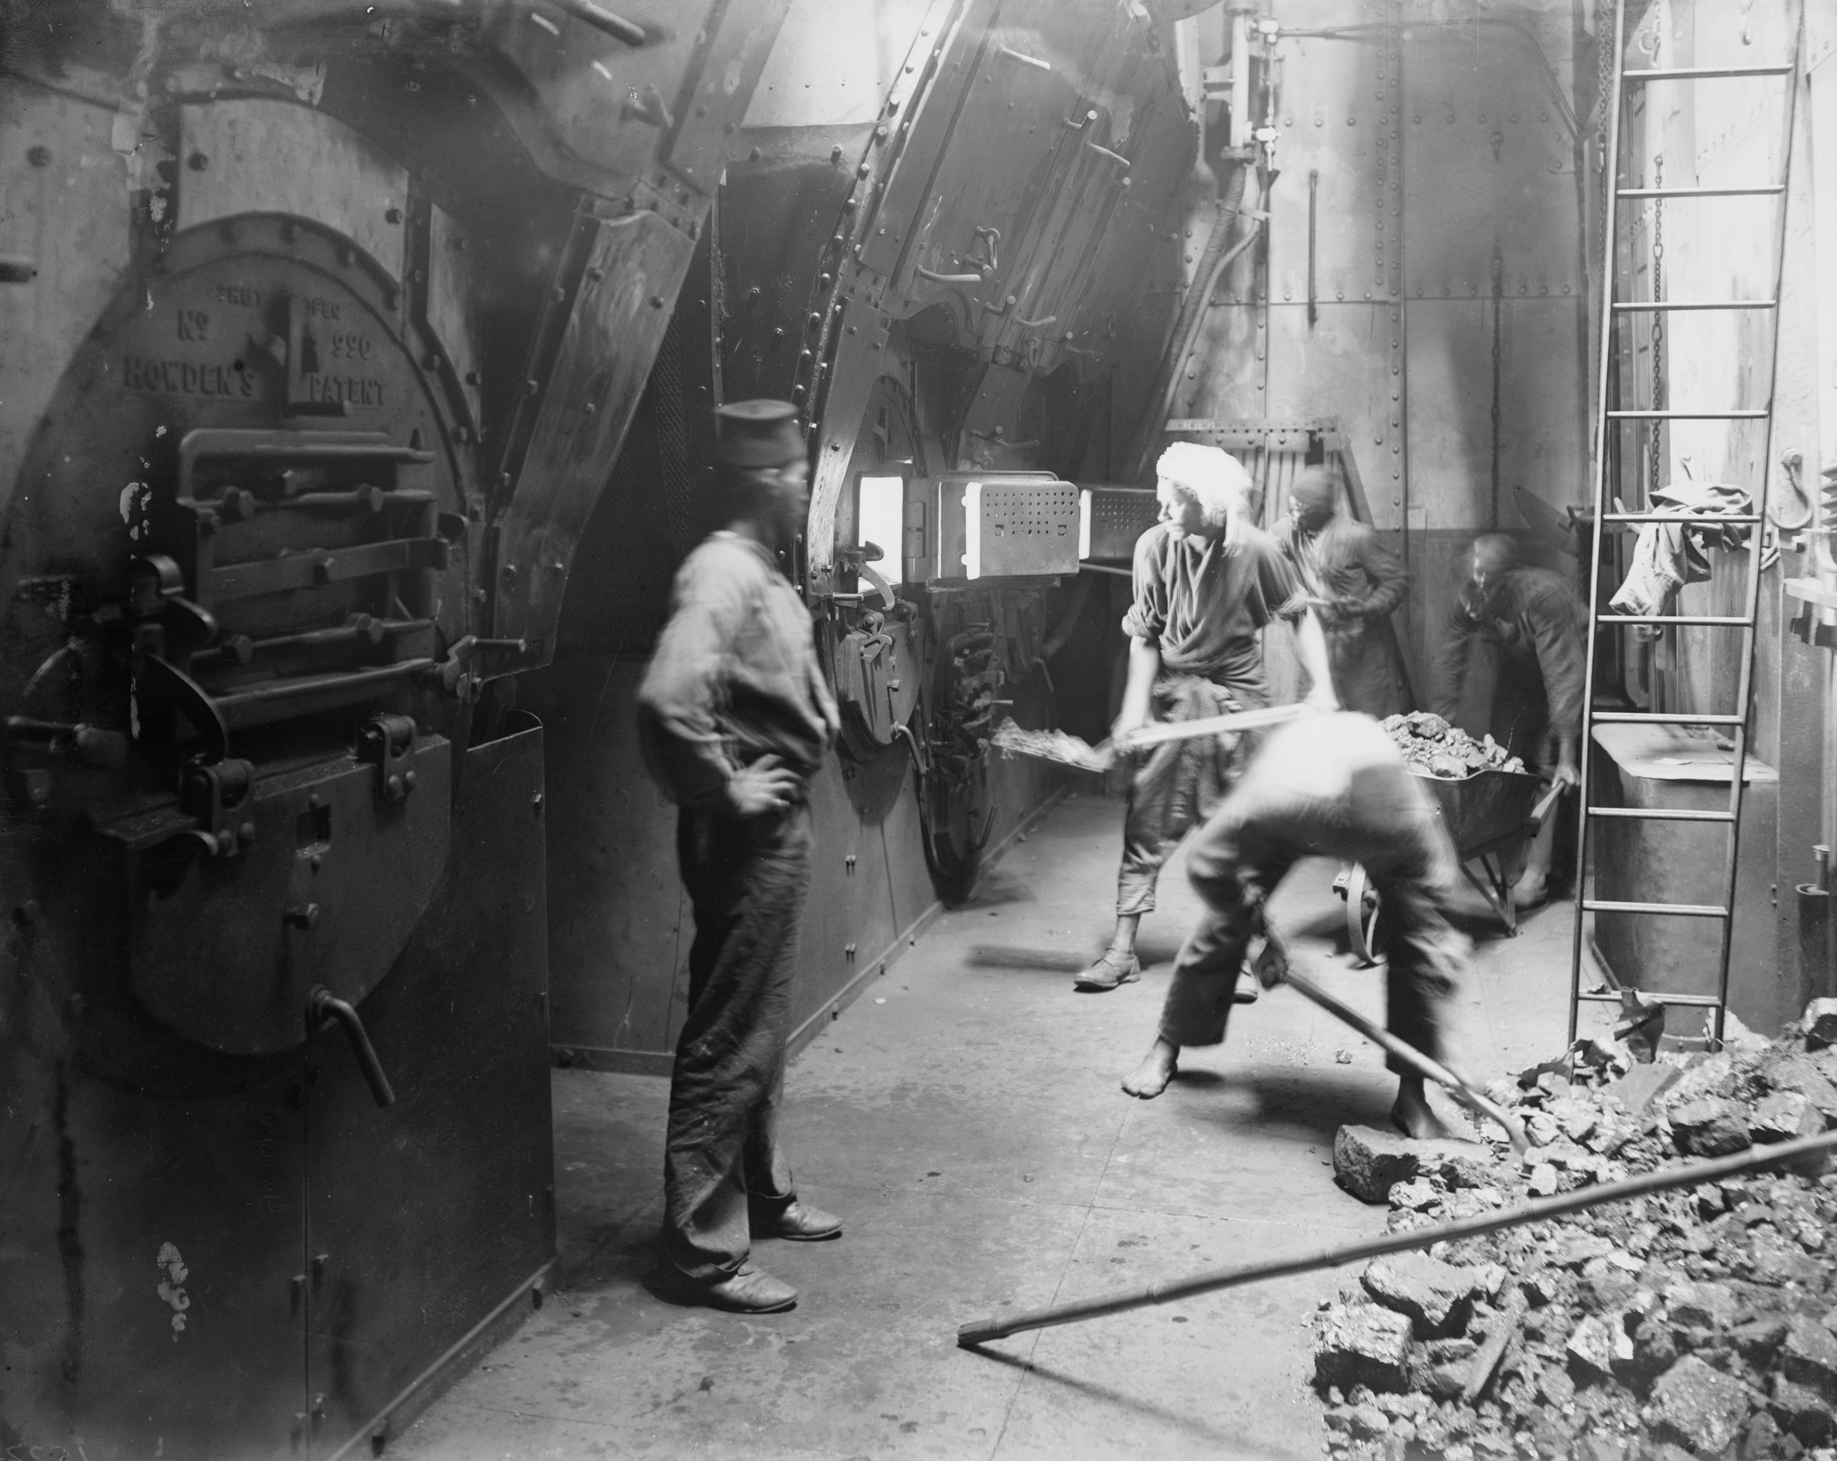
‘Boiler Room’. Lascar stokers in the hold of a P&O steamer shovelling coal to keep the fires burning. Getty Images.

Slide 15
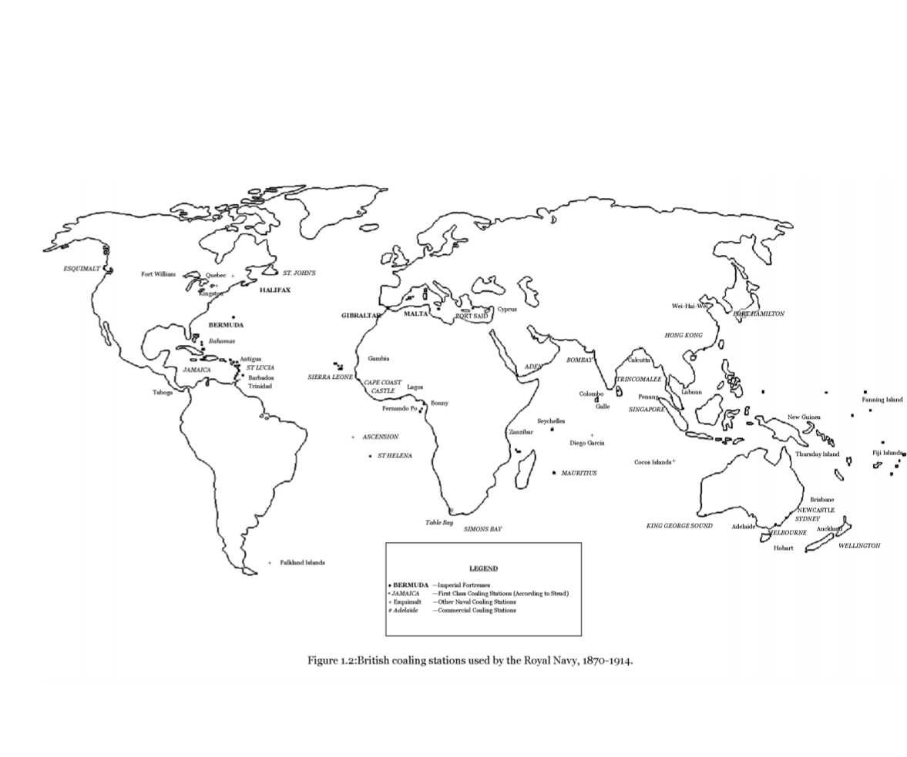

Slide 16
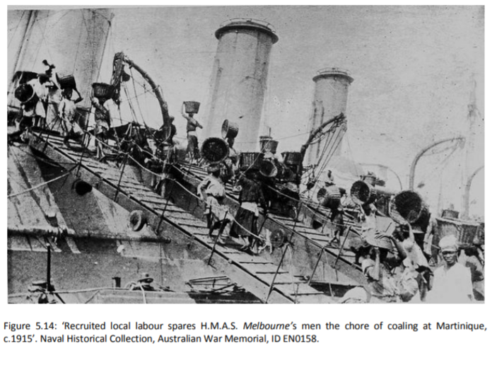
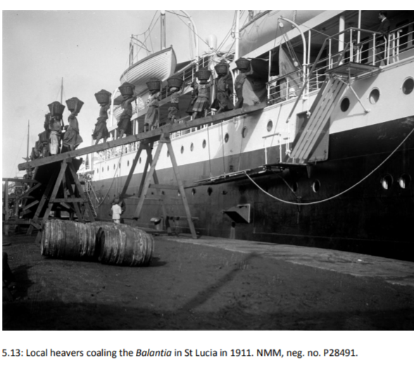

Slide 17
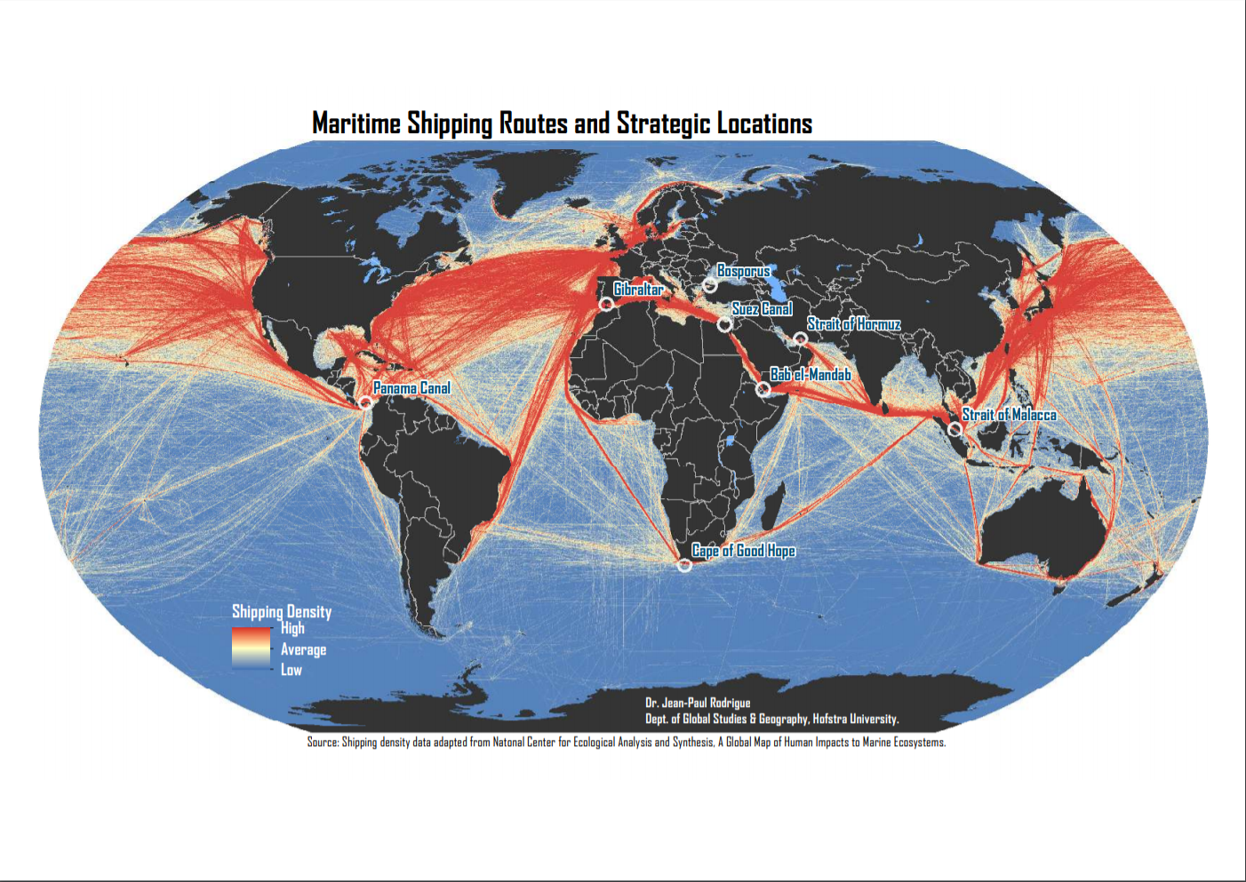

Slide 18
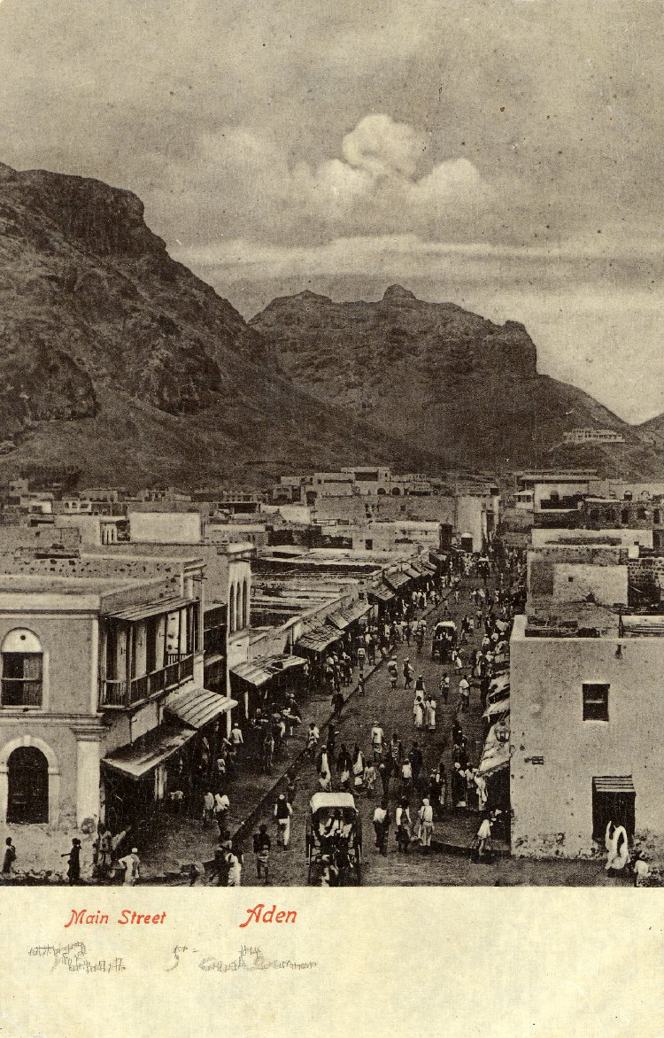
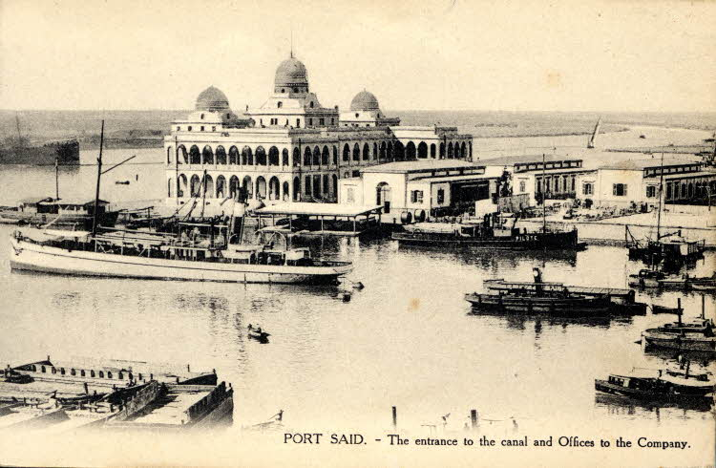
Postcard, printed paper, c. 1910; photograph showing the entrance to the Suez Canal and offices to the Suez Company at Port Said. British Museum, London.
Printed postcard, stamp postmarked Aden 17 April, 1906. British Museum, London.

Slide 19
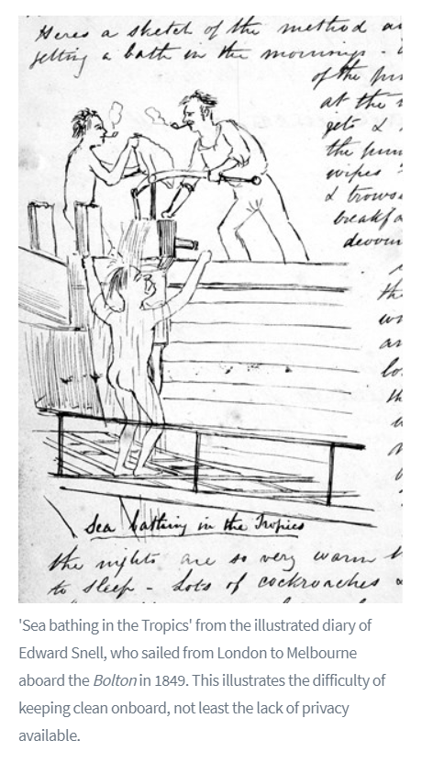
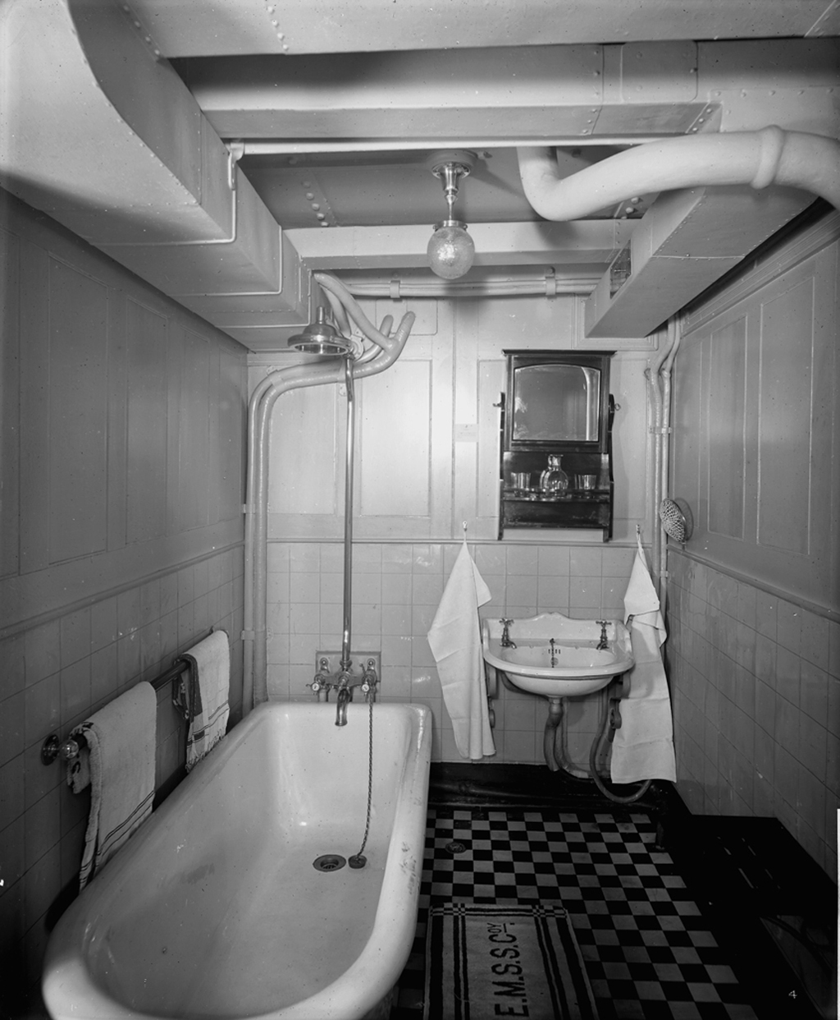
First class bathrooms on the passenger liner Royal George (1907). National Maritime Museum, London.

Slide 20
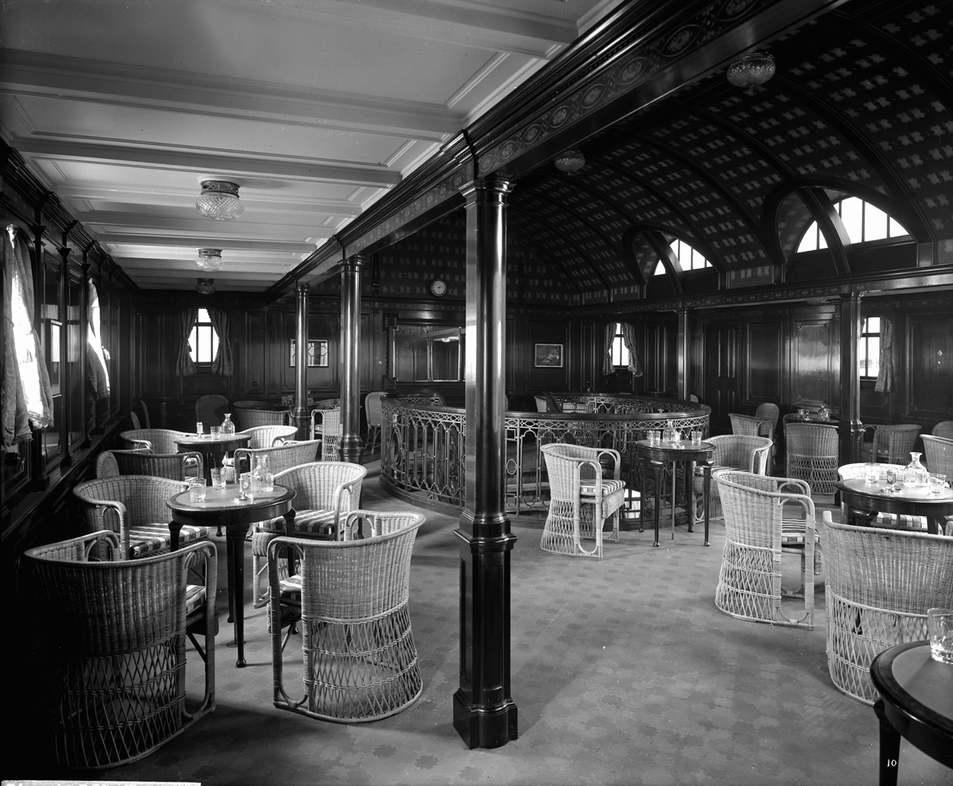
First class smokers’ lounge on the ‘Balmoral Castle’ (1910). National Maritime Museum, Greenwich, London.

