Slide 1
Telegraph
The nervous system of empire?

Slide 2
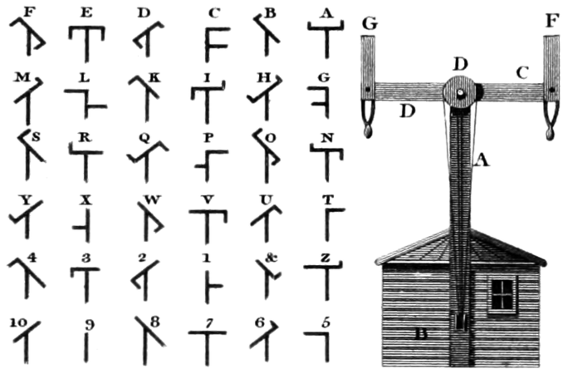

Slide 3
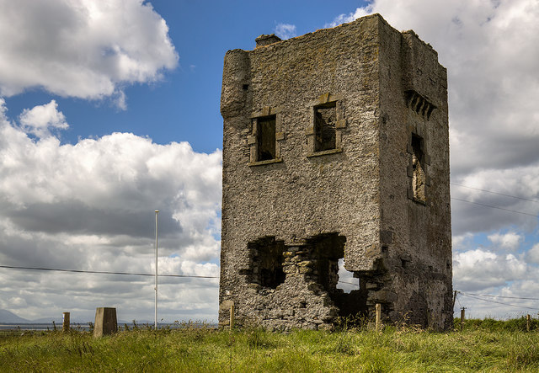
Rathlee signal tower, co. Sligo, part of an optical telegraph system that encircled coastal Ireland during the Revolutionary and Napoleonic Wars.

Slide 4
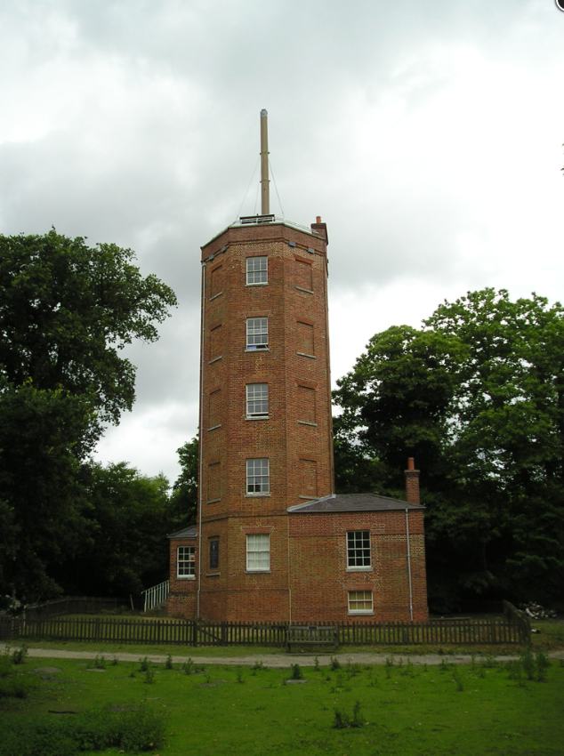
Tower at Chatley Heath, Surrey, part of the 1822 London-Portsmouth semaphore line.

Slide 5
Anglo-American rivalry
Sir William Fothergill Cooke and Sir Charles Wheatstone’s model
Currents travel through wires, moving needles to specific letters and numbers.
Patented in 1837
Samuel F.B. Morse’s model
Developed code of dots and dashes to represent letters and numbers – receiver embossed the dots and dashes on an unwinding strip of paper.
Patented in 1837

Slide 6
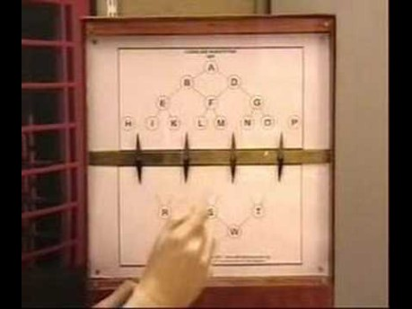
https://youtu.be/XFl7T4aBZAA

Slide 7
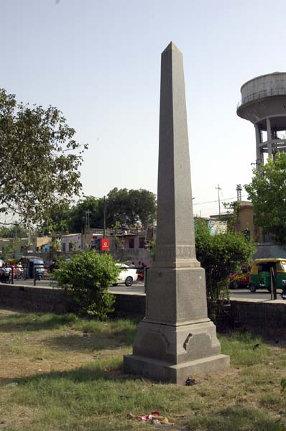
Telegraph memorial, Delhi.

Slide 8
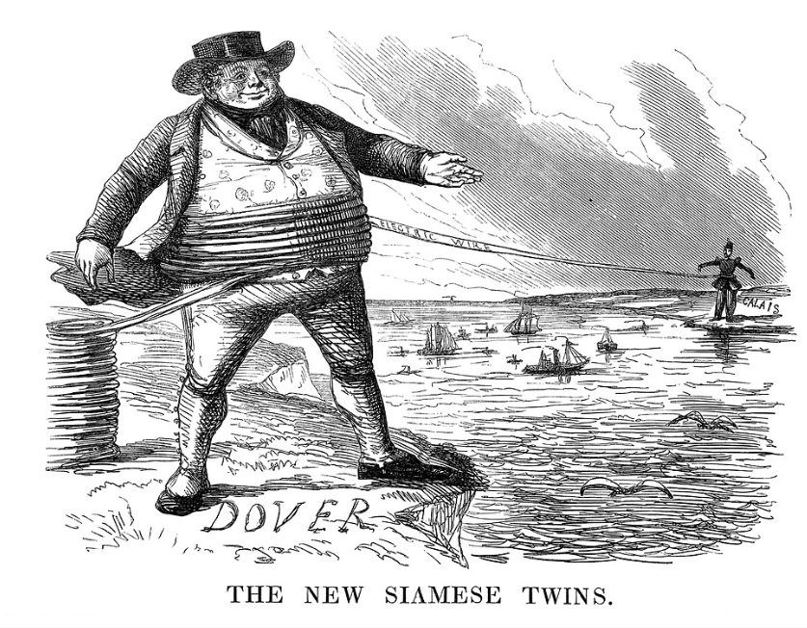
John Leech, The New Siamese Twins, Punch 1851.

Slide 9
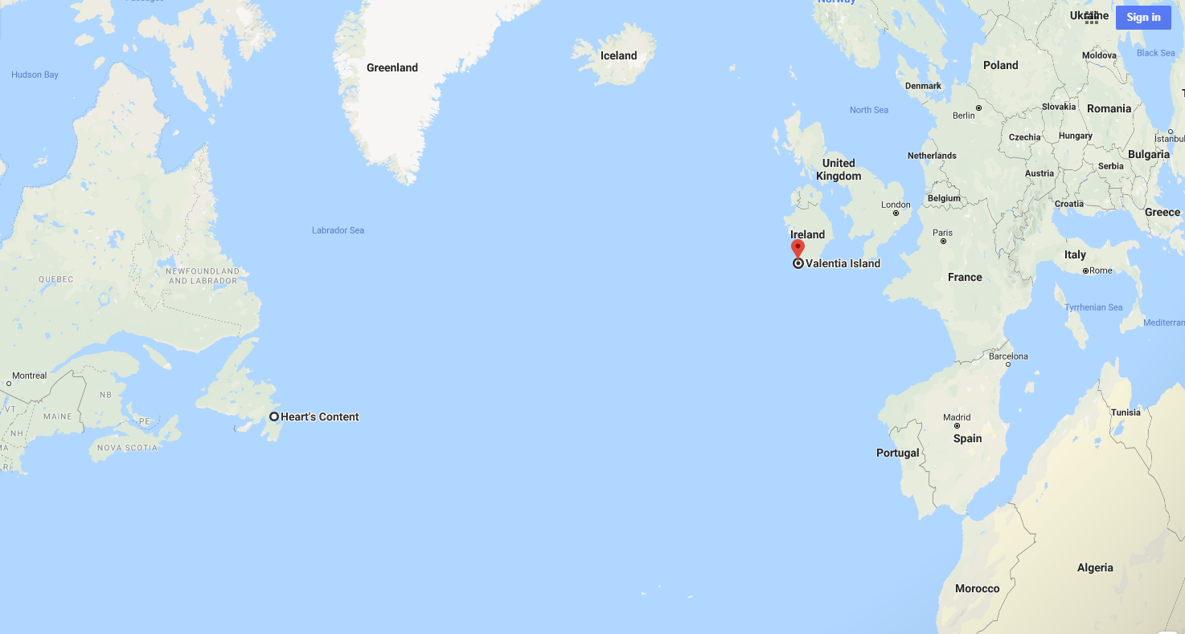

Slide 10
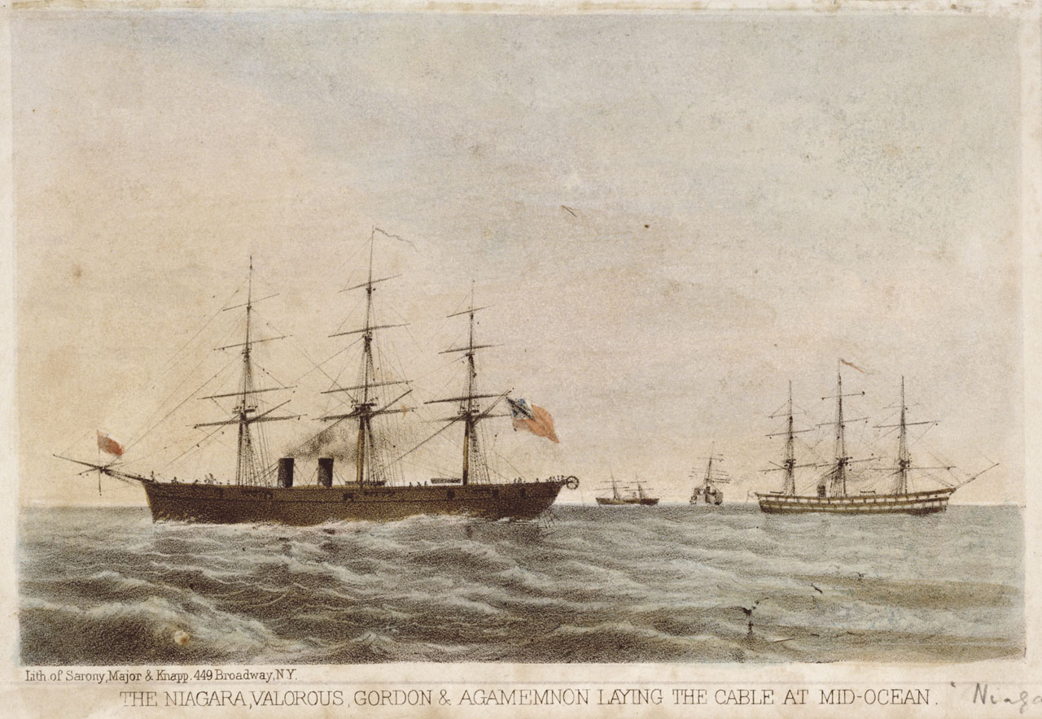
Sarony, Major & Knapp, The Niagara, Valorous, Gordon & Agamemnon laying the cable at mid-ocean. 1861. Tinted lithograph. National Maritime Museum.

Slide 11
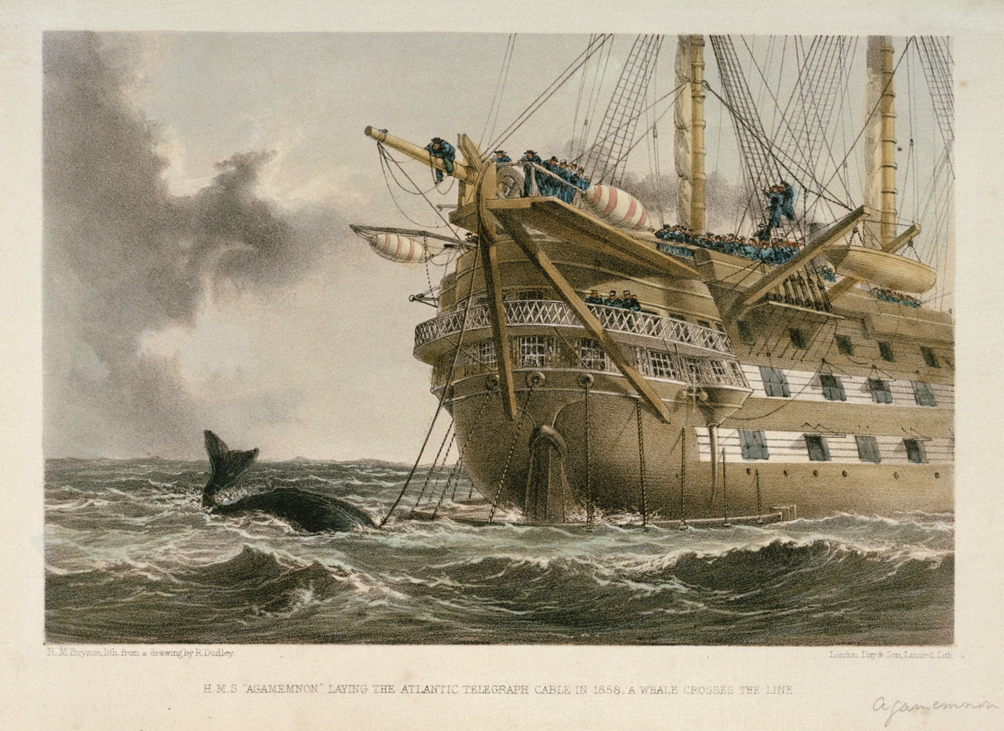
HMS Agamemnon laying the Atlantic Telegraph cable in 1858. Coloured lithograph. National Maritime Museum, London.

Slide 12
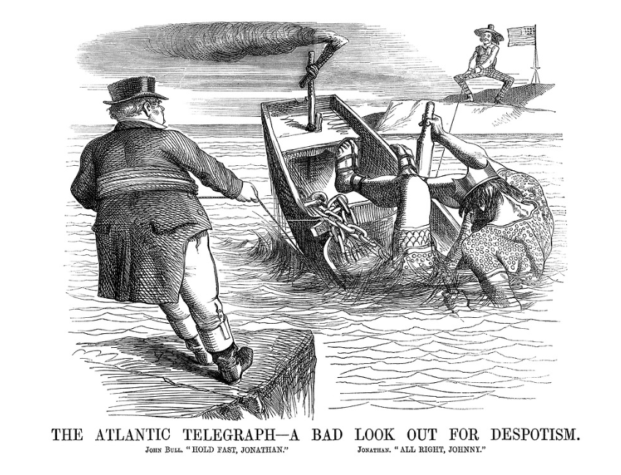
John Tenniel, 1858, for Punch.

Slide 13
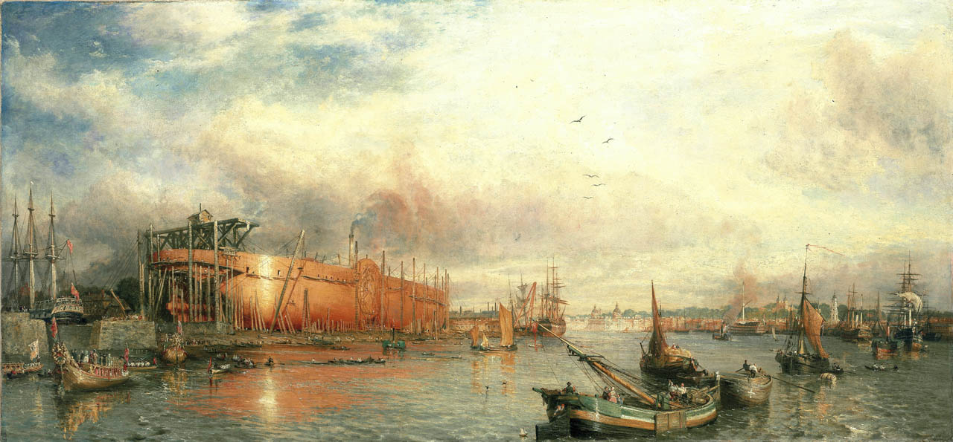
Parrott, William. Building the ‘Great Leviathan’ (the ‘Great Eastern’). 1858. Oil painting. National Maritime Museum, London.

Slide 14
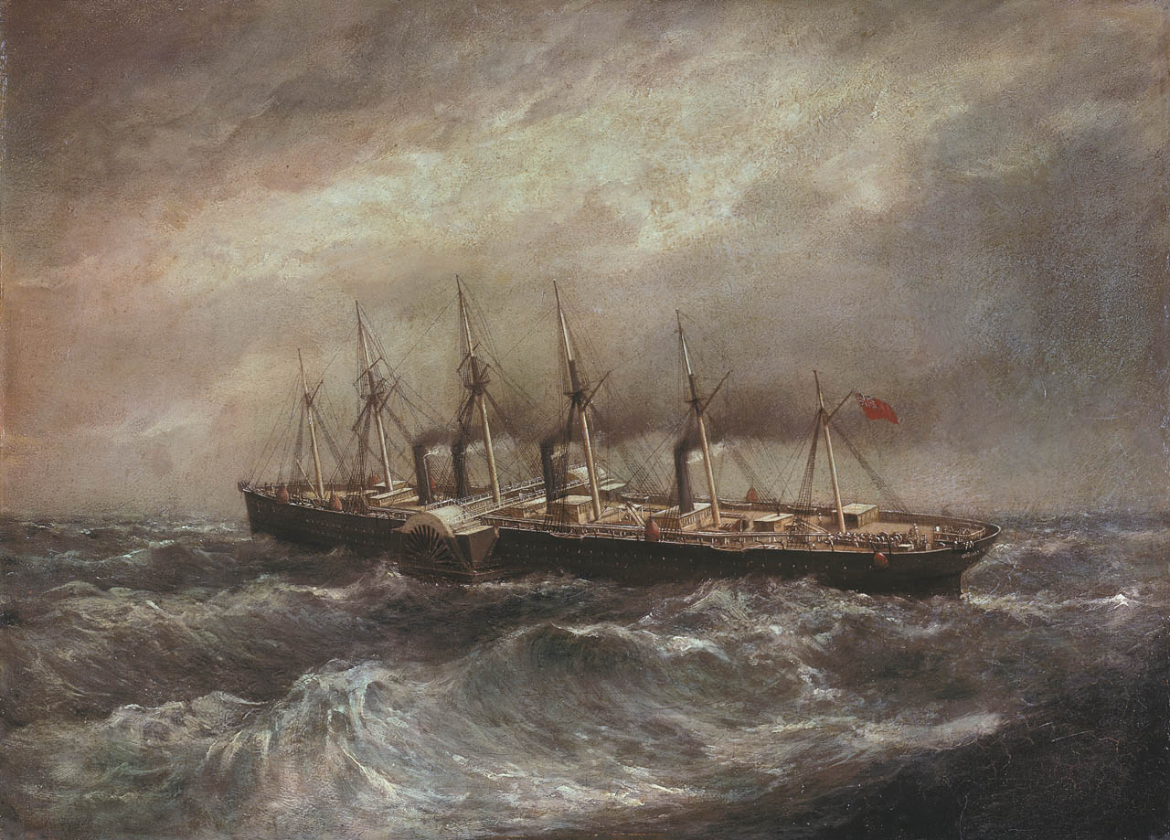
Clifford, Henry. The steamship Great Eastern laying the first successful Atlantic cable. Oil on cardboard. National Maritime Museum, London.

Slide 15
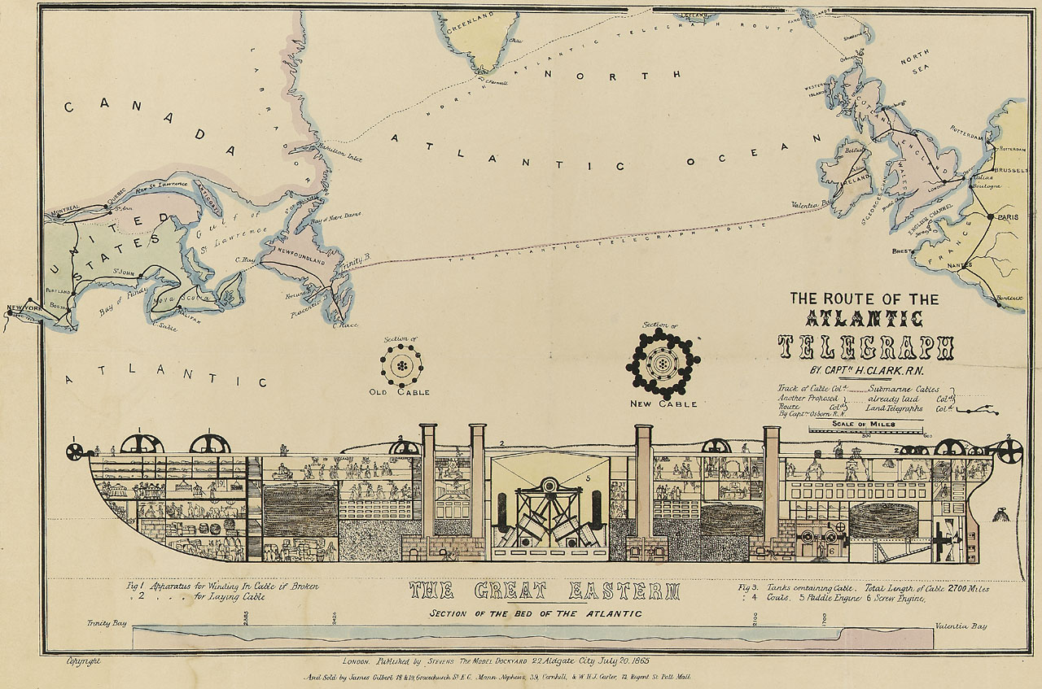

Slide 16
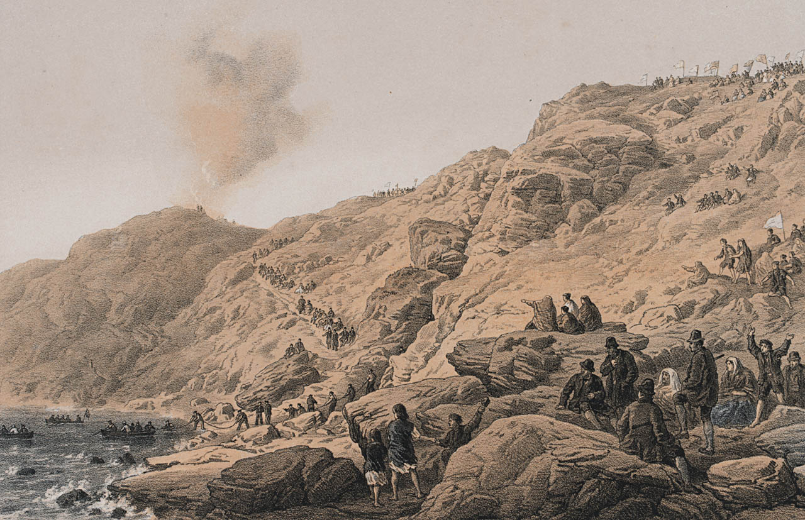
Dudley, Robert. The cliffs Foilhummerum Bay, point of the landing of the shore end of cable July 22nd. National Maritime Museum, London.

Slide 17
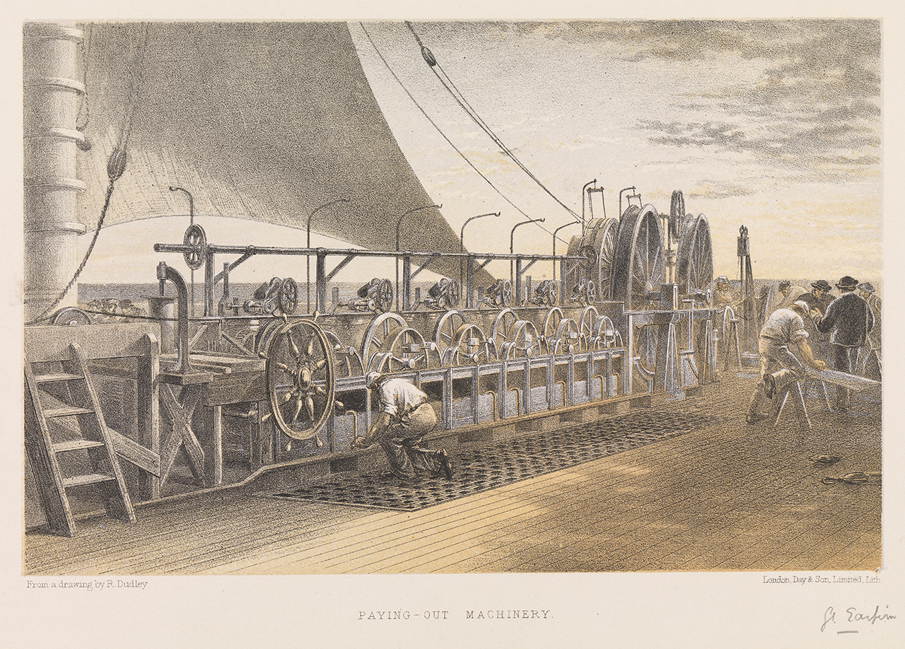
Dudley, Robert. Paying-out machinery (Great Eastern). Lithograph, tinted. National Maritime Museum, London.

Slide 18
Telegraph timeline
1853 – Ireland and Great Britain connected
1864 – Britain and India connected via Persian Gulf
1866 – Britain and Canada connected via Atlantic cable
1871 – Britain linked, via India, with Singapore, Japan, and China
1902 – Pacific cable creates ‘all-red route’

Slide 19
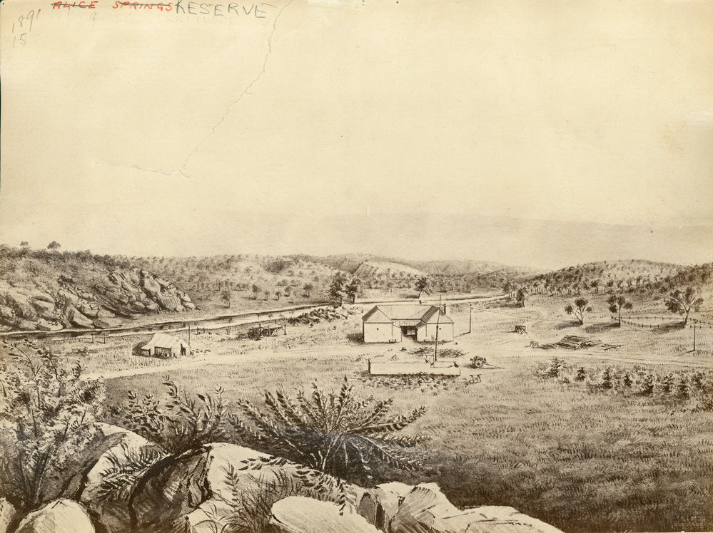
Edwin Stow, Barry. Alice Springs telegraph station. 1872. State Library, South Australia.

Slide 20
I will not wash my face;
I will not brush my hair;
I "pig" around the place —
There's nobody to care.
Nothing but rock and tree;
Nothing but wood and stone;
Oh God, it's hell to be
Alone, alone, alone.
Snow-peaks and deep-gashed draws
Corral me in a ring.
I feel as if I was
The only living thing
On all this blighted earth;
And so I frowst and shrink,
And crouching by my hearth,
I hear the thoughts I think.
I think of all I miss —
The boys I used to know;
The girls I used to kiss;
The coin I used to blow:
The bars I used to haunt;
The racket and the row;
The beers I didn't want
(I wish I had 'em now).
Day after day the same,
Only a little worse;
No one to grouch or blame —
Oh, for a loving curse!
Oh, in the night I fear,
Haunted by nameless things,
Just for a voice to cheer,
Just for a hand that clings!
Faintly as from a star
Voices come o'er the line;
Voices of ghosts afar,
Not in this world of mine.
Lives in whose loom I grope;
Words in whose weft I hear
Eager the thrill of hope,
Awful the chill of fear.
I'm thinking out aloud;
I reckon that is bad;
(The snow is like a shroud) —
Maybe I'm going mad.
Say! wouldn't that be tough?
This awful hush that hugs
And chokes one is enough
To make a man go "bugs".
There's not a thing to do;
I cannot sleep at night;
No wonder I'm so blue;
Oh, for a friendly fight!
The din and rush of strife;
A music-hall aglow;
A crowd, a city, life —
Dear God, I miss it so!
Here, you have moped enough!
Brace up and play the game
But say, it's awful tough —
Day after day the same
(I've said that twice, I bet).
Well, there's not much to say.
I wish I had a pet,
Or something I could play.
Cheer up! don't get so glum
And sick of everything;
The worst is yet to come;
God help you till the Spring.
God shield you from the Fear;
Teach you to laugh, not moan.
Ha! ha! it sounds so queer —
Alone, alone, alone.

Slide 21
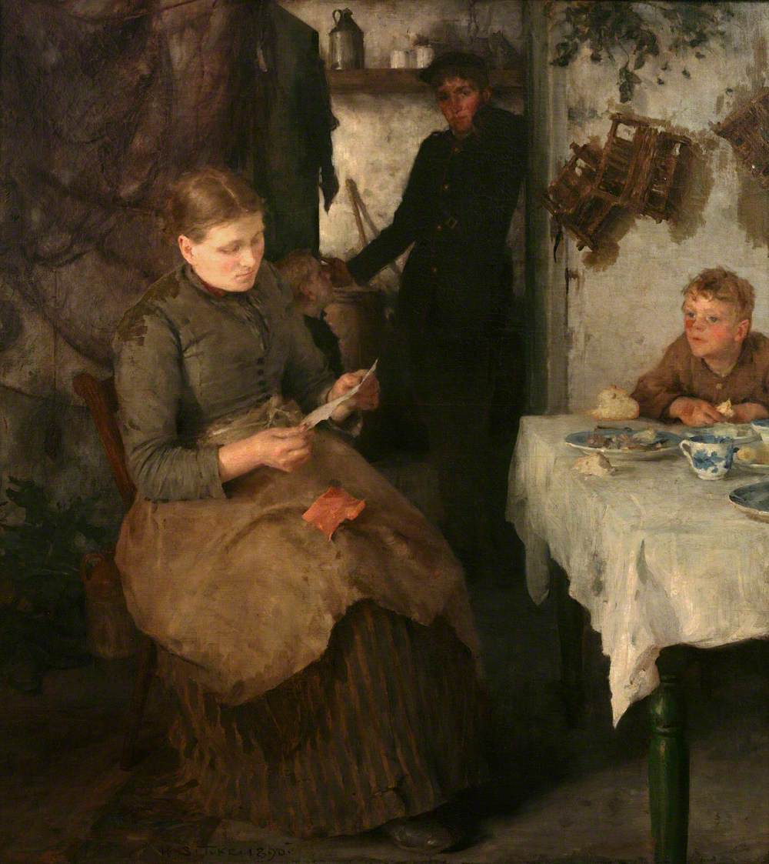
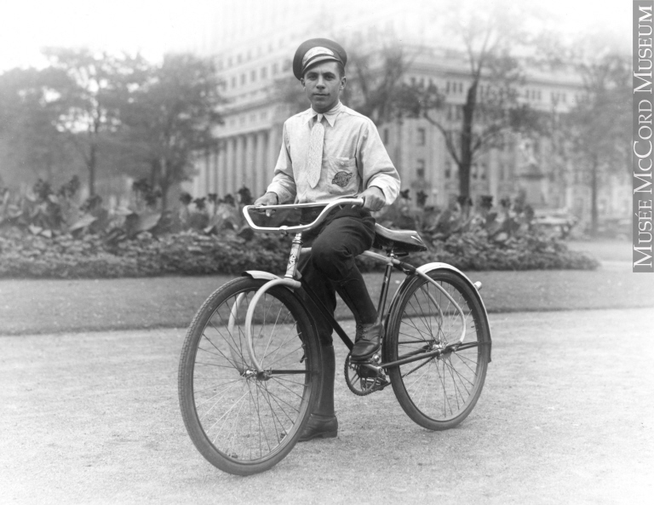
Telegraph boy on bicycle, Dominion Square, Montreal, about 1935. McCord Museum Collections.
Tuke, Henry Scott. The Message. 1890. Falmouth Art Gallery.

Slide 22
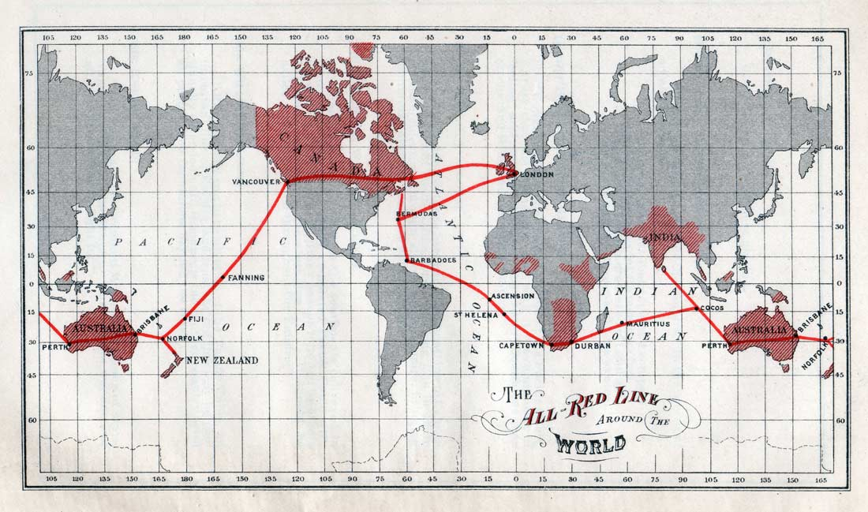

Slide 23
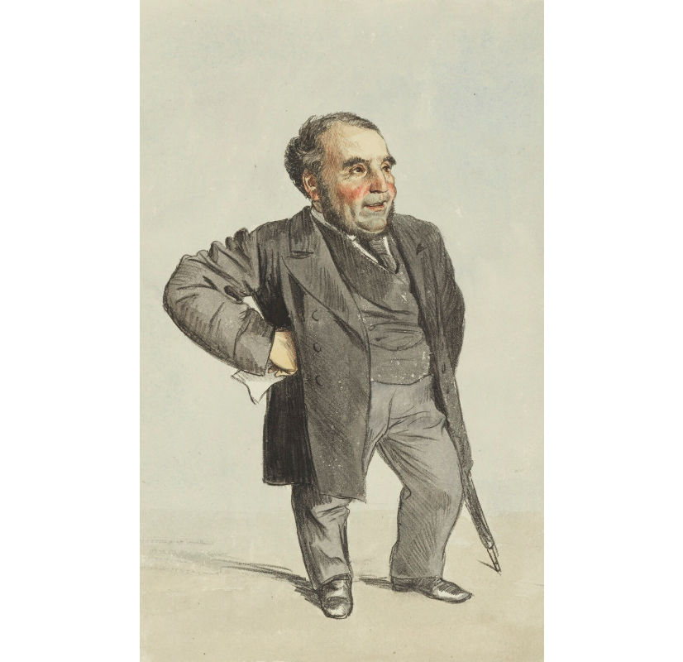
Sir John Pender (1816-96)
Started out as a textile trader, trading to India and China
Invested in the new Atlantic Telegraph Company in 1856
Founded Telegraph Construction and Maintenance Company in 1864 and lay new transatlantic cable
Pender forms the Eastern Telegraph Company in 1872, absorbing smaller companies to become the largest submarine telegraph company in the world
Tissot, James Jacques. Sir John Pender. Published in Vanity Fair, 1871. National Portrait Gallery, London.

Slide 24
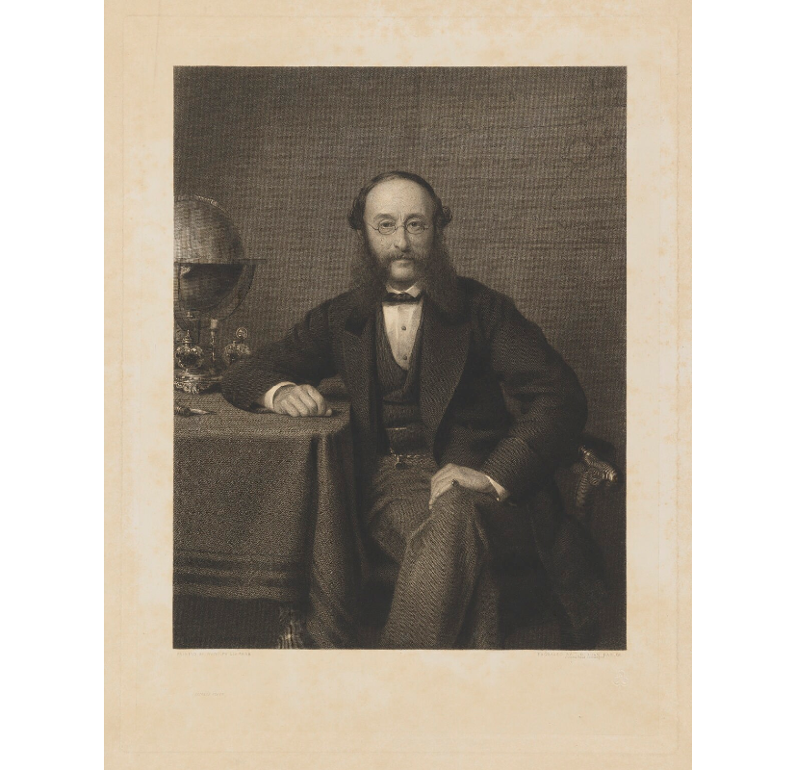
(Paul) Julius de Reuter (1816-1899)
Worked in publishing and news agencies
Set up an office in the Royal Exchange Buildings in London in 1851, using new Dover-Calais cable to transmit information useful on the stock exchanges.
News agency offices established in Alexandria in 1865 and Bombay in 1866.
In 1870 Reuter formed a worldwide news agency cartel.
Barlow, Thomas Oldham. (Paul) Julius de Reuter, Baron de Reuter. 1910. National Portrait Gallery.

Slide 25
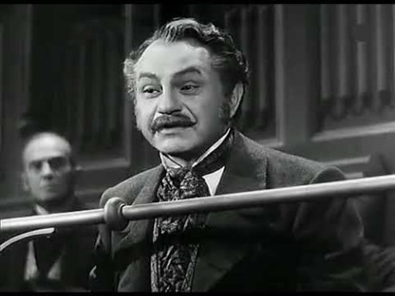
https://youtu.be/_8-WW3t7FSo

Slide 26
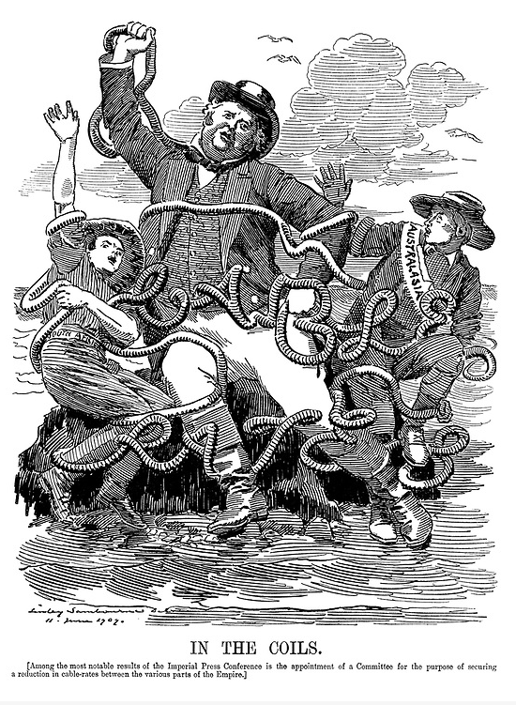
Sambourne, Edward Linely. In the Coils. Punch Magazine, 1909.

