Slide 1
Wind and Sail
1780-1914

Slide 2
Climate and environmental factors
Ice, winds, and currents

Slide 3
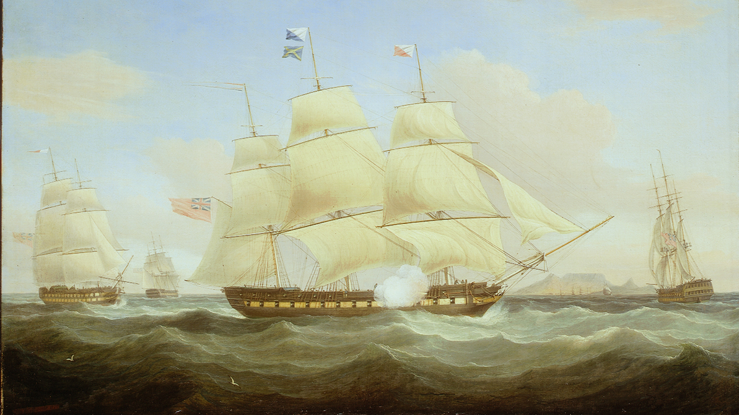
The East Indiamen
Whitcombe, Thomas. The East Indiamen ‘Minerva’, ‘Scaleby Castle’ and ‘Charles Grant’. Oil on canvas. 1820. National Maritime Museum, Greenwich, London.

Slide 4
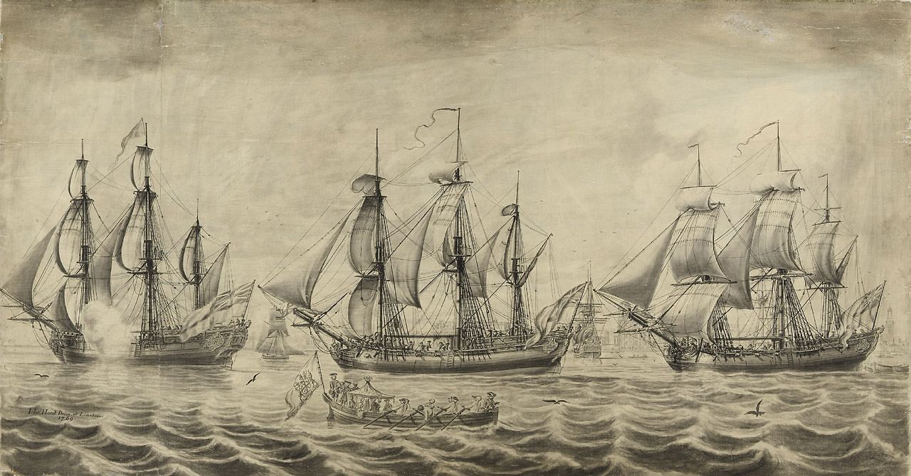
The Nor’westers
Hood, John. Three ships of the Hudson’s Bay Company off Greenwich. Pen and ink. 1789. National Maritime Museum, Greenwich, London.

Slide 5
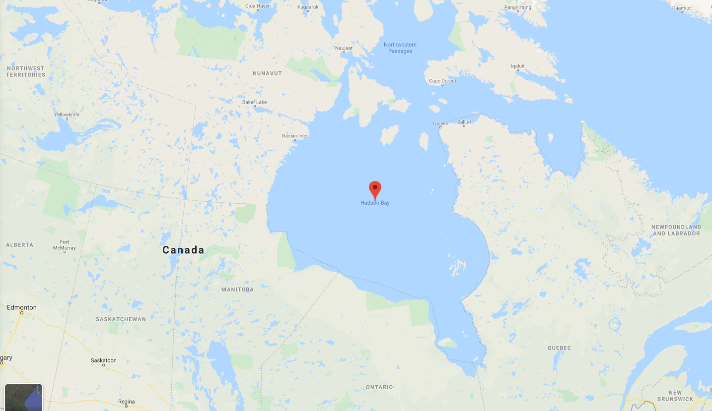

Slide 6
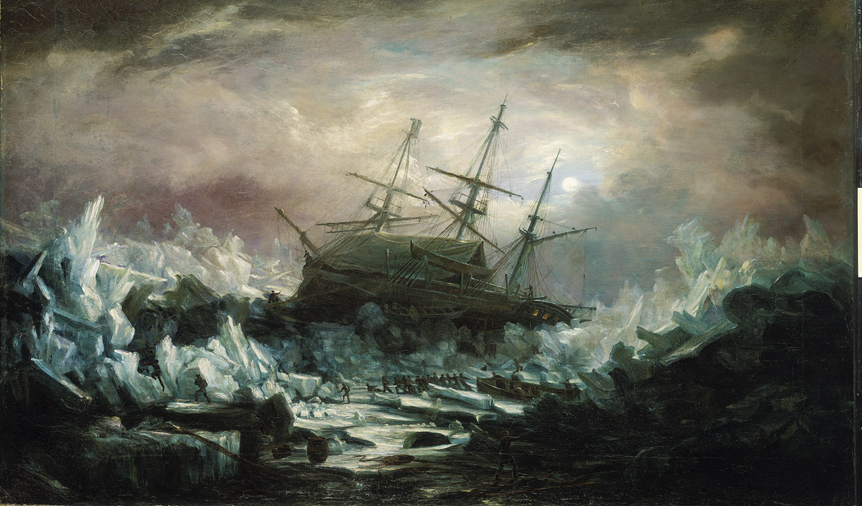
HMS Terror
Smyth, William Henry. Perilous position of HMS Terror, Captain Back, in the Arctic Regions in the summer of 1837. Oil on canvas. National Maritime Museum, Greenwich, London.

Slide 7
Geography
Islands, straits, and canals

Slide 8
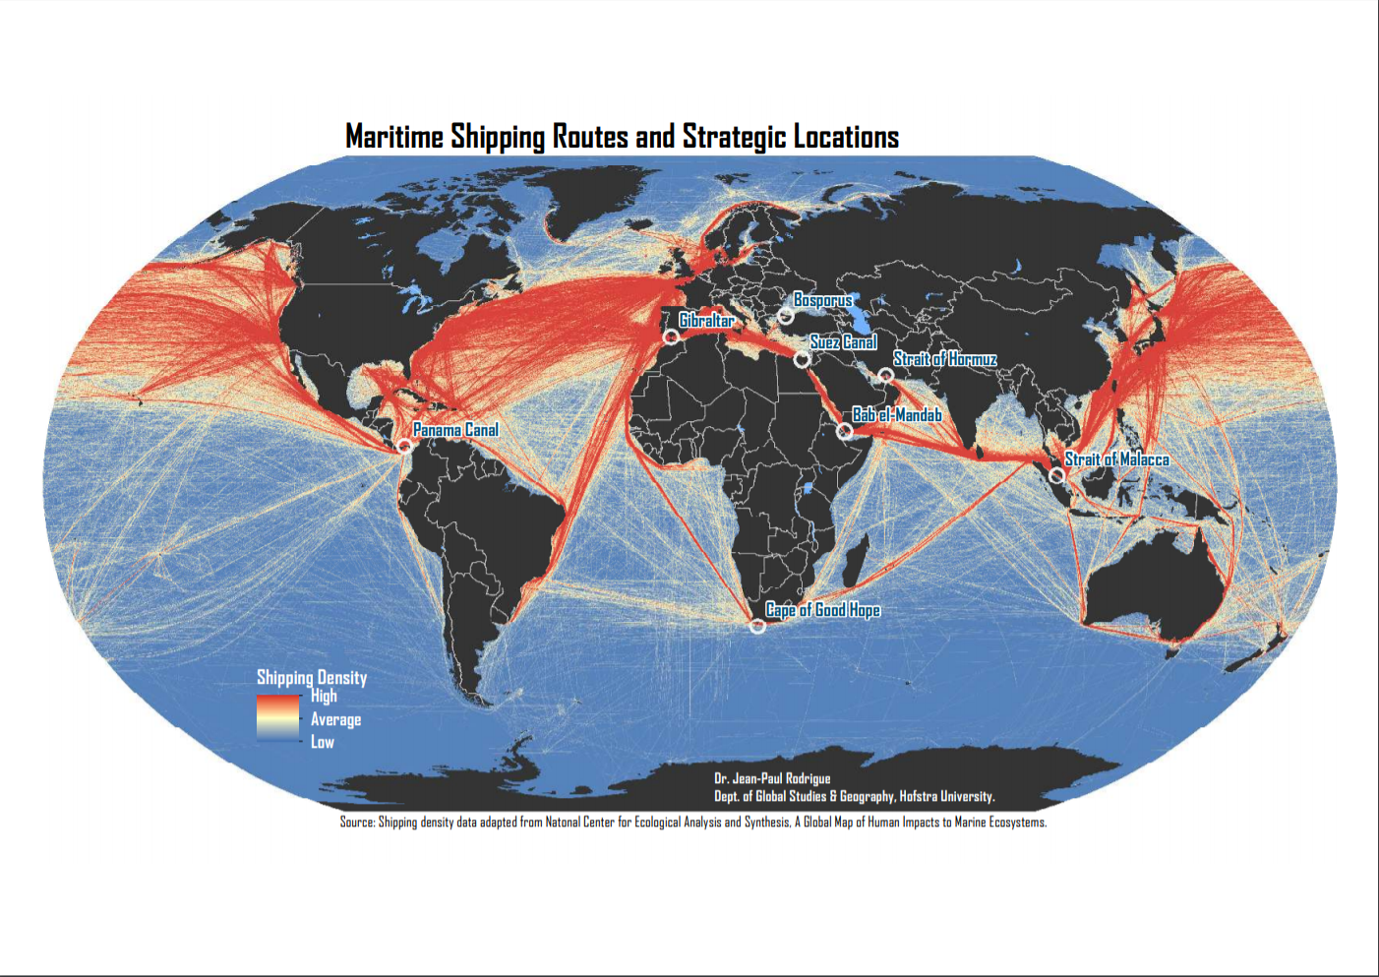

Slide 9
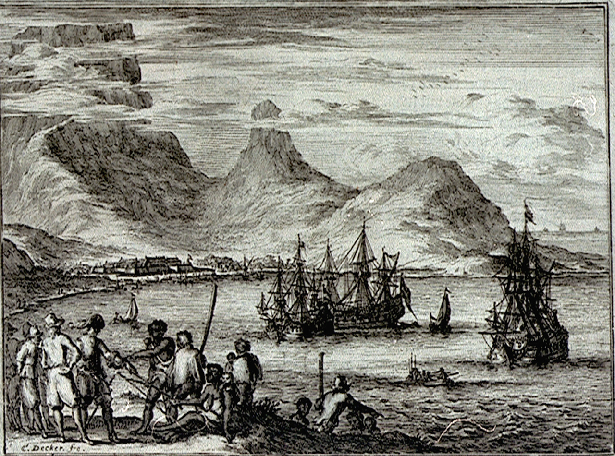
Decker, Coenraet. Engraving. National Maritime Museum, Greenwich, London.
Cape Town

Slide 10
Maritime labour
Freedom and diversity; discipline and mutiny

Slide 11
Key concepts
Hydrarchy
Many-headed hydra
Motley crew

Slide 12
Herman Melville, Moby Dick (1851) – chapter 6, ‘The Street’
‘If I had been astonished at first catching a glimpse of so outlandish an individual as Queequeg circulating among the polite society of a civilized town, that astonishment soon departed upon taking my first daylight stroll through the streets of New Bedford.
In thoroughfares nigh the docks, any considerable seaport will frequently offer to view the queerest looking nondescripts from foreign parts. Even in Broadway and Chestnut streets, Mediterranean mariners will sometimes jostle affrighted ladies. Regent Street is not unknown to Lascars and Malays; and at Bombay, in the Apollo Green, live Yankees have often scared the natives. But New Bedford beats all Water Street and Wapping. In these last-mentioned haunts you see only sailors; but in New Bedford, actual cannibals stand chatting at street corners; savages outright; many of whom yet carry on their bones unholy flesh. It makes a stranger stare.’

Slide 13
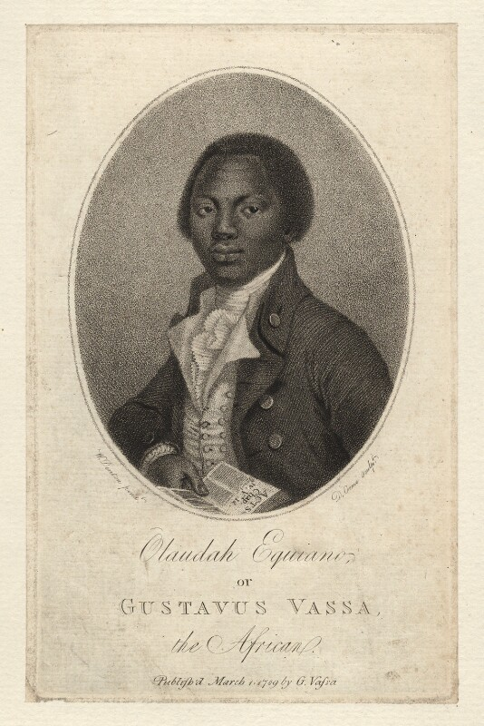
Olaudah Equiano (1745-97)
Born in Nigeria; kidnapped at the age of eleven
Purchased his freedom and moved to Britain
Prominent spokesman for the black community in London and key abolitionist figure
Published his autobiographical Interesting Narrative in 1789, recounting his experiences as a slave.
Portrait by Daniel Orme. Stipple engraving. 1789. National Portrait Gallery, London.

Slide 14
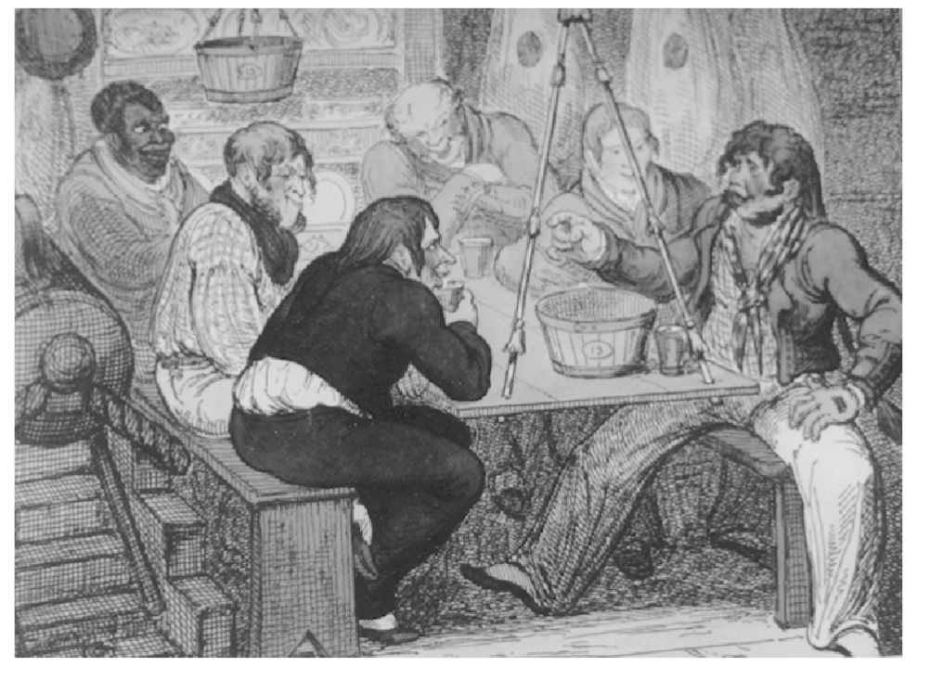
Robinson, Charles Napier. Sailors telling tales belowdecks. 1810. Inc. in A Pictorial History of the Sea Services or Graphic Studies of the Sailor’s Life and Character Afloat (1911). Brown Military Collection, John Hay Library, Brown University.

Slide 15
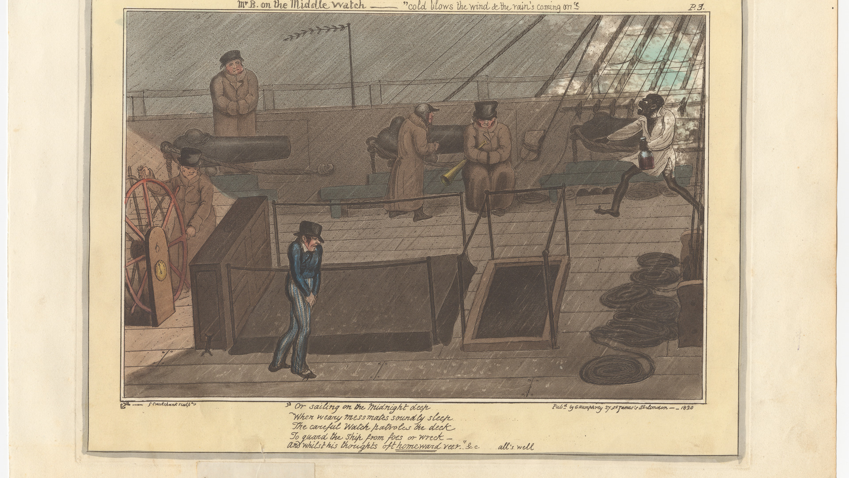

Slide 16
Shipboard life
What was it like to travel by sea?

Slide 17
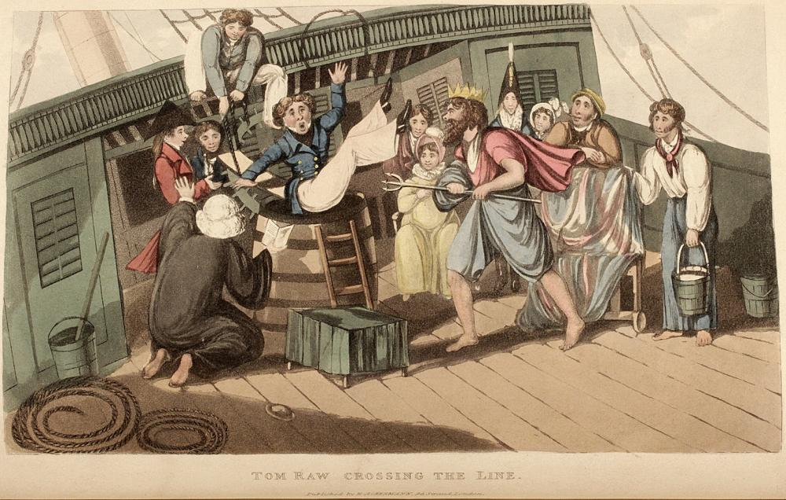
From D’Oyly, Charles, Tom Raw the Griffin: a burlesque poem in twelve cantos, illustrated by twenty-five engravings, descriptive of the adventures of a cadet in the East India Company’s service, from the period of his quitting England to his obtaining a staff situation in India. (London, 1828).

Slide 18
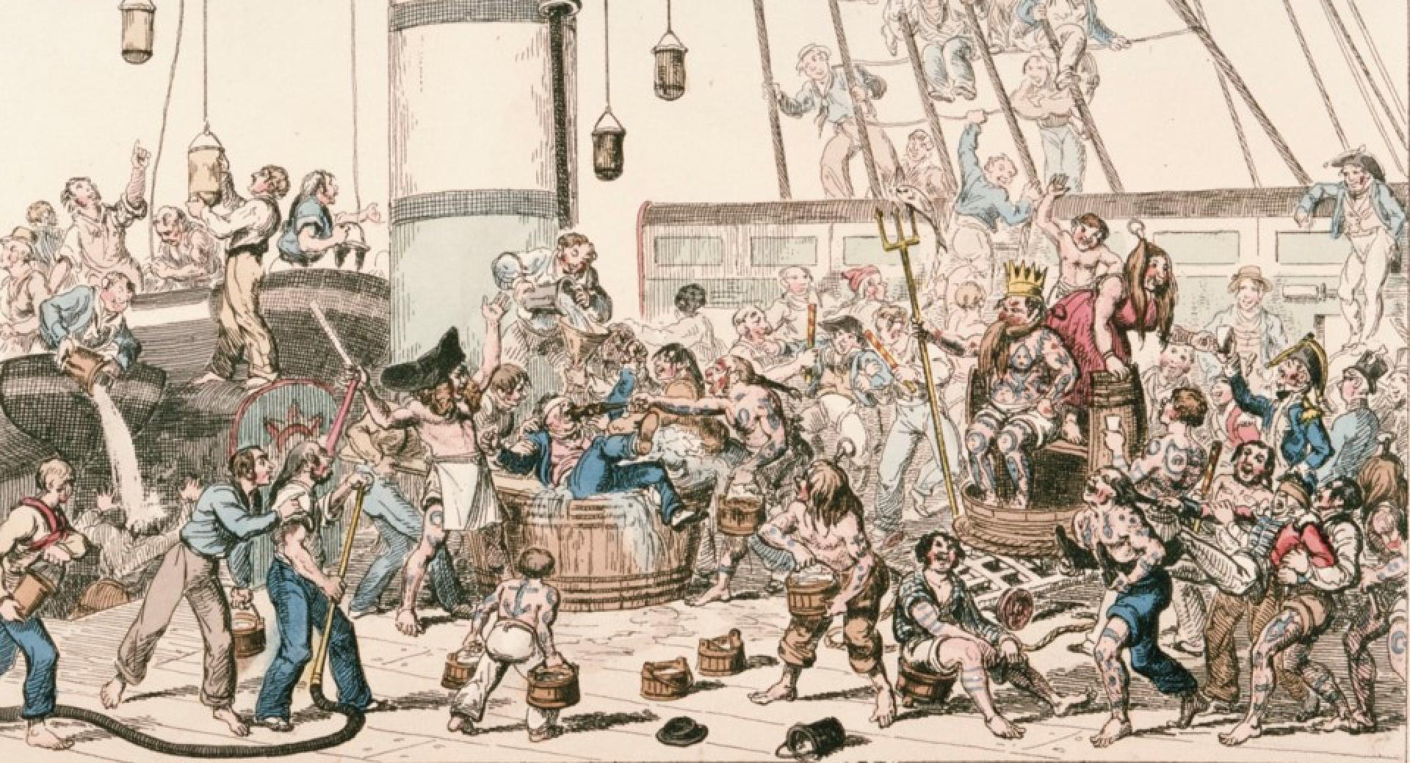
Crossing the Line, 1 September 1825, George Cruikshank

Slide 19
‘Voyages of discovery’
Exploration of the Pacific and the search for the Northwest Passage

Slide 20
Voyages of Captain James Cook
1768-1771: First voyage – Endeavour
1772-1775: Second voyage – Resolution and Adventure
1776-1780: Third voyage – Resolution and Discovery

Slide 21
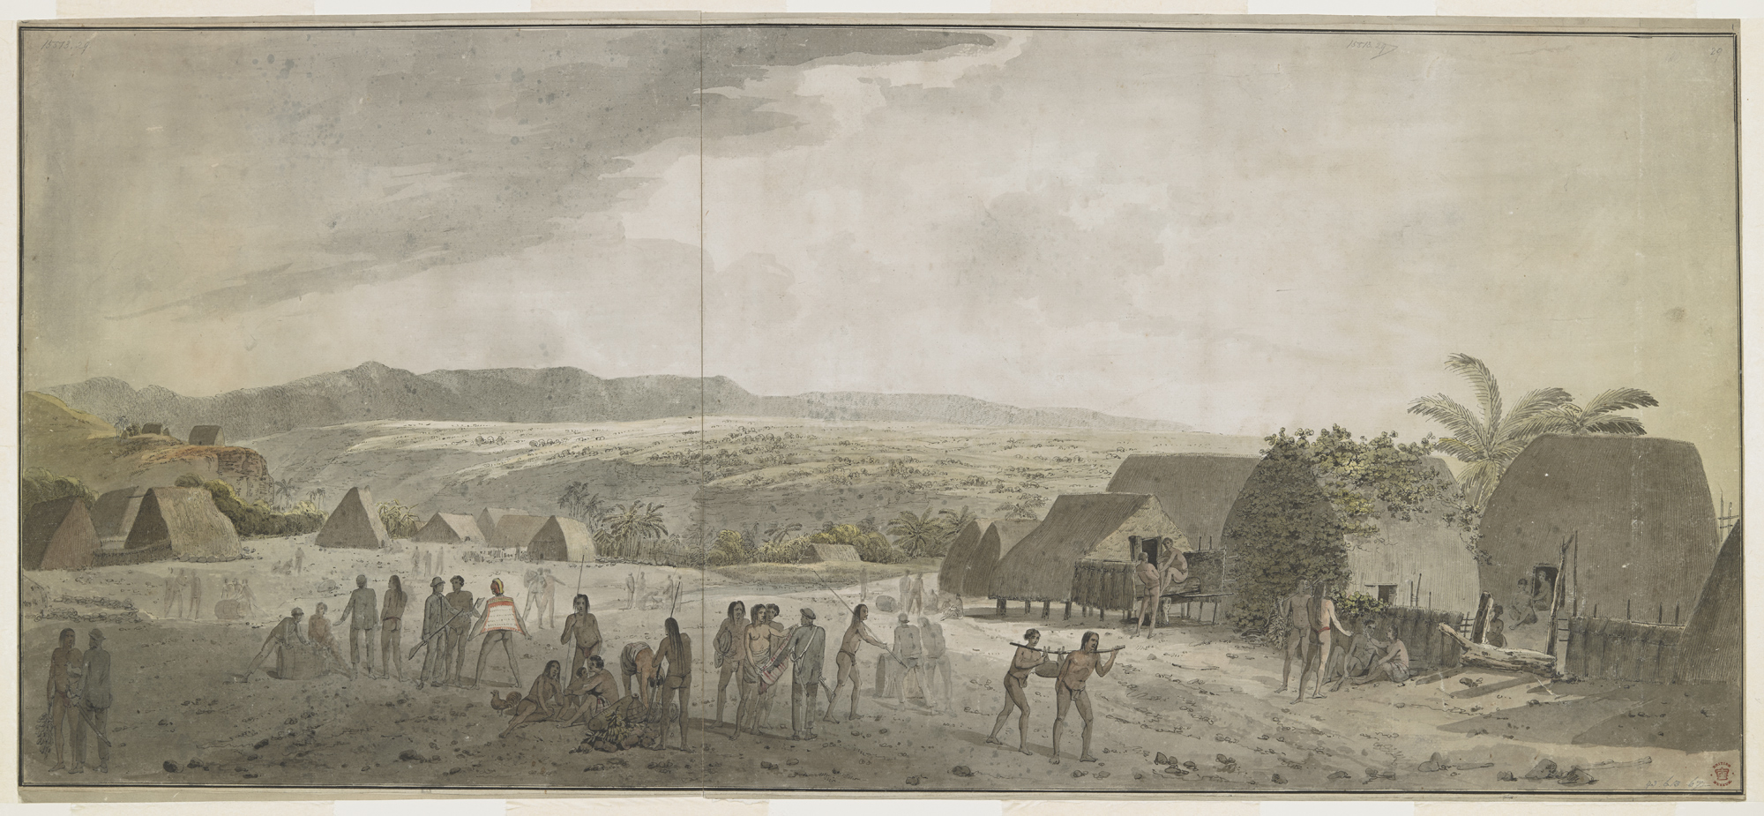
Webber, John. An inland view at Waimea, Atooi. Watercolour. 1778. From Drawings taken during the voyage of Captain James Cook 1777-1779, vol. 1. British Library, London.

Slide 22
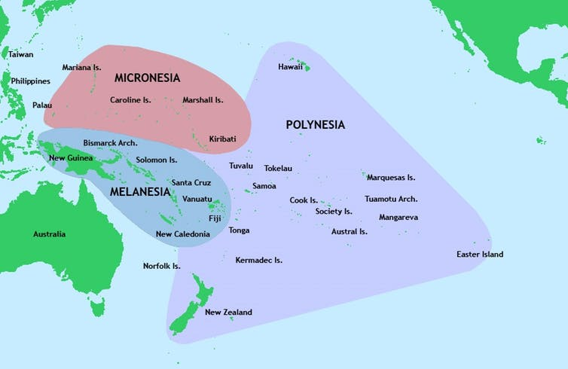
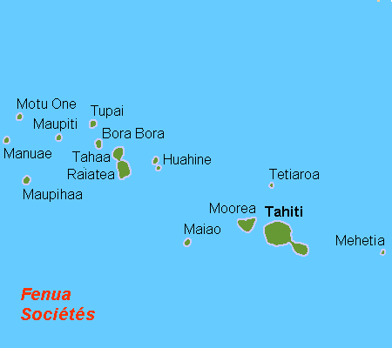

Slide 23
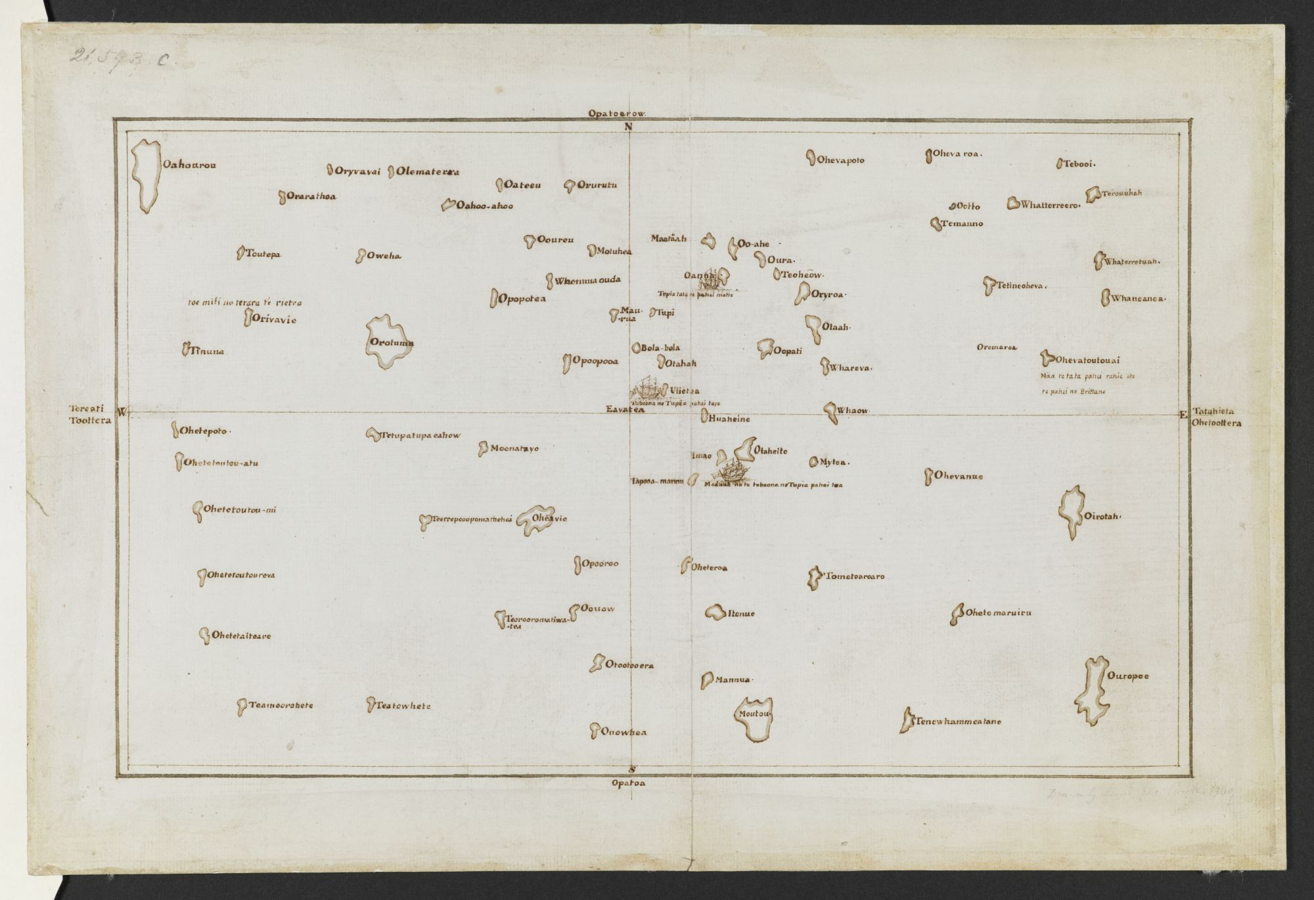
James Cook’s copy of Tupaia’s map of the Society Islands. 1769. British Library, London.

Slide 24
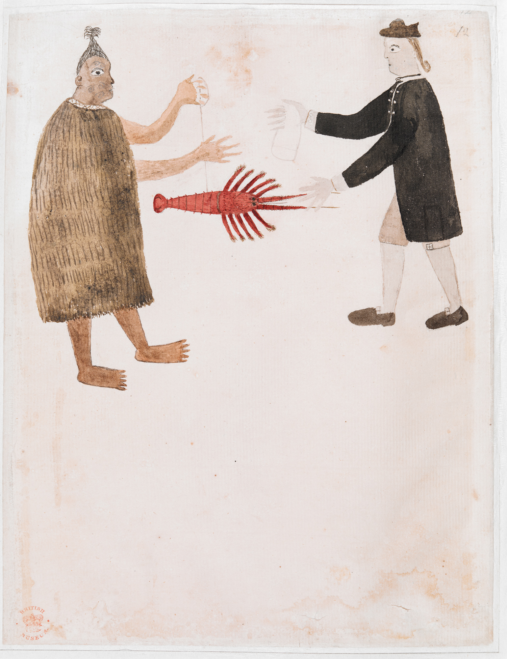
Tupaia. Maori trading a crayfish with Joseph Banks. 1769. From Drawings illustrative of Captain Cook’s first voyage, 1767-1770, chiefly relating to Otaheite and New Zealand. British Library, London.

