Slide 1
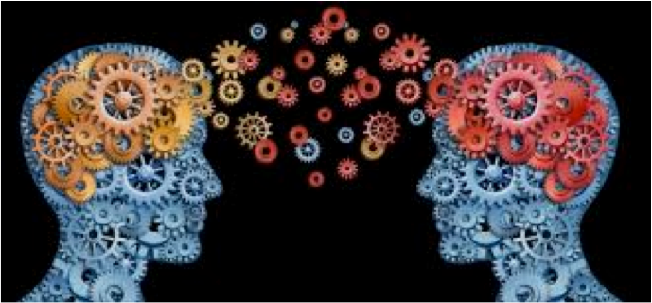
Historiography
The Linguistic Turn

Slide 2
Historical focus:
From agency to language
Do individuals use language to give expression to their autonomous agency?
Or does language shape the parameters of agency, defining what is knowable and thinkable?

Slide 3
Linguistic Turn
Analytical turn upon, or problematisation of, words/language used in a given field of study. Also used to refer to the ‘turn’ to linguistic philosophy in the late 20th century in the humanities and social sciences.
Term first used by the philosopher Richard Rorty The Linguistic Turn (1967)

Slide 4
Sorting out the ‘modern’ and ‘post-modern’
Modernity ≠ Modernism

Slide 5
Modernity
Definition about the time period varies but it generally refers to historical developments such the
rise of capitalism, and the move of Western societies towards industrialization, secularization,
rationalization, the nation-state and its constituent institutions and forms of individual and
collective surveillance.
Modernity may also refer to tendencies in intellectual culture, particularly the movements
intertwined with secularisation and industrial life, such as Marxism, and the formal
establishment of the social sciences. It extends to the 1960s.
(Some theorists, such as Jurgen Habermas, argue that it continues today.)
Modernism
It is a philosophical movement that, along with cultural trends and changes,
arose from wide-scale and far-reaching transformations in Western society in the late 19th
and early 20th centuries. Among the factors that shaped Modernism was the development
of modern industrial societies and the rapid growth of cities, followed then by the horror of
World War I. Some proponents of modernism also began to reject the certainty of
Enlightenment thinking and concepts (progress, rationality, reason, etc.) and many modernists
rejected religious belief (e.g. Friedrich Nietzsche)

Slide 6
Postmodernity
This term refers to sociological, political, economical, technological, etc. conditions of everyday life that differ from those of ‘modernity’. Nation-based Industrialisation gives way to transnational production, service industries and corporations. The multiple identities people carry within them are stressed. The networked, rather than essential, aspect of elements in society(-ies) is the focus. Not what things ‘are’ but how things ‘relate’ to each other. The discussion of postmodernity is the discussion of these conditions.
Postmodernism
Refers to the intellectual, cultural, artistic, academic, and philosophical response to the conditions of postmodern-nity since the 1960s. It is a also philosophy of knowledge, which stands in contrast to that of the Enlightenment and modernity. It questions rationality and empiricism. It is skeptical about the ability of the empirical method to give us direct access to reality and universal truth.
So, it dismantles the entire system of knowledge that was created by Enlightenment empiricism and, starting from scratch, it constructs a new knowledge system,
the central premise of which is the rejection of all ‘meta-narratives’

Slide 7
‘What is postmodernism?’
Scepticism about truth claims
‘Postmodernism is incredulity toward meta-narratives’
Jean-François Lyotard (1924-1998)
French philosopher and literary theorist.
What are meta-narratives? Examples:
      - Historical Progress
      - Rise of Democracy and Human Rights
      - Corruption of Society (e.g. Gibbons’s Decline and Fall of the Roman Empire)
      - History as succession of class struggles on the evolution towards socialism or communism

Slide 8
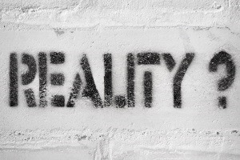
So, what is at stake in all postmodern writing is the question of ‘reality’
Central claim:
It is impossible to show ‘reality’ – only representations of ‘reality’ are possible.

Slide 9
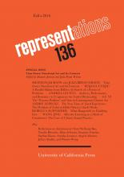
History journal
Founded in 1983
University of California Press

Slide 10
What postmodernist writings offer
They embrace fluid and multiple perspectives, typically refusing to privilege any one 'truth claim' over another
Ideals of universally applicable truths give way to provisional, de-centered, local petits récits -- rather than referencing some underlying universal 'Truth’ (e.g. Walkowitz City of Dreadful Delight)

Slide 11
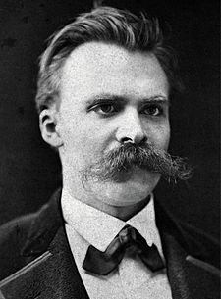
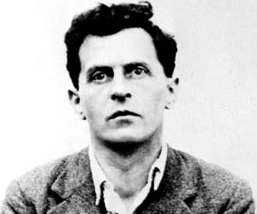
‘Heroes’ of postmodern scholarship
Ludwig Wittgenstein (1889-1951)
Friedrich Nietzsche (1844-1900)

Slide 12
Nietzsche’s genealogy of metaphysical concepts
The Genealogy of Morals (1887)
  Moral concepts and truth claims are not absolute. They have a history and depend on one’s perspective.
The invention of « I » (me)
  Imposes moral responsibility on individual. It opens the door to the moral regulation of the individual… Behind the « I » are social/moral constraints … lonely constraints

Slide 13
Nietzsche:
It’s all in your head!
“It is true, there could be a metaphysical world; the absolute possibility of it is hardly to be disputed [irony]. We behold all things through the human head and cannot cut off this head; while the question nonetheless remains what of the world would still be there if one had cut it off.”
  Human, all too human (1878)

Slide 14
Nietzsche
What is truth?
‘To be truthful means using the customary metaphors - in moral terms, the obligation to lie according to fixed convention, to lie herd-like in a style obligatory for all.’
‘What about these linguistic conventions themselves? Are designations congruent with things? Is language the adequate expression of all realities?’
  ‘On truth and lie and in extra-moral sense’ (1873)

Slide 15
Wittgenstein
Professor of Logic, Language, Mathematics at Cambridge University
Tractatus Logico-Philosophicus (1921) – only 75 pages long.
‘Can language objectively describe truth?’ No.
Language games, with rules that are socially conditioned

Slide 16
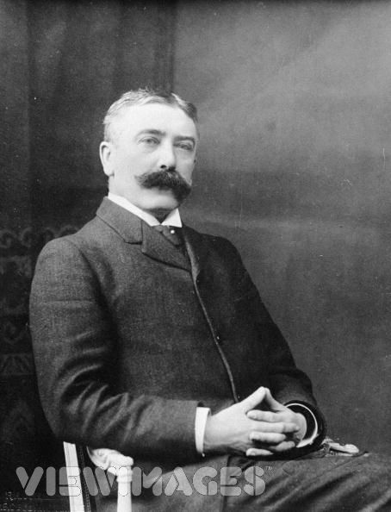
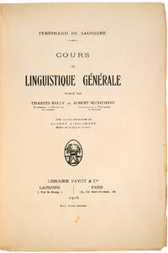
Cours de linguistique générale (1916)
Linguistics: scientific study of language in broadly three aspects: language form, language meaning, and language in context
Ferdinand de Saussure
1857-1913

Slide 17
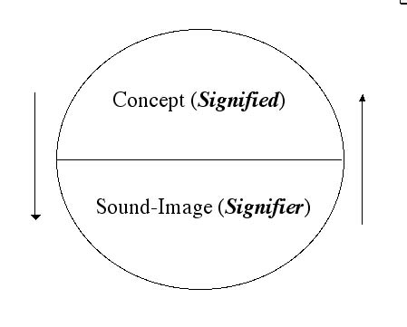
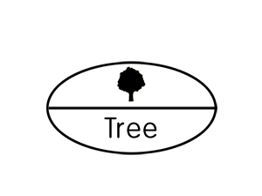
Sign, signifier, signified: The sign is constituted by the relationship of a signifier (a medium, such as a road sign, a word, a gesture) to a signified (also known as the referent, the ‘thing’ being signed.)
Note bene: The signified is not the thing itself, only a mental concept of it which the ‘speaker’ and ‘listener’ share.

Slide 18
Saussure’s Central Claims
Languages are not confined to words but include any system of communication that uses ’signs’.
A sign is composed of a ‘signifier’ (vocal sound, image, gesture) and a ‘signified’ (the mental concept or structure that speaker and listener share).
Important: The mental concept/structure precedes the ‘signifier’ in existence, according to Saussure and later ‘structuralists’ (poststructuralists will reject this).
A‘signifier is established quite arbitrarily and bears no resemblance to the’ signified’. Different languages use different ‘signifiers’ for the same mental images.
Every sign acquires meaning by belonging to a network of other signs. There is in every sign a suggestion of another, oppositional sign.

Slide 19
Significance of Saussure’s claims for historians
Relationship to knowledge becomes uncertain by undermining a) the necessary connection between a ‘word’ (signifier) and its corresponding concept ( (signified);
b) between the sign (word and concept) and the ‘real’ world.
The arbitrariness of the sign challenged the correspondence theory of truth: if words relate only to each other within a semiotic system (a meaning system of signs), how could language be deemed to refer to the ‘real’ world out there? And how could historians argue that their analyses of the past matched up with ‘what really or essentially happened’ (Ranke)?
During the ‘lingustic turn’ Saussure’s ideas were applied to wider human culture; central claims became:
Reality is un-representable in any form of human culture (whether written, spoken, visual or dramatic)
No authoritative account can exists of anything. Nobody can know everything, and there is never one authority on a given subject.

Slide 20
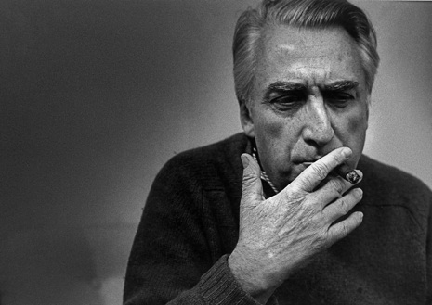
Barthes developed Saussure’s theory further. He politised it, moving it from mere language to the study of cultural & every-day objects. Unlike Saussure, Barthes was a politically motivated left-winger living in right-wing France in the 1950s, and he observed that sign systems are highly motivated and deeply structured by political power. Understanding each sign meant placing it in its political context.
Roland Barthes, 1915-1980
Barthes was first a structuralist (following Saussure) but then turns to post-structuralism
Definition of Structuralism:
posits that elements of human culture must be understood in terms of their relationship to a larger, underlying system or structure (e.g.Clifford Geertz ‘thick description’in Interpretation of Culture (1973).
Epistemology: the branch of philosophy concerned with the nature and scope of knowledge.

Slide 21
Barthes in structural mode:
‘The starting point of these reflections was usually a feeling of impatience at the sights of the ‘naturalness’ with which newspaper, art and common sense constantly dress up a reality which, even though it is the one we live in, is undoubtedly determined by history. In short, in the account given of our contemporary circumstances, I resented seeing Nature and History confused at every turn, and I wanted to track down the decorative display of what-goes-without-saying, the ideological abuse which, in my view, is hidden there.
(Barthes, Mythologies, p. 11)
The aim of his structuralist analyses:
‘The goal of all structuralist activities is to reconstruct an ‘object’ in such a way as to make evident the rules of its functioning.’ That is, to look for the implicit associations between signs and relate them to some structure: e.g., a bourgeois value system or imperialism.

Slide 22
Semiological Systems – Semiology - Myth
Barthes argues and extends Saussure in arguing that we have more going on than just the signifier – signified relationship. He develops different types of signs (symbolic, iconic, indexical), which work in different ways. He argues that each of these different signs is also related to a bigger sign system that transcends the signifier-signified relation described by Saussure. Barthes calls this bigger system, ‘myth’. The ‘myth’ is not necessarily untrue, but is an accepted part of culture and it makes language work.
Everybody in a culture understands not just the sign but also the myth to which it belongs. Barthes showed that signs and sign systems were embedded codes with normative meanings. (for Saussure ‘signs’ were not political but neutral as he was only talking about their meaning within language and not in culture at large)
Barthes called all of this 'the semiological system', and the study of the hidden meanings he called 'semiology'.

Slide 23
Barthe’s Structural work
Mythologies: essay collection using of structural linguistic analysis of cultural icons such as soap-power and detergent or ‘Novels and Children (an acid attack on the women’s magazine Elle ); Steak and Chip; Striptease (the commodification of female nakedness and sex industry); Plastic; the New Citroen; The Brain of Einstein, Wrestler; etc.)

Slide 24
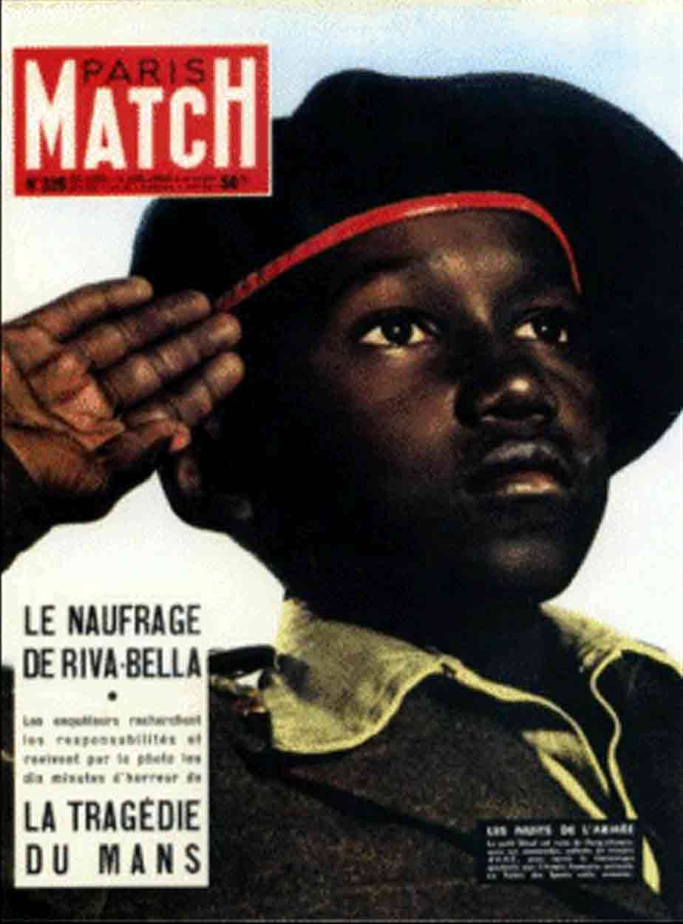
Example:
‘I am at the barber's, and a copy of Paris-Match is offered to me. On the cover, a young Negro* in a French uniform is saluting, with his eyes uplifted, probably fixed on a fold of the tricolour. All this is the meaning of the picture. But, whether naively or not, I see very well what it signifies to me: that France is a great Empire, that all her sons, without any colour discrimination, faithfully serve under her flag, and that there is no better answer to the detractors of an alleged colonialism than the zeal shown by this Negro* in serving his so-called oppressors. I am therefore again faced with a greater semiological system: there is a signifier, itself already formed with a previous system (a black soldier is giving the French salute); there is a signified (it is here a purposeful mixture of Frenchness and militariness); finally, there is a presence of the signified through the signifier... In myth (and this is the chief peculiarity of the latter), the signifier is already formed by the signs of the language... Myth has in fact a double function: it points out and it notifies, it makes us understand something and it imposes it on us...’

Slide 25
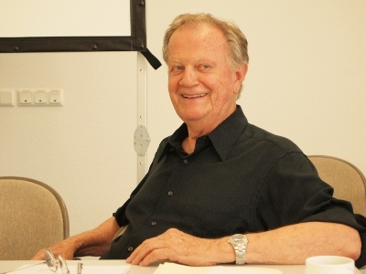
Metahistory: The Historical Imagination in
Nineteenth-Century Europe (1973).
Historical narratives achieve their power through rhetoric, not evidence
4 tropes: the use of figurative language – via word, phrase, or even an image – for artistic effect.
Metaphor: one thing is described as being another, carrying over its associations
Metonymy: substitution of a thing by a symbol for it;
Synecdoche: a part of something is used to describe the whole , or possible vice versa
Irony: saying one thing while you mean or want to suggest the opposite
4 emplotments: romance, tragedy, comedy and satire
Hayden White, 1928-
Metahistory is a structural analysis!!
Point: History writing is about persuasion,
not proof!

Slide 26
Why should we read White?
By focusing on the historian’s language, he does not demonstrate the impossibility of getting hold of past reality, but the naiveté of the kind of positivist intuition customarily cherished among historians.
This idea of a positivist intuition – the historian records reality – is an invention of the historical profession itself
There is a historical reality and White never refuted that (despite caricatures of his views) but historians have forgotten about this past and have mistaken the product of their tropological encoding of the past for the past itself.
One might want to argue that White is the realist here who reminds us of the difference between reality and what is intellectual construction!
White compels us to think about how historical narratives conceal the contradictions and dissonances of society by framing a unifying story that emphasizes continuity
See also F. W. Ankersmit, Hayden White’s Appeal to the Historians’, History and Theory 37 (1998)

Slide 27
Poststructuralism
Definition: a philosophical direction within the wider movement of postmodernism. Postmodernists argue that all knowledge is constructed by humans (through language) within a given culture and time. No ‘facts’ exist independent of linguistic/conceptual ‘structure from which they are created’. Like structuralists, they don’t see these ‘sign’ structures as ‘real’. But they also don’t see them as historical fixed either. They are inventions of the observer and bear the traces of the observer’s condition. (e.g. class, gender, race)
Poststructuralists tend to argue that we need to be aware of structures, using them as devices to aid our inquiry, but we also need to de-centre and problematise them for study (e.g. Joan Scott’s famous article on ‘experience’ is a perfect example).

Slide 28
How Postructuralism differs from Structuralism
Eschews a stable ‘system’ of structuring signs. More room for historical change in ‘structures’.
Stresses inventiveness in appropriating texts. Gap between author and reader.
Still indebted to the analytical tools of structuralism (It’s not a rejection! Same people doing both!)

Slide 29
Poststructuralism was born simultaneously as social movement AND as a theory – it may NOT be as apolitical as some historians and critics like to argue.
Key social movements were:
student rebellion, seen by many as the apotheosis of the rise of youth in western culture after 1945
second-wave feminism (or the women's liberation movement) as it emerged very suddenly in 1969-70, giving rise to struggles for equal opportunities in work , pay, education, and for an end to discrimination in language and depiction
gay liberation in the late 1960s, heralded by liberalisation of laws on homosexuality
collapse of many European empires in the 1960s and 1970s (those of Britain , Portugal, France, Belgium and Holland), making way for European awareness of the structures of Orientalism and race prejudice embedded in western white culture and intellectual thought.
the rise of black consciousness with in the United States and western Europe, allied to liberation movements and developing nations and to the a anti-apartheid movement in South Africa; raising awareness of racial discrimination and racial stereotyping

Slide 30
Barthe’s (poststructural)
The Death of the Author (1967)
Wink to Nietzsche’s ‘God is Dead’ – end of metaphysics
Published a year before the events of May 1968: spirit of revolt against authority (and author-ity)
Stop looking for author’s intentions!!
  We don’t know what they were and they don’t matter
A text is an explosion of language’s myriad possibilities: there is no fixed semiotic system that stabilizes its meaning; texts are unstable; they’re all up for grabs.
A text isn’t authoritative: a text occasions creativity!

Slide 31
The ‘author’s death’ opens up opportunities for historians
Discourses instead of ideas
  Ideas: products of an author’s mind
  Discourse: the broader socio-linguistic context
Conditions of production of texts (technological, financial, institutional)
Uses of texts
  Reading practices (reverential, intensive, or extensive)

Slide 32
Print and the Origins of the French Revolution
Old view: ideas → action
  People read Voltaire, Rousseau. Inspired by their ideas, they overthrew the Ancien Régime!
Poststructural view
  Sociolinguistic discourses create conditions of possibility for revolution.
  Discourses about despotism and corruption undermined the regime, making revolution possible.
  But are these conditions primarily social or linguistic? Historians debate this. Do we look only at texts or do we look at the social and material forces operating outside them?

Slide 33
How this all points to future strands of historiography
Foucault and knowledge regimes
Gender (constructed through language)
Symbolic Anthropology
Intellectual History
  Ideas in Context (Quentin Skinner)
  Social History of Ideas (Robert Darnton)
Subaltern Studies
  From EP Thompson-like experience of colonial subjugation to the discursive construction of subjectivity by colonial powers

Slide 34
Questions for historians
Should we try to capture historical agency (‘free will’) or should we assume that all historical subjectivity has been discursively constructed?
Should we focus only on language, discourse and ‘semiotics’ or should we also factor in material and socioeconomic elements? But how can we do the latter if we can’t gain access to those elements but through language itself?

Slide 35
END

