Slide 1
The Annales
HI323, Historiography
Dr Guillemette Crouzet
Marie Curie Sklodowska Individual Research Fellow
g.crouzet@warwick.ac.uk

Slide 2
Introduction and basic facts
One of the most influential approaches to thinking about and writing history
A kind of ‘revolution’ in historiography
Started in France, in the late 1920s
Spanned most of the 20th century, lasting for nearly 5 decades, until the late 1970s
Has influenced historians beyond Europe, notably in America
Incredible legacy, has changed forever the way we research and teach history

Slide 3
Today’s lecture key questions
What was so revolutionary about the Annales?
How did this methodological revolution unfold?
What was its legacy? What is left today of the extraordinary historiographical ‘moment’ constituted by the Annales?

Slide 4
I-The creation of the Annales school of history
II-The first generation of Annales scholars and their work
III-The second generation and the longer-term legacies of the Annales

Slide 5
I-The creation of the Annales school of history

Slide 6
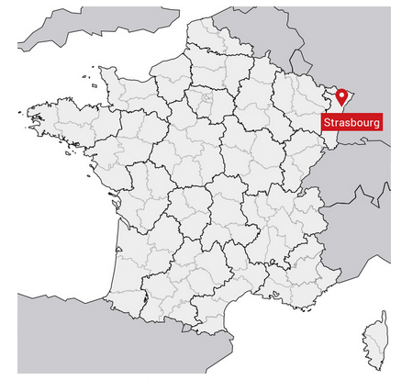
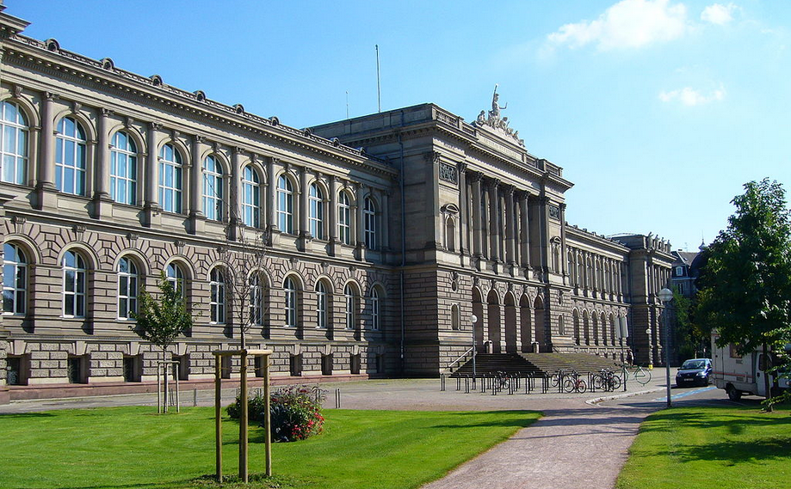
-1929, two junior professors at Strasbourg University, in the east of France, together pioneer a new approach for academic history

Slide 7
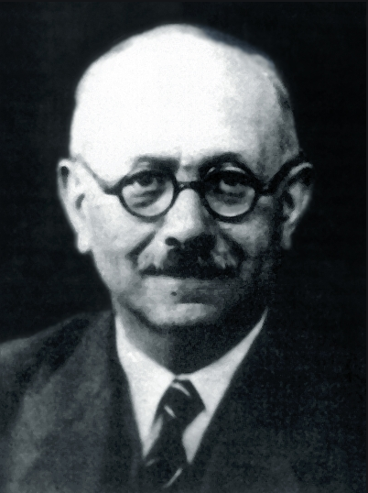
Marc Bloch
-Born in 1886 in a Jewish middle-class family
-Very bright student
-A war veteran, fought in the French armies during WW1
-A medieval historian
-Became a junior professor at Strasbourg just after WW1
1886-1944

Slide 8
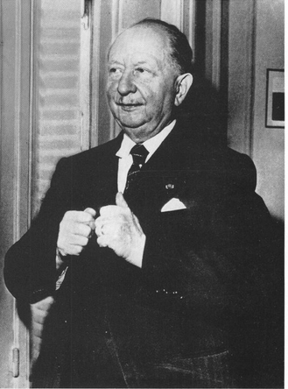
Lucien Febvre
-Born in 1878 in a middle-class family
-Like Bloch, an exceptional student
-Like Bloch, a WW1 veteran
-Also became a junior professor at Strasbourg University just after WW1
-His research specialism was early modern France
-Work focused especially on 16th-century France
1878-1956

Slide 9
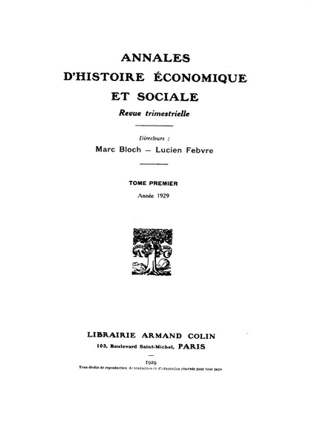
1929 and the first issue of the journal, the Annales
1929: Annales d’histoire économique et sociale

Slide 10
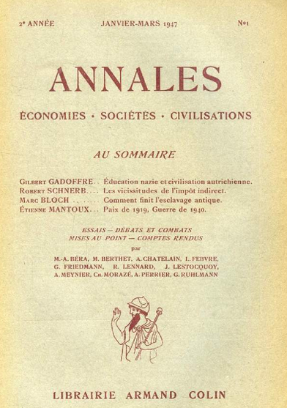
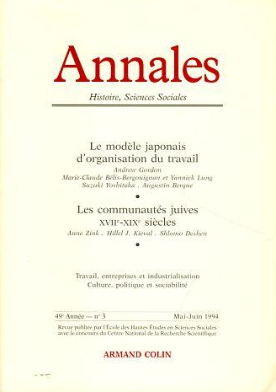
-A history journal in France, published continuously from 1929 to today
-Its title would become the name also given to this new approach to history writing
-After WW2 became Annales: Economies, Société, Civilisations
-In 1994: Annales: Histoire, sciences sociales
-Now also published in English by Cambridge University Press

Slide 11
The Revolution
Broke away from “traditional” history: set itself up against the ”history of great men”, of battles and treaties, and primacy of political, military and diplomatic history
Broke away also from a history focused on events, on a short period of time, and lacking in analysis
Broke away from “histoire positiviste” (i.e. fact-listing description)
Created an “histoire problème”, geared around arguments and analysis
Focused historical analysis more on economic and social data and factors
But also centred historical analysis on mankind, e.g. people’s beliefs, ways of life, society and culture, etc

Slide 12
The Annales project: key words, key facts
Total history, “histoire totale”: bring together geographical, demographic, economic, social, political and cultural approaches into a single embrace. Total history: the task is to uncover all levels of human historical experience
Longue durée, historical analysis has to embrace a very long period of time, often several centuries
Interdisciplinarity: identified a need to build historical analysis in dialogue with social sciences (sociology, anthropology, ethnology, geography, etc.)
“Serial” sources: to embrace the totality of human experience, historians have to rely on serial sources, i.e. draw on a vast documentation in the archives, classified in series (letting historians trace patterns over many years, decades)

Slide 13
Peter Burke on the Annales
-‘The substitution of a problem-orientated analytical history for a traditional narrative of events’
-‘The history of the whole range of human activities in the place of a mainly political history’
-‘Collaboration with other disciplines’ such as geography, sociology, economics and anthropology

Slide 14
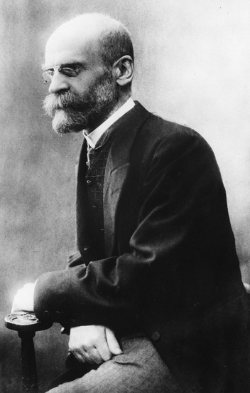
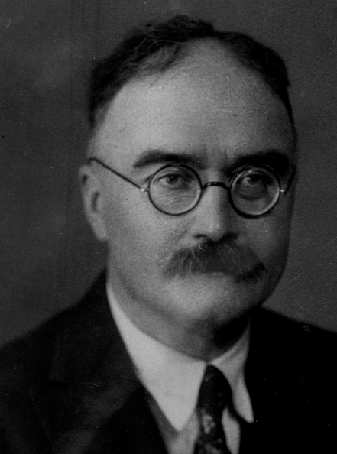
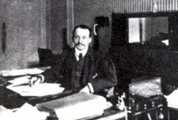
Influences
Bloch and Febvre were deeply influenced in their critical revolution by the French school of sociology around Emile Durkheim, François Simiand and Maurice Halbwachs
Durkheim
Halbwachs
Simiand

Slide 15
Emile Durkheim and his work
An example
Extremely prolific intellectual and writer, started a revolution a Paris at the beginning of the 20th century.
Established sociology as a discipline
Durkheim developed a scientific approach to the study of society
Sociology as the discipline which analyses social facts
“Consist of manners of acting, thinking and feeling external to the individual, which are invested with a coercive power by virtue of which they exercise control over him”
Durkheim was interested in studying how a society is created and what holds a society together

Slide 16
Main themes and topics studied by Durkheim and his disciples
Collective consciousness (beliefs, norms, values), which results in social integration
Culture, as a key social fact, creates mechanical solidarity, important during social interaction
Religion= personal beliefs, the sacred, faith and religious practices, also created solidarity in society
Religion as the most fundamental social institution of humankind, and one that gave rise to other social forms
Family
Collective representations

Slide 17
Annales and sociology
Exploration of society, in historical perspective
Exploration of what held past societies together, including religion, collective representations, collective beliefs and norms
Smaller social units: family, village etc…
Exploration of modes of production (economic systems)
Exploration of individual beliefs as well and their influence

Slide 18
II- The First generation of the Annales and their work

Slide 19

Bloch: Sociological and anthropological inspiration
-Comparative history of royal touch England and France
-Longue durée: historical span 11th-18th centuries
-Not a study of kings’ magical power
-But of people’s belief in this magical power (supposed to cure scrofula)
-Study of society “from below”
-Exploration of popular belief and religiosity
-Histoire des mentalités

Slide 20

-Comparative history, focuses on France, but with comparisons with England, Germany and even Japan
-Longue durée, long historical span, 10-12th centuries
-Not a history of feudalism as an institution, not focused on lords, but on people and how feudalism shaped their lives
-An attempt at understanding feudal society, its emergence, construction and the nature of relations between individuals

Slide 21
Bloch: hero of the French Resistance in the fight against Fascism
Annales published continously during WW2
Divergence of opinions (and historical controversy) on how to “resist” against Nazi Germany between Bloch and Febvre
Febvre continued to teach during WW2; Bloch, as a Jew, was in an extremely difficult situation in France
Bloch wrote two books during the war, both published posthumously in 1949
Bloch entered the French Resistance in late 1942
Bloch arrested, tortured and executed by the Nazis in June 1944

Slide 22

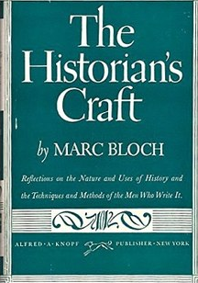
Bloch’s last works
-The Historian’s Craft: a reflection on the craft of history and on writing history
-Strange Defeat: landmark in historiography. Reflection on France’s complete surrender in 1940 against German armies, which Bloch attributed to the incompetence of France’s military generals.

Slide 23
Lucien Febvre and the psychological approach. Towards a history of “mentalités”

Slide 24

The making of Lucien Febvre
Like Bloch, strong focused from the beginning on social and economic facts.
1911, his doctoral dissertation was published. Remains unpublished in English.
Focused on a region in the East of France during almost half of the 16th century
Test of Febvre’s methodology and the inspiration found in the social sciences
Geography, sociology, ethnography
Essentially a study of artisans, workers and peasants. How they lived
and exploited a complex mountainous ecosystem in the early modern period.
The book also charted the religious life of these social groups and
paid particular attention to their beliefs but also to superstitious rituals
which gave a rhythm to their daily life.

Slide 25

Lucien Febvre and the psychological approach. Towards a history of “mentalités”
-Published in French in 1932, English in 1980s
-Not a traditional biography, not a biography of Martin Luther, the German religious reformer and theologian of the 16th century
-An attempt at understanding why Luther became the key pioneer of religious Reformation and why protestant reforms spread in Germany
-Febvre based his analysis and argument on socio-economic factors.
-Social and economic changes led and enabled the development of Lutheranism

Slide 26

-Published in French in 1937, in English in 1982
-An analysis of François Rabelais, French humanist scholar and prolific writer of the 16th century
-A response by Febvre to other studies on Rabelais which had argued that Rabelais was an atheist
-Febvre argues that this was impossible given that categories of “unbelief” and “atheist” did not exist in 16th-century France
-The book is a manifesto of Febvre’s unique historical approach
-Febvre argues that Rabelais had a complex approach to religion, at a time of religious reforms
-Exploration of Rabelais’s imagination, beliefs and thoughts
-Rabelais’s unique approach to religion can only be understood if put into the social and political context of the time

Slide 27
III- The Second Generation of the Annales
and
the legacy of a revolution

Slide 28
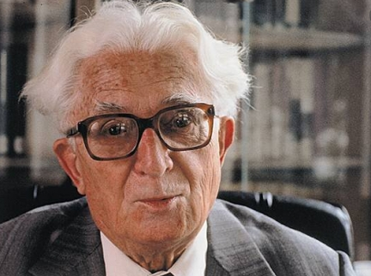
Fernand Braudel
-Fernand Braudel = the key figure of the golden years of the Annales, dominant figure in French history in the the 1950s, 60s and 70s
-Mentored by Febvre, took over as chief editor of the Annales in the 50s
-Started a second revolution in the Annales movement with his work
1902-1985

Slide 29
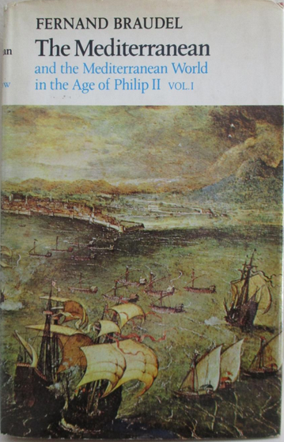
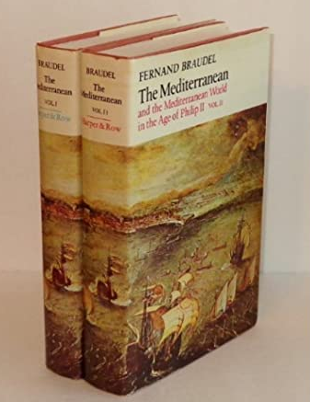
The Mediterranean in the Age of Philip II
-Braudel’s masterpiece, published in French and in
English in 90s
-Epic account of time and place
-The central object, character analyzed is not Philip II of Spain, but instead the Mediterranean
-An attempt to write a “total history” of the Mediterranean (its peoples, geography, economic exchanges)
-Interdisciplinarity, notably by its use of geography, economics, sociology but also ethnography
-Strong influence also of Marxist ideology, attributing overriding importance to economic and social factors
-Scope of analysis goes beyond Europe (e.g. contacts of Europe with Africa, the Middle East)

Slide 30
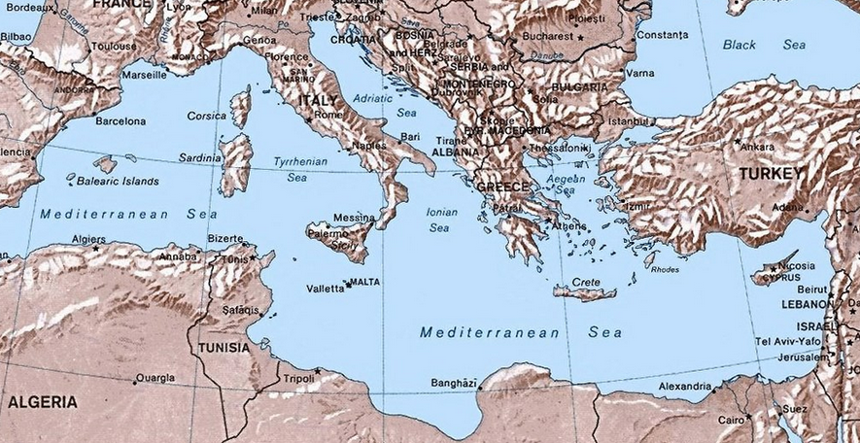
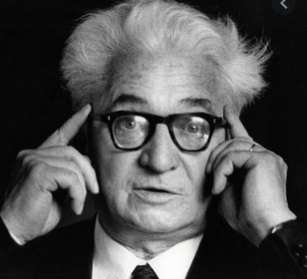
Braudel’s Mediterranean
-Braudel’s passion
-Explored the Mediterranean during his early years as a researcher

Slide 31
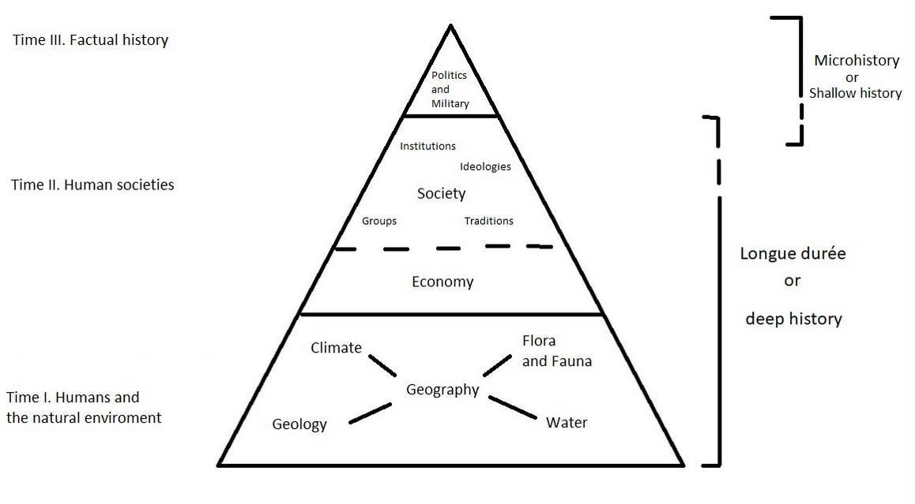
Braudel’s conception of time
1-Deep or underlying structures: geographical conditions, the environment and climate, and how these shape human lives.
Change is slow, only visible over the longue durée (the long run)
2-Conjonctures: medium term trends (5, 10, 50 years): layers of social and economic activities.
A middle or bridging term between (1) longue-durée structures and (3) events
3-‘L’histoire événementielle’, factual history: history of events

Slide 32
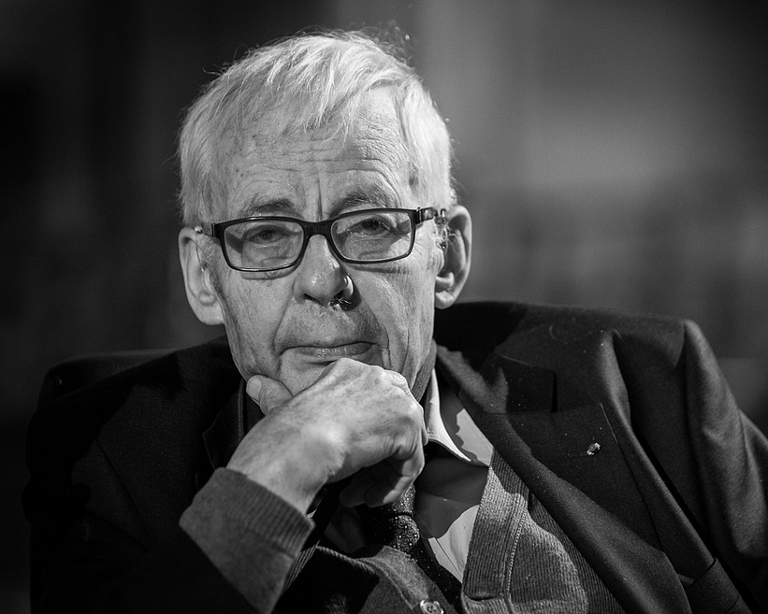
Emmanuel Le Roy Ladurie
Mentored by Braudel
Le Roy Ladurie, world-renown historian
Specialist of medieval and early modern
history
Embraced methodology of the Annales
Longue durée, histoire des mentalités
But also environmental history, a pioneer

Slide 33
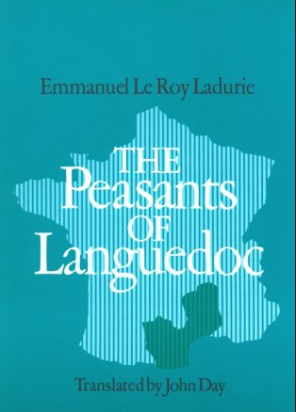
The Peasants of Languedoc (1966, English)
    -Histoire totale (total history) of Languedoc from the 14th to the 18th centuries
    integrates political, cultural, economic, social history and environmental history
    -Pays particular attention to climate history and on how it shaped daily life,
    economics and politics.
    -‘Histoire immobile’ (unchanging history for centuries) with an emphasis on culture
    and economy.

Slide 34

Montaillou, 1975
    -Story of a medieval town destroyed by feuds and religious strife
    in the early modern period
    -Narrower time period: half a century
    -Still ‘histoire totale’ with demography, beliefs, politics, economics
    -But focused on particular individuals (new)
    -Move towards micro-history (a village and some individuals)

Slide 35
Conclusion: the legacy of a revolution
The changes proposed and adopted by the Annales scholars may now seem trivial or obvious
But that is a measure of its success in changing the way the discipline works
The Annales have truly transformed the way we research, write and teach history
The legacy of this school of thought continues to stimulate new avenues of research and historiography

Slide 36
Social and economic history developed following this revolution (e.g. influence on the British historian E. P. Thompson at Warwick, who specialized on the history of the working class)
Importance of interdisciplinarity. New inspirations from the fields of anthropology, sociology enabled the field of cultural history to develop
Focus on a given region, or a geographical area, rather than assuming that the state is the natural subject of study => this can be linked to the development of “Area Studies”
Importance of the agency of human beings, analysed in the context of their communities (village, family) => this enabled the development of micro-history. A flourishing field, notably in Italy (Carlo Ginzburg) and the USA (Nathalie Zemon-Davis)
Importance of longue durée => influences Global history, but also “deep history” or big data
Comparative history, and notably the legacy of Bloch => influenced transnational and global history writing, i.e. the study of connections and comparisons between different parts of the world

