Slide 1
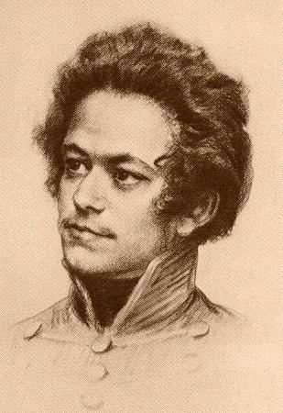
Historiography
Week 5
Karl Marx
1818-1883

Slide 2
For 9 minute overview of Marx’s views, click here

Slide 3
Marx’s Life
1818-35: childhood and early youth in a liberal bourgeois family in Trier. Exposed to Enlightenment, Romantic, liberal and radical world-views through family and acquaintances.
1835-36: University of Bonn. Heavy drinking, gambling, etc. – father intervenes to move him to Berlin.
1836-42: University of Berlin. Develops wide range of intellectual interests: jurisprudence, history, and especially philosophy. Involved in ‘Left-Hegelian’ circles.
1842-49: Cologne, Paris, Brussels, Paris, Cologne, Paris. Years of revolution and counter-revolution: for Marx, constant political exile and flight. Years of intense political agitation, radical political journalism (heavily censored). Marx begins studying political economy. Develops lifelong friendship with Friedrich Engels (son of wealthy manufacturer).
1849-1883: London.

Slide 4
Where he was born
Trier, in what is now the western part of Germany near Luxemburg

Slide 5
1850s
London

Slide 6
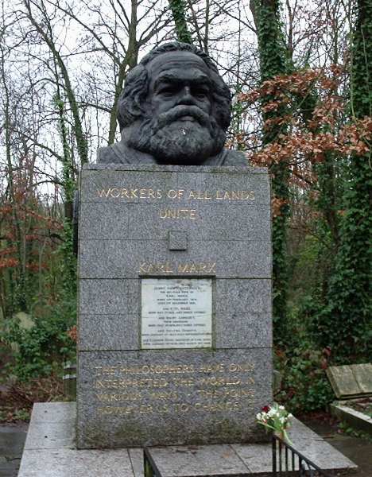
Highgate Cemetery,
London

Slide 7
Marx as seen by many

Slide 8
Marx as he might have seen himself

Slide 9
Marx as seen by those who hated him

Slide 10
Marx as he was for much of his life

Slide 11
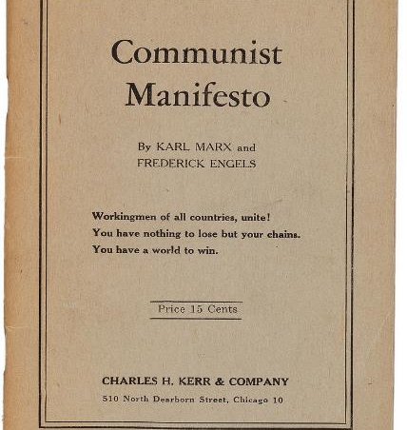
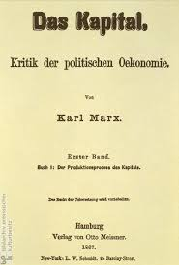
Karl Marx – most famous works
1848
Vol. 1-3
1867-1894

Slide 12
Marx’s Context
Romanticism
Industrial Revolution – Creation of Proletariat
  Alienated from their work and thus themselves
Democratic Revolutions (1789, 1830, 1848)

Slide 13
The well-known Marx
(prone to vulgarisations)
Critic of Capitalism
Historical materialism
History as class struggles
Utopian future without classes or states (communism)
  But never wrote a book about this.

Slide 14
Four phases of Marx’s thought
Until 1845 – Inversion of Hegelian dialectics
  Among the ‘Left’ Hegelians in Germany
  Like Hegel: History as dialectic (tension) between ‘real’ and ‘rational’. This friction propels consciousness forward.
  Hegel’s Endpoint → full consciousness, at one with Absolute Spirit and the state. Man is reconciled with himself, society and nature. History driven by ‘ideas’.
  Marx → Endpoint is communist society (no classes, no state). History driven by ‘material forces’.
  At this stage, Marx is still philosophical and metaphysical: He assumes man’s creative ‘potential’ and sees history as the the gradual realization of it.

Slide 15
Four phases of Marx’s thought
Between 1845 – 1848 Empirical/Materialist
  In dialogue with Frederick Engels, British empiricism
  Marx drops the metaphysics about ‘potential’
  Materialist: human needs, means of production, social relations governing those means of production
  History driven by technological innovations, which alter ‘productive forces’, creating a struggle to redefine the social relations surrounding them
  Thought itself is a product of material reality
    Slavery and proletarianisation frees up some people to be intellectually and artistically creative…

Slide 16
Four phases of Marx’s thought
Between 1848-1857 – Critical theory and materialism
  Had to explain failure of 1848 proletariat Revolution
  More supple about how history unfolds (not a straight line of progress)
  More attention to superstructure and class consciousness

Slide 17
Four phases of Marx’s thought
Between 1848 1857 – Critical Theory and Materialist
  Modes of production (= forces of production + the social relations governing them) allow for various events.
  History as ‘jumps and zigzags’ (Engels), not coherent progression
  From philosophy to critical theory
    Revise your theory in function of new facts!!!
  From stadial history to genealogical: influence of Darwin
    One can discern the ape in the man, but one could not predict the rise of man from the ape. Backwards historical analysis… not driven by utopian telos…

Slide 18
Four phases of Marx’s thought
After 1859 – Harder, economic forces predominate
  Critique of Political Economy (1859)
  Das Kapital 3 vols., 1867-1894
  Begins with classical political economists’ assumptions (Adam Smith, David Ricardo) then disproves their assumptions
  Contract, barter as equivalent exchanges – NO!
  Surplus value through exploitation
  Emphasis on contradictions in system
    Money and labour defy commodity-functions
    Capitalism undermines itself: need for more consumers cannot be met if workers are increasingly impoverished
    Rising inequality lowers productivity and prices

Slide 19

Communist Manifesto (Marx/Engels)
1848
Bestselling book by Penguin Books in 2015
Next to Bible, most influential text in history
Profit = exploitation
Need for working class consciousness
‘Workers of the world, unite!’
Revolution as key to historical change

Slide 20
Communist Manifesto (Marx/Engels)
1848
Progressive income tax
Abolish inheritances
Abolish private property
Free public education

Slide 21
Eighteenth Brumaire (1852)
Marx and Engels
What happened in the 1848 Revolution in France?
  Workers Revolt (Feb)
  Overthrow of monarchy, creation of 2nd Republic
  Crushing of workers (June)
  Establishment of conservative Republic (Sept)
  Louis-Napoleon elected President (Dec)
  Dissolves National Assembly (Dec 1851)
  Crowned emperor (Dec 1852)…

Slide 22
Eighteenth Brumaire (1852)
What went wrong in 1848?
  Revolutionaries guided by ‘spirits of the past’(1789)
  ‘Hegel remarks somewhere[*] that all great world-historic facts and personages appear, so to speak, twice. He forgot to add: the first time as tragedy, the second time as farce.’
  Highly empirical analysis, goes beneath events to analyse each group’s material interests and consciousness, which aren’t always aligned
  Peasants held the revolution back
  Further proletarianisation will strengthen working class’s consciousness & political leverage the next time…
  Need to work on class consciousness!

Slide 23
Eighteenth Brumaire (1852)
Marx and Engels
What went wrong in 1848?
  ‘Just when [people] seem engaged in revolutionizing themselves and things, in creating something that has never yet existed, precisely in such periods of revolutionary crisis they anxiously conjure up the spirits of the past to their service and borrow from them names, battle cries, and costumes in order to present the new scene of world history in this time-honored disguise and this borrowed language...’
Bourgeoisie was willing to sacrifice its republican commitments to protect its private property…

Slide 24
Key Marxist concepts - 1
Productive Forces
  technology
Relations of Production
  Property laws
  How do people relate to production (as workers, as investors, as managers, etc.)
Superstructure
  Politics, ideology, religion, culture, etc.

Slide 25
Key Marxist concepts - 2
Class Struggle and Revolution
  When productive forces change, social relations are thrown into question… struggles ensue
  Revolution: effort to align social relations with current productive forces

Slide 26
Jean Jaurès, Histoire socialiste de la Révolution française (multi-volume, early 20th century)
  Leader of French Socialist Party, 1902
  Anti-militarist, assassinated in 1914 (WWI)
  Context: rise of communist, socialist, and syndicalist (workers’ associations) at end of 19th century
  Sought to combine Michelet’s romantic nationalism with Marx’s ‘history as class struggle’
  Saw future socialist republic in France originating in French Revolution… unlike Marx, he embraced 1789!
  No socialist revolution needed! France could simply deepen the popular and social aspects already begun in 1789…

Slide 27
Antonio Gramsci (1891-1937)
Marxist theorist
Imprisoned under Mussolini
Prison Notebooks (1927-1935)
Builds on Marx’s superstructure
Cultural Hegemony
  The way the state creates ideological shackles to maintain its power and the dominance of bourgeois-capitalist relations
  Accepts state/civil society distinction but sees coercion and manipulation in both
  Bourgeois regimes manufacture ‘consent’
Marxists taking the cultural-historical turn in 1970s and 1980s will borrow from Gramsci

