Slide 1

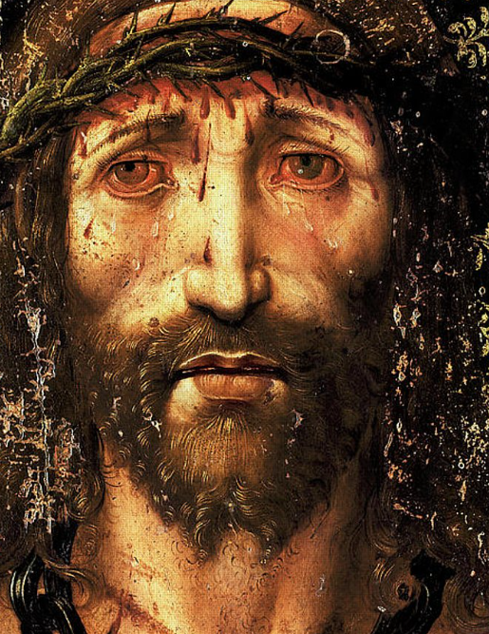
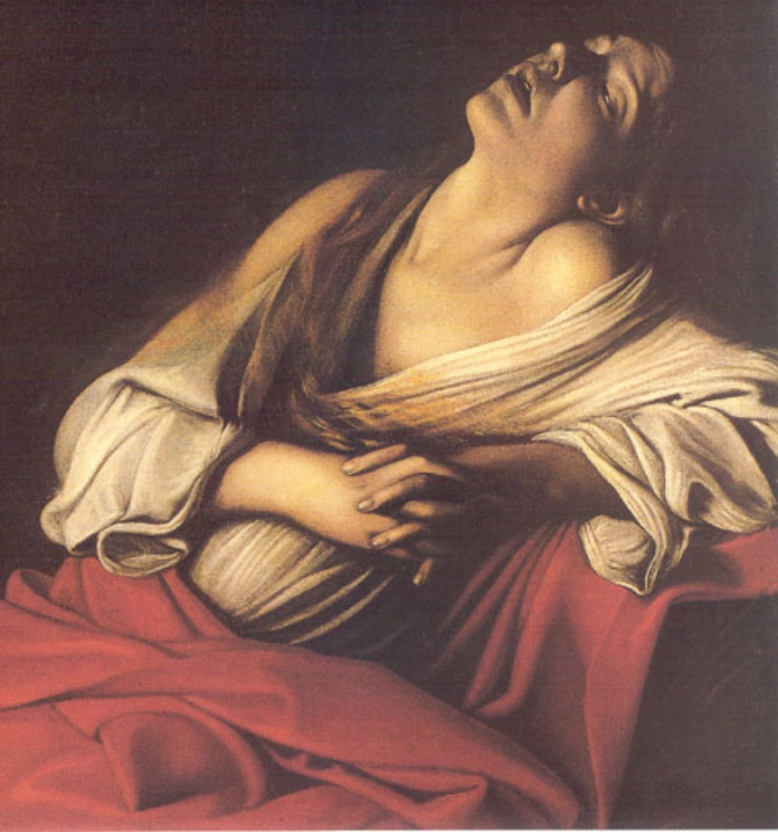
HI2E2 Historiography II
Emotions History
Dr Naomi Pullin
naomi.pullin@warwick.ac.uk

Slide 2
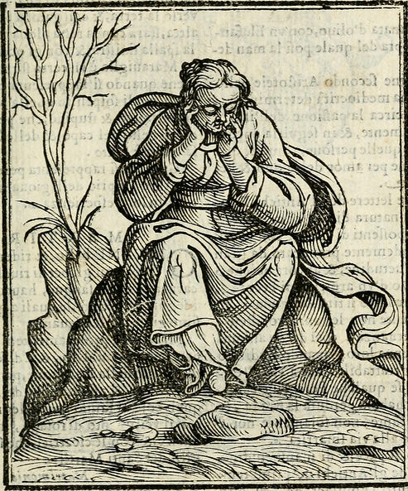
A Social History of Solitude
Key questions:
Can an emotional approach to the early modern period provide new readings to a limited body of historical sources?
How did people feel about, experience and understand the time they spent alone?

Slide 3
Focus of this lecture
Key definitions and terms – what is meant by the history of emotions? What do the ‘emotions’ in emotions history mean?
The evolution of the history of emotions – origins and recent trends.
The challenges and tensions with the history of emotions – things that historians need to overcome.

Slide 4

1. The History of Emotions: Key Definitions

Slide 5
What is the history of emotions?
A history of feeling in the past.
Not just looking at facts and causes of historical events, but using history to understand what (and how) people felt.
Recognises the importance of emotions to historians and students in the 21st century: what did history ‘feel’ like to those who lived through it?
Aims to explore what emotional expression can reveal about social, political, religious, cultural and economic values – the meaning attached to repression and regulation of feeling, as much as its articulation.
Problematises historical causation - recognises that not all acts and actions in the past are undertaken by rational historical actors.

Slide 6

What are emotions?
We don’t know!
Thomas Dixon ‘‘Emotion’: A Keyword in Crisis’ – from a definitional and conceptual perspective.
Meaning of ‘emotion’ as a psychological category is relatively recent. Only existed in this sense from C19.
Emotions technically did not exist before this point – described under range of categories: ‘feelings’, ‘pleasures’, ‘pains’, ‘passions’, ‘sentiments’, ‘affects’/‘affections’.

Slide 7
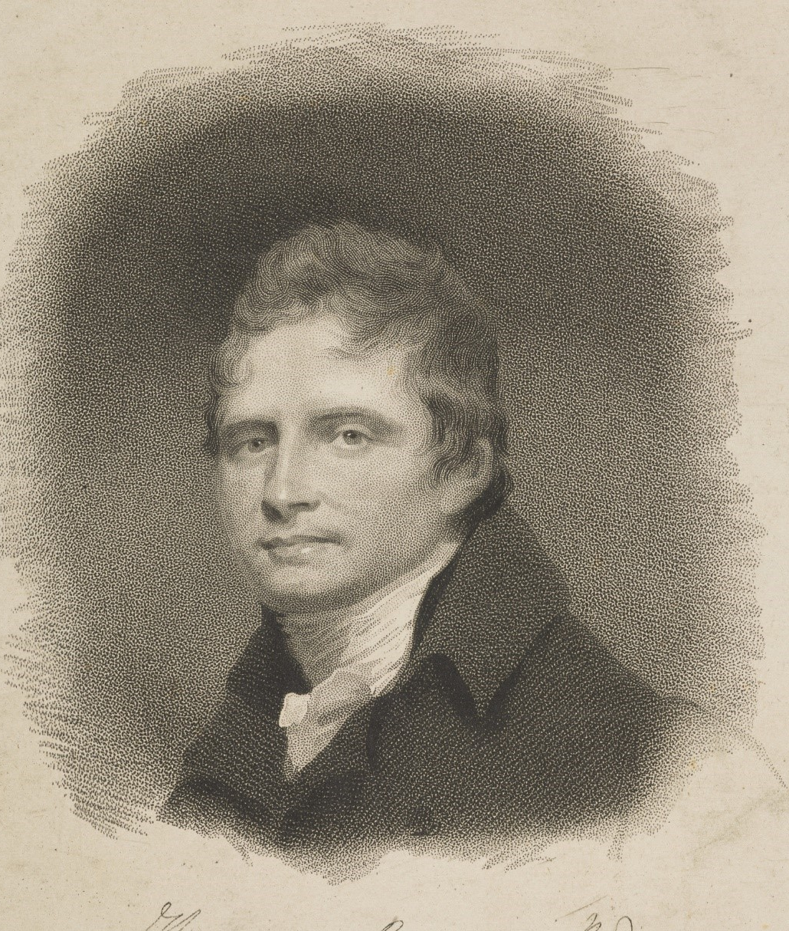
Etymology and ‘invention’
Etymology carries very different meaning than we understand today - from medieval French émotion – to move out, move away, remove, stir up, irritate.
Thomas Brown (1778-1820) – first figure to connect ‘emotion’ with the science of the mind.
Recognised that ‘emotion’ was broad term: ‘Perhaps, if any definition of them be possible, they may be defined to be vivid feelings, arising immediately from the consideration of objects, perceived, or remembered, or imagined, or from other prior emotions.’ = noncognitive, ‘vivid feelings’ separate from intellectual thought.

Slide 8
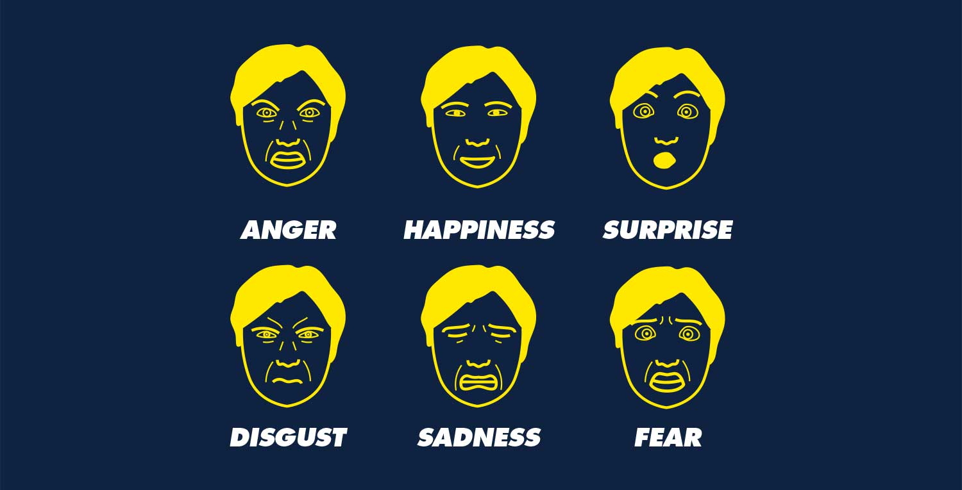
The Psychology of Emotions
Psychologists adopted ‘emotions’ to define human feelings and categorise them.
1970s: Paul Ekman argued that there were six basic emotions universally experience by all people.
Explains why some emotions prioritised over others in history (e.g. solitude and loneliness excluded).
Are emotions universal (biological), or culturally conditioned?

Slide 9
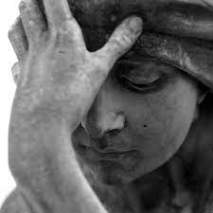
2. The evolution of emotions history

Slide 10
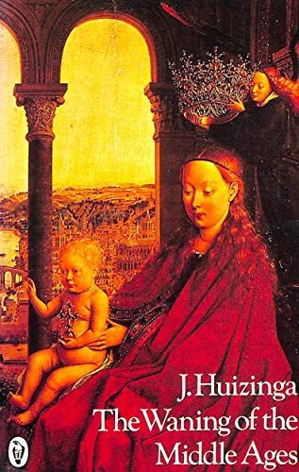
Johan Huizingha, The Waning of the Middle Ages (1919)
Examined emotional climate of 14th and 15th centuries.
Argued for excessive, uncontrolled emotions that were refined from 16th century onwards.
Unrestrained weeping and anger. Dominant culture of cruelty and revenge.
Emotional control of medieval people described as child-like.

Slide 11
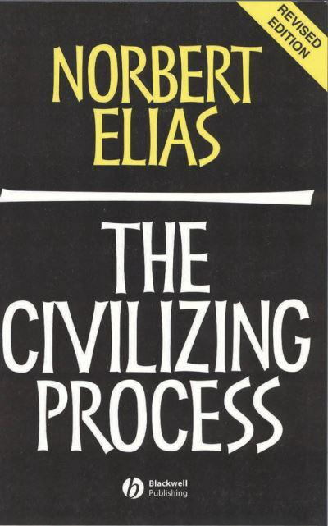
Norbert Elias, The Civilizing Process (1939, English trans. 1978-82)
Examined nobility at court of Louis XIV of France.
European modernity began around 1600 through process of emotional control and restraint.
Emergence of taboos and self-regulation in emotional disposition.
‘Shame’ = key emotion – greater cultural conditions to feel personal and societal shame.

Slide 12
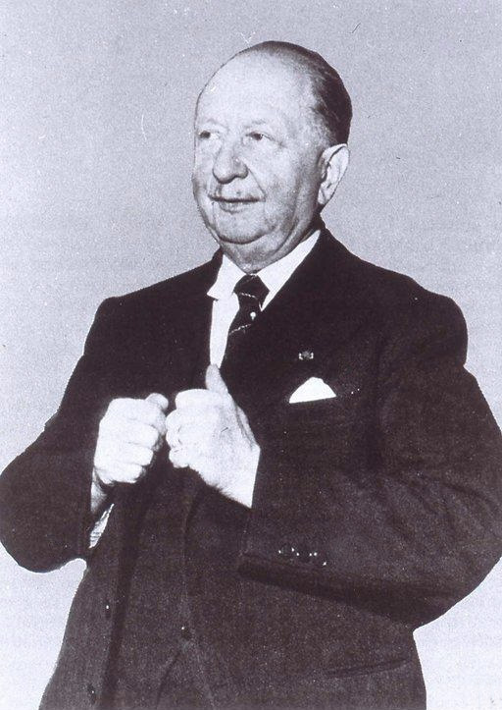
Lucien Febvre and the Annales, 1930s and 1940s
Necessary for historians to ‘plunge into the darkness where psychology wrestles with history’.
A New Kind of History – human feelings culturally constructed for the historian ‘to establish a detailed inventory of the mental equipment of men of the time’.
Attempt to recover the intellectual and moral universe of the people of the past.
Annales set agenda for study of mentalites of people of the past – emphasised interpretation as integral skill of historian.

Slide 13
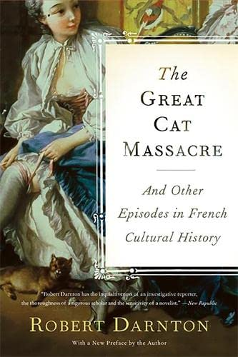
Robert Darnton and The Great Cat Massacre (1984)
Critical of Annales.
Examined massacre of cats by group of apprentices in the rue Saint-Séverin (Paris) in 1730s.
Those who carried out the killing thought it was funny and had symbolic value.
Our inability to understand ‘the joke’ shows the distance that separates us from workers of pre-industrial Europe.

Slide 14
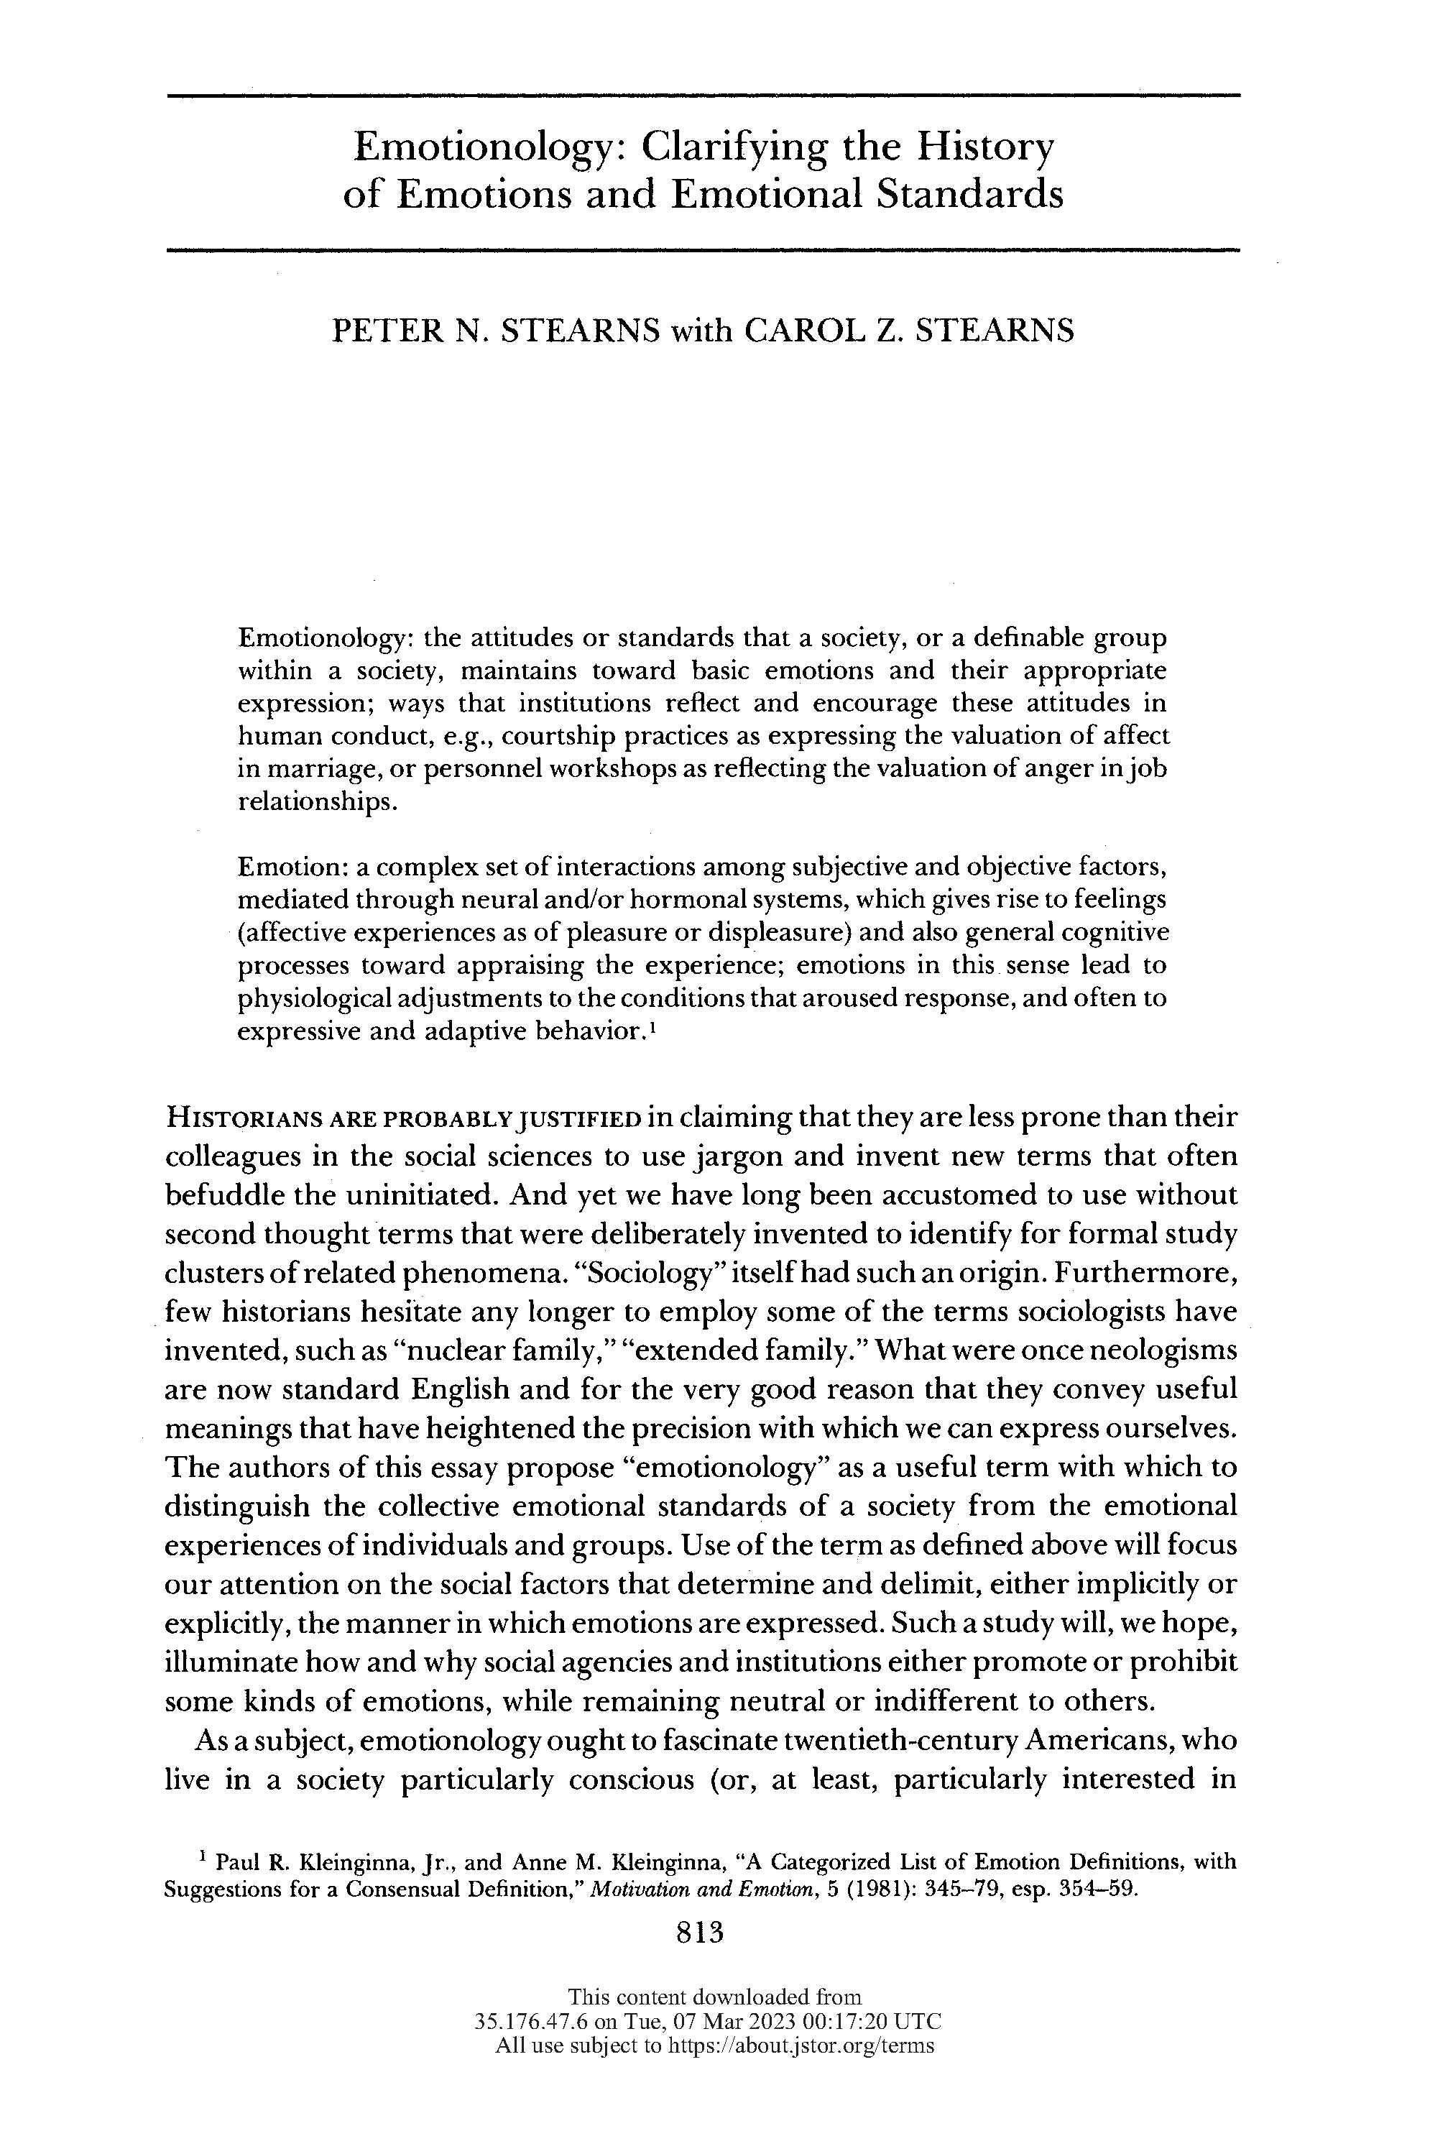
Stearns and Stearns (1985)
Resistant to grand narratives of change over time (e.g. Elias, Huizinga) – to focus on periodisation and individual experience.
Employ Ekman view of the ‘big six’ universal emotions.
‘Emotionology’ = the ‘rules’ of expression that shape meanings attached to emotions in different historical contexts, e.g ‘Anger’.
= show that emotions have a history in their own right.

Slide 15
Key works in the history of emotions
Philip Stearns and Carol Stearns, Anger: The Struggle for Emotional Control in America’s History (1986).
William Reddy, The Navigation of Feeling: A Framework for the History of Emotions (2001).
Barbara Rosenwein, Anger’s Past: The Social Uses of an Emotion in the Middle Ages (1998); Emotional Communities in the Early Middle Ages (2006).
Ute Frevert, Emotions in History - Lost and Found (2011).
Jan Pampler, The History of Emotions: An Introduction (2012).
Barbara Rosenwein, Generations of Feeling: A History of Emotions 600-1700 (2016).
Monique Scheer, ‘Are Emotions a Kind of Practice (and Is That What Makes Them Have a History)? A Bordieuan Approach to Understanding Emotion’ (2012).

Slide 16
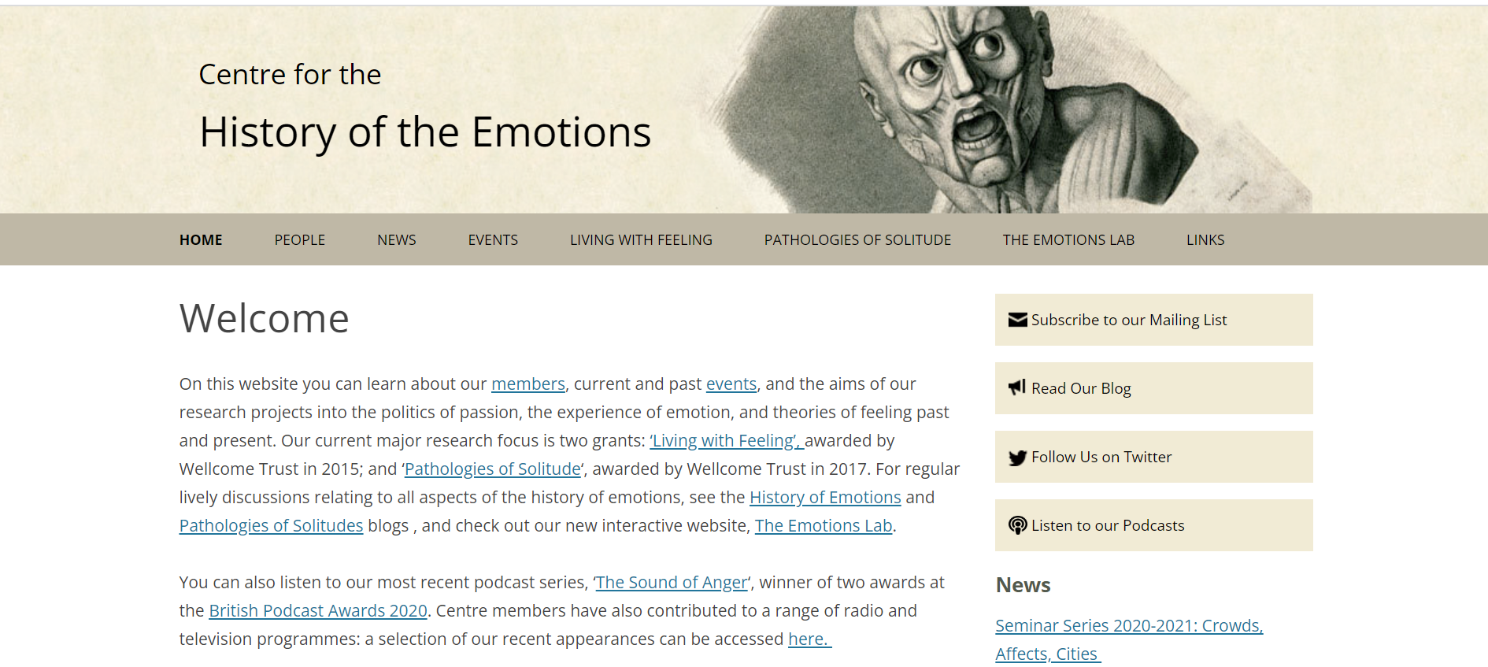
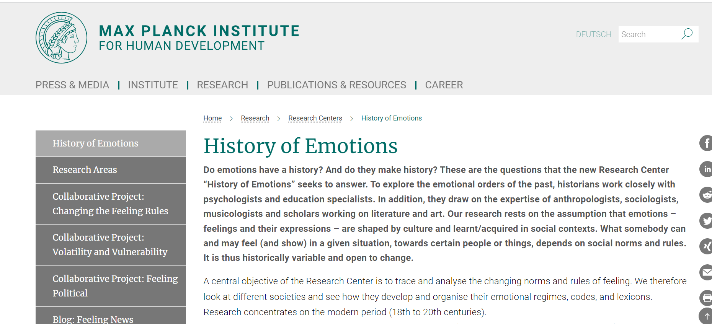
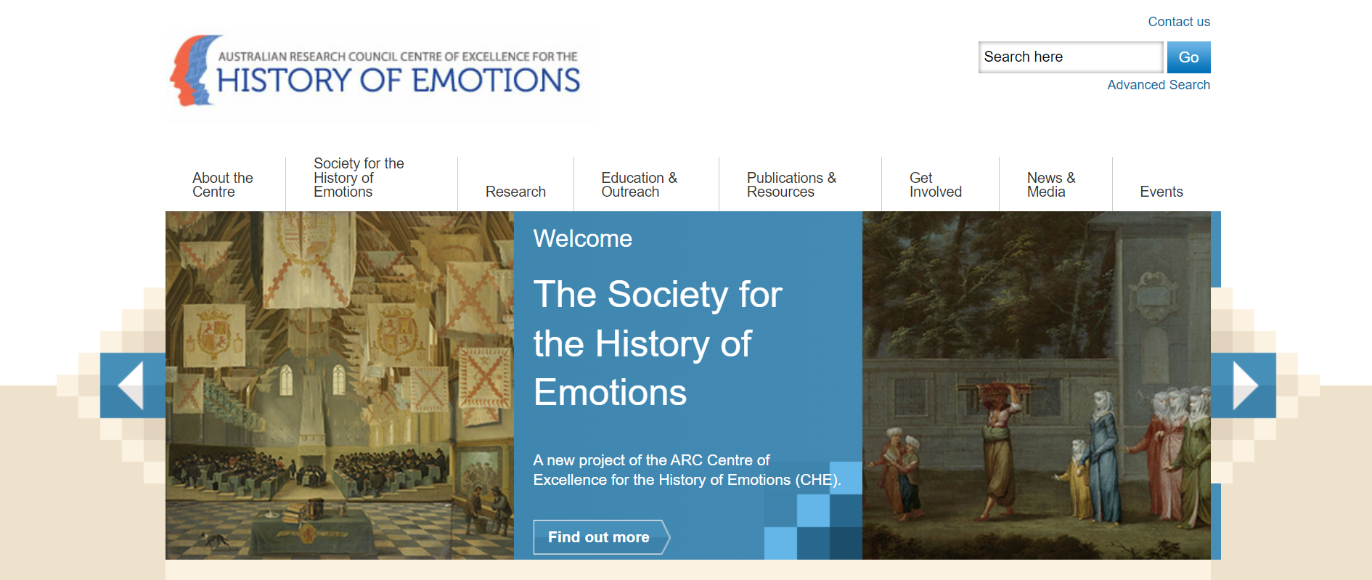
Centres for the history emotions
Queen Mary, University of London
Max Planck Institute, Berlin
Australian Research Council, University of Western Australia

Slide 17
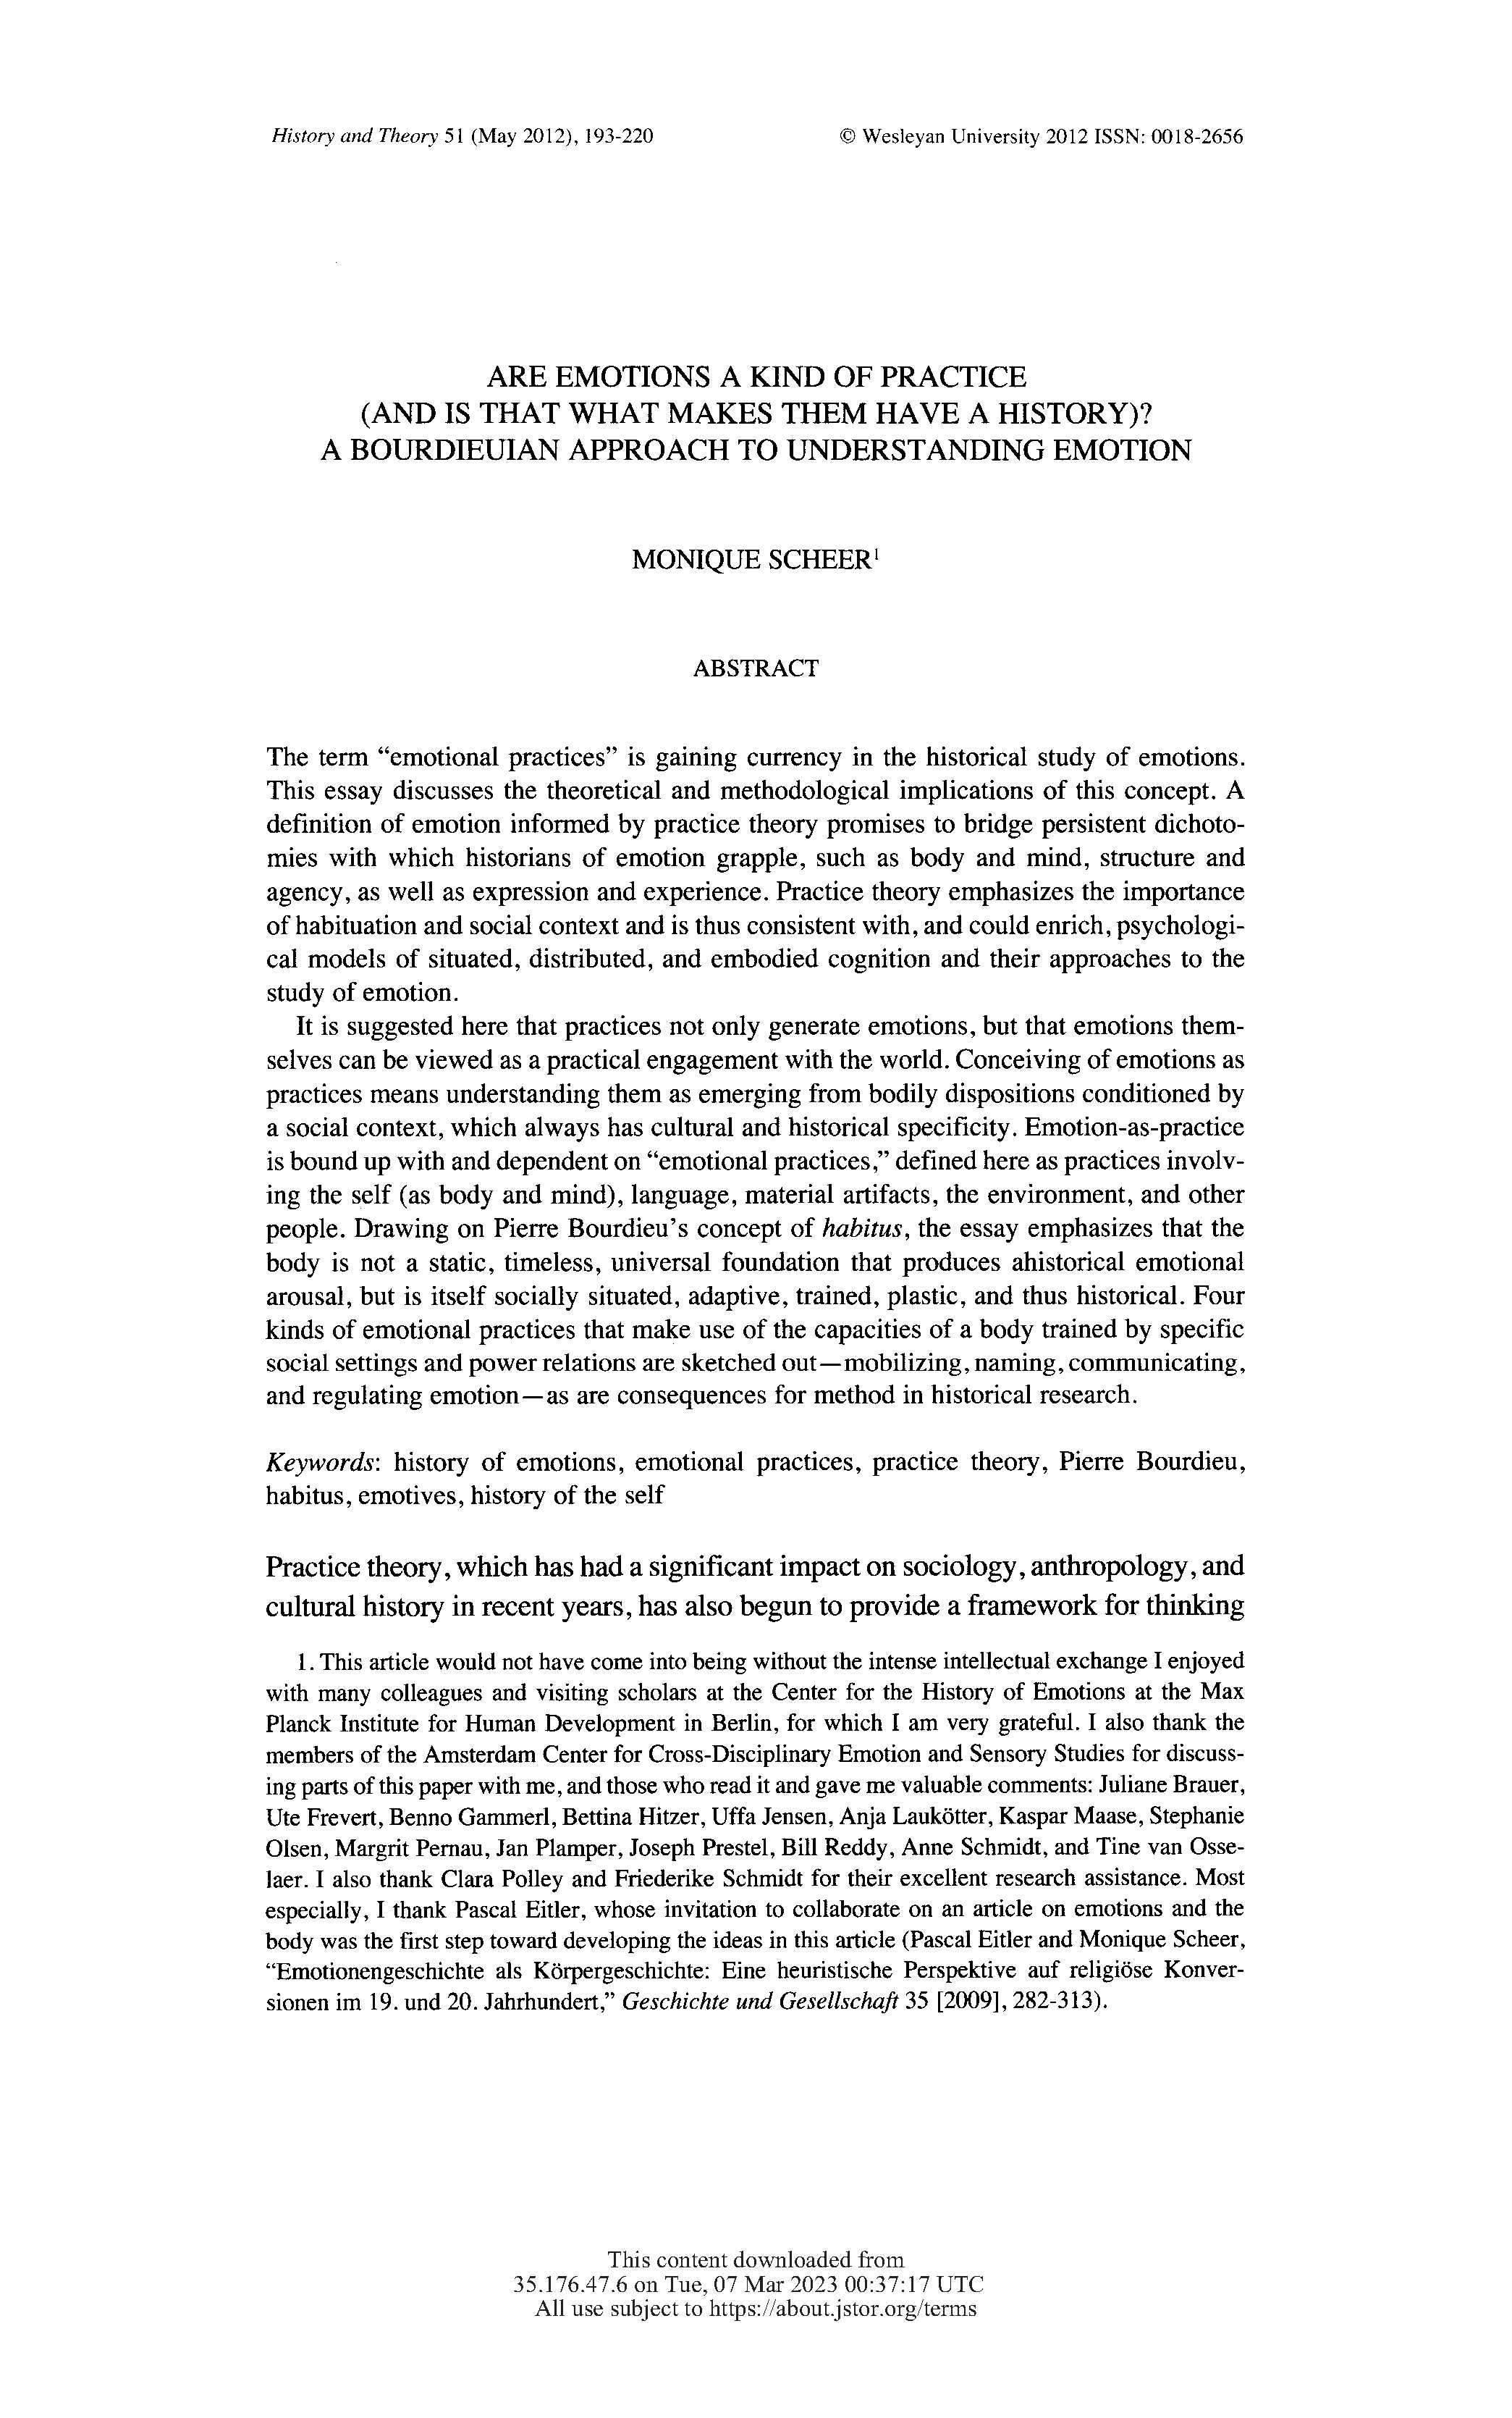
Monique Scheer – emotions and practice (2012)
Sees emotions as things you do rather than things you feel.
Emotions not abstract – deeply connected to body as well as the mind.
Recognises ‘performance’ in the study of past (and present) emotions.

Slide 18

The emotional ‘performance’ of Margery Kempe: ‘The crying saint’
C14 mystic known for expressive visions and revelations.
Travelled to pilgrim sites dressed in white – would weep constantly and loudly.
Uses ‘emotional’ words in her book – schame (shame), joy, dispeyr (despair).
Emotional ‘performance’ through weeping generated reaction from supporters and critics.

Slide 19
Key scholarly findings
Recognition of how emotions shaped history
Exploring what emotions reveal about human experience and social relations.
Roper emotions and German Peasants’ War = way to understand not just behaviour of groups and actors, but what emotions and experiences bind them together.
2. Acknowledgement that emotions have a history
Need to explore emotions on their own terms.
Emotions are important products of the societies and cultures in which they operate.

Slide 20
3. The challenges of working with emotions history

Slide 21
1. The problem of distance
The challenge of articulating everyday emotions – love, grief, despair, heartbreak.
Gap between what people felt and what historians know about those feelings.
The problem of objectivity – easy to look for certain words and sources that connect with the historian’s understanding, experiences and contexts.
Can never be certain whether words and ideas connected to different feelings or described in different ways.
Melancholy c.1500encompassed broad range of meanings: sadness, delusions, anxiety, griefs, phobias, source of creative genius and inspiration.
Connected and multiple emotions could often be contradictory, e.g. the pleasure of pain / the joy of suffering.

Slide 22
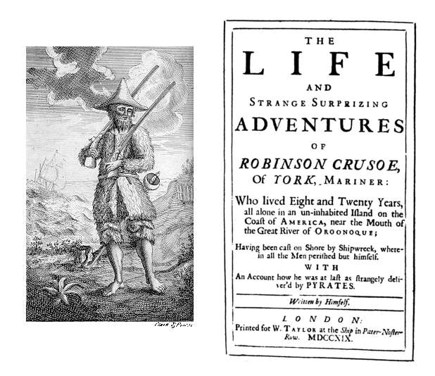
2. The problem of language
Does an emotion have to have a name for us to understand it?
‘Loneliness’ and feeling of being ‘lonely’ – not in widespread use until C19. So, could people feel ‘lonely’ before the 1800s?
Possible, e.g. abandonment by God and spiritual despair.
Raises question of how far language shapes emotions.

Slide 23
3. The problem of class
Words might have different meanings for different groups in the same society.
One of main sources for history of emotions = written sources and records.
Danger that history of emotions is the history of ‘articulate’ and ‘literate’ groups.
Obscures experiences and feelings of socially marginalised.

Slide 24
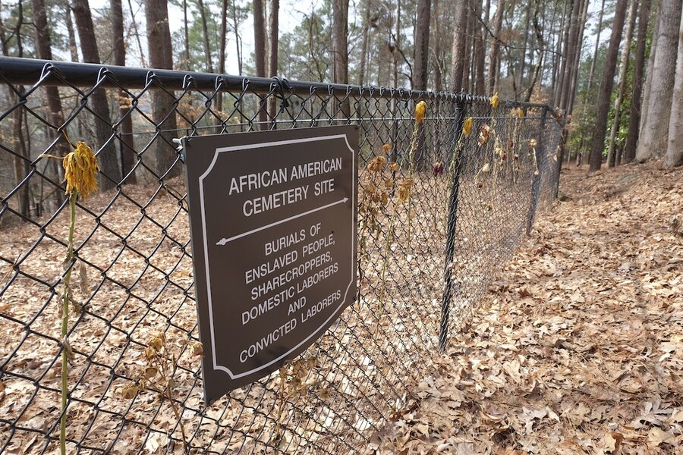
4. Geographical challenges
Regional bias to emotion history centred on nations of Western Europe and North America.
Very little work engages with global dimensions of emotions history – a historical opportunity.
E.g. Archaeological excavations of slave burial grounds in southern colonies = shows slaves buried with artefacts to help them return to Africa in afterlife.

Slide 25

5. What is new about the history of emotions?
Historians long attuned to the emotions, ideas, feelings and expressions of people in the past.
Lyndal Roper used psychoanalysis in 1990s to understand psychology that motivated people to accuse neighbours, friends and relatives of an ‘imagined’ crime.

Slide 26
6. The disciplinary challenge
Does putting the emotions into history undermine the objectivity of history writing and the historical discipline?

Slide 27
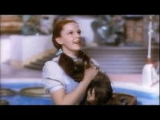
History with ‘a pulse’ (Dixon)
Value in recovering the faint traces and feelings of the past.
Recognises complexity of history – offers an enriched and embodied history of the world.
The past in technicolour?

Slide 28
Conclusions
Exponential growth in emotions history suggests it is here to stay.
Emotions can make history genuinely interdisciplinary.
Whilst basic emotions might be shared, how they are expressed and what they mean varies significantly across time and cultures.
Problem of representation: may marginalise those already excluded from historical record even further – imperative to be creative in sources and approaches beyond written word.
A new historical subdiscipline? OR a new dimension to examine other historical topics (gender, sexuality, environment, politics etc)?

