Slide 1
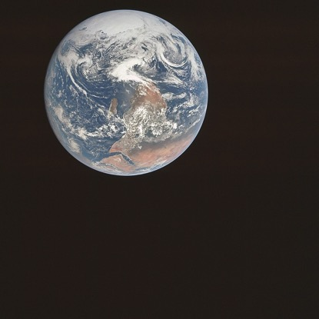
Environmental History

Slide 2
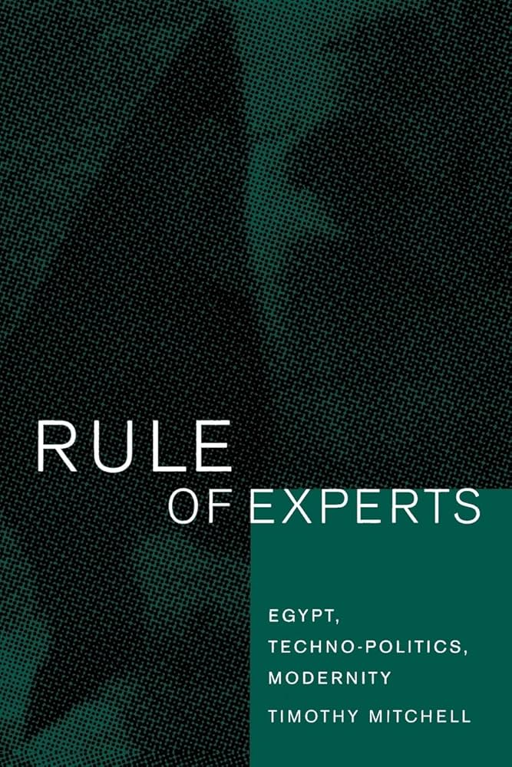
‘Can the subaltern mosquito speak?’
‘The web of events in wartime Egypt […] includes a variety of agencies that are not exclusively human: the anopheles mosquito, the falaciparum parasite, the chemical properties of ammonium nitrate, the 75mm guns of the Sherman tank, the hydraulic force of the river. […] They shape a variety of social processes, sometimes according to human plans, but just as often not, or at least not quite.’

Slide 3
‘Can the subaltern mosquito speak?’
Who and what makes a difference in history?
How can we historians comprehend and represent voices absent from archives (and perspective and motivations distant from our own)?

Slide 4
Lecture overview
A brief history of environmental history
More-than-human historical agency
Large-scale history
Doing history in the Anthropocene

Slide 5
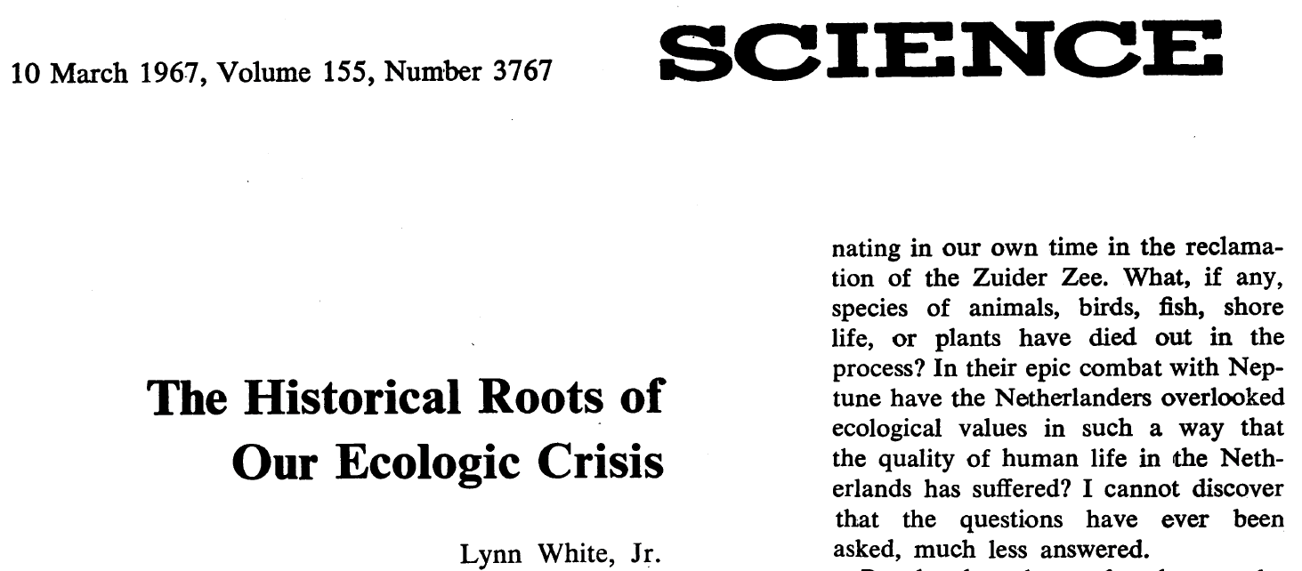
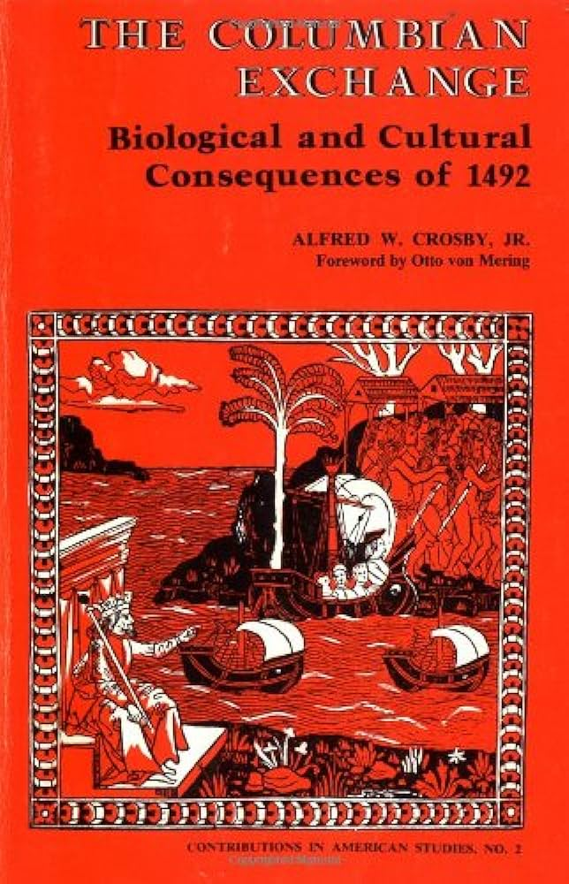
The birth of Environmental History
Environmental ideas (White)
‘Christianity bears a huge burden of guilt’ for environmental crisis
Material environments (Crosby)
‘Biological warfare’
Insects and viruses are ‘maker[s] of history.’

Slide 6
Ideas and knowledge vs. material realities
‘[Environmental historians] understand that the very term they use to describe the environment—nature—is itself an astonishingly complex human construction.’
William Cronon, ‘Modes of Prophecy and Prediction: Placing Nature in History’, The Journal of American History, 76, 4 (1990), p. 1122
‘ … nostalgia for that old narrow focus on the self-referential history of human ideas, society, and culture, with its tendency to dismiss nature as a mere epiphenomenon.’
Donald Worster, ‘Seeing Beyond Culture’, The Journal of American History, 76, 4 (1990), p. 1142

Slide 7
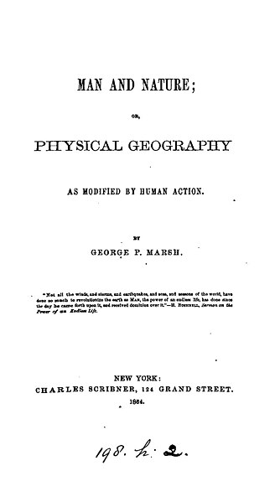
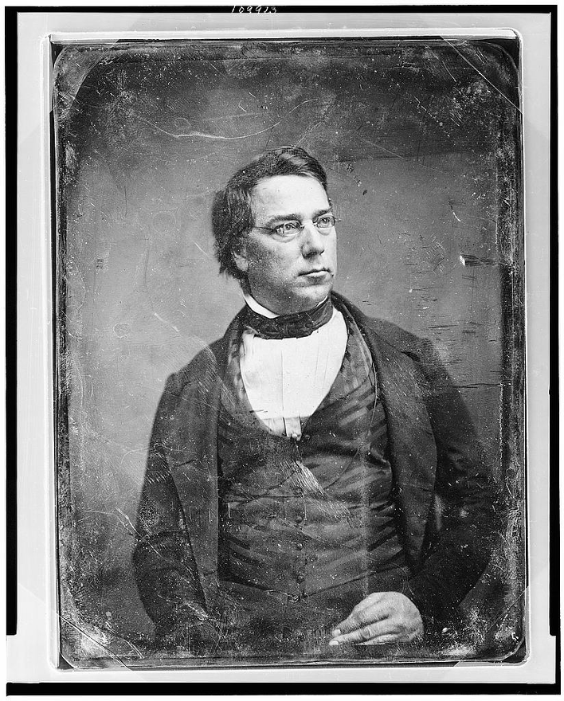
Environmental histories before ‘Environmental History’
‘We have felled forest enough everywhere, in many districts far too much. Let us restore this one element of material life to its normal proportions, and devise means for maintaining the permanence of its relations to the fields, the meadows and the pastures, to the rain and the dews of heaven, to the springs and rivulets with which it waters down the earth.’

Slide 8
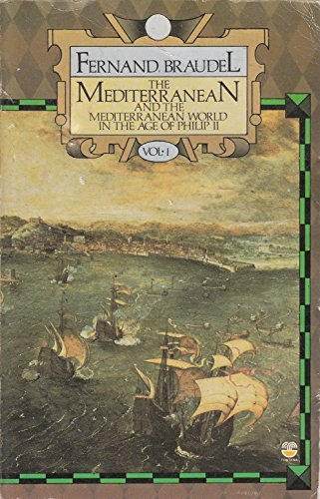
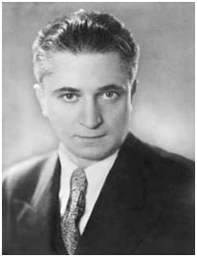
Environmental histories before ‘Environmental History’
‘Statesmen were, despite their illusions, more acted upon than actors …The events of history are merely surface disturbances, crests of foam that the tides of history carry on their strong backs.’

Slide 9
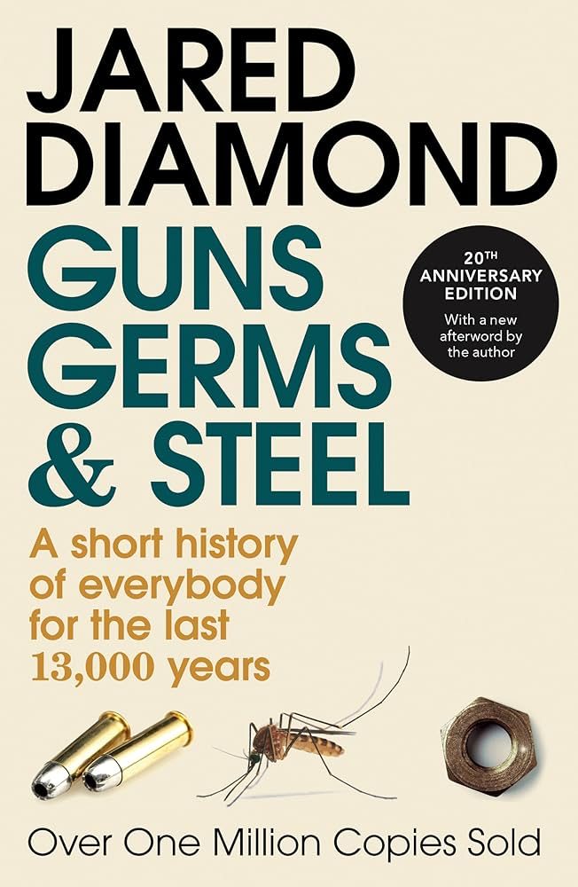
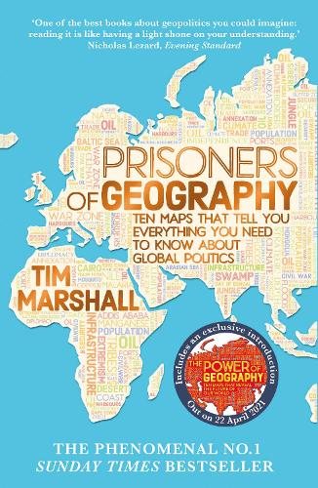
More recent developments
1. Scepticism towards determinism
‘Diamond’s account—like Crosby’s—tends to naturalize European expansion as the outcome of physical conditions and inexorable Darwinian processes of selection… It seems to be precisely [through] simple and easily grasped biogeographical models, that they have gained such wide readerships.’
Alf Hornborg, ‘Imperial Metabolism’, p. 439

Slide 10

More recent developments
1. Scepticism towards determinism
‘The challenge … is to understand the material dimension of imperialism without reducing sociocultural projects to reflections of material exigencies.’
Alf Hornborg, ‘Imperial Metabolism’, p. 438

Slide 11
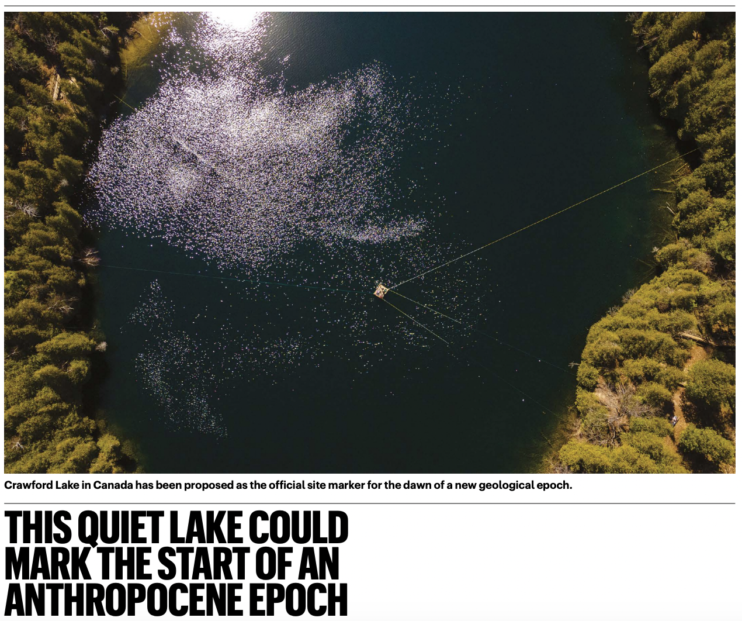
More recent developments
2. Anthropocene and climate change debates

Slide 12
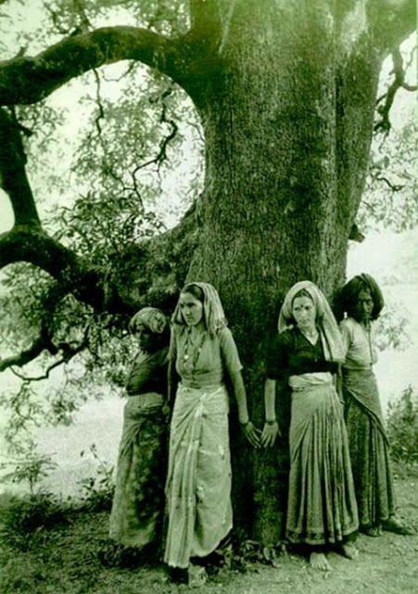
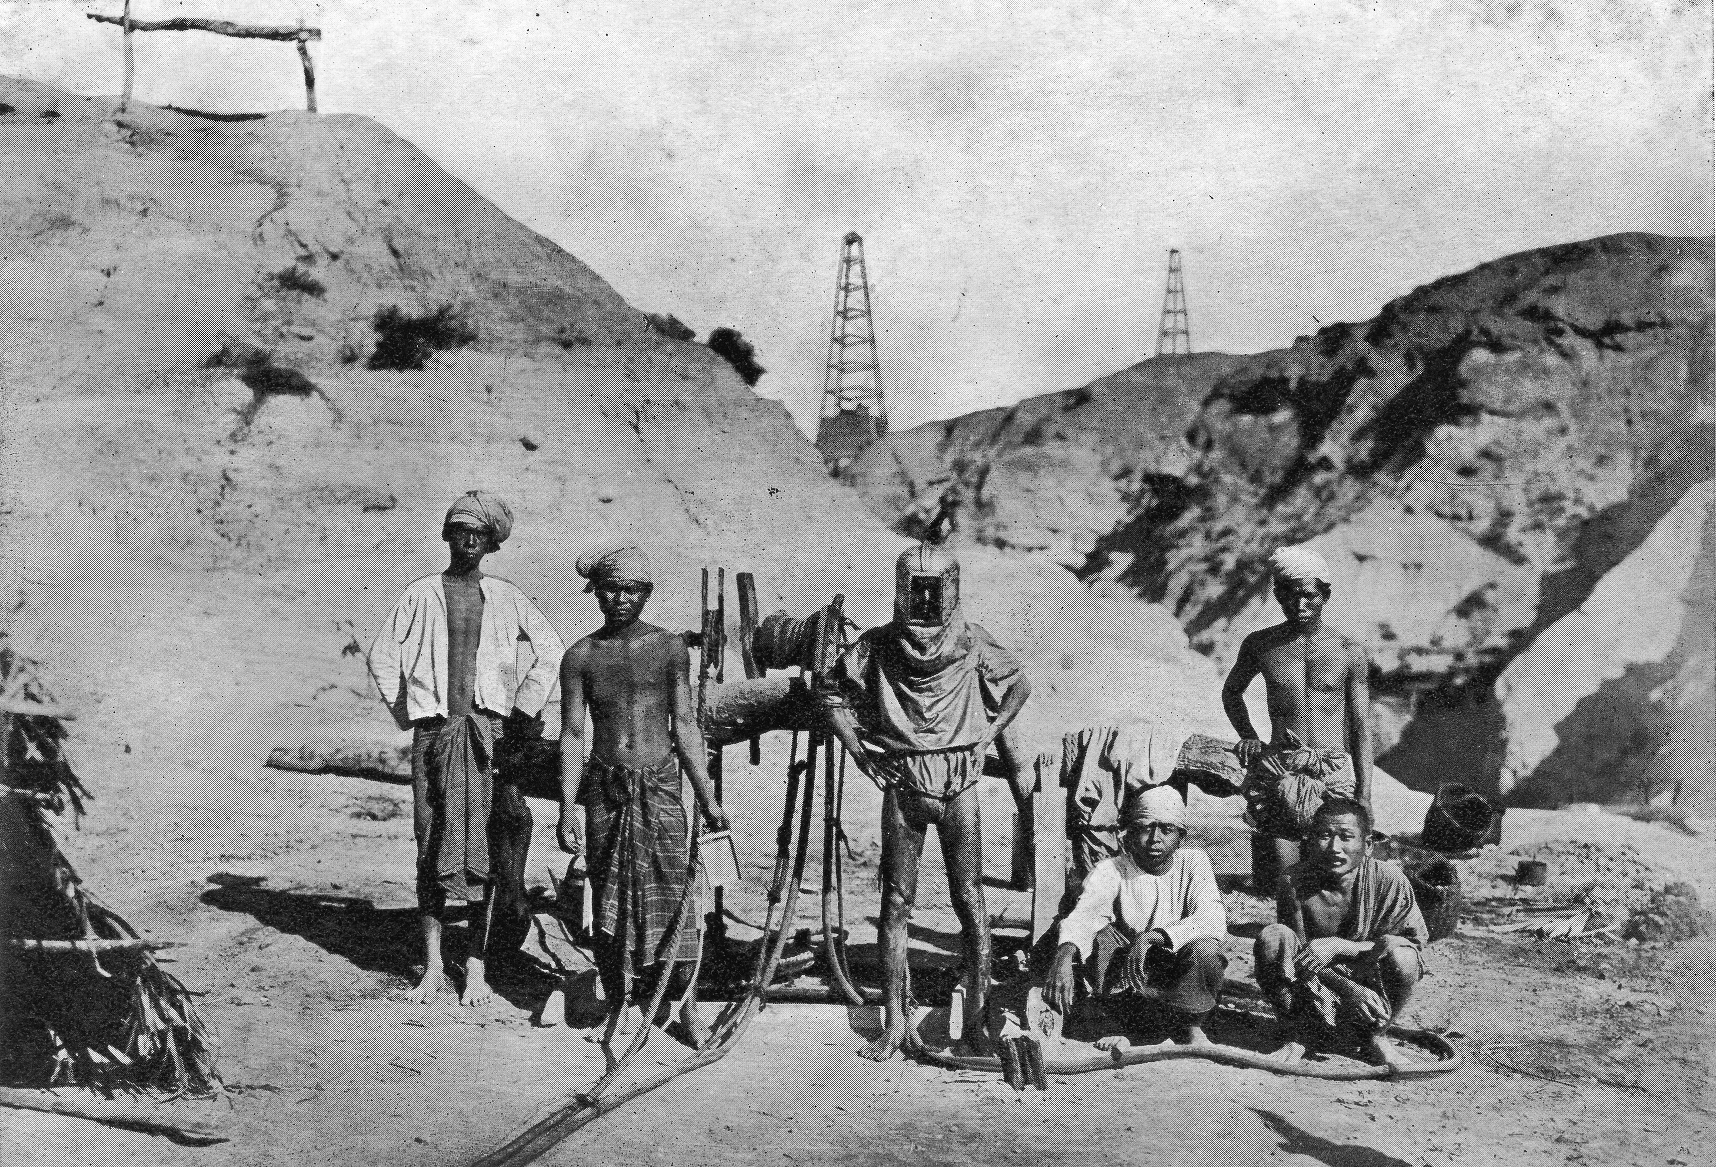
More recent developments
3. A more diverse set of human actors
Above: Chipko movement, India, c. 1970
Left: Burmese oilfield divers, c. 1920

Slide 13
More recent developments
4. Nuanced accounts of nonhuman agency

Slide 14
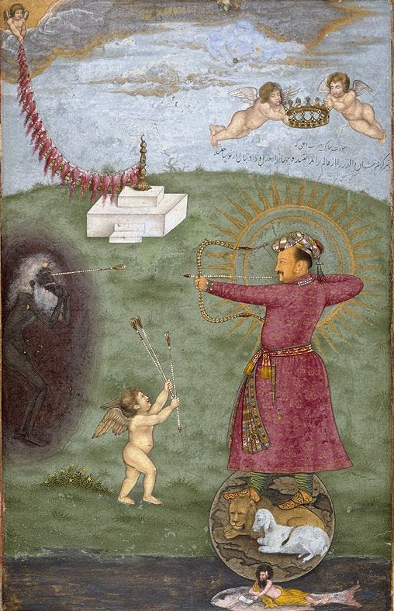
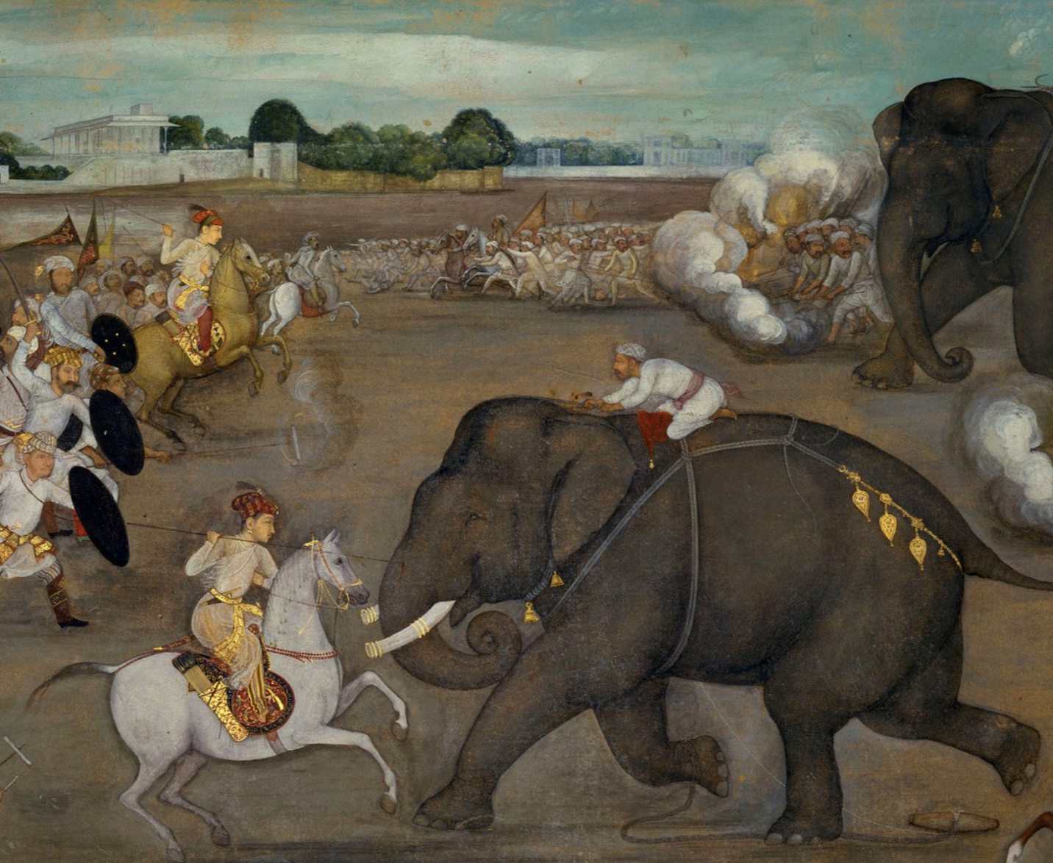
More-than-human history
Above: Mughal prince Aurangzeb facing a maddened elephant named Sudakar, (c. 1635)
Right: Abu’l Hasan, ‘Emperor Jahangir Triumphing Over Poverty’ (c. 1620)

Slide 15
More-than-human histories
‘More-than-human and multispecies approaches see the past and the present as dynamically co-constituted by multiple organisms, including plants, animals, and fungi, as well as by elements and forces, from water to minerals. Here, human meanings and understandings of the world are inseparable from the sets of relationships from which they arise, both shaping and being shaped by these.’
Emily O’Gorman and Andrea Gaynor, ‘More-Than-Human Histories’, Environmental History, 25 (2020), pp. 711–35, here pp. 716–17.

Slide 16
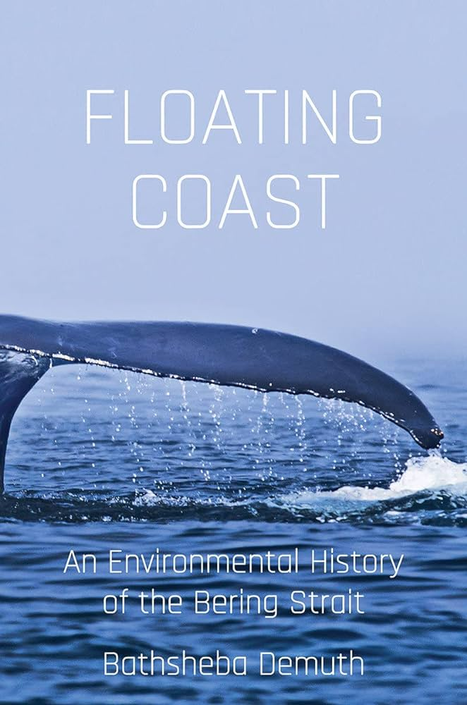
More-than-human histories
Animals have agency
‘The whales began using the floes as a tool against slaughter. Their culture, at the surface observed by commercial hunters, became one of choosing not to die for the market. It was, perhaps inadvertently, a political assertion.’
Demuth, Floating Coast, p. 43

Slide 17
More-than-human histories
Animals have agency
And so do environmental systems
‘Human life … was shaped, in part, by the ways energy moved over the land and through the sea.’
‘People are only part of what shapes action.’
Demuth, Floating Coast, pp. 4, 317

Slide 18
More-than-human histories
Animals have agency
And so do environmental systems
… But distinct human cultures and infrastructures make very different things of these environments
‘What made the 1840s distinct in Beringia was […] the foreigners who arrived with their proliferation of ideas.’ Demuth, Floating Coast, p. 7

Slide 19
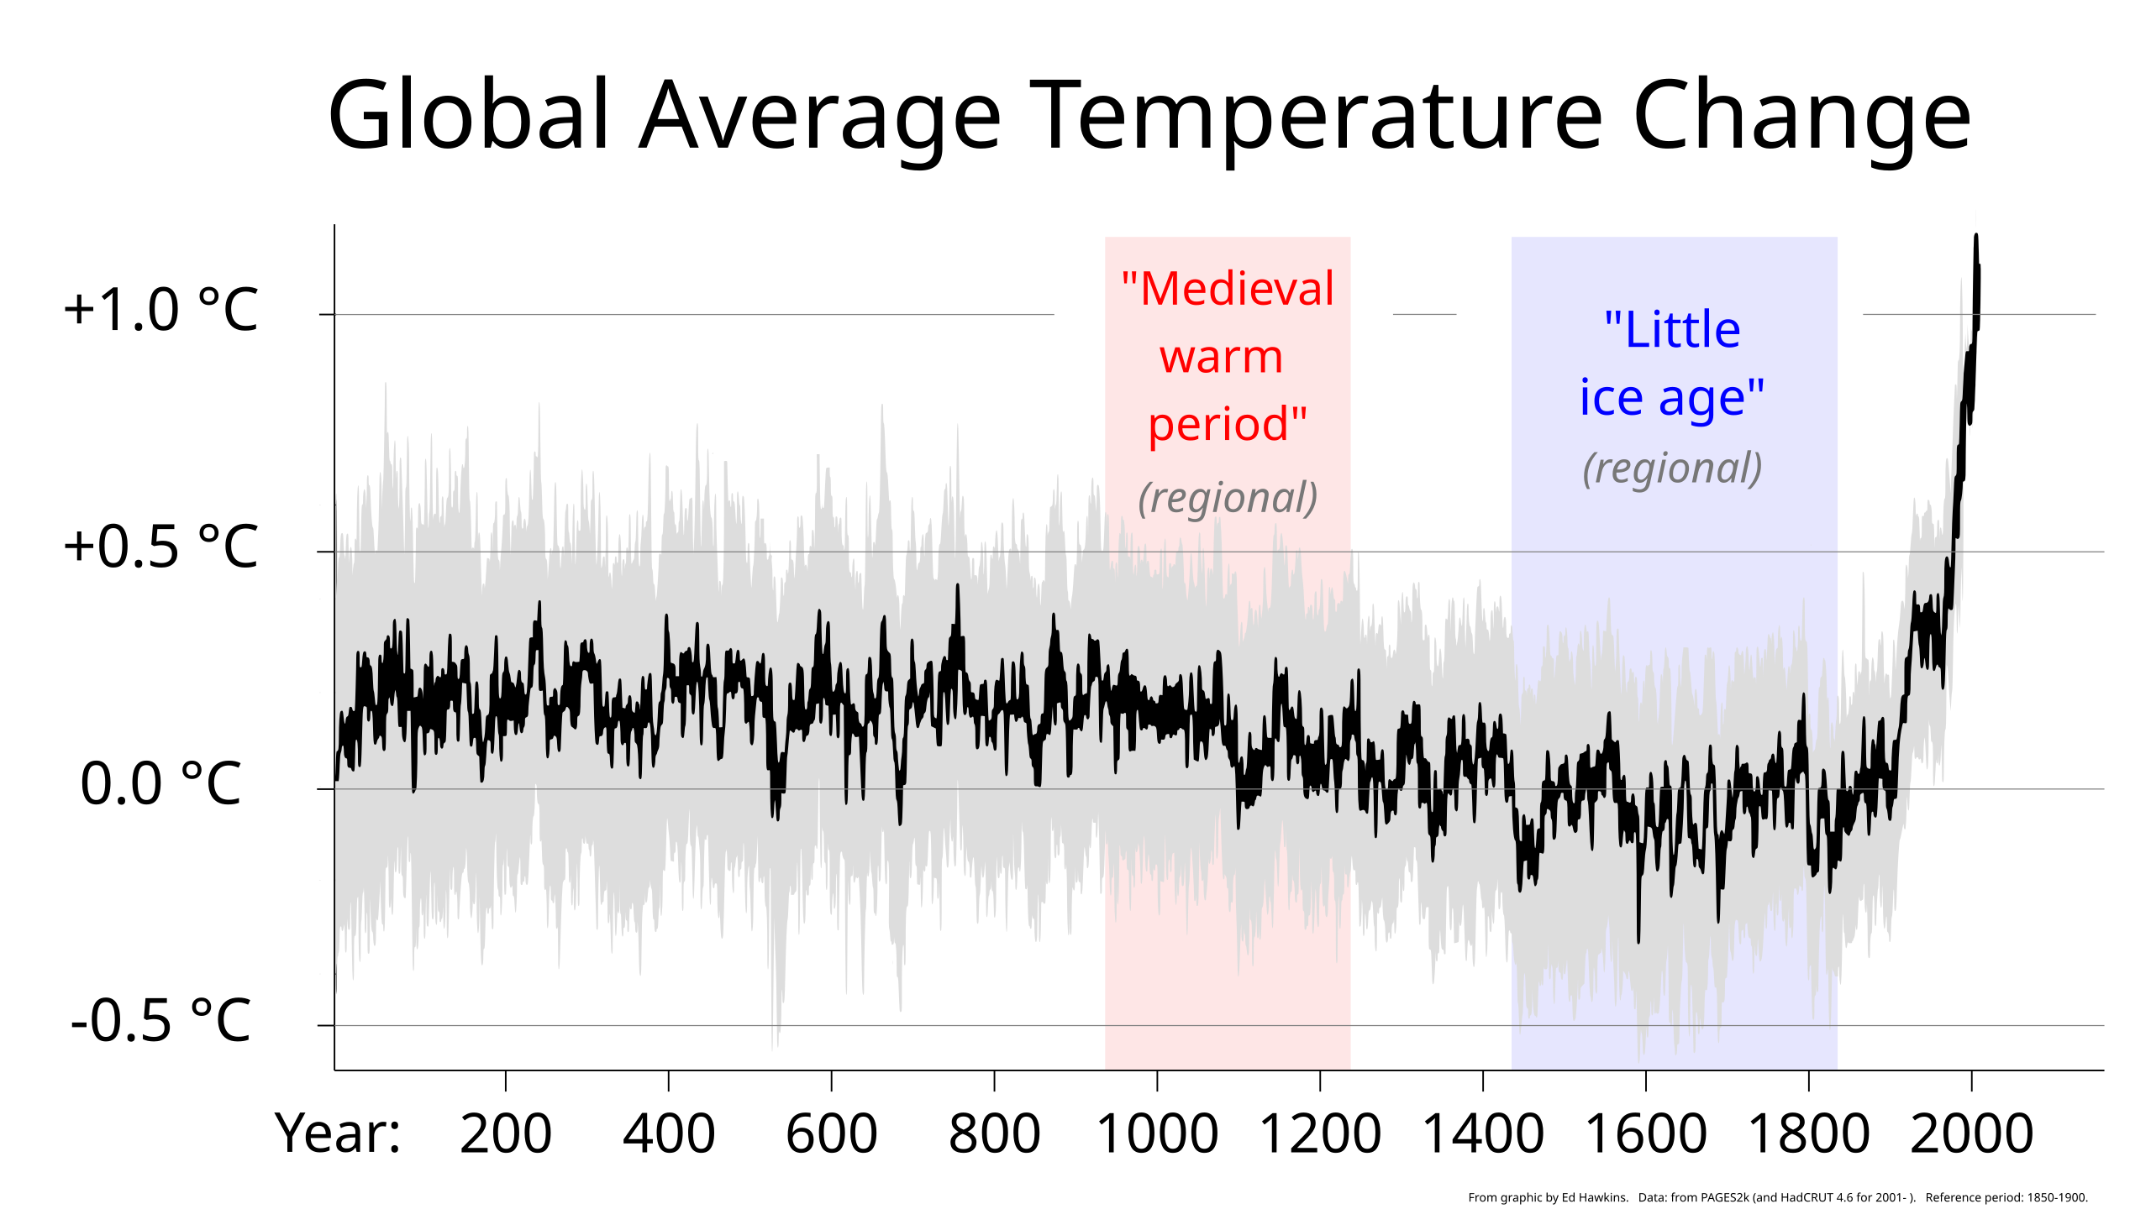
Large-scale history

Slide 20
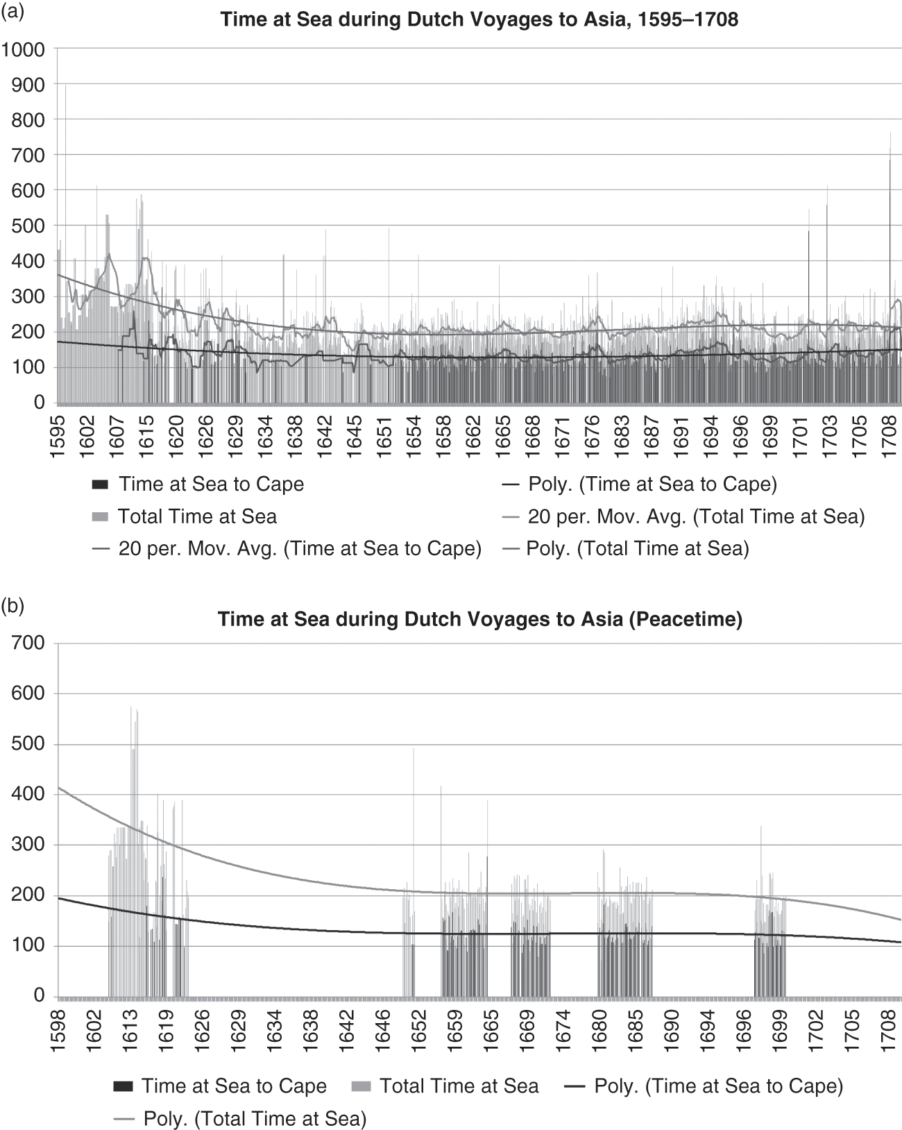
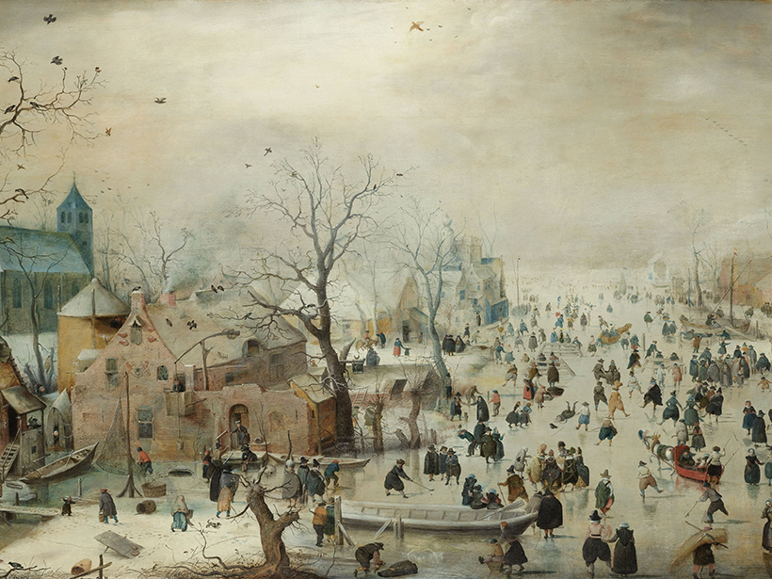
Large-scale history
Above: Dagomar Degroot, The Frigid Golden Age, pp. 100–101
Left: Hendrik Avercamp, ‘Winter Landscape with Skaters’ (c. 1608)

Slide 21
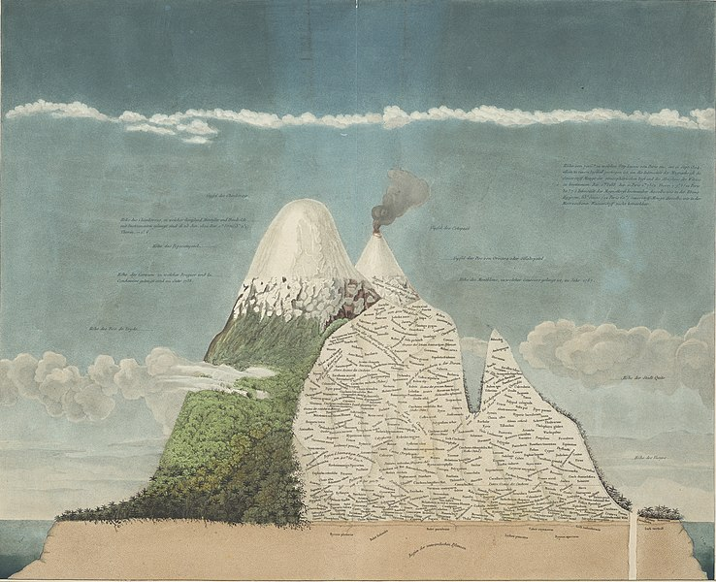
Large-scale history
Whose knowledge went into (or was excluded from) this source?
Does this source contest or corroborate environmental ideas put forward by others?
Did this source enable (or constrain) particular environmental interventions?
Alexander von Humboldt, ‘Tableau Physique’ (1807)

Slide 22
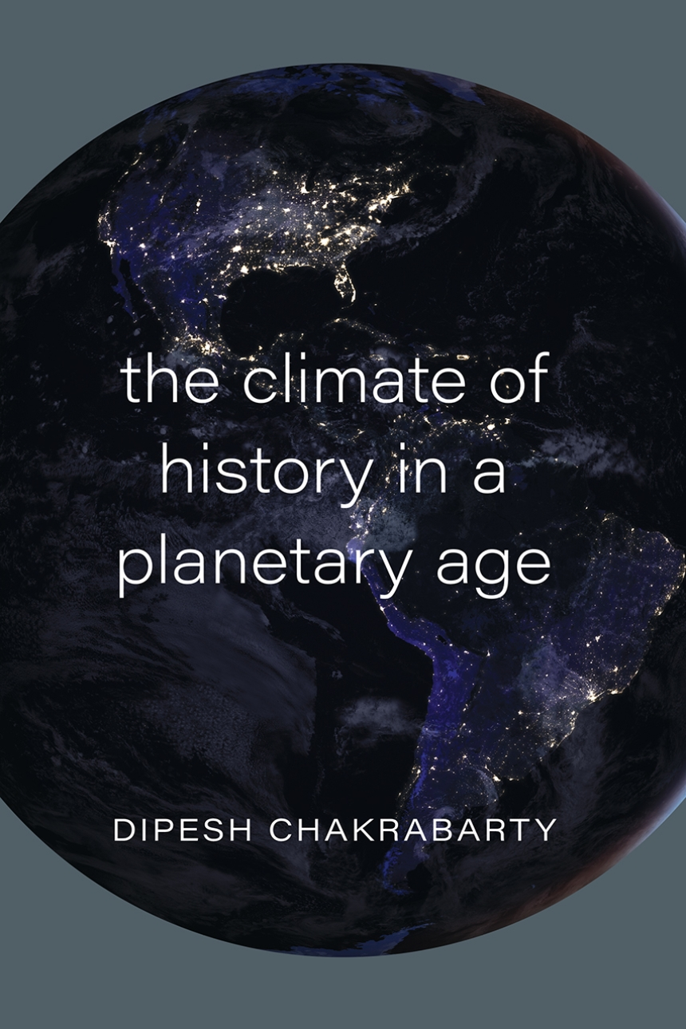
History in the Anthropocene
‘Climate Change spell[s] the collapse of the age-old […] distinction between Natural History and Human History.’
‘The crisis of the Anthropocene—the prospect of inhabiting a less habitable planet—reduces us to our creatureliness.’

Slide 23

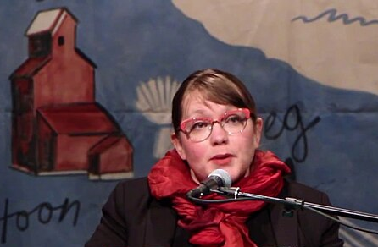
History in the Anthropocene
‘Colonialism … was always about changing the land, transforming the earth itself, including the creatures, the plants, the soil composition and the atmosphere.’
Heather Davis and Zoe Todd, ‘On the importance of a date’, pp. 763, 770

Slide 24
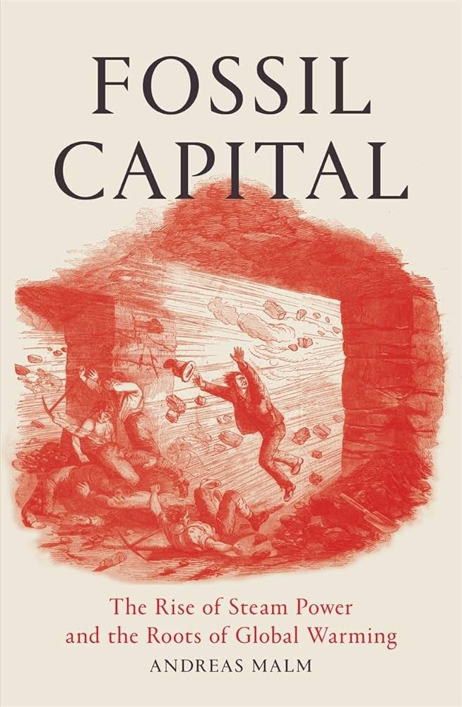
History in the Anthropocene
‘Outside of hard climate science, history should be the preeminent field for the study of global warming […] We are dealing with a historicized climate, a biosphere that carries the imprint of what some have done in the past, and it is their momentous course of action that needs to be retraced.’
Andreas Malm, ‘Who Lit This Fire? Approaching the History of the Fossil Economy’, Critical Historical Studies, 3, 2 (2016), pp. 215–48, here pp. 216–21.

Slide 25
History in the Anthropocene
1. Extending empathy
‘Not only can [historians] potentially help us empathise with human others, but they can also draw the non-human into our moral sphere as co-inhabitants of a shared planet.’
Katie Holmes, Andrea Gaynor & Ruth Morgan, ‘Doing environmental history in urgent times’, History Australia, 17, 2 (2020), p. 238.

Slide 26
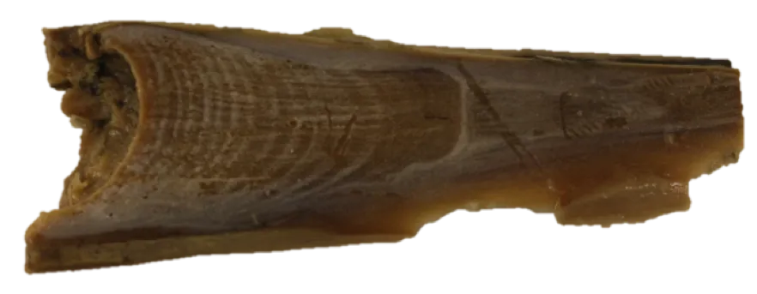
History in the Anthropocene
1. Extending empathy
‘Historians might also use sources like whale ear wax, which registers signs of stresses like whaling and climate change, to reconsider these histories from the perspectives of whales.’
Emily O’Gorman and Andrea Gaynor, ‘More-Than-Human Histories’, Environmental History, 25 (2020), p. 727.

Slide 27
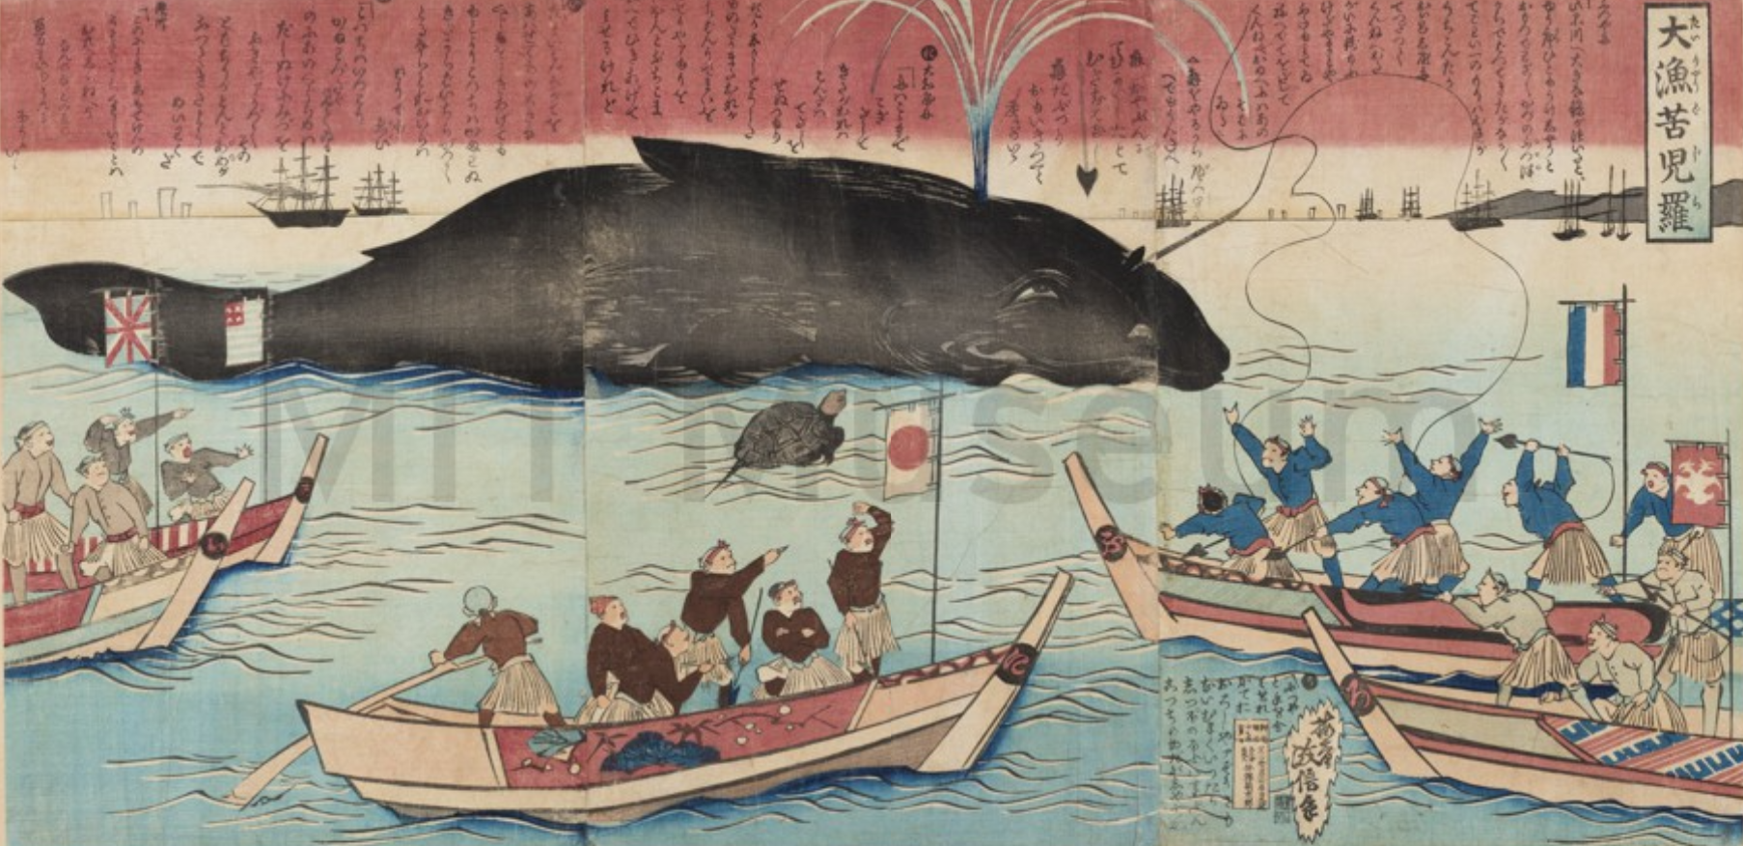
History in the Anthropocene
Tai-ryo Kujira, ‘A Great Whale Catch’ (1884)

Slide 28
History in the Anthropocene
2. ‘Radical remembering’
‘Environmental histories are needed now to counter dangerous and proliferating historical falsehoods, and to provide the insights and emotional fortitude we need as we face the escalating climate and ecological crises. They are essential to diverse forms of ‘radical remembering’ needed to disrupt the accidental or cultivated silences that sustain business as usual.’
Katie Holmes, Andrea Gaynor & Ruth Morgan, ‘Doing environmental history in urgent times’, History Australia, 17, 2 (2020), p. 234.

Slide 29
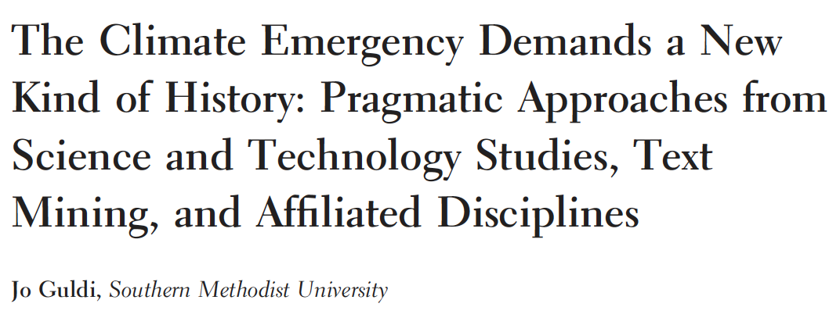
History in the Anthropocene
3. Being urgent, being polemical
‘The tone of much climate writing in the humanities and social sciences is far from urgent. Indeed, in the main, most interventions of this kind have fallen short of treating climate change […] as an emergency that requires immediate and practical adjustments to life.’

Slide 30
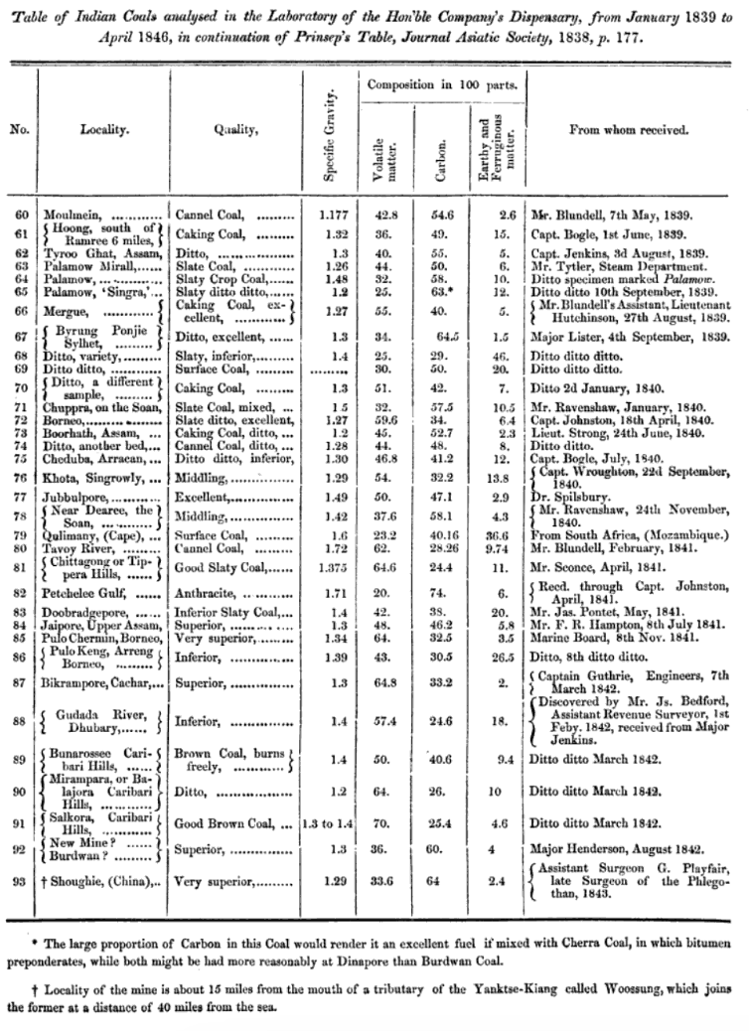
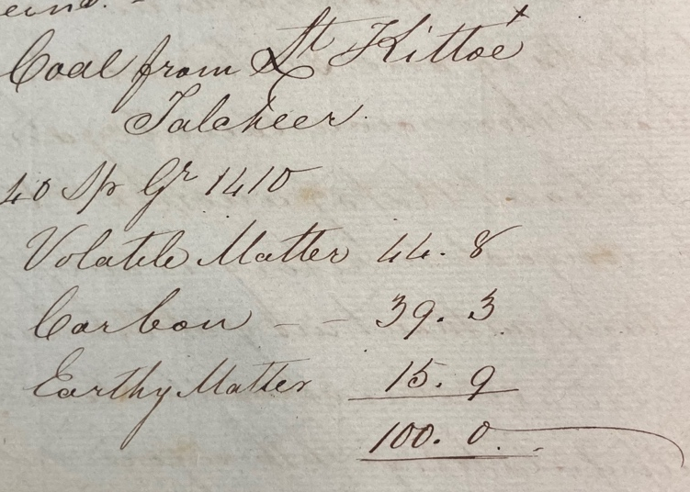
History in the Anthropocene
3. Being urgent, being polemical

Slide 31
Some conclusions
Environmental history in connection to Subaltern Studies:
  Extending who (and what) counts as a historical subject
  Exploring how to represent those with sparse archival traces
Environmental History was formally born at a time of acknowledged environmental crisis in the 1960s-70s …
But has changed significantly in recent decades:
  More nuanced more-than-human histories
  Less fixated on a binary opposition between ideas and material realities
History in the Anthropocene:
  Need to adapt our methods and modes of communication …
  But our critical analytical skills enable vital contributions to these debates

