Slide 1
Marginality
Dr Claire Shaw

Slide 2
Lecture Outline
Marginality: Historiography and Influences
Writing the History of Disability
Live Debates in the History of Disability/Marginality

Slide 3
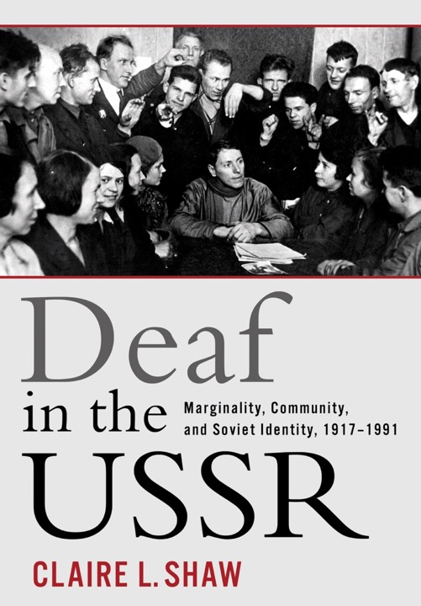

Slide 4
Marginality
‘the marginal man is a mixed blood […] who lives in two worlds, in both of which he is more or less of a stranger.’
Robert E. Park, ‘Human Migration and the Marginal Man’, American Journal of Sociology, vol. 33, no. 6, 1928, pp. 881–893.

Slide 5
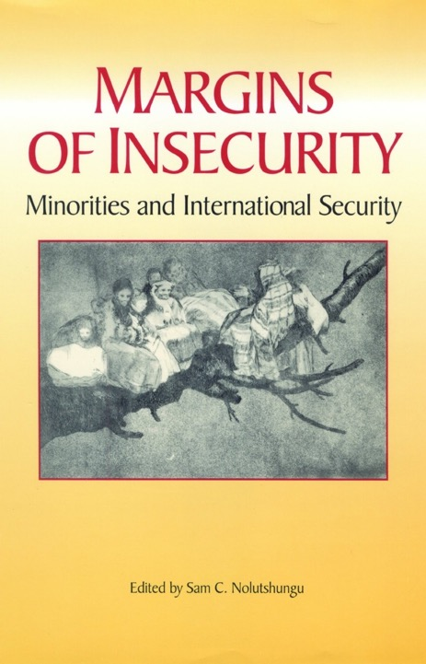
‘marginal populations are distinguishable minorities within states whose integration to the society and state is markedly incomplete so that their participation in either is partial, intermittent, or subject to special qualifications and restrictions’
Sam C. Nolutshungu

Slide 6
‘[marginal social groups] deserve the full attention of historians and social scientists because the impact of marginalization and the mobilization of hitherto marginal social categories can profoundly affect political life’.
Michael Hanagan, ‘Changing Margins in Postwar European Politics’

Slide 7
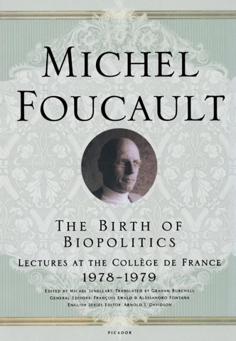
Influences
‘Othering’
‘Biopower’
'History from Below’

Slide 8
Disability Rights Activism:
from ‘Medical Model’ to ‘Social Model’
Protesters demonstrating in favour of access rights,
San Francisco, April 5, 1977
(Anthony Tusler)

Slide 9
Disability Studies
‘Disability studies’ project is to weave disabled people back into the fabric of society, thread by thread, theory by theory. It aims to expose the ways that disability has been made exceptional and to work to naturalize disabled people – remake us as full citizens whose rights and privileges are intact, whose history and contributions are recorded, and whose often distorted representations in art, literature, film, theatre, and other forms of artistic expression are fully analysed’.
Simi Linton, “What Is Disability Studies?” PMLA, vol. 120, no. 2, 2005, pp. 518–522.

Slide 10
Disability History
‘Until we can document the past with the evidence and rigor that solid historical research necessitates, the absence of disability from our written history, its suppression in our formal collective memory, jeopardises the current quest of Americans with disabilities for full citizenship. This history matters, and not in the abstract’.
Paul Longmore and Lauri Umansky, ‘Introduction’

Slide 11
Disability History
‘Heritage Hunting’
Documenting Oppression: ‘ableism’ and ‘audism’
Tracing cultures, values, identities and activism of disabled people.

Slide 12
Deaf President Now! Gallaudet University, Washington D. C., 1988

Slide 13
Disability History
From subject matter to analytical tool

Slide 14
‘Opponents of political and social equality for women cited their supposed physical, intellectual, and psychological flaws, deficits, and deviations from the male norm. These flaws—irrationality, excessive emotionality, physical weakness— are in essence mental, emotional, and physical disabilities, although they are rarely discussed or examined as such. Arguments for racial inequality and immigration restrictions invoked supposed tendencies to feeble-mindedness, mental illness, deafness, blindness, and other disabilities in particular races and ethnic groups. Furthermore, disability figured prominently not just in arguments for the inequality of women and minorities but also in arguments against those inequalities.’
Douglas Baynton, ‘Disability and the Justification of Inequality in American History’ in The New Disability History: American Perspectives

Slide 15
Debates in Marginality/ Disability History
Historicizing Disability: Definitions, Language, Geography
Intersectionality (Kimberlé Crenshaw)
Positionality
Ethics
George Edward Shuttleworth collection © Wellcome Library, London

Slide 16
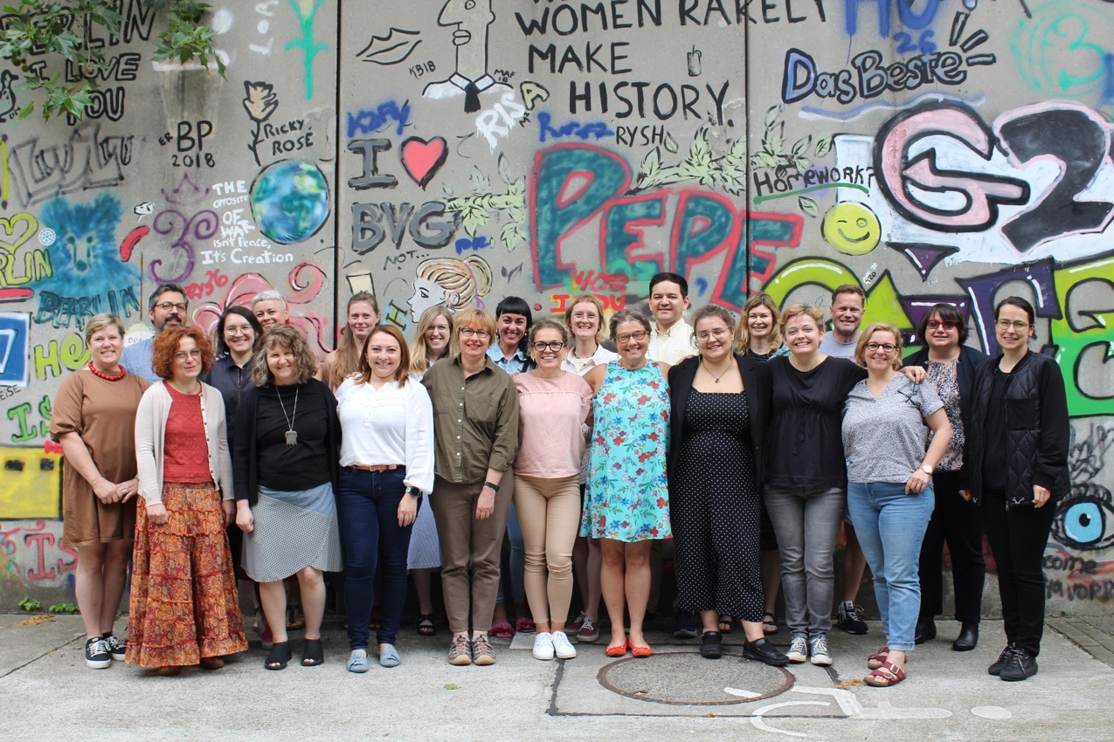
Participants at the conference ‘Towards a History of Disability in Eastern Europe’
Berlin, June 30-July 2, 2023

