Slide 1
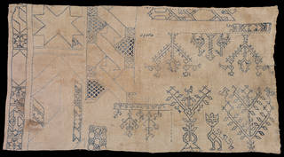
Material culture
Historiography II
Anne Gerritsen

Slide 2
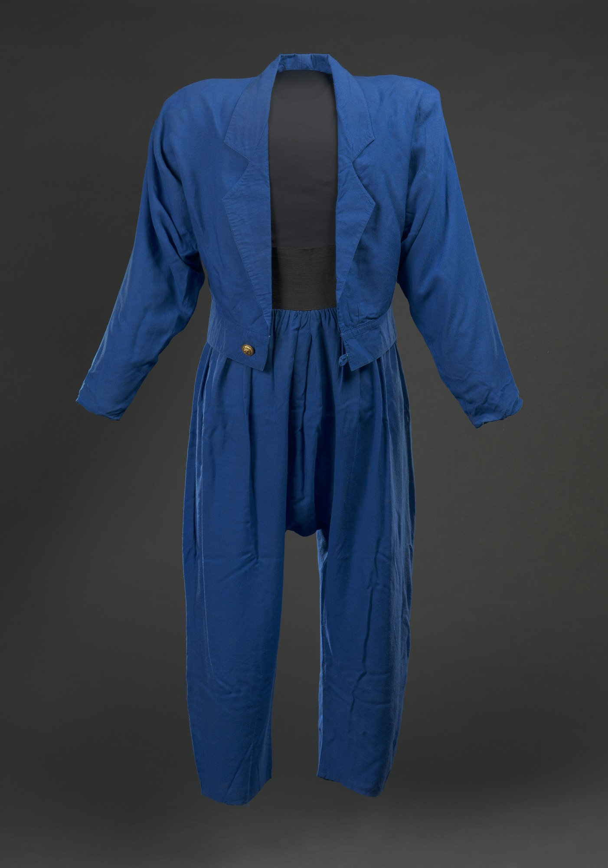
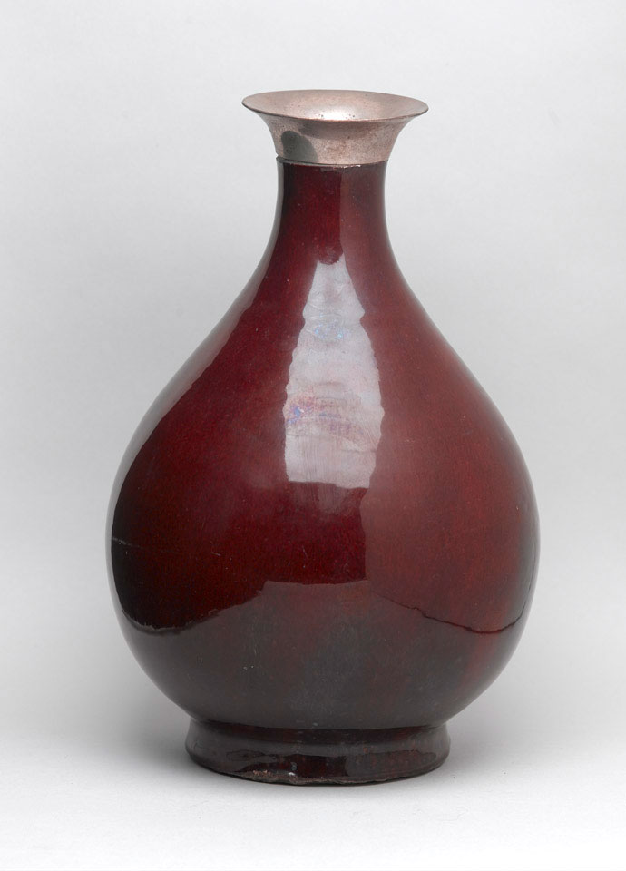
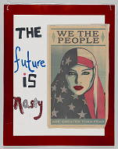
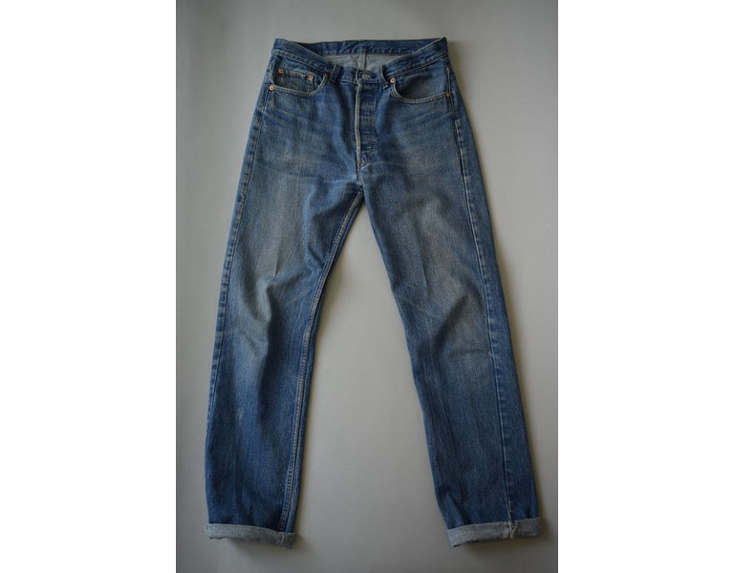
Lecture outline
Choosing an object
Looking at an object
Analysing an object
Using objects to write new histories

Slide 3
What is material culture?

Slide 4
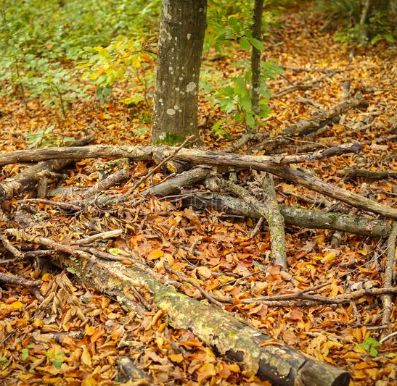
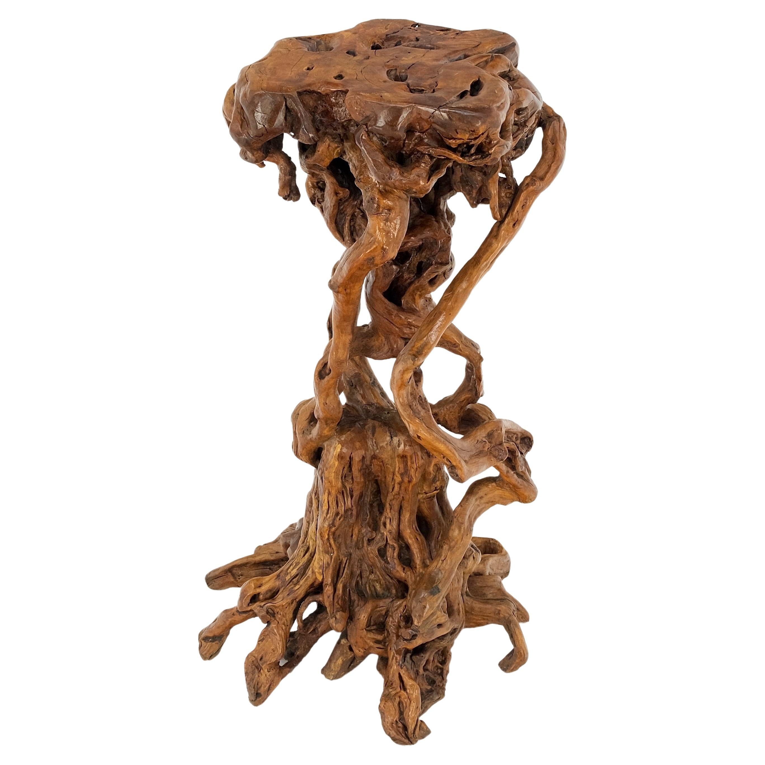
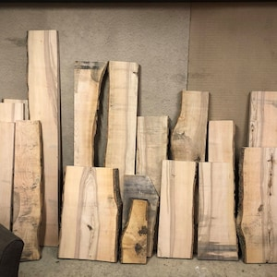

What is material culture?
Material culture is a multi-disciplinary approach to the study of objects.
Not natural objects, but some evidence of human interference or manipulation

Slide 5
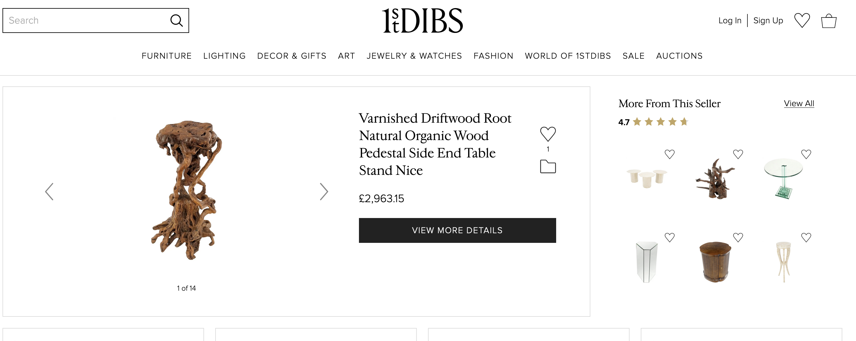

Slide 6
What is material culture?
‘cultural objects’: Objects that show traces of human adaptation

Slide 7
Choose an object with a context that interests you
Fashion and clothing
Chinese ceramics
Protest movement

Slide 8
To study material culture, you need objects that interest you

Slide 9
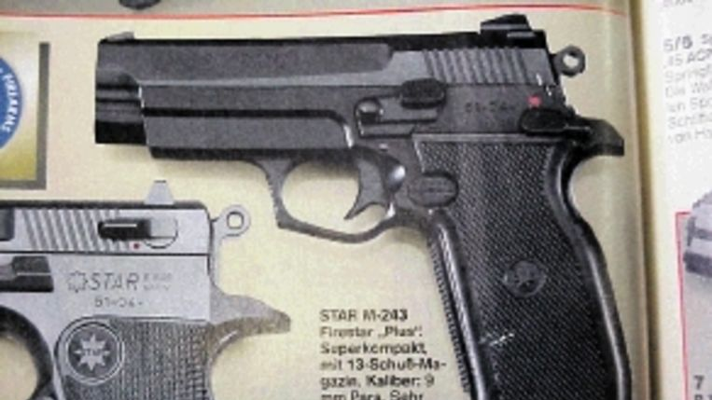
Look closely at an object
Art historical skill of looking closely

Slide 11
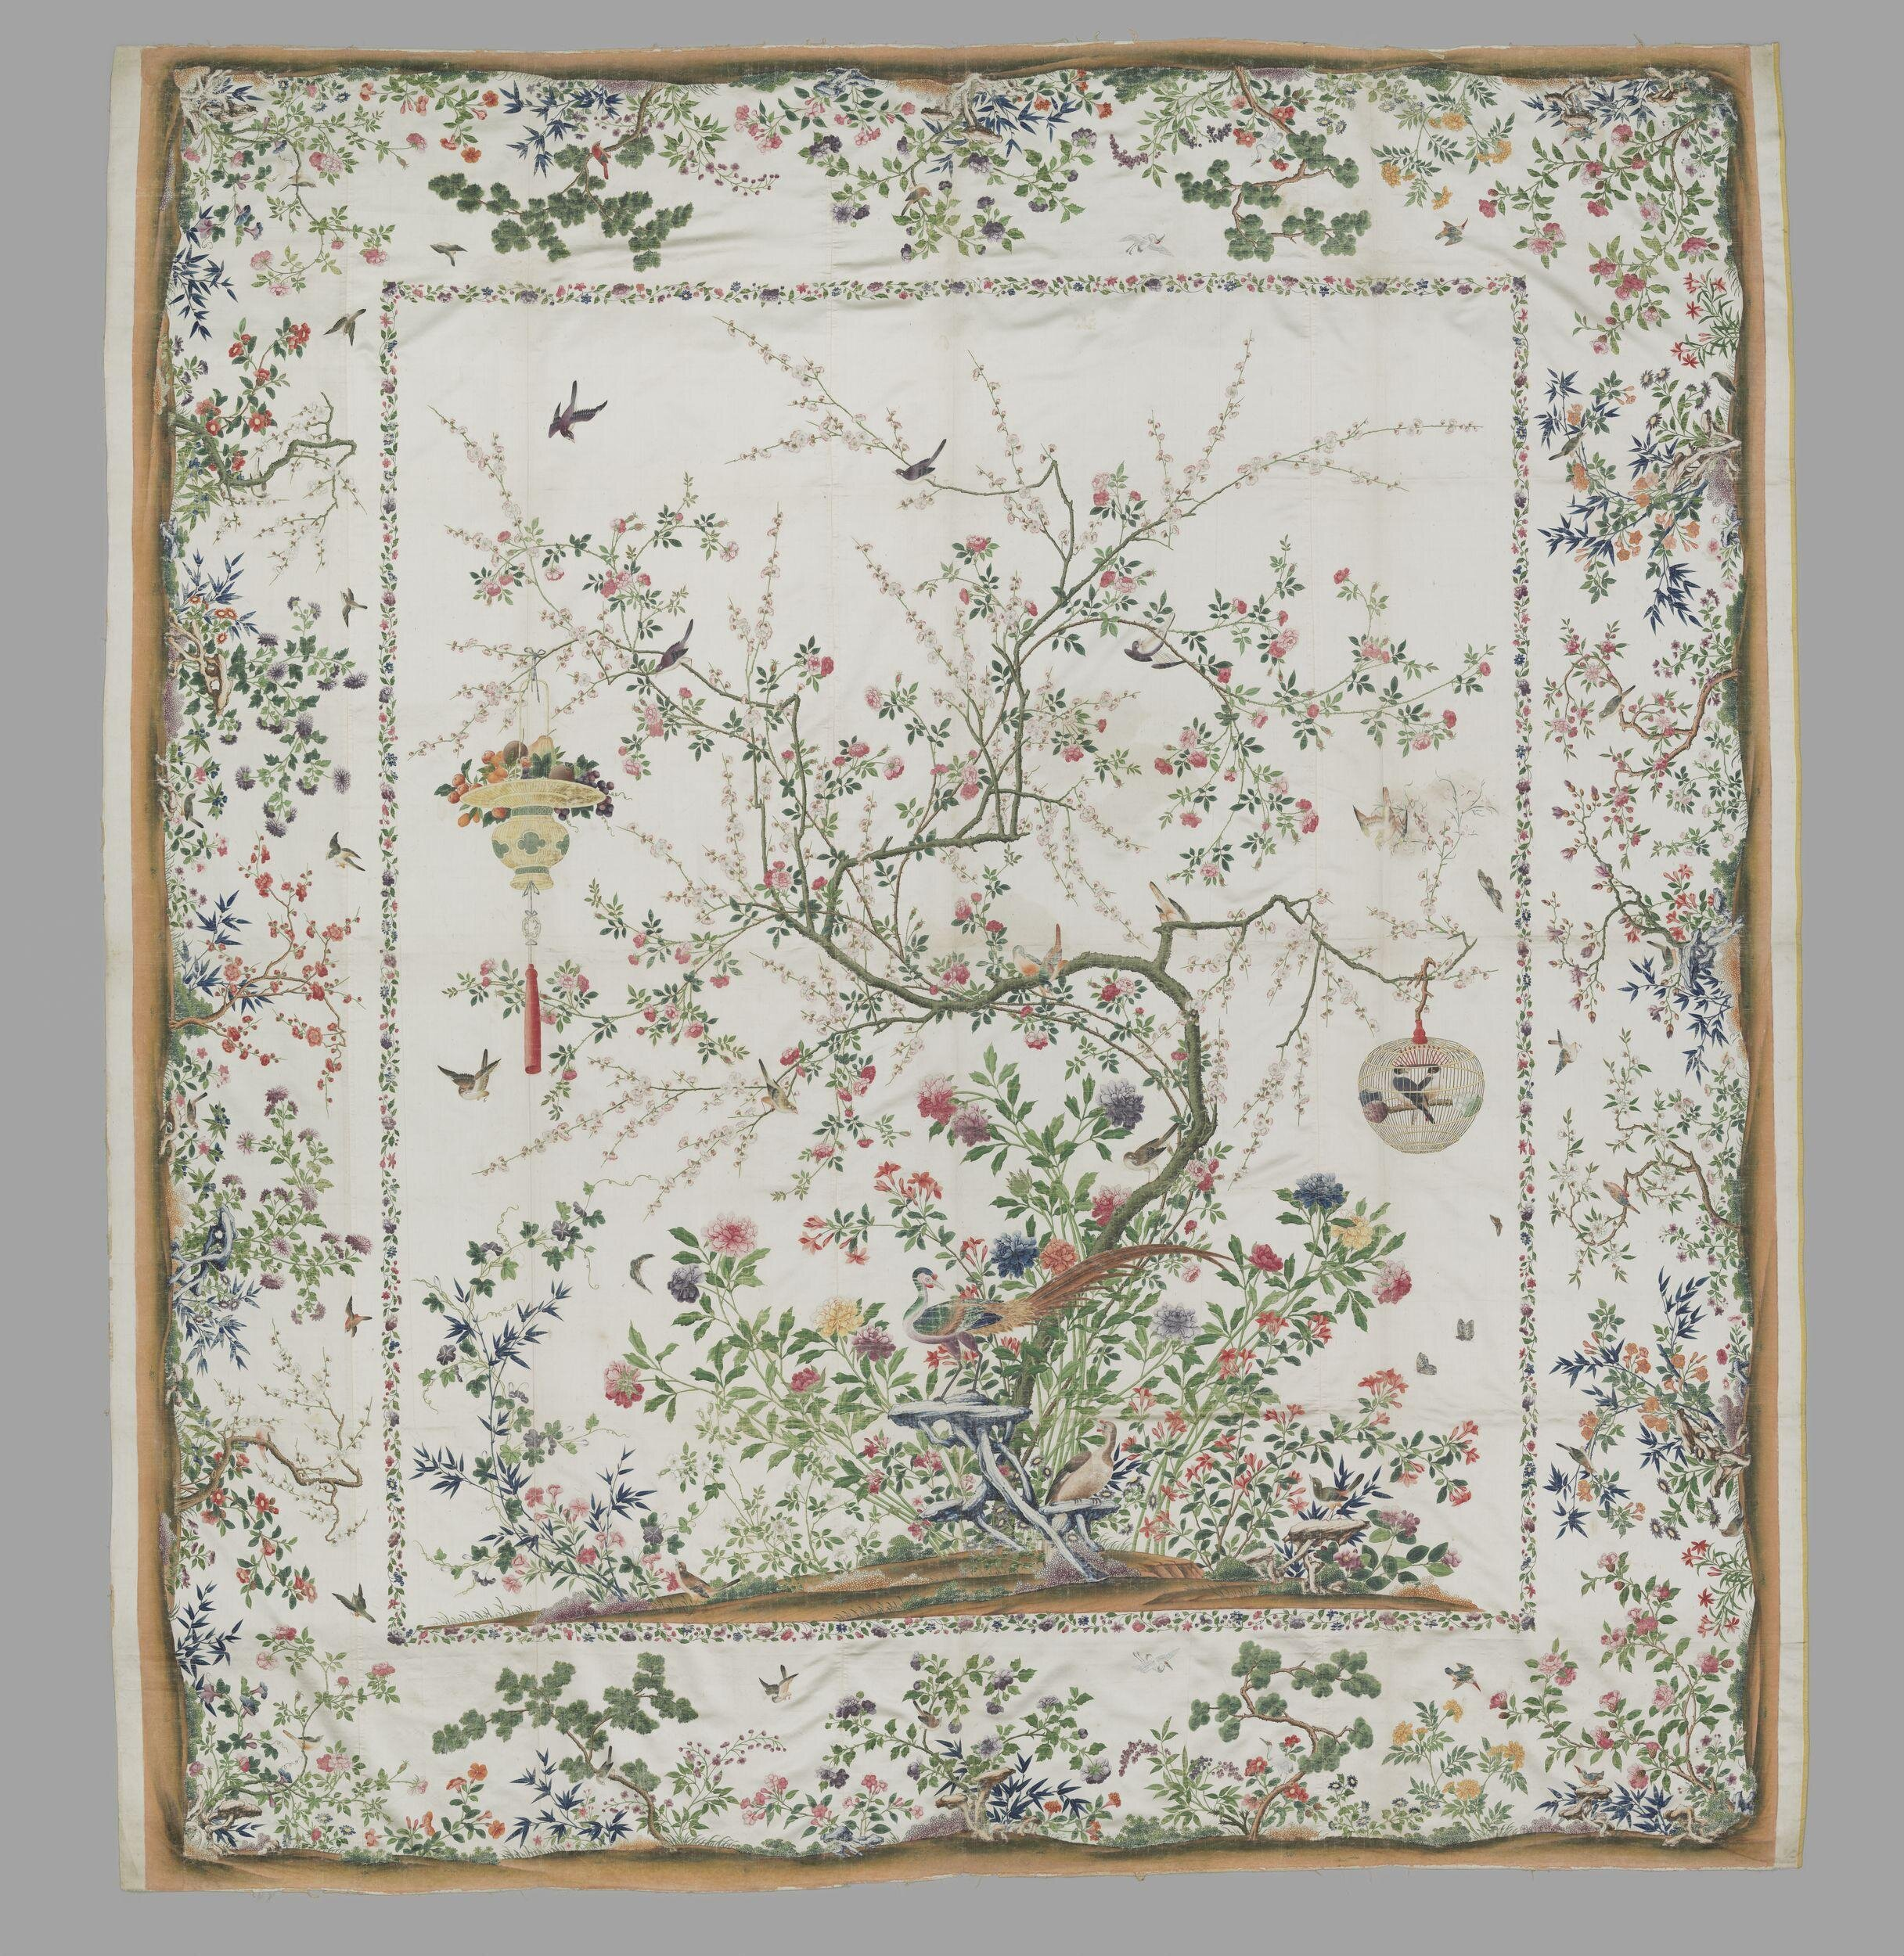
Design
Materials
Colour
Technology

Slide 12
Design
Materials
Colour
Technology

Slide 13
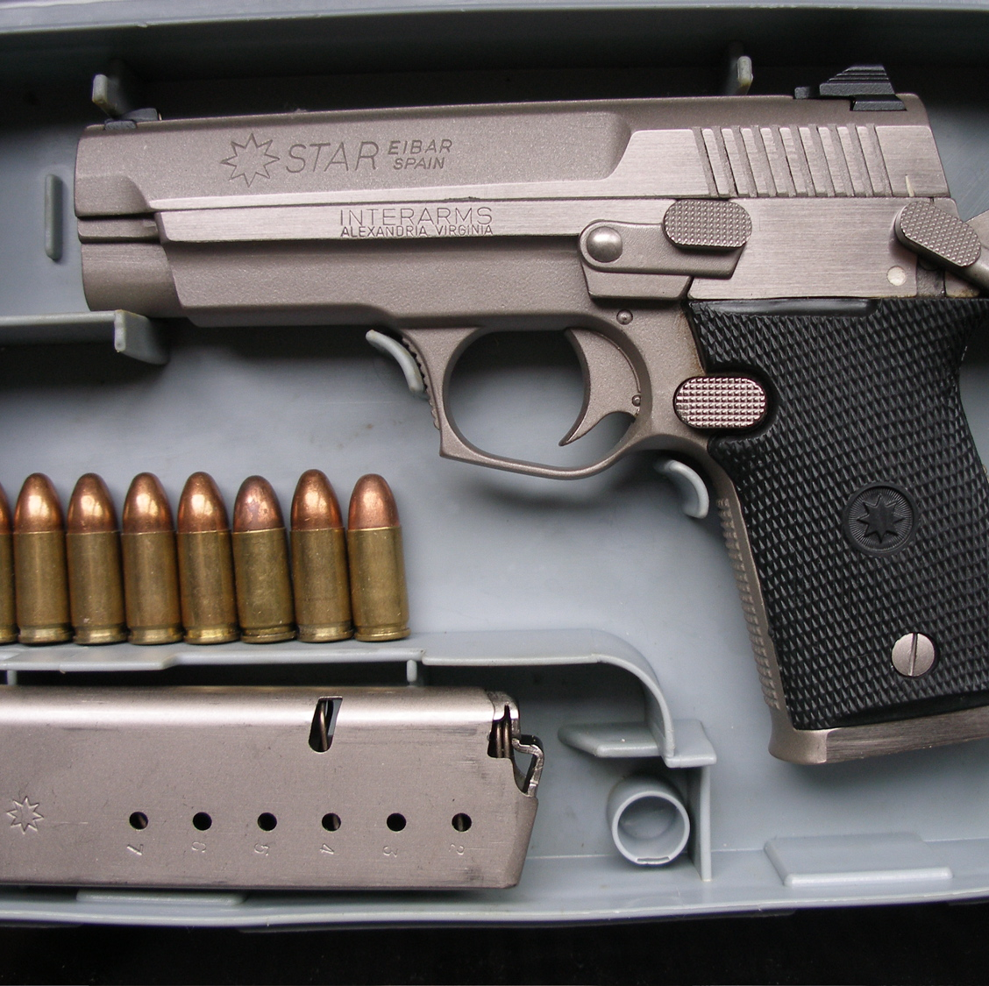
Design
Materials
Colour
Technology
Star M-43 Firestar
single action semi-automatic pistol
Made by Star Bonifacio Echeverria, S.A. in Eibar, Spanje

Slide 14
Start by looking closely

Slide 15
Ask about the object’s history:
When and where was it made?
When and where was it used?
What is the story/history of the object?

Slide 16
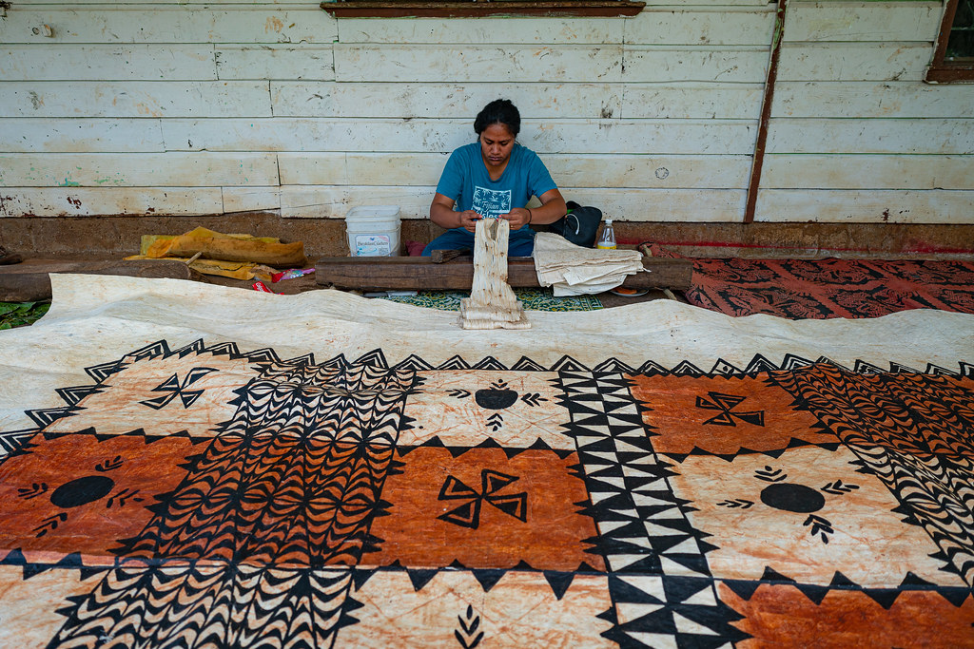

Slide 17
Analyse an object:
When and where was it made?
When and where was it used?
What is the story/history of the object?

Slide 18
What is the story/history of the object?
Jun ware
Part of the collection of the imperial palace of the Qing
Displayed at the Summer Palace in the mid nineteenth century
Outbreak of the second Opium War in 1860
British and French forces were given the order to destroy the palace
Looted objects brought to Europe

Slide 19
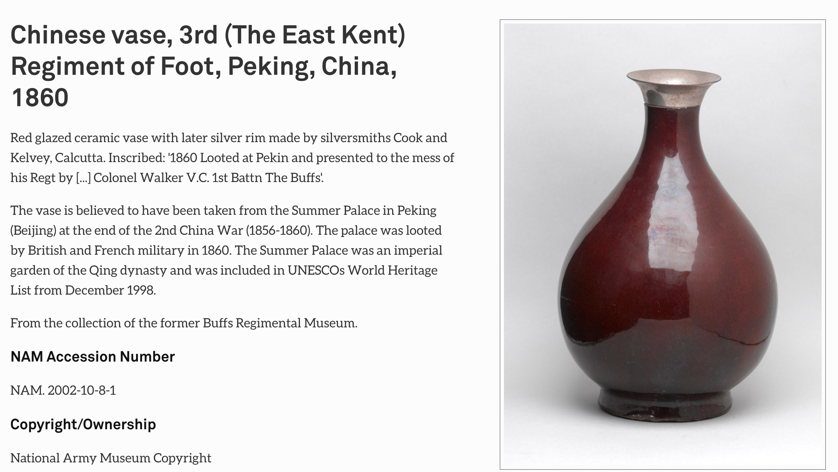

Slide 21
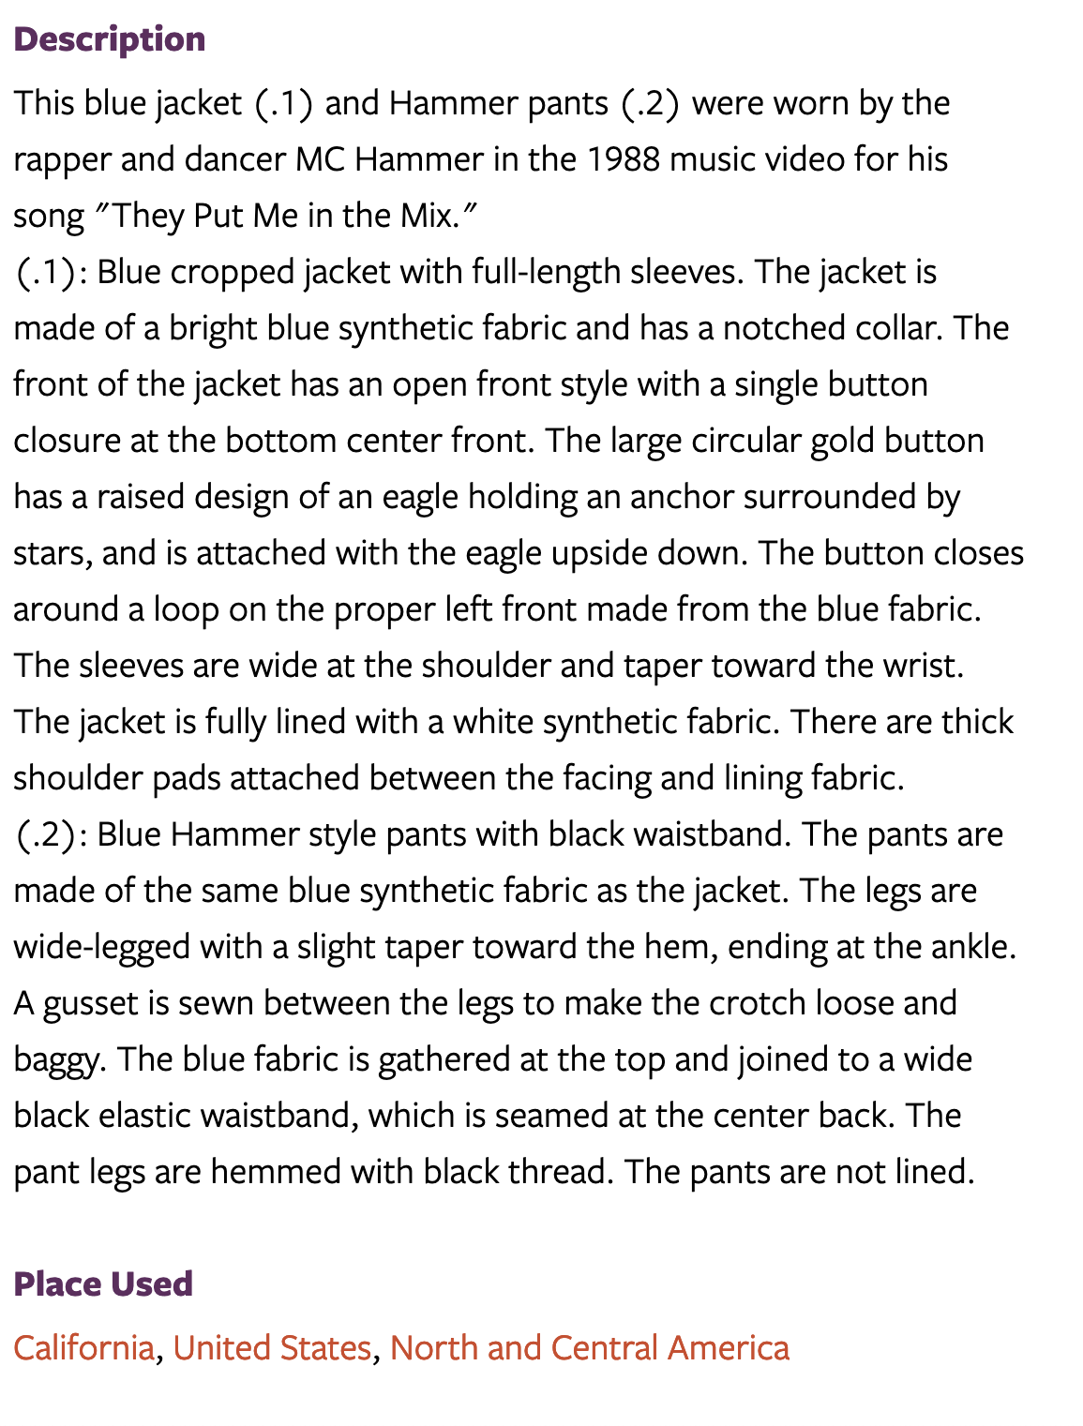

Slide 22
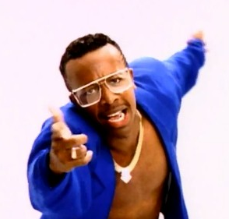
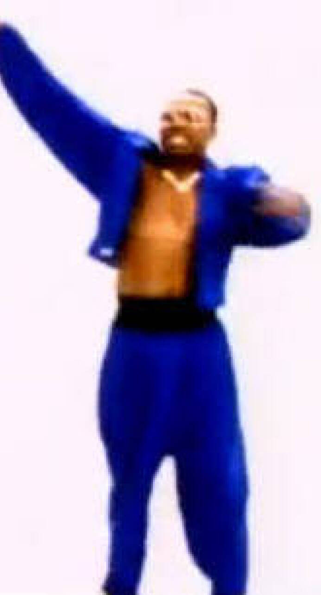

Slide 23
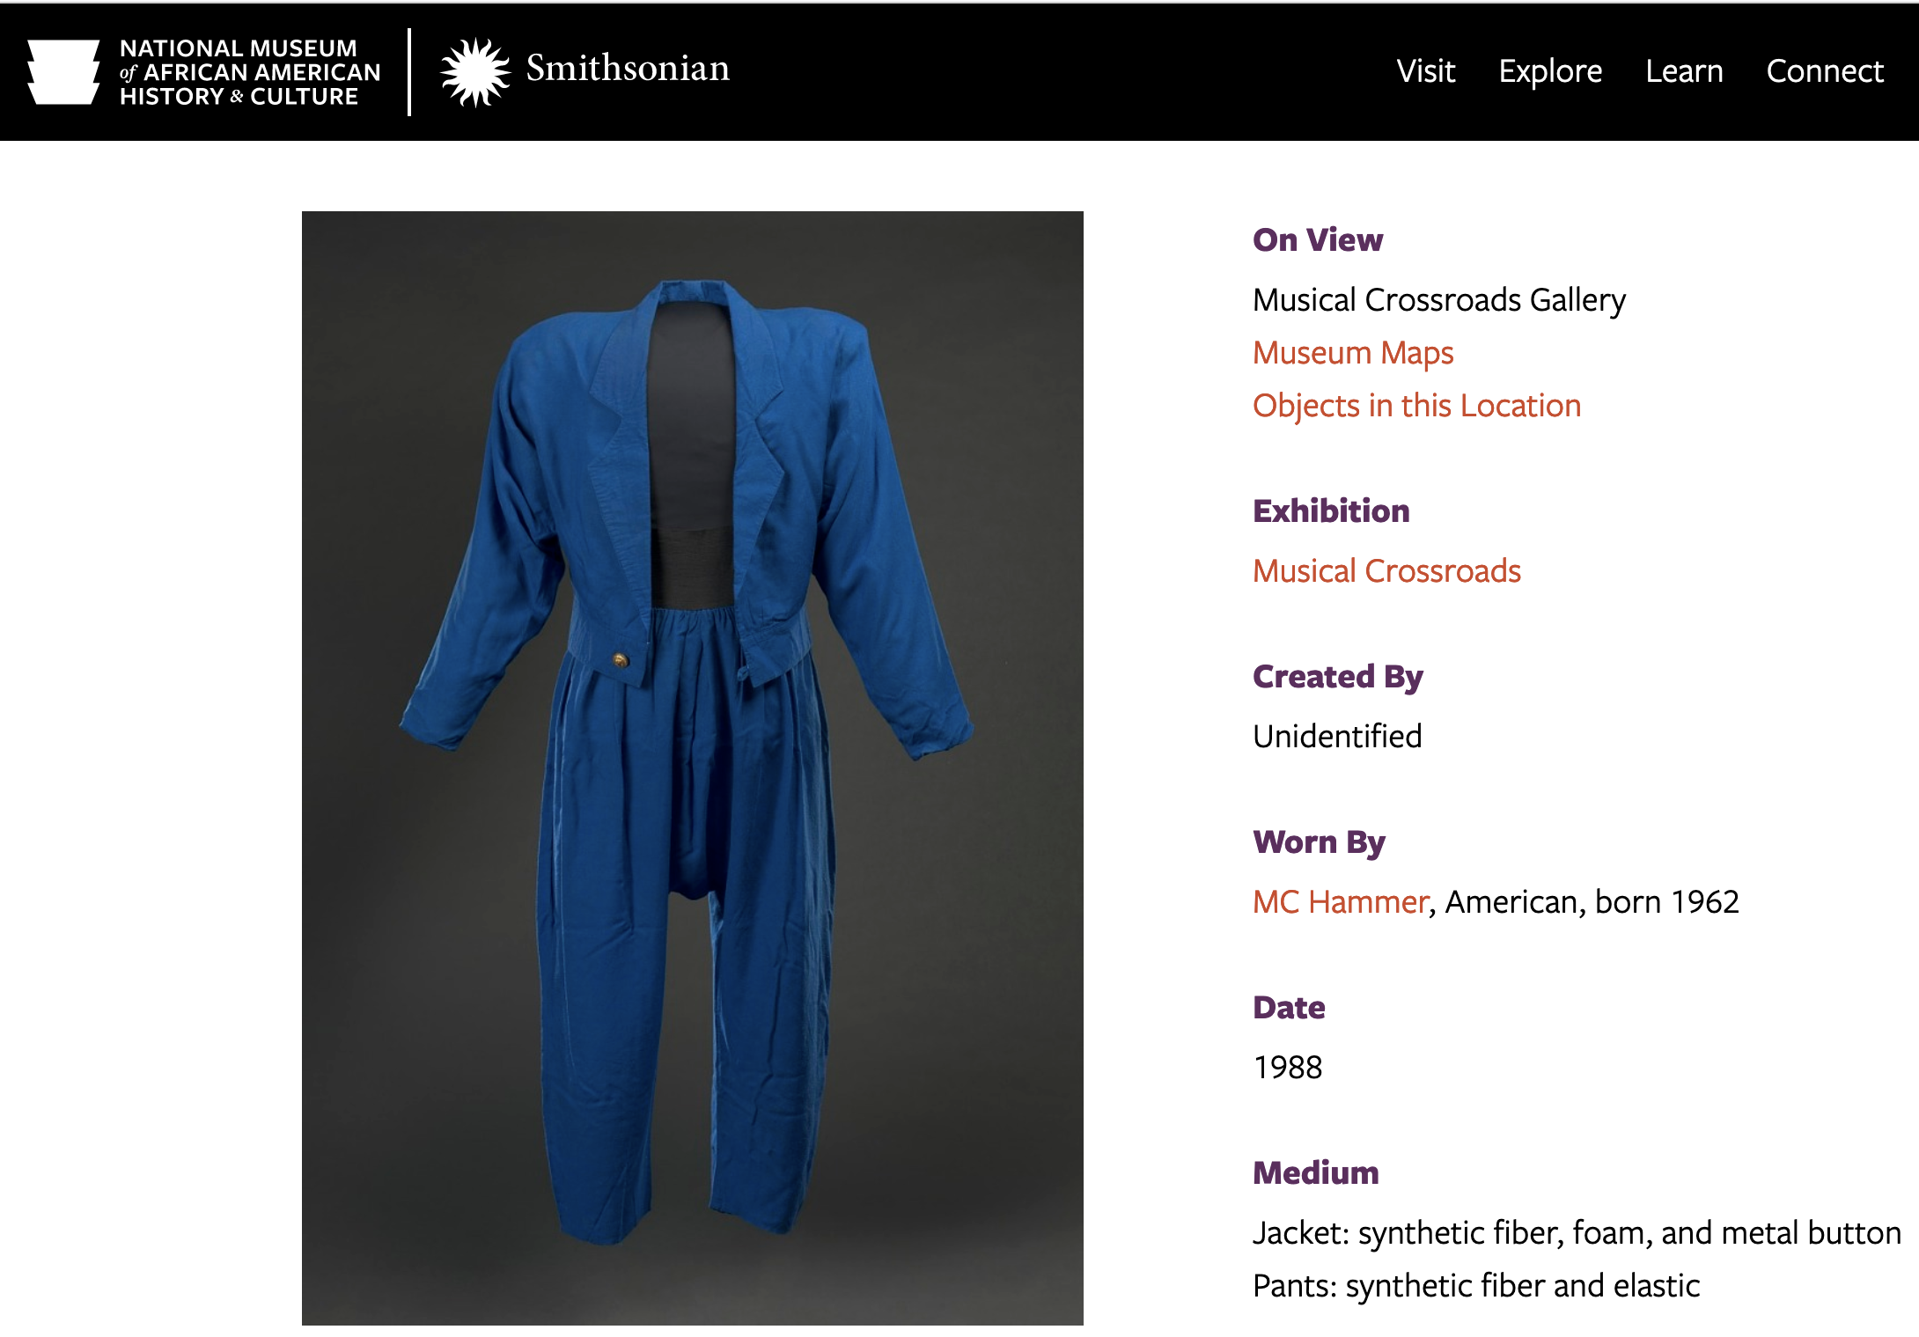
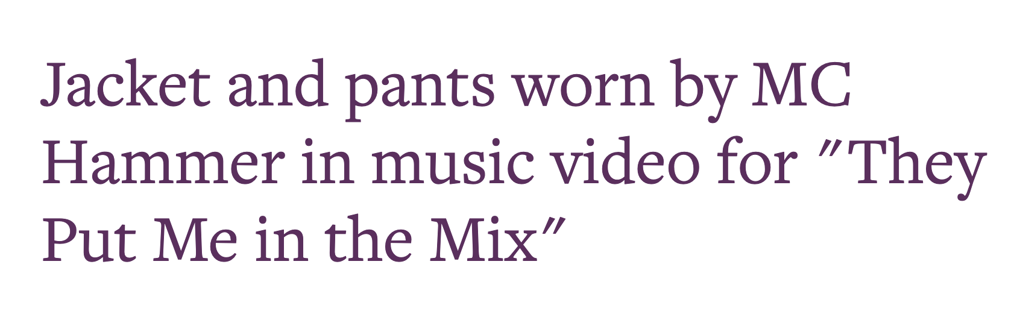
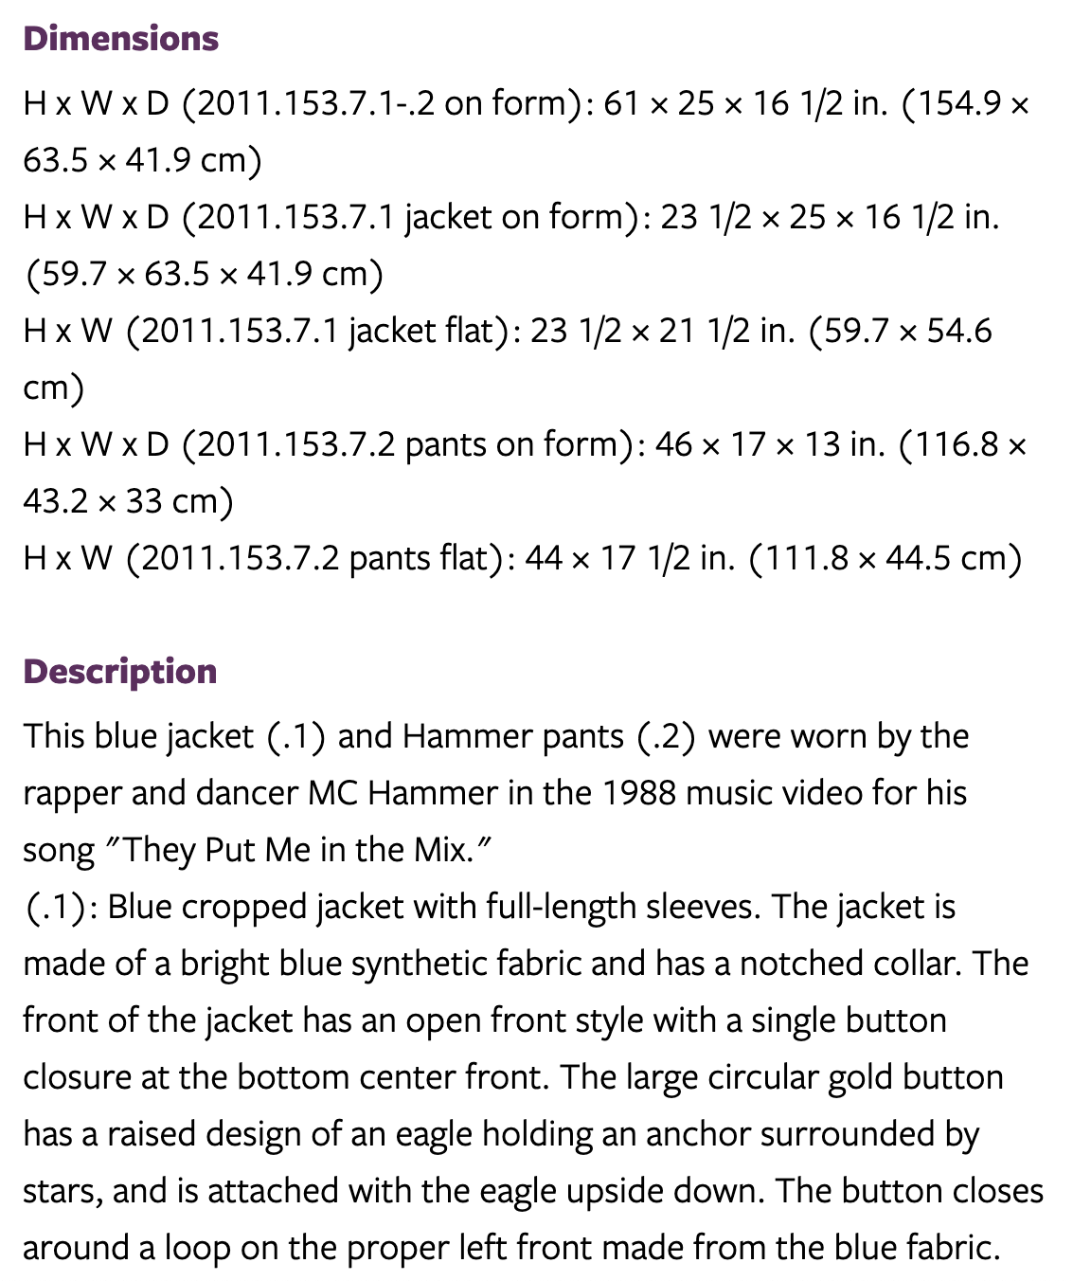

Slide 24
Levi Strauss & Co. 501 jeans made in 1993. Courtesy V&A
Cotton
Indigo
Zip
Metal studs
Labour history ‘follow the traces’

Slide 25
Objects have complex histories

Slide 26
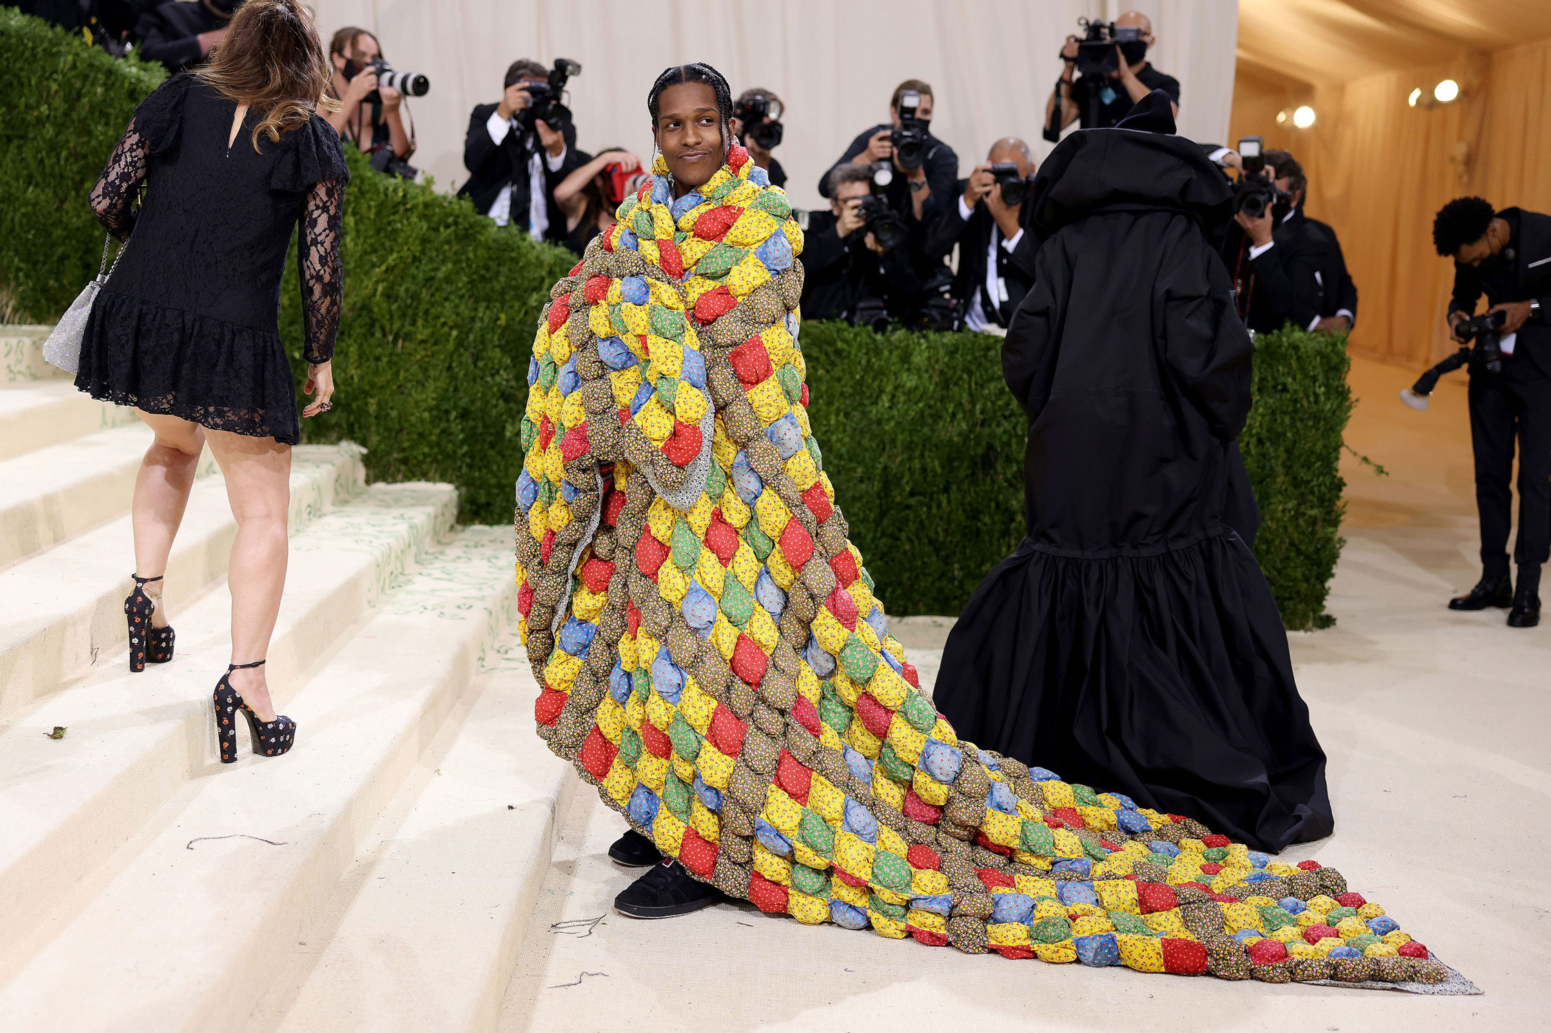

Slide 27
What does the object mean?
To whom?
When?
Why is it valuable?
Appadurai, The Social Life of Things
Objects have long and complex lives
The value of objects is determined at the moment of exchange

Slide 28
Use an object to uncover a larger history
‘In the mid 1990s, while Section 28 of the Local Government Act banning the ‘promotion’ of homosexuality in the UK was still in force, exhibitions about LGBTQ+ life were almost unheard of, or at the very least considered risky for museums.
Yet, Shaun Cole, who was a V&A curator at the time, made the defiant move to acquire more than 100 posters from around the world that related to the HIV/AIDS epidemic and put them on display as part of an exhibition entitled ‘Graphic Responses to AIDS’.
Also, the museum’s ground-breaking ‘Streetstyle: From Sidewalk to Catwalk 1940 to Tomorrow’ exhibition included a controversial lesbian and gay style section that displayed six outfits worn by lesbians and gay men between 1951 and 1994. Displaying outfits from gay men in other exhibition sections, such as skinhead and new romantic, the exhibition opened up discussions about queer styles in relation to subculture and street styles.

Slide 29
What is the value of an object?

Slide 30
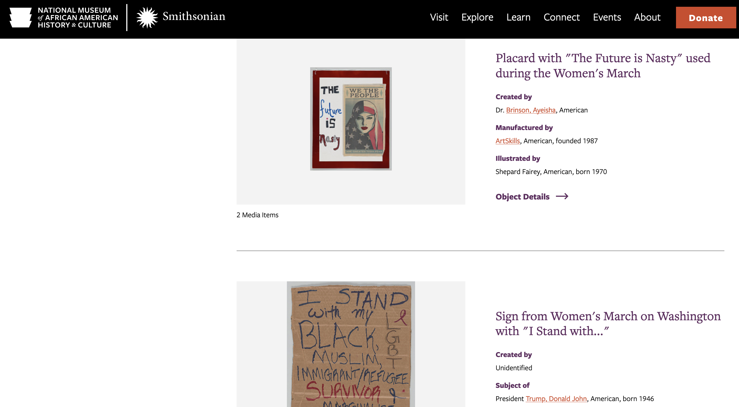

Slide 31
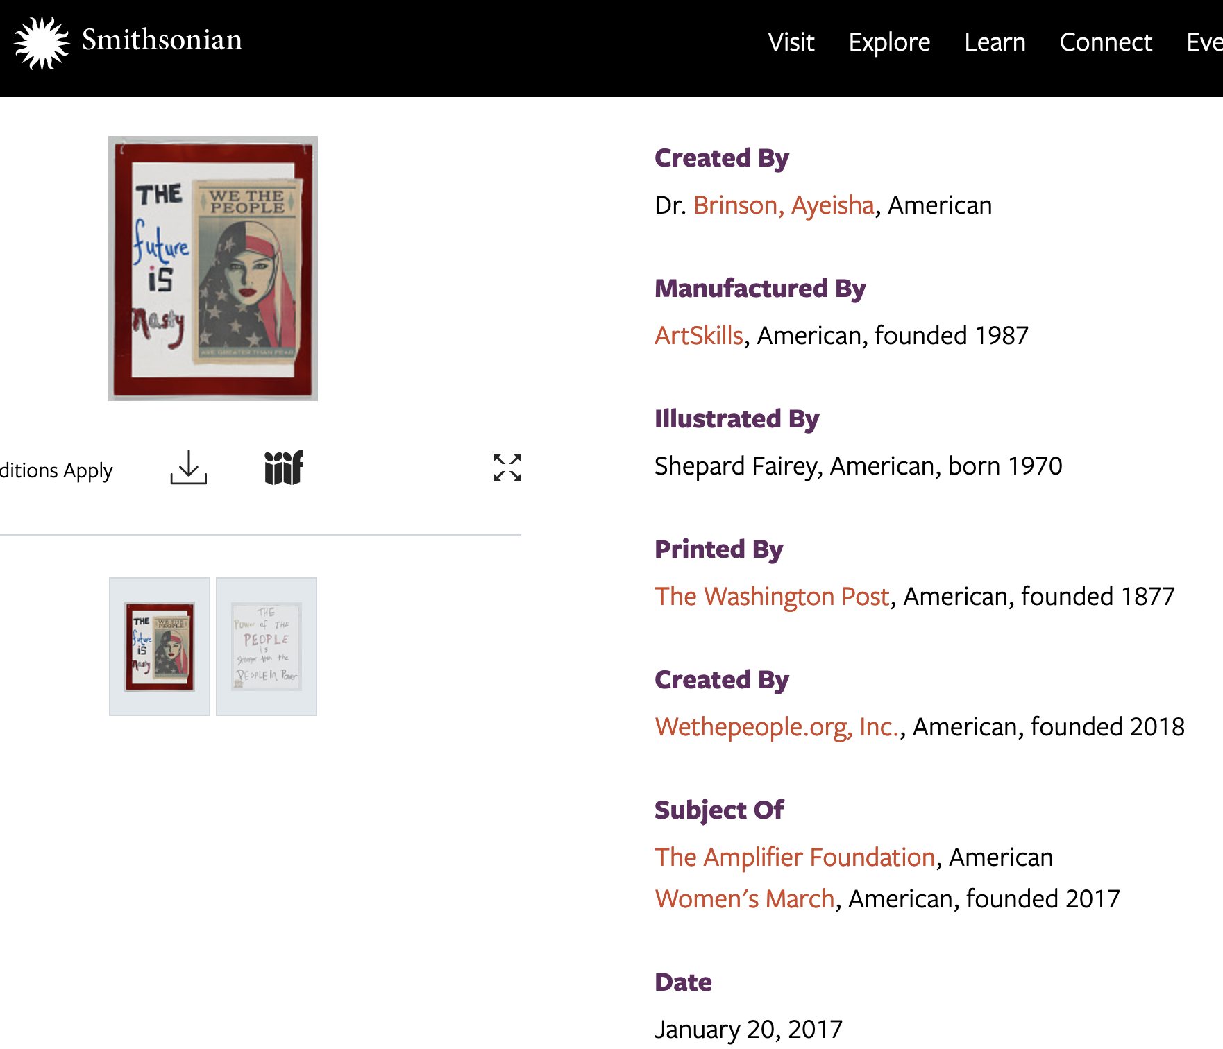
What is the value of an object?

Slide 32
Meaning and value are constructed and in constant flux

Slide 33
How do you access an object? OR what gets in the way?
Material qualities
Ownership
Preservation
Collecting practices
Museum principles
Cataloguing practices
Accessibility

Slide 34
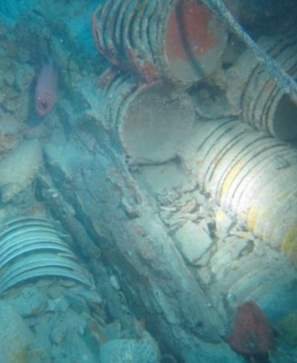
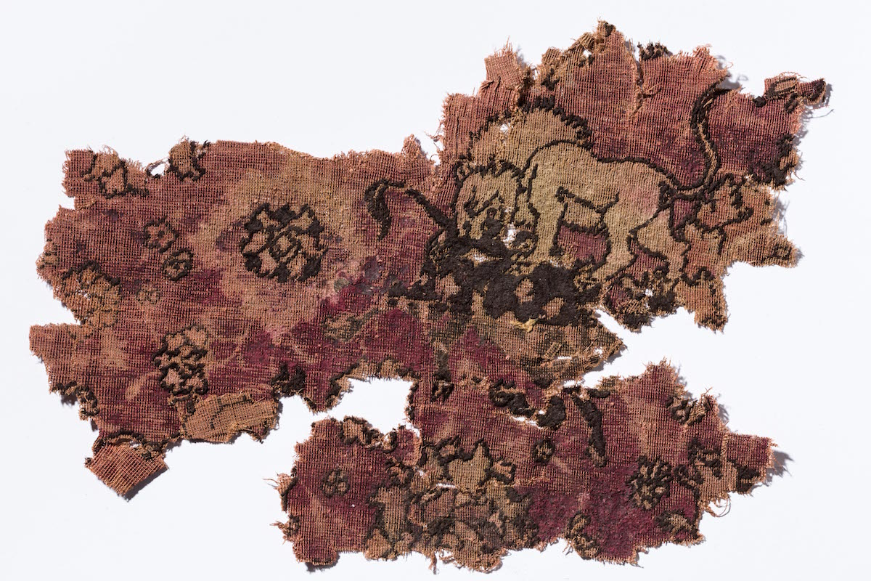
How do you access an object? OR what gets in the way?
Material qualities
Ownership
Preservation
Collecting practices
Museum principles
Cataloguing practices
Accessibility

Slide 35
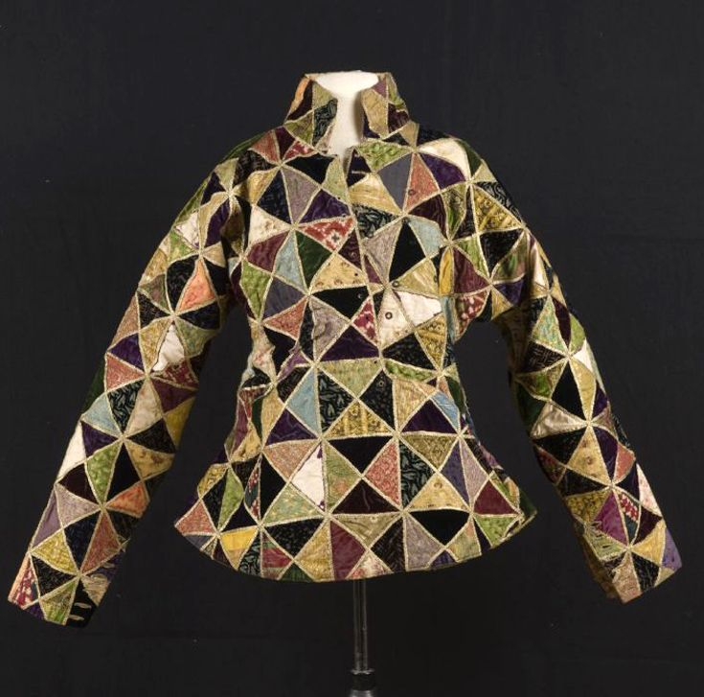
Ownership
State jacket of the Sultan of Yogyakarta, Hamengku Buwana VII (1877-1921). Java, Indonesia | TropenMuseum Amsterdam

Slide 36
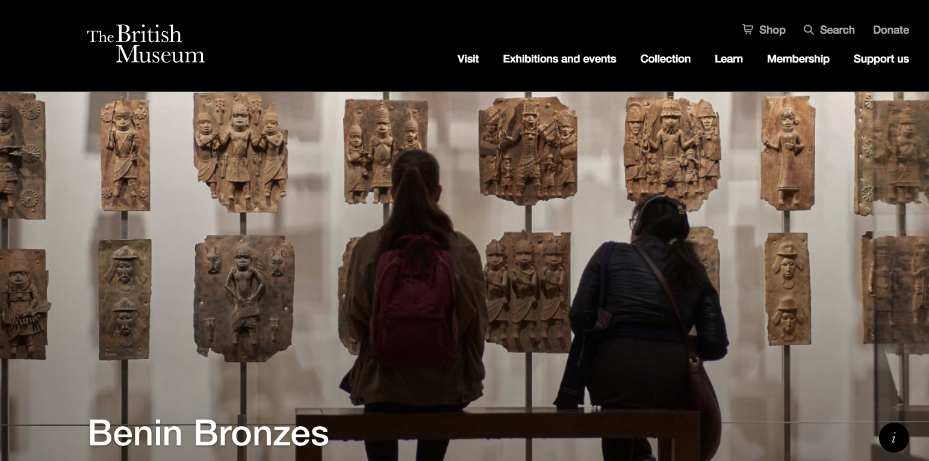
Museum principles

Slide 37
Museum principles
Star M-43 Firestar
single action semi-automatic pistol
Made by Star Bonifacio Echeverria, S.A. in Eibar, Spanje

Slide 38
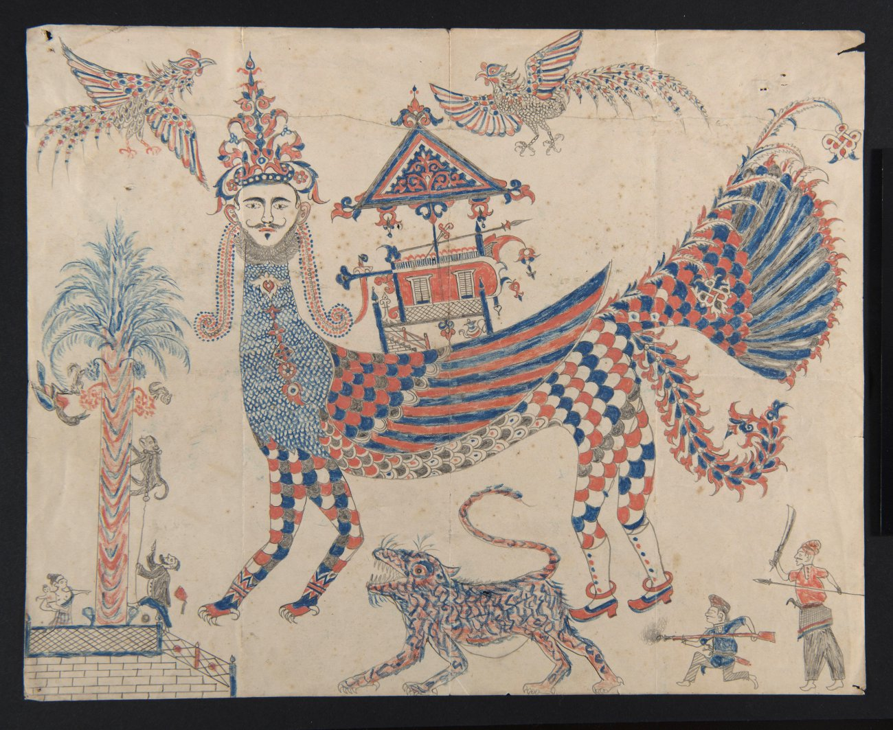
Cataloguing practices

Slide 39
Identify the structures and experiences that shape how you know about an object

Slide 40
Objects have a lot to say
Take time to look closely
Consider its story over time and through space
Identify different ways in which value and meaning have been assigned to the object
Pay attention to the structures and practices of knowledge making that shape how you know about the object

