Slide 1
Edward Said and Orientalism
Professor David Lambert
Historiography II (HI2E2-15)
14th January2025

Slide 2

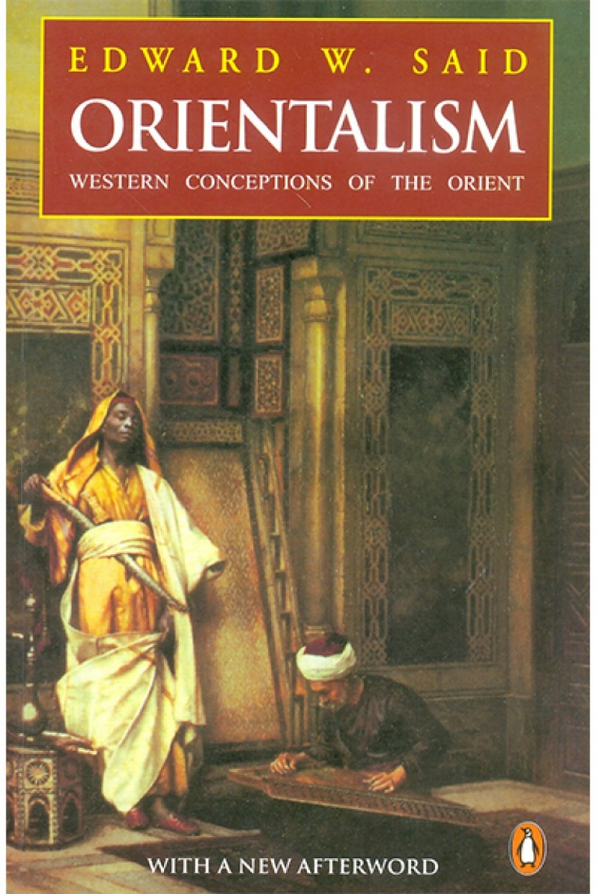
Edward Said, Orientalism (1978)
Edward Said (1935-2003)

Slide 3
Lecture structure
Contexts
  History-writing after the Second World War
  Anti-colonial precursors to postcolonialism
Said’s Orientalism
  Defining ‘Orientalism’
Sources of Said’s theory
Impact, criticism and overview

Slide 4
Contexts I: History-writing after the Second World War
Broad direction of travel was ‘leftward’ and ‘critical’ (esp. from 1960s):
More theoretically self-conscious
Rise of ‘history from below’
From 1970s, a shift from social to cultural history

Slide 5
Contexts II: Anti-colonial precursors to postcolonialism
Orientalism is a founding text of postcolonial theory
Anti-colonial precursors:
  Economic critiques of colonial rule
  Marxist anti-imperialism
  Francophone anti-colonial writers
Hopes for decolonization in 1950s and 1960s
Optimism difficult to sustain by end of 1970s
Postcolonial theory partly a response to this

Slide 6
Defining ‘postcolonialism’
‘Historiographically, the postcolonial perspective has sought to deconstruct the grand narratives of imperial and national histories deriving often from an Enlightenment vision of a progressive history, in order to reveal or point to suppressed, defeated, or negated histories and stories’ (Duara, 2002, p. 417).

Slide 7
Contexts II: Anti-colonial precursors to postcolonialism
Orientalism is a founding text of postcolonial theory
Anti-colonial precursors:
  Economic critiques of colonial rule
  Marxist anti-imperialism
  Francophone anti-colonial writers
Hopes for decolonization in 1950s and 1960s
Optimism difficult to sustain by end of 1970s
Postcolonial theory partly a response to this

Slide 8
Said’s Orientalism
‘European culture was able to manage – and even produce – the Orient politically, sociologically, militarily, ideologically, scientifically and imaginatively during the post-Enlightenment period’ (Said, 1978, p. 3).

Slide 9
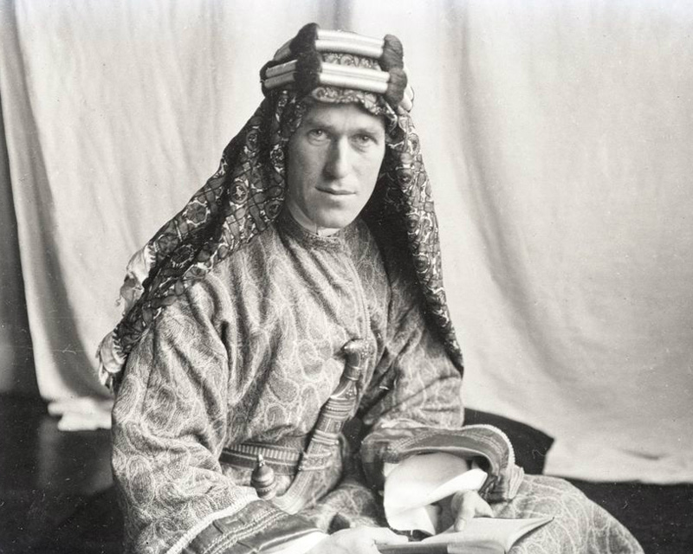
T. E. Lawrence, aka ‘Lawrence of Arabia’ (1888-1935)

Slide 10
Said’s Orientalism
‘Taking the late eighteenth century as a very roughly defined starting point Orientalism can be discussed and analyzed as the corporate institution for dealing with the Orient – dealing with it by making statements about it, authorizing views of it, describing it, by teaching it, settling it, ruling over it: in short, Orientalism as Western style for dominating restructuring, and having authority over the Orient’ (Said, 1978, p. 237).

Slide 11
Said’s Orientalism
‘ “The Arabian traveller is quite different from ourselves. The labour of moving from place to place is a mere nuisance to him, he has no enjoyment in effort [as ‘we’ do], and grumbles at hunger or fatigue with all his might [as ‘we’ do not]. You will never persuade the Oriental that, when you get off your camel, you can have any other wish that immediately to squat on a rug and take your rest (isterih), smoking and drinking. Moreover the Arab is little impressed by scenery [but ‘we’ are]” ’ (Smith, 1912 quoted in Said, 1978, p. 237).

Slide 12
Meanings of ‘Orientalism’
Said uses the term in three ways:
An academic and intellectual tradition of knowledge production by Western scholars about the ‘Orient’

Slide 13
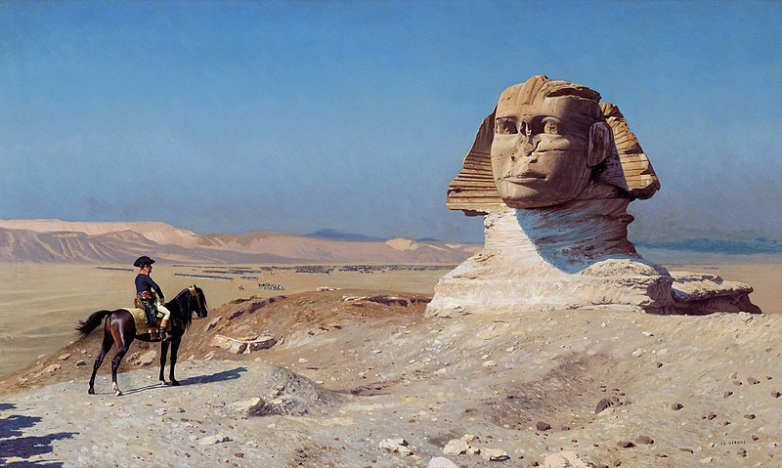
French expedition to Egypt and Syria (1798-1801)

Slide 14
Meanings of ‘Orientalism’
Said uses the term in three ways:
An academic and intellectual tradition of knowledge production by Western scholars about the ‘Orient’
A characteristic way of thinking about the world in terms of a binary division between ‘West’ and ‘East’
A major form through which Western power was (and is) exercised over the non-Western world

Slide 15
Sources of Said’s theory
Antonio Gramsci and the concept of ‘hegemony’
Michel Foucault, ‘power/knowledge’ and the study of discourse
Liberal humanism
Political anger

Slide 16
Impact and criticism
Foundational text of Postcolonial Studies
Spawned extensive work on ‘colonial discourse’

Slide 17

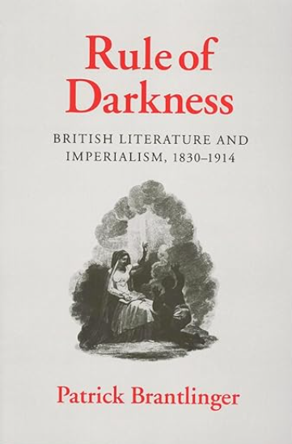
Wider work on ‘colonial discourse’

Slide 18
Impact and criticism
Foundational text of Postcolonial Studies
Spawned extensive work on ‘colonial discourse’
Criticisms:
  Defensive criticism from Orientalist scholars
  Right-wing
  Left-wing

Slide 19
Impact on history-writing
Encouraged a ‘textual’ and ‘discursive’ turn in the study of imperialism and its characteristic forms of power
Revealed the long-standing binary split between notions of an ‘essential’ Orient and an equally ‘essential’ Occident
Underscored the link between Orientalist discourse and the perpetuation of Western domination over parts of the globe

Slide 20
Edward Said and Orientalism
Professor David Lambert
Historiography II (HI2E2-15)
14th January2025

