Slide 1
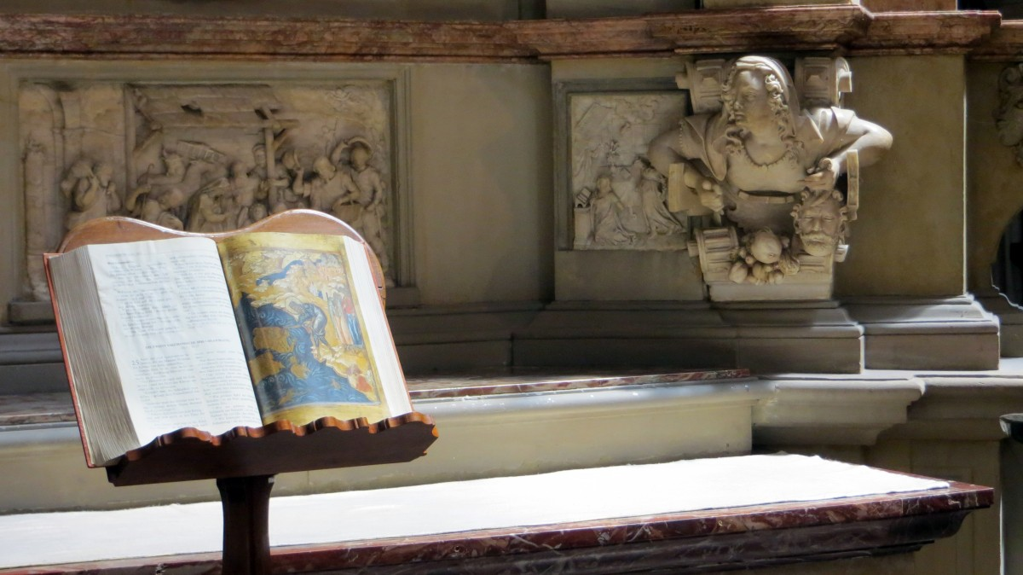
Historiography II (HI2E2)
Race and Ethnicity
Dr Simon Peplow
Associate Professor of
Modern British History

Slide 2
Lecture Content Note
Discussion of
race and racism.
Quotations and images
on slides that use outdated and/or offensive language.

Slide 3
Race
Social construct – no biological meaning,
subjective method of differentiating peoples.
‘A race, as defined by skin colour,
is no more a biological entity than is
a nation, whose identity depends only
on a brief shared history.’ (Steve Jones)
Criteria for racial categorisation
varies in different times/locations –>
How racial categories are formed & applied revealing of different societies/individuals.

Slide 4
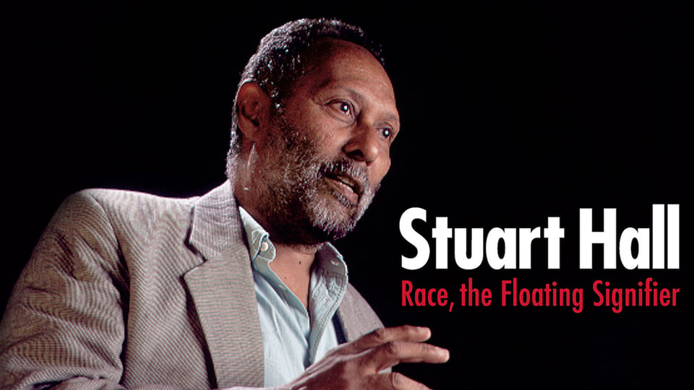
Race
Stuart Hall – race a ‘floating signifier’:
‘both a socio-economic “fact” and a social construct’:
‘Race works like a language. And signifiers…
gain their meaning, not because of what they
contain in their essence, but in the shifting
relations of difference, which they establish
with other concepts and ideas in a signifying field.’
‘Cultural category of difference that is
contextually constructed as essential
and natural, as residing within the very
body of the individual’. (Paul Silverstein)
‘An organising principle of domination
almost without parallel’ . (Richard Jenkins)

Slide 5
Early Ideas of Race
Not a fixed identity – that people could change/assimilate.
Skin colour only one method of categorisation.
Monogenism (idea all humans have common descent).
Should earlier notions/prejudices be considered as ‘race’?
‘African slavery was legitimized by already existing views of Africans as inferior, which were then developed once the institution of African slavery became firmly established…
Slave traders and plantation owners had a crucial interest in representing the black as fit for no other fate’. (Ali Rattansi)
‘I think of race as an important name for a repeating tendency to demarcate human beings through differences among humans that are then selectively essentialized as absolute and fundamental in order to distribute powers and positions differentially to human groups.’ (Geraldine Heng)

Slide 6
The Impact of Enlightenment Thought
Enlightenment as wide-ranging project of categorisation.
Races conceived of as being permanent and discrete – differences not a product of environmental factors
but believed to be part of ‘the natural order of things’.
‘By inventing the “race” concept… European elites developed a new way to understand and govern
different groups of human beings. Scientists in the
fields of natural history, ethnology, anthropology,
and biology took up and refined the “race” concept
as an object of study as scientists, but their guiding
assumptions were deeply informed by prevailing
social, political and cultural forces.’ (Bruce Baum)
‘Race account[s] for social inequalities
by attributing them to nature’. (Kenan Malik)

Slide 7
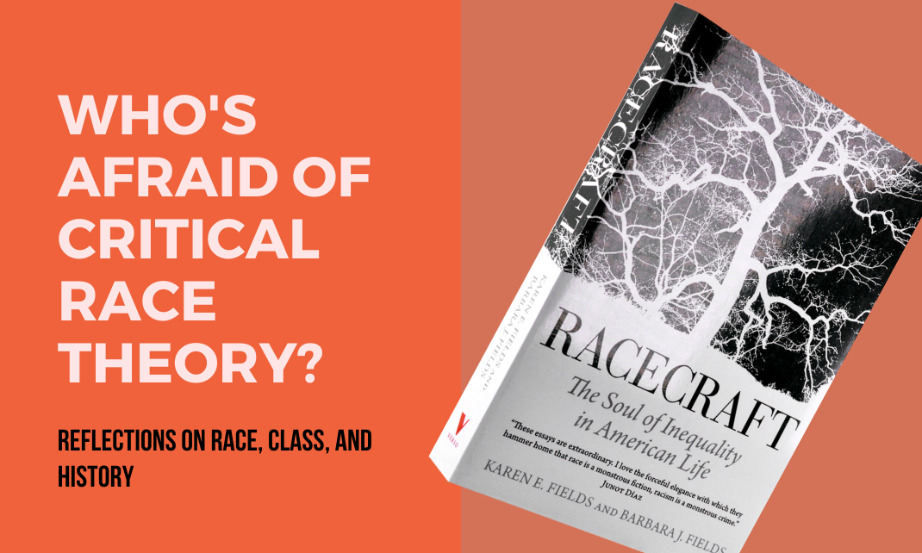
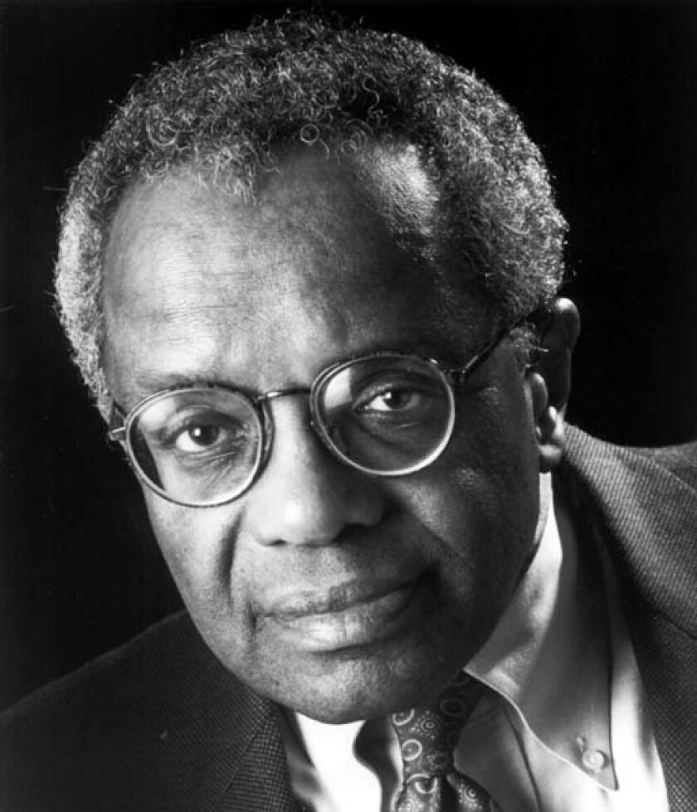
Critical Race Theory (CRT)
Began as legal movement in 1970s USA, critical of some Enlightenment-influenced ideas (universalism, liberalism, etc.)
‘Because racism is an ingrained feature of our landscape,
it looks ordinary and natural to persons in the culture. Formal equal opportunity – rules and laws that insist on treating blacks and Whites (for example) alike – can thus remedy only the more extreme and shocking forms of injustice, the ones that do stand out. It can do little about
the business-as-usual forms of racism that people of color confront every day.’ (Richard Delgado and Jean Stefancic)
‘Imagining racism as a fixable aberration… obfuscates
the way in which racism functions as an ideological
lens through which Americans perceive themselves,
their nation, and their nation’s other.’ (Derrick Bell)

Slide 8
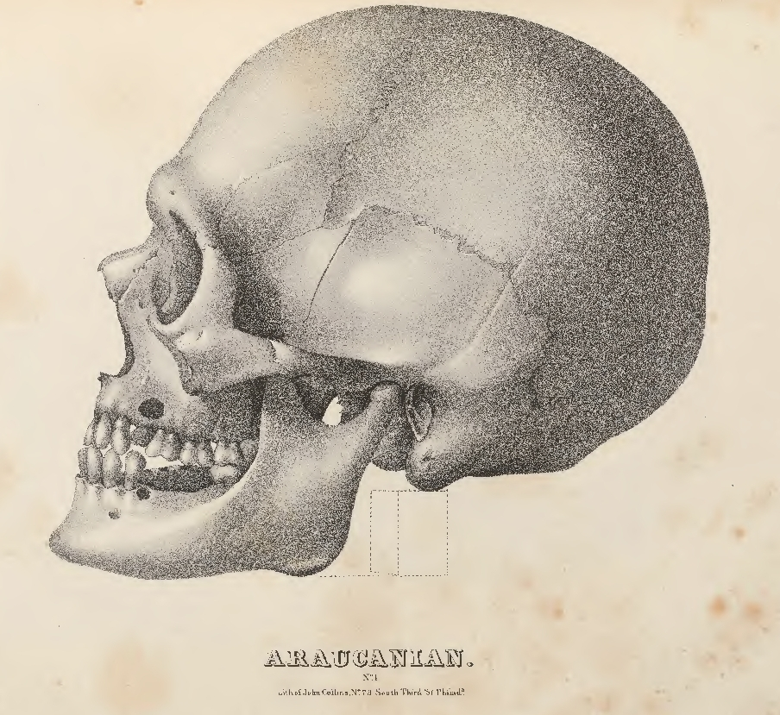
‘Scientific’ Racism
Science replaced religion in explaining natural and social worlds –> pseudoscientific beliefs about race.
Increased encounters, perceived limitations
of previous explanations for human difference.
Polygenism – argued hierarchy of human races
had separate creations and different origins.
Eugenics – ideas of ‘improving the human stock’; selective breeding, opposition
to interracial relationships, etc.
E.g., Samuel Morton measuring
skulls to ‘determine’ intelligence
– but his methods/conclusions
were influenced by racial biases.

Slide 9
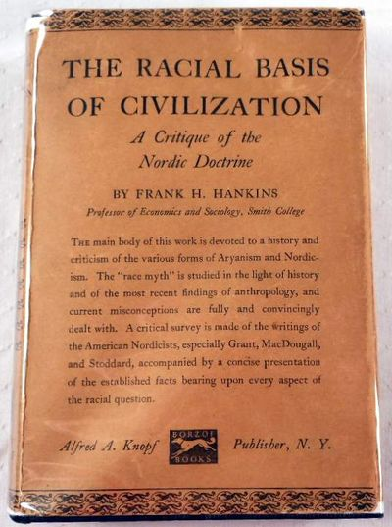
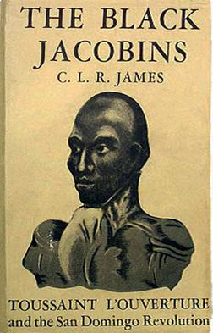
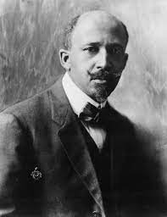
Historians and ‘Scientific’ Racism
‘The inherent inequality of races was simply accepted as scientific fact’ (Reginald Horsman)
‘While we are denying the extravagant claims
of the Nordicists, we also deny the equally perverse and doctrinaire claim of the race egalitarians… Although the negro [sic] has on many occasions lived in contact with centres
of advanced culture or even in the midst of
them, he has generally lagged behind the
level of such cultures.’ (Frank H. Hankins, 1926)
Some rejected the ‘fact’ of scientific racism:
‘The human species so shade and mingle with each other… it is impossible to draw a color line between black and other races’. (W.E.B. Du Bois, 1906)

Slide 10
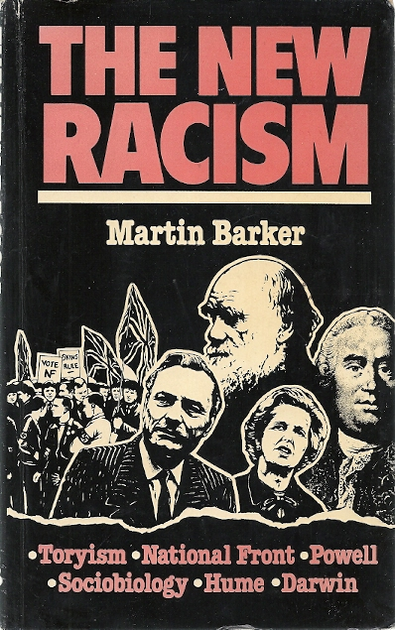
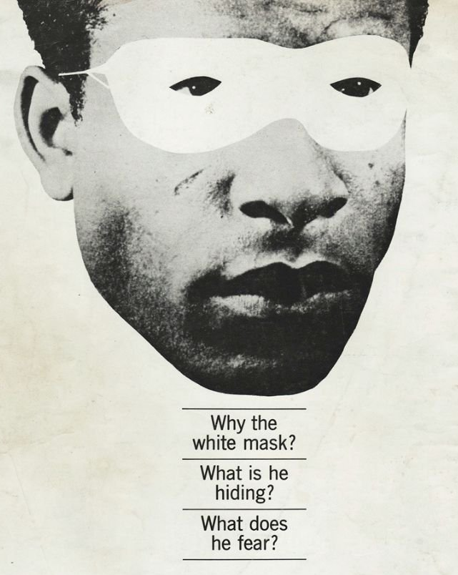
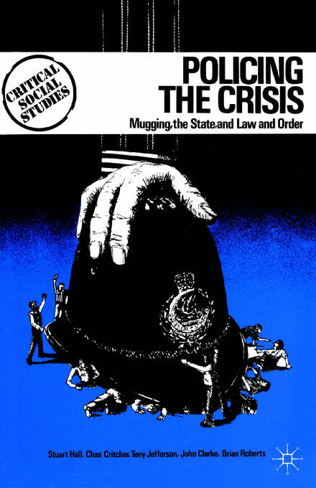
Post-WWII and
‘New’ Cultural Racism
Understandings of race became increasingly
domain of social, rather than biological sciences.
Ideas of difference transferred to culture –
‘New racism’: ‘more indirect, more subtle,
more procedural, more ostensibly non-racial’ .
‘It is easy to exaggerate the divide between
an “old” biological racism and a “new” cultural
racism. While taboos against biologically based conceptions have become stronger and classical
racial arguments have lost scientific credibility,
they both continue an underground existence
and are always available as resources to be
drawn upon in arguments over immigration,
national belonging and citizenship’. (Ali Rattansi)

Slide 11
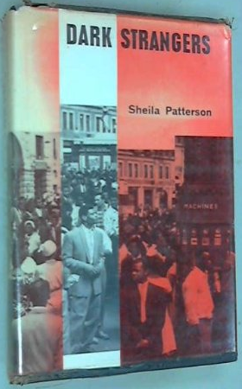
‘Race Relations’ and Racialisation
Academic study of ‘race relations’, esp. 1960s –
criticised for, e.g., reifying concept of race.
Rhetoric of mid-20th century ‘race relations’
sociologists was strongly paternalistic, attempting
to speak for so-called ‘dark strangers’ in postwar Britain.
‘The appearance that all human beings can be
categorised by ‘race’ might seem seductively tangible
but has no objective basis. Humanity is not like a Dulux
colour chart with everyone falling into discrete categories,
each with a unique name and character. Human beings
are composed of a constellation of characteristics, physical
and mental, which shade into each other.’ (Kenan Malik)
Importance of concept of racialisation: ‘Process by which ideas about race are constructed, come to be regarded as meaningful, and are acted upon’ (Karim Murji & John Solomos)

Slide 12
Ethnicity
Often argued: ‘race’ = biological, ‘ethnicity’ = cultural.
E.g., ethnicity ‘Avoids biological determination
and identifies groups primarily in terms of the
self-definitions of their members’. (David Mason)
But, notions of race have included biology & culture?
E.g., anti-Semitism (Deborah Cohen article).
Racialisation as analytical tool.
Stuart Hall – meaning of ethnicity slides between essentialist (nationalistic, exclusionary, restrictive) and anti-essentialist (hybrid, fluid, plural, constantly being made/remade); what he called ‘new ethnicities’.

Slide 13
Whiteness and Whiteness Studies
‘Whiteness’: socially constructed and malleable. Definition has changed to include/exclude certain people.
‘This assumption that of all the hues of God whiteness alone is inherently and obviously better than brownness
or tan leads to curious acts… I am quite straight-faced
as I ask soberly: “But what on earth is whiteness that
one should so desire it?” Then always, somehow,
some way, silently but clearly, I am given to
understand that whiteness is the ownership of the
earth forever and ever, Amen!’ (W.E.B. Du Bois, 1910)
‘The decision not to see race meant at the same time
that it was possible for whiteness, now seen as having nothing to do with race, to become the norm or standard. Racelessness is in fact synonymous with whiteness.’
(Alana Lentin)

Slide 14
Intersections with Gender
bell hooks: the ‘imperialist white supremacist capitalist patriarchy’ as an interlocking system of oppression.
Kimberlé Crenshaw: ‘Intersectionality’ (1989).
‘With Black women as the starting point,
it becomes more apparent how dominant conceptions
of discrimination condition us to think about subordination
as disadvantage occurring along a single categorical axis…
This single-axis framework erases Black women in
the conceptualization, identification and remediation
of race and sex discrimination by limiting inquiry to the experiences of otherwise-privileged members of the group’.
Beverley Bryan, Stella Dadzie and Suzanne Scafe,
The Heart of the Race: Black Women’s Lives in Britain (1985);
Hazel Carby’s chapters in The Empire Strikes Back (1982) – synthesises ‘triple oppression of gender, race, and class’.

Slide 15
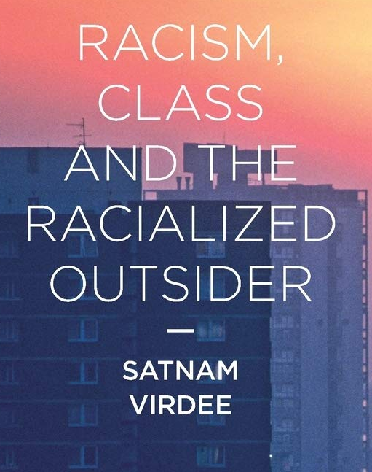
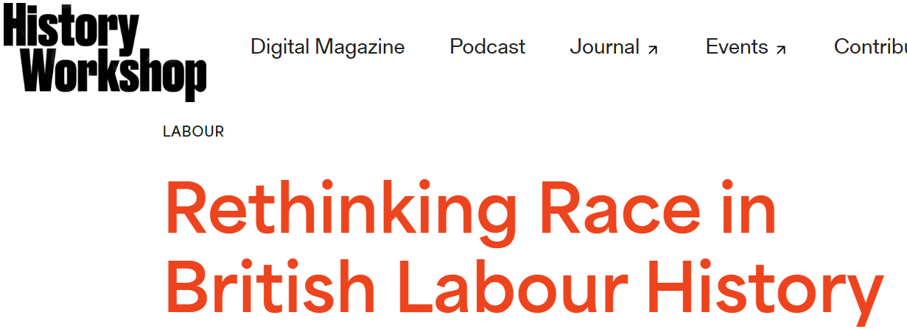
Intersections with Class
Du Bois’ Black Reconstruction: capitalism as racial stratification; class and race intersect in significant ways.
E.g., debated existence of ‘underclass’ in modern Britain:
‘…the minorities were systematically at a disadvantage compared with their white peers and that, instead of identifying with working class culture, community and politics, they formed their own organisations and became effectively a separate underprivileged class’.
(John Rex and Sally Tomlinson, 1979)
Satnam Virdee – race central to the way
class works; racial ‘othering’ deployed
as a mechanism of class-making,
linked with ideas of belonging.
Recent reconceptualisations
of race and labour history.

Slide 16
Methodologies – ‘Reading Against the
Grain’ and Importance of Terminology
‘Accessing the history of visible minorities,
particularly that of women, requires more
imaginative ways of researching’. (Caroline Bressey)
‘Reading against the grain’ – interrogating sources
for traces of marginalised voices, or studying how dominant voices think about and represent others.
‘Reading along the bias grain’: ‘Writing enslaved women back into history even when there’s no explicit or very fragmented representations of them.’ (Marisa Fuentes)
Importance of terminology: avoid outdated/offensive terms, avoid replicating oppression (e.g., use ‘enslaved people’ instead of ‘slaves’), problematic imprecise groupings lacking specificity (umbrella use of ‘black’, ‘BAME/BME’, etc.).

Slide 17
Methodologies – Oral History
‘It becomes the job of the historians to discover which elements in oral tradition are reliable as sources of data, which are unreliable, and which can provide clues to the locations of reliable sources elsewhere’. (Phillips Stevens)
‘An assumption that the African continent still lay in a prehistoric period lacking writing systems, civilization,
or a proper sense of history. Such historians mistook the predominance of oral cultures and traditions… to mean a lack of historical consciousness’. (Monsuru Muraina)
‘Historical information need not be taken away
from the community for interpretation and
presentation by the professional historian. Through
oral history the community can, and should, be given
the confidence to write its own history.’ (Paul Thompson)

Slide 18
Positionality and ‘The Outsider Within’
‘...gender, race, class and other aspects of our
identities are markers of relational positions rather
than essential qualities. Knowledge is valid when it includes an acknowledgment of the knower’s
specific position in any context, because changing contextual and relational factors are crucial for defining
identities and our knowledge in any given situation.’
(Frances A. Maher and Mary Kay Tetreault)
‘This “outsider within” status has provided a special standpoint on self, family, and society for Afro-American women. A careful review of the emerging Black feminist literature reveals that many Black intellectuals, especially those in touch with their marginality in academic settings, tap this standpoint in producing distinctive analyses of
race, class, and gender.’ (Patricia Hill Collins)

Slide 19
Other Considerations
Race, Ethnicity & Equality Report (RHS, 2018):
96.1% of university historians in Britain are white.
Less than 1% are Black.
Only 11% of History students from ‘BME’ backgrounds.
Impact of Eurocentric curriculums, centring white experiences, perspectives and approaches to the past.
Black British history was long considered ‘outside
the scope’ of British historians (James Walvin, 1992).
Paul Gilroy’s concept of the ‘Black Atlantic’ – a ‘call for
a strategic realignment in the study of Black history’ .
Latest work (e.g., Kennetta Hammond Perry, Rob Waters, Sadiah Qureshi, etc.) transnational in approach,
& more regional studies – i.e., Black Britain outside London.

Slide 20
Criticism of Western knowledge system developed during renaissance/Enlightenment and imperialism.
Questions ‘whether the historical methodology nurtured by the colonial powers is so hopelessly compromised
that it is useless for the task’. (Keith Windschuttle)
‘The master’s tools will never dismantle
the master’s house.’’ (Audre Lorde)
‘Most of the truly exciting intellectual work…
has uncovered the central role that race
and racialization play in the formation of the
paradigms, methodologies, and practices of
disciplinary knowledge production’. (Harry Garuba)
‘Far back as one may go into the past…
the African has always and every where presented a concept of the world which is diametrically opposed to the traditional philosophy of Europe.’ (Leopold Sedar Senghor)

