Slide 1
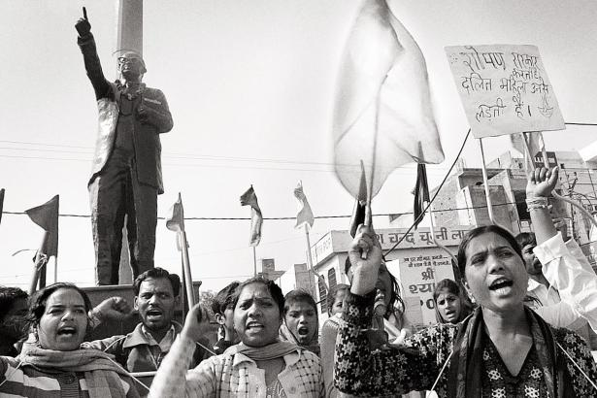
Subaltern Studies and Postcolonialism

Slide 2
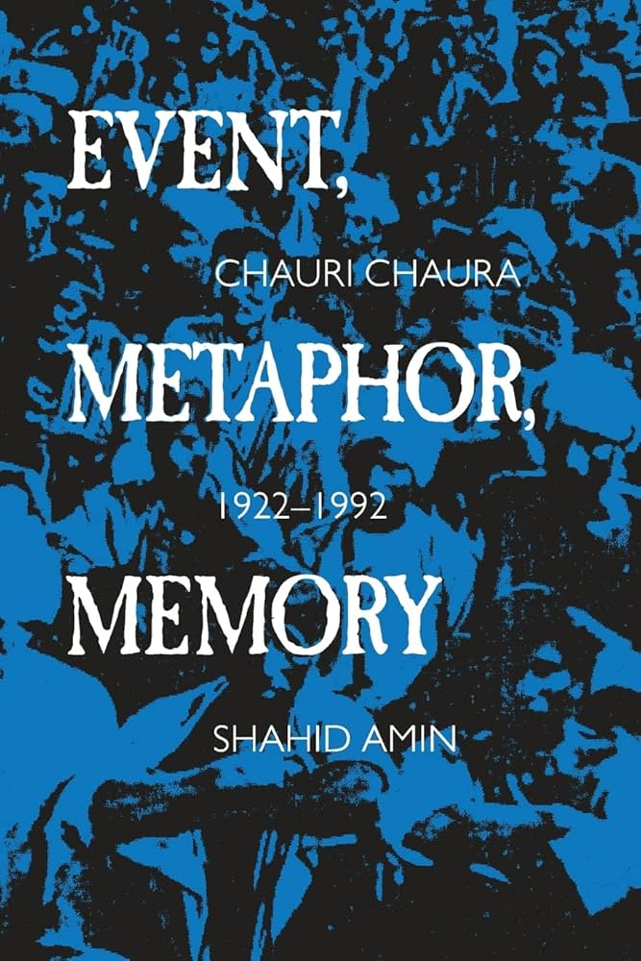
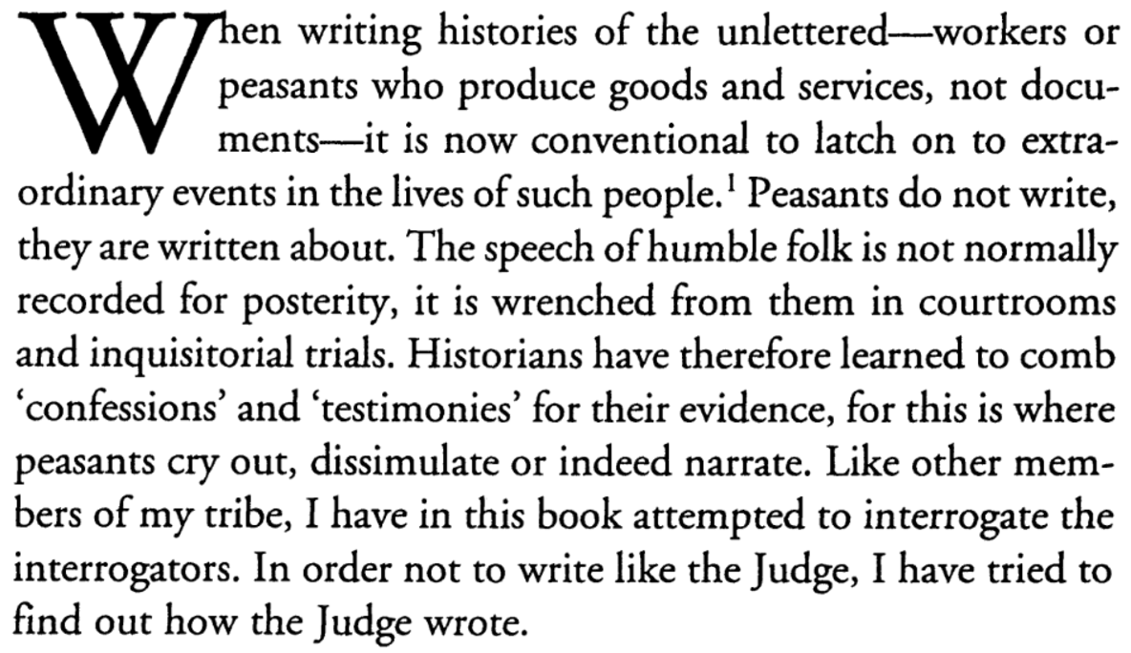

Slide 3
Three takeaways from Amin’s paragraph
‘Humble folk’ (aka, subalterns) lack autonomous self-representation in historical records →
Historians have to search hard for traces of subalterns and adopt specific analytical strategies →
Through this, the historian can break the monopoly of the powerful on historical representation and agency

Slide 4
The rest of the lecture
Influences on Subaltern Studies (and their limits)
A potted history of Subaltern Studies (and its varieties)
Major principles of Subaltern Studies (and their critics)
How to be a Subalternist: some pointers

Slide 5
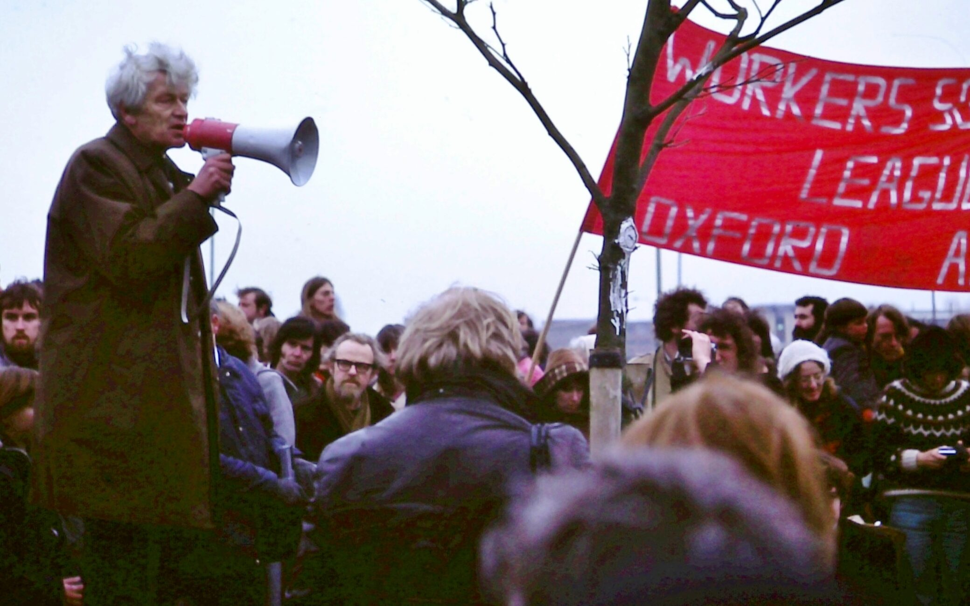
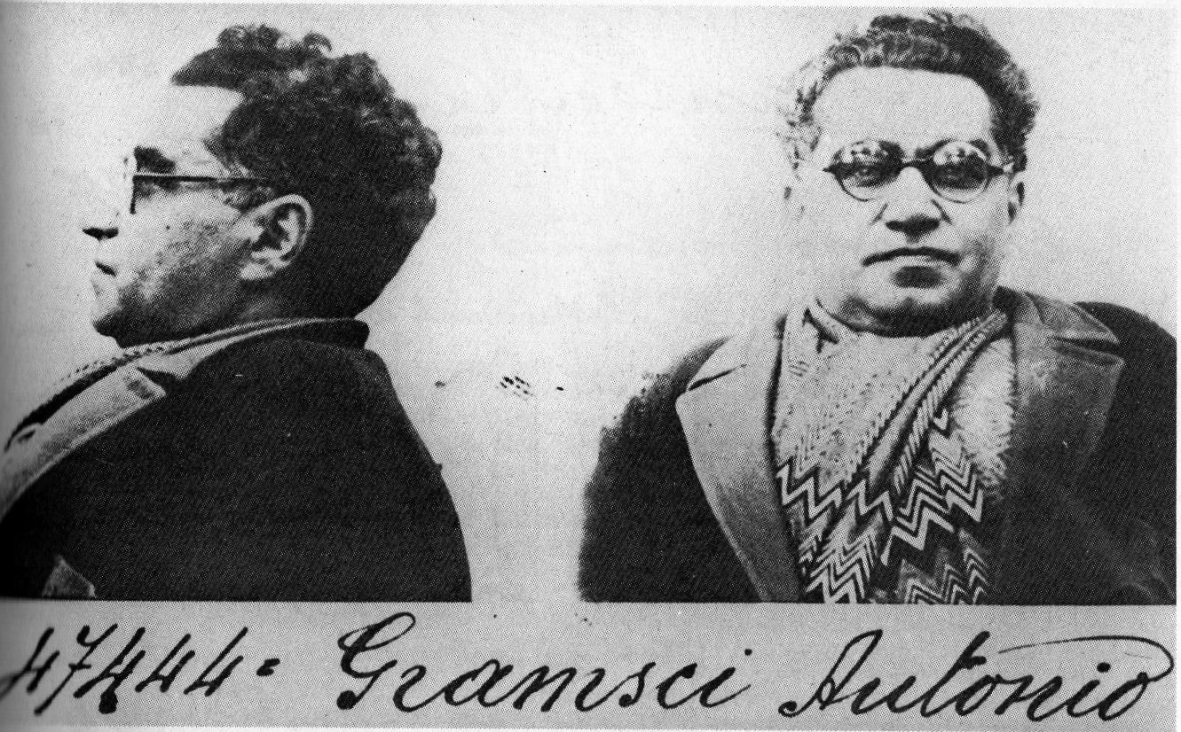
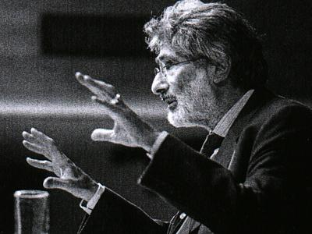
Influences on Subaltern Studies
‘History from below’
Antonio Gramsci
Edward Said and literary theory

Slide 6
Influences: ‘History from below’
Subalternists at first ‘borrowed liberally from Thompson’s ideas, rhetoric and example’.
Rajnarayan Chandavarkar, ‘“The Making of the Working Class”: E.P. Thompson and Indian History’, History Workshop Journal, 43 (1997), pp.177-96, here pp. 181–2.

Slide 7
Influences: ‘History from below’
‘Moral economy’: importance of cultural norms as opposed to economic determinism.
Focus on variety within classes and their emergence over time.
Significance of (rural) cultural inheritances for the (urban) industrial working class.

Slide 8
Influences: ‘History from below’
But some (arguable) differences:
Thompson’s self-described empiricism differs from Subalternists’ more interventionist way of reading sources against the grain.
Relatedly, Subalternists pay more attention to unpacking how archives function as sites of power/knowledge
Subalternists go further than Thompson in fragmenting ‘universalist’ categories like capital, class, and modernity

Slide 9
Influences: Antonio Gramsci
Hegemony: ‘intellectual and moral leadership’ securing consensual domination of the ruling elite over the rest of society.
A ‘sturdy structure’ of civil society, including schools, churches, newspapers.
Departs from classical Marxist economic determinism.
Antonio Gramsci (1891–1937)

Slide 10
Influences: Antonio Gramsci
Subalternists develop Gramsci’s …
category of ‘the subaltern’ to denote those excluded by cultural hegemony
focus on ad hoc political organization (rather than just fully theorised uprisings)
notion that subaltern consciousness first emerges as ‘negation’ (i.e., construction of a ruling class as enemy)
Antonio Gramsci (1891–1937)

Slide 11
Influences: Antonio Gramsci
Subalternists depart from Gramsci …
in the turn by some towards linguistic theory and focus on representation (and its limits)
by insisting that outright coercion (e.g., threat of physical violence) matters even in situations in which there’s deep cultural hegemony (see Guha’s Dominance Without Hegemony (1997), p. 23)
Antonio Gramsci (1891–1937)

Slide 12
Influences: Edward Said and literary theory
Said
Reading with the grain
Focus on how knowledge and representations constitute (colonial) power
Interest in the impact and durability of binaries (East/West; tradition/ modernity, etc.)
Subalternists
Reading against the grain
Focus on how even the structurally disempowered have agency and autonomy
Interest in how subaltern agency complicates and subverts such binaries (e.g. fragments of tradition persist in modernity)

Slide 13
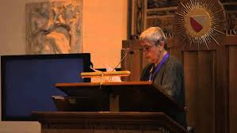
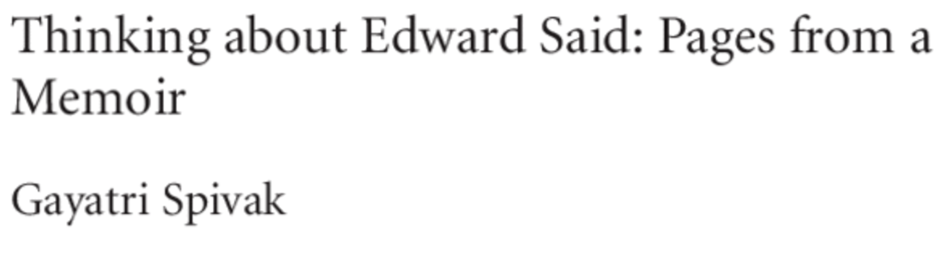
Influences: Edward Said and literary theory
But increasing influence among Subalternists focused on the power of discourse and representations (especially Spivak).
Some shared intellectual reference points, esp. Foucault.
Gayatri Spivak giving the keynote address at the 2013 Edward Said Memorial Conference

Slide 14
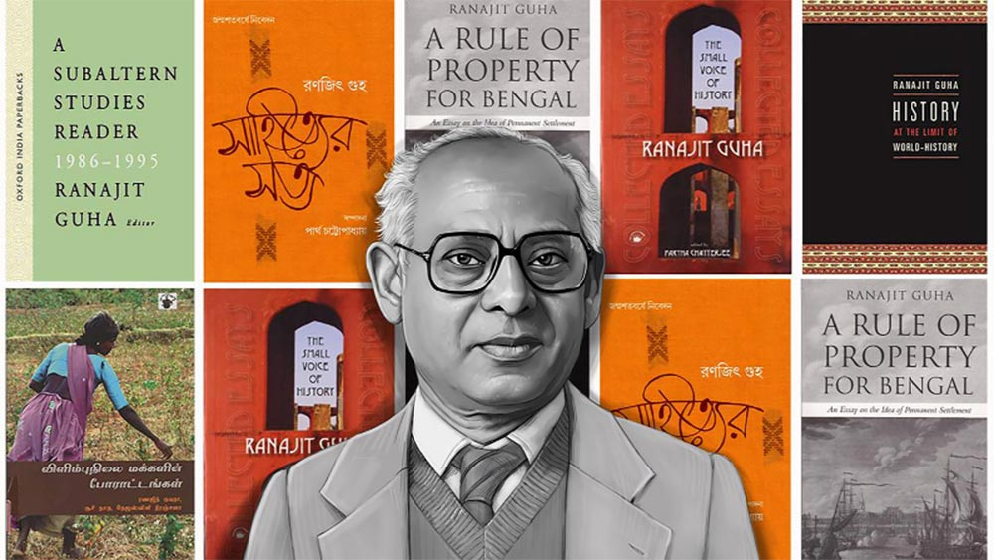
A potted history of Subaltern Studies
Ranajit Guha (1923–2023)

Slide 15
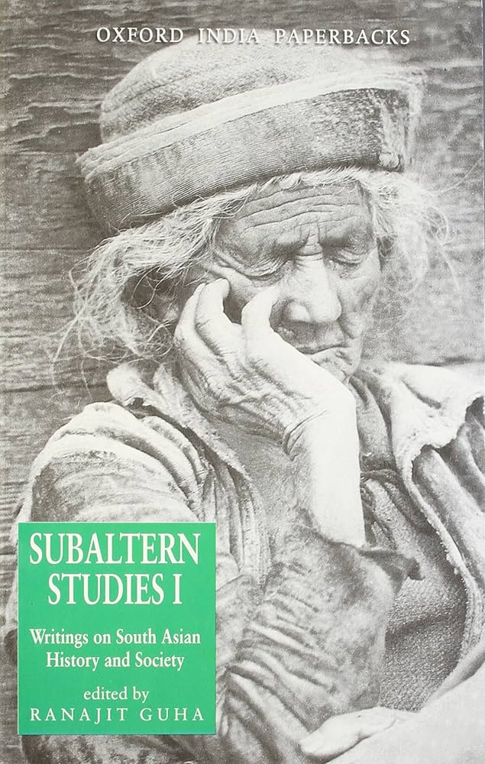
A potted history of Subaltern Studies
Subaltern Studies I (1982), including Guha’s introductory essay ‘On Some Aspects of the Historiography of Colonial India’
Against ‘elitist’ historiographies that claim India’s political modernity is an ‘elite achievement’.
Instead highlights ‘the contribution made by the people on their own’ (emphasis in original → key concept of autonomy of Subaltern politics)
Subaltern politics was traditional in the sense of deep precolonial roots, but ‘by no means archaic in the sense of being outmoded’ → blurring traditional/modern binary

Slide 16
A potted history of Subaltern Studies
‘There were vast areas in the life and consciousness of the people which were never integrated into [the Indian bourgeoisie’s] hegemony’
Gramscian language
Contrast to Said’s focus on the power of elite representation
Subaltern politics could not achieve national mobilization nor ‘a decisive victory over colonialism’
This is the ‘central problematic’ for historians of India

Slide 17
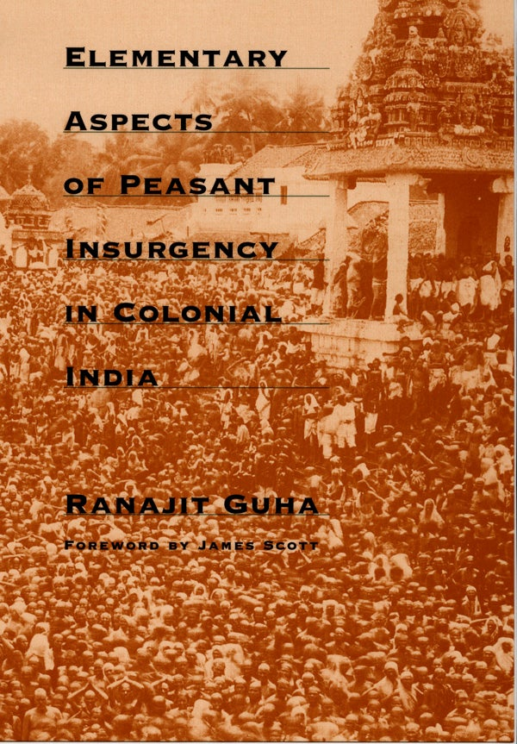
A potted history of Subaltern Studies
‘The reports, despatches, minutes, judgments, laws, letter, etc. in which policemen, soldiers, bureaucrats, landlords, usurers and others hostile to insurgency register their sentiments … do not get their content from that will alone, for the latter is predicated on another will – that of the insurgent. It should be possible therefore to read the presence of a rebel consciousness as a necessary and pervasive element within that body of evidence.’ (p. 15)

Slide 18
A potted history of Subaltern Studies
‘It is possible for the historian to use this impoverished and almost technical language as a clue to the antonymies which speak for a rival consciousness – that of the rebel.’ (pp. 16–17)
E.g., ‘fanatic’ = a rebel with a religious revivalist doctrine

Slide 19
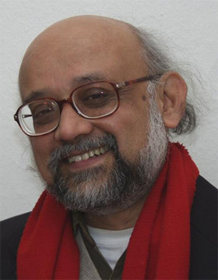
A potted history of Subaltern Studies
‘There is little by way of a “shared presupposition” among [Subaltern Studies I] contributors, except a certain dissatisfaction with the current historiography orthodoxies.’
Partha Chatterjee’s ‘Peasants, Politics and Historiography: A Response’, Social Scientist (1983)
Partha Chatterjee (1947–)

Slide 20
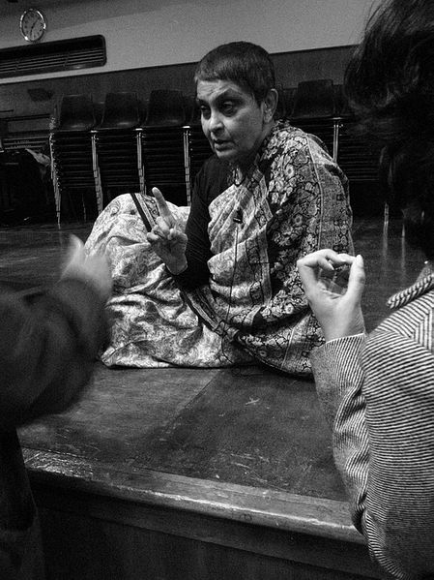
A potted history of Subaltern Studies
Gayatri Spivak, ‘Subaltern Studies: Deconstructing Historiography’ (1985) and ‘Can the Subaltern Speak?’ (1988)
Influenced by (and translator of) Jacques Derrida and deconstructionism, and feminist theory.
Turns the method of Subaltern Studies—reading against grain—back onto Subaltern Studies.
Gayatri Chakravorty Spivak (1942–)

Slide 21
A potted history of Subaltern Studies
Gayatri Spivak, ‘Subaltern Studies: Deconstructing Historiography’ (1985) and ‘Can the Subaltern Speak?’ (1988)
Subaltern consciousness is always elusive: ‘You can only read against the grain if misfits in the text point the way’ (1985, p. 351).
Criticises Subalternist focus on autonomy as reimposing a Western liberal ideal of subjecthood.
Gayatri Chakravorty Spivak (1942–)

Slide 22
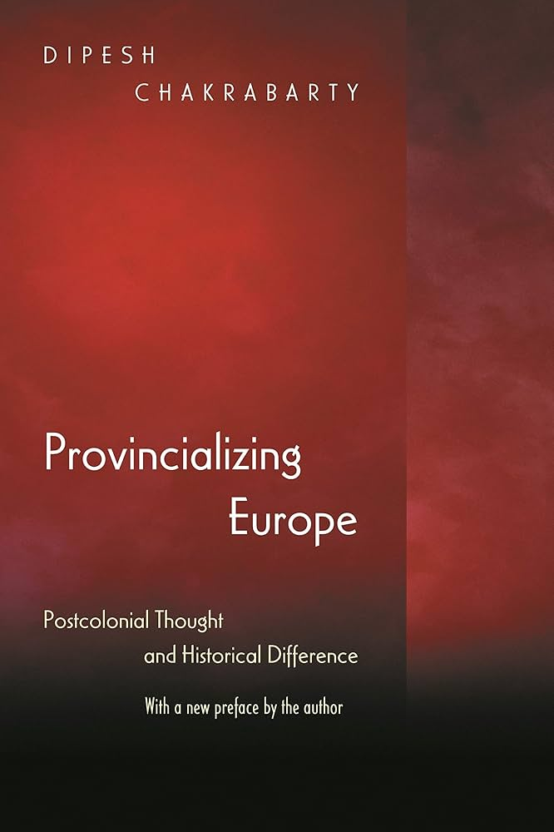
A potted history of Subaltern Studies
Dipesh Chakrabarty’s Provincializing Europe (2000)
Categories like class, modernity, reason, etc. are not universal (‘our historical differences actually make a difference’)—but some projects of political justice require universalist terms.
Applies Subalternist methods to explore the limitations of European/Western norms in Global South locations (‘thought is related to place’)—contrast with Said!

Slide 23
Major principles of Subaltern Studies
A Subaltern Studies glossary:
Subaltern (and ‘elite’)
Hegemony (and ‘dominance’)
Autonomy (and ‘political’)
‘The politics of the people … [was] an autonomous domain, for it neither originated from elite politics nor did its existence depend on the latter.’
Guha, ‘On Some Aspects’, p. 4

Slide 24
Major principles of Subaltern Studies
A Subaltern Studies glossary:
Subaltern (and ‘elite’)
Hegemony (and ‘dominance’)
Autonomy (and ‘political’)
‘The politics of the people … [was] as modern as indigenous elite politics.’
Guha, ‘On Some Aspects’, p. 4

Slide 25
Major principles of Subaltern Studies
Reading against the grain/listening for the small voice
‘Try to relate to the past by listening to and conversing with the myriad voices in civil society. These are small voices which are drowned in the noise of statist commands…
‘It is up to us to make that extra effort … and above all cultivate the disposition to hear these voices and interact with them…
‘To listen is already to be open to and existentially disposed towards: one inclines a little on one side in order to listen.’
Ranajit Guha, ‘The Small Voice of History’, Subaltern Studies IX (1996), pp. 3–9

Slide 26
Major principles of Subaltern Studies
Particularity and difference within modernity
(See especially Chakrabarty and Chatterjee)
South Asia has distinct elements that mean it cannot be analysed through categories developed in relation to Europe/the West (include Marxist concepts such as ‘class’, ‘capital’, ‘labour’).
Subalterns disrupt historians and social scientists, forcing to rework the analytical tools they rely upon.

Slide 27
Three major criticisms of Subaltern Studies
Subalternists end up conceiving their subjects in a ‘liberal humanist’ vein: heroic individuals, free to dictate their own history.
→ Rosalind O’Hanlon, ‘Recovering the Subject’ (1988)

Slide 28
Three major criticisms of Subaltern Studies
Subalternists end up conceiving their subjects in a ‘liberal humanist’ vein: heroic individuals, free to dictate their own history.
Subalternists essentialise South Asia as a timeless space of cultural difference.
→ The idea of subaltern cultural ‘inheritances’ turned ‘into a static, timeless, indeed Orientalist characterization of a “traditional” Indian, implicitly “Hindu” culture.’
Raj Chandavarkar, ‘E. P. Thompson and Indian History’ (1997)
Notes:
This has the inadvertent effect of making Subalternist sounds like colonialists, and also of sharing a good deal of common ground with some claims of modern Hindu nationalism in India.

Slide 29
Three major criticisms of Subaltern Studies
Subalternists end up conceiving their subjects in a ‘liberal humanist’ vein: heroic individuals, free to dictate their own history.
Subalternists essentialise South Asia as a timeless space of cultural difference.
Subalternists overstate the differences of specific subaltern groups, which can in fact be well understood through Marxist concepts of class.
→ Vivek Chibber, Postcolonial Theory and the Spectre of Capital (2013)

Slide 30
How to be a Subalternist
Focus on underrepresented and difficult-to-reach historical actors by reading against the grain (or listening for the small voice)
Sources dealing with episodes of violence are the most likely to give (fragmentary and imperfect) glimpses of subalterns

Slide 31
How to be a Subalternist
Complicate universal categories like ‘modernity’, ‘class’, and ‘labour’, showing how particularity and complexity matters
Edward Said identifies and shows the power of binaries (East/West; backward/progressive; barbarity/civilization; superstitious/rational)
Subalternists critique and show the limits of such binaries

Slide 32
How to be a Subalternist
Complicate universal categories like ‘modernity’, ‘class’, and ‘labour’, showing how particularity and complexity matters
‘We do not have analytic categories in our aggressively secular academic discourse that do justice to the real, everyday, and multiple connections that we have to what we, in becoming modern, have come to see as nonrational. Tradition/modernity, rational/nonrational, intellect/emotion – these untenable and problematic binaries have haunted our self-representations in social-science language since the nineteenth century.’
Dipesh Chakrabarty, Habitations of Modernity (2002), p. 26

Slide 33
How to be a Subalternist
Specify your type of Subalternist approach

Slide 34
Key takeaways
Subaltern Studies scholars were influenced by ‘history from below’, Gramsci, and (in some cases) poststructuralism, but didn’t simply replicate any of these.
The initial focus on uncovering rebellion and resistance (esp. Guha) partially shifted towards a focus on (the limits of) language and representation (esp. Spivak).
Focusing on key concepts (‘subaltern’, ‘hegemony’, ‘autonomy’) is a good way to get to grips with Subaltern Studies.
You can be a Subalternist by: (a) reading sources against the grain; and (b) exploring how structurally disempowered groups complicate binaries like ‘tradition/modernity’.

Slide 35
Key takeaways
Said’s Orientalism and Subaltern Studies (especially Guha) offer two very different postcolonialist methodologies

