Slide 1
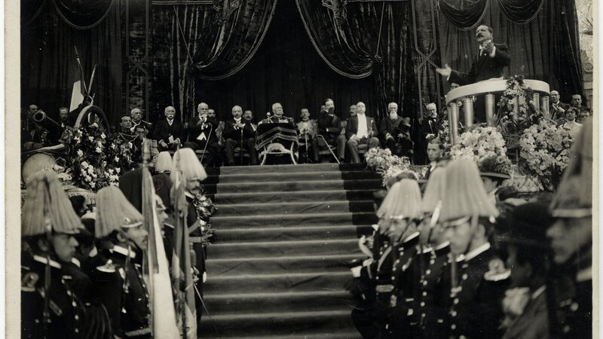
Land, Labor and Modernity during the Porfiriato, 1876-1910

Slide 2
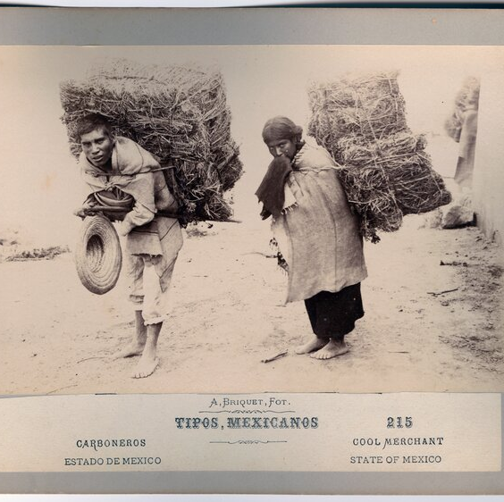
Seminar Questions
What were the effects of Porfirian economic changes on land tenure?
To what extent was late nineteenth century Mexico economically dependent?

Slide 3
Further Questions
Why did Mexico undergo such rapid growth during the Porfiriato?
What were the changes in land ownership in Mexico, 1870 to 1940?
How did Mexican women's roles change, 1910-1940?
To what extent did the Porfiriato usher in a “land grab of massive proportions”?
How did different peasant groups negotiate the new land laws of the Porfiriato?
What were the cultural effects of modernity on Mexico?
How did Porfirian state culture envisage subaltern groups?

Slide 4
Primary Sources
How might the primary sources be useful or less useful for studying the Porfiriato?
UT Austin Exhibition: Pictures of the Porfiriato

Slide 5
Representations of the Porfiriato
Mexican Fantasy/ Que Viva Mexico, SergeI Eisenstein, (43.00-50.00)
https://www.youtube.com/watch?v=5rknic8PmWI

Slide 6
Mexican Pastorelas
Teatro Campesino’s Pastorela: https://sites.dlib.nyu.edu/hidvl/ffbg79nz
Borderlore’s description of the pastorela: https://borderlore.wordpress.com/2008/12/01/from-the-borderlore-archives-all-about-the-pastorela-december-2008/
Coates Library Pastorela from the archives: https://lib.trinity.edu/2021/12/la-pastorela-a-christmas-treasure-in-special-collections/

