Slide 1
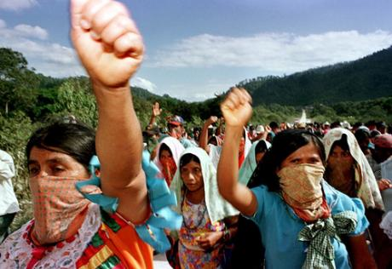
The Zapatistas and Indigenous Movements in Mexico, 1970-2010

Slide 2
Growth of Mexico’s Indian Population
Mexico: 62 languages, 100s of mutually unintelligible dialects
1970: 3.11 million spoke one of these languages
2000: 6.04
2012: 11 million (largest in LA)
Without migration, growth rate would be even higher....

Slide 3
Identity Politics comes to Mexico
Top down shifts
Radical shift in Mexican Anthropology. Until 1970s, most anthropologists worked with the state in order to incorporate/assimilate indigenous groups.
1970s Radical anthropologists like Guillermo Bonfil Batalla and Roger Bartra start to question anthropologists’ role.
In México Profundo, Bonfil Battala explores “internal colonialism”, continuation of racist colonial structure in modern capitalist society.
Shift in Church Policy. Liberation Theology aka “the option for the poor” ushers in new pro-indigenous policy, acceptance of indigenous spirit systems and practices, church support for indigenous social movements, establishment of Comunidades Eclesiasticas de Base. E.g. Sergio Mendez Arceo, bishop of Cuernavaca
Shift in Government policy. Under populist president, Luis Echeverria, state devotes more energy to “indigenous problem”
INI (National Indigenous Institute): “coordination centres” increased from 12 to 84 between 1970-1982.

Slide 4
Bottom-up shifts
  Peasant organizations, like ejido boards, contained indigenous members. But, they did not couch their demands in terms of their ethnic group.
  Guerrilla organizations in Chihuahua and Guerrero included people of indigenous descent but failed to take much note of “indigenous” roots of socio-economic problems. Instead, they claimed, following Marx, that their problems were one of class.
  But, some exceptions. Ruben Jaramillo, 1960s peasant leader translates Communist Manifesto into Nahuatl.
  Creation of Consejo Supremo Tarahumara in the late 1950s was an attempt to bring together indigenous Tarahuamara into supra-regional governing council.
  Birth of first exclusively indigenous political organization, the Coalición Obrera, Campesina, Estudiantil del Istmo (COCEI) in Juchitan founded in 1973.

Slide 5
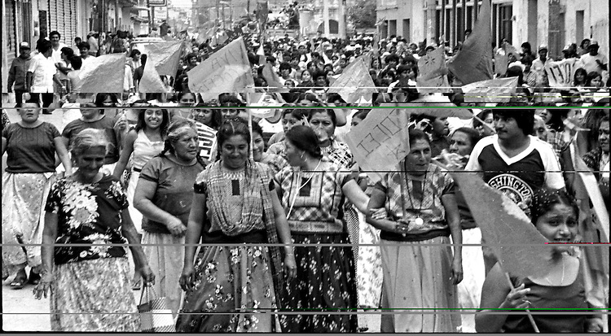
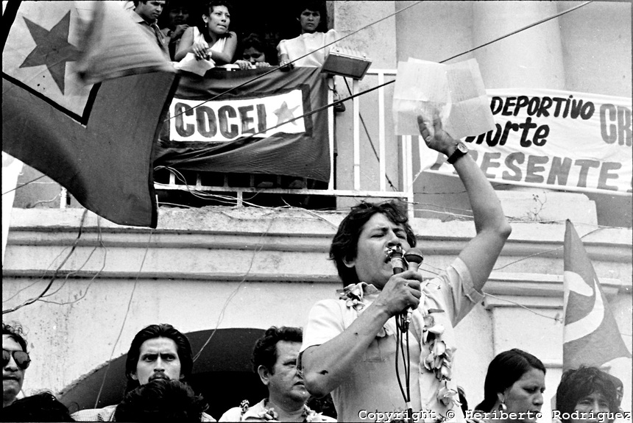
COCEI, Juchitán

Slide 6
Neo-liberalism & indigenous groups
1980s Indigenous leaders integrate within national organizations such as UNORCA (National Union of Autonomous Peasant Organizations) 1980s & 90s. Here they start to challenge assimilationist assumptions.
Yet debt-strapped Govt. cuts rural programmes (INI by 60% under Miguel de la Madrid (1982-1988)
Concerned by indigenous activism Carlos Salinas (1988-94) increases INI budget and launches Solidaridad programme

Slide 7
Chiapas under the PRI
Social reforms of the Revolution barely touched Chiapas.
In Highland Chiapas, PRI used bilingual indigenous caciques to force indigenous Mayans to work lowland coffee plantations.
At the same time, allowed cattle ranchers to take over indigenous lands.
Racism and institutional violence were the norm.

Slide 8
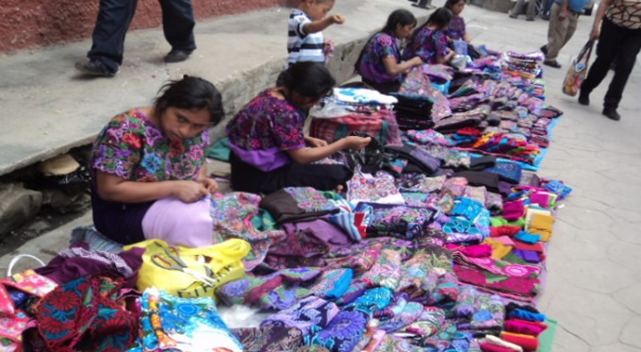
Indigenous Mayans, Chiapas 2015

Slide 9
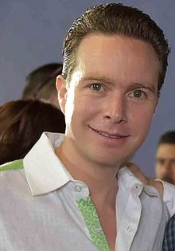
Manuel Velasco, governor of Chiapas (2012-2018)
https://www.youtube.com/watch?v=u44j-D3HMuY
http://www.sinembargo.mx/20-01-2015/1224861

Slide 10
“Sociological awakening” of Chiapas’s indigenous communities
1960s: Bishop Samuel Ruiz and Catholic Church trained 8.000 catechists and 400 deacons in 2,500 indigenous communities in Chiapas
Unions and catechists create a “sociological awakening” in indigenous communities
Late 1960s – 1980s, Student Maoist organisers arrive in Chiapas to work with peasants.

Slide 11
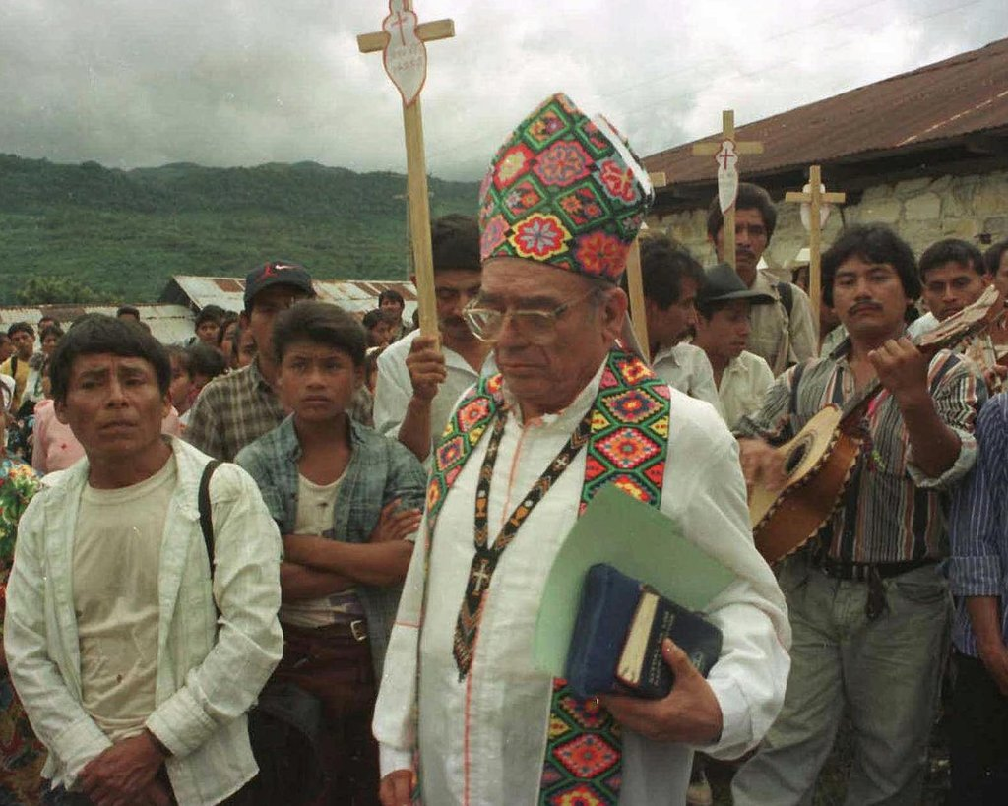
Bishop Samuel Ruiz

Slide 12
Subcommandante Marcos aka Rafael Sebastián Guillén Vicente
Former philosophy professor at UAM in Mexico City.
Heavily influenced by Marxism of the 1970s.
Joined guerilla group and went to Chiapas in 1980s.
At first, rejected by indigenous communities.
Ditched Marxist rhetoric and instead concentrated on indigenous problems.

Slide 13
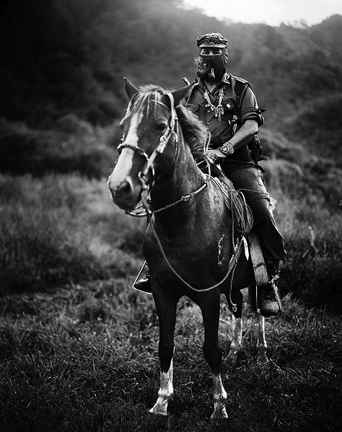

Slide 14
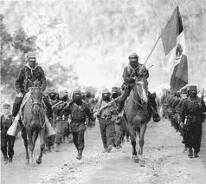
1 January 1994 Zapatista Army of National Liberation (EZLN) Uprising

Slide 15
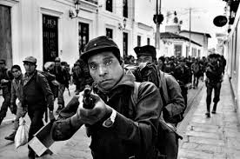

Slide 16
Subcomandante Marcos
As to whether Marcos is gay: Marcos is gay in San Francisco, black in South Africa, an Asian in Europe, a Chicano in San Ysidro, an anarchist in Spain, a Palestinian in Israel, a Mayan Indian in the streets of San Cristobal,… a Jew in Germany, a Gypsy in Poland, a Kurd in Turkey, a Mohawk in Quebec, a pacifist in Bosnia, a single woman on the Metro at 10pm, a peasant without land, a gang member in the slums, an unemployed worker, an unhappy student and, of course, a Zapatista in the mountains….Marcos is all the exploited, marginalised, oppressed minorities resisting and saying "Enough!" He is every minority who is now beginning to speak and every majority that must shut up and listen. He is every untolerated group searching for a way to speak. Everything that makes power and the good consciences of those in power uncomfortable — this is Marcos.
  "The Majority Disguised as the Resented Minority" (31 May 1994)

Slide 17
1 January 1994 EZLN Uprising
“The Zapatistas have pulled back the curtain that covered up the other Mexico. It is not the Mexico of eager entrepreneurs lined up to open Pizza Hut franchises and consumers eager to shop at Wal-Mart, but rather the Mexico of malnourished children, illiteracy, landlessness, poor roads, lack of health clinics, and life as a permanent struggle.”
Lynn Stephen (1994)

Slide 18
Demands: democracy - “never again without us” – not to take power (rejection of party system, caciques, spoils, etc. )
157 dead...rebels withdraw to Cañadas of East Chiapas
1994-95 two government offensives met with not with arms but the internet creating national and international solidarity
1996 San Andres Peace Accords

Slide 19
President Ernesto Zedillo promises constitutional amendment to permit indigenous autonomy and state and national political representation
Govt. breaks agreement - low intensity warfare/counter-insurgency “to break the relations of support that exist between the population and the violators of the law (EZLN)”
Encouragement of para-militaries involving arming of loyal (“priista”) indigenous factions
1996-97: 1,500 deaths
Acteal Massacre 22 December 1997 : 60 “priistas” attack makeshift refugee camp killing 45 Totzil Indians (7 men, 19 women and 19 children)

Slide 20
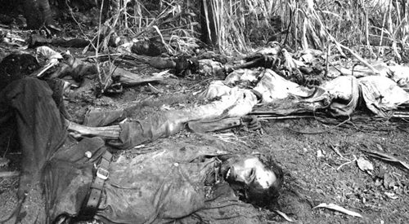

Slide 21
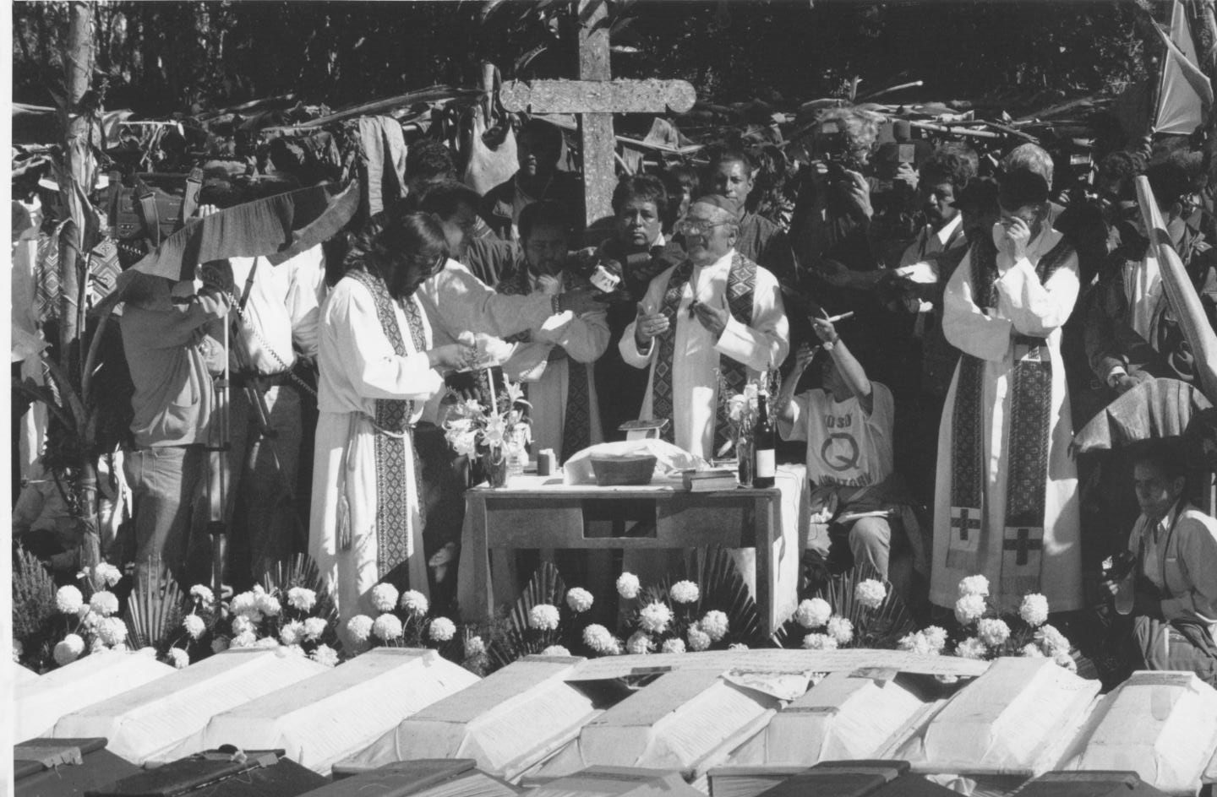
Bishop Samuel Ruiz, Acteal, Dec 1997

Slide 22
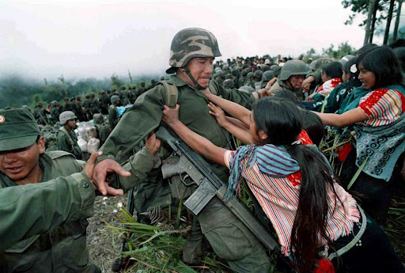
Acteal massacre demonstrations, Chenalho, December 22, 1997

Slide 23
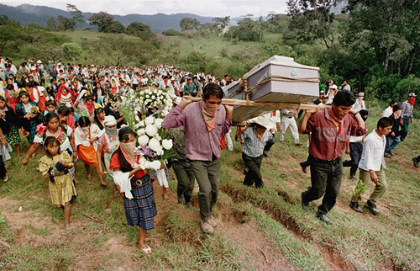

Slide 24
2000 : Vicente Fox withdraws army from 50 positions in rebel zone
San Andres agreement sent to Congress for ratification
2001: “Zapatour” 3.000 mile march to Mexico City to tumultuous welcome: Commandante Esther speaks to nation in broken Spanish...

Slide 25
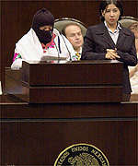
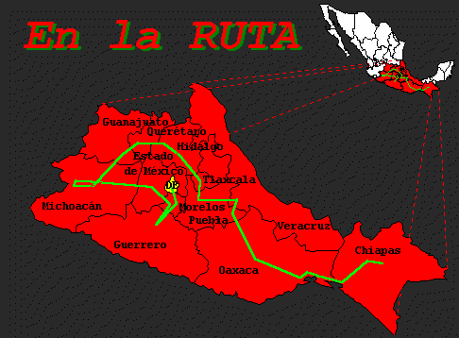
Zapatour & Comandante Esther

Slide 26
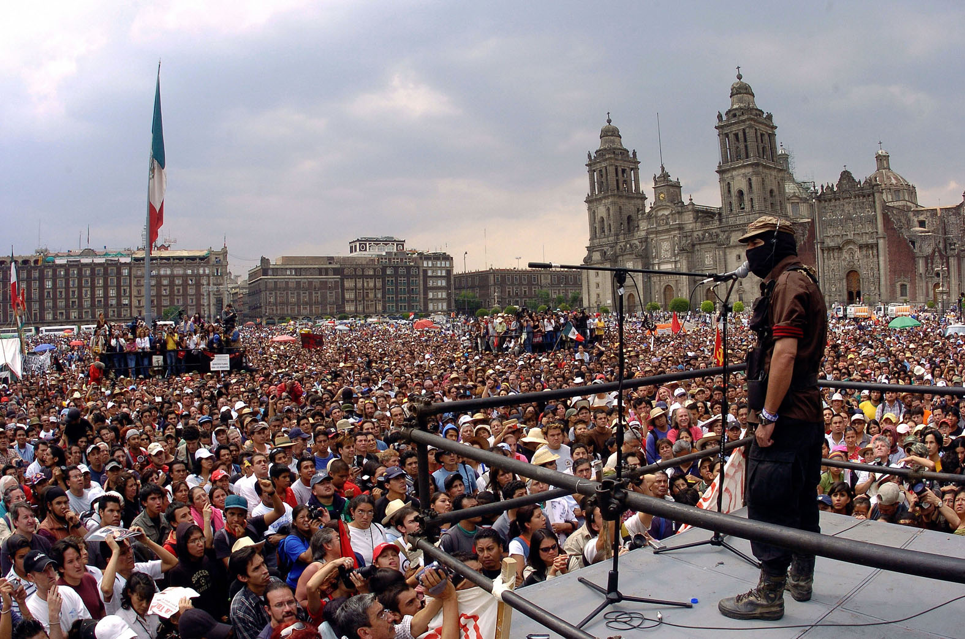
Sub-comandante Marcos, Zocalo, 11 March 2001

Slide 27
2001- loss of momentum on indigenous law
Fox disbands INI and establishes CDI (National Commission for the Development of Indigenous People) headed by Otomi businesswoman, Xochitl Galvez, to coordinate health, education and other programmes rather than to implement them as INI had done
Budget in 2004 19.6 billion pesos: $200 per Indian per year.......

Slide 28
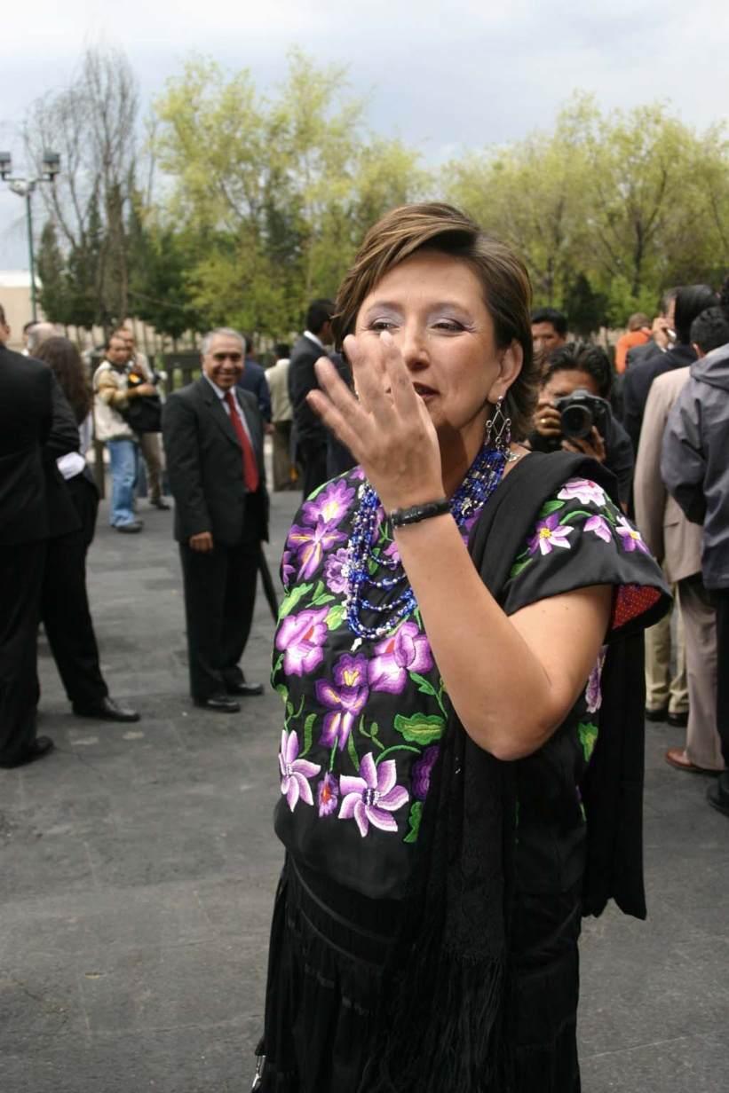
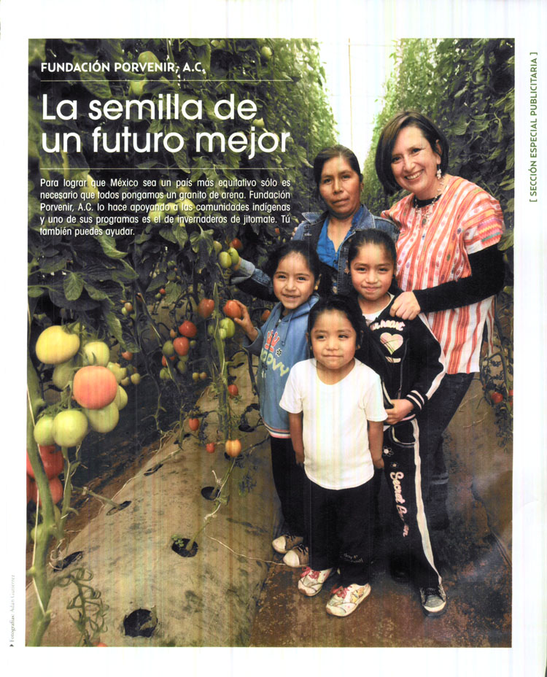
Xochitl Galvez, Director CDI

Slide 29
Caracoles/Juntas del Buen Gobierno
2003 EZLN establish ‘Caracoles’ / JBGs ‘Juntas del Buen Gobierno’ (Good Government Juntas) covering much of Highland and Eastern Chiapas
Caracol (conch shell): holds up sky while Gods are distracted, alerts others to evils in the world

Slide 30
Marcos on Caracoles
‘With the creation of the Caracoles and the Good Government Juntas, the Zapatistas decided to put the San Andres Accords into practice and to demonstrate, in action, that we wanted to be part of Mexico. It also reflects that the struggle has become as much political as military. It’s long been recognised that it is in the area of self organising and improving the quality of life on the ground, and not in armed struggle, where the Zapatistas have had great successes.’

Slide 31
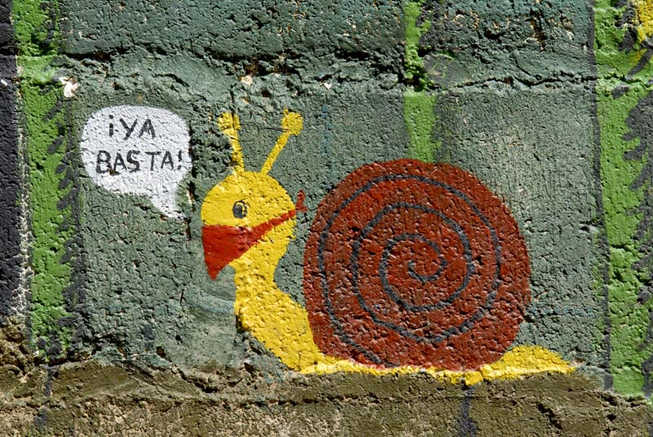
Caracol: “Ya Basta !”

Slide 32
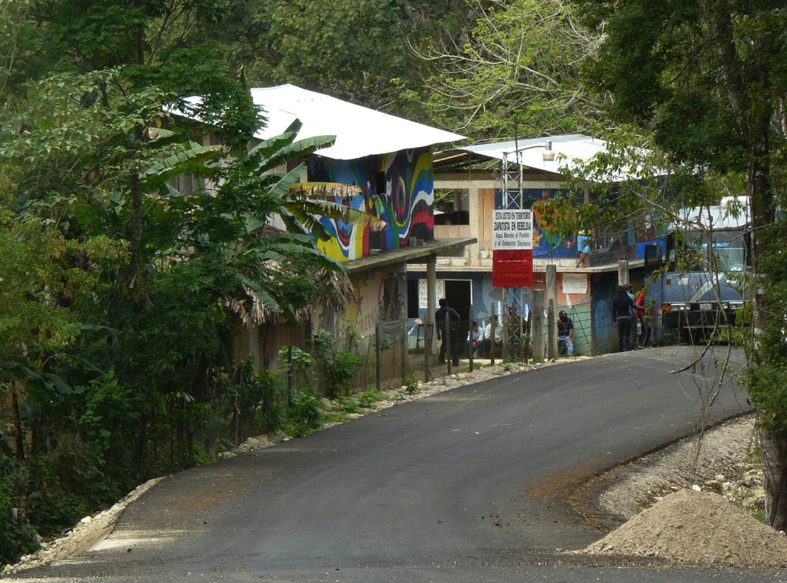

Slide 33
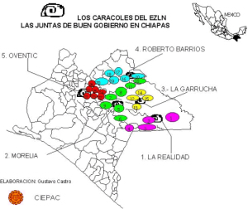

Slide 34
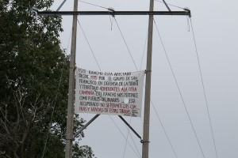

Slide 35
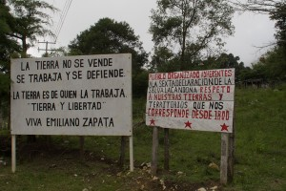

Slide 36
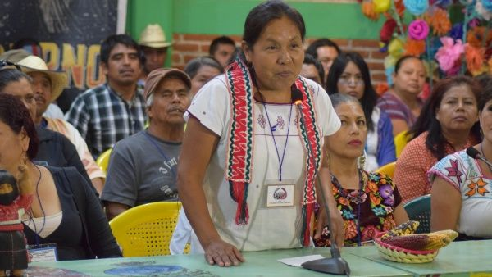
María Patricio Martínez Marichuy, the feminist, indigenous candidate running for 2017 presidency

Slide 37
Zapatista invasion of Europe
https://www.youtube.com/watch?v=6lX4vXDBZTM

