Slide 1
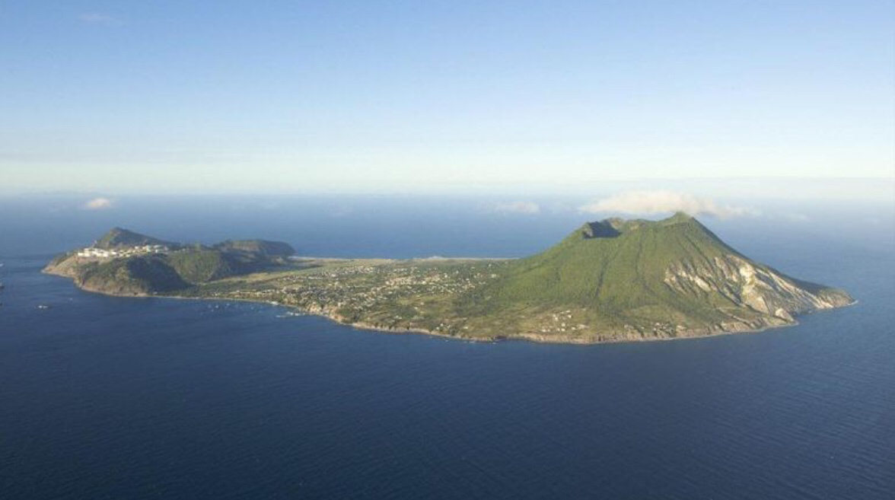
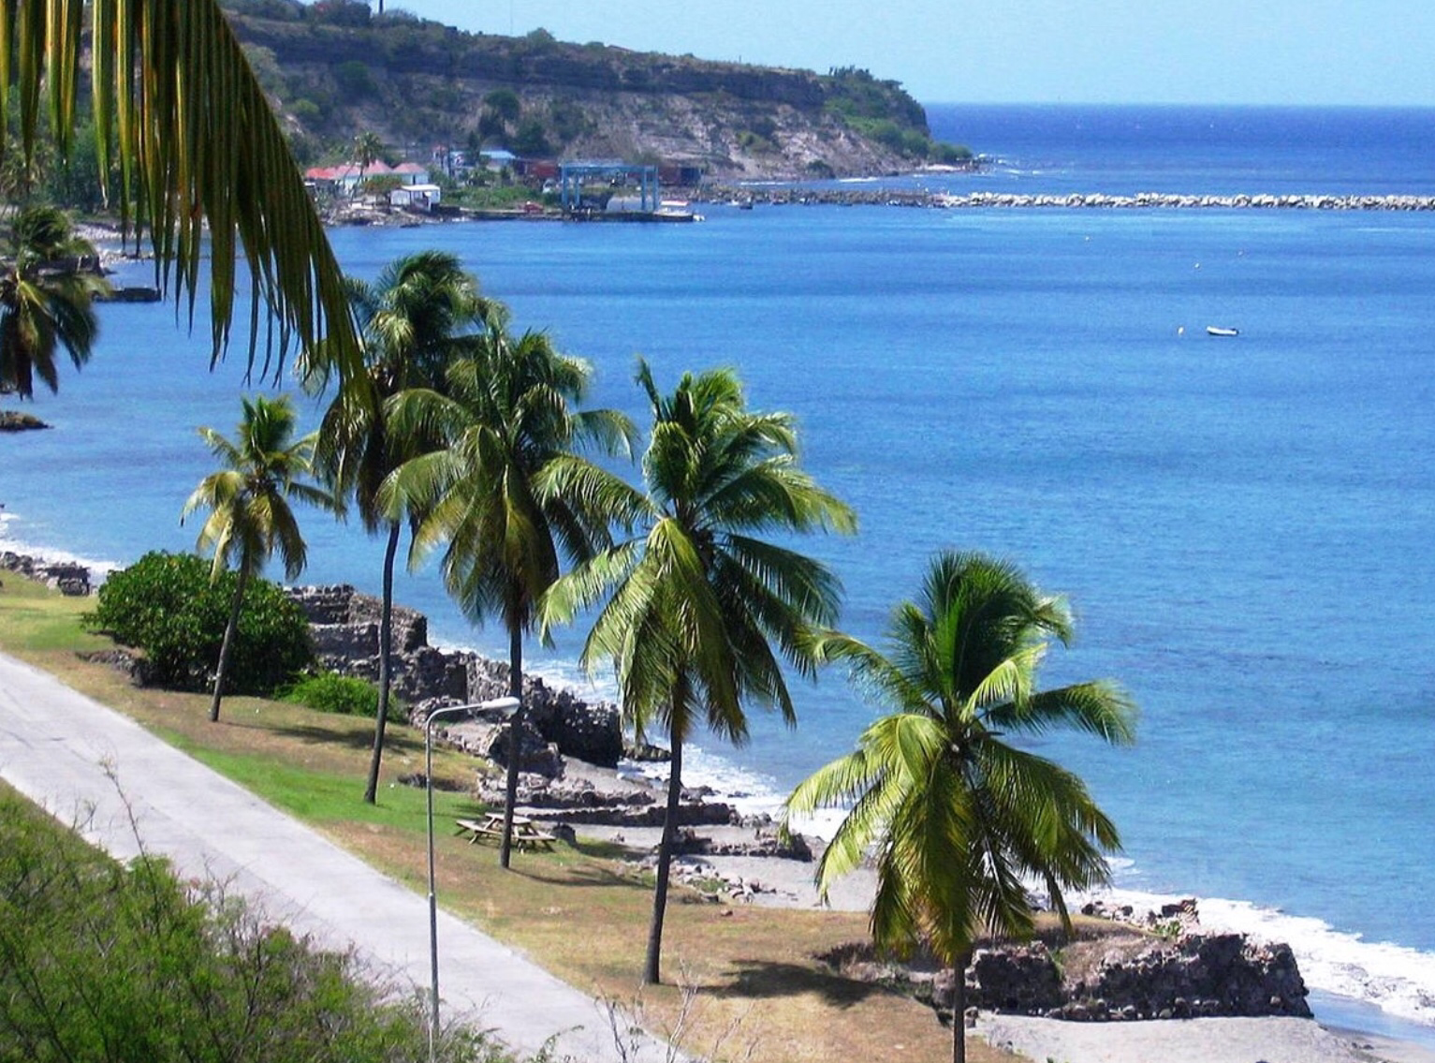
Sint Eustatius

Slide 2
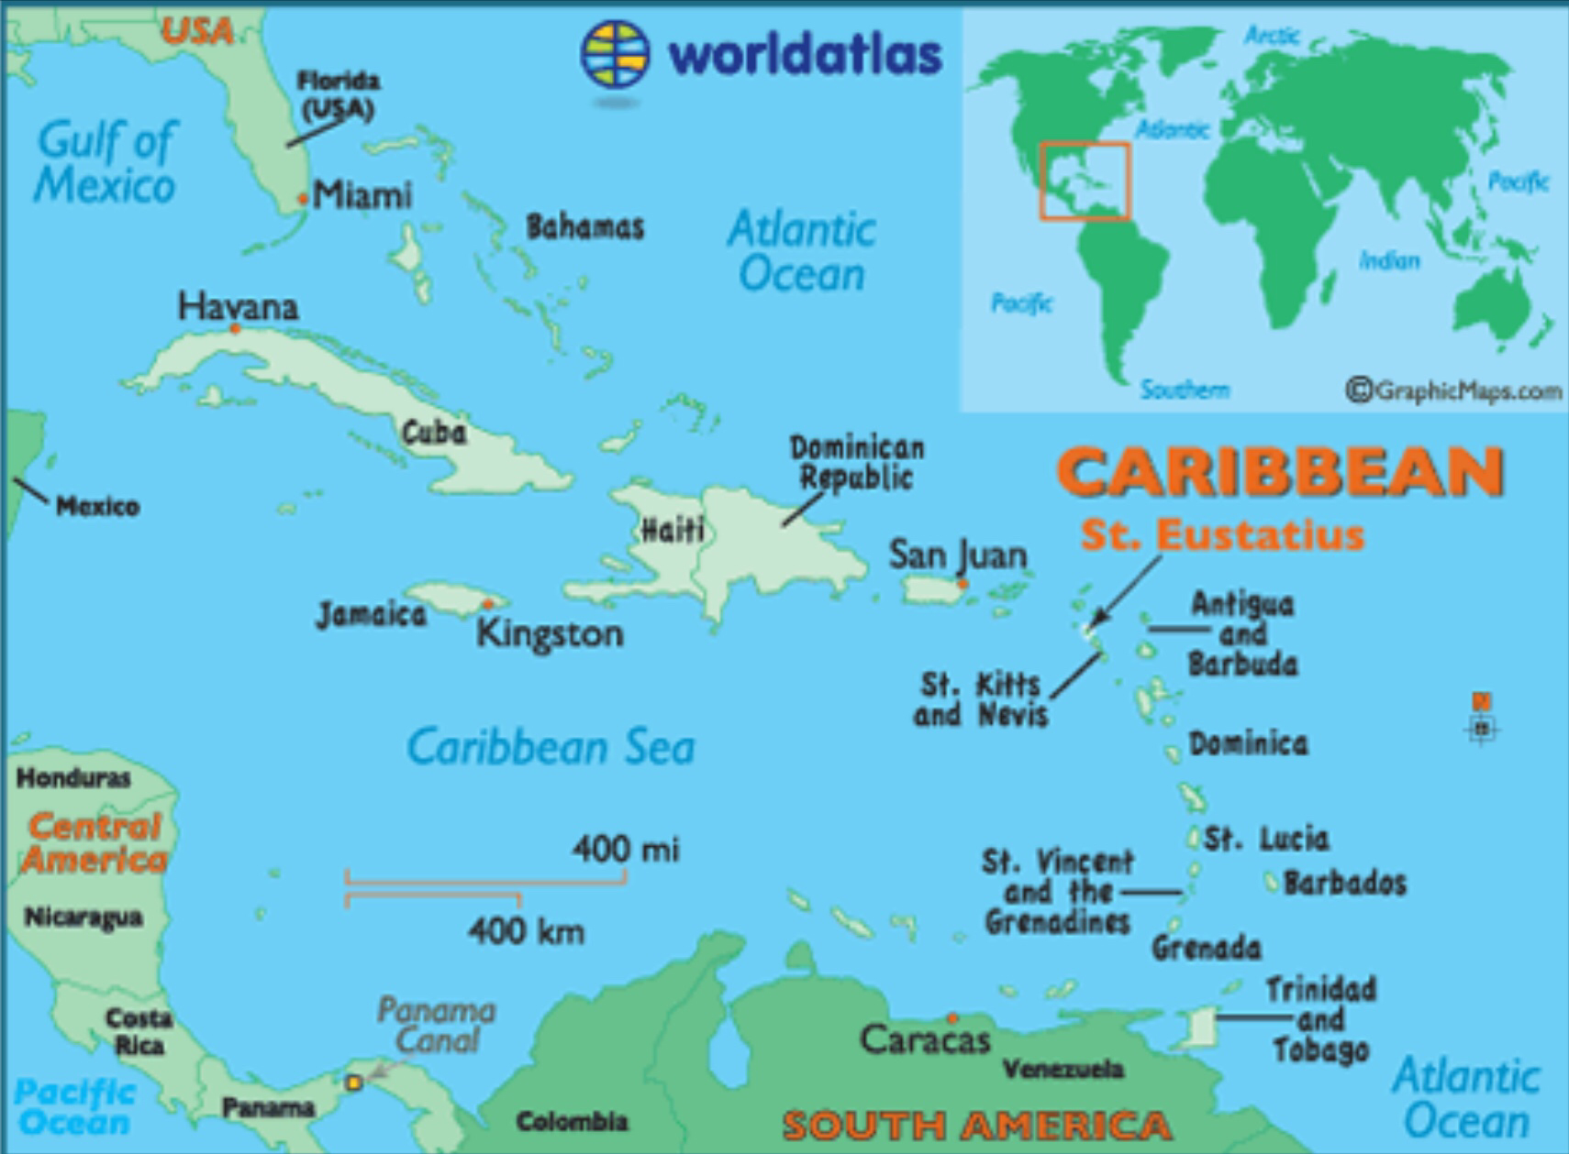
Sint Eustatius is a special municipality within the kingdom of the Netherlands
It is is in the lesser Antilles in the Northeastern Caribbean Sea

Slide 3
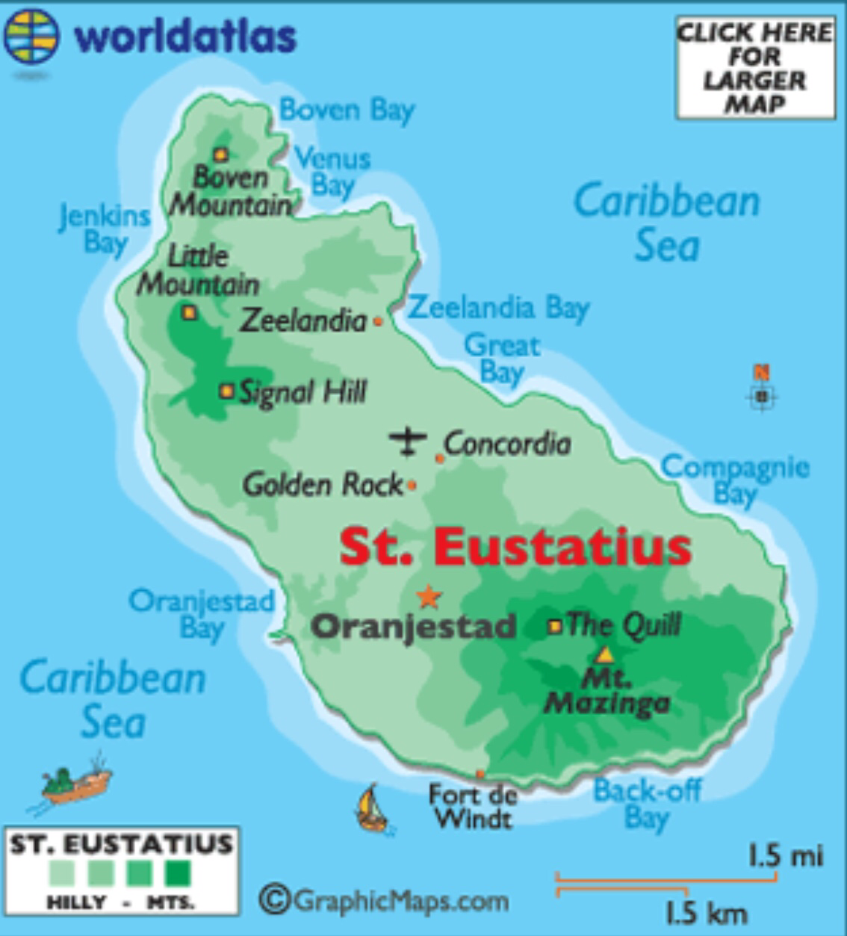
The modern day capital is Oranjestad and the island was first colonised by the French and English in 1625, but was taken by the Dutch in 1632.
In 1954 the Dutch dependencies, including Sint Eustatius, we’re organised into the Netherlands Antilles and were given autonomy in local affairs
Dissolution of the Netherlands Antilles occurred in 2010, however as of 2018-imposition of direct rule

Slide 4
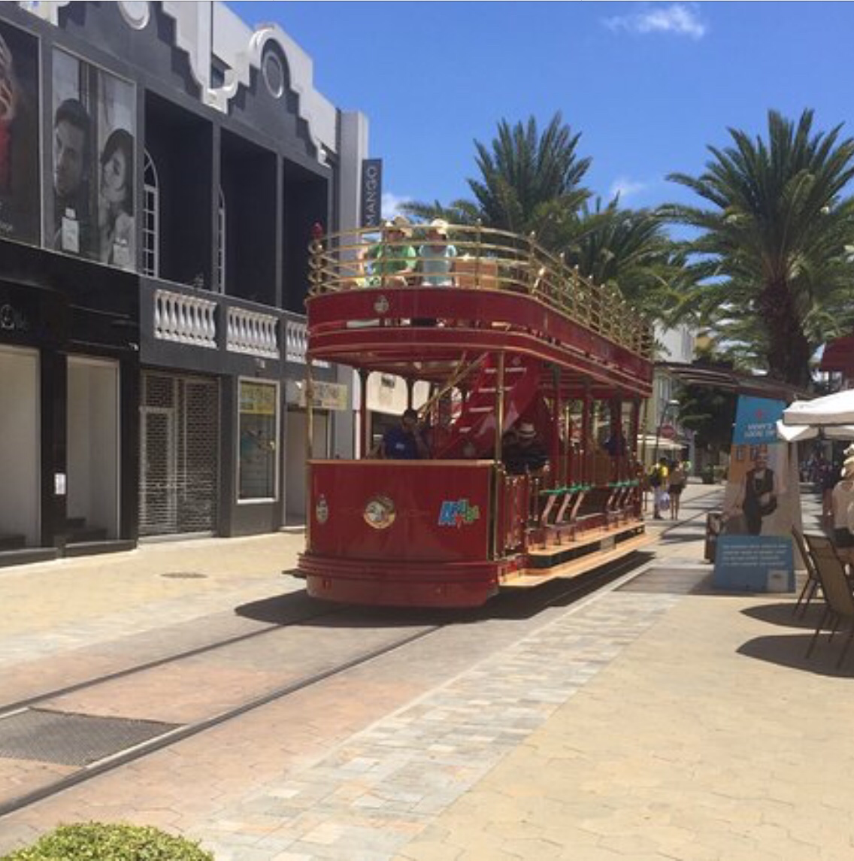
Official language spoken is English and majority of the population concentrated in capital. The island also had bilingual Dutch education

Slide 5

The Quill

