Slide 1
Domincan Republic

Slide 2
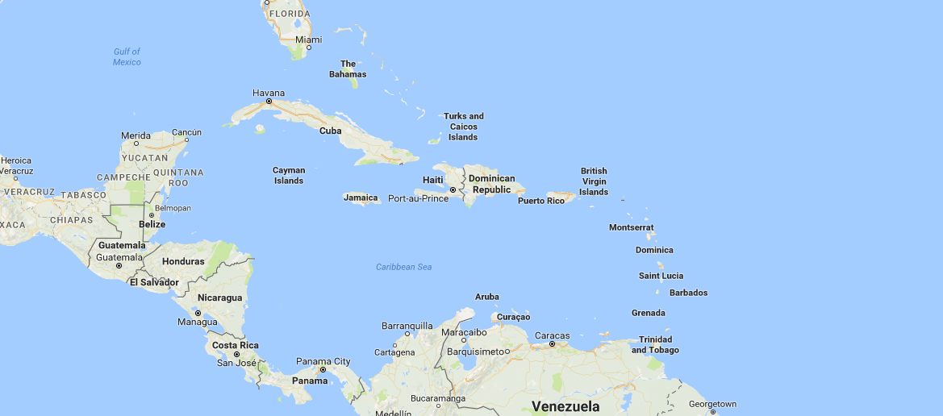

Slide 3
Facts
Hispaniola
2nd Largest Caribbean Island
Spanish language
Santo Domingo- Oldest continuously inhabited city by Europeans in the New World

Slide 4
Decolonisation
Declared independence in November 1821 after more than 300 years of Spanish Rule
Led by José Núñez de Cáceres
  Dominican politician and writer
Wanted to unite with the country of Gran Columbia
Forcefully annexed by Haiti
Won independence from Haiti in 1844
Fell back under Spanish Rule
Spanish permanently ousted after 1865 War of Restoration

Slide 5
Post Independence
Civil War
American Occupation between 1916 and 1924
Dictatorships
Civil War 1965
Joaquín Balaguer, 1966-1978
Moved towards representative democracy

Slide 6
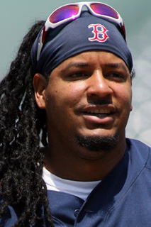
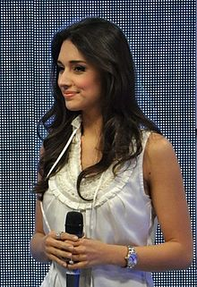
Famous People
Manny Ramirez
  Professional Baseball player
  One of 25 players to hit 25 career home runs
Amelia Vega
  Actress, Singer, Model and Beauty Queen
  First Dominican woman to be named Miss Universe
  Donald Trump named her his favourite Miss Universe ever

Slide 7
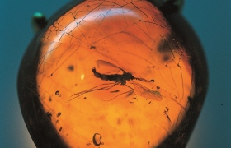
Interesting Fact
The famous amber in Jurassic Park can be found in the Amber Museum in Puerto Plata

