Slide 1
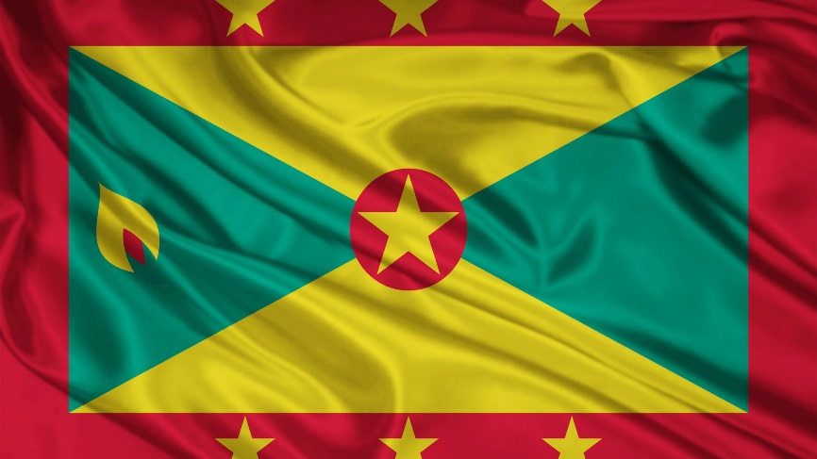
Grenada

Slide 2
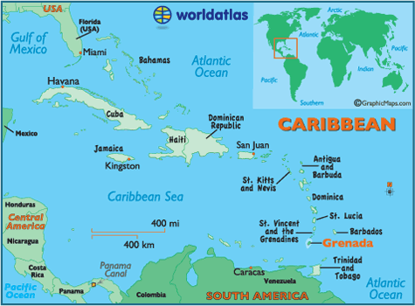

Slide 3
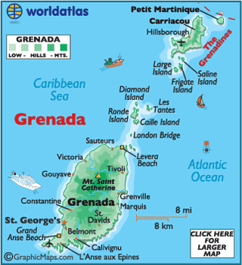
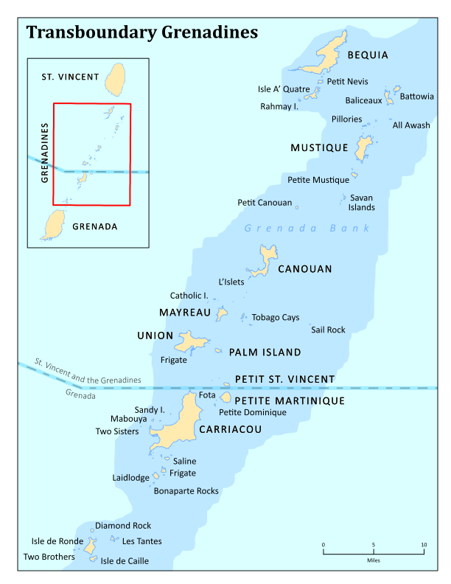

Slide 4
Grenada Today
Capital city: St George’s
Language: English (official) and French Patois
Population: 105,897 (2013)
Ethnicity: 82% of African origin, the rest a mixture of European and East Indian and trace of Arawak/Carib f Amerindian
Landscape: Volcanic, hilly, mountain ranges
Principal crop/export: Nutmeg and mace
Religion: Christianity
Dependencies: Carriacou & Petite Martinique

Slide 5
Brief History
1498 – Columbus arrived in Grenada
1650 – colonisation by French settlers from Martinique
1793 – Treaty of Versailles which permanently ceded the Island to the British
1795 – Fédon’s Rebellion
1834 – slavery abolished
1974 – independence from Britain
1979- The Grenadian revolution; The People's Revolutionary Government proclaimed
1983 – ‘Operation Urgent Fury’ – the US invade

Slide 6
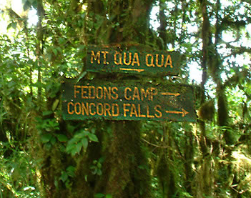
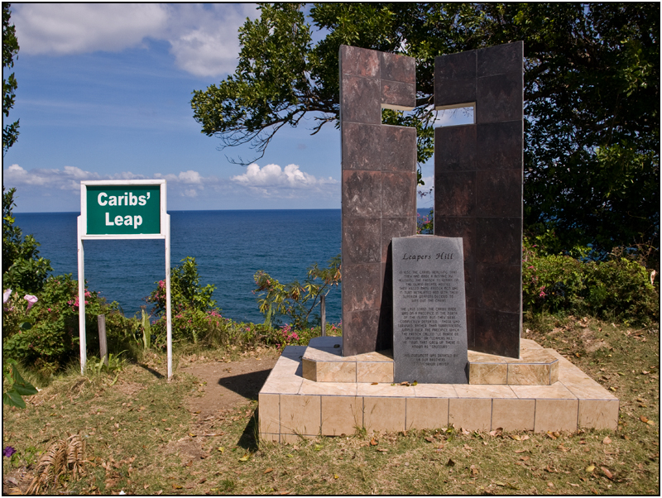
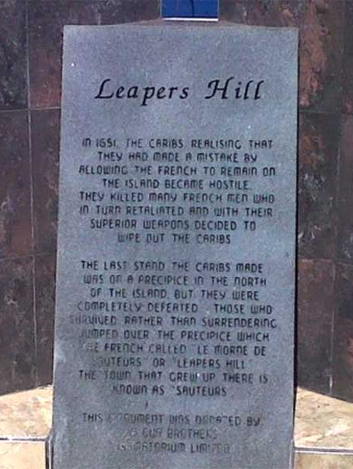
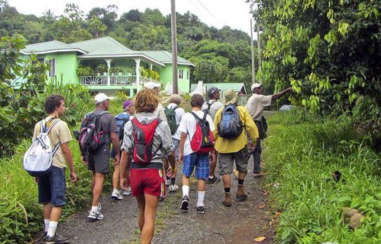
INTERESTING FACTS
“Leapers Hill”
Fédon's Camp

Slide 7
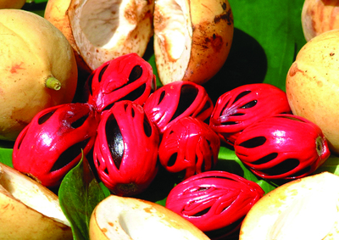
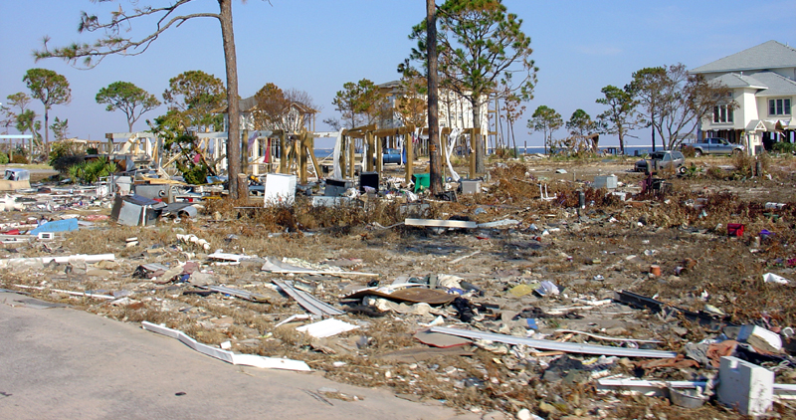
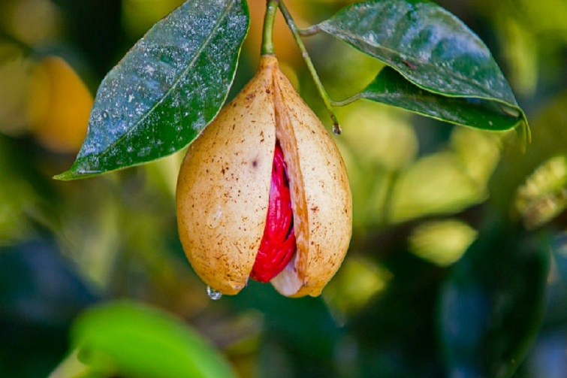
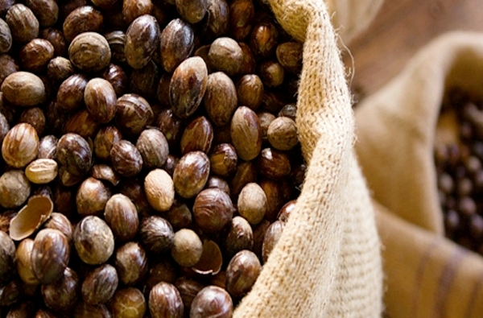
INTERESTING FACTS
‘Spice Island’
Hurricane Ivan

Slide 8
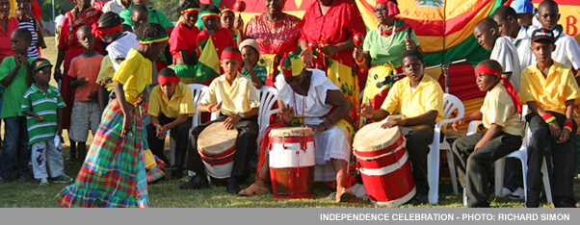
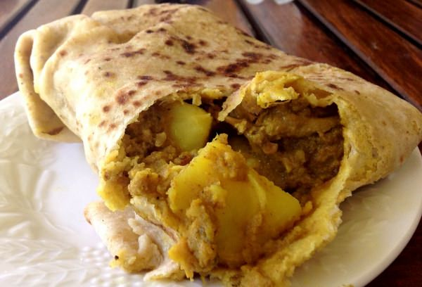
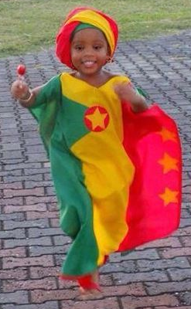
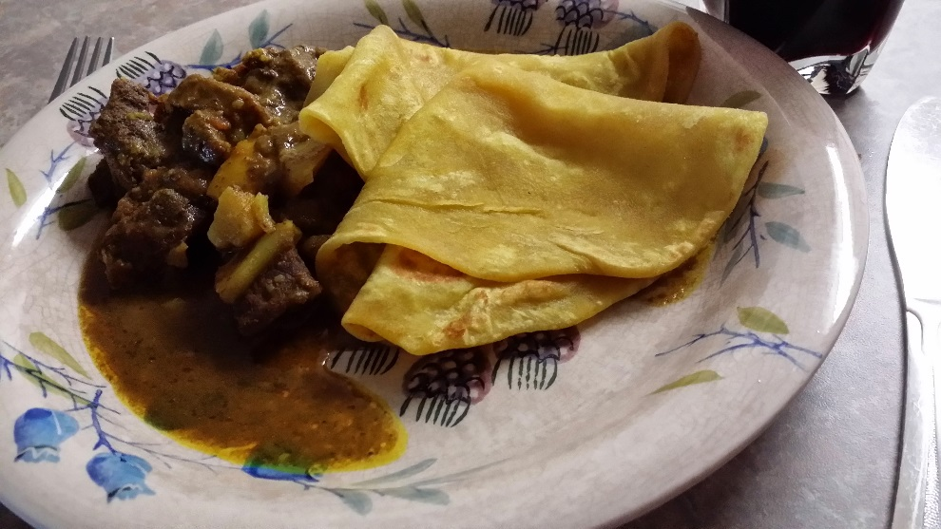
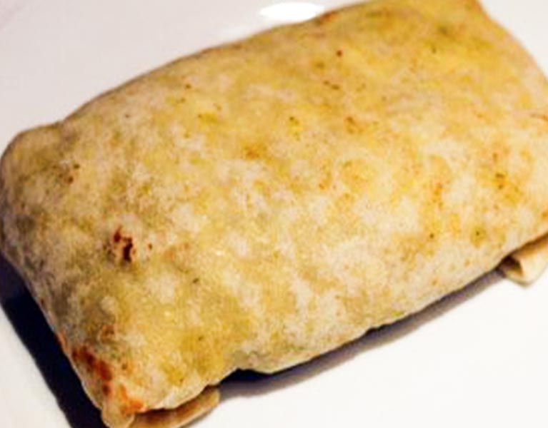
INTERESTING FACTS
Culture

