Slide 1
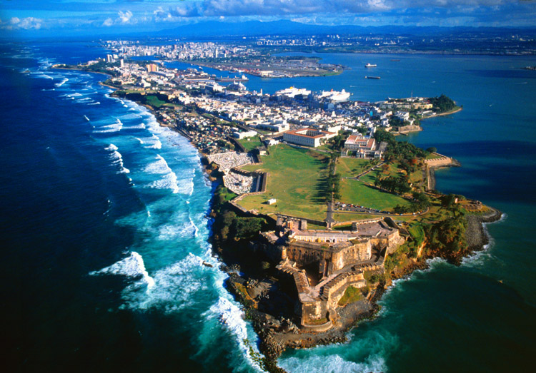
Puerto Rico

Slide 2
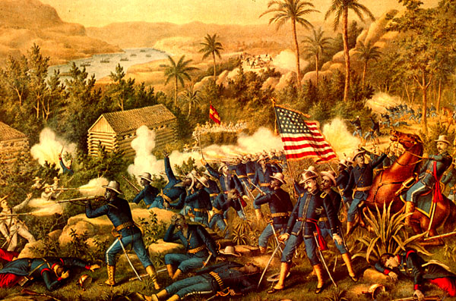
History of Puerto Rico
1493 discovered
1508 Spanish settle permanently
1898 Becomes U.S colony

Slide 3
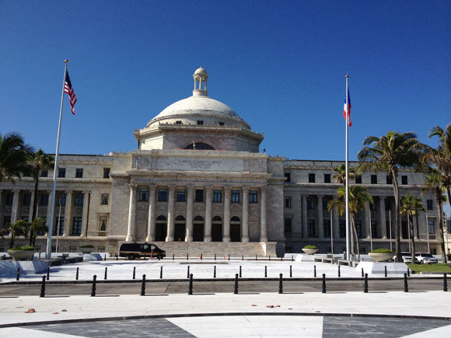
US Territory -They can vote in US Presidential primaries, NOT general election -They have US passports - Bound by US constitution
But
no senators
no representatives in the House
Only a delegate with little power.

Slide 4
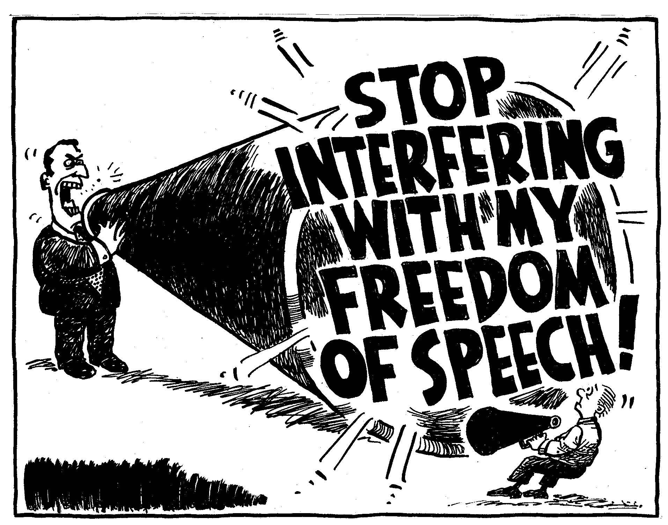
Gag Law 1948
Illegal to speak in favour of Puerto Rico independence from U.S
Made unconstitutional in 1957

Slide 5
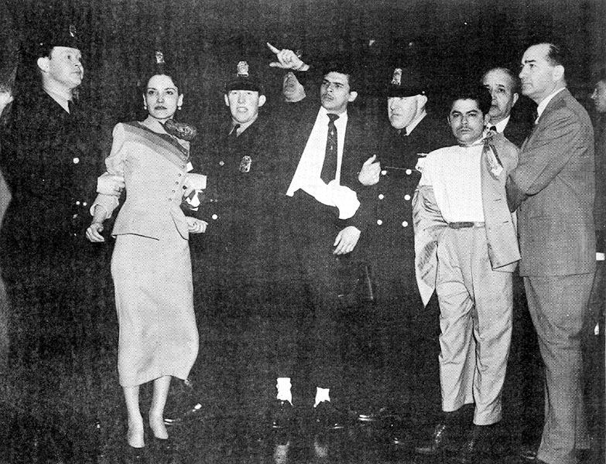
U.S. Congress attacked by Puerto Rican Nationalists
Happened in 1954.
convicted.
Life imprisonment.
Pardoned by Jimmy Carter

Slide 6
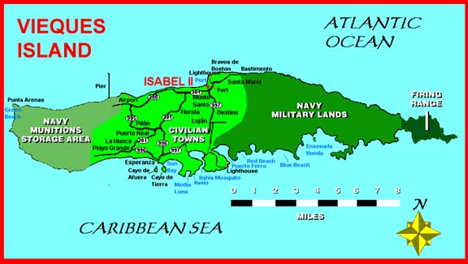
Two-thirds of the Island was a U.S. naval base for almost 60 years.

Slide 7
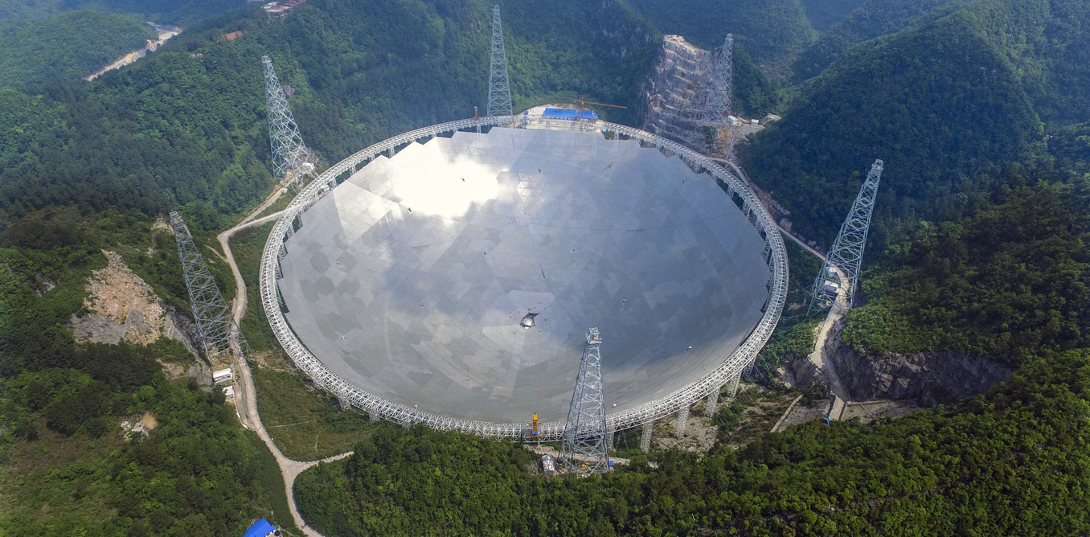
Largest telescope in the world

Slide 8
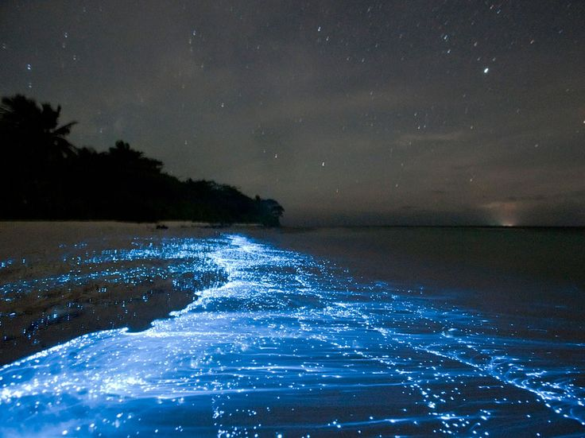
Bioluminescent Bay - Glowing sea

