Slide 1
HI127 The Medieval World The Twelfth-Century Renaissance Powerpoint will be on the website

Slide 2
‘... [The Twelfth-Century Renaissance is] a mere term of convenience which can mean almost anything we choose to make it mean... the sort of sublime meaninglessness which is required in words of high but uncertain import.’ [R.W. Southern, ‘The place of England in the twelfth-century renaissance,’ History 45 (1960), p. 201]

Slide 3
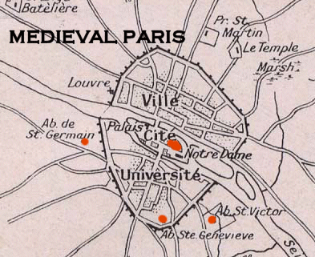

Slide 4
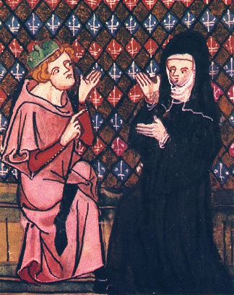
Peter Abelard and Heloise

Slide 5
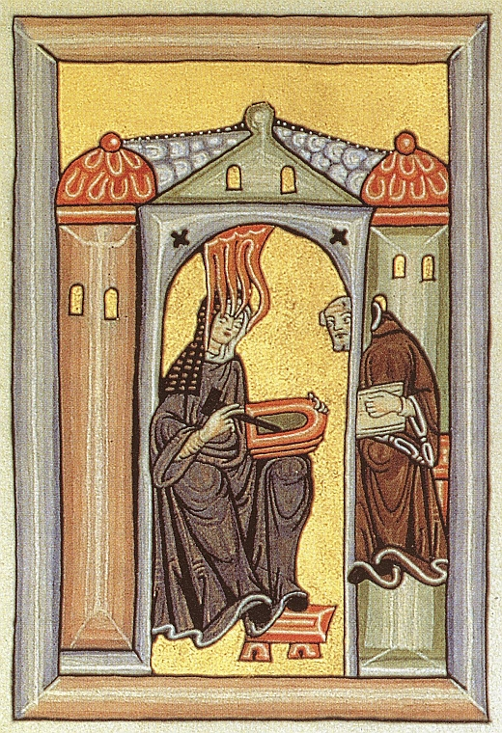
Hildegard of Bingen

Slide 6
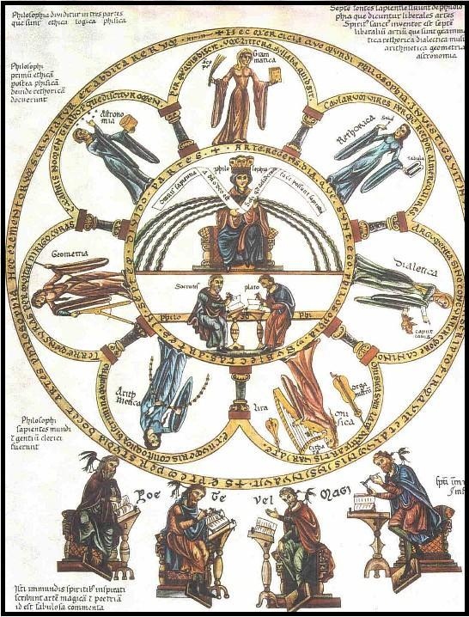
The Seven Liberal Arts

Slide 7
According to Adam of Perseigne, ‘...rhetoric adorns the discourse that grammar constructs from words, and... dialectic sharpens it by distinguishing truth from falsity.’ (Quoted in Swanson, The Twelfth-Century Renaissance, p. 29)

Slide 8
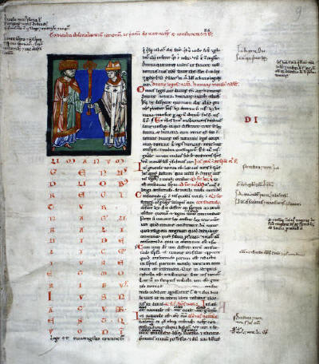
Gratian, Decretum

Slide 9
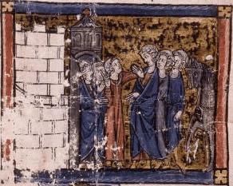
Chrétien de Troyes, Le Chevalier de la Charrette

