Slide 1
LATE MEDIEVAL MONARCHY:
England and France
1453-1500

Slide 2
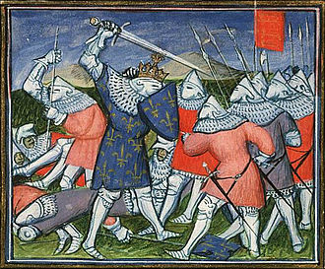
Aftermath of Hundred Years War
England lost war & French lands > civil war/dynastic disputes
English and especially French economies began to recover
Trade took off from 1460s
Revolutionised warfare: rise of permanent/standing paid armies
Better tax collection & administration
Rise of centralised ‘nation states’ but processes already underway
‘New monarchies’: including development of diplomacy, not just in England & France but also Spain

Slide 3

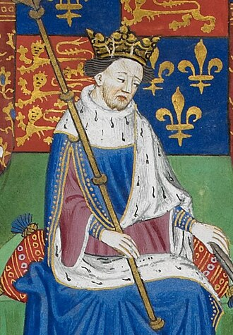
Henry VI (1422-61, 1470-71)
Lack of domestic control: over nobility (local power feuds), politics, economy…
Spiralling finances > increasing debt
Growing discontent e.g. Cade's rebellion 1450
Advisers blamed for incompetence during incapacity of king
Yet also seen as pious, bookish (Eton & King’s College) & peace-loving
Inconsistencies & favouritism > instability
Dynastic challenges > ‘Wars of the Roses’
York vs Lancaster: competing claims; 1st Battle of St Albans 1455; battles 1459-61 in favour of Lancastrians, but Yorkists seized London

Slide 4

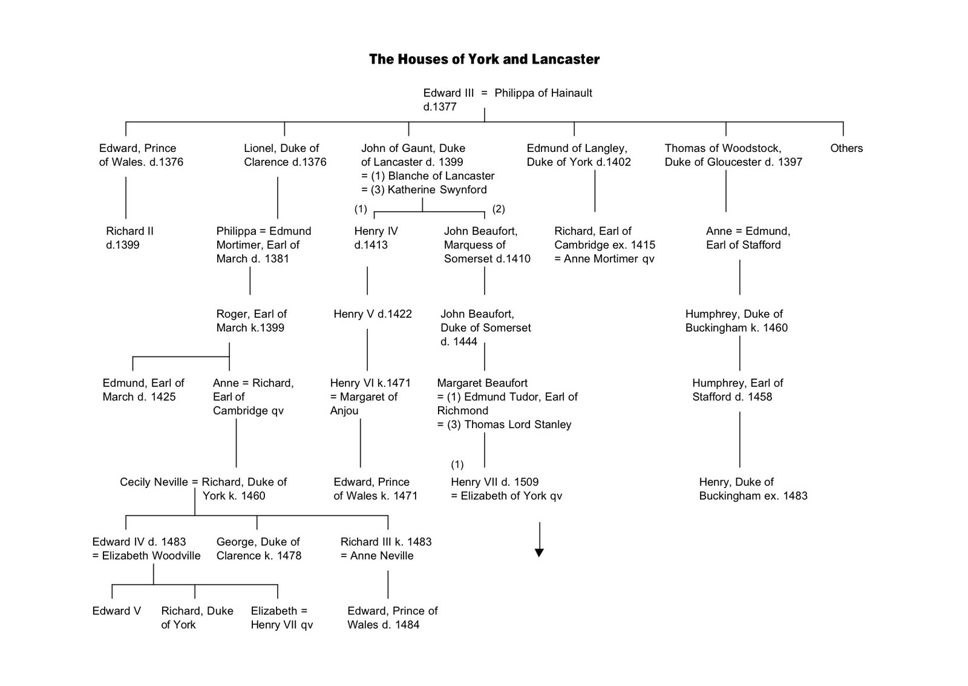
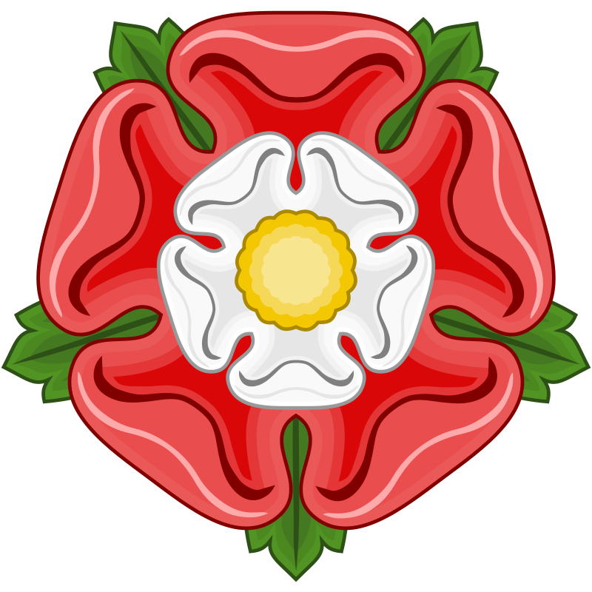

Slide 5
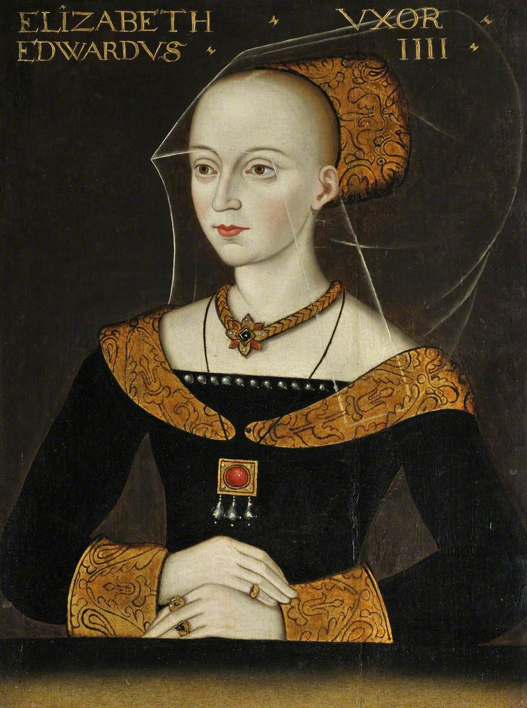
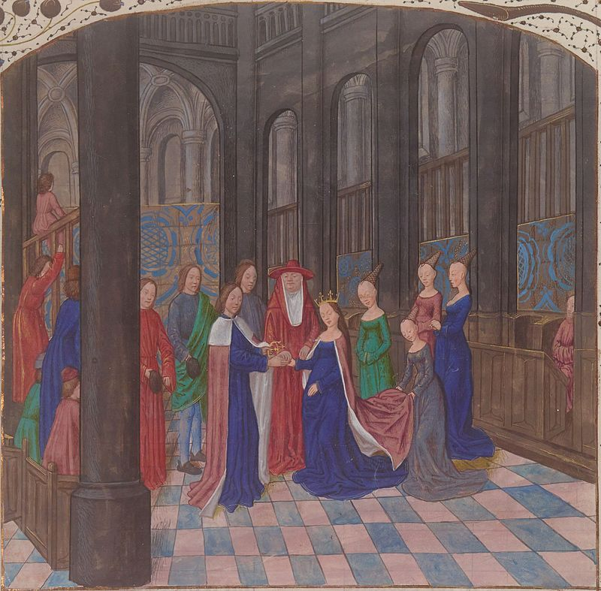
Edward IV (1461-70, 1471-83)
Victory incomplete: seen as coup
Dependent on counsellors, especially Neville/Warwick (‘the kingmaker’) & Woodville family
Neville/Warwick defected to Margaret of Anjou 1469
Lancastrian restoration 1470-71
Edward won Battle of Tewkesbury 1471
End of Lancastrian dynasty & rule
Elizabeth Woodville
(c.1437-92)

Slide 6
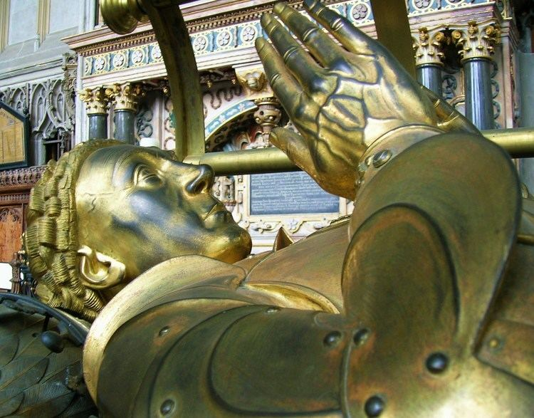
‘Overmighty’ vs ‘Under-mighty’?
‘Only an under-mighty ruler had anything to fear from overmighty subjects; and if he were under-mighty his personal lack of fitness was the cause, not the weakness of his office and its resources’ (Macfarlane)
Succession of politically dominant individuals
Independent from crown?
Access to royal patronage crucial
‘Bastard’ Feudalism?
Personal relationships ‘corrupted’ by money
Loyalty ‘devalued’
Chivalric values ‘undermined’
‘Effective kings governed through ‘bastard feudalism’; ineffective or dangerous kings were overthrown by means of it; it posed no threat to the crown as such’ (Gillingham)
‘Good King’ = detached and fair; rise above feuds/rivalries vs political vacuum

Slide 7
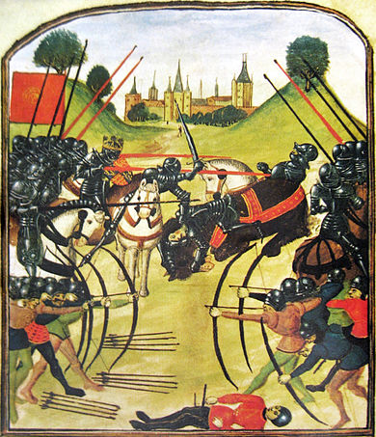
‘Wars of the Roses’ (c.1453-85)
Every aspect contested
Essentially dynastic war (but not always!)
Fighting sporadic (only 20 weeks in 30 years)
Pitched battles: Towton & Tewkesbury
Struggles for power within landed elite

Slide 8
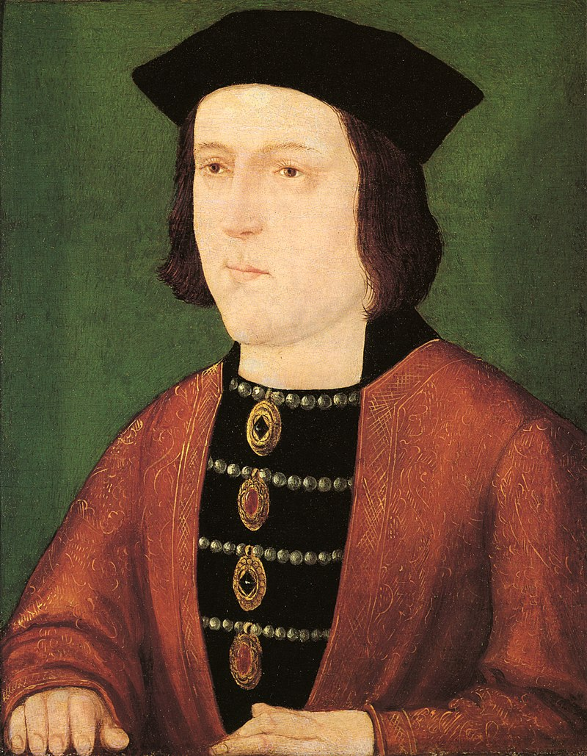
Edward IV (1461-70, 1471-83)
Positives
Re-established royal authority
Reconciliation with opponents
Better finances (despite recession)
Better image
Decisive action
Good links with local communities
Dies in his bed
Negatives
Wrong marriage
Initially dominated by Warwick
Invades France, 1475 Treaty of Picquigny
Pointless wars with Scotland, 1480-82
Failure to secure succession for 12-year old son, Edward

Slide 9
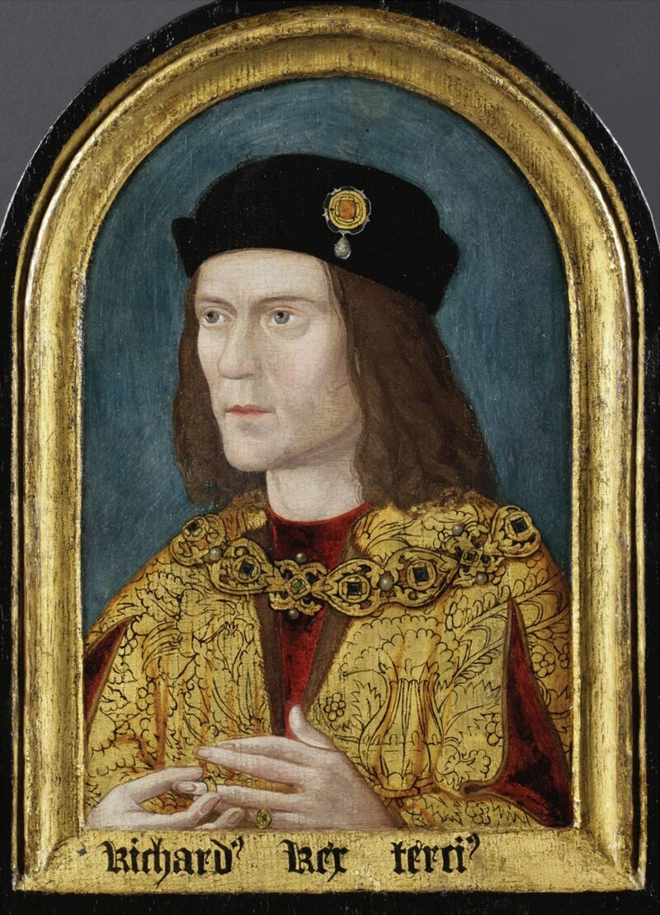
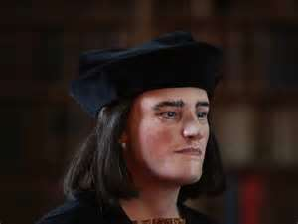
Richard III (1483-85)
Villain or opportunist?
Opposed Woodvilles & declared Lord Protector
Claimed Edward IV’s sons (his nephews) illegitimate (& probably had them killed – disputed!)
Lacked noble support, unpopular
Killed at Battle of Bosworth (Aug.1485)
Body ‘rediscovered’ under Leicester carpark and reburied in 2015

Slide 10
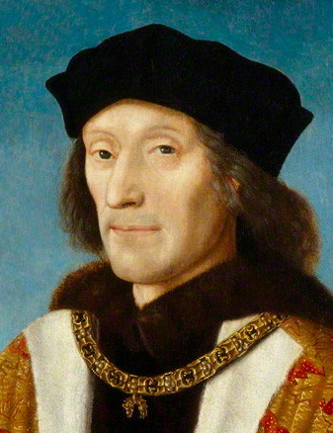
Henry VII (1485-1509)
Outsider, in exile in Brittany for 14 years
Married Elizabeth of York (daughter of Edward IV) to strengthen claim
Faced northern rebellion & pretenders: Lambert Simnel and Perkin Warbeck
Seen as just: settled quarrels
Excellent with finances: solvent by 1492
Consolidation: administrative reforms effective
Faced serious challenges, but achieved stability
Economy favourable
Improved image of ‘good’ kingship

Slide 11
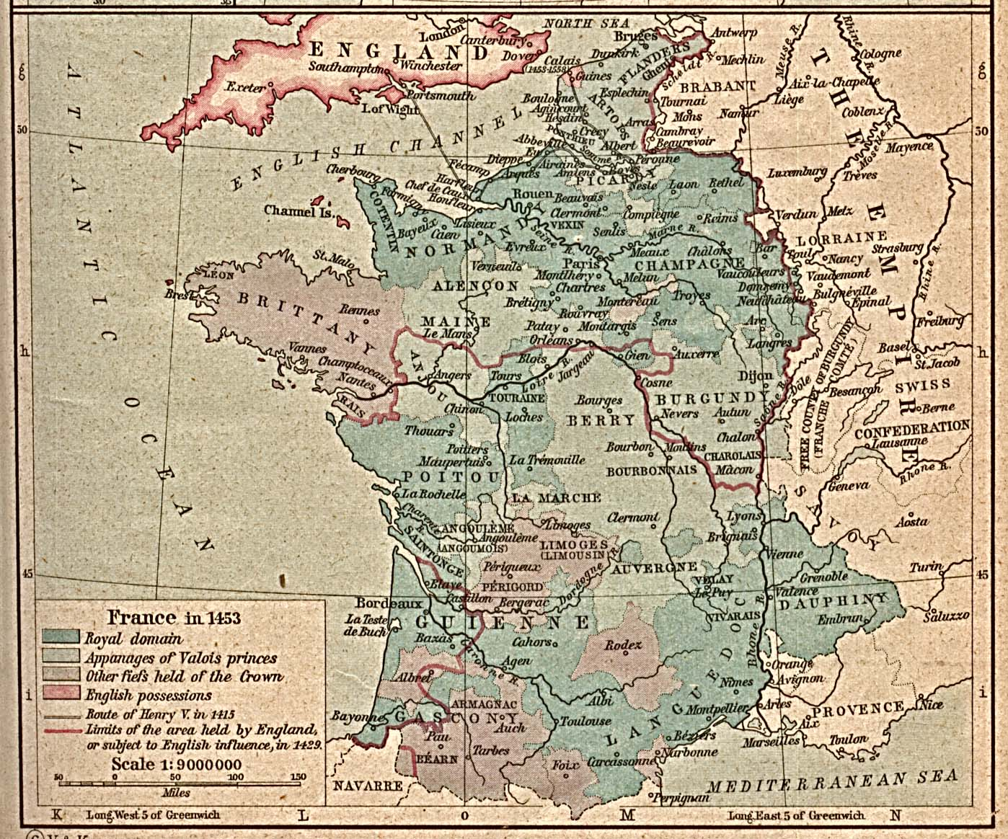
France in 1453

Slide 12

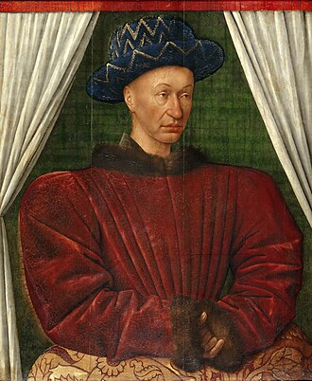
Charles VII (1429-1461)
Presided over lowest point & end of Hundred Years War
Burgundy detached from England (but harboured dauphin)
Revolutionised army: archers, cavalry & mercenaries
Controlled castle building & fief acquisitions
Limited seigneurial taxation
Expanded royal jurisdiction at expense of private justice
Expanded court by employing nobility

Slide 13
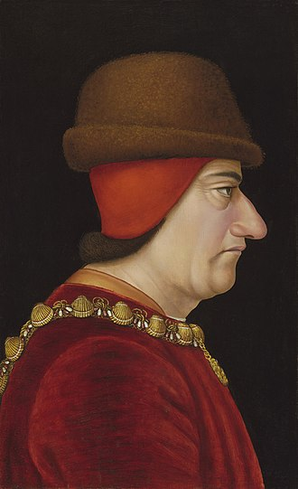
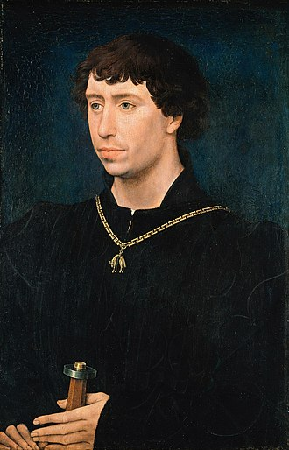
Louis XI (1461-83):‘spider king’
Faced & led plots & conspiracies e.g. vs father
Inherited semi-independent duchies > united under crown
Forced migrations > noble rebellion, war of the 'Public Weal’ (1465)
Overthrew independent duchy of Burgundy
Subdued higher nobility
Put end to English interests in France with Treaty of Picquigny, 1475
Revived economy through strong state involvement
Efficient tax collection
Charles the Bold, duke of Burgundy (1467-77)

Slide 14
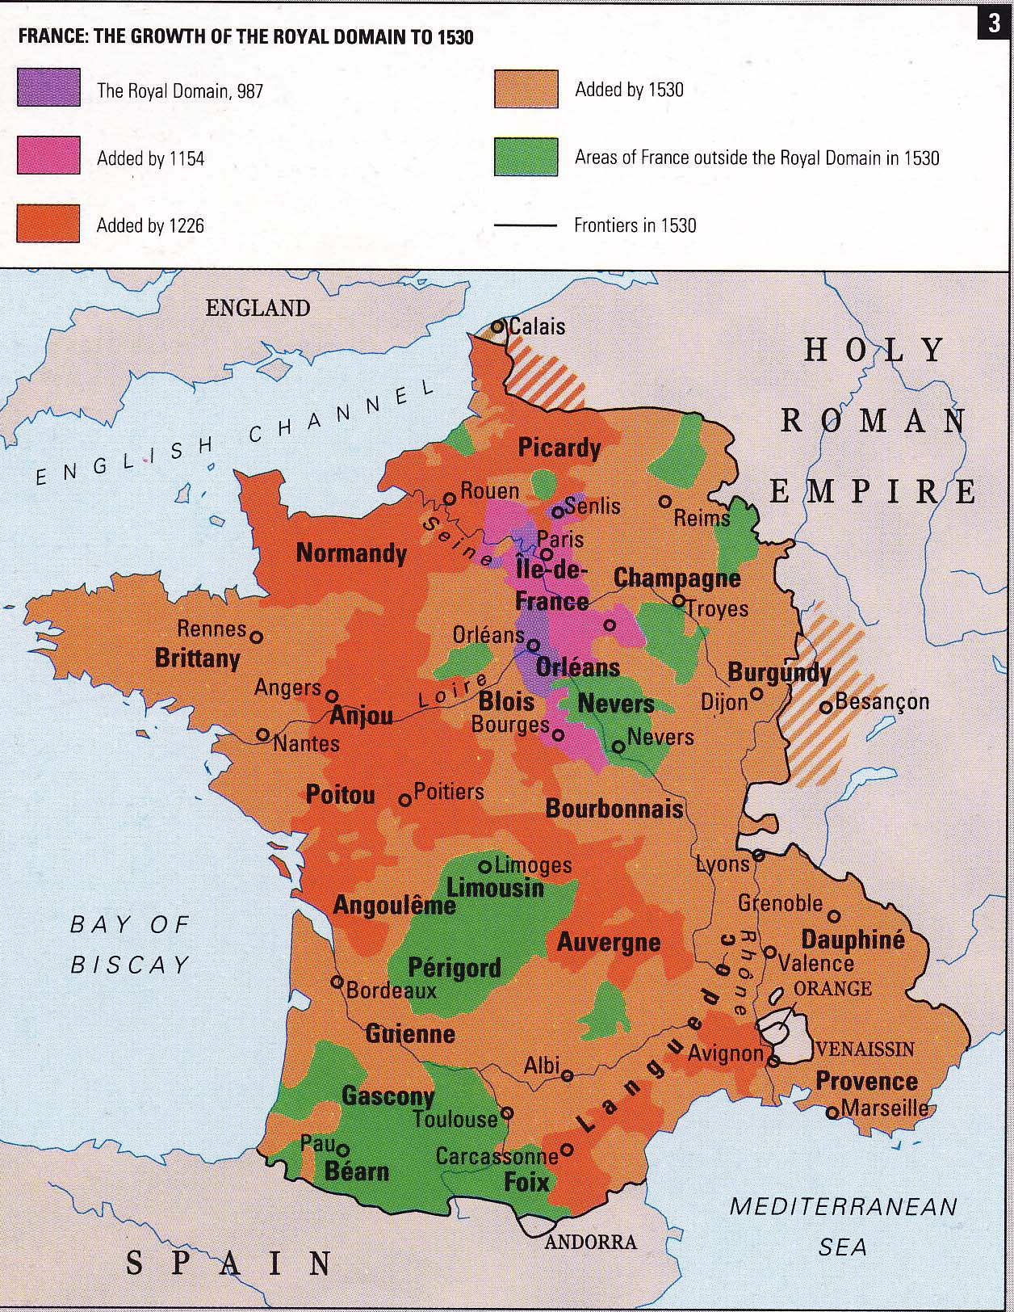
France: the Royal Domain

Slide 15
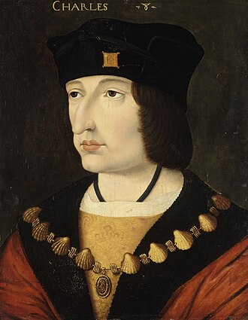
Charles VIII (1483-1498)
By end of period:
territorial cohesion (Brittany), borders established
Italian Wars (1494-1559)
‘monarchical absolutism’ (Bernard Chevalier), still restricted
restructuring of military, ﬁnancial (1337, 26 tonnes of silver cf 140 under Louis XI) & legal structures (323 courts by 1515 under Louis XII)
good links between crown and urban and rural communities
new political ideas and doctrines
stronger image of king through language of symbolism & court
State formation: centralization of power & development of ‘bureaucracy’, (rise of officeholders) in England & France

