Slide 1

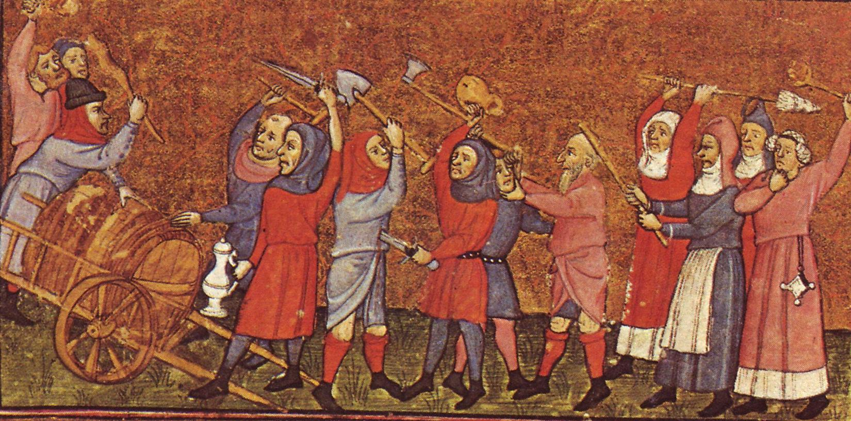
Popular Protest
Expectations of improvement thwarted & perceived injustice & inequality led to resentment & protest

Slide 2
Frequency of revolt (Samuel Cohn):
1200 to 1425: 1,112 revolts in the Low Countries, France, Italy and England
1200-1348: 470 revolts (3+ per year inc. Flanders in 1320s)
1348-1425: 642 (8+ a year)
In the post-Black Death period, revolt became a common occurrence especially 1378-1382

Slide 3
Why rebel (and why not more)?
Denied access to opportunities & rights restricted
Sense of unfairness & thwarted expectations of improvement
Rarely most poor or desperate, but those with something to lose
BUT
Rebellions rarely succeeded, often violent suppression
Life hard enough & difficult to organise on large scale
Required good leadership, organisation & communication: provided when demands and targets coalesced

Slide 4
Motives & Leadership
Motives varied & sometimes difficult to judge
Propaganda of the victors
But sources do reveal attitudes, opinions & concerns
Mixture of peasants (elite & poor), townspeople, lesser nobility
Leadership also varied:
Dependent on context (rural or urban or mixed)
Philip Wolff on peasant revolts: leaders emerge from 1) land-owning middle peasantry 2) peasants at periphery of manorial relations
Reflected social structures (legitimacy)
Conservative vs radical?
Short-term or long-term change

Slide 5
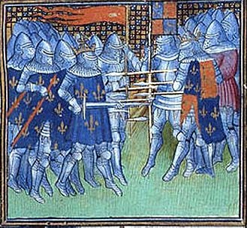
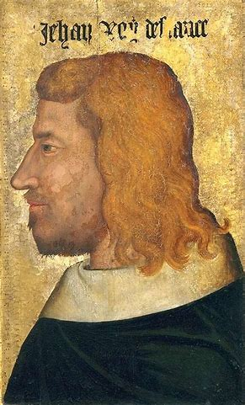
Background to the Jacquerie (1356-58)
Aftermath of the Black Death
Defeats and cost of the Hundred Years War
Absent (imprisoned) King John II of France
Taxes increased
Mercenaries on the loose > pillage
economic stresses caused by the above
popular discontent (both urban and rural)

Slide 6
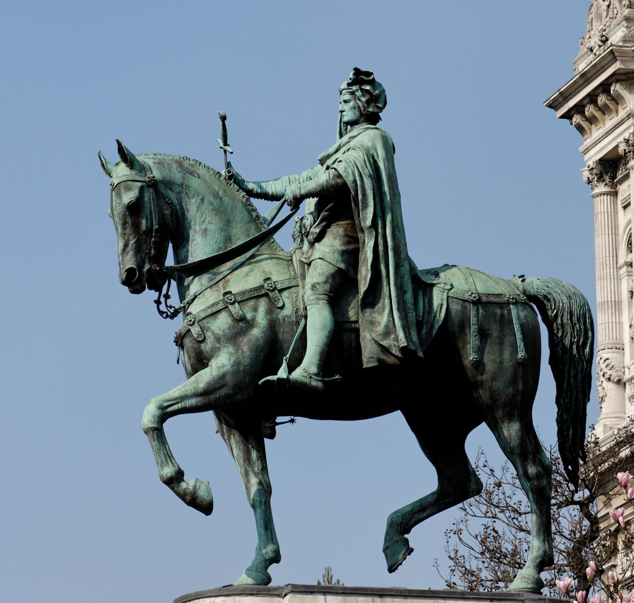
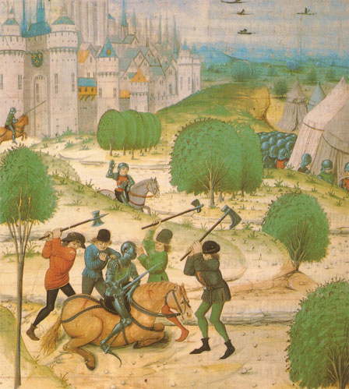
The Jacquerie: rural vs urban
Rural revolt
Discontent with nobles & taxes
Led by rural elite
Violent attacks on chateaux
Urban revolt
Led by Etienne Marcel – provost of Paris
Sought self-governing commune vs regent
Manipulated peasantry to attack opponents

Slide 7
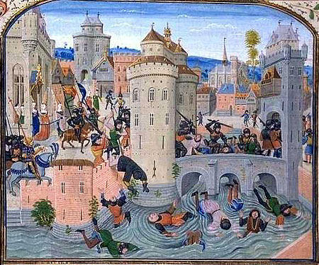
Froissart’s Chronicles: Peasants beaten at Meaux

Slide 8
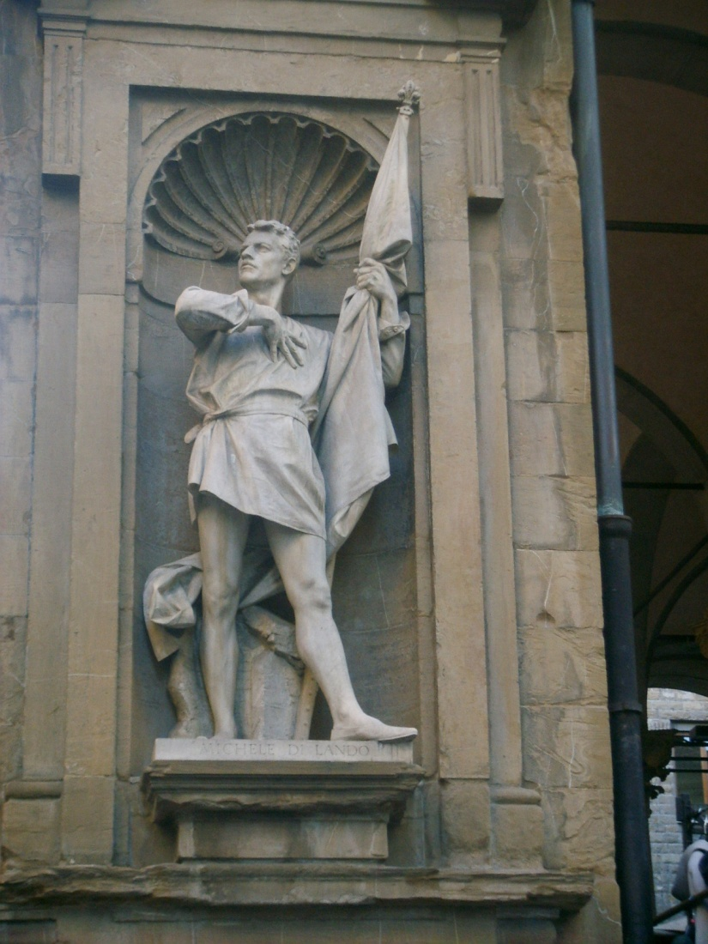
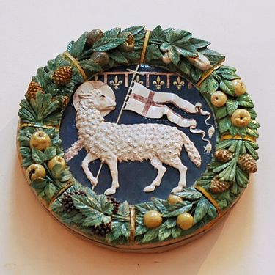
Ciompi in Florence (1378)
Urban revolt by clothworkers
cf Flanders, 1378-85
Wool-carders but also small-scale entrepreneurs, artisans and patricians
Fight with pope over territorial borders
Trade interrupted
Unemployment and fiscal troubles
Demanded guilds & political representation in government
Radical potential not realised
Michele di Lando - leader

Slide 9
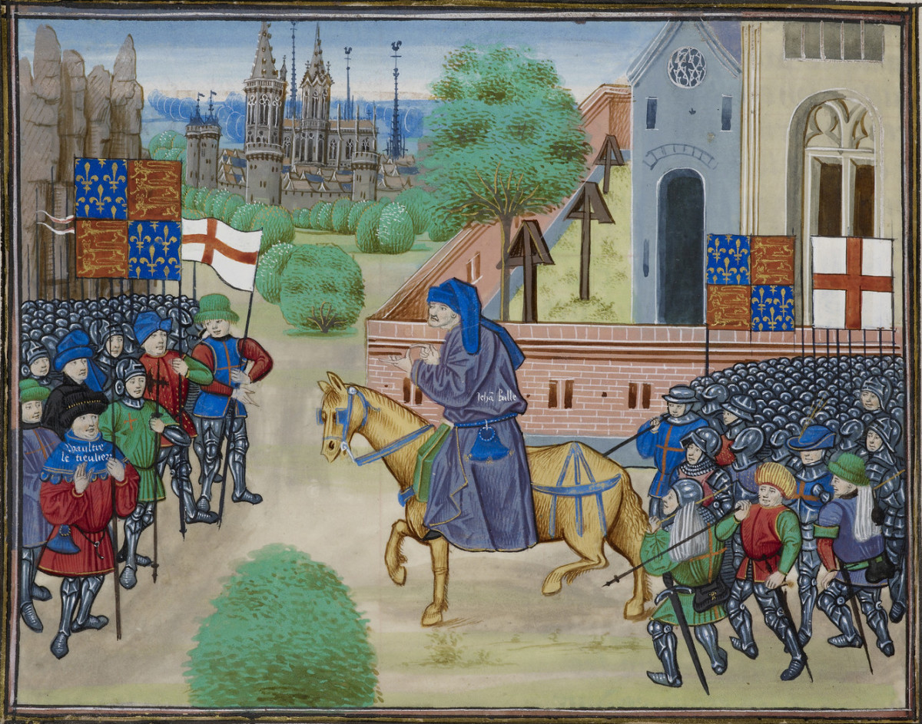
Most well-documented = English Rising of 1381
Other revolts: urban and rural
Tuchins - cf Jacquerie but in South West France (1360s-‘80s)
Social banditry vs authorities. Regional conditions favoured (cf Cathars)
Remensas – Catalan unfree peasants (c. 1388-1486); allied w crown of Aragon vs lords & towns
Spanish pogroms vs Jews in 1391 (scapegoats)

Slide 10
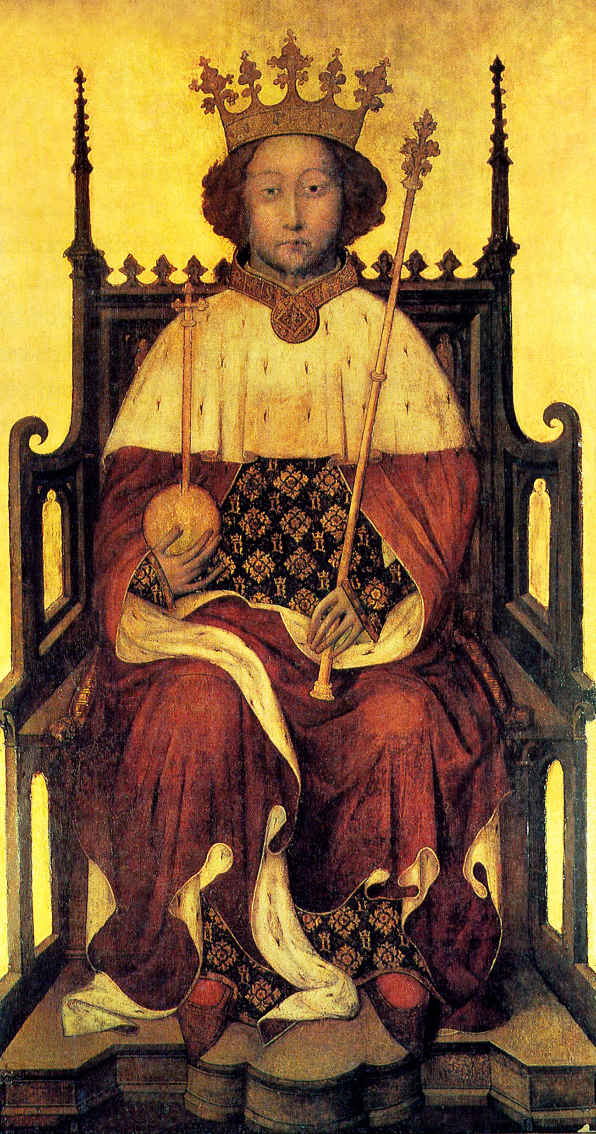
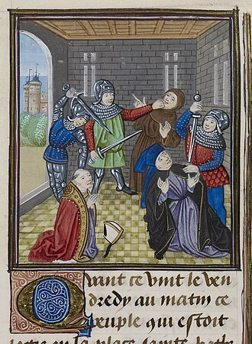
The Background
Ordinance (1349) and Statute of Labourers (1351)
Sumptuary Law 1563
Taxation: third poll tax granted 1380
Dissatisfaction of ‘Good’ Parliament 1376
Young king Richard II and ‘evil’ counsellors
John of Gaunt (Savoy palace burned down)
Simon Sudbury, archbishop of Canterbury, chancellor of England, & Robert Hales, head of Hospitaller Order & treasurer of kingdom, seized & killed

Slide 11
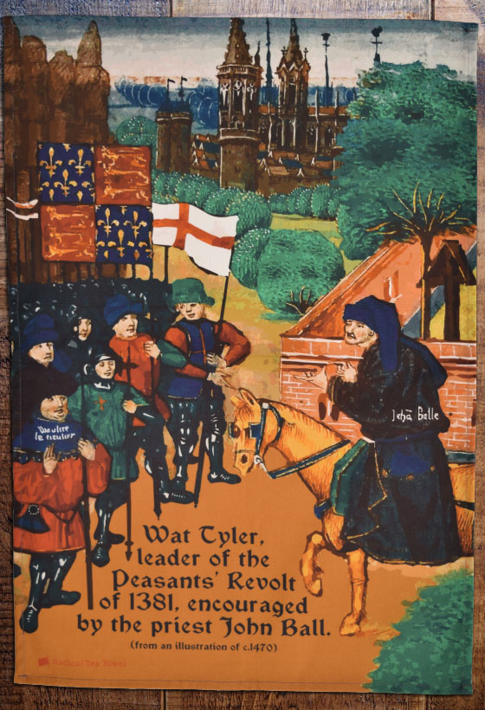
Who were the Rebels?
Mostly free peasants & townspeople from south & east
Large ecclesiastical estates at Canterbury, St Albans, Bury St Edmunds, Ely
Leaders = John Ball & Wat Tyler (‘Jack Straw’?)
Coercion of lower aristocracy?
Urban & rural: vs lords, lawyers, ministers & tax-collectors
Hostile sources: ‘Confession of Jack Straw’ > kill nobility, hold all in common
Ideas of equality: radical preacher John Ball
‘When Adam delved and Eve span, who was then the gentleman?’

Slide 12
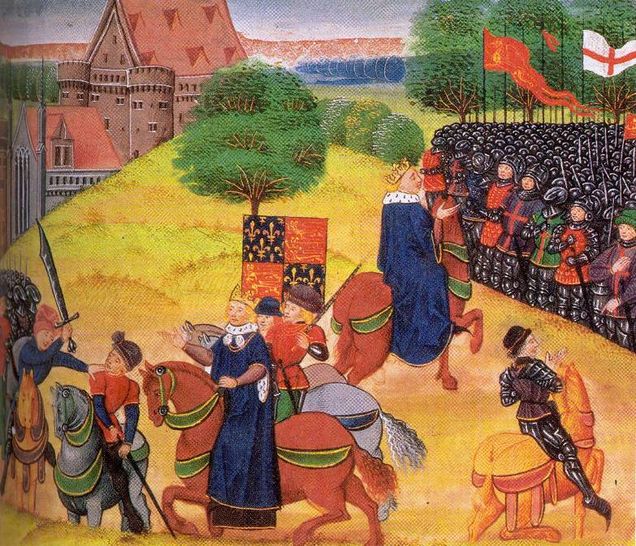
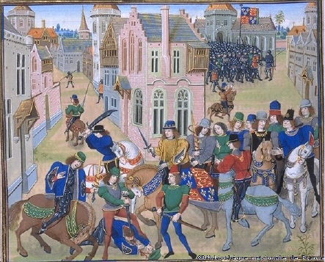
Aims: ‘fair’ rents (4d an acre) & higher wages; protection of rights; abolition of poll tax vs manorial records & sought tax accounts Influence of Lollardy?
Urban support: e.g. Canterbury, Cambridge, Rochester
Londoners directed vs Temple Bar, Lambeth Palace, Flemish
End of Revolt: Mile End & Smithfield
Meetings with king on 14 & 15 June
Given promises & royal charters of pardon > disperse
Wat Tyler killed
Others identified & fined; few ringleaders executed
Class Antagonism (Hilton)? Failure re demands?
Local dissent continued & trends eroded burdens

Slide 13
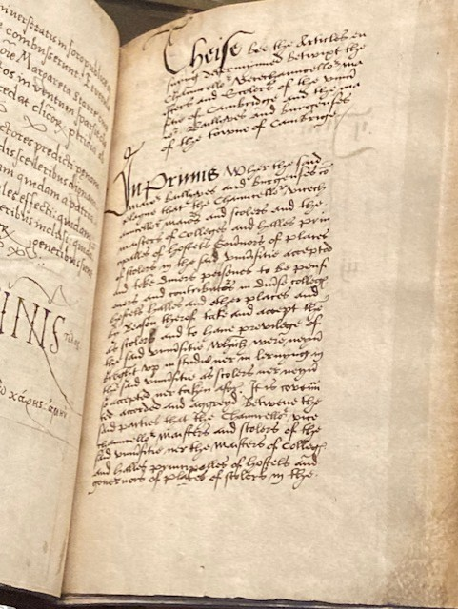
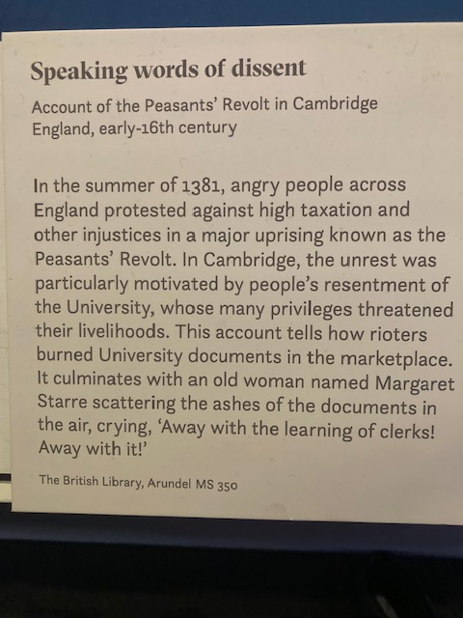
Urban Revolt in Cambridge 1381 vs University

Slide 14
End of Serfdom?
Cf 1450 Jack Cade’s Rebellion
based in Kent; dissatisfaction with how war going > War of Roses; socio-econ & political grievances; violence vs lords & suppression
Never formally abolished
Landlords often let go of services and dues gradually
Rise of long-term farms & copyhold tenure
Serfs manumitted throughout 15th century
But fugitives still hunted down
Heriots still there
Some feudal rights (including labour services) still included in some leases
Still a few serfs found in 16th-century sources

