Slide 1
HI127 The Medieval World The Medieval Church LOLLARDS AND HUSSITES Powerpoint will be on the website

Slide 2
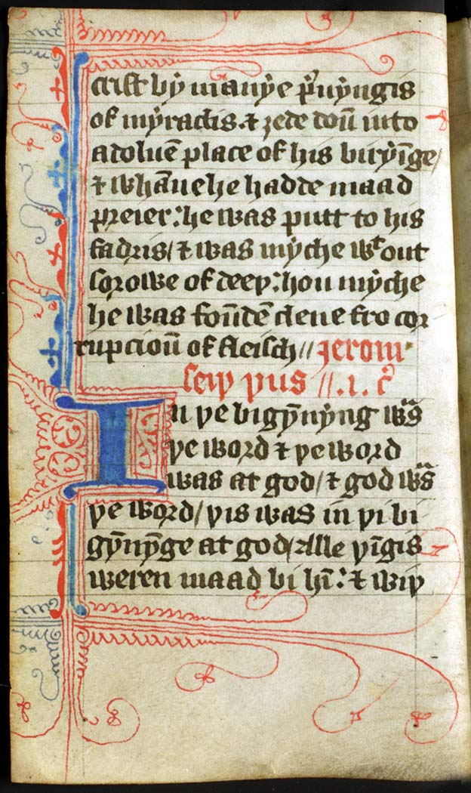
Lollard Bible, late 14th century

Slide 3
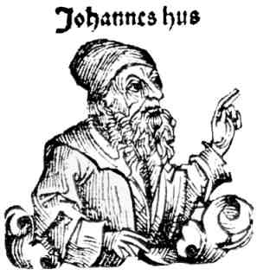

Slide 4
‘One of the most developed criticisms of the medieval church came from the English Lollards’. [Steven Ozment, The Age of Reform 1250-1550 (New Haven, 1980), p. 210]

Slide 5
‘Prior to the Protestant Reformation, no religious movement had advanced more successfully against the late medieval church than the Hussites of Bohemia’. [Ozment, The Age of Reform, p. 165]

Slide 6
What were the origins of the Lollard movement? What did the Lollards believe? How did the Lollard movement develop? What were the origins of the Hussite movement? What did the Hussites believe? How did the Hussite movement develop?

Slide 7
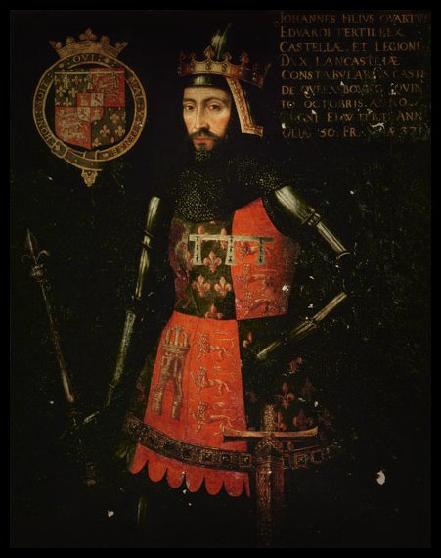
John of Gaunt

Slide 8
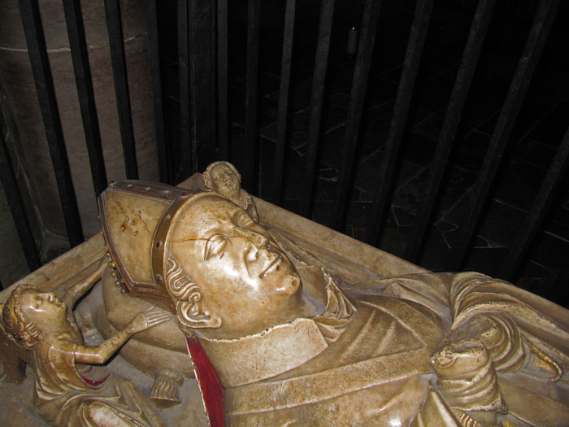
William Courtenay, Archbishop of Canterbury

Slide 9
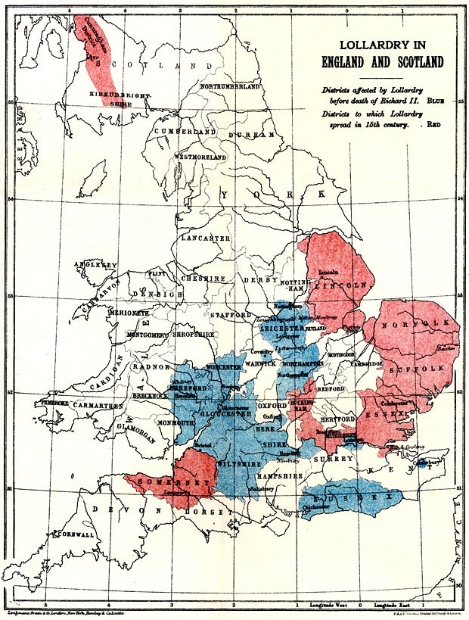

Slide 10
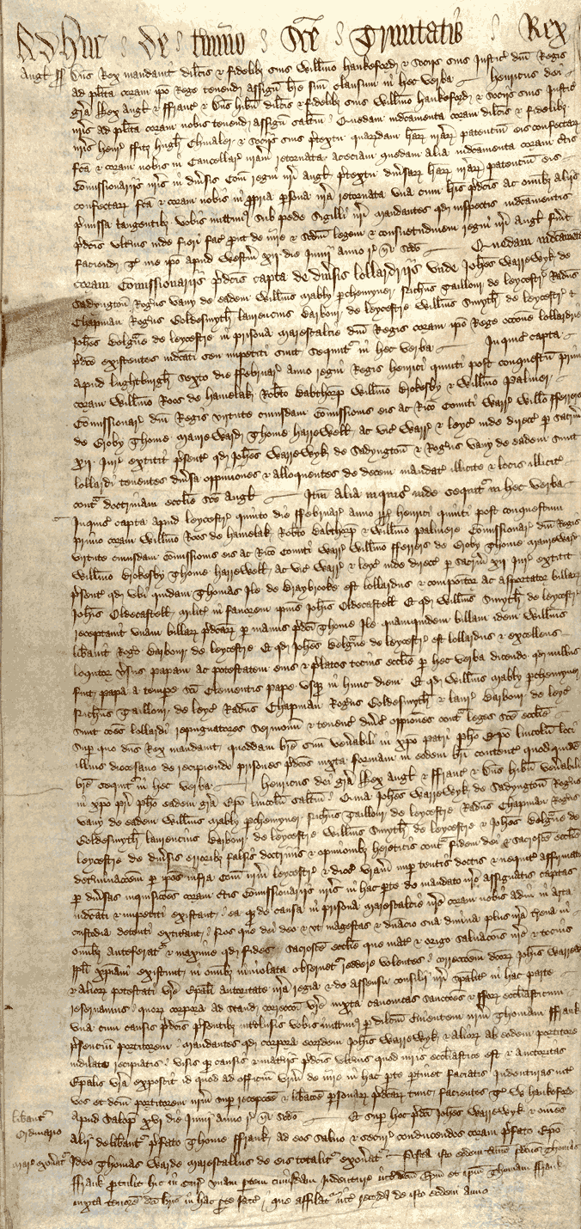
Prosecution of Lollards in Leicestershire in 1414 For a transcription and translation, see http://tiny.cc/5s26bx

Slide 12
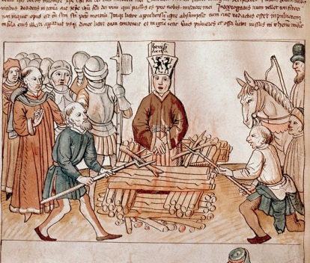
The execution of Jan Hus

Slide 13
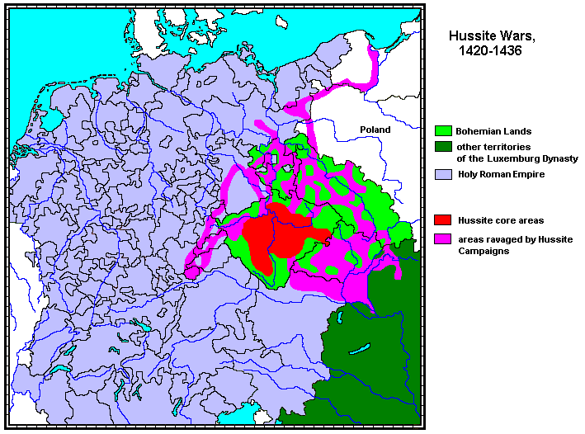

Slide 14
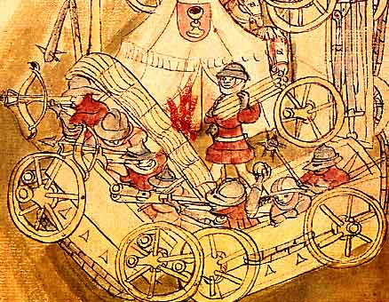
Hussite vozová hradba (wagon fort)

