Slide 1
Medieval Iberia

Slide 2
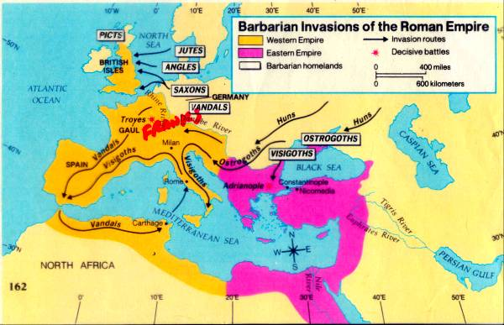
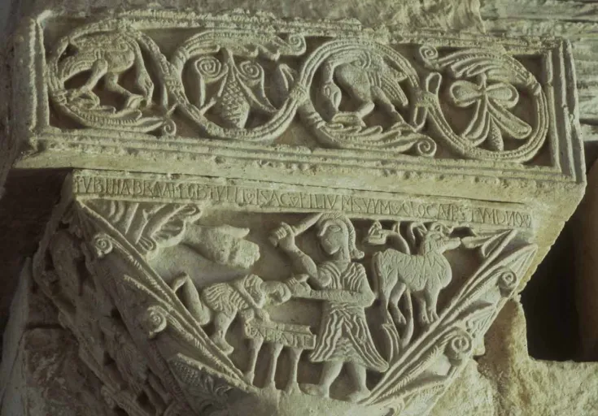
End of the Roman Empire
Visigoths in Iberia (415-711); adopt Christianity (Arianism); Roman law
6th century, king Leovigild establishes a monarchy
They convert to Catholicism at the end of the 7th century

Slide 3
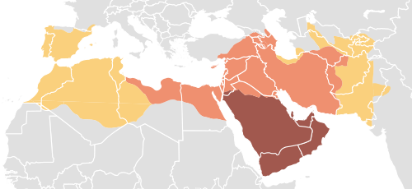
Expansion of Islam
630-2: Conquer Arabia, including Yemen.
633-42: occupy Syria, Palestine (Jerusalem) and Egypt.
633-45: Byzantine empire loses almost half its lands
632-61: Conquer half of north Africa.
674-78: besiege Constantinople
By 750: conquer the rest of North Africa and most of Spain.

Slide 4
Conquest of Iberia
711: Tariq ibn Ziyad, the governor of Tangier, lands in Gibraltar
Beats the last king of Visigothic Spain Rodrigo at the battle of Guadelete (711)
716 : Cordoba is the capital, ruled by appointed emirs.
732 : battle of Tours, beaten by Charles Martel.
750: the Abbasid caliphate founded in Baghdad
756: the Umayyad emirate founded in Cordoba
929: Umayyad caliphate becomes independent.

Slide 5
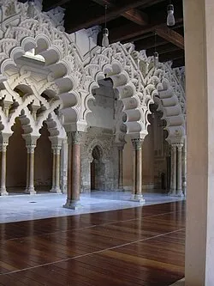
Conquest of Iberia
Christians (Mozarabes) become subjects (dhimmis), pay taxes; keep their own churches, laws (Liber Judiciorum) and officials; adopt Muslim language, culture, dress, architecture. Christian bishops and judges serve as interpreters and translators
Conversion (Cassius to ‘Banu Qasim’); Eulogius and Paulus Alvarus criticise the youth who study Arabic and adopt their customs
Martyrdom (Martyrs of Cordoba)
Some emigrate

Slide 6
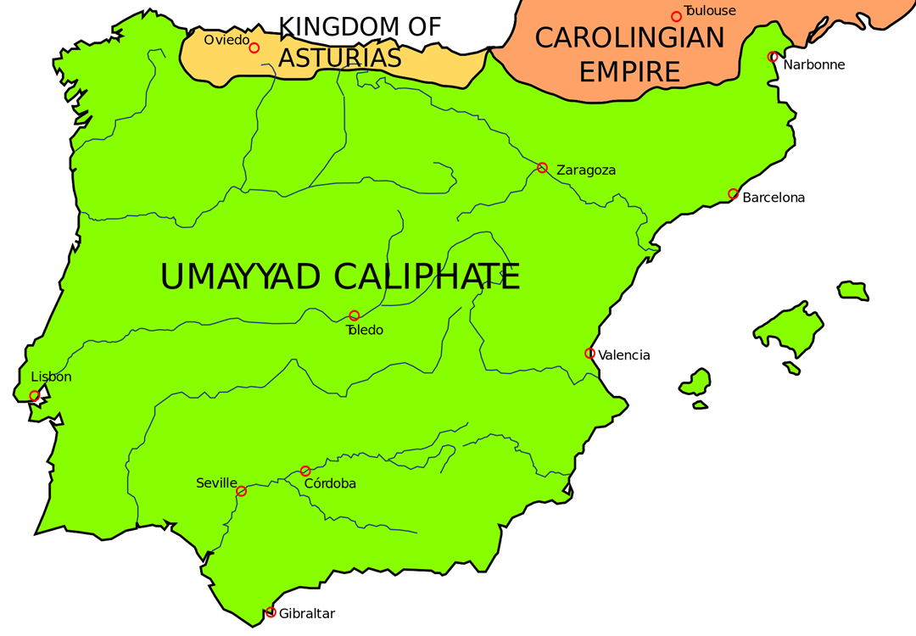
8th and 9th centuries
8th Century:
Kingdom of Asturias in the northern strip of the peninsula
Identify with the Visigothic past
receive refugees from other parts of Iberia
9th century
roots of Navarre and Catalonia
Barcelona captured in 801, by Charlemagne’s son Louis the Pious
From 800 onwards the castles around upper Ebro> Castile

Slide 7
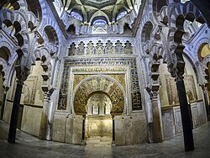
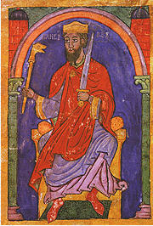
The ‘Golden Age’ of the Caliphate 900-1000
Caliphate established in 929 in Cordoba: Abd al-Rahman III (912-61) the first caliph
Cordoba: a centre of commerce and civilisation, population 100.000.
Economy: affluent; well-connected to the Mediterranean trade routes; fertile agricultural areas.
Culture: Arabic the leading language, most people bilingual
Warfare: All able-bodied Muslim men serve in the army; Christians/Jews serve as mercenaries.
Some alliances: King Sancho I (el Craso/the Fat) of Leon, deposed by his nobles, asked for help from the Umayyad caliph ʿAbd ar-Raḥmān III; regained his kingdom, also losing weight (treated by Jewish doctor Hasdai Ibn Shaprut)
Al-Mansur c980s to 1002: Hisham II’s general; brings forward the idea of Holy War

Slide 8
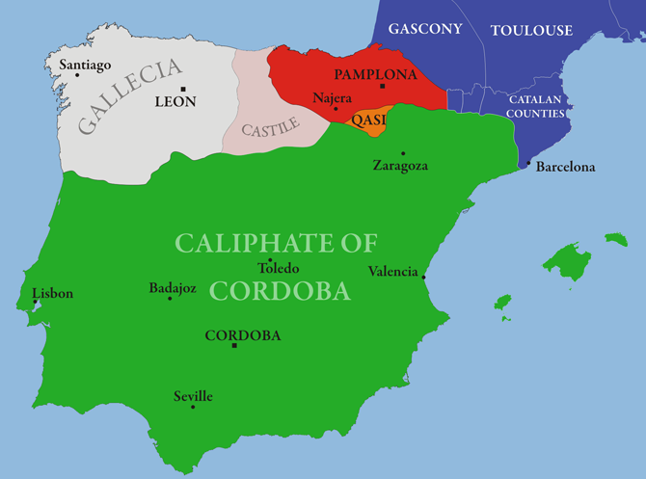
In the 10th century
910: Kingdom of Leon established
Castile becomes independent
a wide frontier is created, which gradually moves south.

Slide 9
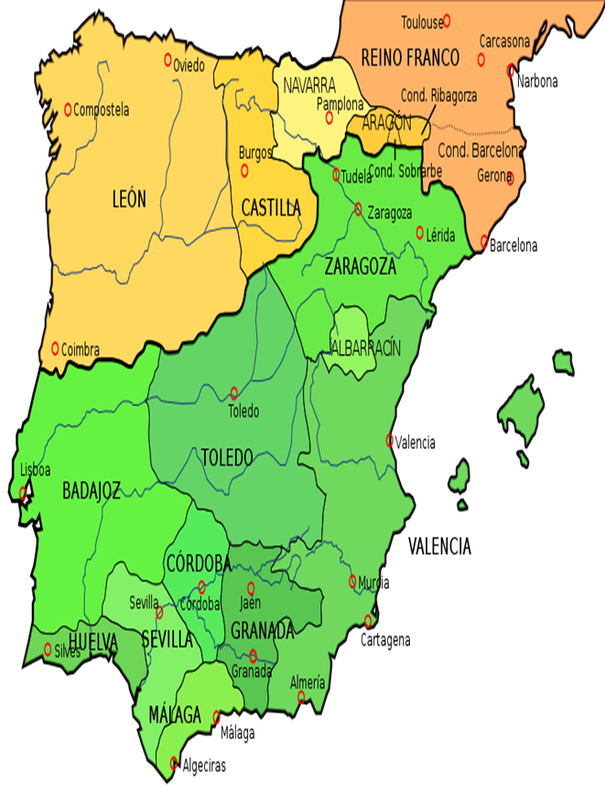
The Taifa States (1027-1095) after the collapse of the Caliphate:
23 taifa states in the 11th century
By the end of the 11th century, 11 remain: Badajoz, Seville, Toledo, Malaga, Granada, Valencia, Murcia, Denia, Zaragoza, Lerida and the Balearic Islands
Kings of Leon play one state against another and collect annual protection money (parias)
Deals are struck across religious borders

Slide 10
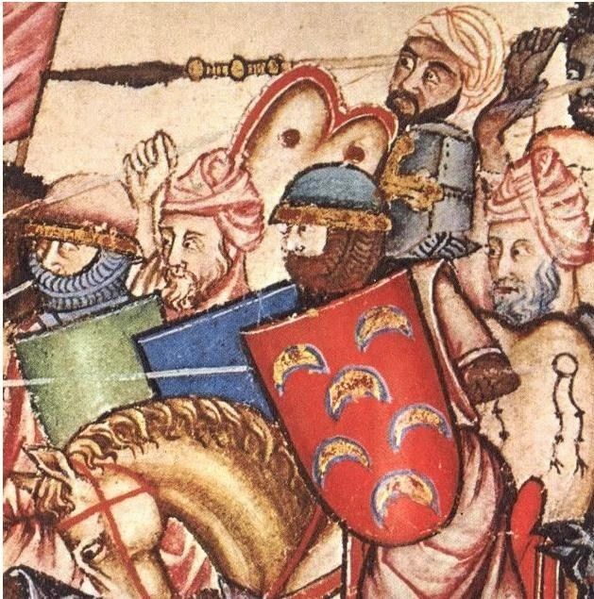
In the 11th century:
‘Reconquista’: a much debated, ideologically loaded, anachronistic term
Tribute collected from the Muslims helps consolidate power and form stable states
Mercenaries employed
When Muslim towns surrender, they are allowed to practice their religion
Monasticism spreads (especially Cluniac)

Slide 11
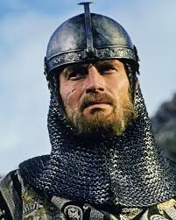
El Cid: (1043-1099): Rodrigo Diaz de Viva
a Castilian nobleman
Falls out with king Alfonso VI around 1081, is exiled and offers his services to the Muslim ruler of Zaragoza.
A freebooter for most of his life
Fights against the Catalans and the Aragonese
Ends up as the independent ruler of Valencia from 1094
Marries his daughters to the count of Barcelona and the prince of Navarre.
A decentralised and politically fragmented landscape

Slide 12
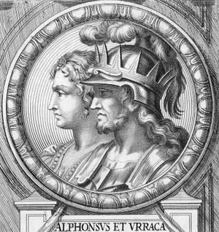
Eleventh Century Events
1063: Barbastro falls north-east of Zaragoza, troops drawn from Burgundy, Normandy, Aquitaine and possibly Norman Sicily.
1085: Toledo falls to Alfonso VI of Castile
Muslims call for help from the Almoravids

Slide 13
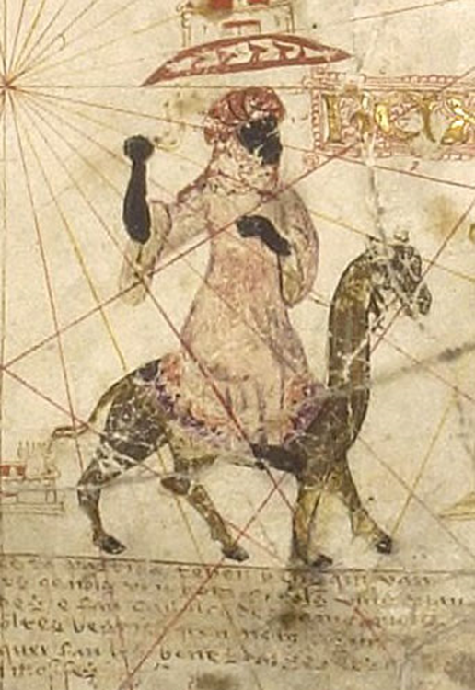
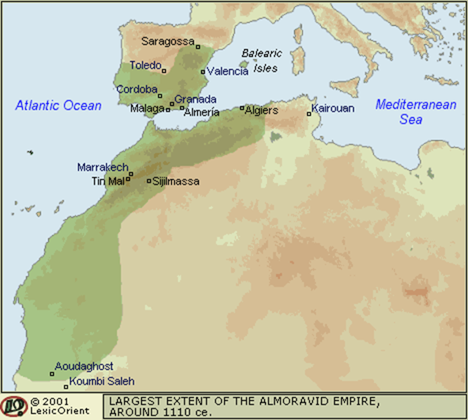
Almoravids (al-murabitun) (1086-1157):
They cross the straits into Iberia in 1086
Army: Moroccan peasants, Saharan nomads, and camel cavalry from Sudan
A Maliki sect, following a strict/puritan version of Islam
Access to West African gold.

Slide 14
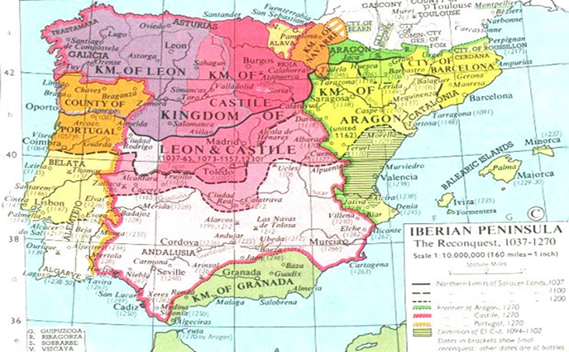
The 12th Century
Post 1150s, five (roughly equal) kingdoms of Leon, Portugal, Castile, Aragon and Navarre.
1095-the first Crusade is called
Crusades: full crusader rights and privileges applied to campaigns in Spain by the papacy.
1125-the Archbishop of Santiago de Compostela, Diego Gelmirez:
‘And just as the soldiers of Christ and faithful sons of the holy Church opened up the way to Jerusalem with much labour and the shedding of much blood, so let us prove ourselves to be soldiers of Christ and, having vanquished his most wicked enemies, the Saracens, let us also with the help of his grace open up a way to that same sepulchre of the Lord through the region of Spain, which is shorter and much less laborious’
(Historia Compostellana, 2:78 in: Patrologia Latina, vol. 170, no. 1134)

Slide 15
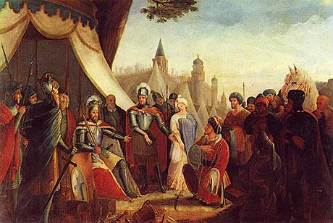
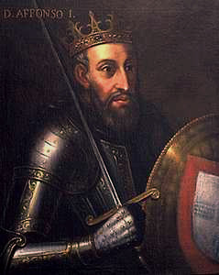
Zaragoza falls in 1118 to Alfonso I (‘the battler’) of Aragon: a papal indulgence is granted
1146: Genoese attack on the town of Almeria
Alfonso VII of Castile joined them; contacted pope Eugenius III in 1147 and asked for a papal bull
1148: a new bull for the Catalan-Genoese attack on Tortosa
1147-8: Crusaders on their way to the Holy Land are persuaded by King Afonso Henriques of Portugal to attack Lisbon
Crusading privileges are attached to ongoing wars
The Almohads arrive

Slide 16
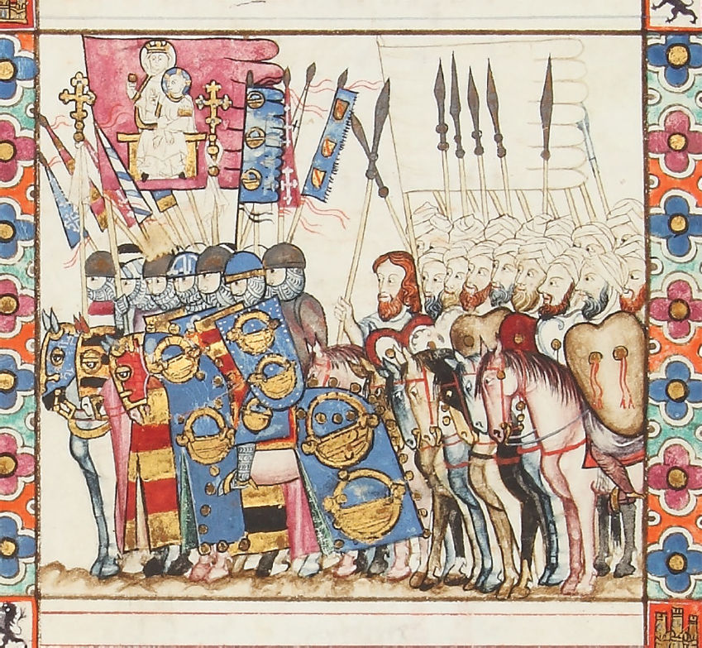
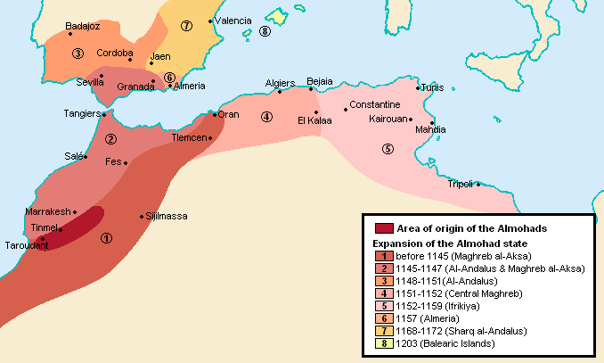
The Almohads (1157-1212) (al-Muwahiddun)
1172: Almohads conquer all former-Almoravid territory
Less tolerant (some non-Muslims had held high offices under the Taifa states; not so under the Almohads)
1187: Pope Clement III: Third Crusade to include Iberia (Spanish nobles shouldn't leave for the Holy Land)
1195 Alarcos: Almohads win a major victory against Alfonso VIII of Castile; some Castilian (rebel) nobles were fighting on the side of the Almohads
Both Alfonso IX León and Sancho VII of Navarre were on occasion allied with the Almohads
1212 Las Navas de Tolosa: French, Castilian and Aragonese armies fight the Almohads. A turning point, after which the Almohads crumble

Slide 17
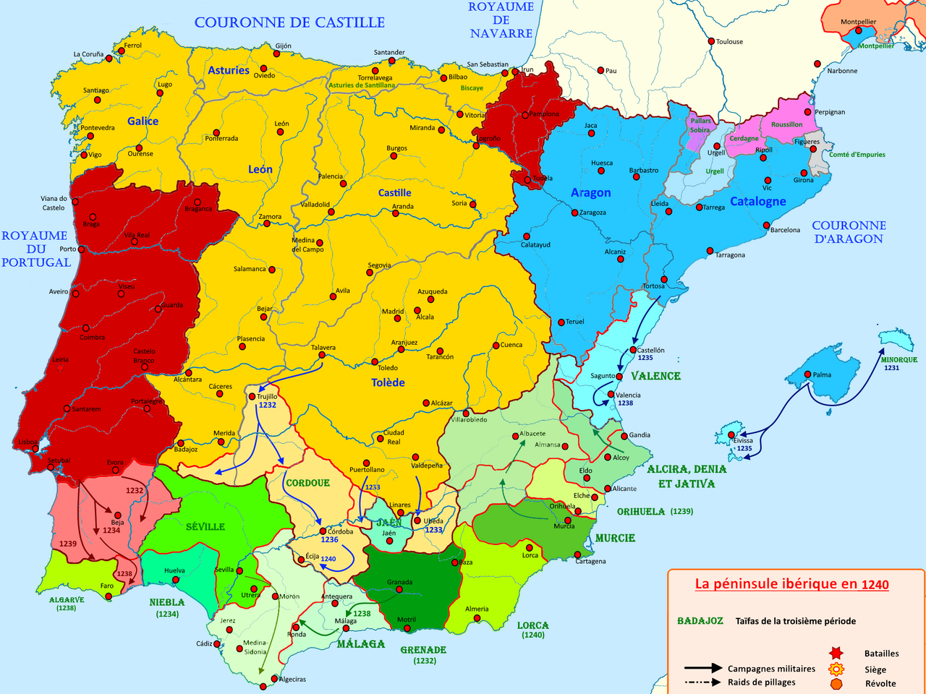
The 13th century
1229: Mallorca annexed
1231-8: Valencia falls; Muslims stay.
1236: Cordoba captured
1243: Murcia falls
1248: Seville captured, Muslims expelled and city partly settled by Christians coming from elsewhere

Slide 18
Muslim communities under Christian rule (mudejars)
Have property rights
Religious rights: free to practice religion and teach it; calls to prayer allowed, some mosques turned into churches
Pay taxes
Laws: right to rule themselves according to Sharia
Some segregation: in some cities, they were forced to live in separate quarters
towns have their own fueros (laws)
Andalusian Muslims saw themselves as different to Berbers/Almoravids/Almohads etc
sometimes forced to wear distinctive clothes
Presence of enslaved people

Slide 19
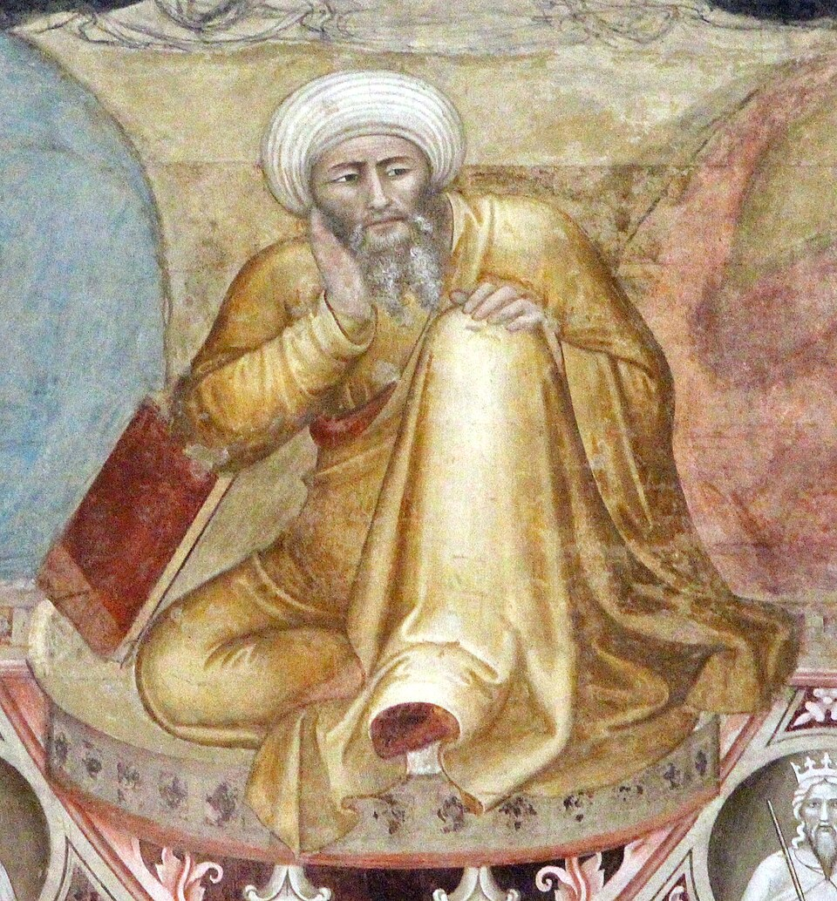
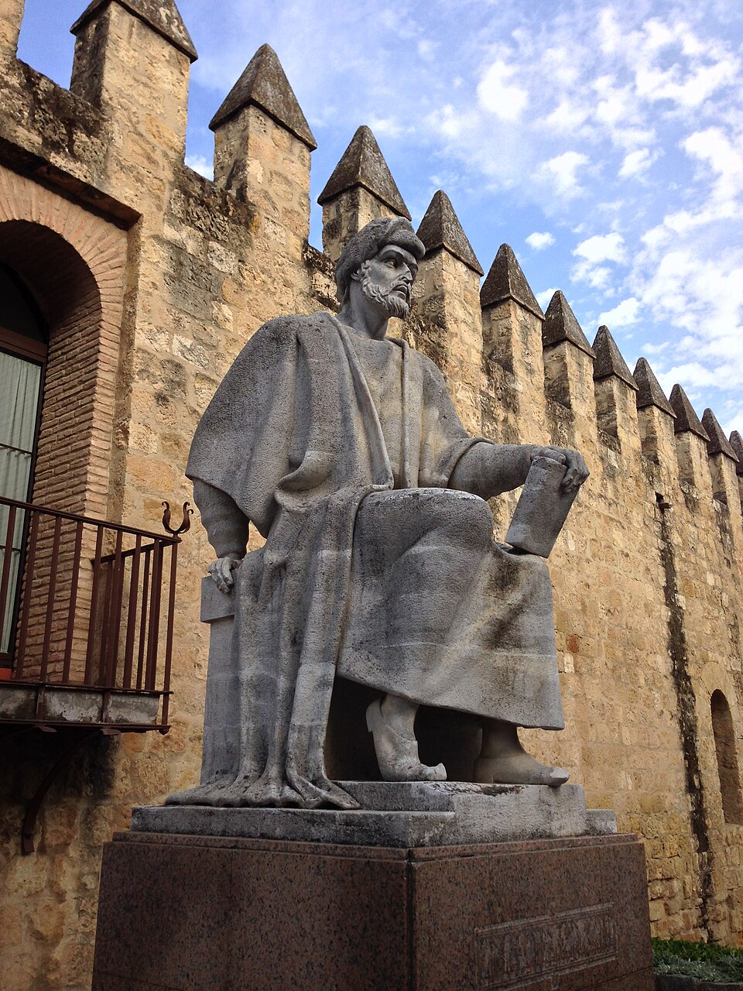
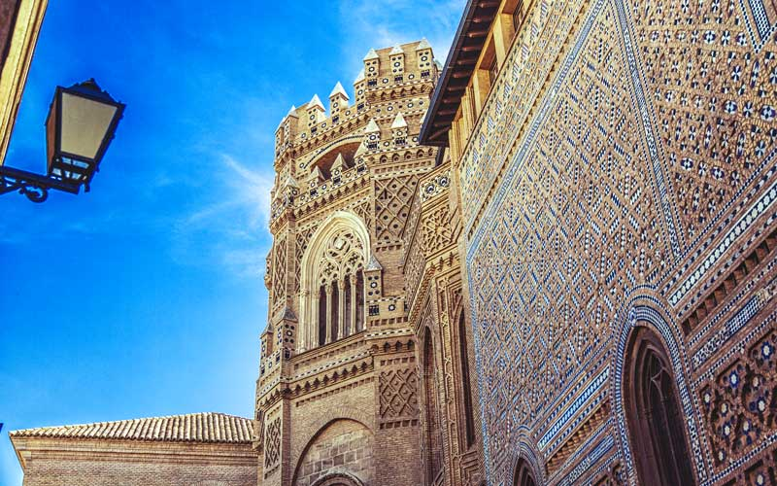
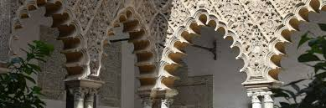
Was medieval Iberia a society organised for war?
Art & architecture
Translation projects & the transmission of learning: the works of Al-Farabi, Ibn Sina (Avicenna) were translated
Ibn Rushd (Averroes) was born in Al-Andalus in 1126, producing over 100 works on medicine, law, astronomy…, as well as commentaries on Aristotle
Jewish people were employed as doctors, envoys, tax-collectors

Slide 20
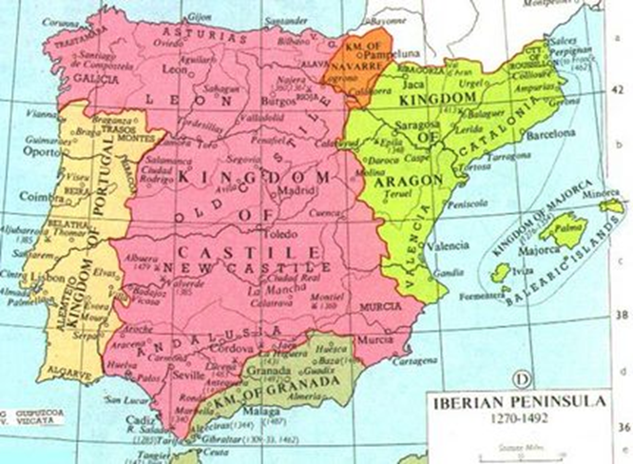
‘Reconquista’ vs ‘convivencia’ vs ‘conveniencia’?
convivencia (people of different faiths, co-existing)
Conveniencia (mutual interest generated by an interdependence)
‘Hence, within the environment of broader society and the context of quotidian interaction we find a spectrum of relations between Muslims and Christians running from intimate affection and camaraderie, to acculturation and imitation, to rejection and contempt, to the violence of blind fury, and everything in between – often at the same time.’
(Brian Catlos, Muslims of Medieval Latin Christendom, c.1050–1614 (2014), p.524.

