Slide 1
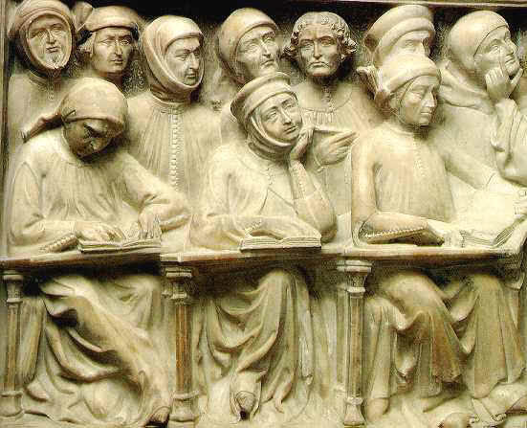
HI2E9 Crossing Boundaries and Breaking Norms in the Medieval World THE RISE OF UNIVERSITIES PowerPoint is on the website

Slide 2
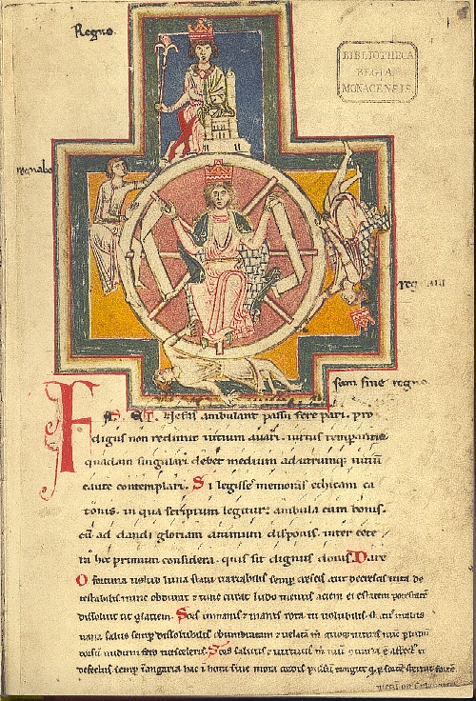
Codex Buranus (Carmina Burana), Wheel of Fortune https://youtu.be/FWiyKgeGWx0?si=4lXZAYpMMfyFY8Yd

Slide 3
‘The university is arguably one of the most important legacies which medieval Europe has bequeathed to the modern world.’ [Alan B. Cobban, Universities in the Middle Ages (Liverpool, 1990), p. 1]

Slide 4
Definitions
Universitas - ‘corporation’. It was applied to a range of corporate bodies: municipal corporations; craft guilds; academic guilds of masters and students.
Studium generale (plural studia generalia) – a studium was a centre with organised facilities for study. Generale referred to the ability to attract students from a wide geographical area.

Slide 5
Phases of Development
There were three phases:
Before 1300.
1300-1378.
1378-1500.

Slide 6
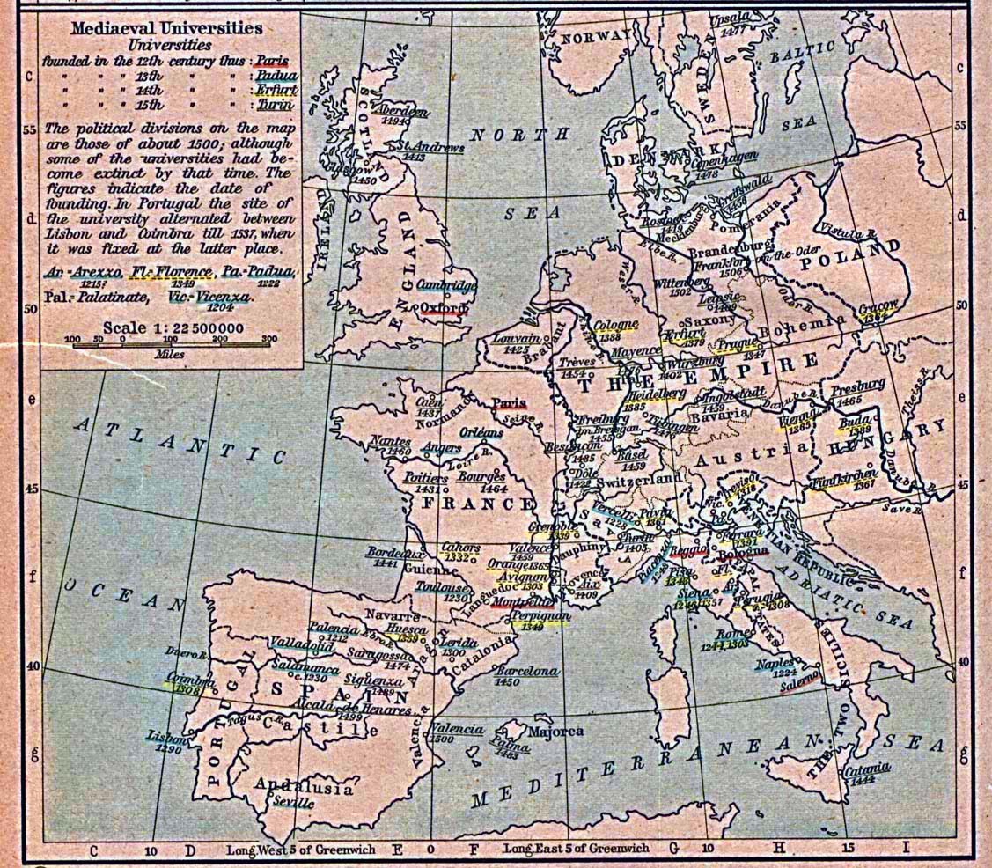

Slide 7
Before 1300
Paris: the masters’ university
Bologna: the student-university
Oxford and Cambridge
Padua (1222)
Reggio Emilia (c. 1188); Vicenza (1204-1209); Arezzo (1215-1255); Vercelli (1228-1244); Siena (1246-1252)
Naples (1224); Toulouse (1229); studium curiae [of the papal court] (1245); Salamanca (1218-1219); Valladolid (pre-1300); Lisbon (1288).

Slide 8
1300-1378
Nineteen new universities were founded.
Fifteen were in southern Europe.
Four were in northern Europe.
Prague (1347)
Cracow (1364); Vienna (1365); Pécs [Hungary] (1367)

Slide 9
1378-1500
Eight were founded in the Iberian peninsula.
Eight in France.
Eight in the Italian states.
Fifteen in the German states
Nine on the fringes (Scotland, Scandinavia, Poland, Hungary).

Slide 10
The Faculties
Arts
Medicine
Law (canon and civil)
Theology

Slide 11
The Arts Curriculum
The seven liberal arts: the trivium (grammar, rhetoric, dialectic/logic) and the quadrivium (arithmetic, geometry, astronomy, and music).
Natural philosophy
Moral philosophy
Metaphysics
Core texts:
N.B. the works of Aristotle.
Arithmetic: Boethius, De institutione arithmetica and Sacrobosco, Algorismus.
Geometry: Euclid, Elements.
Astronomy: Sacrobosco, Sphere.
Music: Boethius, De institutione musica.

Slide 12
The Medicine Curriculum
Core texts:
The works of Hippocrates and Galen.
Avicenna, Canon.

Slide 13
The Law Curriculum
Core texts:
Canon law: Decretum, Decretals, Liber Sextus, Clementines.
Civil law: Codex, Digestum vetus, Infortiatum, Digestum novum, Volumen.

Slide 14
The Theology Curriculum
Core texts:
The Bible
Peter Lombard, Sentences.

Slide 15
Types of student
The ‘simple student’ (scholaris simplex)
The bachelor (baccalarius)
The master-student
The student of rank
The specialist student

Slide 16
The Roles of Women in Universities
‘The world of the medieval student was thoroughly masculine. For the girl or woman student this world had no place…’ [Rainer Christoph Schwinges, ‘Student education, student life’ in Hilde de Ridder Symoens (ed.), A History of the University in Europe, vol. 1, Universities in the Middle Ages (Cambridge, 1992), p. 202]

Slide 17
The Roles of Women in Universities
Magdalena Buonsignori
Novella d’Andrea
Dona Beatriz Galindo
Salamanca
Queen Isaballa of Spain

