Slide 1
Week 7 A Democratic Interlude: “Populism,” Industrialisation and Labour, 1945-c.1960

Slide 2
This week
Vargas’ return as populist democrat
“Populism”: significance and pitfalls of the term
“Populism” and organised labour
Industrialisation, uneven growth
Internal migration and its implications for labour and culture

Slide 3
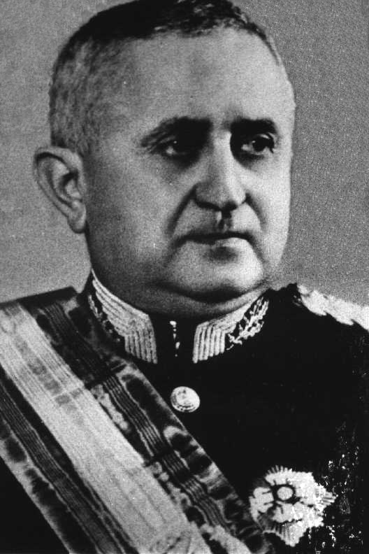
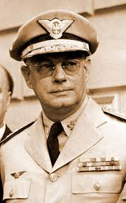
Two military presidential candidates
Eurico Gaspar Dutra (PSD – pro-Vargas party)
Brigadier Eduardo Gomes (UDN – anti-Vargas party)

Slide 4

Brigadeiro sweets, named after Brigadier Eduardo Gomes (UDN candidate in 1945)

Slide 5
The 1945 election
1945 election: 6.7 million votes cast – three times as many as in 1930
Politics still corrupt, but expanding urban electorate no longer so “manageable” - hence the politics of populism
Dutra wins (3.2M votes); Gomes gets 2M; communists get 0.5M

Slide 6
A new constitution: 1946
Initially Dutra governs under old authoritarian constitution of Estado Novo
Constitutional Assembly drafts a new constitution, 1946.
Brazil’s fifth constitution (others are 1824, 1889, 1934, 1937)
Full political freedom for first time: Communist Party legal (briefly)
Restoration of rights and freedoms lost under Estado Novo constitution
Powers of the presidency are REDUCED
Powers of states are extended again
Elections held are relatively more free and fair than before.

Slide 7
Latin American post-war electoral politics
Latin America comes in on American side; supposedly support democracy over dictatorship
Defence & economic pacts with US
Lat Am govts keen to show their democratic credentials
So former authoritarians go to the polls…
Vargas in Brazil; Fulgencio Batista in Cuba; and Juan Perón in Argentina

Slide 8
Populism
“the phenomenon whereby a politician tries to win power by courting mass popularity with sweeping promises of benefits and concessions to large interest-groups, usually drawn from the lower classes. Populist leaders lack a coherent programme for social change or economic reform, but try to manipulate the existing system in order to lavish favours on underprivileged sectors in return for their support” (Edwin Williamson)

Slide 9
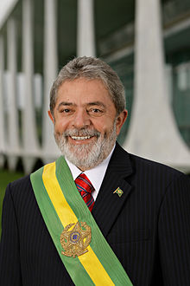

Slide 10
Populism: a problematic term?
Way of dismissing working-class political aims?
Politicians aim at manipulation, but doesn’t mean this is all that is going on
Need to take working class political activity seriously…

Slide 11
… e.g. Brazilian labour history is not just about manipulation by Vargas
Labour movement long pre-dated Vargas
Activists avoided Vargas-controlled unions during Estado Novo (-37-’45)
but labour movement later decides to work WITH Vargas in democratic period
Organised labour pushes him to fulfil promises to workers…

Slide 12
“Working people in São Paulo were not mobilized from above by politicians; they gave populists their votes in exchange for the populists’ support of their demands.”
Joel Wolfe, São Paulo and the Rise of Brazil’s Industrial Working Class (1993), 194

Slide 13
Dutra 1945-50
Fairly CONSERVATIVE
no major industrialisation initiatives; reliance on coffee exports
difficult post-war economic situation: trade restored, Latin America flooded with imported consumer goods from abroad.
High cost of living; major STRIKES IN SÃO PAULO 1947; widespread unrest …
Dutra outlaws Communist Party (PCB)
PTB (founded by Vargas) replaces Communists as major force on Left

Slide 14
Vargas the democrat…
Courts elite power brokers: fazendeiros (planters), industrialists, state political bosses, MILITARY
POPULIST promises to the masses about working conditions and salaries
Election of 1950: wins with nearly 50% of vote.

Slide 15
Industrialisation and development
Major industrialisation during Vargas second term…
Signature institutions to promote development and industrialisation:
the National Bank for Economic Development (BNDES)
state enterprises in oil (Petrobrás)
and electricity (Eletrobrás)
all still exist today

Slide 16
Downfall and suicide
* POLARISATION OF POLITICAL POSITIONS: exacerbated by Cold War
Petrobrás criticised both by Left and by Right
US and conservative military turn on Vargas.
Economic woes: inflation; debt; IMF pressures for STABILIZATION PROGRAMME.
Meanwhile Vargas takes a NATIONALIST turn
Strike in SP, 1953: 300,000 people.
Finance minister, João Goulart, implements a 100% hike in the minimum wage
24 August 1954: Vargas commits suicide

Slide 17
More wealth and more poverty…
Fast but very unequal economic growth
Greater income inequality overall: Industrial workers get paid more, rural workers don’t; south-east benefits disproportionately
Overall in Brazil, life expectancy is 53 by 1961.
But in the poor northeastern state of Rio Grande do Norte, it’s only 40.
Infant mortality in Brazil overall by early 60s is 145 in 1,000;
In RGN, it’s 420 in 1,000
Nearly 40% of income goes to top 10% of population; only 25% goes to the bottom 3/5 of the population.

Slide 18
Migration and unplanned urban expansion
Major internal migration, to the cities of the South-East, especially São Paulo, and from rural to urban areas
Rapid, uncontrolled urbanisation in south-eastern cities
Foreign business executives describe S Paulo as “Latin America’s number 1 boom city” by 1950. Population of 2.2 million. One new building in SP every 50 minutes!
Causes social problems: favelas and slum housing; no sanitary provision or basic quality of life for these new arrivals; not all arrivals find jobs…
Populism is partly a political response to enlarged urban populations
Migrants discriminated against; but also bring culture of north-eastern sertão (backlands) to the south-east

Slide 19
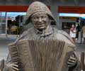
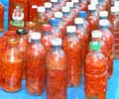
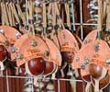



Slide 20

Luiz Gonzaga, Brazil’s most famous north-eastern musician

Slide 21
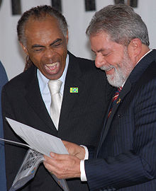
Two famous nordestinos: Gilberto Gil, musician and former Minister of Culture; and former President Lula

Slide 22


Film Eu, tu, eles about life in the North-East

Slide 23
Seminar questions
What problems did rapid industrialisation bring to Brazil from the 1940s to the 1960s?
How successful were the demands of Brazilian organised labour in the middle years of the twentieth century?
How did those demands interact with the state?
From the perspective of organised labour, did 1945-54 look different from 1930-45? How? Why?
How did internal migration shape urban life and working-class politics in the Brazilian southeast?

Slide 24
Seminar readings
John D. French, The Brazilian workers' ABC: class conflict and alliances in modern São Paulo (1992), Ch 5, “Popular Getulismo and Working Class Organization,” 132-151 [on library scans page]
•Joel Wolfe, Working women, working men: São Paulo and the rise of Brazil's industrial working class, 1900-1955 (1993), Chapter 3, “Class Struggle versus Conciliação: the Estado Novo, 1935-42,” pp 70-93. [on library scans page]
A suggestion for further reading:
Paulo Fontes, Migration and the Making of Industrial Sao Paulo. Duke University Press, 2016. [E-book at Library]

