Slide 1
Trouble in the Empire: The Paraguayan War (1864-70) and Socioeconomic Change in the 1860s

Slide 2
Last class…
“Regresso:” liberal experiment revoked; Emperor crowned 1840; centralised rule
Provinces accept rule from Rio but tensions remain
Second Empire underpinned by coffee: production doubles 1850-1880 (and triples again in the 1890s)
Slavery: 1M Africans imported 1800-1850 (700,000 after 1831), then internal trade
Politically: Emperor preserves balance of power between Liberals and Conservatives;
Wide franchise but system operates through patronage

Slide 3
A delicate balance of forces…
Buoyant economy BUT depends on volatile external markets
Tension between liberalism and slavery; most other American nations abolishing slavery
Regional differentiation in slaveholding: by 1888, ¾ of all slaves are in Rio de Janeiro or São Paulo
Rural, oligarchic leaders but growing urban-based government and state institutions
Success of moderating power depends significantly on Emperor’s personal image and abilities

Slide 4
Demographic and social changes by the 60s and 70s…
Brazil’s population 90% rural by 1900
BUT: significant urbanisation: Rio de Janeiro has 275,000 inhabitants by 1872 (one of the largest cities of the Americas);
New educational opportunities in cities e.g. at law and medical schools
Growth of an urban middle class, less tied to rural life/ slavery, with no direct access to parliamentary politics
Immigration grows from 60s: 84,000 foreign-born residents in Rio, 1872 (although the greatest influx happens 1870s-1910s)

Slide 5
The war: the view from Paraguay
War remembered as devastating, “genocide” by Brazilian troops especially
Paraguay’s male population falls from 460,000 (1864) to 153,000 in 1870 (65%)
Industry (e.g. coal) destroyed
Half territory lost

Slide 6
Paraguayan context to the war
Independence from the Spanish from 1814 but Buenos Aires does not recognise; ongoing territorial ambitions from Argentina/ Brazil
Isolationist mentality; resist export-orientated economy; economic self-sufficiency; small cooperative farms
Francisco Solano Lopez from 1862: promotes economic development, external trade, industry, railways…
ARMY becomes most powerful in South America
Geopolitical interests in Parana river
Lopez supports Uruguayan conservatives; Brazilian ship seized; Brazil drawn into conflict with Argentina and Uruguayan Liberals

Slide 7
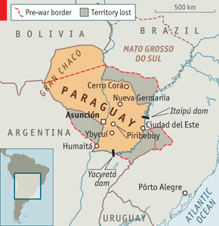
Paraguay, showing loss of territory after the war

Slide 8
The war from the Brazilian perspective
Early victories on Paraguayan soil surprise the Brazilians
Brazilian troops badly paid, funded, prepared; Paraguay has 64,000 troops to Brazil’s 18,000
“Volunteer” soldiers (in fact, long history of impressment and violent treatment of soldiers)
Slaves are used in war
War is eventually won but takes much longer than anticipated

Slide 9
The war and the Brazilian military
Military as bulwark of Second Empire undergoes significant (slow) change 1820s-1860s.
Military academies open in Rio and Porto Alegre in 1850s (plus preparatory schools): social mobility for some poorer boys
BUT: declining influence in politics? E.g: law grads replace military as provincial presidents; a dozen military men in Senate under Pedro I, only four in 1850s

Slide 10
The war and the Brazilian military
Major mobilisation: officer corps expands: from 1,500 to 10,000
New corporate unity; sectors of military call for political reforms e.g. republicanism, abolitionism
Opening of the Military Institute in 1871 in Rio (led by Floriano Peixoto): forum for debate on army but also politics
Pantheon of war heroes, e.g. Caxias: become significant political leaders after the war

Slide 11
The war: general consequences
Huge losses: 200,000 men are mobilised; 139,000 fight; 30,000 casualties.
External debt (mainly to Britain) increases again
Heightens national anxiety about slavery and race: Brazilian propaganda re “civilization” but use of slaves…
Political crisis: Emperor ousts ruling Liberal cabinet in favour of Duke of Caxias;
Resentment among Liberals;
1869 Liberal manifesto calls for electoral reform, abolition of the moderative power, abolition of slavery
Liberal SPLIT in 1870: one faction forms the Republican Party (campaigns against monarchy)

Slide 12
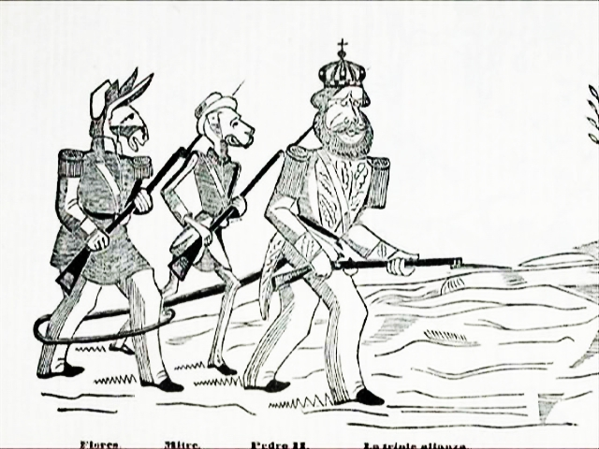
Notes:
Paraguayan cartoon showing the three main allies in the triple alliance, pedro II as “el macacon”

