Slide 1
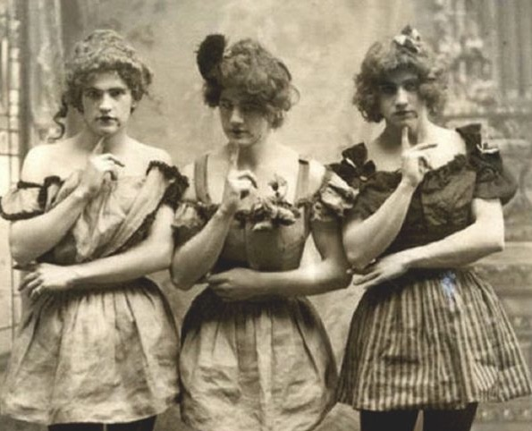

Gender and class at the turn of the century
https://www.boweryboyshistory.com/2018/01/slide-new-yorks-notorious-fairy-resort-history-behind-scene-alienist.html
Notes:
Hey folks and welcome back to another round of slides, notes, and audio lectures. I hope you’ve all prepared the week 2 materials or at least started to work through them. The Mitchell chapter continues our path through his important book on public space and the right to the city while the Chauncey and Flanagan pieces provide us some glimpse into the ways sexuality and gender intersect with class in cities. So please do read through these carefully and come along with notes to this Friday’s seminar session. Again, the week 2 seminar will take place from 5 to 6pm this Friday, following our week 1 seminar session at 4pm.
Following on from last week’s lecture, where we set out some guiding debates for our module, we will focus mostly on New York and Chicago this week to get a sense of both political and social networks that operated in these cities at the turn of the century and some decades into the 20th century as well. We will establish how both working class and middle class city dwellers built, navigated, and negotiated both informal and formal networks. While Chauncey largely details some informal networks for gay men in New York to socialize, Flanagan looks at two politically-minded social clubs in Chicago and their differing views for the future of Chicago with regards to police violence, public education, and waste collection.
Even when our lens for this week will follow critical interrogations of gender and sexuality, it is important for us to place class at the heart of this discussion, which will be quite a running theme for the entire module. As I mentioned in the first week’s lecture, you cannot study cities without considering class. If you are a respected, middle-class white man in the early 20th century in New York, you have plenty of ways to socialize in often private gay spaces, protecting yourself and your status fairly easily. However, as Chauncey notes in his book, you don’t have this luxury as a working class gay man. Your gay social network is more vulnerable and out in the open in neighborhoods like the Bowery and the Tenderloin. Ok, let’s move on.

Slide 2
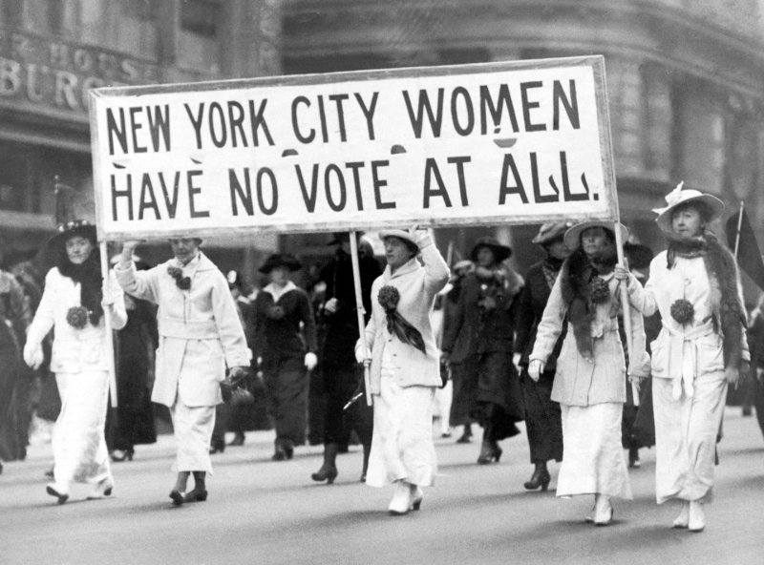
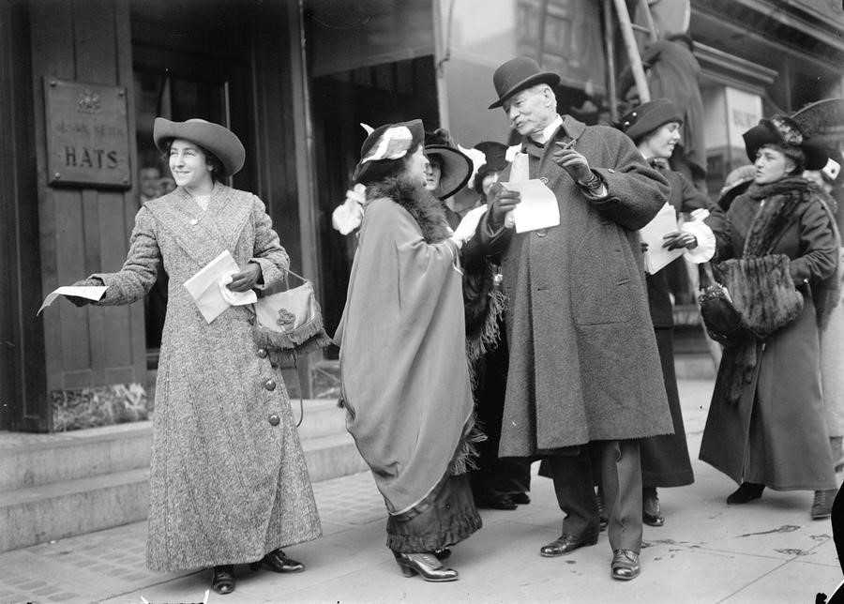
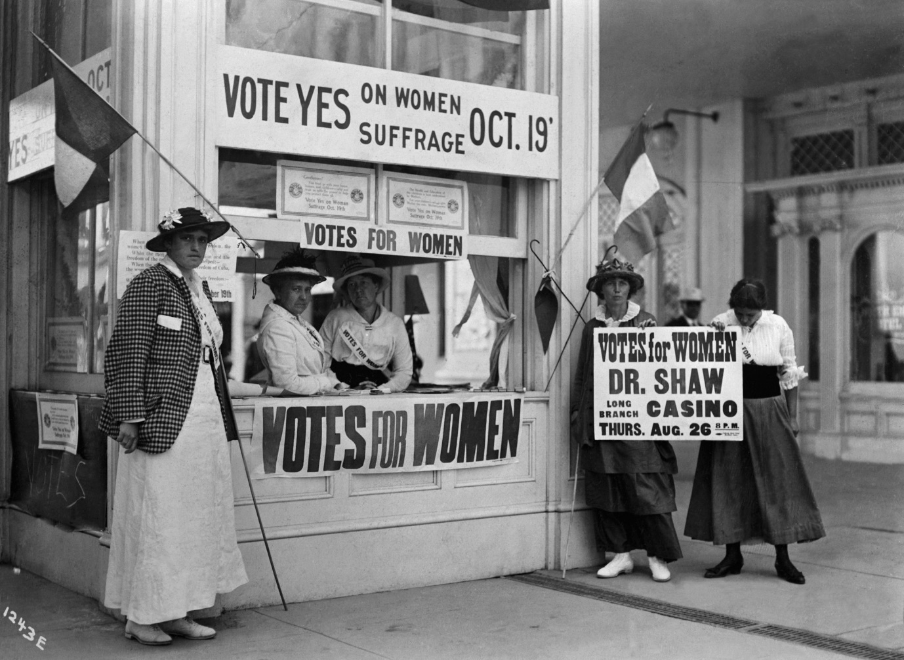
Women’s suffrage
Notes:
Now, I know that especially with these first few weeks of the module, I will be referring to a lot of material you should all be familiar with from your first year. The women’s suffrage movement is one of those reform movements that you already know about, so I won’t go into detail outlining the timeline here. However, I do want to bring this into our discussion of gender at the turn of the century as women largely fought for and claimed their right to vote in cities. They distributed flyers in the streets, they gave speeches in street corners, they marched in parades, and they organized marches to Washington and the governor of New York. They navigated public spaces, such as streets and parks, to claim their right to the city, their right to vote and participate in the civic and political future of their country and their cities. You will, hopefully, know about the emergence of the “New Woman” at the turn of the century, a concept scholars and historians use to pool together various emerging traits and attitudes of women at this time. This includes suffrage, female independence, consumerism, women working in traditionally male jobs, and women being increasingly visible in public spaces, especially in cities.
Of course, it is important to not confine the women’s suffrage movement to this particular period between about 1890 and 1920. More organized claims for women’s suffrage can be traced back to 1848 and the Seneca Falls Convention. However, as we saw last week, the process of urbanization really only gained momentum at this time in the mid 19th century. But in the early 20th century, cities like New York or Chicago were sprawling spaces to mingle and meet, making it easier to communicate political message and organize in political or social clubs. The many, many protests, marches, and strikes over three decades exemplify how women at this time claimed their right to the city. By no means would the powers that be, the city administration, the state politicians, or the White House just hand out such an important right. As Mitchell writes in the introduction you should have all read for week 1, the right to the city is “always contested, always only proven in practice, never, that is, guaranteed in the abstract.”
Some of you may ask how the right to vote is considered a right to the city. It is true that, obviously, this fundamental right as a citizen goes beyond the scope of single cities as it is a federal matter. However, when we, when activists, invoke the right to the city, the focus of the term is less in the exact nature of the issue (here women’s suffrage), but rather the process of fighting for, negotiating, and claiming this right. As you might have seen in the documentary I linked in the Team channel for the week 2 seminar, women in small towns and rural communities also fought for the right to vote, but this was not able to produce a massive collective claim by itself. Fighting for this right from the smallest mining towns to the largest metropolitan cities was crucial, but the masses lived in cities, the masses were not able to avoid the issue in the streets, at home, in parks, and in front of city or governmental buildings. Protest movements and marches in and of themselves are quite the urban phenomenon purely and simply because it takes a great number of people to organize and stay strong together as they openly proclaim their demands and fight for them through informal and formal networks. If there is only a single thing I want everyone of you to remember for the rest of your lives it is that streets have been and still are the most effective tools in a fight for human rights and justice. No other public or private space, be it the home, governmental property, or parks, have as much potential and power as streets to boost the effectiveness of a campaign for justice, no matter how small or large the campaign is. As we move through the module, again and again you will see how streets are used in marches, how streets are policed, how streets are “beautified,” and cleaned, how streets are graffitied, how streets are designed by the city, and how streets are shaped by the people living on them. Streets are highly contested spaces where citizens negotiate what role the streets should play, how they should look, and how much they want the city administration to regulate the properties adjacent to them. Alright, let’s move on.

Slide 3
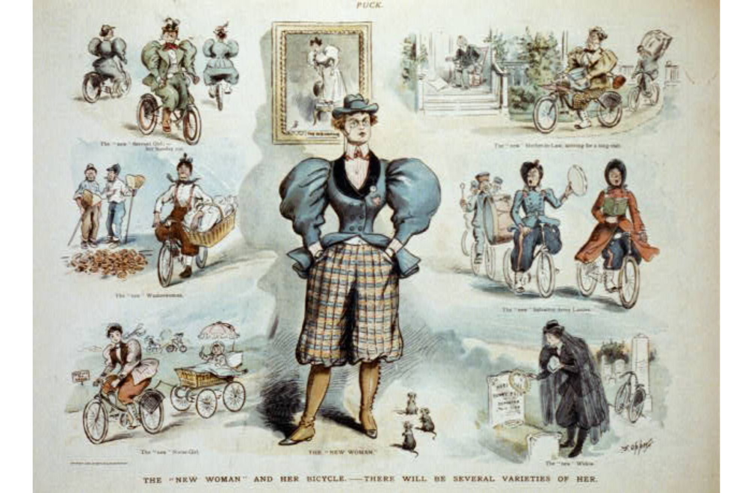
https://www.jstor.org/stable/pdf/1908504.pdf
Notes:
With respect to the “New Woman” and the suffragettes, there are some key things we should consider if we want to include class in our discussion. While the new consumer-minded “New Women” tended to be well-off and middle class, the suffragette movement was not wholly middle class. In an article on the suffrage movement, Ellen DuBois looks at the movement and key characters like Harriot Stanton Blatch who helped shape this political movement. For a long time, historians have characterized the movement as distinctly middle class, but this term does not adequately consider the complex relationships between marital status, place of work, and their social status. While there obviously was overlap between the independent women who were following new consumer trends in fashion and the women who fought for their right to vote, this alone does not explain the diverse and radical character of the suffragettes who organized in social circles and on the streets.
There is a good amount of literature out nowadays on the nature of the suffragettes in the US so if any of you are interested to interrogate this movement with a focus on class and urban space, you will find quite a lot and it’s really interesting to dig into this. A lot of the local action that took place in specific cities and neighborhoods is still to be fully represented in scholarship and key texts like that of DuBois here paved the way for interrogating further.
For any of you thinking of writing about this time period, it is important to consider the gender dynamics, some of which I have outlined here. Women were very much supposed to stay at home, stay within her lane of moral and social aspects of family life, and stay loyal to their husbands. The vast majority of women who participated in politics, informally or formally, were not radicals, if we want to define radicals as communists, socialists, or other types of leftist activists who fought for justice at the time. However, socialists and working-class women did participate and even lead in the suffragette movement and many of these became communists later on. These histories of radicals are very important for a clearer picture of such a pivotal movement and if we want to interrogate the complex relationship between gender, class, and the city, we will find it hard to ignore the diverse character of this protest movement. Ok, I will leave it at this for now. Plenty of stuff to think about if you’re interested to dig deeper or if you’re just looking for some extra context for the readings for this week, primarily the Flanagan text of course. Ok let’s move on.

Slide 4
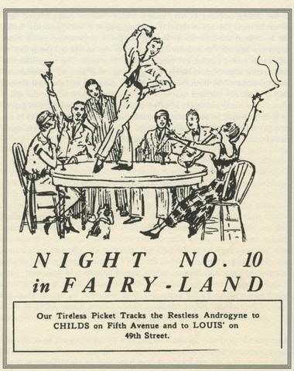
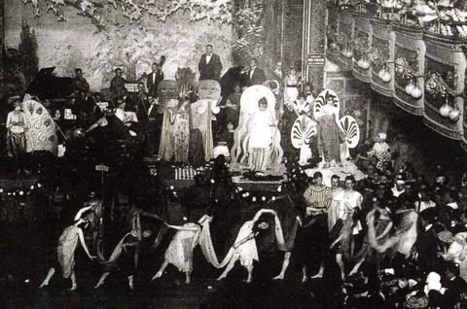
https://nymag.com/nightlife/features/gay-bar-history-2013-1/
Notes:
Following on from our discussion of gender and class, I’d like us to consider sexuality and class to give us a better sense of the dynamics of sexuality at the turn of the century and some ways into the 20th century. This will provide some context for the Chauncey text, which I recommend you all read if only for the fascinating and ground-breaking stories Chauncey uncovers in this book. I want to step back a bit from the brief note on Chauncey’s text at the start of this lecture. Sexuality at this time in US, both one’s sexual identity and any intimate acts, was still quite taboo subject both in public discourse as well as in private conversations over dinner, for example. Thanks to studies by scholars like John D’Emilio and Estelle Freedman we do have quite a good insight into family, marriage, and sex in the US over the centuries and until the 1950s and 1960s it’s fairly clear that women largely focused on conservative ideas of reproduction as the main purpose of intercourse whether they privately had other fantasies and desires or not. Of course, it is immensely difficult to measure the true nature of sexuality and intimate thoughts as this was rarely ever expressed openly, and certainly not on a nice document that would be archived for us historians.
In any case, men and women were family-oriented and focused on their offspring. As Chauncey details in his book, however, a lot of so-called “fairies,” queers, and cross-dressers certainly had a rich and intricate network, largely informal, to socialize and perhaps live out their own sexual desires and fantasies. Since Chauncey’s book, we have quite a bit more insight into the history of sexuality in the US and the role cities and urban spaces have played. Every state in the US had sodomy laws, all of which made homosexual encounters illegal and this remained the case until the 1960s though it was not until 2003 when sodomy laws in all states were effectively overwritten. Despite the sodomy laws, cities such as New York provided ample private and even public spaces in some cases to allow for men to socialize. In fact, the enforcement of sodomy laws in larger cities was considerably weaker at this time until about the 1930s when Depression-era anxieties tightened restrictions and society as a general became more anxious about what they considered degenerates and sexual deviants. Still, for quite a few decades, dance halls, gay clubs, and other private networks of apartments thrived in what might be called the underbelly of New York. As Chauncey notes, a lot of the most famous clubs and halls were located in the Bowery, the Tenderloin, and the Lower East Side though you can also find more work done on speakeasies and clubs in Harlem because of the Harlem Renaissance, which boomed from the 1910s to the 1930s, also very much the same timeframe as the peak of early 20th century gay clubs and events insofar as they could be public without too much fear of the police. Alright, let’s move on to the next slide.

Slide 5
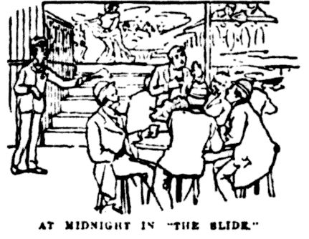
Notes:
So, with regards to the intersection of class and sexuality in early 20th century cities, I will not go into too much detail here as you will find most of this information in the Chauncey text, especially the introduction and some extra chapters. Primarily, we need to separate the ways in which middle class and working class men navigated their gay social circles. Middle class men, or men with families or just men who had a certain status to uphold, largely tended to navigate private spaces, maintaining a risk-averse attitude in their choices of spaces and partners. Even when they might generally be well-off financially or in their social status, they are by no means a homogenous group. They came with different levels of curiosity, they had different preferences for more feminine or masculine presenting partners, and they had different ideas about whether these encounters meant anything for their own understanding of their sexual and sometimes even gender identities. However, most of them considered what they were doing immoral and illegal and they used their connections and wealth to buy them privacy to evade both the law and the consequences for their careers and family life.
Most working-class men did not enjoy these privileges and so they had to choose speakeasies, dance halls, and gay clubs to socialize and find partners. Their spaces were more public and more vulnerable, but they nevertheless contributed to and participated in a wonderfully thriving and artistic community of networks, what Chauncey calls the gay world. Small towns and rural communities simply didn’t allow for the same amount of privacy and anyone who engaged in what were considered illegal and degenerate activities would be ousted and likely worse. Cities allow for individuals or entire subcultures to hide among the masses, establish complex social networks and codes, or spread information and knowledge more rapidly and more easily. This matters for the social life in a city just as much as it does for the physical environment. Just walking a few streets into a new part of town or a different neighborhood would afford almost complete anonymity. There are too many alleys, too many residential streets, too many clubs and bars and halls, too many people who are busy with their own jobs and families and lives, and simply not enough policemen to patrol the city. New York alone grew from about 3.5 million in 1900 to about 7 million in 1930. That is a 100% growth in just 30 years. We always talk about the roaring twenties in US history but in reality, cities of this size in any time period were roaring. If we want to interrogate the interplay of sexuality, class, and cities at this time in early 20th century, the lives of gay men in cities like New York are absolutely crucial to get a fuller picture here. Furthermore, you can imagine that a lot more work has do be done by historians to uncover the queer lives of African Americans and women in this time period. There is fragmented literature out there, certainly enough if any of you wish to look at this for your essays, but this is a highly active field for ongoing discourse. In any case, you will find more on this in the readings for this week. Let’s move on!

Slide 6
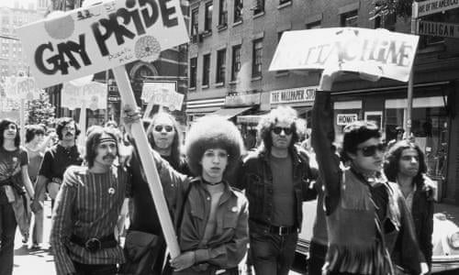
https://fordham.libguides.com/c.php?g=354894&p=2393991
Notes:
In our ongoing discussions of how city dwellers have claimed their right to the city, it’s perhaps quite obvious to see how suffragettes claimed their right in their marches and organized activism to demand the right to vote. With the gay world becoming fare more hidden between the 1930s and 1960s, it was not until the Gay Liberation Movement in the 1960s and 1970s that there was a considerable mass movement for queer men and women to claim their right to the city. They marched and paraded, building networks of solidarity with other movements, including the Civil Rights Movement and second-wave feminism, as well as demanding their right to love and their right to participate in the future of their communities and cities, openly not from inside the closet they were forced into. The election of Harvey Milk to the San Francisco Board of Supervisors in 1977 exemplifies such an effort of an openly gay man to actively try and shape city politics.
One of the questions that I would like to pose to you this week, something that might also be useful for your own assignments, is whether the right to the city can be part of a conservative or far-right campaign or if it is always pre-supposed that the right to the city works on a radical and leftist spectrum, characterized by, as I mentioned in the first week lecture, a fight against injustice, a fight for the powerless and the poor. We have seen many anti-lockdown and anti-mask protests in cities across the world, especially in the UK and the US. Are these protesters proclaiming their right to the city, their right to freedom, their right to move without fear of regulation and fines that restrict what they wear and where they can go? What do we make of this? It’s a question that we have to keep in mind as we move through the module.
Finally, before I end the lecture, I would just like to point out an interesting link that points to many queer archives and databases. It’s at the bottom of this slide here and I encourage anyone to check this out. I know no one is presenting for week 2, but nevertheless this is something to keep in mind if any of you wish to write on a related topic for their final essay, even if it concerns a different time period or focus. Ok, that’s it for this week. I am really excited to finally get into our first two seminars this Friday and as much as you are likely sick of me reminding you, it’s 4 to 6pm in our Teams channels for weeks 1 and 2. Alright. That’s all for now. Enjoy the week, well, as much as possible in our current situation.

