Slide 1
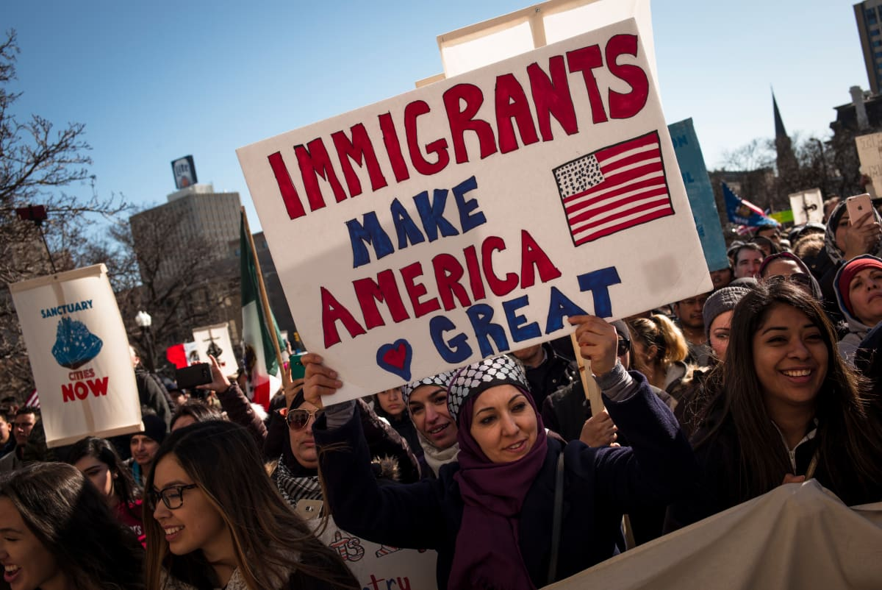

Immigration and reform in the twentieth century city
Notes:
Hey folks, welcome to the week 3 lecture on immigration and reform in the twentieth century. You all contributed wonderfully to our first online session last Friday so thank you so much for that. By now you will have received an email about the seminar structure for week 3, which will run more like a forum where we will not meet live at 4pm on Friday, but instead we will evolve our discussions on the week 3 content over 5 days, from Friday to Wednesday. On Wednesday, I will then see where you all are with this approach and we can decide, definitively, which approach we will use going forward in this module. This will be your choice to make and if we wish to change the approach to stick with the week 3 one, I will need a unanimous decision from all of you or else we will go back to the week 1 and week 2 approach of a live, 1 hour seminar session each Friday. I will likely create the posts for our week 3 discussions sometime on Friday and will absolutely notify you via email too just to be safe. I hope this will mean we will be able to actually respond to each other more directly, so it feels more interactive in this way. Anyways, watch this space for further updates on this.
The other, short, piece of housekeeping for this week is that I’ve added a general marking scheme for oral presentations on the module website on the assessments page. You can find the link in Teams in the General channel, I added a post there. I personally don’t find this general scheme too helpful in actually designing a presentation for you guys, as it’s not specific enough. It just serves as a basic guide for teachers to mark oral presentations, it’s less useful for actually creating the presentations. The actual guide you should follow is laid out in the week 1 lecture over 2 full slides and you can find some info on the module website too though it’s more detailed on the lecture so 100% check it out and keep it in mind for when you’re up to create your presentation! That said, we’re expecting 2 presentations this week if all goes well and hopefully those will be up by Friday. The deadline for these is 6pm on Wednesdays and you can find this info in the presentation schedule if you’re unsure. Hopefully you will all be able to post your presentations there (see next slide for instructions), but in case you are unable to upload files there (I haven’t’ tested this) do absolutely email me all your presentation materials by the Wednesday 6pm deadline so I can upload them. I will note down if you fail to send in your presentation by the deadline and this will be reflected in your mark for this part of the module. Since presentations count for 40% of the module, I cannot stress enough how important it is that you don’t lose out on marks because of late submission. You will all have to upload your documents to Tabula too once this is set up correctly so don’t delete the files either! Ok, let’s move on.

Slide 2
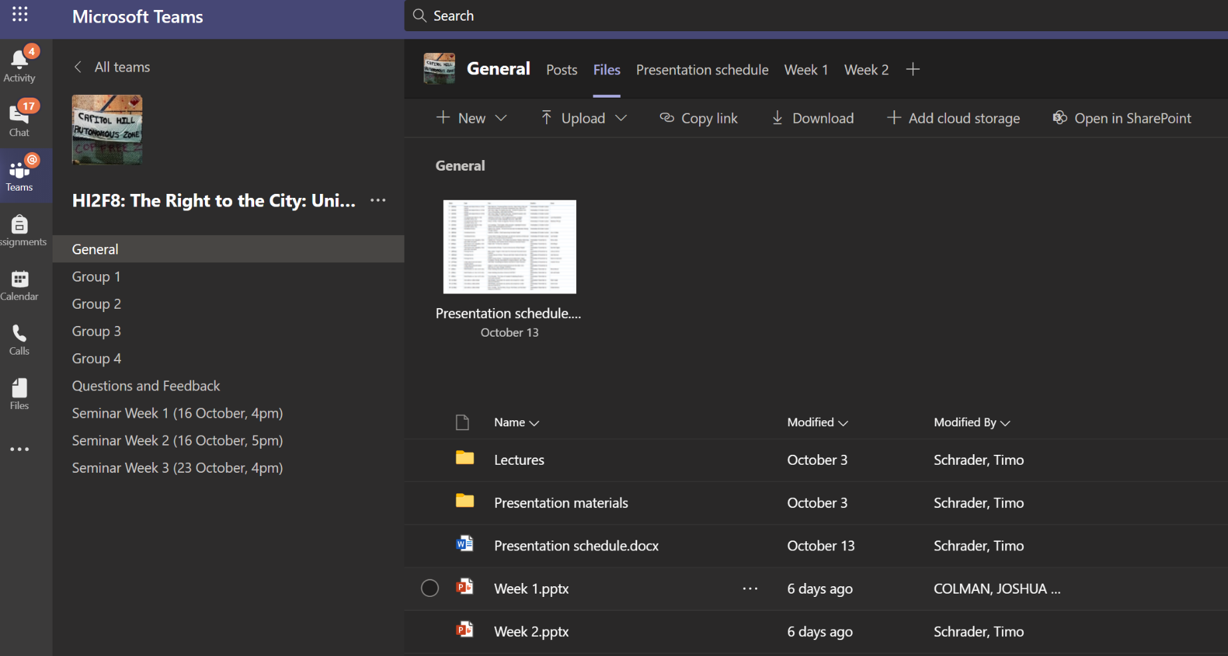
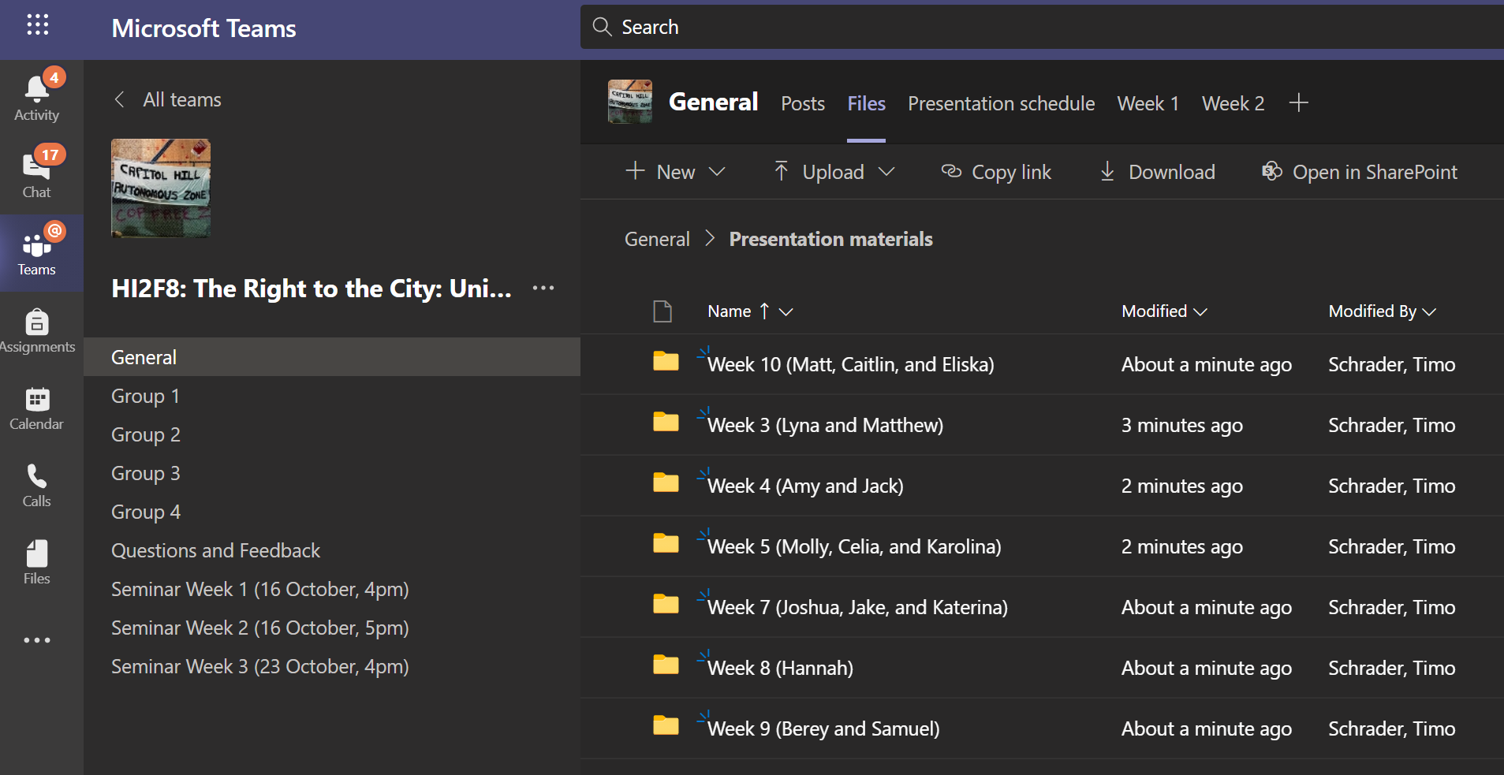
Notes:
Alright, so this is just a quick tutorial so you know where you should upload your presentation materials, including some visual companion, a one-page handout, and the actual presentation in audio or video format. Like I said on the previous slide, if you are unable to upload anything in this space, do let me know AHEAD of the 6pm deadline on Wednesday, not after!
So, from your Microsoft Teams section just navigate to our module and then click on the General channel on the left side. In the top left picture you can see where to click on the Files tab at the top, just under the search bar, and you should find some documents and folders here (Lectures, Presentation materials, Presentation schedule, and the lectures). Click on the “Presentation materials” folder and you should see something like in the bottom right picture here, a bunch of folders sorted by week and names of presenters. Just find your name and week and upload your presentation materials in that folder. If you have multiple files, try naming them in a way that everyone can easily see they belong together (for example “Matthew-handout, Matthew-powerpoint, Matthew-video” or something like that). You can upload files, hopefully, by clicking on the Upload button in the menu bar just under the tab bar (where it says New, Upload, Copy link, Download, and Open in SharePoint). Ok, let’s move on!

Slide 3
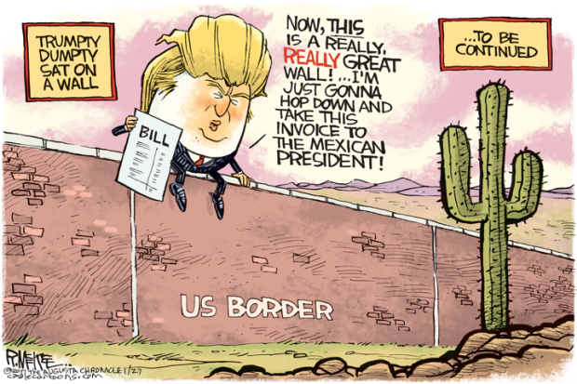
https://www.youtube.com/watch?v=6_35a7sn6ds
Notes:
Alright, for this week we will focus on the history of immigration to the United States and I will largely focus on the key legislation and case studies that really show that the history of immigration is the history of cities and vice versa. When people migrate to the US, they largely settle in cities, not rural or suburban areas. There are some obvious reasons for this If they are violating immigration laws, they can hide among the anonymous masses of the cities. If they have family in the US, these will be concentrated in cities and specific communities already. With the exception of agriculture, immigrants will have the best job opportunities in cities. America has always been, and, despite the best efforts of Republicans in the last decades, continues to be a nation of immigrants. If you haven’t seen or heard of the musical Hamilton yet, I recommend checking out a track from the Hamilton Mixtape called “Immigrants (We Get the Job Done)” via the link on the slide.
In terms of the structure for this lecture, then, I will start off with some context on immigration before the 1924 immigration act, then I will get into immigration after WWI, and finally end on the 1965 immigration act and changing migration patterns since then. You should all be reading two chapters from Sanchez’s book Becoming Mexican American for this week as well as another chapter of Mitchell. Keep in mind that on Talis, the Sanchez book might not look like it is available online but if you click the button to check the availability in the library on our reading list, you will see there is a link to the ebook so it’s absolutely available, just a quirk of the system I’m afraid that it doesn’t show as “available online” on Talis right away. With that said let’s move on to see just why immigration, just like race, is at the very core of US urban history and the history of the United States in general. Let’s move on!

Slide 4
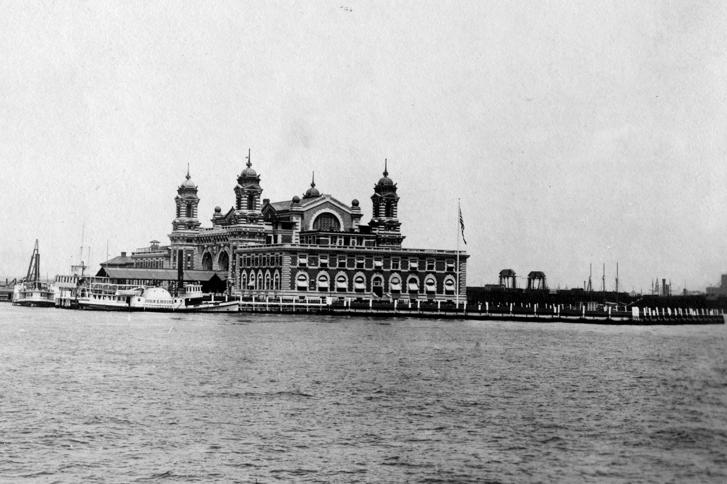
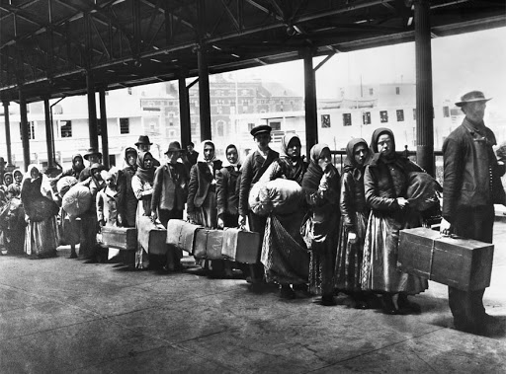
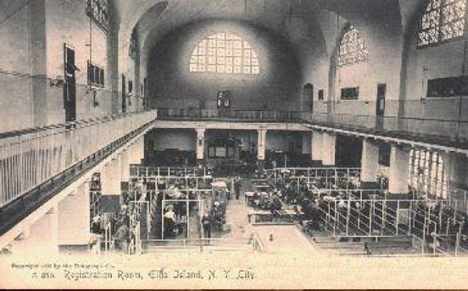
https://www.youtube.com/watch?v=8X4CypTaOQs https://www.youtube.com/watch?v=RJVqs_mhOA4
Notes:
Before the mid 1800s, only a few thousand people emigrated to the US, largely from Europe. You should, hopefully, all remember this from your year one modules but early immigrants from about 1820 to 1920 largely came from Germany, Italy, Ireland, the UK, Poland, Sweden, and Holland to name just the largest groups. During the California Gold Rush in the 1850s, many Chinese also came to the US resulting in the Chinese Exclusion Act of 1882. At this time, the borders were more or less completely open, though “free” black immigrants were only allowed after 1860. The Chinese Exclusion Act marks the first major law in the US to curb and control immigration, to keep out unwanted immigrants. Chinese immigrants were tolerated at first, when gold was still plentiful, but eventually the sources dried out, the Chinese settled in enclaves in cities like San Francisco, and they started “stealing” low-wage jobs in the eyes of their fellow Americans, a fear only exacerbated by the economic decline following the Civil War. No matter the strict policies and laws that followed to stop Chinese immigrants, the result of this early Gold Rush generation of Chinese immigrants is the largest and oldest Chinese enclave outside China and current-day San Francisco would not be the same without the lively streets of Chinatown. To this day Chinese immigrants gravitate towards this enclave in particular because housing stock is far more affordable than anywhere else in inner-city San Francisco.
Another story I’d like to bring up here is Ellis Island as an immigration station in New York. From about 1892 to 1924, the island served as the country’s largest immigrant inspection gate, accepting hundreds of thousands of immigrants each year, with the exception of years when the station had to be expanded or rebuilt. To get a better picture of the scale of this mass immigration from 1820 to 1920, just consider that about 30 million immigrants entered the US during this period, 12 million alone via Ellis Island, while the US population is calculated at about 9.6 million in 1820 and 106 million in 1920. That’s an enormous growth in just a century. The UK only grew from about 21 million to about 42 million in the same period while China grew from about 381 million to about 470 million in this century. Both of these countries serve to show the growth of this young nation at this time. This is very important context to consider if we want to explain how the US become an urban nation during this time and why immigrants made up a considerable percentage of city dwellers. I highly recommend checking out the short documentary on Ellis Island via the link above here! We cannot get a good sense of the perils and barriers immigrants faced without some documentary evidence and insight into this infamous island in New York specifically. Despite major restrictions already in place before the Immigration Act of 1924, it should not be underestimated that few immigrants were deported or detained at Ellis Island. However, when the immigration inspection station became a detention center following the 1924 act, it became the symbol of immigration detention and this history of immigration detention connects all the way up to current-day detention centers, especially in states like Arizona, which has been in the news a lot for their de-facto concentration camps. Check out the second link on the slide for a 4 min video on Arizona’s detention centers. Well, ok, let’s get into immigration after 1924.

Slide 5
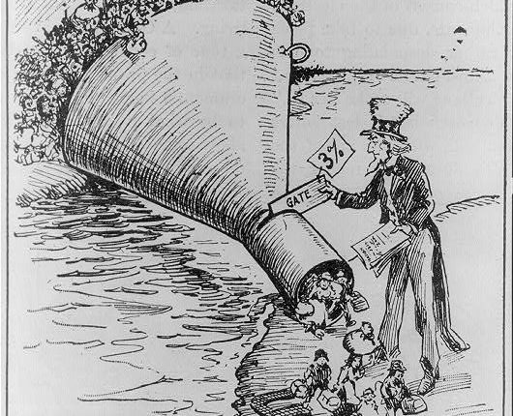
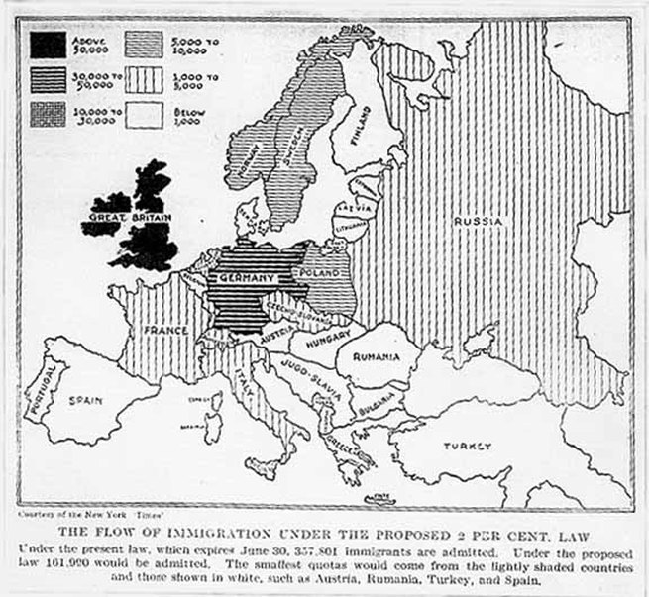
Notes:
And so we come to the Immigration Act of 1924, a law that had been long in the making. Before this, the US restricted immigration via more specific laws in 1917 and 1921, but the 1924 Act was the final nail in the coffin to curb immigration from Europe and Asia especially, the cartoon on this slide is a good representation of the effect of the law. Protestants in the US feared the new non-Protestant immigrants from southern and eastern Europe as well as any immigrants from Asia in general. They considered these new immigrants racially and culturally inferior, a sign of America’s early 20th century nativist movement. Many immigrants living in cities were poor and had to content with terrible working and living conditions and instead of focusing on fixing these urban problems that kept immigrants in these conditions, other Americans blamed the immigrants themselves, fears that eventually resulted in the strict immigration laws.
This act in 1924 is a specific case study that symbolized the growing urban-rural divide in the country. Many of those who propagated the tight immigration laws also criticized the increasing urbanization of America, a country that, as I mentioned on the last slide, has been undergoing a dramatic demographic change with small towns, farms, and other rural areas losing significance and power to the exploding population growth in cities. As you can see, the fear of immigrants is directly tied to the fear of cities in this period because cities represented the waste and squalor of America to these critics. In our discussions for this week, I’d also like us to think about how white Americans, urban critics, the rich, and the powerful segregate and keep out immigrants these days. How has it changed if at all? An important factor in this comparison might be the strength of the Ku Klux Klan in the 1920s in America, whose networks pervaded rural and small town America. What about white supremacists today?
In any case, the 1924 Act certainly had a significant impact on immigration numbers, which plunged from about 1.2 million in 1914 to 300.000 in the late 1920s and then just about 30.000 in the mid 1930s. Despite the decline, the cities had already established well-connected and strong ethnic enclaves all over the country. For a fun exercise, and potentially some ideas for an essay, just do a Google search on a specific ethnicity and a city and you will likely find a local variant of Chinatown, Little Italy, Little Germany, Polish Downtown, Koreatown, etc. Consequently, the drop in immigration did little to curb the population growth and expansion of cities across the US.
Finally, while the New Deal era might be considered progressive at the time, it also catalysed and institutionalized patterns of racial and ethnic segregation and supported the deportation of many immigrant, especially Mexicans. This is where you will hopefully make use of the Sanchez readings for this week to get a better grip on the experience of Mexicans and Mexican Americans in the US, which I am not delving into for this lecture. Let’s move on!

Slide 6
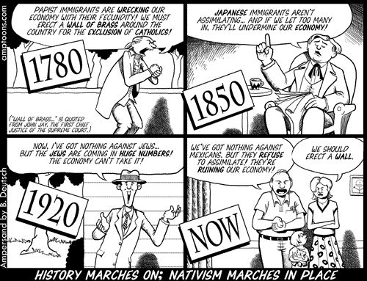
Notes:
While the focus of our discussions this week will be on earlier restrictions and fears of immigrants, I do want to briefly address the Immigration and Nationality Act of 1965. Signed by Lyndon B. Johnson in a swathe of Civil Rights laws in the 1960s, the law essentially nullifies the 1924 Act, removing restrictions for Europeans and Asians, opening up America’s borders a bit more once again. There were still quotas on specific regions of the world, but the hope was the new law would enable families from southern and eastern Europe especially to reunite. In fact, most immigrants came from Latin American and Asia, including many refugees from Southeast Asia following the Vietnam War.
The effect on cities was visible very quickly. Economic decline and substantial migration patterns left cities abandoned and the growing resentment for the lack of support from cities and the government to help cities made itself known in the form of inner-city riots across the country. Left to their own devices, it were immigrant communities like Mexican Americans in Los Angeles, Puerto Ricans in New York, or South Asians in New Jersey who rebuilt their neighborhoods and started small businesses. Following the urban crisis in the 1970s, we move into the reclaiming of inner cities by white Americans in the 1980s and I will leave it at that as this will be the focus of subsequent topics as well. It’s just important for this topic on immigration to understand the way that immigrants across the century have been dealt the heaviest blows and nevertheless helped revitalize their own neighborhoods in the wake of America’s long urban crisis in the 1970s. Let’s move on to the final slide.

Slide 7
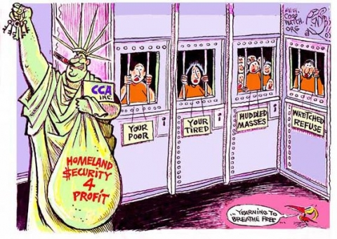
Notes:
And so, to end this lecture, we come to Trump’s America, his immigration bans, his racist rhetoric, and his naïve idea that a wall can keep out Mexicans. A nation’s immigration laws directly reflect its hospitality and while America might have once considered itself the land of the free, a laughable notion in its own right if we just consider slavery, it has not been a hospitable country for migrants for a long time now, certainly not since the Chinese Exclusion Act of 1882 and the strict regulation of immigration following WWI and the Immigration Act of 1924. The history of immigration is a history of people’s irrational fear of the unknown, all the potential criminals, all the people of inferior skin colors, all the people who will steal our jobs, all the uncultured masses, the low-lifes, and the terrorists. The famous lines of a poem, written on the base of the Statue of Liberty and here depicted in a satirical cartoon, have long been America’s greatest joke. A country so afraid of and angry at the poor, the tired, the huddled masses, and the wretched refuse does not deserve to call itself the land of the free and a beacon for democracy. We might consider Trump an exception, an extreme candidate with extreme views, but his rhetoric and policies on immigration, as well as a host of other issues, is reflective of the views of a large percentage of Americans. His views reflect current-day anxieties as well as fears in the past. The fears of Muslims after 9/11, the fears of Mexicans ever since the 1970s, the fears of Germans after WW2, the fears of Japanese after WW1, the fears of Chinese after 1882, and the fears of the “wrong” Europeans before then.
As we go into our discussions this week, we need to carefully think about what cities can and should do to welcome immigrants and migrants, and how cities have historically undermined the immigrant’s right to the city, their ability to participate in the design, life, and future of the city. Let’s end the lecture on this thought and pick this back up in our seminar starting this Friday. Thank you enjoy the readings!

