Slide 1
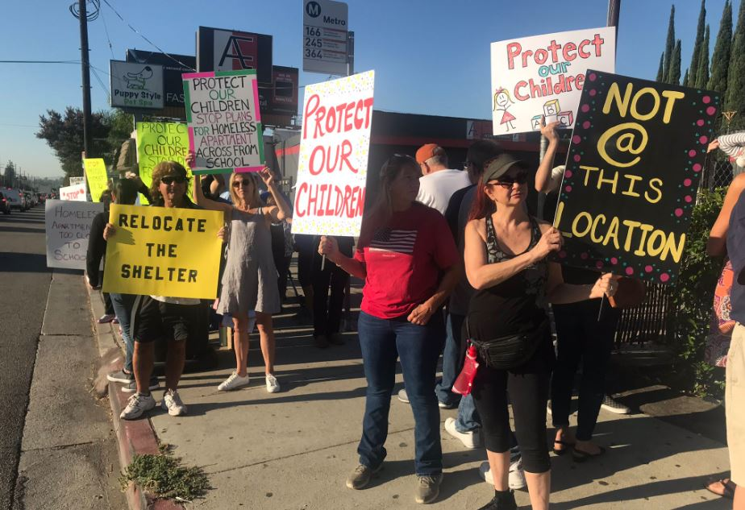
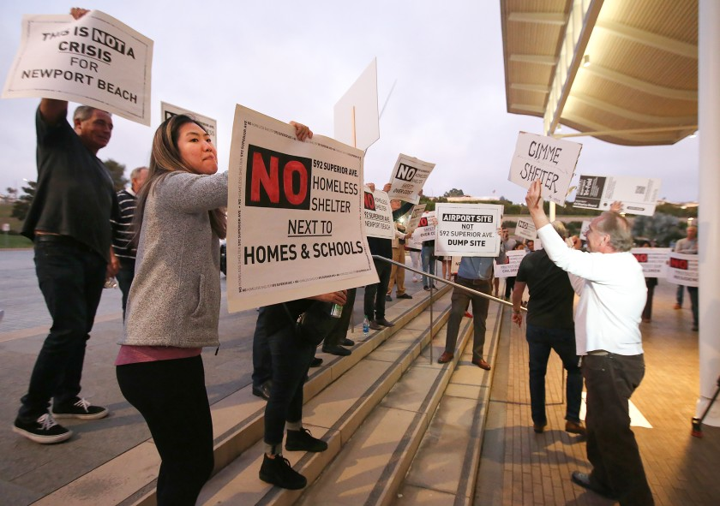

Homeless America
https://www.huffpost.com/entry/war-on-poverty-homelessness_b_1590847?
Notes:
Hello and welcome to week 4 of the module. I hope you all enjoyed the readings for week 3 and thank you again for going along with the trial to run the seminar over the course of 5 days. It did help to get some of you to engage more closely with the discussions and your peers and I really enjoyed seeing you point out how important immigrants and ethnic communities are for the economic and cultural life of a city. However, unfortunately a lot of you did not contribute at all, which means we will go back to the normal schedule we used in week 1 and week 2. So, for the rest of the module, we will meet every Friday at 4pm for an hour in Teams. I will, however, monitor the seminar space even after the seminar ended so please absolutely do keep contributing to discussions, especially if you feel you weren’t able to contribute as much during the hour. Your seminar participation counts for 10% of the module and while this might seem like it’s not important, it is also such an easy way to get a hight mark if you just turn up to the seminars and contribute critically, even if you do so after the one hour. I believe that’s all for housekeeping stuff. Well, actually, I do want to emphasize again that we will hopefully have 2 presentations for this week, by Amy and Jack. Do check these out ahead of the seminar!
Now, for week 4 we will be talking about homelessness in America. At the beginning of the module we already discussed the rise of urban homelessness in the form of our curious child pickpockets in the Bowery and we will briefly look at late 19th century and early 20th century homelessness again for this week. But the focus of this week will be on the post-Depression era and the rise of homelessness in the 1960s and 1970s. Within our framework of the right to the city, homelessness is a very complex issue do dissect. There have been plenty of protests on this issue, both recently and historically, but as the two pictures on this slide exemplify, the protests are usually not to end homelessness, create shelters, or otherwise demand reform to protect and care for the most vulnerable group of city dwellers. In fact, protests take place when citizens don’t want a shelter near their homes or schools. Quite simply, from an economic point of view, homeless shelters no matter where they are de-value the homes and other properties near it. They obviously attract the homeless and that also includes those who are intentionally violent or engage in criminal activities, not unlike the child pickpockets of the 19th century. The reason homelessness is such a complex urban problem comes down to a few key items: nobody wants them (neither city dwellers nor the city administration), they have no political or economic power, and they are practically unavoidable in cities unless you live in a gated community. And as articles like the one at the bottom of the slide indicate, cities try very hard to beautify, clean up, and gate off public spaces to manage and control where the homeless can exist. As we think about the plight of the homeless this week, we need to understand that they are the human waste of a capitalist society. They are the ones who have somehow not managed to churn their way through the capitalist machinery and have been spat out as a result. You guys said that immigrants, even the ones illegal in the eyes of federal law, have a right to the city because they contribute creatively and productively to the life and future of a city. But what about the homeless, then? Do they have a right to the city if they are not only unable to contribute to the design and life of a city but often times engage in violent or criminal activities, making streets or other public spaces “unsafe” as politicians or protesters like the ones on this slide would say? It will be important for us, in this week especially, to focus our critique on the ways cities are planned and controlled in a capitalist society. The reason we will focus our historical examples on reforms like the New Deal and the War on Poverty is because these are the only major attempts in US history to end homelessness, though not effectively at all as we will see. With that, let’s move on!

Slide 2
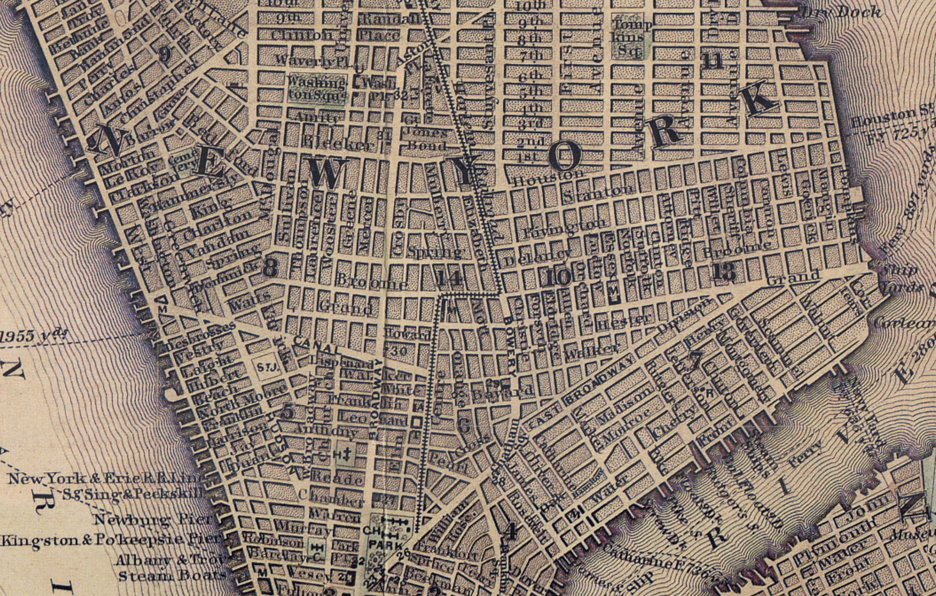
http://povertyhistory.org/
Notes:
So as we begin our inquiry into one of America’s urban plights, we need to go back a bit to the Bowery in New York, America’s most infamous skid row in the late 19th and early 20th centuries. In the last decades of the 19th century, the Bowery was home to the poor as well as the poorest of the poor who frequented the various amenities roughly between Chatham Square and Cooper Square, as you can see on the slide. For a fun exercise on your part, try and locate Chatham Square and Astor Place on this map from 1847, which is roughly the shape of the Bowery alongside the Bowery street. The neighborhood was home to gambling halls, religious missions, pawn shops, used clothing stores, public shelters, cheap hotels, greasy restaurants, dive bars, and, of course, plenty of public space for prostitutes, child pickpockets, and white homeless men. And it is important to stress that the homeless in this area at this time were white men. To this day, there is a crucial absence of studies and histories of homeless women and homeless men and women of color. Even histories of homelessness itself are scarce and the work that has been done has not been fully able to uncover the voices of the homeless themselves. Those archives often don’t exist or are written and recorded by the city, the elite, or those who try to pathologize and victimize homeless, essentially treating them like stray animals to be treated rather than humans to be helped. One of the main reasons why African Americans who were homeless were usually found up in Harlem is actually quite obvious: Jim Crow laws and racial segregation banned African Americans from even making use of many of the facilities on skid row.
While we will use the homeless as a general term now, there have been plenty of, often derogatory, terms to describe people living on the streets or in run-down cots and shared apartments in poor neighborhoods: tramps, transients, bums, vagrants, and hobos. So in your search for primary and secondary sources on the homeless in the 19th century or the early 20th century, those terms will come in handy. In any case, even at this time, people avoided skid row and the city and police enforced various regulations to manage what they saw as criminals and low-lifes. Local ordinances banned drunken behavior, loitering, vandalism and the police very much ensured that the homeless would stick to skid row and not venture further out into nicer neighborhoods as even at this time businesses and homeowners decried how shelters and the shady amenities of skid row drove down property values. At the end of the 19th century and some way into the first two decades of the 20th century, cities and charitable organizations established lodging houses and work farms alongside shelters but they generally saw the cure for homelessness in getting the homeless back to work by making them cut wood, clean, or do other jobs in exchange for meal tickets rather than cash. There was a fear the homeless would become lazy and dependent if they received actual money for their labor, so direct-relief and truly free shelters, meals, and accommodation was rare.
What happened to the Bowery? Well, it turns out despite all the best efforts of the police, citizen campaigns, and the city administration, the Bowery remained the hub for the homeless until the 1970s when the spread of gentrification finally scattered the homeless across the city. Trendy shops, smart real estate developers, and adventurous tenants not afraid of the Bowery’s reputation, in fact seeking it out, eventually helped make the Bowery a sought-after and hip neighborhood and of course gentrification spread like a wildfire in downtown Manhattan in the 1970s and 1980s. Let’s move on to the New Deal and the Depression! Oh before I forget, do check out the link at the bottom of the slide, which is a fantastic visual timeline and guide to poverty in New York, even though it has some technical problems. Ok, now let’s move on!

Slide 3
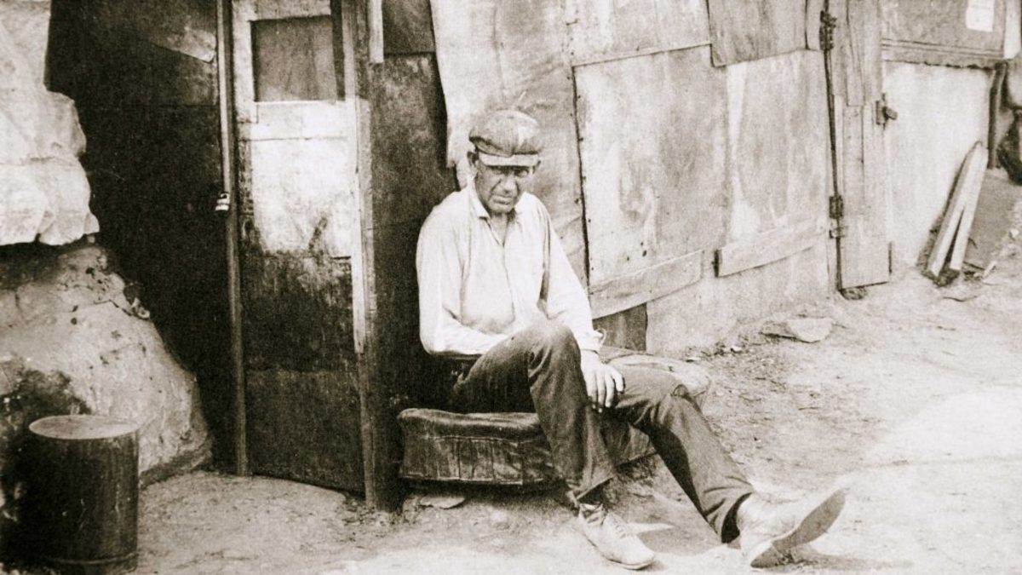
https://www.youtube.com/watch?v=YHLI13X29h8
Notes:
In order to understand New Deal attempts to combat homelessness, we also need to understand how the homeless have been portrayed and effectively romanticized in books and films like Charlie Chaplin’s The Tramp, which is linked here on the bottom of the slide. Following these artistic works by Chaplin or Jack London as well, society started seeing the homeless more as victims and less as criminals. When Roosevelt’s Social Security Act established the Federal Transient Program in 1933, it was designed to provide states with the financial means to help the homeless. Local efforts in cities like St. Louis helped shape this federal program in the 1920s and early 1930s. In the example of St. Louis, the Bureau for Homeless Men understood shelters, work houses, and jails as the cause for homelessness rather than the solution and they, instead, focused on homelessness as a result of a lack of family attachment. St. Louis “constructed homelessness as an individual matter resulting from deficiencies in white masculinity” according to an article by Doug Genens. St. Louis did also help homeless black men through material means, but ultimately the caseworkers did not see black men as potential breadwinners for families, so the support ended there while support for white men was more in-depth in order to help these men find work and become the head of families. The city did not care about homeless women at this time. While historical records and statistics of homelessness are flawed, a 1933 survey estimated a rough 1,225 million homeless in the US with only 14,000 women.
The New Deal efforts managed to help combat the idea of homeless as criminals that needed to be put into work camps to slave away for meal tickets and the prevention and “cure” for homelessness was increasingly considered to be of an individual, case-by-case nature rather than some mass plague to be eradicated. Still, homeless men were still considered to be deviants and victims that need to be treated and “fixed” socially or psychologically as it was unacceptable that a white male adult was not a family men or a man of some social standing. The interviews with homeless men were designed to, hopefully, make the men realize they should go home and find their family. Black men, according to the interviewers, had “less regard for family conventions.”
Franklin D. Roosevelt, much like Lyndon B. Johnson after him in the 1960s, seemed to make it his mission to help the poor. In a speech in 1932, he said he is committed to projects “that build from the bottom up and not from the top down, that put their faith once more in the forgotten man at the bottom of the economic pyramid.” He cemented this idea in his famous Four Freedoms speech in 1941, specifically in the freedom from want. His administration’s assistance, in the form of the Federal Transient Program, lasted for only about two years and did little to materially provide relief to the homeless scattered across America’s cities. Local and state power struggles as well as citizen critique of the programs as being wasted on the homeless ensured that these social policies, quite radical for their time though not fully-developed to work, failed to make a significant dent in the rising number of the homeless. Let’s move on to the next slide!

Slide 4
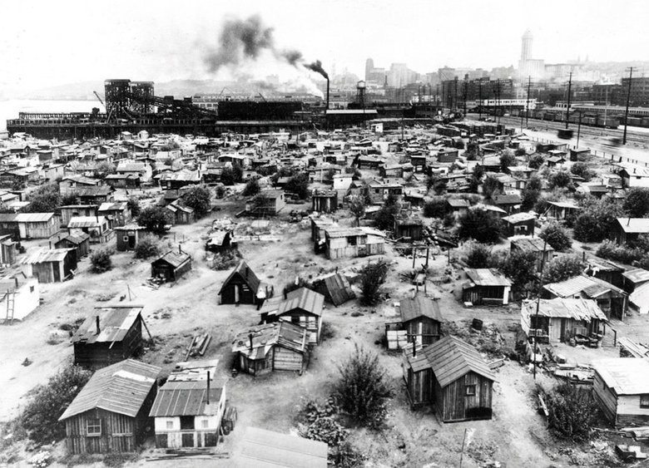
https://depts.washington.edu/depress/hooverville_seattle.shtml
Notes:
Moving from the St. Louis’s Midwest to the north western Seattle, we find that one phenomenon connected both cities in the mid-1930s: Hoovervilles. The very efforts promoted by Roosevelt in the mid to late 1930s were a direct response to the images from this slide and the last slide. Hoovervilles, named after President Herbert Hoover, erupted across cities during the Depression and very much looked like the Seattle Hooverville on this slide here. Seattle actually had 8 Hoovervilles in total, while St. Louis’s Hooverville had its own sectors, a mayor, and churches as well as other community groups. Another notable Hooverville was in Anacostia in Washington, D.C, which was home to WWI veterans seeking benefits for their service. Some Hoovervilles lasted for a few months or a year while others, like the one pictured above near the Seattle port, lasted for almost a decade. As even this image above shows, these were quite sophisticated villages, housing thousands of homeless and poor people suffering from the Depression and a large-scale economic crisis brough on by bank failure, widespread debt, low wages, and high unemployment.
Hoovervilles had such a visible effect on US society that there was an actual attempt to help the poorest of the poor but the Hoovervilles outlasted the federal program by several years, all the way to WWII. And why would homeless choose these so-called shanties over shelters offered by churches and other charities? The shelters were in horrible shape and many homeless men simply preferred to scrap together some material and build their own little house.
While Hoovervilles were shut down by the army or the police, with many men finding opportunity in joining service in WWII, the phenomenon did not completely end and was resurrected in the 1980s during the urban crisis with a renewed rise of homelessness as a result of gentrification. A tent city was created in New York’s Tompkins Square Park because citizens were forced out of their homes due to their inability to pay rent for refurbished and trendy homes in downtown Manhattan. This tent city was, of course, violently torn down by the police in a horrendous riot in 1988. Hoovervilles represent an interesting look into the intersection of urban life and the homeless, so I recommend checking out the website on Seattle on this slide or research yourselves and maybe you’ll find an idea for a great final essay in this phenomenon. Hoovervilles, by and large, represent a real and visible effort of the homeless to claim their right to the city and their “right to shelter,” which is an idea we will get back to in a couple of slides. For now, let’s move on!

Slide 5
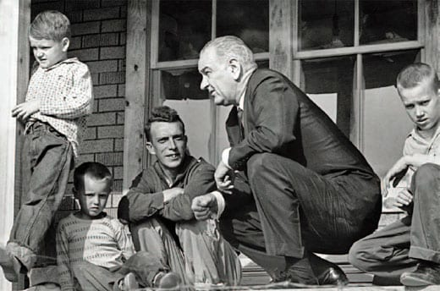
https://www.youtube.com/watch?v=f3AuStymweQ
Notes:
Following the ill-intentioned attempts of churches and charities to help the homeless as well as the weak and ineffective social policies of the New Deal, the last major effort came in the 1960s with Lyndon B. Johnson’s so-called war on poverty. After WWII, federal and city programs funded a range of projects to develop and rejuvenate cities and “clean up” inner cities to make them more attractive to white city dwellers again. Unlike New Deal policies, there was no more real interest in building and expanding public housing for cheap to house the poor and homeless. Instead, America’s famous 1950s middle-class moderates preferred renewal programs to beautify properties and build new, expensive homes designed for the middle-class rather than the working class or the poorest of the poor.
While concentrated hubs for the homeless, such as the Bowery, came to an end in the 1960s and 1970s, homelessness was in no way “fixed” and federal programs such as President Johnson’s Great Society once more tried to help the homeless. The funding of Great Society projects went further than New Deal projects, stipulating that funding would go directly to local and neighborhood organizations that applies for grants and monies, rather than distributing the money to states or city administrations only, though this happened as well. The programs, however, lasted not even two years (1964 to 1965), abruptly usurped by a need to focus more on the conflict in Vietnam. Now, it is important to stress that the laws Johnson pushed through Congress greatly expanded social welfare, helping the elderly, people with disabilities, children, uneducated teenagers, and widows among other groups. However, since our focus is specifically on the homeless, it is very fair to say that Johnson’s programs simply did not focus on the homeless as much as Roosevelt’s New Deal programs did. The Great Society programs focused a great deal on funding loans for urban housing and it certainly helped subsidize efforts to revitalize inner cities, but none of this funding was realistically available to homeless people. At best, charities and shelter organizations were able to apply for loans and funding, though this filter ensured there was little to no direct relief to homeless people even when new shelters were built or old ones renovated. In essence, while there was a concerted effort to help the poor, to fight poverty, in the 1960s, there was no real effort to help the poorest of the poor, considered once again powerless, voiceless, and disposable. Let’s move on to the last slide!

Slide 6
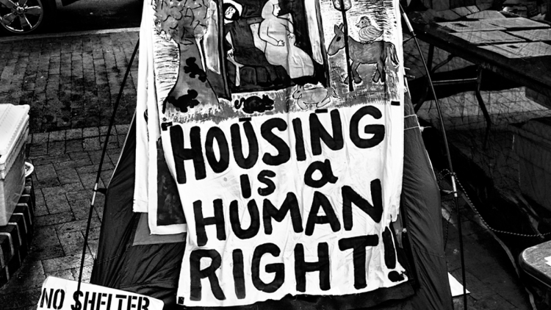
https://caselaw.findlaw.com/ny-court-of-appeals/1102948.html
Notes:
For our final slide for this week, I’d like to return to the idea of the right to the city and how we place homeless people in this framework. One way to help us answer this is based in the Callahan v. Carey court case from 1979. Robert Hayes, who co-founded Coalition for the Homeless, sued the state of New York and New York City in a class action lawsuit to argue that homeless have a constitutional right to shelter based in Article XVII of the New York State Constitution, which declares that “the aid, care and support of the needy are public concerns and shall be provided by the state and by such of its subdivisions.” You can find the full court ruling on the link on the slide here, but in essence, city and state agreed to the terms of the lawsuit in 1981 and thus accepted to provide shelter for homeless men, women, and children who meet the requirements for shelter support. Robert Callahan, the lead plaintiff in the case, was homeless and sleeping rough in the Bowery when Hayes found him and asked him to help build a class action lawsuit. Unfortunately, Callahan himself died on the streets before the lawsuit was successful, but while many of the stories surrounding the support for the homeless have so far been quite horrendous or sad, the victory for this right to shelter enabled a host of charitable organizations to more effectively receive funding and help the homeless. The Coalition for the Homeless is a well-established, grassroots organization helping the homeless in New York, and this time not just white men in the Bowery. We do need to remind ourselves, however, that no matter how effective an organization like this is, all that’s done is provide relief to homeless, not end it. Programs like this help shelter and feed homeless New Yorkers but such programs don’t exist in all cities, it’s a unique situation, it’s not a federal law.
It does, however, mean that there is a path to legal interpretations of the right to the city as a right to shelter. We can clearly see how the homeless in New York have a legal right to the city via their right to shelter, but do we think this goes far enough? And in our seminars for this week I would also very much like to dissect how homeless people claim their right to the city besides fighting for their right to shelter. Crucially, we need to think about whether homeless people help shape, design, and grow the city or if we think they are not in a place to do so without socio-economic power. What is clear is that we cannot discuss cities without considering how cities treat its poorest. They are a stark and continuing reminder how a capitalist economic system and society without a social safety net leaves many behind. Latest estimates put the number at anywhere between half a million and a million who require shelter and food every night and the pandemic is not only pushing more people out of work and out of their homes, it is also making life that much harder on the streets. If we want to even begin discussing how we can end homelessness, we have to give a voice to the homeless and provide unconditional, direct relief not just to shelter them but to rehabilitate them and help them find work if possible.
That’s it for the lecture for this week. Please do read the required texts for this week and check out the presentations when they are uploaded on Wednesday or Thursday. And like I said, we will meet LIVE at 4pm for an hour this Friday and we will do so for the rest of the module! No more experimenting, I think, yes, I think we’re good with the experiments. Ha! Bye bye!

