Slide 1
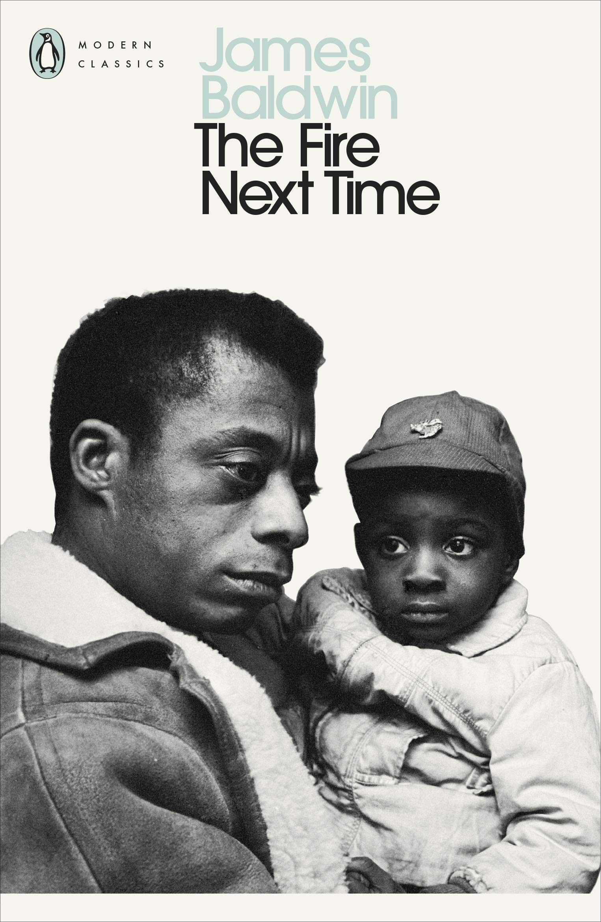
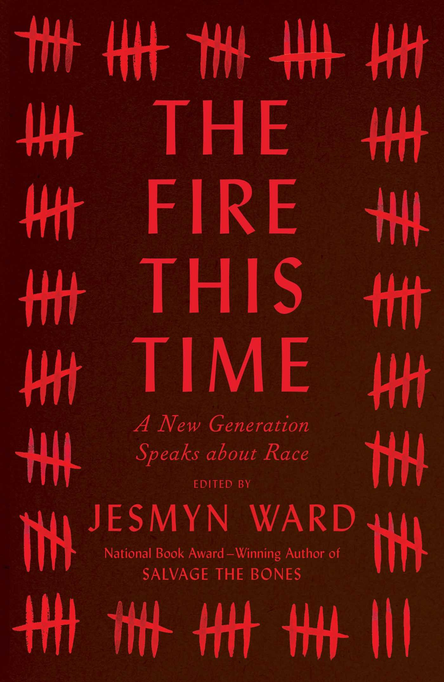

Notes:
Hey folks and welcome to week 5, the last week before reading week, and one that I hope will fire you up as you prepare for the seminar this Friday and, more importantly, your prep for the final essay. As I mentioned in the email on Sunday, do make sure to plan ahead for your final essay. I will let you know once I have the full schedule for your deadlines on Tabula, but for now just make sure you are ready to have a title for your final essay ready in week 6 when I will prompt you for it via email. With that bit of housekeeping out of the way, let’s get into it.
Our focus for this week is on black urban history and, specifically, the ways in which black city dwellers have been oppressed as they have sought to claim their right to the city, from the days of plantation slavery all the way to modern-day slavery in the form of mass incarceration. To begin with, I’d like to address the quote in the title for this week: “The Fire This Time.” It comes from the title of an important collection of essays by Jesmyn Ward in the wake of the Black Lives Matter protest movement and this, in turn, is based on a fundamental text in American literature: The Fire Next Time by James Baldwin. In his two essays, Baldwin discusses the history and continued reality of black suffering at the hands of white America. He mentioned the "rope, fire, torture, castration, infanticide, rape; death and humiliation; fear by day and night, fear as deep as the marrow of the bone; doubt that he was worthy of life, since everyone around denied it; sorrow for his women, for his kinfolk, for his children, who needed his protection, and whom he could not protect; rage, hatred and murder, hatred for white men so deep that it often turned against him and his own, and made all love, all trust, all joy impossible...The apprehension of life here so briefly and inadequately sketched has been the experience of generations of Negroes, and it helps to explain how they have endured and how they have been able to produce children of kindergarten age who can walk through mobs to get to school. It demands great force and great cunning continually to assault the mighty and indifferent fortress of white supremacy.”
And this is at the core of our discussions and readings this week, how this fortress of white supremacy has oppressed African Americans trying to settle and live in cities across the US. Why are cities so racially segregated? How do landlords visibly and invisibly discriminate against black tenants? How does the city manage to prevent black city dwellers from voicing their concerns, electing politicians, and building a city to live in and not get killed in. And, with a keen eye on the Black Lives Matter movement, why do cops still get to beat and murder black men and women in the streets? Cops killed African Americans during the years of urban crisis in the 1970s and 1980s, they killed them during the Civil Rights protests, they killed them during Jim Crow, and they most certainly killed them when they were not even considered full human beings in the eyes of American law. We will tackle some of these critical questions this week, especially in the small groups on Friday, but one thing I want all of you to keep in mind as well is that while homeless folks may be pitied, ignored, and tossed aside, African Americans are both strategically and impulsively oppressed, choked, or gunned down. The history of American cities is as much a history of capitalist supremacy as it is a history of white supremacy. Let’s move on!

Slide 2
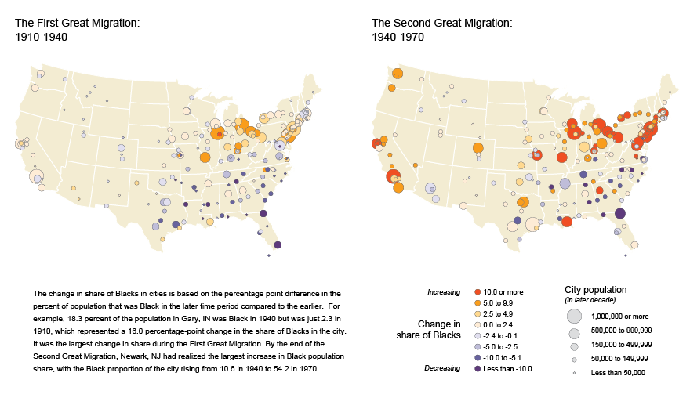
https://www.census.gov/dataviz/visualizations/020/
Notes:
I mentioned shifting migration patterns in previous weeks already, but it’s important to say that there were two major migrations between the 1910s and the 1970s, which tremendously changed the American urban landscape, specifically increasing the ratio of non-white city dwellers across the US, but especially in the Midwest as well as along the East and West Coasts. As official census data shows on the slide, the city of Newark in New Jersey had an increase in its share of African Americans from 10.6 in 1940 to 54.2 in 1970. And as the map shows, cities like Los Angeles, San Francisco, Seattle, New York, Chicago, New Orleans, Detroit, Philadelphia, Cleveland, Washington, and Pittsburgh, all provided sought-after destinations for African Americans between WWI and WWII as well as after WWII. Besides the obvious reasons such as labor and family relations, many African Americans fled the Jim Crow South, not unlike refugees fleeing from a war-torn or hostile country to seek shelter wherever they could find it. The radical demographic change cannot be understated as many cities very quickly counted a majority or near-majority of non-white city dwellers, including migrants with Asian and Spanish-speaking backgrounds.
Now, while there was, and still is, widespread racism and discrimination against people of color, cooperation and solidarity between African Americans, Latinos, and other ethnic minorities was rare and rarely successful for a sustained amount of time. I would point you all to the entire edited collection by Kusmer and Trotter, of which you are preparing one chapter for the seminar, as a fantastic guide to this complex history of the fight against Baldwin’s fortress of white supremacy in cities. In some instances, like with the Puerto Rican group the Young Lords, there was a great deal of solidarity and cooperation between Latinos (specifically Puerto Ricans) and African Americans, but in other cases such as in Phoenix or Philadelphia, there were a lot of interethnic struggles and disagreements that hindered any sustainable fight against their shared experience of discrimination by the city administration, landlords, and the police. In addition, if you remember last week’s mention of the urban renewal projects of the 1950s and 1960s, for example, a lot of these programs did create new public housing projects and tried to help poor and working-class families, but they also removed and cleared vast inner-city areas considered to be “slums,” “ghettos,” or generally “blighted.” And, you guessed it, this meant that many African American homes, businesses, and other civic properties were torn down and replaced, forcing those who lived and worked there to either move to a “blighted” area not yet cleared out or settle in the increasing numbers of black suburbs in the 1970s and 1980s during the urban crisis and the force of deindustrialization, which significantly shaped the new economy in these decades. These two major migrations help contextualize our discussions for this week and to get a better sense of why America became rapidly urbanized during the twentieth century. Let’s move on!

Slide 3
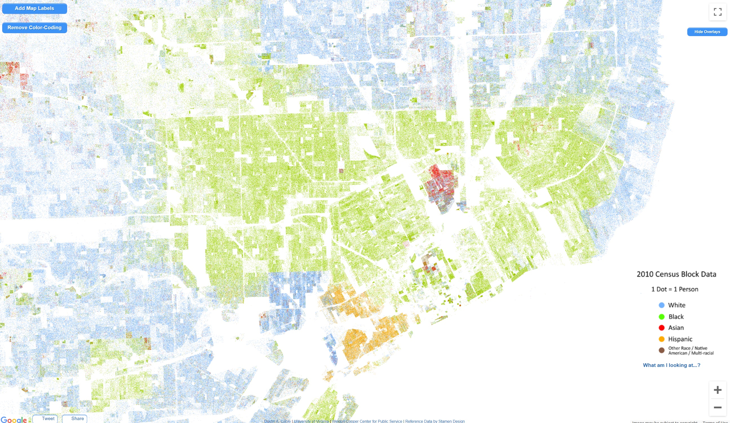
http://racialdotmap.demographics.coopercenter.org/
Notes:
One major topic we have to discuss is residential segregation and how city planners have divided cities of the twentieth century to produce cities that look like Detroit on this slide and you can find similar examples if you visit the website at the bottom of the slide, which links you to the important Racial Dot Map project. The map simply puts down a colored dot for the different racial backgrounds of citizens and that’s how you get to maps of cities that look so meticulously segregated. The furthest suburbs and smaller towns are white, then there is a large area of black suburbs and neighborhoods surrounding the inner city of Detroit, and finally you get to the inner city, which is relatively diverse, but also quite white and Asian as opposed to black. Even in a city like Detroit, with its recent history of large-scale abandonment and slow rejuvenation, the inner city is still expensive and not home to working-class or poor folks. You will find similar trends if you check out any other major city in the US on the map, each with their own variants, of course. In many cities, you will find a significant north-south divide along the color line with white city dwellers usually occupying the well-maintained and well-funded north side. Atlanta or Chicago are examples of this. So how do we get to such maps?
Following the National Housing Act of 1934, the Federal Housing Administration and the Home Owners’ Loan Corporation strategically surveyed cities and created residential security maps to help banks and developers identify safe areas for investment and mortgage lending. Of course, this ended up barring many black and other non-white city dwellers from accessing loans to build or buy homes and properties. This process is called redlining and it’s hopefully a term you should have heard at some point. This widespread federal regulation severely held back African Americans from accessing much-needed bank loans to get started on the housing market. This is why they were unable to cope with the urban crisis of the 1970s, while white homeowners were able to move, buy, sell, and secure as they saw fit to escape the economic crash following deindustrialization and increasing unemployment. Mass production moved overseas or into more remote towns and suburbs outside the city, which left African Americans behind to live among the abandoned and ruined factories that were integral to the lifeblood of cities. This is, of course, part of the context that brought about the so-called city riots of the 1970s. In the grand narrative of American history, taught in schools, remembered by older generations or regurgitated by the media and politicians, these riots are associated with violent and unruly African Americans. Of course all of us know better, we see the context of oppressive and racist systems within cities that held back African Americans and ensured that they were in a very vulnerable position during the urban crisis. They were, pretty much, stuck in towns and cities without enough work to go around. Ok, let’s move on.

Slide 4
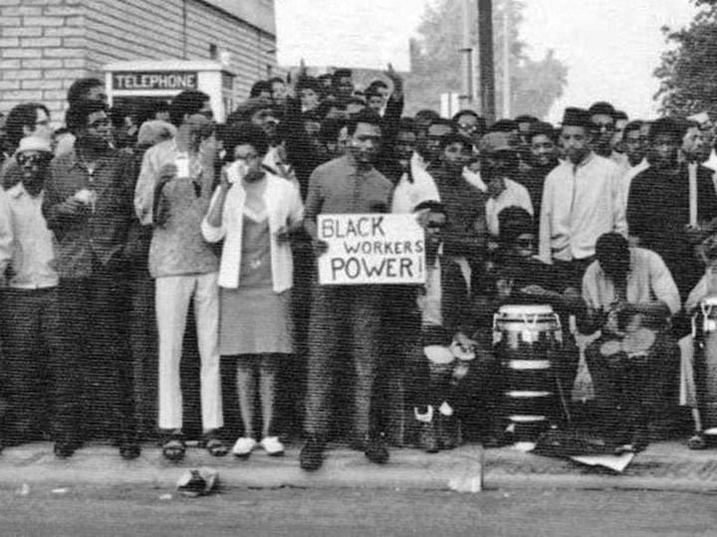
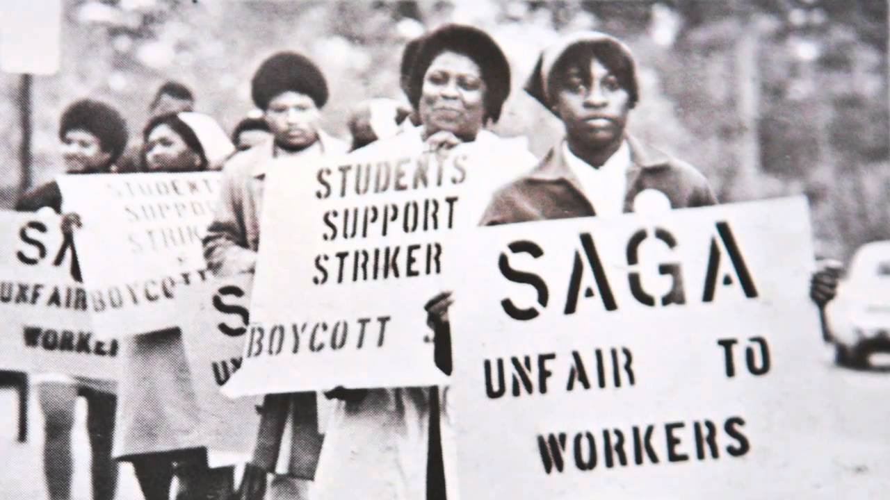
https://exhibits.lib.unc.edu/exhibits/show/protest/foodworker-essay
Notes:
True to the name of the module, I’d like to move on to some efforts by communities in cities to fight against injustice, including redlining, and claim their right to the city, which, as we have already discussed in the seminars, includes a right to housing. I am confident you have all discussed the Civil Rights Movements as a distinct movement in modules elsewhere as well as in school, but in relation to cities I’d like to focus on the period after the Voting Rights Act of 1965. One example for this, and you can get more details in the essay by Thompson you will read for the seminars, is workplace activism in cities such as Detroit. Following the Detroit rebellion of 1967, black urbanites in Detroit organized in factories such as Chrysler Dodge. They called their movement the Dodge Revolutionary Union Movement and it spread to other plants in Detroit as well before becoming the League of Revolutionary Black Workers, with a considerable overlap with Detroit Black Power activists. As a black union movements, they were not just critical of the management at Chrysler plants, they were continuously at odds with the larger United Auto Workers union. Elected union officials from the League were replaced or fired as soon as possible in the following years to ensure the movement would not take hold. It’s one of those stories that we can find again and again repeated in the struggle for social justice and human rights. These black unionists were too radical, too left for the so-called “liberals” who are, in essence, just centrists who don’t like Republicans. It’s even a story that you should all know from the recent months of protests in the US. Sure, liberals think African Americans should not be killed by the police, but to “riot” and “vandalize” the city, to call cops bastards, and to call for the abolishing of the police force as it exists now, that, of course, goes too far. It’s too “extreme,” it’s “terrorism,” we heard in the media, but it exposes just how few Democrats or liberals, those who think they are on the correct side of the political spectrum, are genuinely dangerous in their centrist and often even right-wing rhetoric when the chips are down.
Workplace activism such as this was widespread in the 1960s and 1970s, African Americans found just enough support from Civil Rights organizations and the new Civil Rights laws to enable them to organize, unionize, and protest in the face of the poor working conditions. In another example of workplace activism, the construction industry absolutely boomed in the postwar service economy. At times the industry employed about 10% of the entire male workforce in the US, which is significant. This also means that construction unions had a lot of power to control wages and worker access in the industry. By and large, as you can imagine, industry-wide racism also prevented black workers from moving from industrial jobs to management jobs. In one case in Philadephia in 1963, activists built a grassroots movement incorporating Civil Rights tactics to confront institutionalized racism in the industry. Civil Rights groups CORE and NAACP helped workers start a series of protests and shutdowns to demand that they be included in city-sponsored construction projects that would help them move up and ahead, they hoped. Protests like this one in Philadelphia were successful in shaping the northern freedom movement and it shaped significantly how Black Power activists envisioned the present and future of their cities. There is plenty more on workplace activism and how it shaped city economies and the Civil Rights and Black Power movements, but I’ll leave this for you to research if you plan to write about this for your final essay! One other case study is a food strike and you can find more info at the link on the slide. Check it out! Let’s move on.

Slide 5
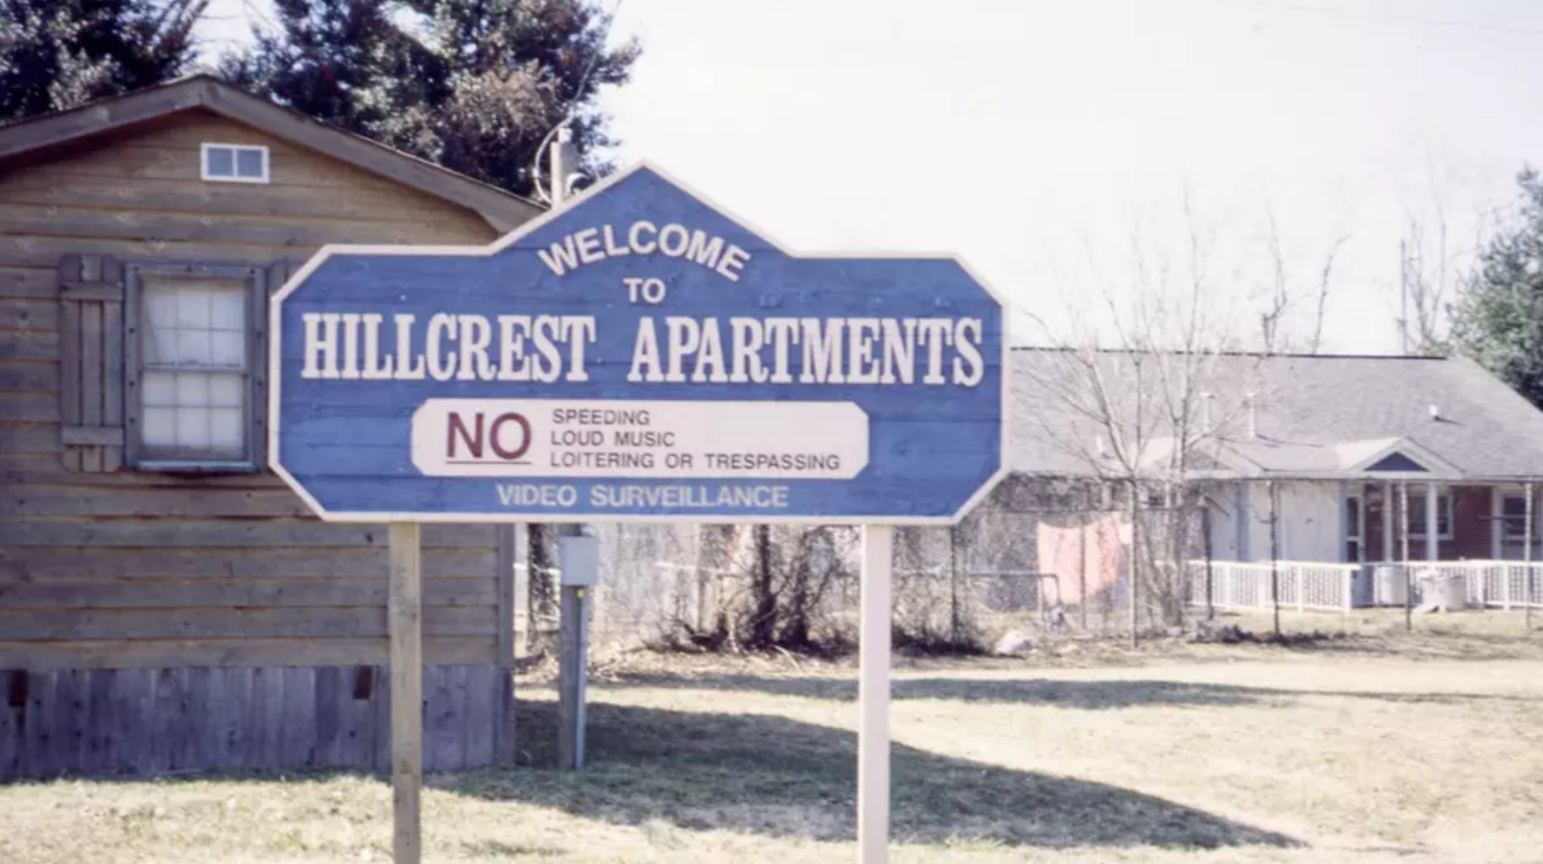
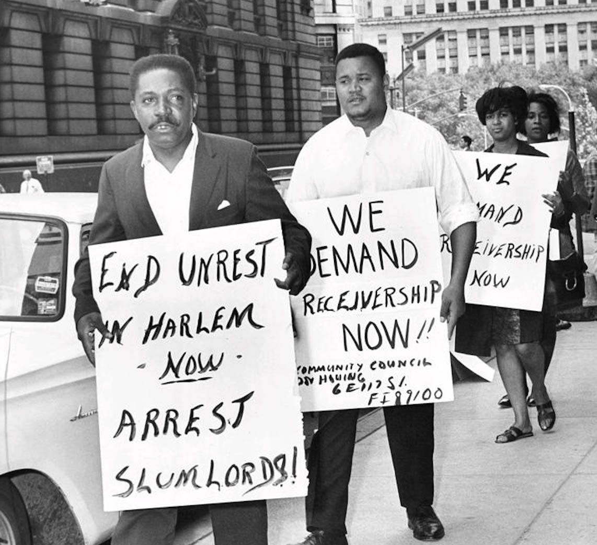
Notes:
Another domain of intense and widespread urban activism in the 1960s and 1970s was, of course, tenant activism. Facing racist redlining policies, racist landlords, racist real estate developers, and racist city administrations, many black tenants in these decades found their activist voice as they proclaimed, in the case of Asheville, “we are human and we want our freedom.” Sarah Judson has an amazing article on this among your readings for this week and I can ensure you that if you look at the rhetoric of many activists at this time, it is striking how much it resembles abolition rhetoric. I have read very similar things in the letters and flyers of Puerto Ricans in the 1970s, who shared a similar fate as African Americans during the urban crisis. They demand to be considered human and they just want their freedom. This is no exaggeration, of course, as for many African Americans, the racism they faced in all aspects of their daily lives made it clear again and again that far too many Americans, neighbors, colleagues, do not consider them human. They were not free, trapped and enslaved in new forms of economic, legal, and cultural slavery. In any case, tenants from Asheville’s public housing complexes began a rent strike in 1967, which is a straightforward strike to withhold rent until certain conditions are met (including building maintenance or eliminating racist barriers). Within the Civil Rights Movements, we heard about the calls to end racism, overturn racial inequality, and affirm black voting rights. However, when you get down to all the activist campaigns and local strikes such as in Asheville, what you will often find sounds quite ordinary: “Residents protested the ways that their quality of life was constantly undermined and downgraded…they complained of commodes that leaked into kitchen sinks, overflowing dumpsters, having to wade through mud and standing water whenever they left their front stoops, and broken windows and appliances that were never fixed or replaced.” Nobody should live in such conditions but such was the nature of both private and public apartments for non-white city dwellers or those barely able to maintain rent payments. Now, the rather ordinary nature of this rent strike, and others like, does not in any way reduce their significance, in fact it makes it all the more clear how important such small-scale, local action in cities was and continues to be to this day! When we look at protest and social movements fighting for human rights and social justice in the US all the way from the slaughter of Native Americans to the slaughter of African Americans in 2020 in the middle of the street in daylight, you will find that this fight for justice tends to just claim a right to be considered human, a right to live in peace, a right to the same opportunities as white Americans, a right to clean and safe apartments, a right to walk the streets without fear of being killed, a right to just exist as the vast majority of white Americans do. And yet, at very turn, progress towards this simple goal stops right in front of the fortress of white supremacy. And sure, over the centuries, oppressed folks have managed to put quite a lot of dents and holes in this structure, finding some path inside even, but the fortress still stands and it’s just something we all have to keep in our minds at all times. That any progress has been achieved is simply down to the strength, creativity, and force of will of activists at every level, from small rent strikes in a single building over the course of a few weeks all the way to large-scale and historic marches to Washington. Let’s move on!

Slide 6
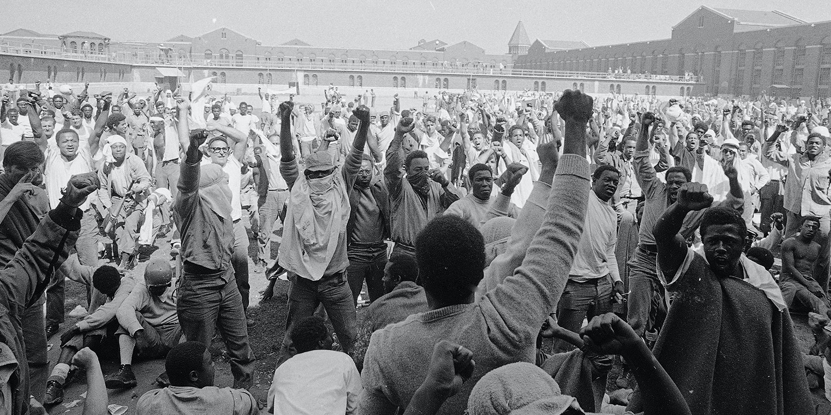
https://www.youtube.com/watch?v=oG1f7FzgXY8
Notes:
For our last example to showcase this strength of activists, we should look at mass incarceration and its role in oppressing African Americans. Now, there is a great documentary with source footage on Youtube here on this slide, but I have to disappoint you if you hoped it would be short. If you cannot find the time to watch all of it, just start at about minute 7 and watch for a few minutes. You can even see how the prisoners here built their own version of a makeshift tent city within the prison. In any case, there is a reason mass incarceration is such a crucial topic when we discuss the oppression of African Americans. Before the 1970s, the inmate population in state and federal prisons usually rollercoastered between 100,000 and 200,000 total. However, the population exponentially grew from about 200,000 at the time of the Attica prison rebellion in 1971 to about 400,00 a decade later, and 800,00 in the mid-1990s to almost 1.6 million in the mid-2000s. Why? You probably already know this, but just like Jim Crow laws replaced slavery, so did mass incarceration replace Jim Crow. I hope you’ve all seen the 2016 film 13th, but either way the Attica rebellion and the exponential growth of the prison-industrial complex between the 1970s and the 2000s exemplifies a new form of slavery, with outright slave labor for prisoner who don’t get a vote and don’t have basic citizenship rights otherwise. Just like the tenants or the workers outside the prison, they are not considered human, they are not considered American citizens with full access to their legal citizenship. They are systematically criminalized in cities, picked up and arrested in the streets, thrown into jail, and forced into the prison system with little hope to get out or rehabilitate afterwards. If the oppressive conditions of the prison itself don’t hold them back, it’s the barriers to employment and housing afterwards that will surely make it significantly harder for African Americans to get back on track, as if it wasn’t hard enough before prison. There have been a few prison rebellions in the US, but the Attica rebellion in 1971 remains an important historical event that showed the true horrors of prison labor and the fact that it’s predominantly African Americans as well as Latinos who are being funnelled into prison via racist cops and racist laws. But we’ll speak more about policing in week 7.
As for the rebellion itself, the claims for justice, to have their humanity recognized and affirmed, do not sound so much different to the tenants in Asheville. I quote Elliott James Barkley, who became the group’s spokesperson and who was tragically killed when the prison was taken back: “We are men! We are not beasts and we do not intend to be beaten or driven as such. The entire prison populace, that means each and every one of us here, have set forth to change forever the ruthless brutalization and disregard for the lives of the prisoners here and throughout the United States. What has happened here is but the sound before the fury of those who are oppressed. We will not compromise on any terms except those terms that are agreeable to us. We’ve called upon all the conscientious citizens of America to assist us in putting an end to this situation that threatens the lives of not only us, but of each and every one of you, as well.” Again, you can hear more in the documentary. As we discuss mass incarceration in our seminar, we need to also understand how black citizens are here strategically rendered voiceless with respect to their ability as citizens to vote. Whereas homelessness is perhaps a by-product of a brutally heartless and capitalist society, mass incarceration is a clear product in its own right, both of capitalism, considering how many prisons are run as private profit-making companies, and of white supremacy. And once again, those do go hand in hand in many ways.
That’s it for this week’s lecture folks. I hope you’re fired up. I am recording this on election day in the US and the outcome of this is, as always, far more significant for vulnerable groups, minorities, African Americans, those who fall beneath the cracks, and those who are living from paycheque to paycheque. For these marginalized and oppressed folks, the choice is between a bad outcome and a far worse outcome. Biden won’t crack down on the prison-industrial complex, he won’t help end residential segregation, he won’t fix the education system, and he won’t reform the police force. But he also won’t outright say there are “two sides” when white supremacists terrorize the streets. It’s not nothing but it’s certainly not enough, not by a long stretch. I’ll see you all on Friday at the usual time!

