Slide 1
The Making of Eastern Europe and the Russian attack on Ukraine
Making of the Modern World, Spring Term, Week 10
Christoph Mick

Slide 2
Introduction
Mapping Eastern Europe
History Matters
Imperialism and belated Decolonisation
Putin’s miscalculations
NATO
Conclusion

Slide 3
Introduction
Mapping Eastern Europe
History Matters
Imperialism and belated Decolonisation
Putin’s miscalculations
NATO
Conclusion

Slide 4
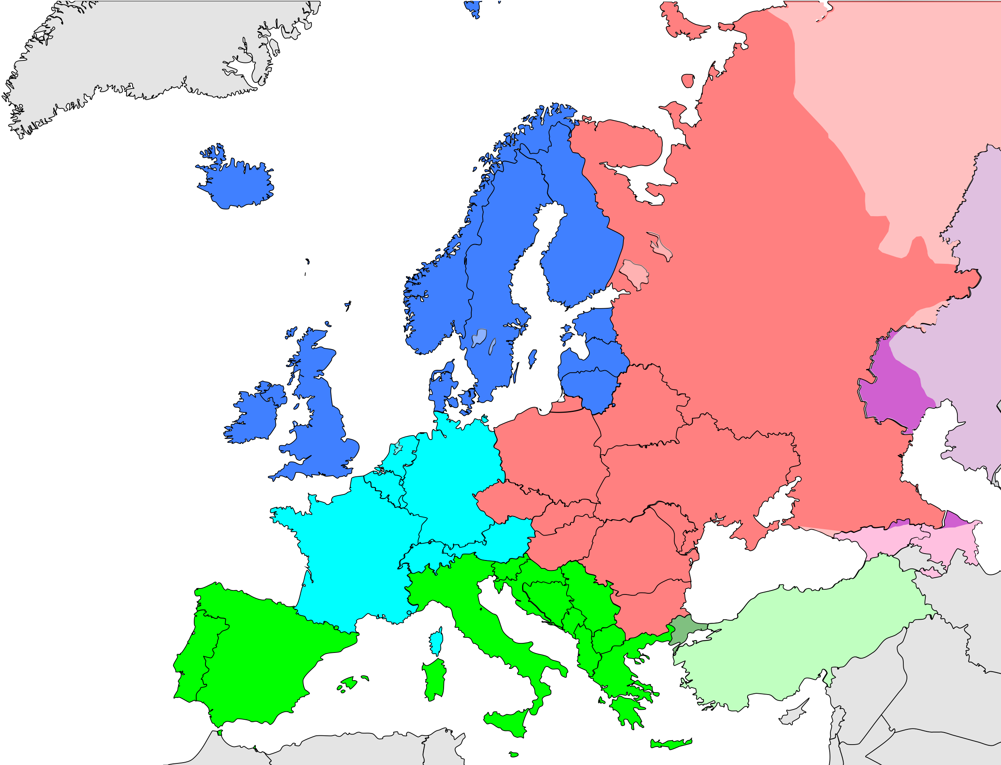
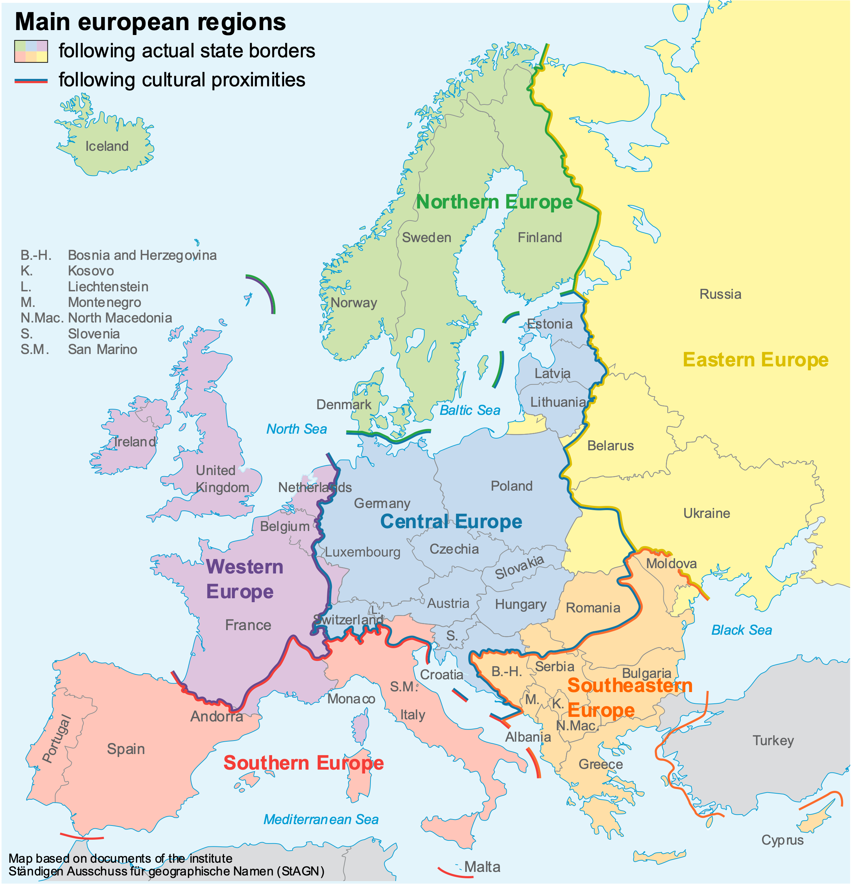
United Nations Statistics Division
Eastern Europe, Northern Europe,
Southern Europe, Western Europe
Traditional cultural borders of Europe: usage recommendation by the Standing Committee on Geographical Names, Germany.

Slide 5
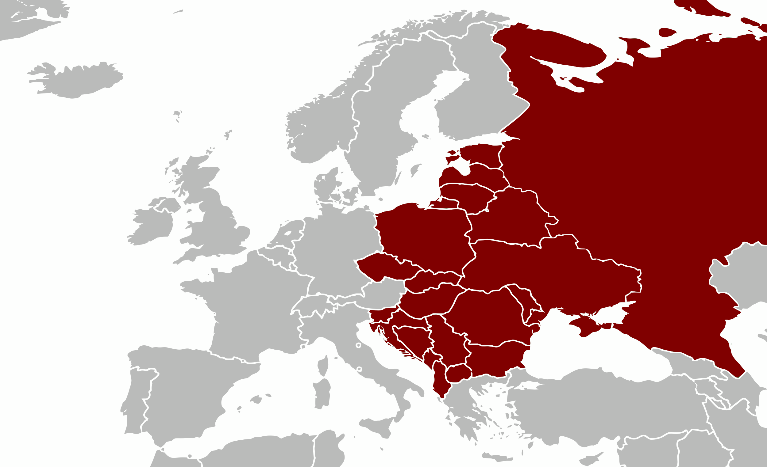
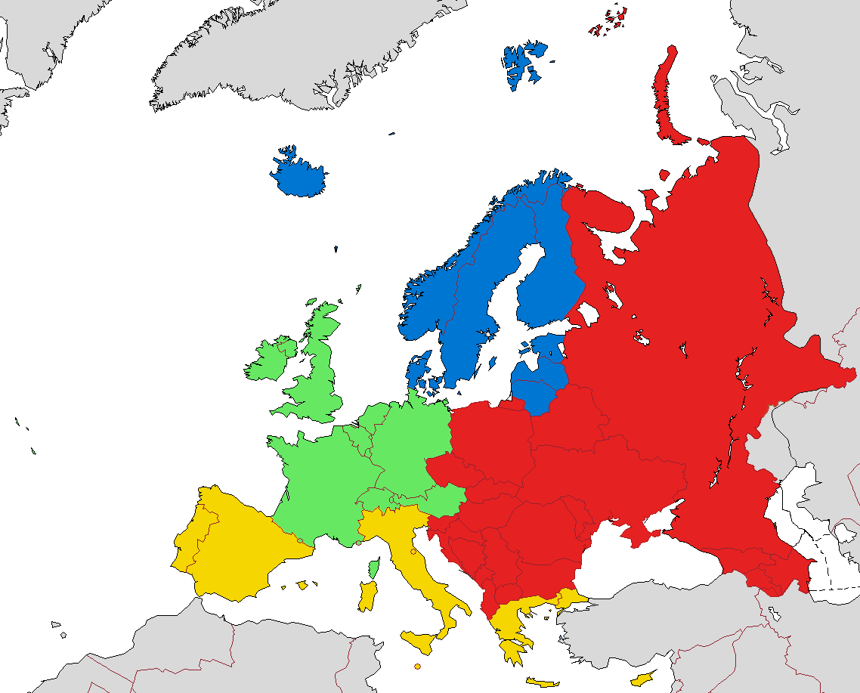
Eastern Europe during the Cold War
(Iron Curtain)
European sub-regions according to EuroVoc Central and Eastern Europe Western Europe Southern Europe Northern Europe

Slide 6
Introduction
Mapping Eastern Europe
History Matters
Imperialism and belated de-colonisation
Putin’s miscalculations
NATO
Conclusion

Slide 7
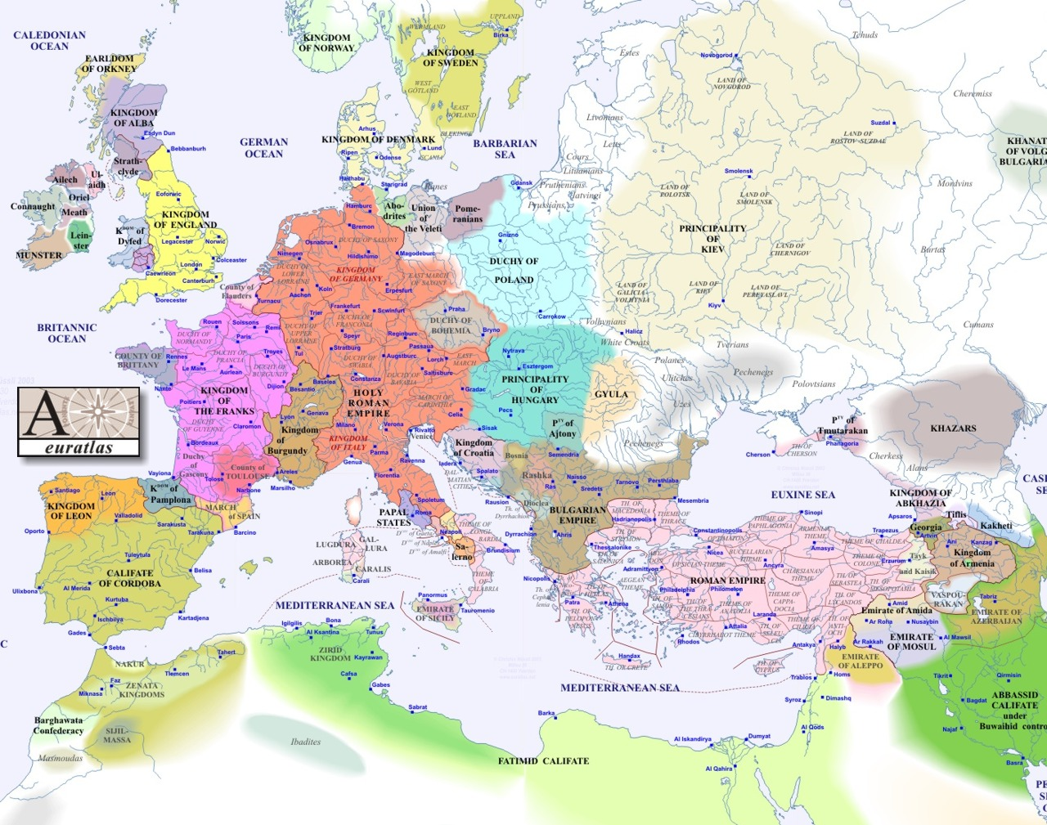
1000

Slide 8
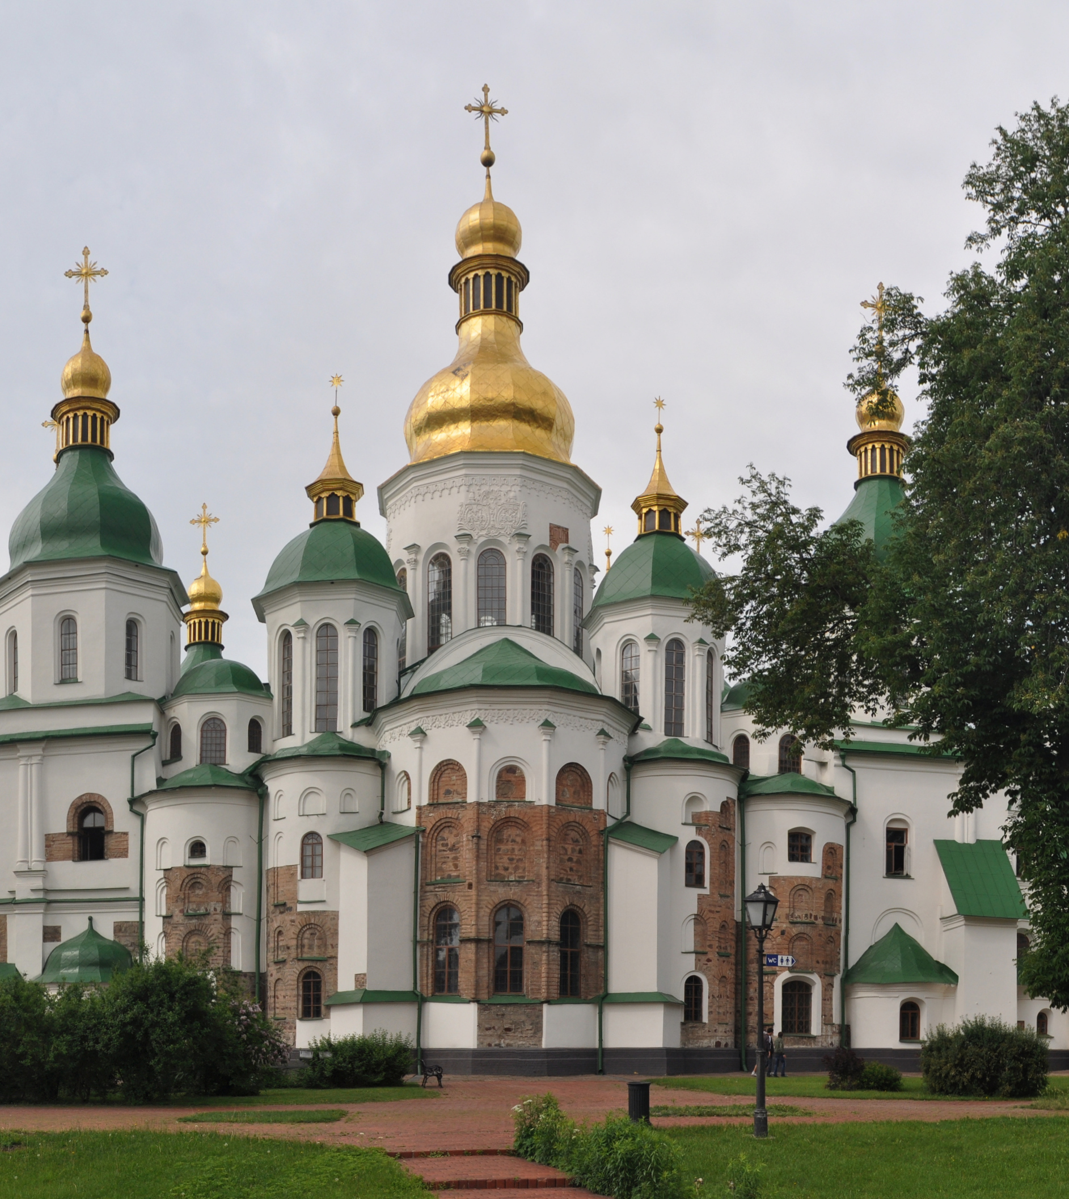
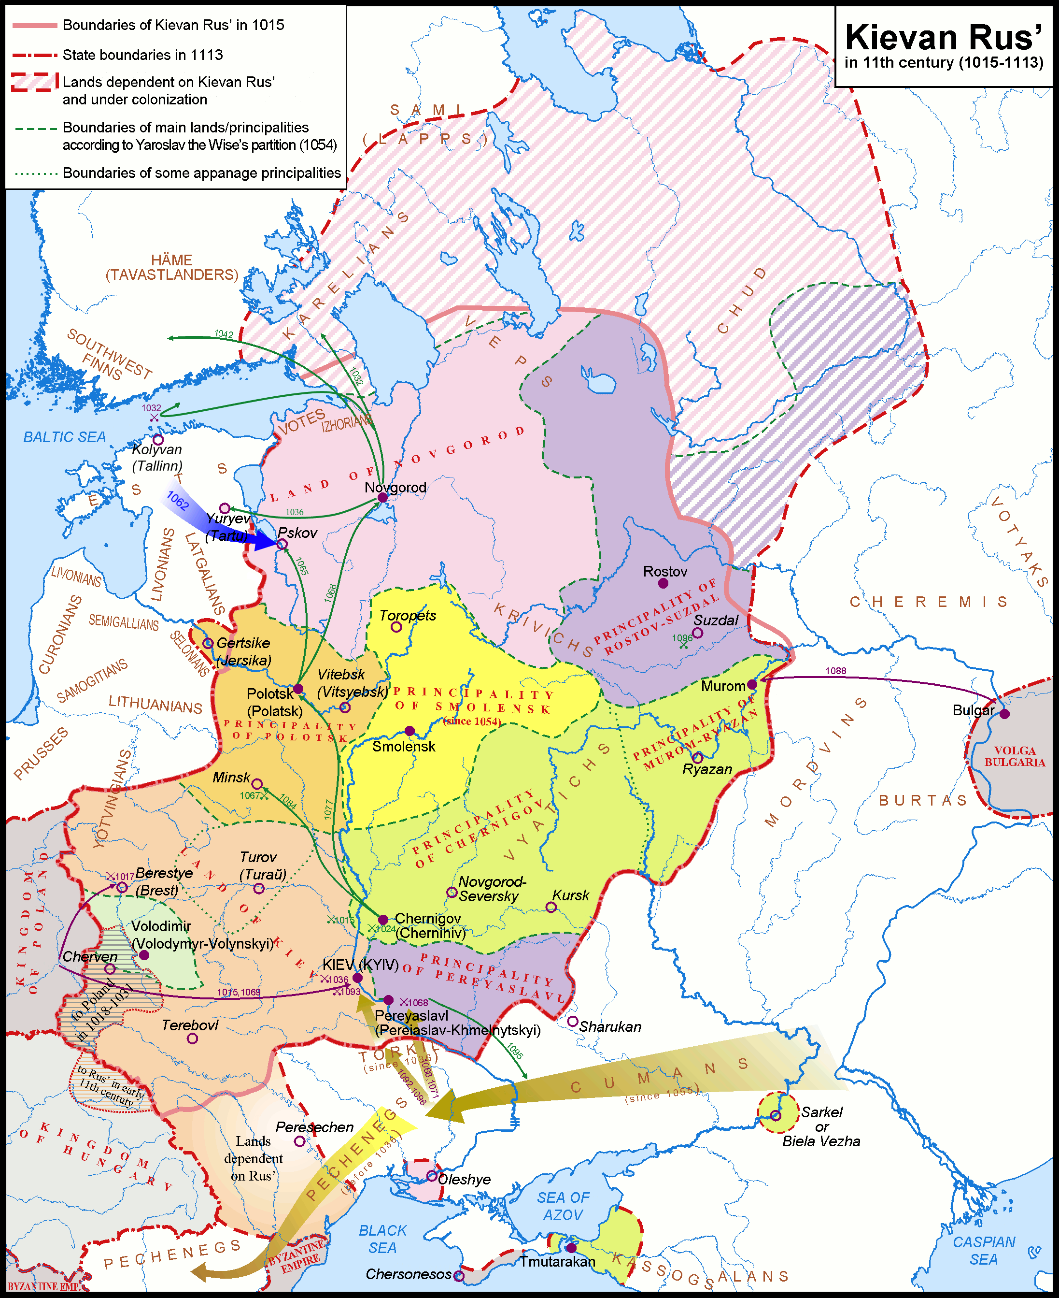
Saint Sophia Cathedral, Kyiv, 11th century, rebuilt in 16th cenutry

Slide 9
‘This is not just Ukraine’s civilizational choice. Here at this site, at the baptismal site on the Dnieper River, a choice was made for the whole of Holy Rus, for all of us… When I say “for our entire people”, we know today’s reality of course, know that there are the Ukrainian people and the Belarusian people, and other peoples too, and we respect all the parts of this heritage, but at the same time, at the foundations of this heritage are the common spiritual values that make us a single people (…)
In mediaeval times, Ukraine was part of first one and then another European power centre, came under the rule of one country, then another. But the vision of uniting both the western and eastern parts of Rus, the state that had its beginnings here in Kiev (…) always lived on in the east and in the west, wherever our people lived. (…)
Let me say again that we will respect whatever choice our Ukrainian partners, friends and brothers make. The question is only one of how we go about agreeing on working together under absolutely equal, transparent and clear conditions.’
2013 Putin addressed a conference in Kyiv celebrating the 1025th anniversary of the baptism of the ‘Rus’

Slide 10
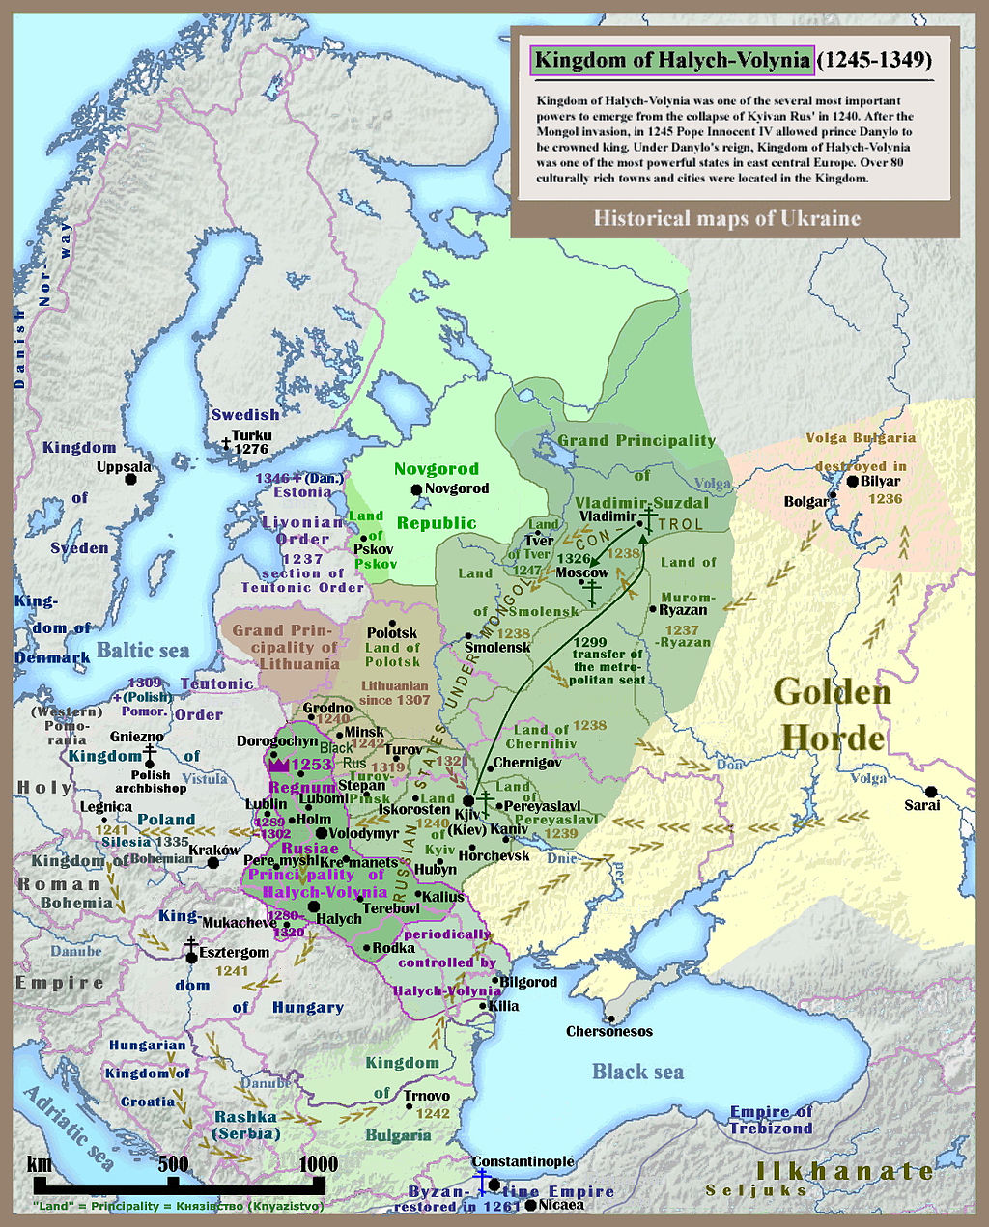
Contested History
Map of Kievan or Kyjivan Rus (Principality of Kiev Kyjiv), 1245-1349

Slide 11
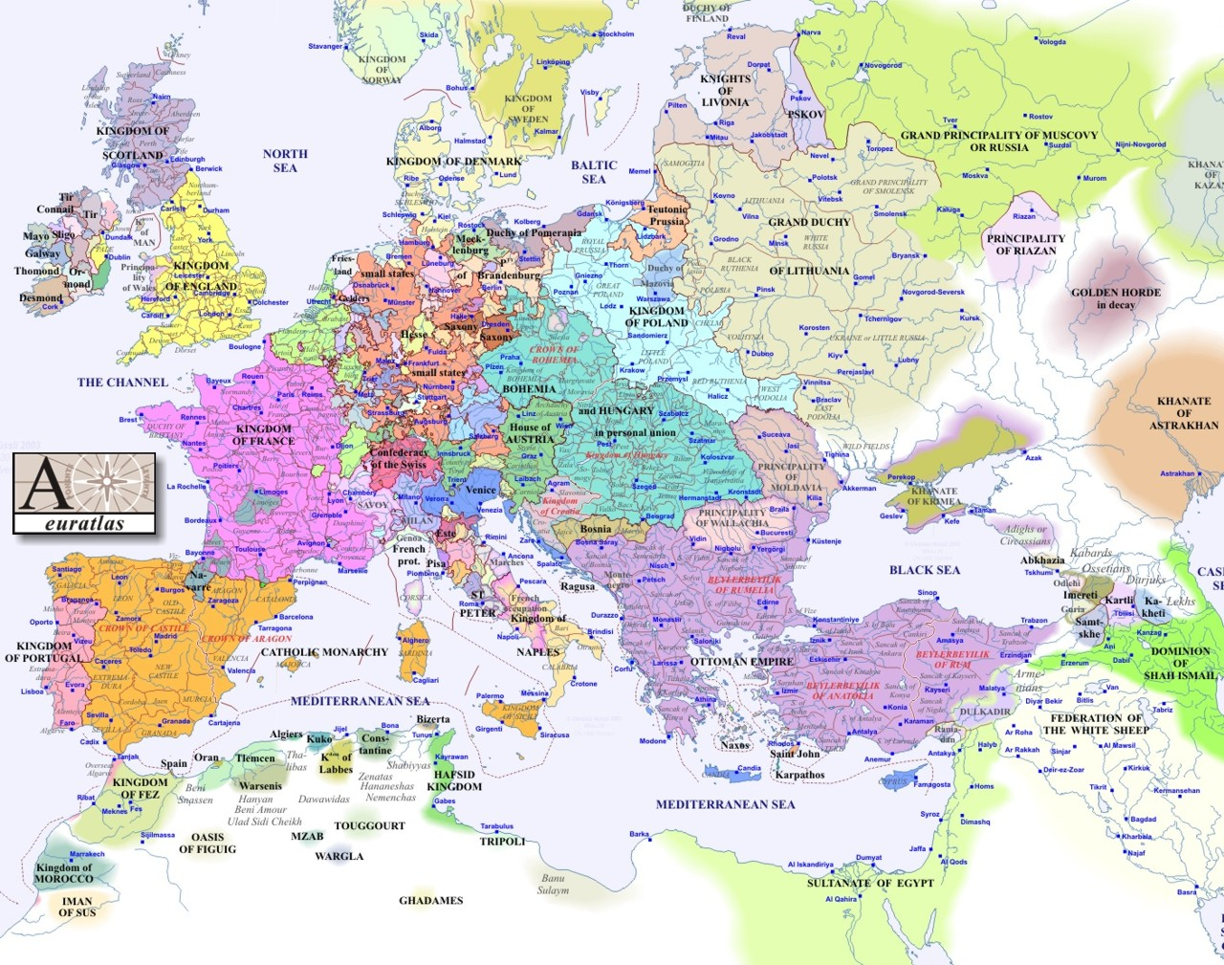
1500
Notes:
11
11

Slide 12
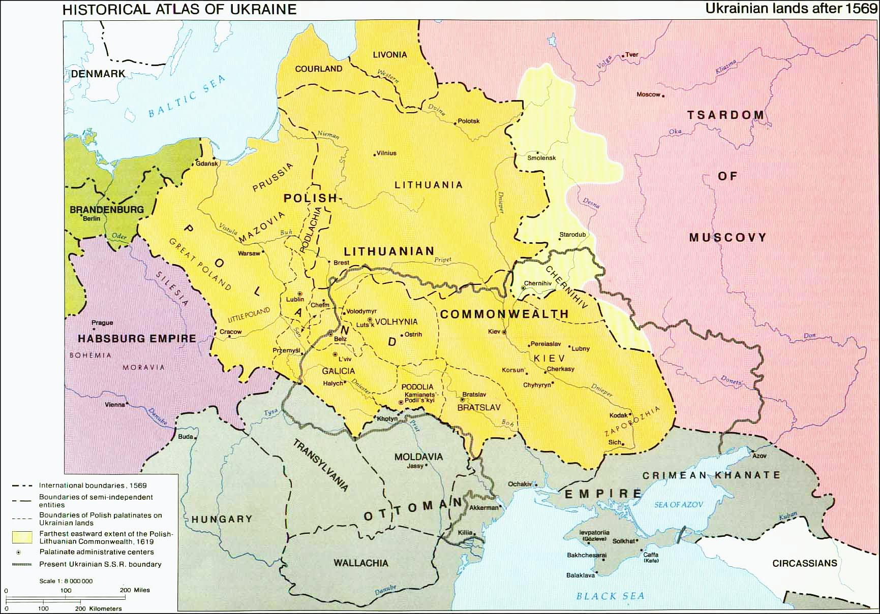
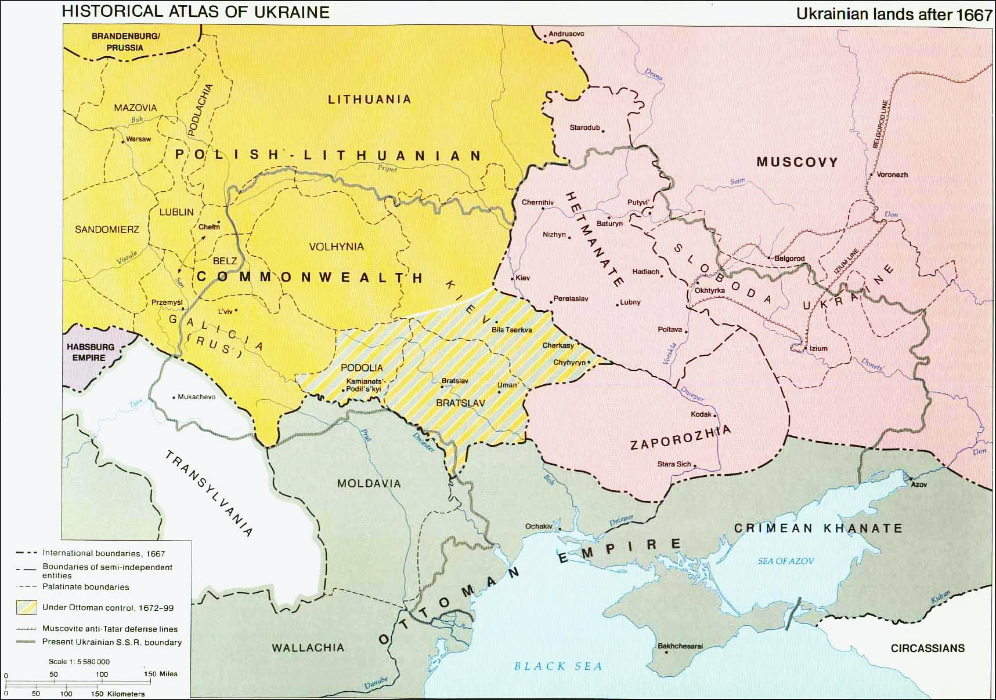
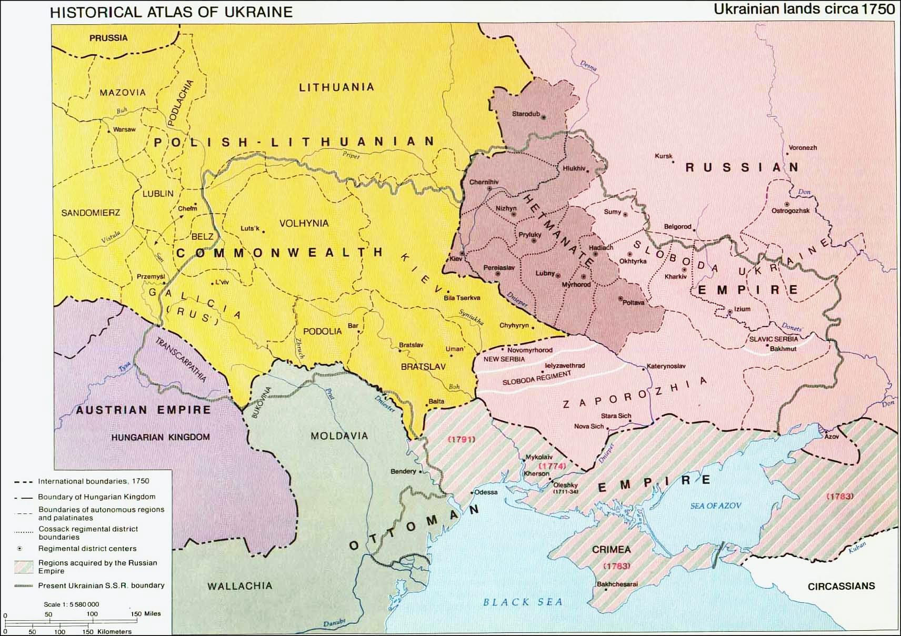
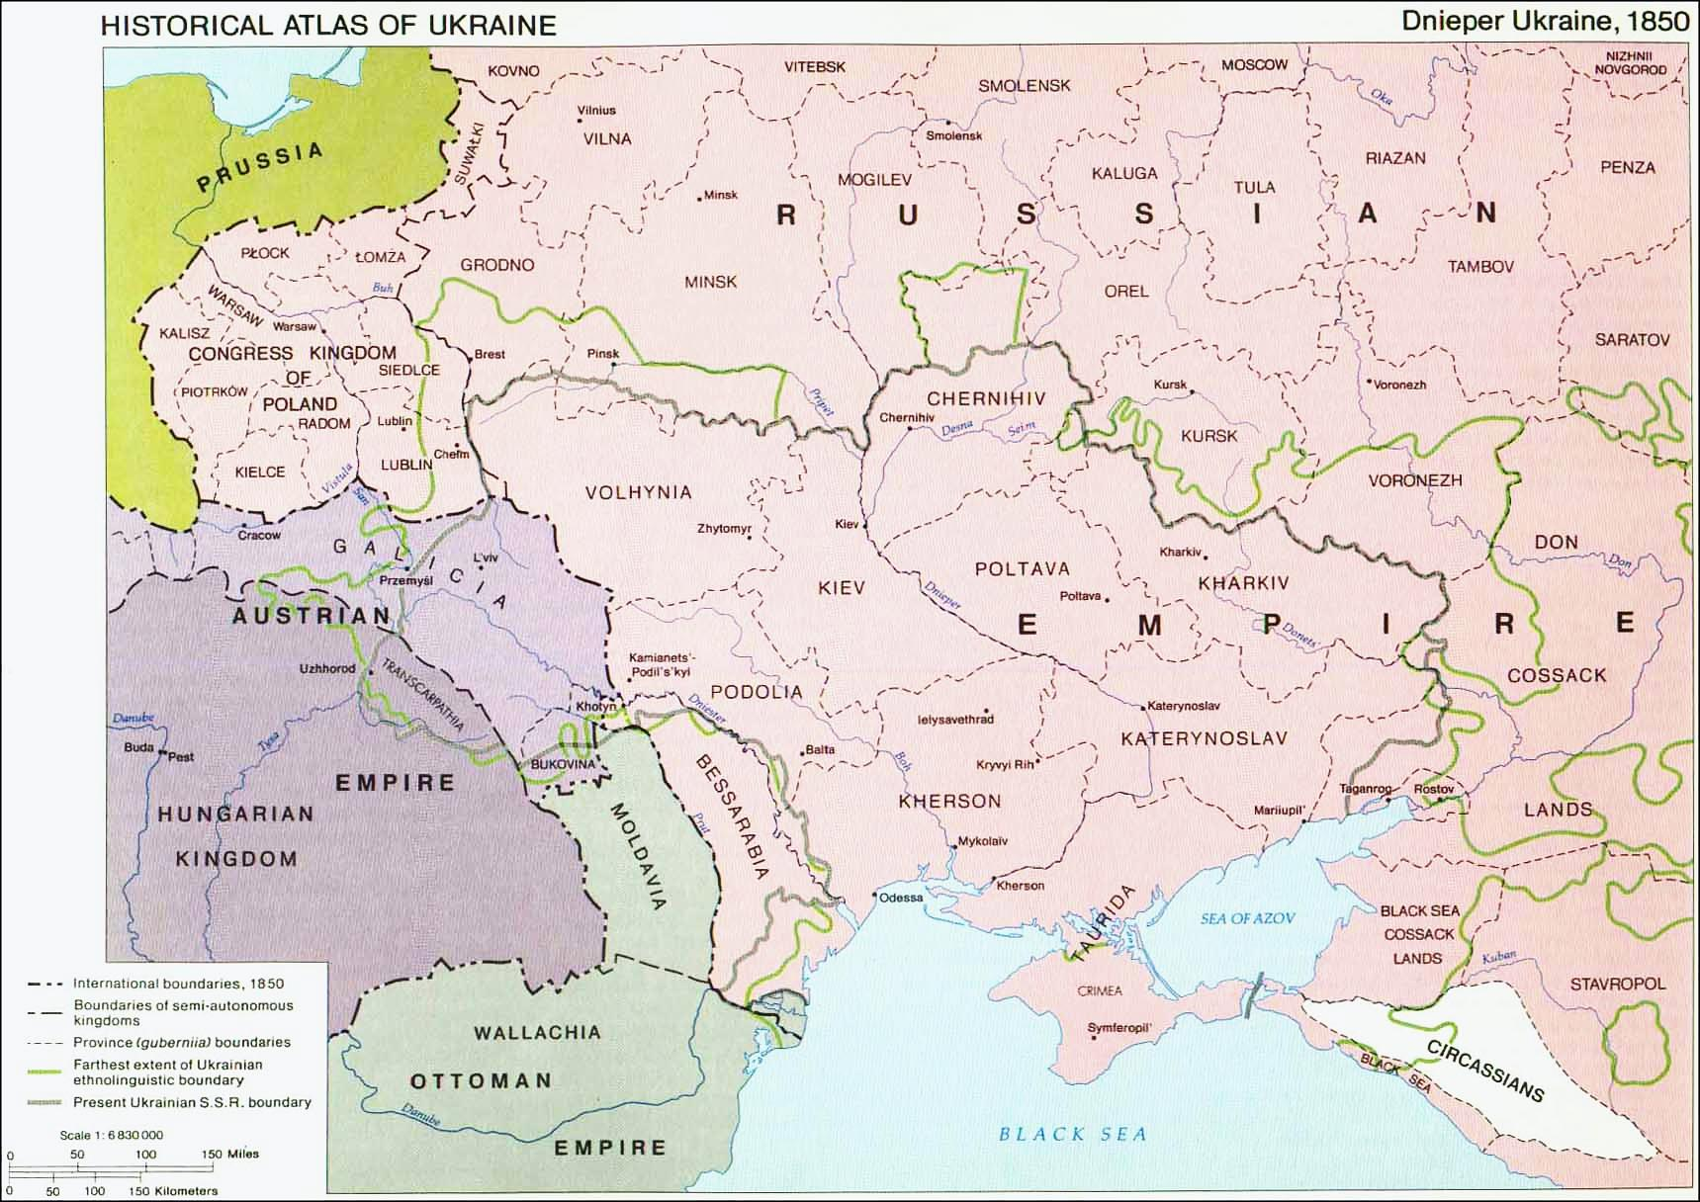
Notes:
12

Slide 13
The Russian narrative in 1914 – re-activated by Putin
The Ukrainian narrative in 1914
The Tsardom of Muscovy and the Russian Empire are the legitimate (and only) successors to the Kievan Rus
The population of the territory of the Rus came under foreign rule, as a result Belarusians and Little Russians (Ukrainians) were alienated from the Great Russians
Ukrainians and Belarusians are not separate nations, they are branches of the Russian nation
The Russian Empire collected the land of the Kievan Rus and liberated Belarusians and Ukrainians from foreign oppression
The integration of Ukraine and Belarus into the Russian Empire was historically necessary, legitimate and united Ukrainians and Belarusians after several hundred years of enforced separation with their Russian brothers and sisters.
The Ukrainian nation is the legitimate heir of the Kyjivan Rus, the Principality of Halychina is the true successor of Kyjiv
Ukraine was partitioned and occupied by Muscovy, Poland and others but there were always Ukrainians who wanted to build an independent state
The Ukrainians are a separate nation and purely East Slavic (with a bit of Varangian – Viking – ‘blood’). Great Russians are a mixture of Finns, Tatars and East-Slavic tribes
Russian imperial rule is foreign oppression
Ukrainians need to be recognized as a separate nation, they need cultural and political autonomy within the Austrian and Russian Empire, in the longer perspective there should be an Ukrainian nation state
Notes:
13

Slide 14
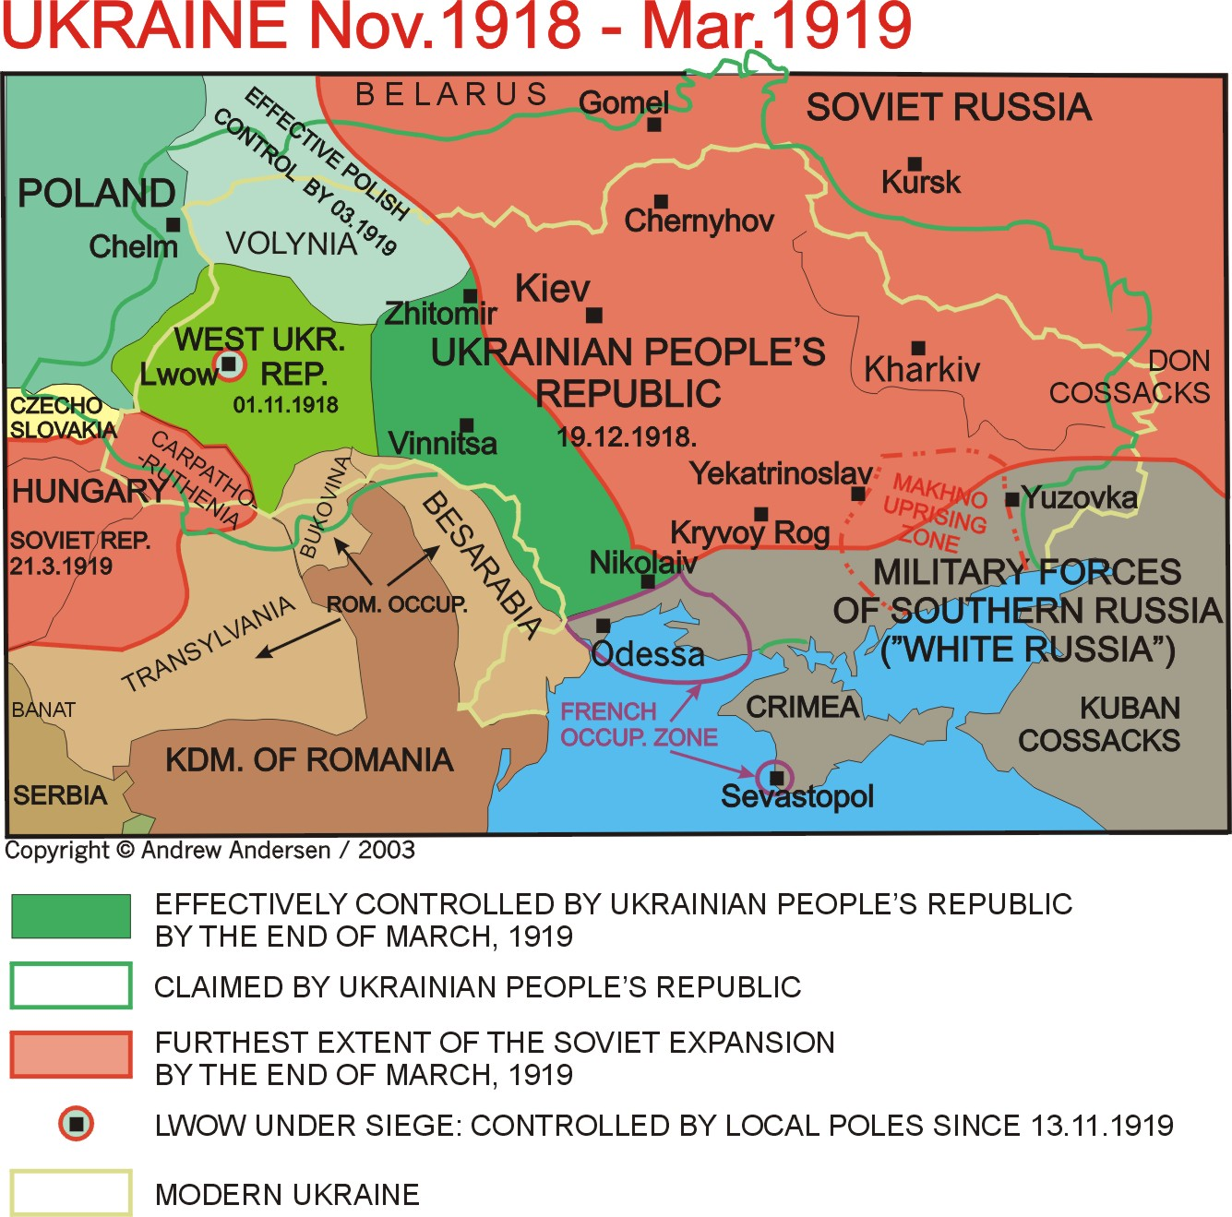

Slide 15
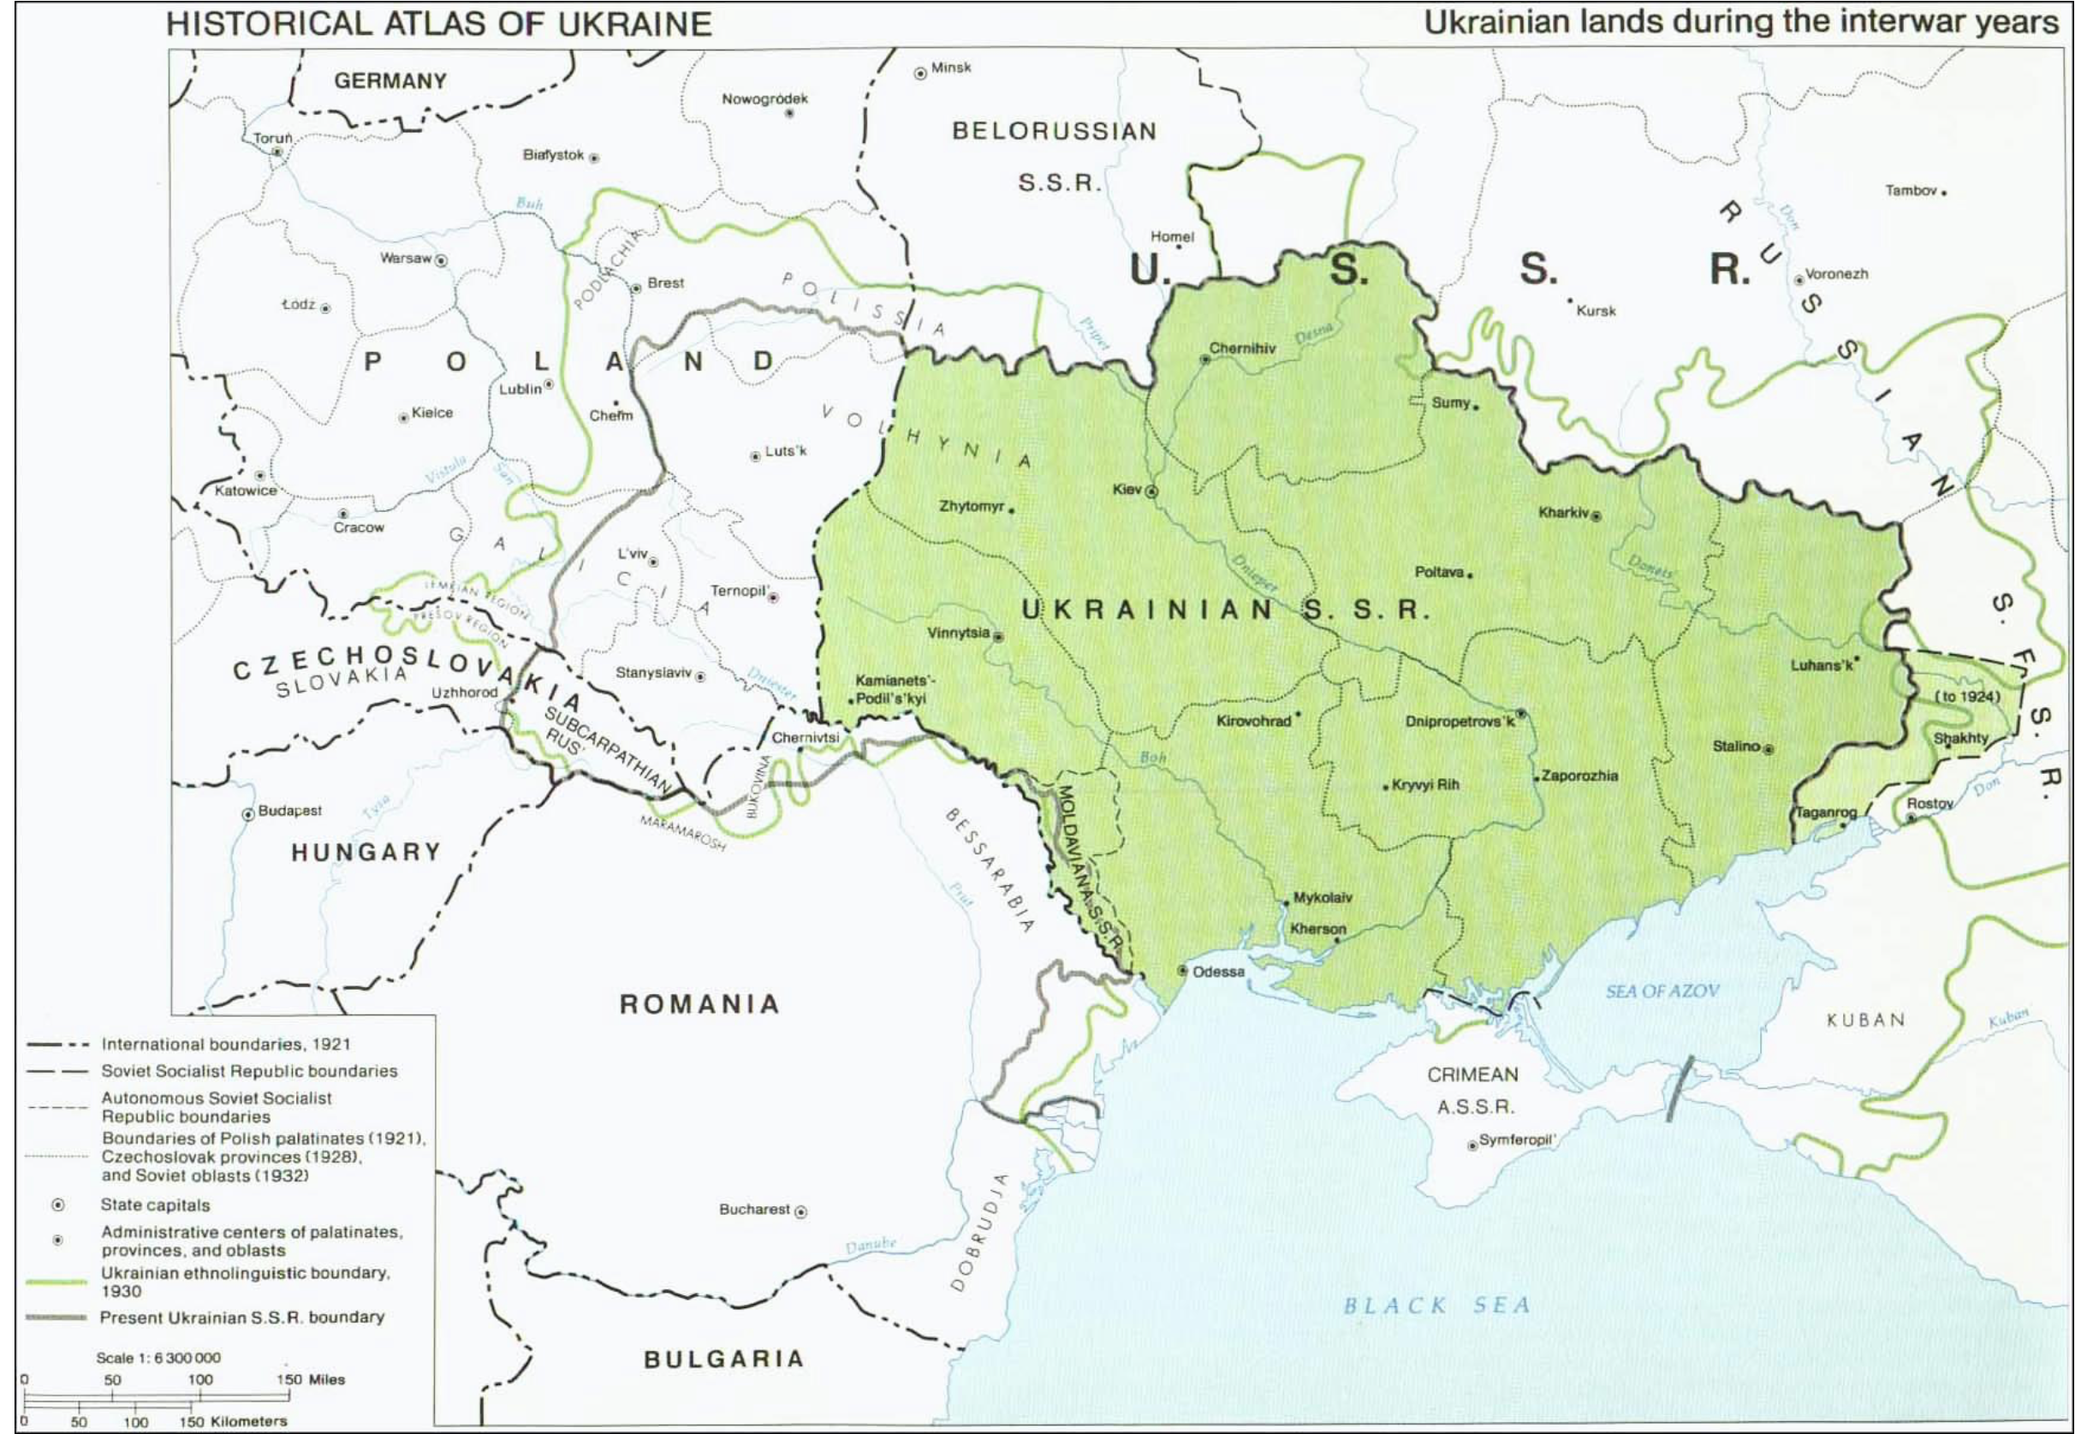

Slide 16
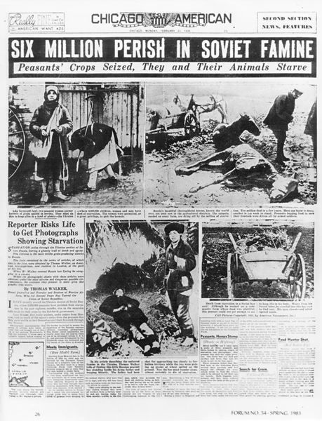
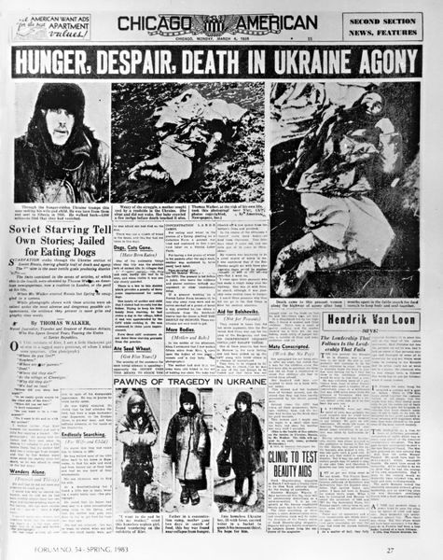
http://www.holodomor.org/
Notes:
16

Slide 17
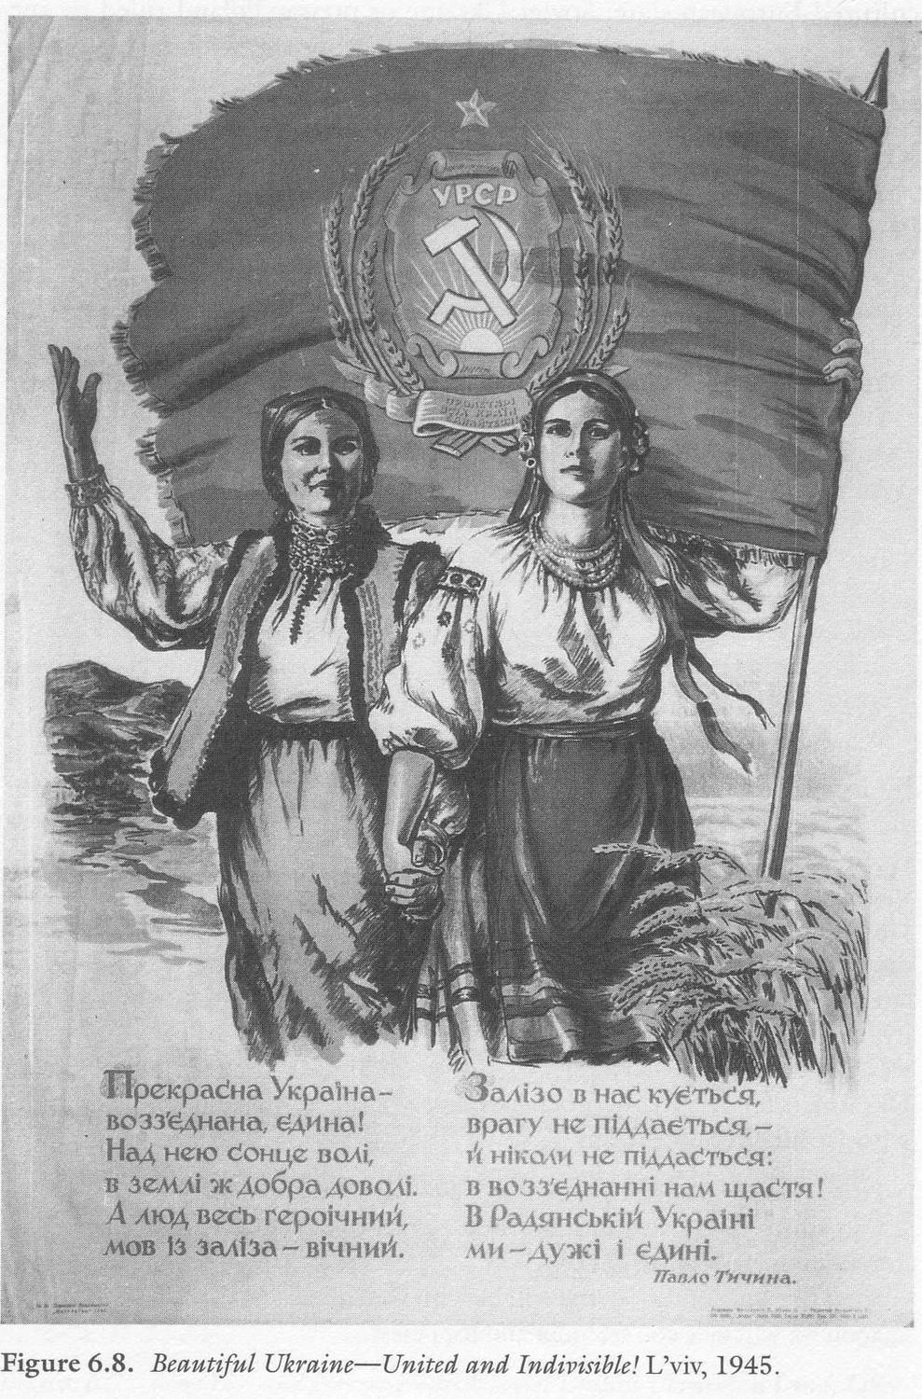
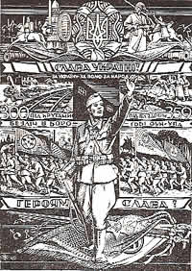
WWII Propaganda poster of the Organisation of Ukrainian Nationalists (OUN)
Soviet propaganda poster 1945

Slide 18
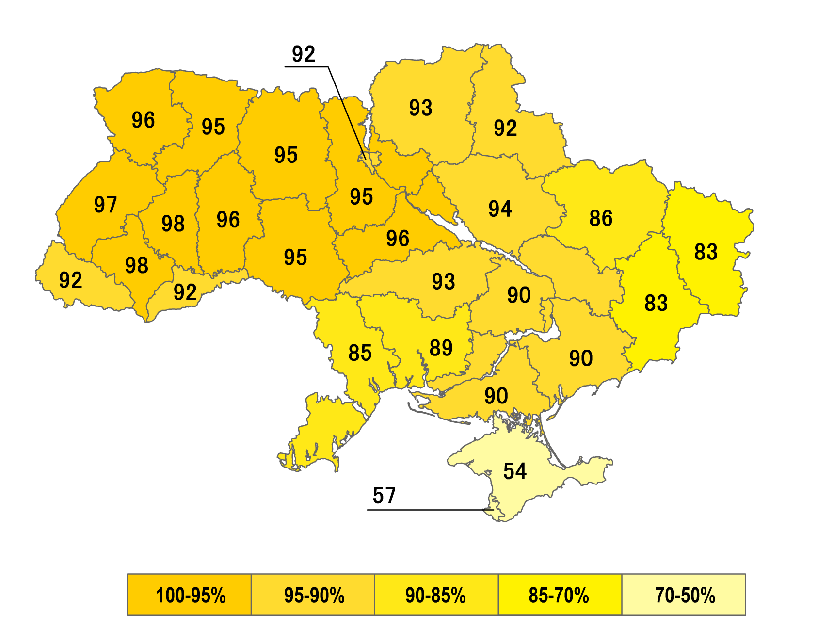
Referendum, 1 December 1991: ”Do you support the declaration of independence of Ukraine?”

Slide 19
Introduction
Mapping Eastern Europe
History Matters
Imperialism and belated Decolonisation
Putin’s miscalculations
NATO
Conclusion

Slide 20
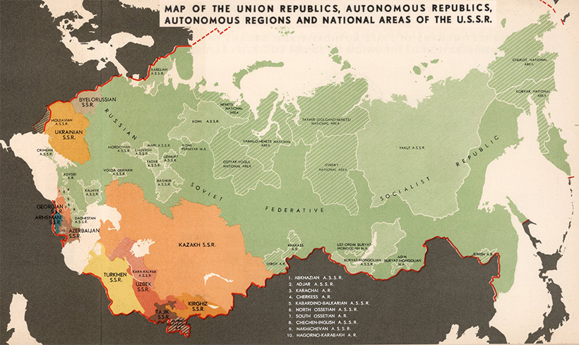
Before 1939

Slide 21
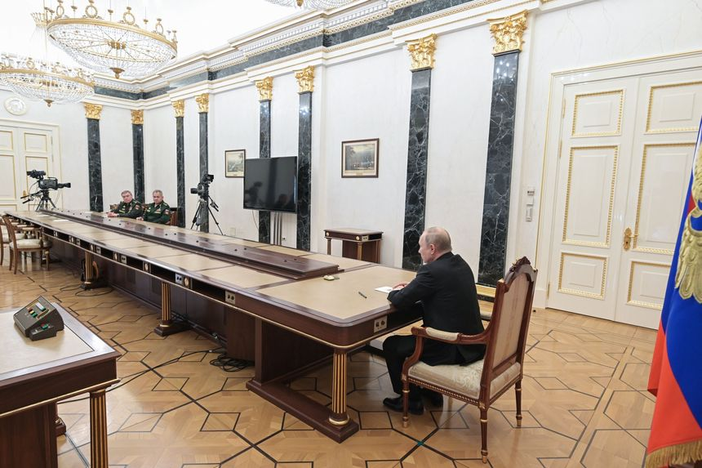

Slide 22
Introduction
Mapping Eastern Europe
History Matters
Imperialism and belated Decolonisation
Putin’s miscalculations
NATO
Conclusion

Slide 23
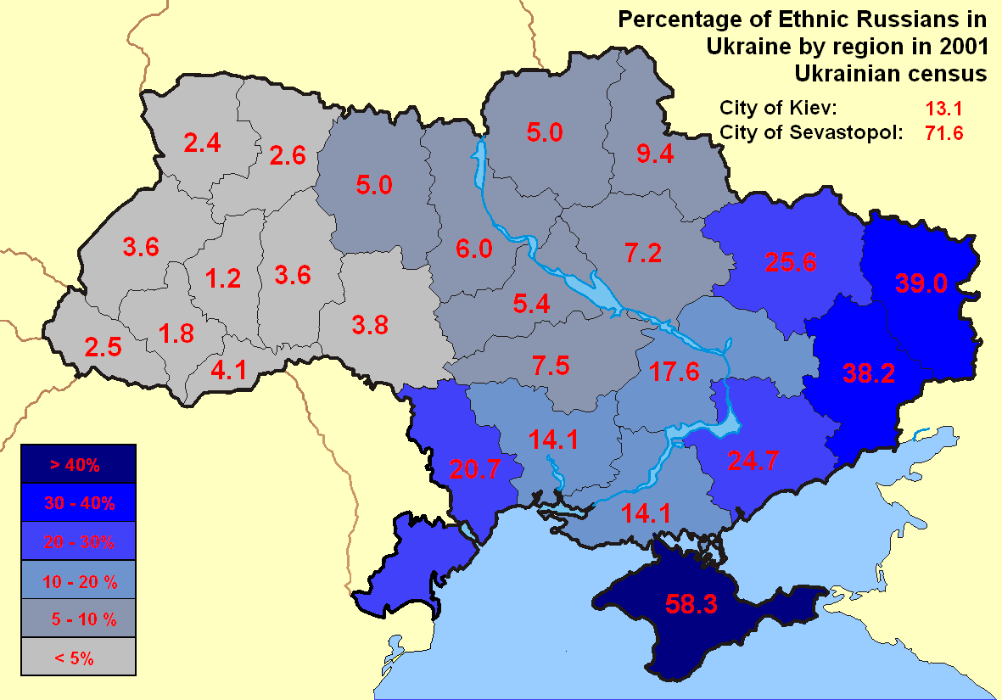
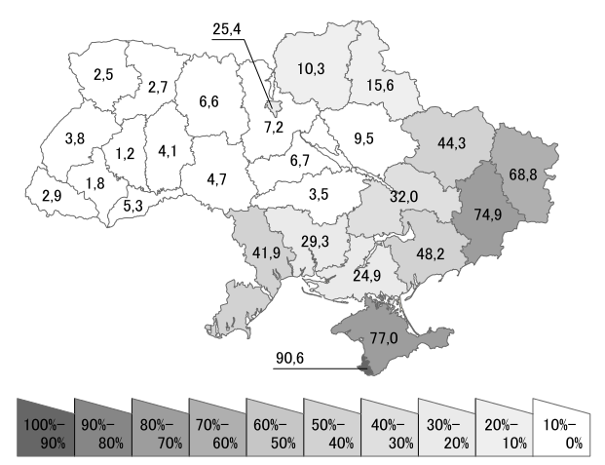
Share of people with Russian as first language in % (Census 2001)

Slide 24
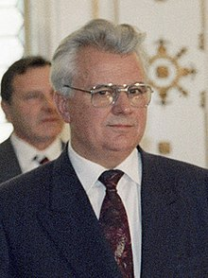
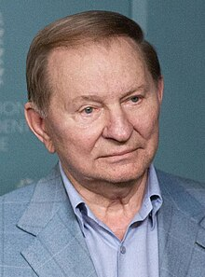
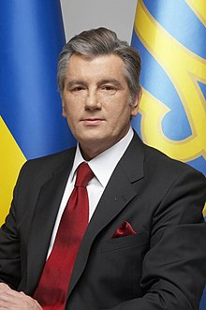
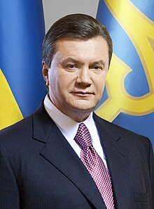
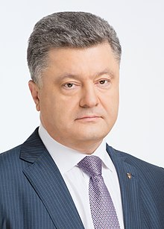
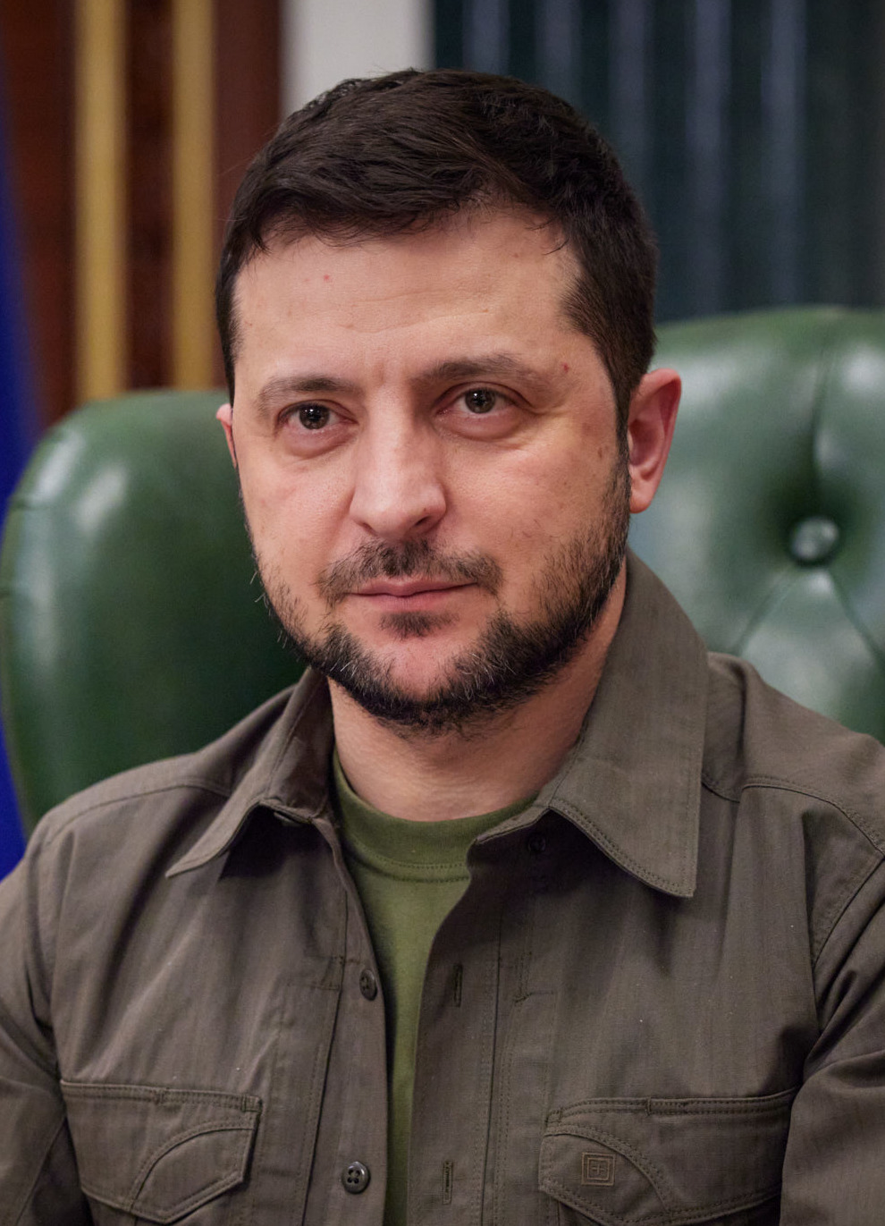
Leonid Krachuk 1991-1994
Leonid Kuchma 1994-2005
Viktor Yushchenko 2005-2010
Viktor Yanukovych 2010-2014
Viktor Poroshenko 2014-2019
Volodymyr Zelensky 2019-

Slide 25
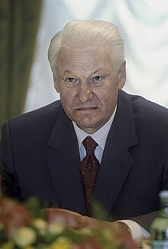
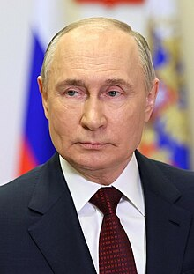
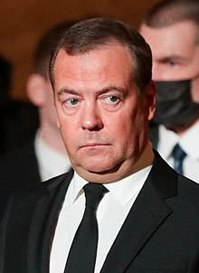
Boris Yeltsin 1991-1999
Vladimir Putin 2000-2008
Dmitry Medvedev, president 2008-2012, Putin was prime minister
Vladimir Putin 2012-2024
Vladimir Putin 2024 -

Slide 26
Introduction
Mapping Eastern Europe
History Matters
Imperialism and belated Decolonisation
Putin’s miscalculations
NATO
Conclusion

Slide 27
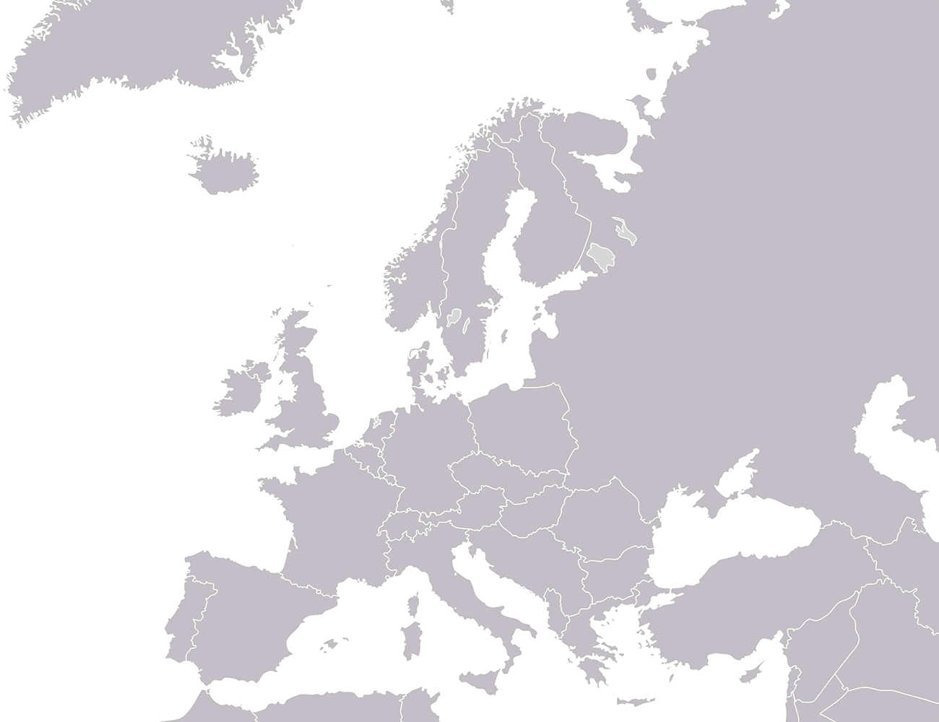
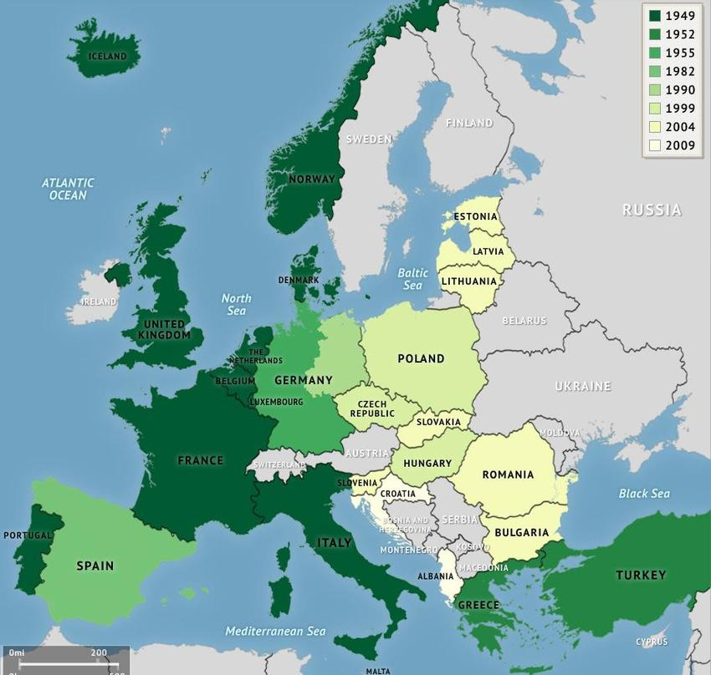
Stages of NATO enlargement

Slide 28
Introduction
Mapping Eastern Europe
History Matters
Imperialism and belated Decolonisation
Putin’s miscalculations
NATO
Conclusion

Slide 29
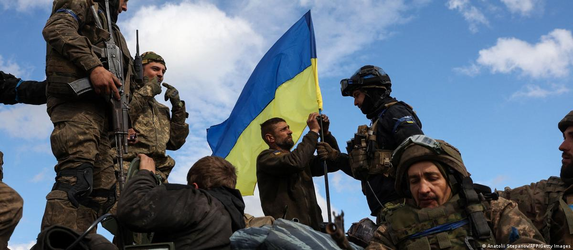
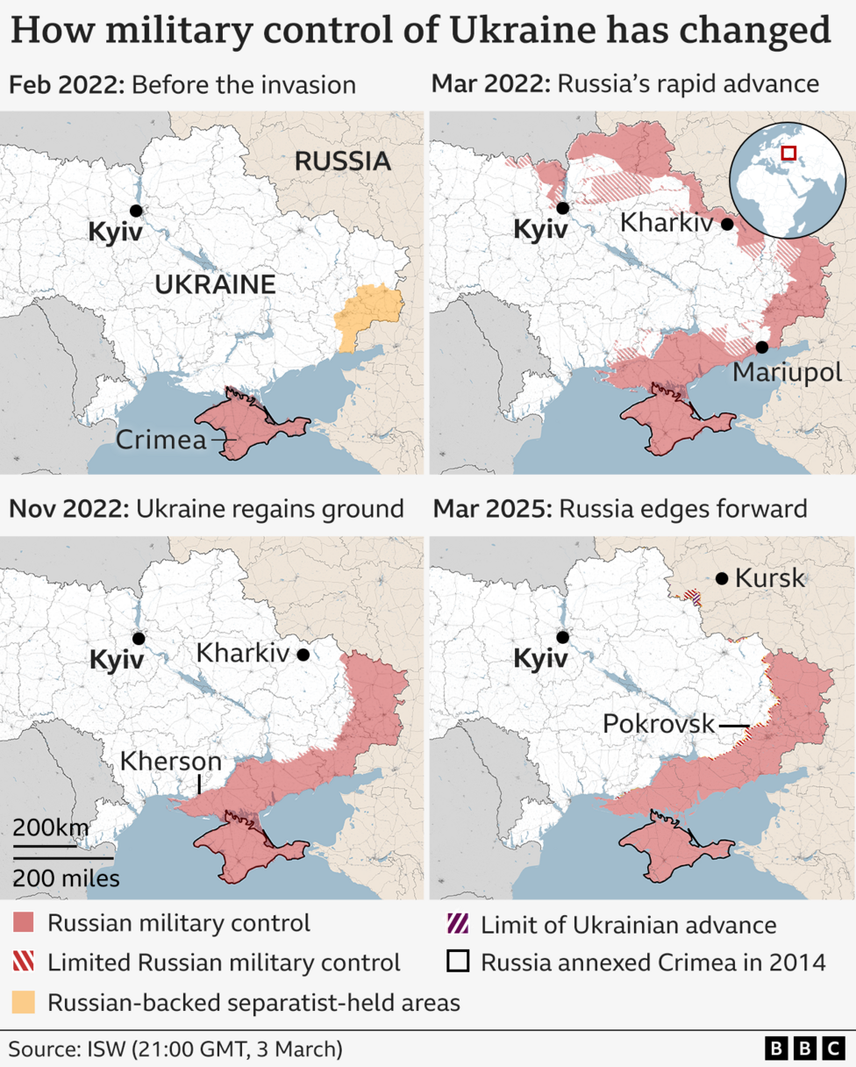
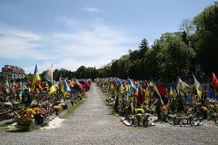
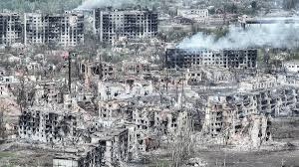
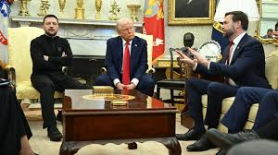

Slide 30
