Slide 1
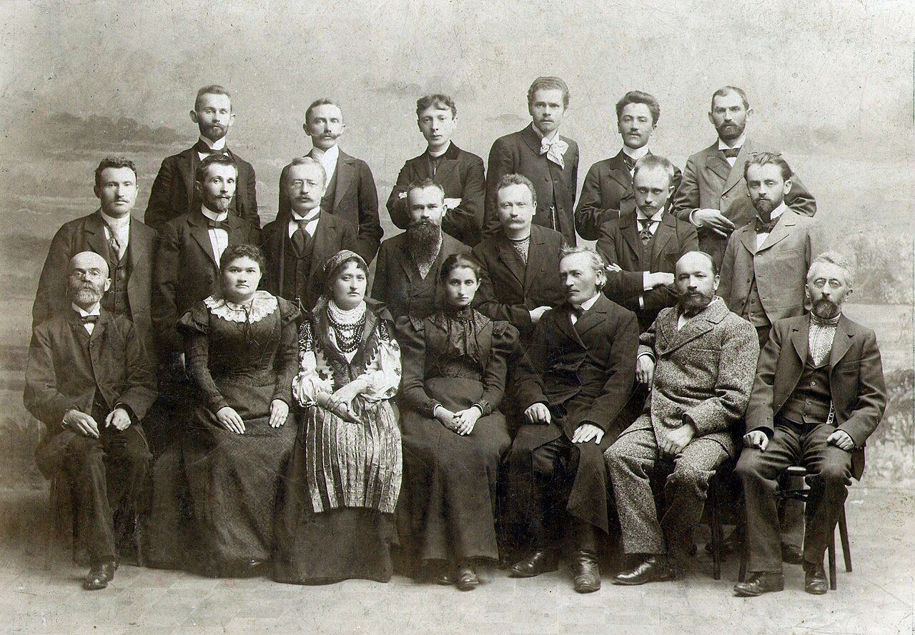
Entangled History: Ukraine and her neighbours from the Middle Ages to the present
Lecture 11
National boundaries, hybrid identities and the ‘Jewish Question’

Slide 2
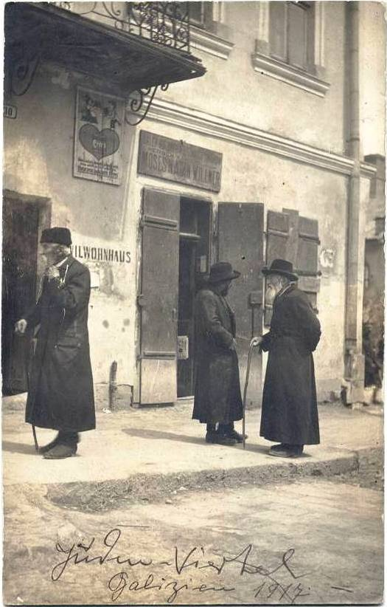
Outline
Hybrid identities
Emancipation
Rise of modern nationalism and anti-Semitism
Options
Conclusion
Jews in Austrian Galicia, 1917

Slide 3
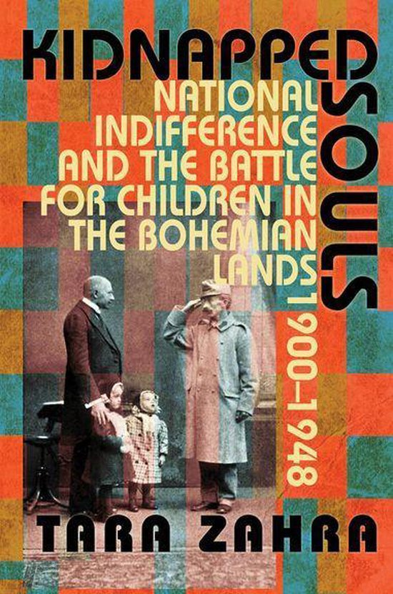
Hybrid National Identities
Different relations and interplay of national, state, regional, religious, linguistic identities and loyalties
Various layers or dimensions of identity getting precedence or mobilised depending on circumstances
National Indifference (Tara Zahra, Jeremy King)
How one defines themselves (self-identification) vs How one is defined by others (attribution) vs How state authorities define one’s identity (labelling)
Patterns of inclusion and exclusion
Difficulties of putting people into ethnic or national categories based on objective criteria

Slide 4
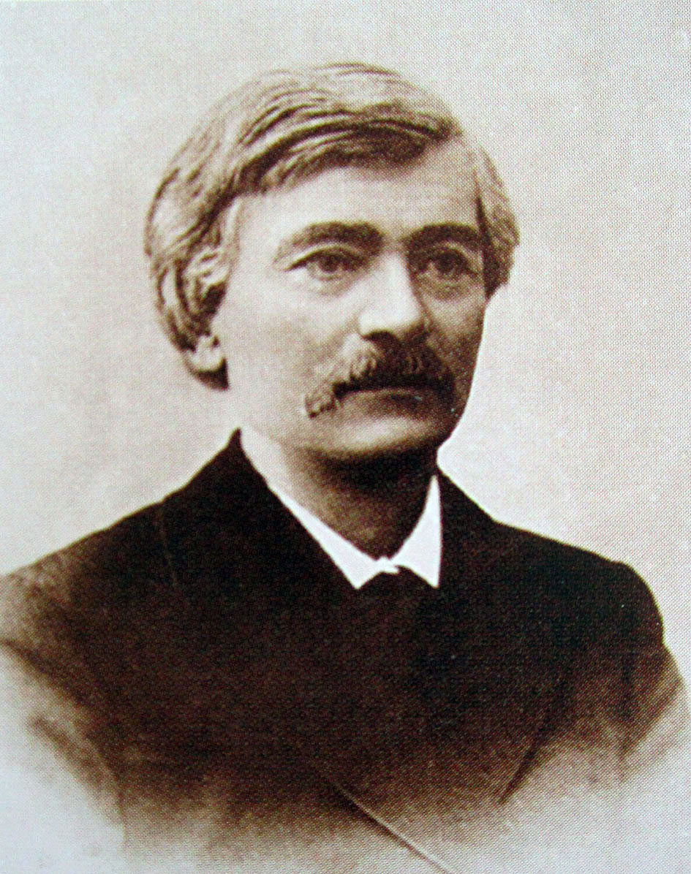
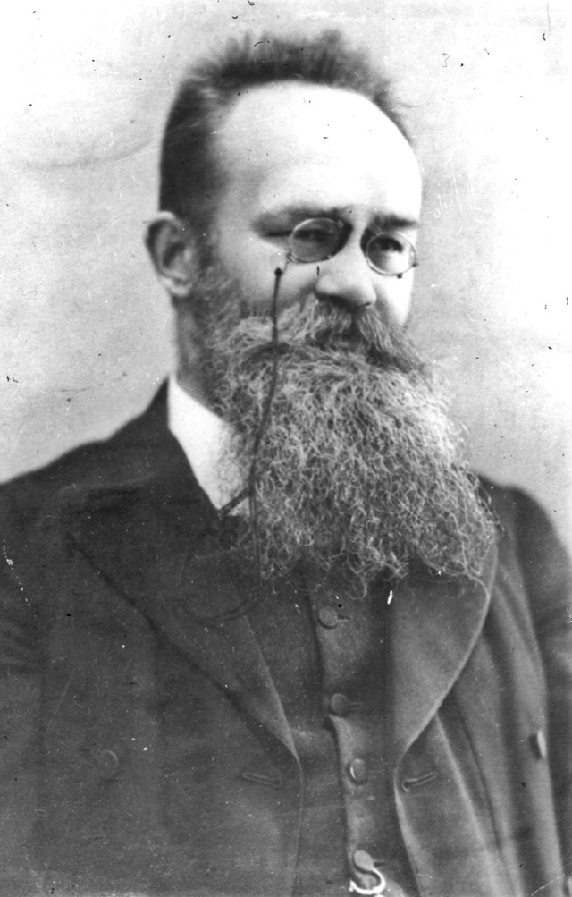
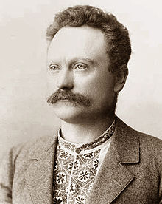
Volodymyr Antonovych 1834-1908
* In Makhnivka (Kyiv/Kiev)
Family: impoverished Polish gentry
Historian, Professor at Kyiv/Kiev University
Populist and ‘peasant-lover’
Mykhailo Hrushevs’kyj 1866-1934
* In Chełm (Russian Empire)
Father: University professor, family priests and parish servants
Historian, Professor in Lemberg, politician and head of first Ukrainian state 1918/19
Ivan Franko
1856-1916
* In Nahujevychi (Galicia)
Writer, journalist, translator, and politician
Father: Blacksmith of German origin
Mother: poor Ruthenian-Polish noblewoman
Socialist and Ukrainophile, spent time in Austrian prison

Slide 5
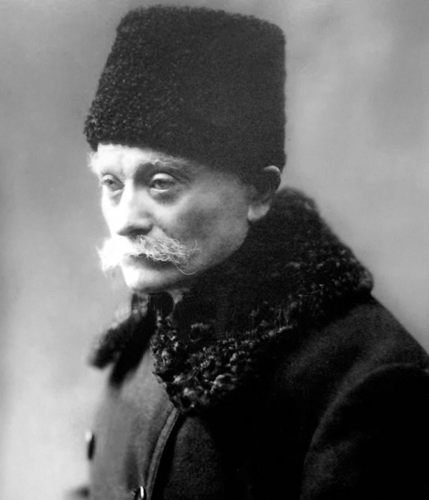
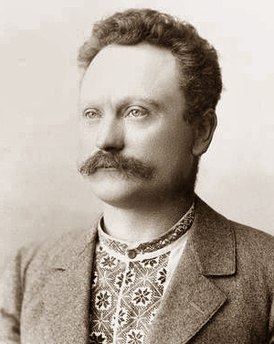
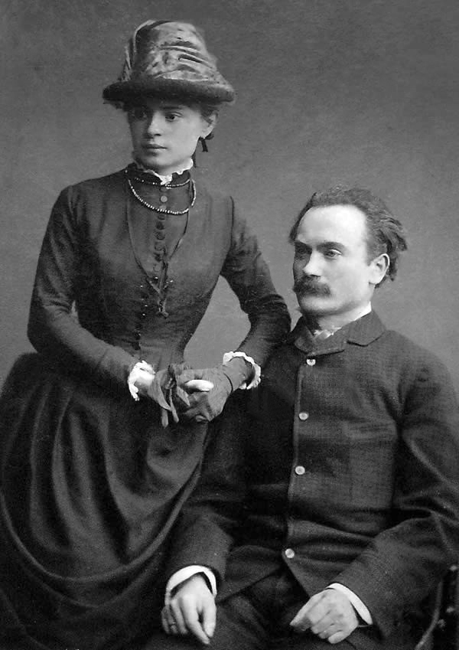
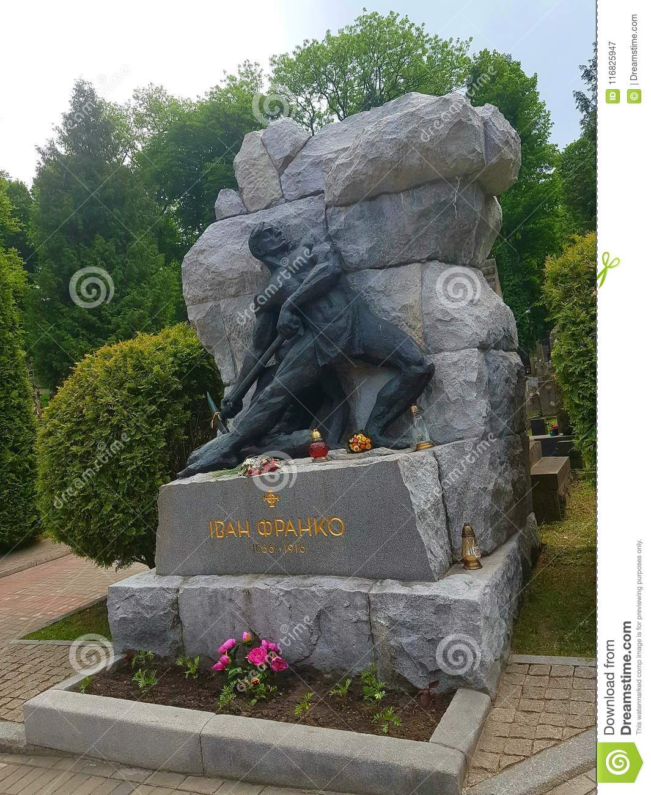
Ivan Franko, 1856-1916
Franko and his wife Ol’ha Choruzhyns’ka, 1886
Ivan Frankos grave on Lychakiv cemetery, Lviv

Slide 6
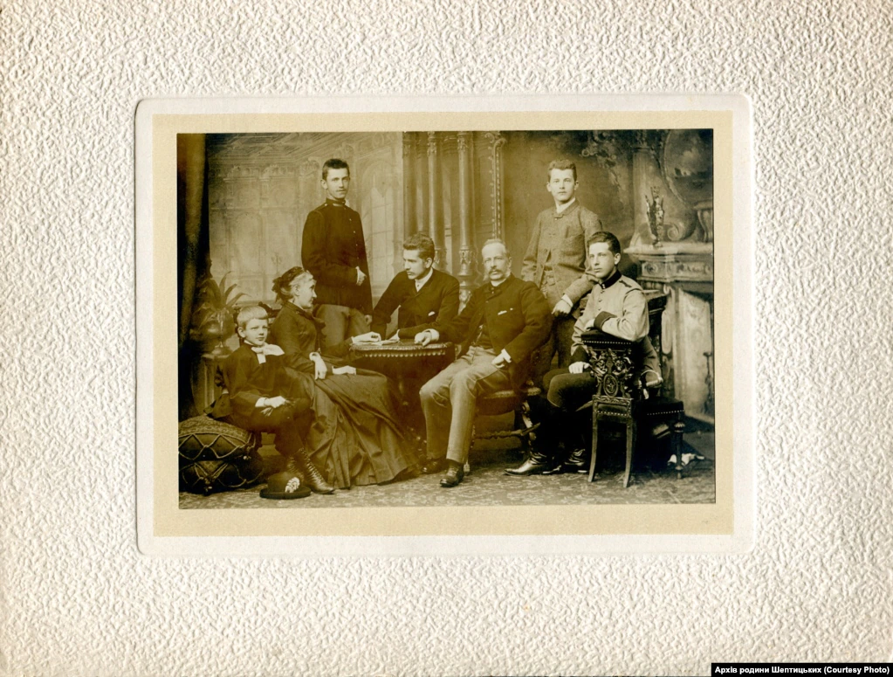
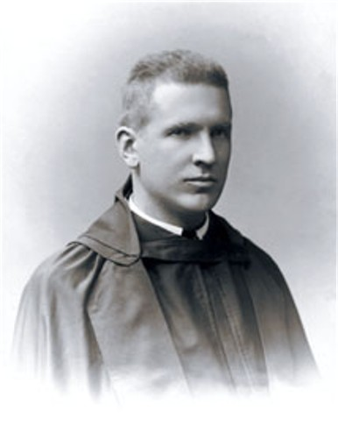
Andrej (Roman) Sheptytskyj, 1864-1944
The Szeptycki/Шептицький family around 1886, left to right: Leon, Zofia (mother), Stanisław (standing), Roman, Jan Kant (father), Kazimierz (standing) und Aleksander.

Slide 7
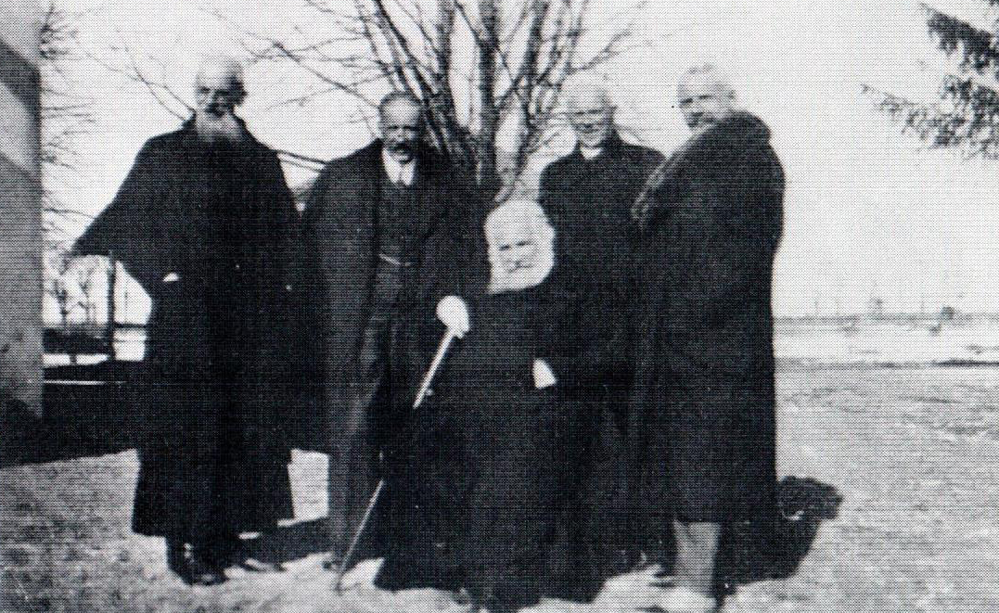
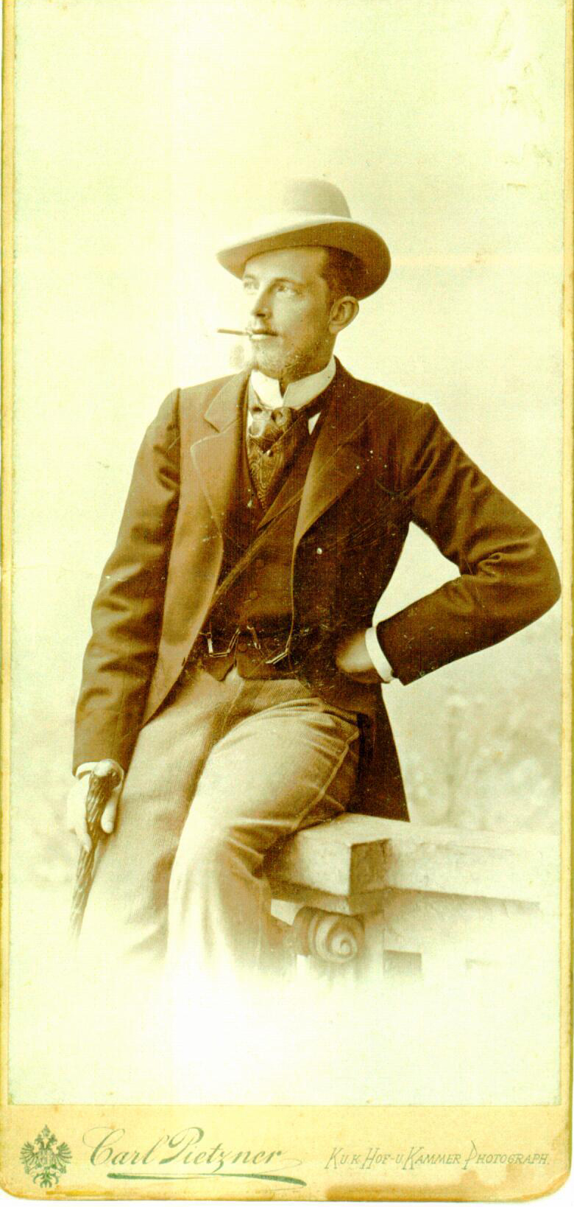
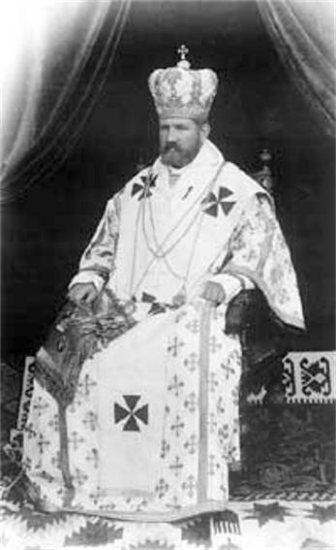
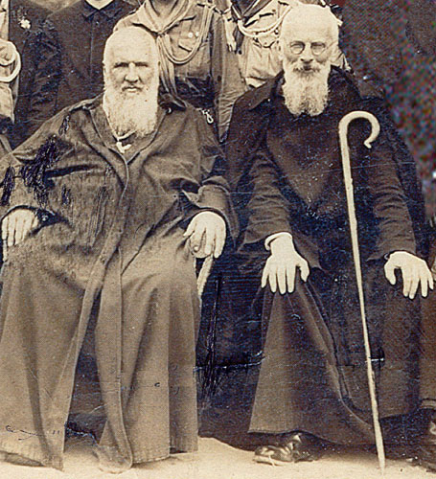
The brothers Szeptycky/ Sheptytskyj visiting the family estate in Przyłbice (owned by Leon) in the 1930s
Kazimierz Szeptycki, before he became Klimentij
Andrej as archbishop/metropolitan of Lviv
Andrej and Klimentij

Slide 8
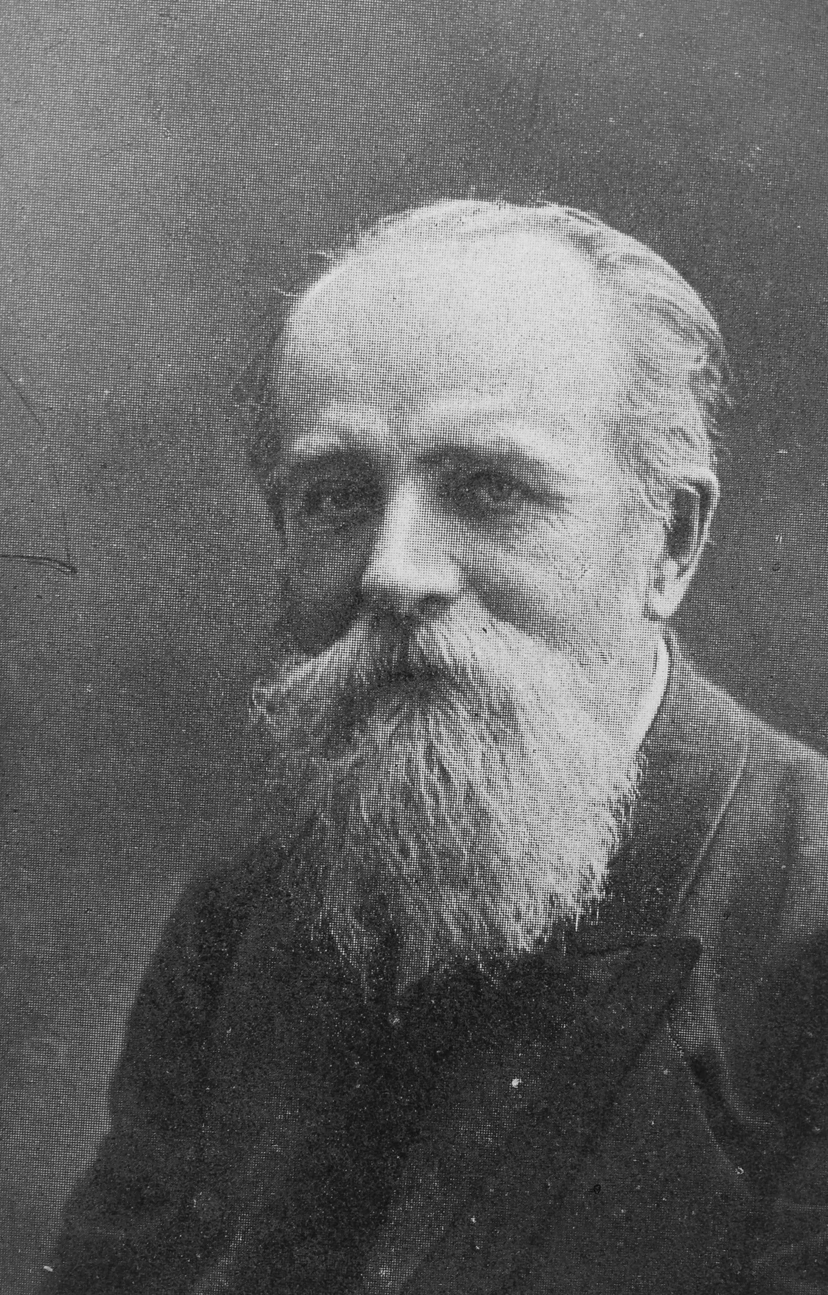
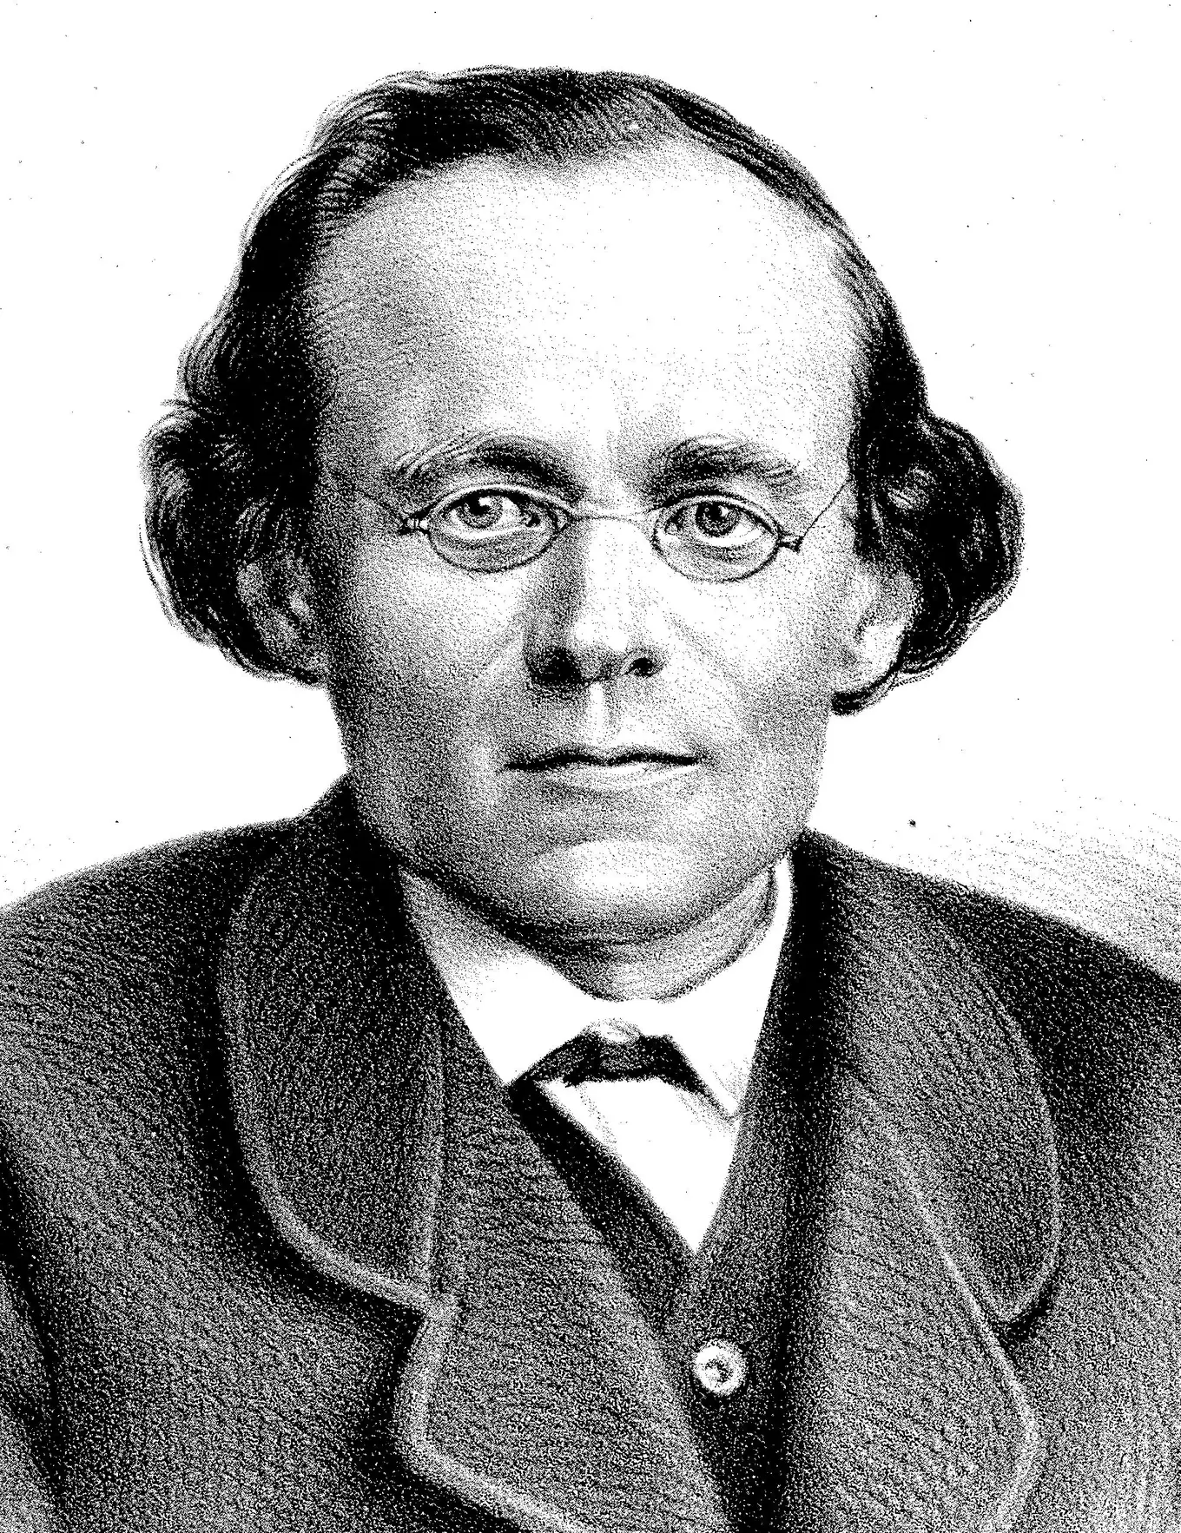
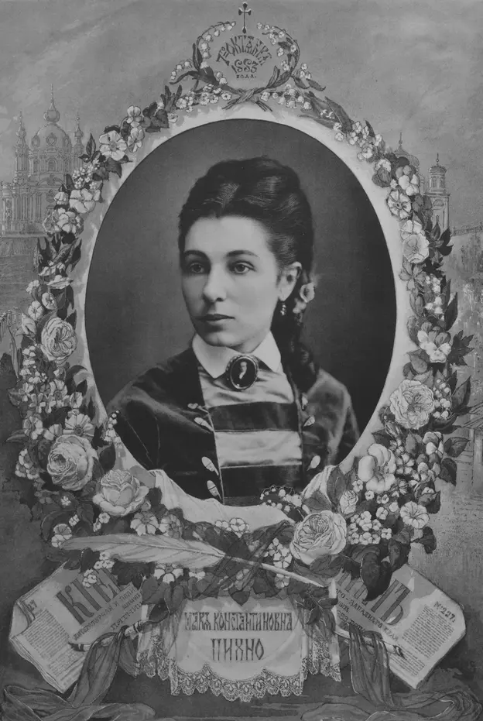
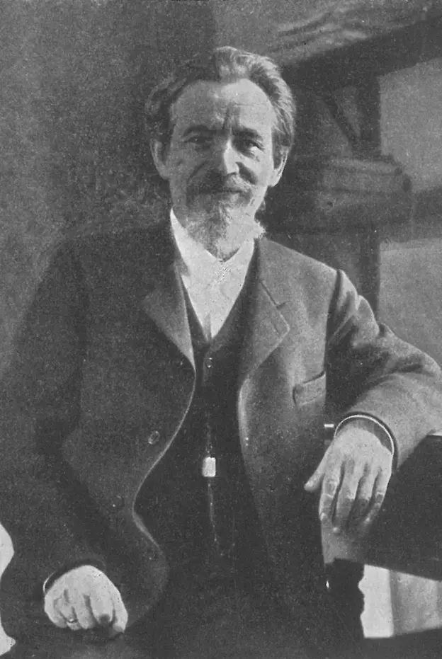
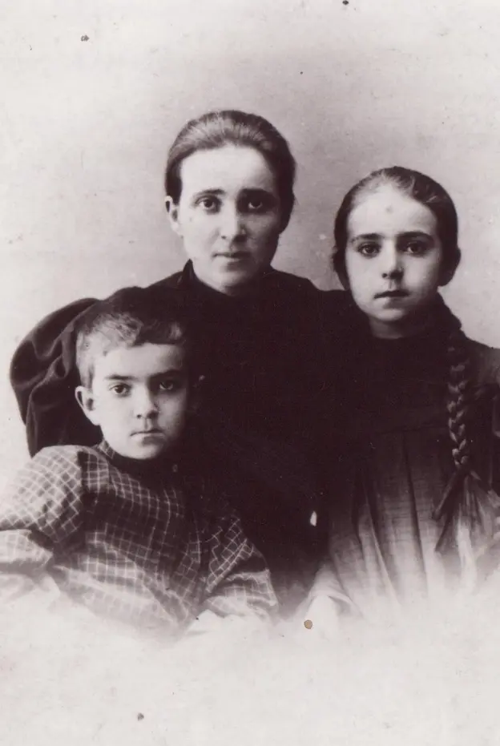
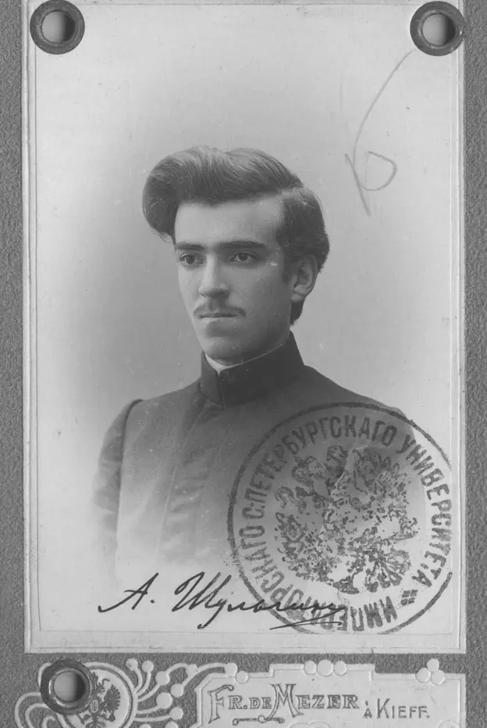
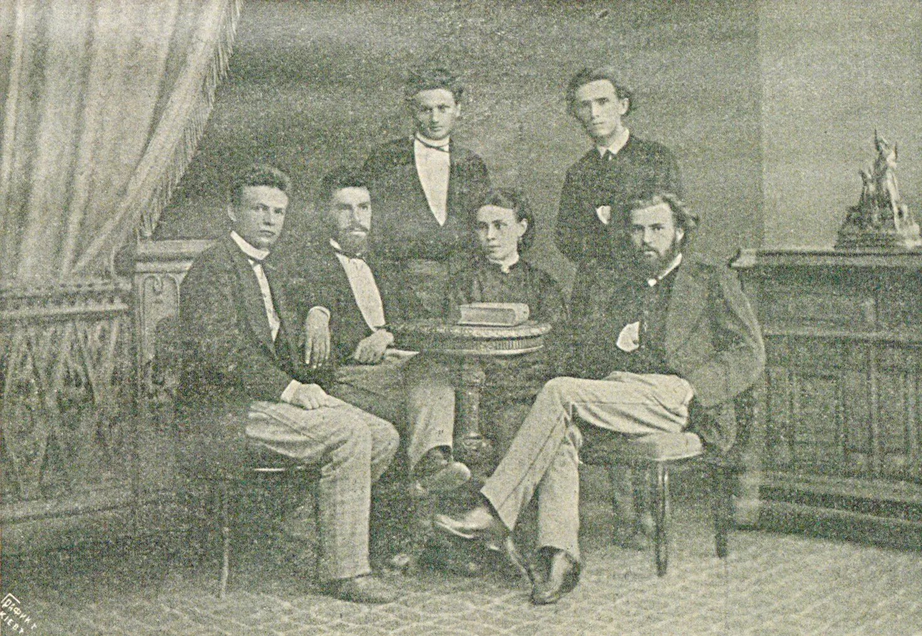
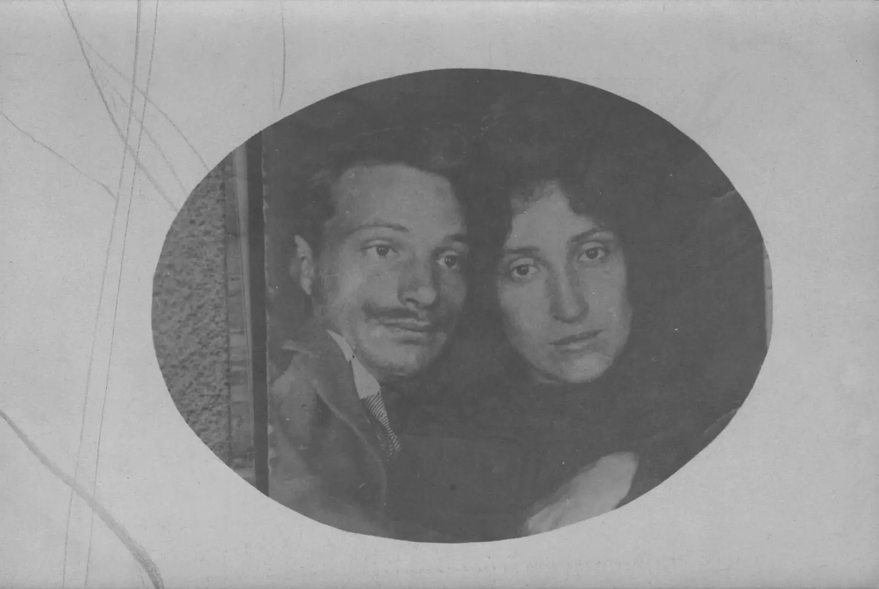
Yakiv Shul’hyn, nephew of Vitalij
Vitalij Shul’gin
Dmitrij Pikhno (second husband of Maria Shul’gina and probably father of Vasily
Maria Shul’gina, wife of Vitalij
Oleksander Shul’hyn
Dmitrij Pikhno), sitting left, Yakiv Shul’hyn standing right
Ljubov Ustimovych, wife of Yakiv), with son Oleksander and daughter Nadiya
Vasily Shul’gin and Ekaterina Shul’gina
Fabian Baumann, Dynasty Divided: A Family History of Russian and Ukrainian nationalism (2023)

Slide 9
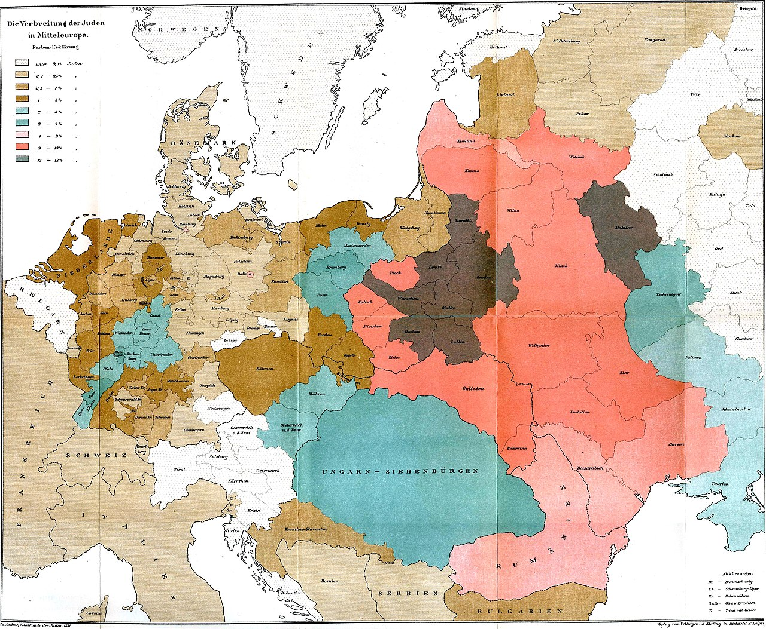
Jews in Europe (1881)

Slide 10
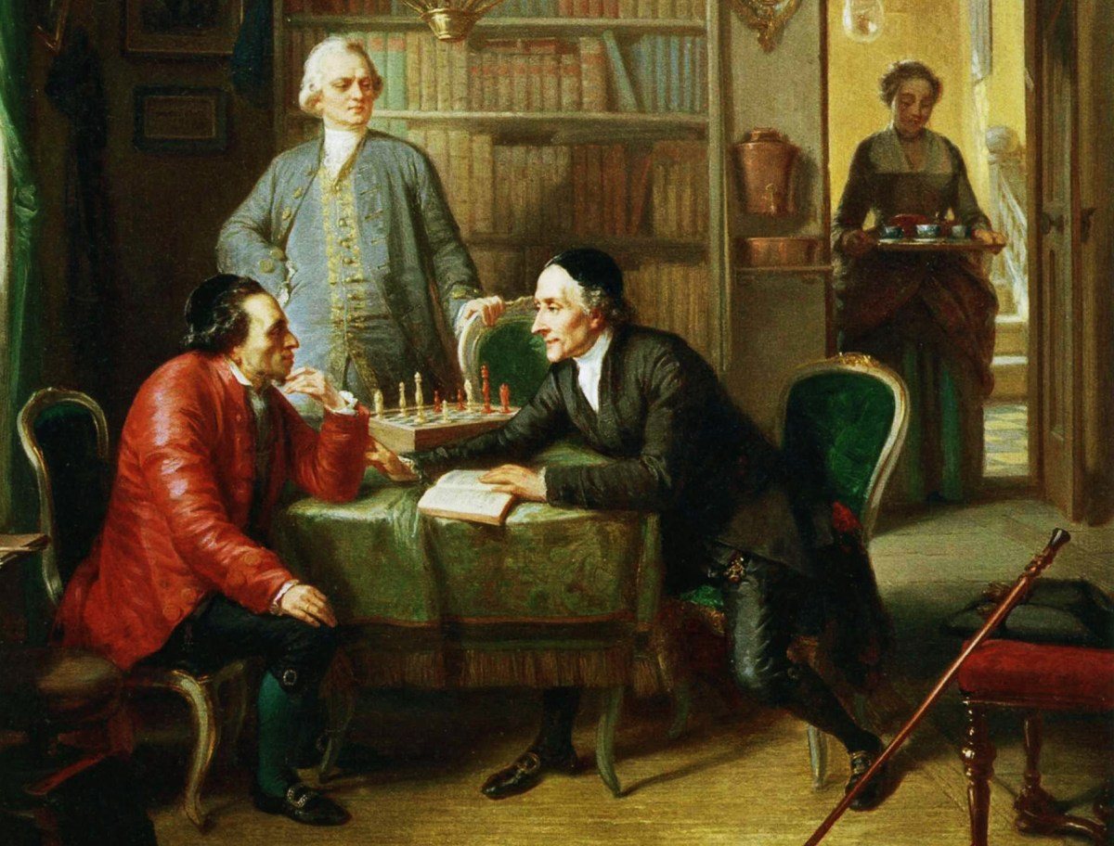
Haskalah (Jewish Enlightenment)
Maskilim - enlightened, learned, scholarly
Promoting Enlightenment values in Jewish community, working for better integration of Jews in society, emphasis on secular education and modern science/scholarship
Lessing and Lavater as guests in the home of Moses Mendelssohn. Painting by Moritz Daniel Oppenheim, 1856.

Slide 11
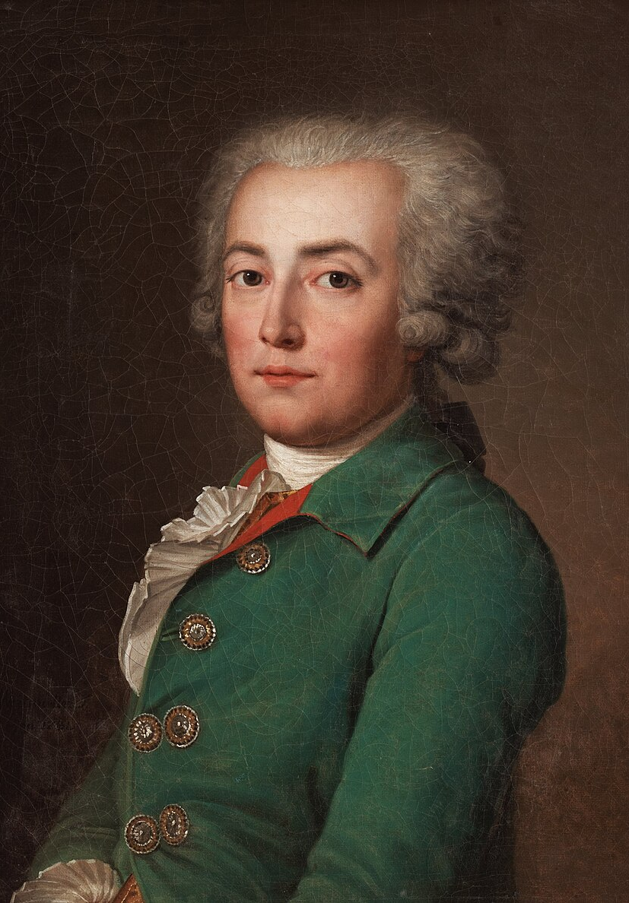
Emancipation – the perspective of an enlightened politician during the French Revolution
‘But, they say to me, the Jews have their own judges and laws. I respond that is your fault and you should not allow it. We must refuse everything to the Jews as a nation and accord everything to Jews as individuals. We must withdraw recognition from their judges; they should only have our judges. We must refuse legal protection to the maintenance of the so-called laws of their Judaic organization; they should not be allowed to form in the state either a political body or an order. They must be citizens individually. But, some will say to me, they do not want to be citizens. Well then! If they do not want to be citizens, they should say so, and then, we should banish them. It is repugnant to have in the state an association of non-citizens, and a nation within the nation. . . . In short, Sirs, the presumed status of every man resident in a country is to be a citizen’.
Comte de Clermont–Tonnerre, "Speech on Religious Minorities and Questionable Professions" (The French National Assembly 23 December 1789)

Slide 12
Jewish Responses to emancipation and rise of modern nations
Assimilation
Reform
Tradition

Slide 13
Hasidic Courts, Dynasties and Disciples of the BeSHT (Baal Shem Tov)

Slide 14
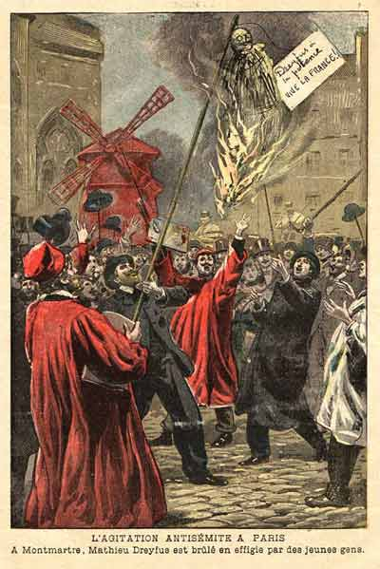
The ‘Jewish Problem’
Economic, legal, political dimensions
Can Jews be fully integrated in the German, French, Russian, Polish, Ukrainian etc. nation?
Will they be loyal, unconditionally support the respective nation?
need/craving for self-definition and self-expression
Does being Jewish mean to belong to an ethnic group, to a nation, to a religious group, to a ‘race’, or something else?
Picture on the right. Antisemitic agitators in Paris burn an effigy of Mathieu Dreyfus during the Dreyfus affair.

Slide 15
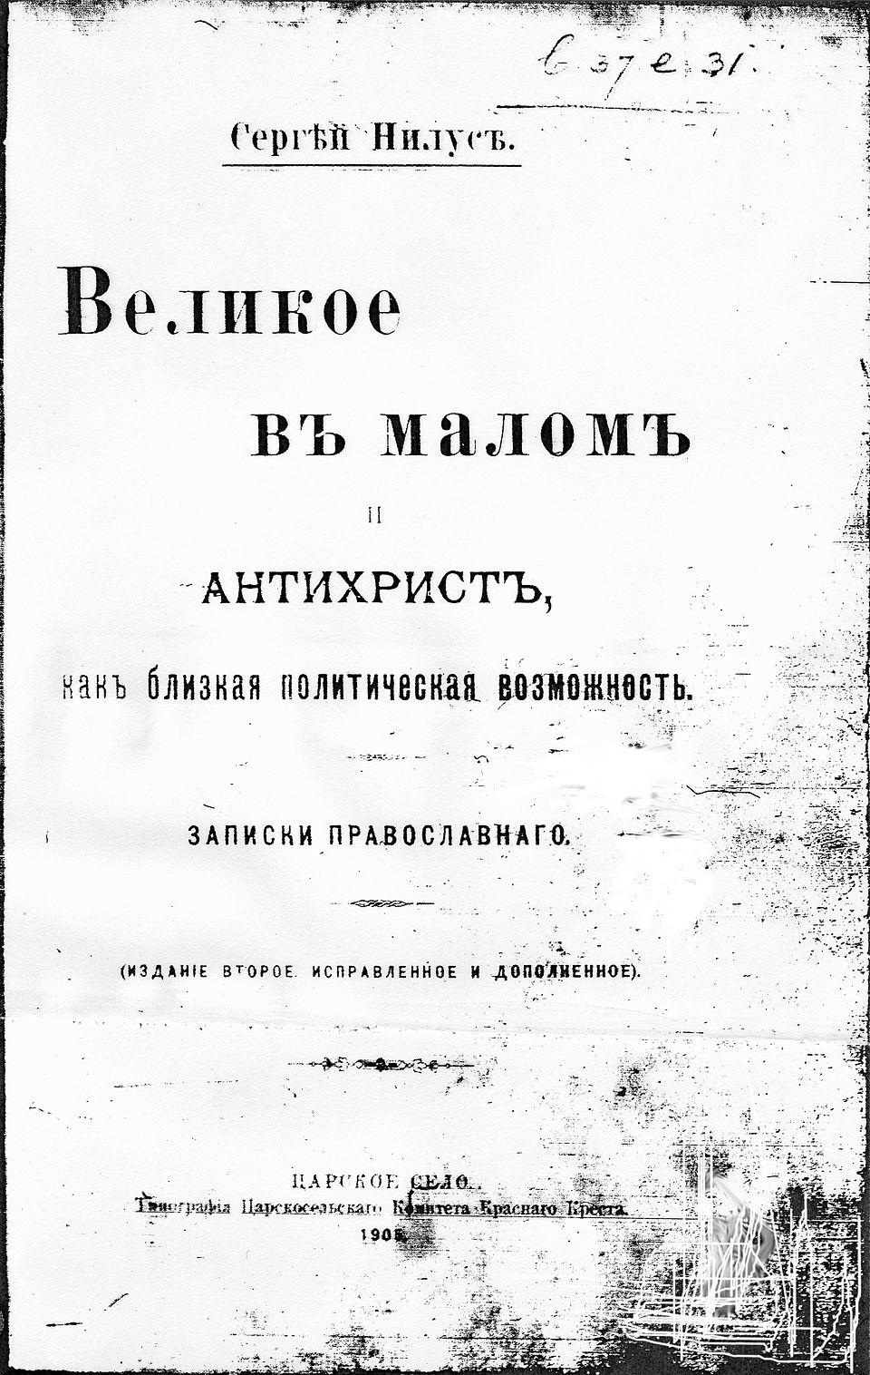
Anti-Semitism
anti-Semitism is a new term (19th century) drawing on “scientific” anthropology and physiology, coincides with emergence of nationalism
easily adapted for other tasks and easily absorbs earlier anti-Jewish rhetorics
Cover of the first book edition of The Great Within the Minuscule and Antichrist, in which the Protocols of the Elders of Zion appeared as an appendix

Slide 16
Pale of Settlement
1791 to 1917 (de facto until 1915)
Permanent residency by Jews allowed in the Pale and beyond the Pale Jewish residency, permanent or temporary mostly forbidden
Most Jews excluded from residency in a number of cities in the Pale as well
Exceptions: some with university education; the ennobled, members of the wealthy merchant guilds and particular artisans; some military personnel; dependents, families, sometimes servants

Slide 17
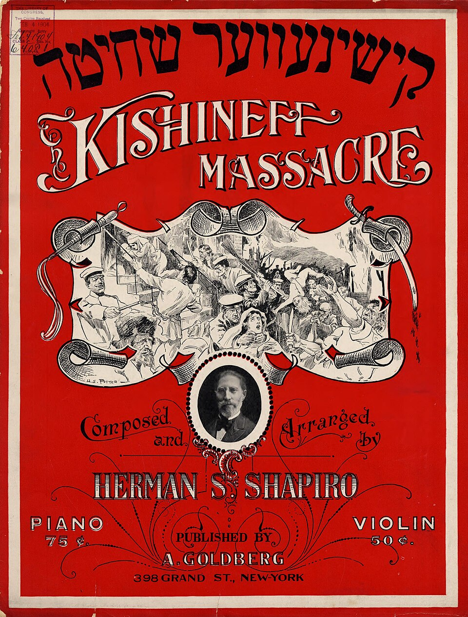
Pogroms in Russian Empire
In Odessa: 1821 and 1859 perpetrators mainly Greeks, in 1871 many Russians joined Greeks, 1905 over 400 Jews killed (perpetrators: Russians, Greeks, Ukrainians)
1881-1884 – over 200 anti-Jewish events in Russian Empire (pogroms in Kyiv/Kiev, Warsaw, Odessa, etc.)
1903-1906 – more pogroms, compared to earlier pogroms, many more Jews were killed

Slide 18
Jewish Responses to emancipation and rise of modern nations
Assimilation
Reform
Tradition
Converting to Christianity
Ultra- Orthodox
Modern Orthodox
Jewish Poles, Russians, Ukrainians, Germans, French etc
Yiddishism
Zionism
Labour (Socialist) Z.
Secular Z.
Religious Z.
Hasidism
Atheism, Socialism/Communism

Slide 19
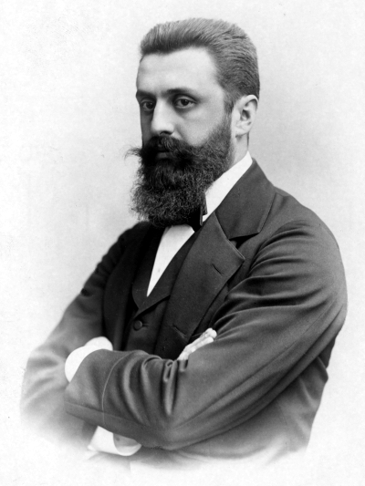
Jewish Nationalism
Diaspora Nationalism
historical: Simon Dubnow
socialist: Bund
Zionism
political: Herzl (on the right)
cultural: Ahad ha-Am (Asher Ginzberg)
Secular vs religious Zionism

Slide 20
Diaspora Nationalism (late 19th/early 20th centuries)
Jews as separate ethnic group
achieve minority rights within multi-national empires
give up claim to independent state in return for national status
Jewish self-defense

Slide 21
Hybrid identities, national identification and attribution
Nationalism and anti-Semitism
The ’Jewish question’
Hebrew vs. Yiddish
Revolutionary socialism

