Slide 1
Entangled History: Ukraine and her neighbours from the Middle Ages to the present
Lecture 12
The Great War: Hopes, aims and expectations

Slide 2
Outline
1. Nationalism and the Great War
2. National concepts and war aims
3. Galicia and Russian Poland
4. The February Revolution
5. Outlook

Slide 3
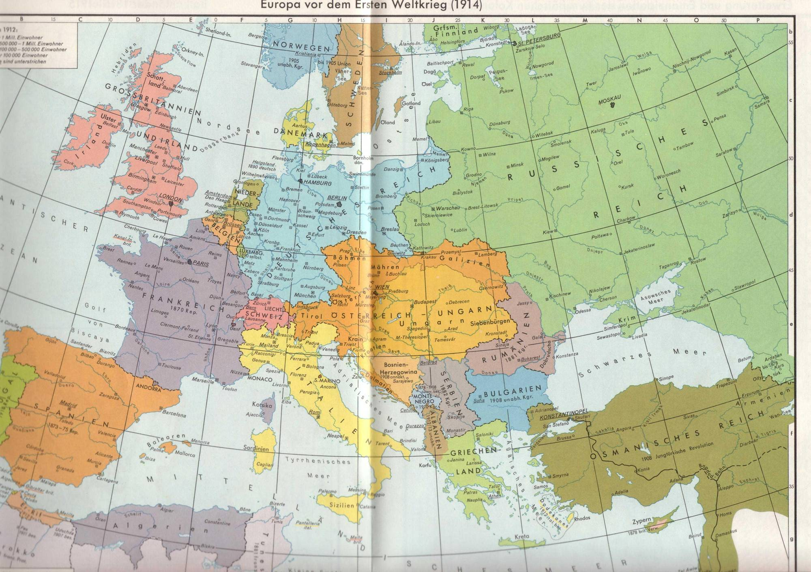

Slide 4
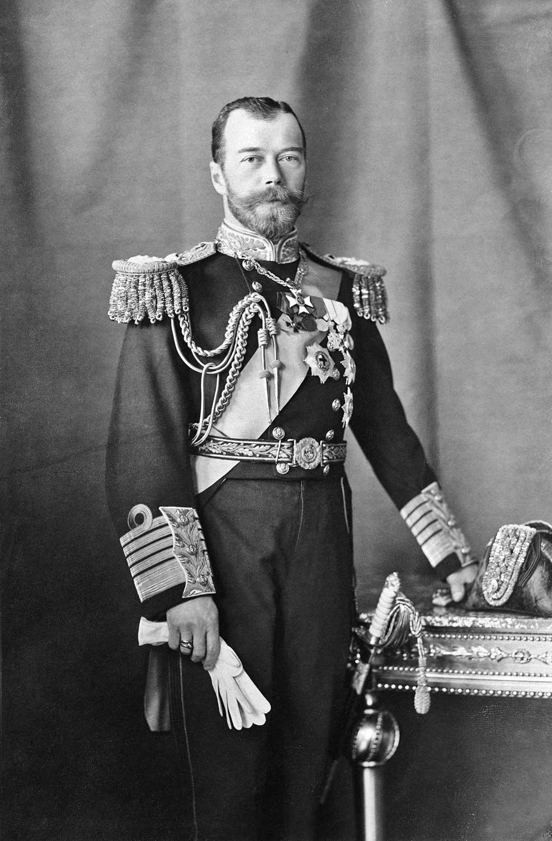
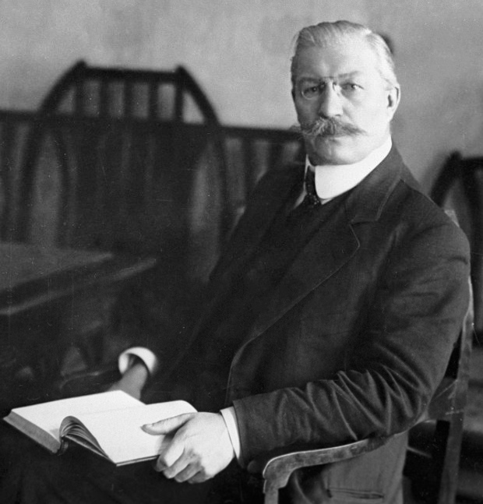
Russia
Pavel Miliukov, leader of the liberal party (Kadets)
Nikolay II

Slide 5
Russian Concepts 1914
Tsar and supporter of autocracy
Strengthening of the authority of the Tsar
Territorial gains in West and South (Constantinople)
Defeat of Germany and Austria
Annexation of East Galicia and Bukowina – Liberation of Russian (East Slavic – Ruthenian/Ukrainian) population
To win the support of the Poles – Promise of autonomy of unified ethnic Polish territory under tsarist rule
There are no Ukrainians – they are a branch of the Russian people
(Most) Liberals and nationalists
Constitutional reforms, participation of society
Territorial gains in West and South (Constantinople)
Defeat of Germany and Austria
Annexation of East Galicia and Bukowina – Liberation of Russian (East Slavic – Ruthenian/Ukrainian) population
To win the support of the Poles – Promise of autonomy of unified ethnic Polish territory as part of the Russian Empire or a Russian Republic
There are no Ukrainians – they are a branch of the Russian people

Slide 6
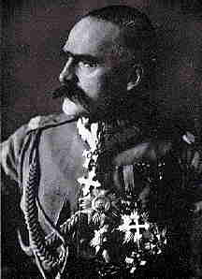
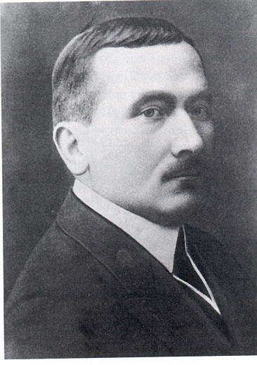
Poland
Roman Dmowski, leader of the Polish National- Democratic Party
Józef Piłsudski, leader of the Polish legions and former Social Democrat

Slide 7
Polish Concepts
Piłsudski
Independence
Together with Austria and Germany (until 1917)
Federation or at least confederation of Poland with Ukraine, Lithuania etc., inclusive from (1918 on)
Rights of minorities
Jagiellonian Poland – territory in the East
Enemy No. 1: Russia
Dmowski
Autonomy of a unified Poland under tsar
Together with Russia
Polish nation state, exclusive, mainly Polish Catholics (1918 ff)
Assimilationist
“Piast Poland” – territory in the West
Enemy No. 1: Germany

Slide 8
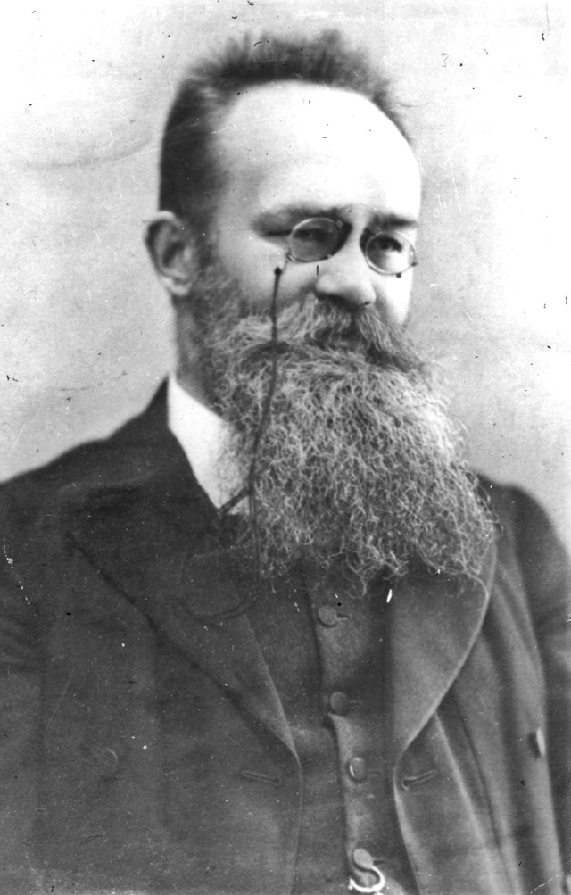
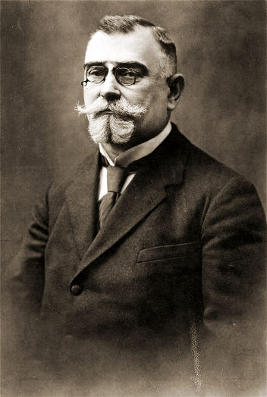
Mykhailo Hrushevsky, 1866-1934, first chairman of Central Rada 1917 in Kyiv/Kiev
Kost Levytsky, 1859-1941, leader of the Ukrainian national democrats in Austria-Hungary

Slide 9
Ukrainian Concepts 1914
Russian Ukraine
Defeat of Austria-Hungary
Unification of ethnic Ukrainian territories in Austria-Hungary with ethnic Ukrainian territories in Russian Empire
Autonomy of all Ukrainian territories as part of a federalised, constitutional or democratic Russia
Unification of Ukraine under Tsar
Territories with Ukrainian majority in Austria Hungary
Defeat of Russia
Partition of crownland Kingdom of Galicia and Lodomeria, unification of all ethnic Ukrainian territories in Austria- Hungary and creation of an autonomous Ukrainian crownland
Autonomy for all Ukrainian territories (of Russian Empire and Austria-Hungary) in some connection with Austria-Hungary
Unification of Ukraine under the emperor or another member of the Habsburg family

Slide 10
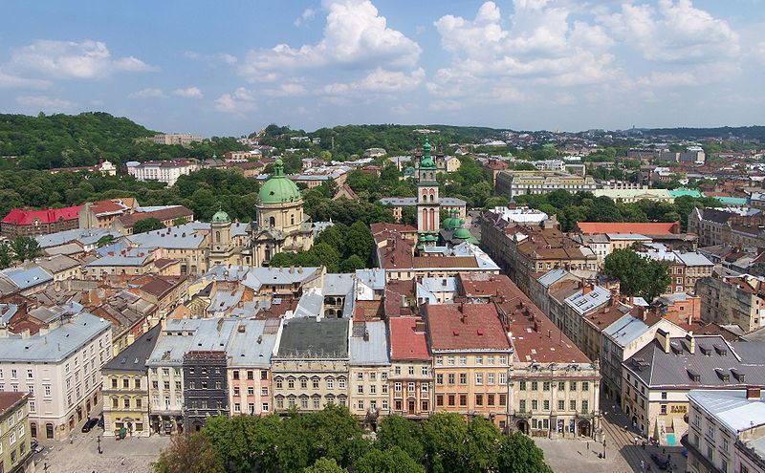
Lemberg, Lwów, L‘viv in 2010

Slide 11
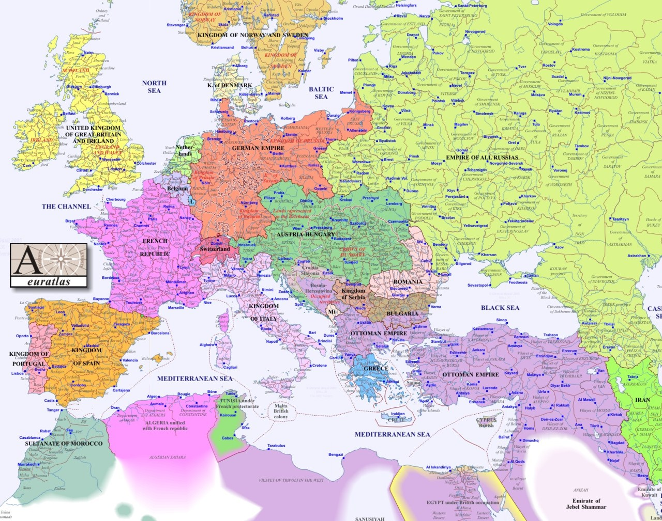
1914

Slide 12
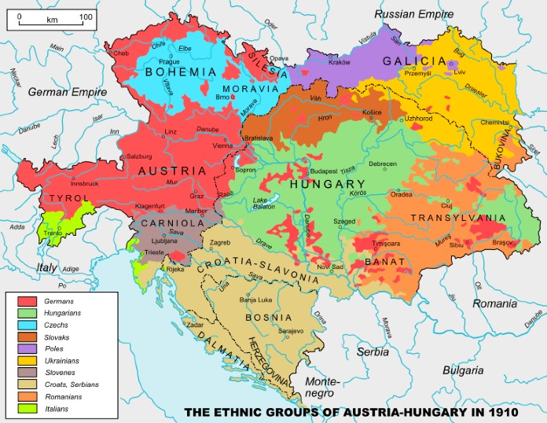

Slide 13
Multiethnic borderland Confessions/Religions
Lviv/Lwów/Lemberg
212,000 inhabitants
51% Roman-Catholic
28% Jewish
19% Greek-Catholic
Crownland Galicia and Lodomeria
8,016,000 inhabitants
46.5% Roman-Catholic
42.1% Greek-Catholic
10.9% Jewish
East Galicia
5,235,000 inhabitants
25.3% Roman-Catholic
12.4% Jewish
61.7% Greek-Catholics
West Galicia
2,689,000 inhabitants
88.6% Roman-Catholic
7.9% Jewish
3.2% Greek-Catholic

Slide 14
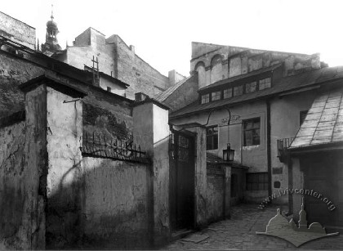
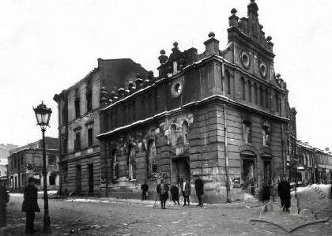
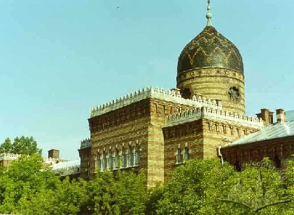
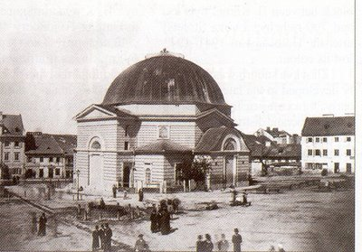
Lemberg
Lwów
L‘viv
Synagogue 'Golden Rose'
One of the Khasidic synagogues
Jewish hospital
Progressive synagogue 'The Temple'

Slide 15
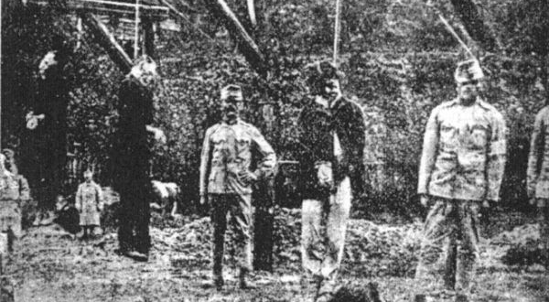
One of the executions О. Роман Березовский и крестьяне Лев Кобылянский и Пантелеймон Жабяк (См.стр. 31). http://www.talergof.org.ua/foto/1-114.html

Slide 16
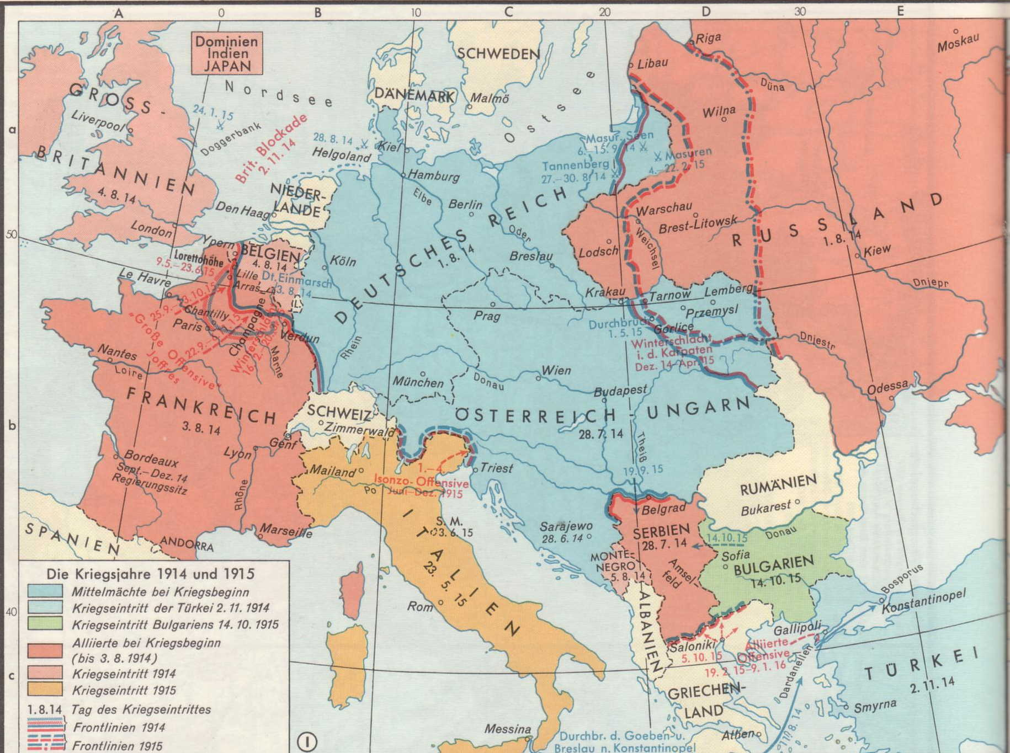
World War I

Slide 17
Russian Occupation Policy
Making East Galicia Russian: Russification
Ukrainians perceived as Little Russians
Persecution of Ukrainophiles
Church Policy – pushing back influence of Greek-Catholic Church
Co-operation with Polish elites: with limited success
Discrimination of Jews, anti-Jewish violence, deportation, and pogroms

Slide 18
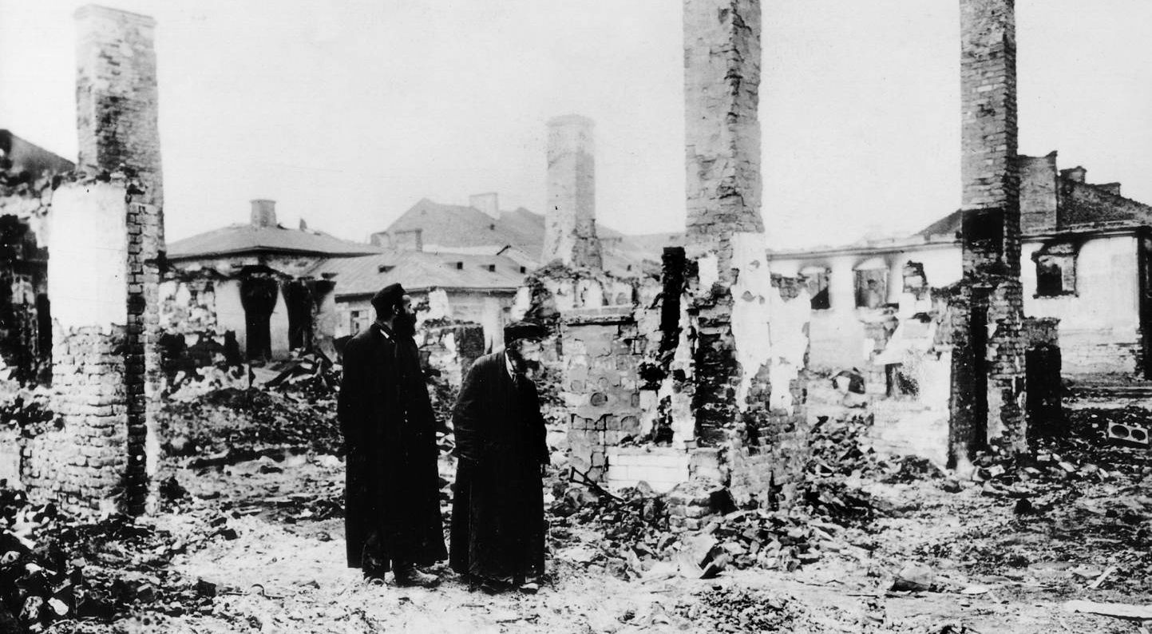
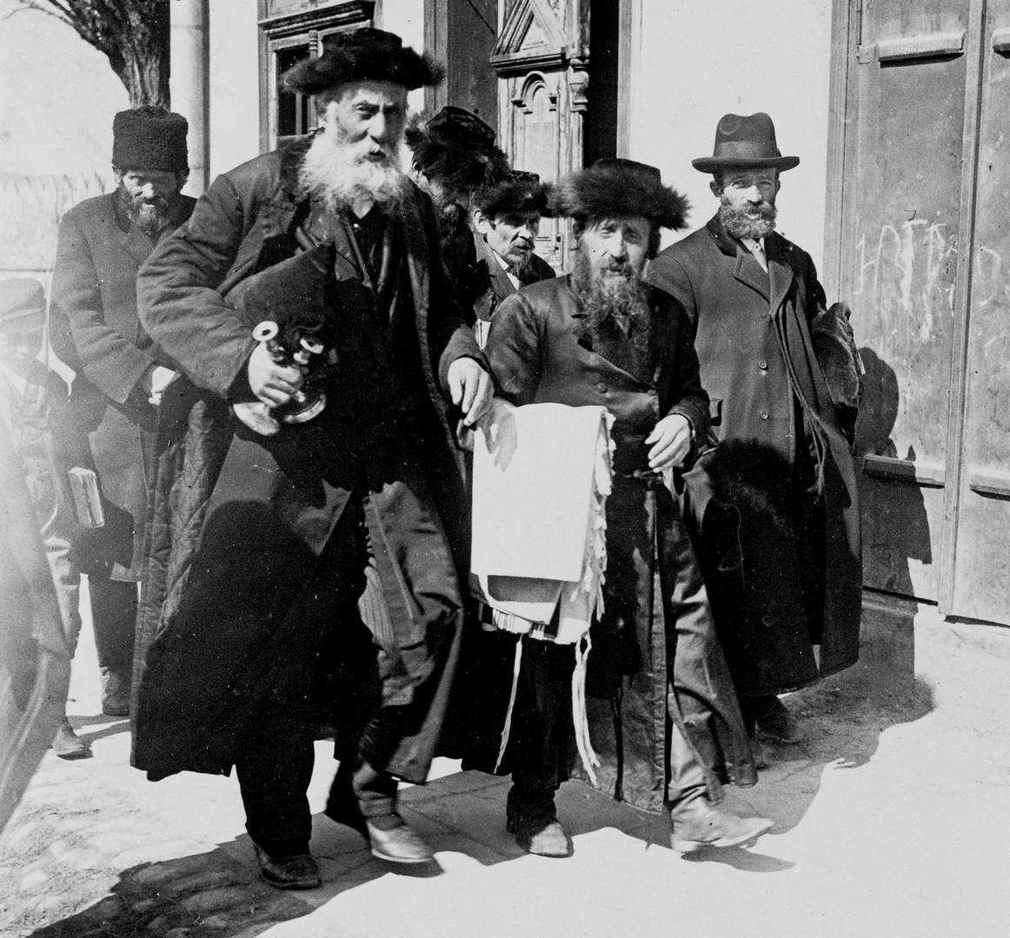
Destroyed Jewish settlement in Galicia, 1914 Österreichisches Staatsarchiv, Kriegsarchiv http://kurier.at/thema/erster-weltkrieg/fuer-kaiser-und-vaterland-juedisches-leben-und-sterben-im-ersten-weltkrieg
Saving sacred objects from the fire, 1914 © Österreichisches Staatsarchiv/Kriegsarchiv

Slide 19
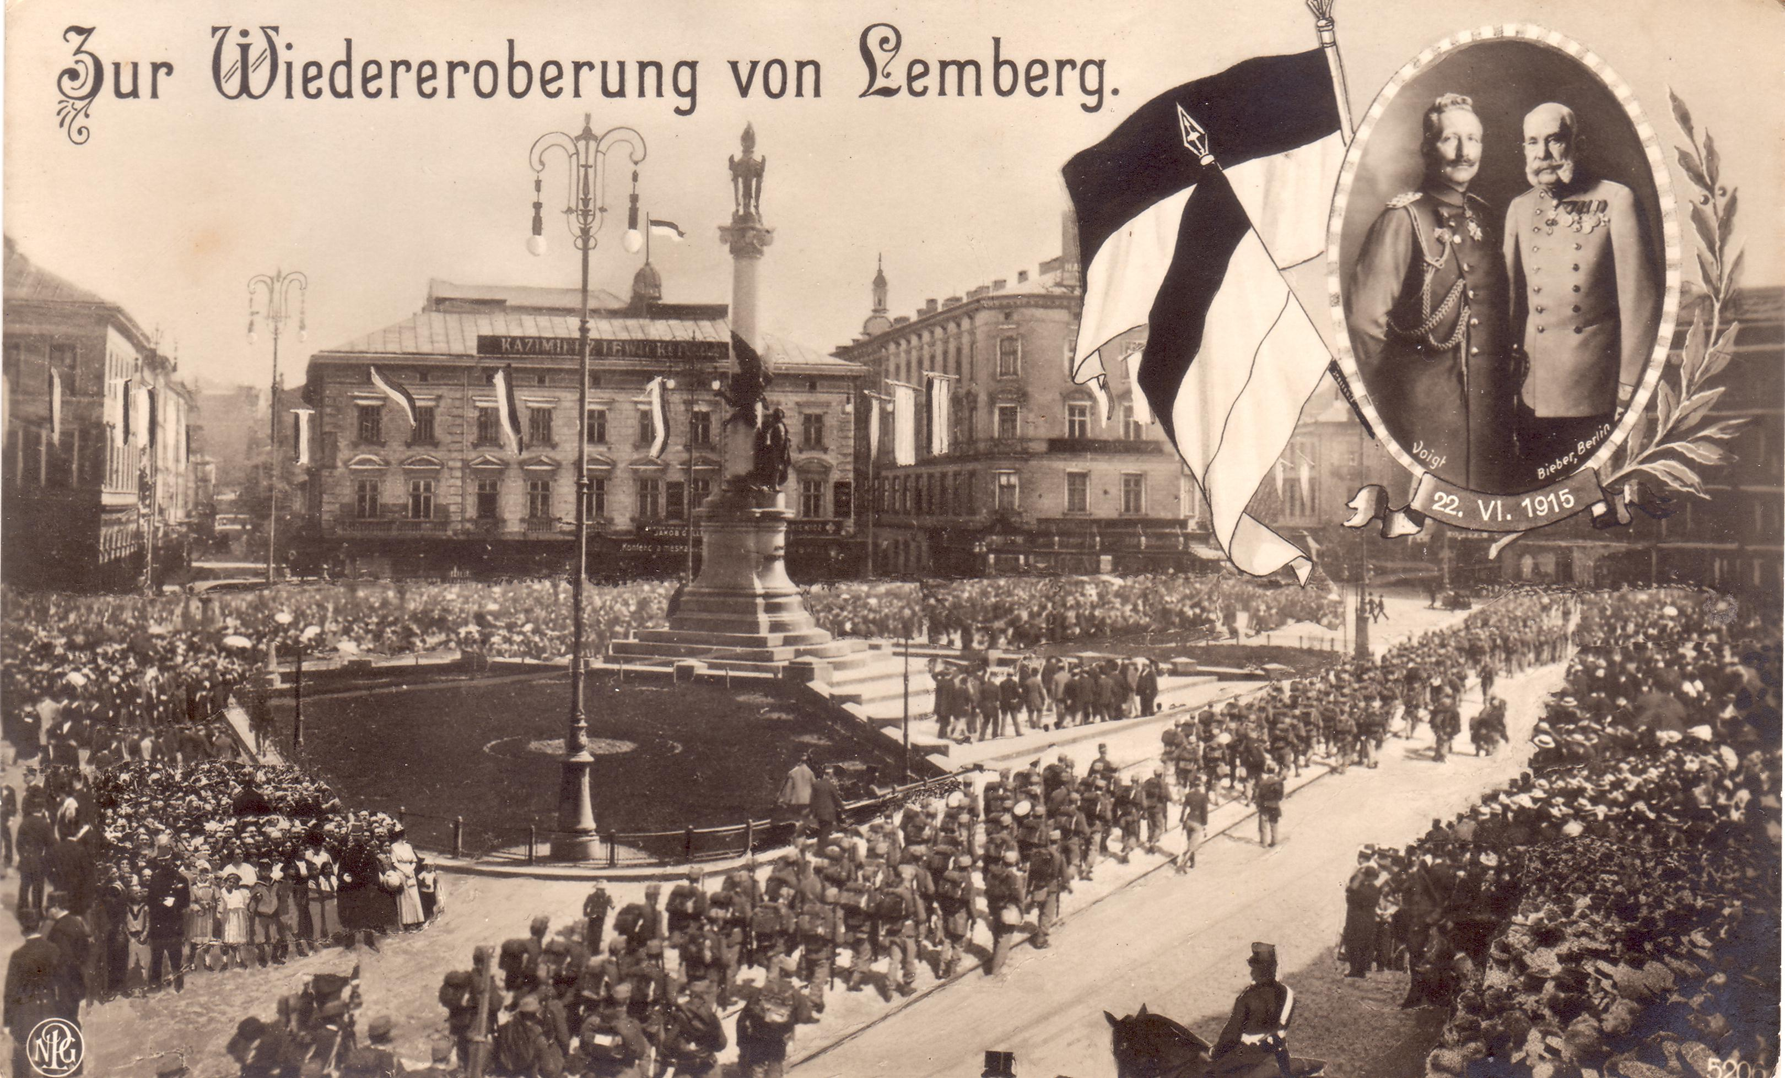
The reconquest of Lemberg, 3 June 1915: The return of Austrian-Hungarian troops

Slide 20
Russian Poland – Congress Poland – Kingdom of Poland
1914: Tsar promises autonomy – creation of a pro-Russian Polish National Committee
Poles loyal, fight on Russian side, Dmowski sets hopes in Russian victory
1916: Most of Poland occupied by Central Powers (Austria-Hungary and German Empire)
Occupation policy of Central Powers
Both emperors promise creation of a Kingdom of Poland, for present: Regency Council
In both cases offers stop short of full independence
Either in personal union with Russia or client state of Austria-Hungary and/or Germany
To win support of Polish population: under German and Austrian-Hungarian occupation - Polonisation of education and self-administration – does not manage to convince population

Slide 21
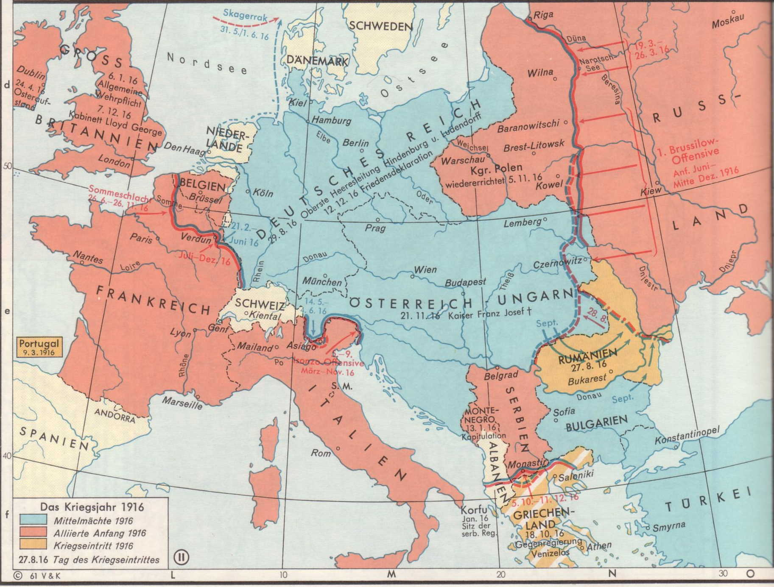

Slide 22
Total Mobilisation
Nationalising empires (Eric Lohr); conflicts with dynastic loyalty
Mobilisation of ethnicity (Mark von Hagen)
Concept of ‘enemy aliens’ (Jews, Germans in the Russian Empire; Russophile Ruthenians, Serbs in the Habsburg Empire)
Weaponisation of the ‘national question’
Social and economic upheaval
Deportations and internment camps
Refugees (Peter Gatrell, A Whole Empire Walking)

Slide 23
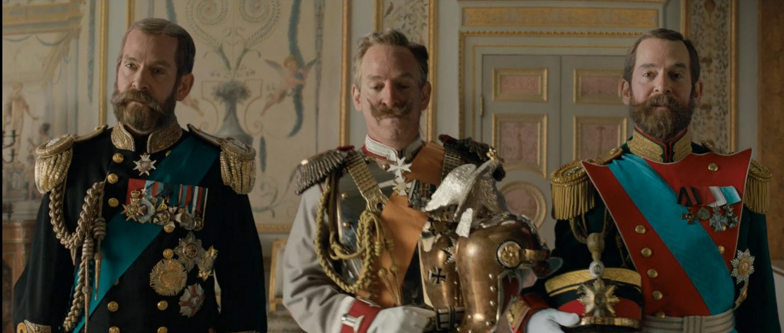
Source: IMDB

Slide 24
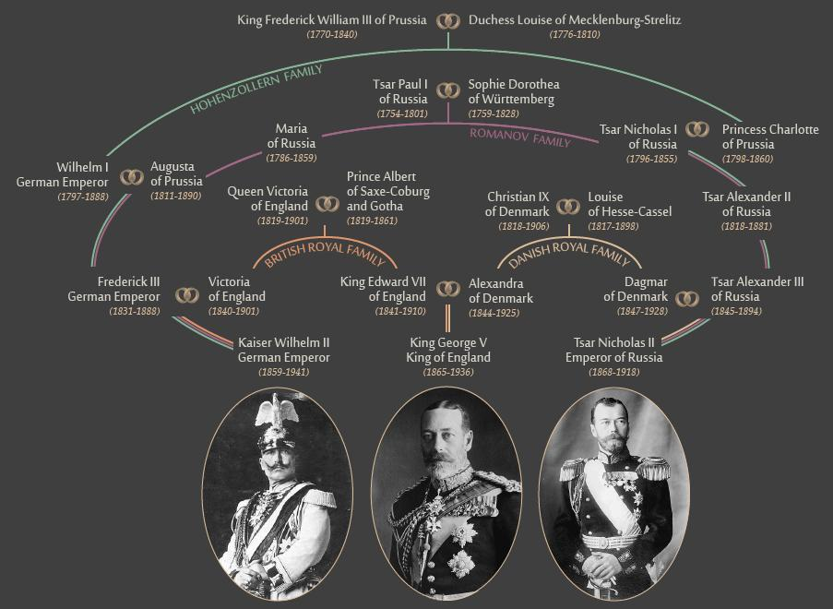
Family tree image by Marcia Underwood; https://www.brookings.edu/articles/the-family-relationships-that-couldnt-stop-world-war-i/

Slide 25
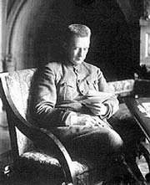
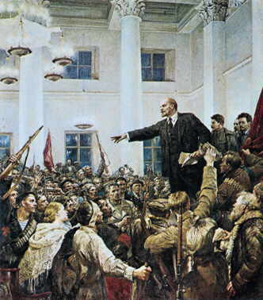
Revolutions in Russia
Alexander Kerenski
Head of the Provisional Government
Vladimir I. Lenin, leader of the Bolshevik party, after November 1917, head of the new revolutionary government

Slide 26
Consequences of the February Revolution
For Poles full independence now a realistic option
Austrian and German offers no longer very attractive
In Galicia: weakens Polish loyalty to Habsburg dynasty (also result of death of Emperor Franz Josef)
Ukrainians in Galicia: still loyal – need Austrian support against Poles – partition of Galicia and Lodomeria and creation of Ukrainian crownland
Ukrainians in Russian Empire: Divided in – loyalists, revolutionary socialists, Ukrainophiles – who attempt to get control of state structures in ethnographic Ukrainian territories of Russian Empire, unite those territories and demand autonomy in a Russian Federation
Most Jews loyal to Austria

Slide 27
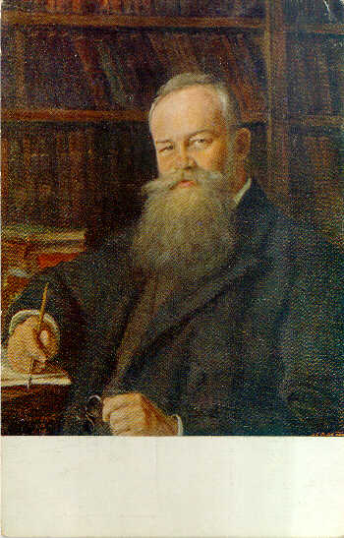
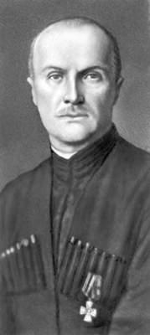
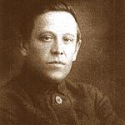
Symon Petliura
1879-1926
Mykhailo Hrushevsky
1866-1934
Pavlo Skoropadsky
1873-1945

Slide 28
Central and Eastern Ukraine
March 1917 February Revolution in Petrograd: Formation of Provisional Government and Councils of Workers and Soldiers
March 1917 Formation of a Central Rada (Council) in Kyiv/Kiev
June 1917: 1st Universal of Central Rada: Autonomy in a reformed, federal Russia
3 July 1917: 2nd Universal: Central Rada claims to represent all inhabitants of nine Ukrainian provinces
7/8 November 1917: October Revolution in Petrograd, Revolutionary government
22 November 1917: 3rd Universal: Central Rada proclaims Ukrainian People’s Republic (UNR) – but federated with Russia
22 December 1917 – Begin of peace negotiations between Central Powers and Soviet Russia in Brest-Litovsk
22/25 January 1918: Central Rada: Proclamation of independence of UNR
9 February 1918: Peace Treaty between UNR and Central Powers
3 March 1918: Peace Treaty between Soviet Russia and Central Powers
April 1918: Central Powers support Hetman Pavlo Skoropadsky, begin of Hetmanate
11 November 1918: Armistice on Western Front
13/14 November 1918: Directorate – re-establishing UNR

Slide 29
What we demand in this war, therefore, is nothing peculiar to ourselves. It is that the world be made fit and safe to live in; and particularly that it be made safe for every peace-loving nation which, like our own, wishes to live its own life, determine its own institutions, be assured of justice and fair dealing by the other peoples of the world as against force and selfish aggression.
XIII. An independent Polish state should be erected which should include the territories inhabited by indisputably Polish populations, which should be assured a free and secure access to the sea, and whose political and economic independence and territorial integrity should be guaranteed by international covenant.
8 January, 1918 President Woodrow Wilson's Fourteen Points (Delivered in Joint Session of the Congress, January 8, 1918)

Slide 30
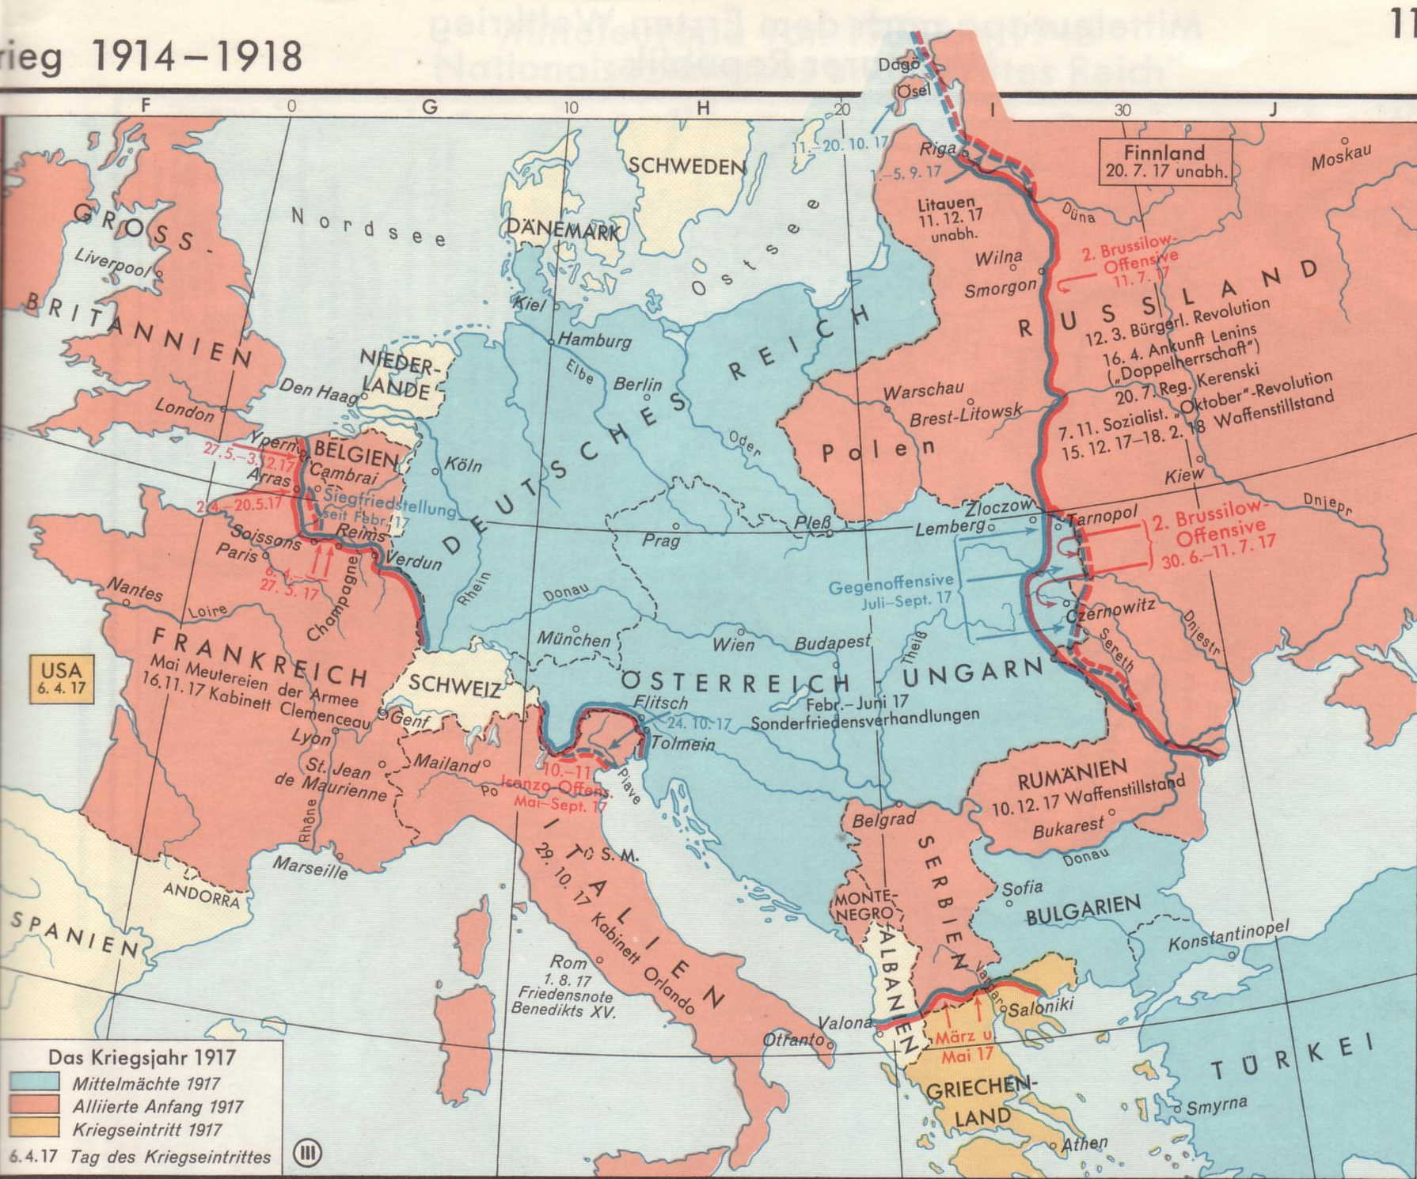

Slide 31
Brutalisation of political and ethnic conflicts (also availability of weapons and trained soldiers)
Defeats and war related problems undermine loyalty to Austrian and Russian Empire
Possibility of national autonomy or independence have a mobilising effect on ethnic minorities in Empires
Question: who will profit more from destabilisation of old imperial order? Will there be socialist or national revolutions?

